Slide 1
Virtualization

Slide 2
VIRTUALIZATION
Server virtualization allows you to run multiple virtual machines on a single physical server.
Desktop virtualization allows you to run multiple desktop machines on a single physical server, and distribute them.
Application virtualization allows you to distribute multiple copies of an application from a single physical server.

Slide 3
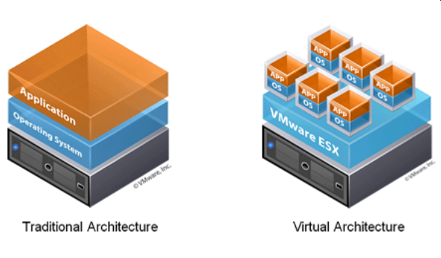
VIRTUALIZATION

Slide 4
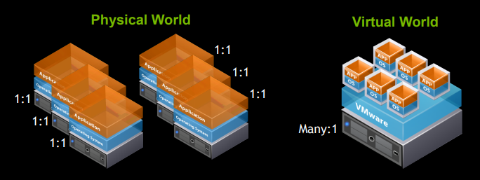
SO WHY VIRTUALIZE RESOURCE OPTIMIZATION!
Increased density
Improves resource optimization but without sacrificing performance

Slide 5
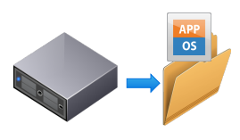
SO WHY VIRTUALIZE: THE OTHER ADVANTAGES…
Partitioning
Run multiple operating systems on one physical machine
Share physical resources between virtual machines
Portability
Entire virtual machine is saved as a file, so…
Move, copy, or export as easily as a file
Security
Hardware is isolated from the operating system
Recovery as easily as restoring a file
Agnostic
Migrate a virtual machine between similar, or different, physical servers

Slide 6
SO WHY VIRTUALIZE: BUT WHAT ABOUT DESKTOPS?
We thought in terms of the personal computer
— 1:1 computer to worker
— Refreshed every 3-5 years
We were happy in our cubes
— It was the only place we could connect
IT budgets grew with PC sprawl

Slide 7
SO WHY VIRTUALIZE: BUT WHAT ABOUT DESKTOPS?
Business demanded:
— Cost savings
— Flexibility
— Mobility
End users demanded:
— Frequent refresh
— More “power”
— Mobility
— BYOD (Bring your own device)
— Graphics

Slide 8
SO WHY VIRTUALIZE: AND WHAT ABOUT APPS?
Application virtualization allows distribution of multiple copies of an application from a single physical server.
— Streamed to BYOD — Centrally managed — Ease of support
Typical solutions:
— Citrix Metaframe...Presentation Server...now XenApp
— VMware ThinApp — Microsoft App-v — Others...

