Slide 1

Seminar
On
Inventory
Management
Notes:
1
1

Slide 2
CONTENT
Introduction
Forms of Demand
Forms of Inventories
Classification of Inventories Cost
Inventory Control
Objectives of Inventory Control
References

Slide 3
INTRODUCTION
Inventory is material that the firm obtains in advance of need, holds until it is needed, and then used, consumes, incorporates into a product, sells, or otherwise disposes it of. A business inventory is temporary in nature.
Inventories are stock of any kind like fuel and lubricants, spare parts and semi-processed materials to be stored for future use mainly in the process of production or it can be known as the ideal resource of any kind having some economic values.

Slide 4

Inventory valuation involves two process
Determination of quality of each type of inventory held.
Assignment of the values of the
units items of inventory

Slide 5
Two Forms of Demand
Dependent
Demand for items used to produce final products
Tires stored at a Goodyear plant are an example of a dependent demand item
Independent
Demand for items used by external customers
Cars, appliances, computers, and houses are examples of independent demand inventory

Slide 6
Forms of inventories
There are many types of inventory. The form of inventories depends upon the type of concern. All types of inventory do not require same treatment and therefore policy with regard to each may also differ.

Slide 7
Raw material inventories:
There are raw materials and other supplies, parts and components, which enter into the product during the production process and generally form part of the product.
Work in process inventories:
These are semi finished, work in progress and partly finished products formed at the various stages of production.

Slide 8
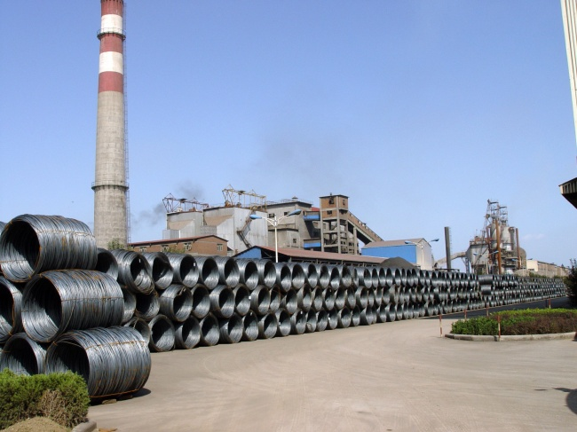
m.r.o inventories/ Spare part inventories:
Maintenance, repairs and operating supplies which are consumed during the production process and generally do not form part of the product itself are referred to as spare part inventories.
Finished inventories:
These are complete finished products ready for sales. In a manufacturing unit, they are the
final output of the production process.
They can also be classified as:-
Movement inventories
Lot size inventories
Anticipation inventories
Fluctuation inventories

Slide 9
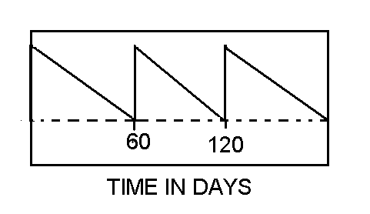
Cycle stock and safety stock
CYCLE STOCK AND SAFETY STOCK
ON
HAND
INVENTORY

Slide 10
Classification of inventories cost:
Inventories’ cost are traditionally categorized into four basic types:

Slide 11
Purchase cost:
For items that are purchased from outside the firms, this is usually the unit price that the firm pays to its vendor. As an item moves through the logistics system of the firms, it purchase cost in the inventory analysis should reflect its fully landed cost, by which is meant the cost to acquire and moves the item to that point in the system.
Ordering cost:
In addition to the per unit purchase cost, there is usually an additional cost which is incurred whenever we order, reorder or replenish the inventory. If we produce items internally then there will be an organization set up cost. This happens because we have to shut down the manufacturing line and change over, reconfigure the line to make a specific item.
This is the cost involved with processing the order, involving paying the bill, auditing, and so forth.

Slide 12
Holding cost:
The cost that accrue due to the actual holding of the inventory over a time period. Many different kinds of cost can be considered as holding cost. The key characteristics of holding cost varies with the amount of inventory being held and the time that the inventory is held. The holding cost can further be classified as follows:
Storage cost
Service cost
Risk cost
Capital cost.
Shortage cost:
When a demand arises which cannot be satisfied from available inventory an inventory shortage occurs. Purchase, ordering and holding cost can be thought of as the cost of having inventories, while shortage cost result for not having inventory, or for not having enough inventory at the right place at the right time

Slide 13
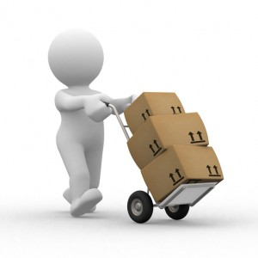
Four specific case where shortage cost may exist are:
Back orders
Lost sales
Lost customer cost
Disruption cost

Slide 14
Inventory control:
Inventory control is the means by which materials of the correct quality and in correct quantity are made available as and when required with due regard to economic in storage and ordering cost. Hear the desired level of inventory can neither be high or low because high level inventory will lead to increase in carrying cost while low level of inventory will lead to increase in ordering cost

Slide 15
The activities of inventory control normally include the following:
Determination of the limits of the inventories to be held.
Determination of inventory policies.
Selling out of investments pattern and its regulations as per individual and collective requirements.
Follow up to examine the work of inventory policy and effect change as and when needed.

Slide 16
Scope of inventory control:
SCOPE OF INVENTORY CONTROL
Determination of inventory policies.
Determining economic order size
Determining lead time
Examining the work of inventory policy
Determining various stock levels
Safety or buffer stock

Slide 17
Objectives of inventory control:
To ensure smooth flow of stock.
To provide for required quality of materials.
To control investments in stock.
Protection against fluctuating demand.
Protection against fluctuations in output.
Minimization of risk and uncertainty.
Risk of obsolescence.
Minimization of material cost.

Slide 18
References
www.google.com
www.wikipedia.com
www.studymafia.org
www.pptplanet.com

Slide 19
Thanks

