Slide 1
Effective Project Management:
Traditional, Agile, Extreme, Hybrid
8th Edition
Introduction
Presented by
(facilitator name)

Slide 2

Introduction
Introduction
Introductions
Program Overview
Program Objectives
Course Learning Objectives
Course Format
Course Materials
What’s Expected of Me?
Course Outline
Class Exercise #1: Create the Hot Topics List
Introduction to the Case Study
Notes:
Explain how each of these contributes to the growing importance of project management in the business world.

Slide 3

Course Learning Objectives
Introduction
Have a working knowledge of EPM
Understand the impact of uncertainty and complexity in project management
Understand linear, incremental, iterative, adaptive and extreme models of the project management life cycle
Know how to choose the best fit model based on project characteristics
Adapt EPM to the best fit model
Adapt EPM to the case study
Notes:
Explain how each of these contributes to the growing importance of project management in the business world.

Slide 4

Course Format
Introduction
Adaptive
Interactive
Discussion and practice oriented
Exercise-driven
Practice on a case study in a team format
Notes:
Explain how each of these contributes to the growing importance of project management in the business world.

Slide 5

Course Materials
Introduction
Wysocki, Robert K., (2014). “Effective Project Management: Traditional, Agile, Extreme, 7th Edition,” (New York, NY: John Wiley Sons)
Case Study Materials
Copies of slide presentation
Notes:
Explain how each of these contributes to the growing importance of project management in the business world.

Slide 6

What’s Expected of Me?
Introduction
Be on time
Be actively involved
Be committed to your team members
No side conversations
No ringing cell phones, pagers, Blackberries, PDAs...
Have fun!
Notes:
Explain how each of these contributes to the growing importance of project management in the business world.

Slide 7

Course Outline
Introduction
Part
1
Part I: Understanding the Project Management Landscape
  Ch01: What is a Project?
  Ch02: What is Project Management?
  Ch03: What are the Project Management Process Groups?
Notes:
Explain how each of these contributes to the growing importance of project management in the business world.

Slide 8
Course Outline
Introduction
Part
2
Part II: Traditional Project Management
  Ch04: How to Scope a TPM Project
  Ch05: How to Plan a TPM Project
  Ch06: How to Launch a TPM Project
  Ch07: How to Monitor & Control a TPM Project
  Ch08: How to Close a TPM Project
Notes:
Explain how each of these contributes to the growing importance of project management in the business world.

Slide 9
Course Outline
Introduction
Part
3
Part III: Complex Project Management
  Ch09: Complexity & Uncertainty in the PM Landscape
  Ch10: Agile Project Management
  Ch11: Extreme Project Management
  Ch12: Comparing Linear, Incremental, Iterative, Adaptive and Extreme PMLC models
Notes:
Explain how each of these contributes to the growing importance of project management in the business world.

Slide 10
Course Outline
Introduction
Part
4
Part IV: Managing the Realities of Projects
  Ch13: Prevention & Intervention Strategies for Distressed Projects
  Ch14: Organizing Multiple Team Projects
  Ch15: Establishing & Maturing a Project Support Office
  Ch16: Establishing & Managing a Continuous Improvement Program
Notes:
Explain how each of these contributes to the growing importance of project management in the business world.

Slide 11
Course Outline
Introduction
Part
5
Part V: End State: Maturing to an Enterprise-Level PM Model
  Ch17: Establishing a Project Portfolio Management Process
  Ch18: Establishing a Practical Project-Based Model of the Enterprise
Notes:
Explain how each of these contributes to the growing importance of project management in the business world.

Slide 12
Contemporary Project Environment
Introduction
High Speed
High Change
Lower Cost
Increasing Levels of Complexity
More Uncertainty
Challenges to Effective Project Management
  Flexibility and Adaptability
  Deep Understanding of the Business & Its Systems
  Take Charge of the Project and Its Management
  Project Management is Organized Common Sense
Notes:
Explain how each of these contributes to the growing importance of project management in the business world.

Slide 13


Class Exercise #1
Introduction
Create the Hot Topics List
Here is your opportunity to contribute any topics
you would like discussed by the class.
We’ll list your contributions and integrate them into the course. As part of our course wrap-up, we will return to the list to make sure all items have been addressed.
Notes:
Put the following list of possible projects on a flip chart and have the class pick 4 or 5 projects. Then have students choose which project team they want to be on. Team sizes should be between 4-6. If a large number of students want to work on the same project, set up two teams for the same topic.
1. Implement a Project Support Office for IT
2. Select a project management software tool for all IT projects
3. Create an information system to collect and report all project history
4. Design and implement a vendor selection process
5. Design and develop an IT training curriculum
6. Design and implement an IT project classification system

Slide 14

Introduction to the Case Study
Introduction
Pizza Delivered Quickly (PDQ)
Read the case study background document. Take notes
on any questions you may have.
We will discuss the case study to make sure we are all on
the same page.
Notes:
Explain how each of these contributes to the growing importance of project management in the business world.

Slide 15
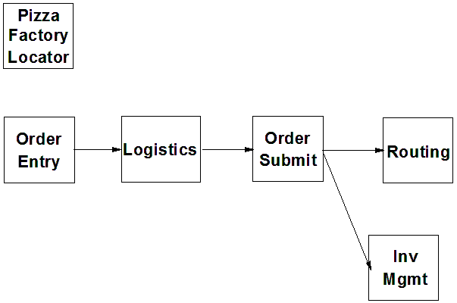
Introduction to the Case Study
Introduction
PDQ Sub-system dependencies
Notes:
Explain how each of these contributes to the growing importance of project management in the business world.

