Slide 1
Effective Project Management:
Traditional, Agile, Extreme, Hybrid
8th Edition
Ch01: What is a Project?
Presented by
(facilitator name)

Slide 2

Summary of Chapter 1
Ch01: What is a Project?
Defining a project
An intuitive view of the project landscape
Defining a program
Defining a portfolio
The enterprise level
Understanding the scope triangle
The importance of classifying projects
The contemporary project environment
Notes:
Explain how each of these contributes to the growing importance of project management in the business world.

Slide 3
Ch01: What is a Project?
Defining a Project
A project is a sequence of unique, complex, and connected activities having one goal or purpose and that must be completed by a specific time, within budget, and according to specification.
Activity C
Activity E
Activity A
Activity D
Activity B
What’s missing from this definition?
Notes:
Project duration. How long does it have to be to be considered a project versus a “to do” or a task. 80 hours labor and two weeks duration is typical to be considered a project.
Business value should be part of the definition.

Slide 4
Ch01: What is a Project?
A Business-focused Definition of a Project
A project is a sequence of finite dependent activities whose successful completion results in the delivery of the expected business value that validated doing the project.

Slide 5
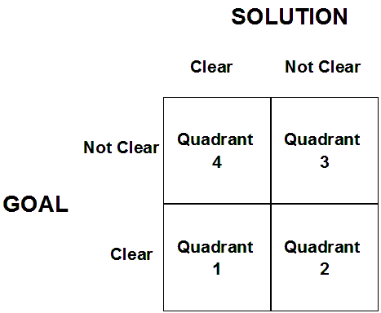

Ch01: What is a Project?
An Intuitive View of the Project Landscape
Figure
01-01

Slide 6
Ch01: What is a Project?
Defining a Program
A program is a collection of related projects that share a common goal or purpose.
Program 1
Program 2
Project C
Project E
Project A
Project D
Project B

Slide 7
Ch01: What is a Project?
Defining a Portfolio
A portfolio is a collection of projects that share some common link to one another.
For example,
Same business unit
New product development projects
R & D projects
Maintenance projects
Process improvement projects
Staffed from the same resource pool
Same budget

Slide 8
Ch01: What is a Project?
The Scope Triangle is a System in Balance
The Scope Triangle is a system in balance.
The lengths of the three sides exactly bound scope and quality.
Change in the variables will cause the system to be out of balance
Scope and Quality
Time
Cost
Resource Availability
Figure
01-02

Slide 9
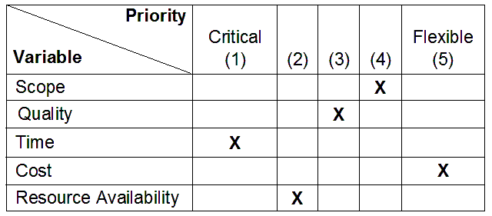
Ch01: What is a Project?
Prioritizing the Scope Triangle
Figure01-03

Slide 10
Ch01: What is a Project?
Applying the Scope Triangle
The scope triangle can be used to:
  Build a problem resolution strategy
  Scope change impact analysis

Slide 11

Ch01: What is a Project?
Project Classification
To adopt a “one size fits all” approach to every project is just asking for trouble.
Your approach to managing any project must adapt to the characteristics of the project.
A classification rule can help you choose that approach

Slide 12
Ch01: What is a Project?
Classification by Project Characteristics
Risk
Business Value
Duration
Complexity
Technology used
Number of departments affected
Cost

Slide 13
Ch01: What is a Project?
Example Project Classes and Definitions
CLASS
DURATION
RISK
COMPLEXITY
TECHNOLOGY
LIKELIHOOD OF
PROBLEMS
Type A
> 18 months
High
High
Breakthrough
Certain
Type B
9-18 months
Medium
Medium
Current
Likely
Type C
3-9 months
Low
Low
Best of Breed
Unlikely
Type D
<3 months
Very Low
Very Low
Practical
Few
Table 01-01

Slide 14
Ch01: What is a Project?
Classification by Project Application
Installing software
Recruiting and hiring
Setting up a hardware system in a field office
Soliciting, evaluating and selecting vendors
Updating a corporate procedure
Developing application systems

Slide 15
Ch01: What is a Project?
Required and Optional Processes
Project Management Process
Project Classification
IV
III
II
I
Define
Conditions of Satisfaction
R
R
O
O
Project Overview Statement
R
R
R
R
Approval of Request
R
R
R
R
Plan
Conduct Planning Session
R
R
O
O
Prepare Project Proposal
R
R
R
R
Approval of Proposal
R
R
R
R
Launch
Kick-Off Meeting
R
R
O
O
Task Schedule
R
R
R
R
Resource Assignments
R
R
R
O
Statements of Work
R
O
O
O
Monitor/Control
Status Reporting
R
R
R
R
Project Team Meetings
R
R
O
O
Approval of Deliverables
R
R
R
R
Close
Post-implementation Audit
R
R
R
R
Project Notebook
R
R
O
O
Figure
01-04
R = Required
O = Optional

Slide 16
Ch01: What is a Project?
The Contemporary Project Environment
High Speed
High Change
Lower Cost
Increasing Levels of Complexity
More Uncertainty

Slide 17


Ch01: What is a Project?
Class Exercise #1
Read the Case Study and Form Teams
Pizza Delivered Quickly (PDQ) has fallen on hard times
and needs your help to survive. Read the Case Study
and be prepared to ask questions for clarification.
Once the case study has been clarified teams will be
chosen. Teams will work on the same case study but
independently of each other. Team size should be
between 4-6.

