Slide 1
Effective Project Management:
Traditional, Agile, Extreme, Hybrid
8th Edition
Ch02: What is Project Management?
Presented by
(facilitator name)

Slide 2

Summary of Chapter 2
Ch02: What Is Project Management?
Understanding the fundamentals of project management
Challenges to effective project management
Managing the creeps
What are requirements – really?
Introducing project management life cycles
The project landscape
Traditional Project Management (TPM)
Agile Project Management (APM)
Extreme Project Management (xPM)
Emertxe Project Management (MPx)
Choosing the best-fit PMLC Model
Notes:
Explain how each of these contributes to the growing importance of project management in the business world.

Slide 3
Ch02: What Is Project Management?
The Fundamentals of Project Management
Project management is a set of tools, templates and processes designed to answer the following six questions:
What business situation is being addressed by this project?
What do you need to do?
What will you do?
How will you do it?
How will you know you did it?
How well did you do?

Slide 4
Ch02: What Is Project Management?
Definition of Project Management
Project management is an organized common-sense approach that utilizes the appropriate client involvement in order to deliver client requirements that meet expected incremental business value.

Slide 5
Ch02: What Is Project Management?
Challenges to Effective Project Management
Flexibility and Adaptability
Deep Understanding of the Business and Its Systems
Take Charge of the Project and Its Management
Always remember that
Project Management is
Organized Common Sense.
If it doesn’t make sense don’t do it.

Slide 6
Ch02: What Is Project Management?
Managing the Creeps
Scope Creep
Hope Creep
Effort Creep
Feature Creep
The Creeps

Slide 7
Ch02: What Is Project Management?
Definition of Requirements (IIBA BABOK, 2009)
A requirement is:
A condition or capability needed by a stakeholder to solve a problem or achieve an objective.
A condition or capability that must be met or possessed by a solution or solution component to satisfy a contract, standard, specification, or other formally imposed documents.
A documented representation of a condition or capability as in (1) or )2).

Slide 8
Ch02: What Is Project Management?
A Business Value Definition of Requirements
A requirement is a desired end-state whose successful integration into the solution meets on or more needs and delivers:
  specific
  measurable
  incremental business value
to the organization.
The set of requirements forms a necessary and sufficient set for achieving expected business value.

Slide 9
Ch02: What Is Project Management?
The Value of this Definition of Requirements
Reduces the number of requirements from dozens
(even hundreds) to 6 or 8.
Identifying the complete definition of most
requirements happens only through iteration.
Simplifies the search for a solution with acceptable
business value.
Choosing among alternative solution directions is
simplified.
Provides for better use of scarce resources (money,
time, and people).
It is a working definition.

Slide 10
Ch02: What Is Project Management?
Generating Complete Requirements is not likely
Changing market conditions
Actions of competitors
Technology advances
Client discovery
Changing priorities
You can never know for sure that requirements are complete. When in doubt err on the side that they are not complete.

Slide 11
Ch02: What Is Project Management?
Definition of a Project Management Life Cycle
A project management life cycle is a sequence of processes that includes:
Scoping
Planning
Launching
Monitoring & Controlling
Closing
NOTE: Every valid project management approach must include these processes.

Slide 12

Ch02: What Is Project Management?
Introducing Project Management Life Cycles (PMLC)
SOLUTION
Clear
Not Clear
MPx
Extreme
xPM
Extreme
Not Clear
GOAL
Clear
TPM
Linear
Incremental
APM
Iterative
Adaptive
Figure
02-01

Slide 13
Ch02: What Is Project Management?
TPM – Traditional Project Management
SOLUTION
Clear
Not Clear
Characteristics
Low Complexity
Few Scope Change Requests
Well-Understood Technology
Infrastructure
Low Risk
Experienced and Skilled
Project Teams
Plan-driven TPM Projects
Not Clear
GOAL
Clear
TPM

Slide 14
Ch02: What Is Project Management?
Linear PMLC Model
Figure
02-02

Slide 15
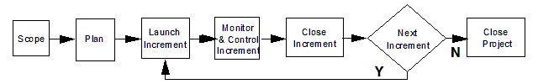
Ch02: What Is Project Management?
Incremental PMLC Model
Figure
02-03

Slide 16
Ch02: What Is Project Management?
APM – Agile Project Management
SOLUTION
Clear
Not Clear
Characteristics
A Critical Problem without a
Known Solution
A Previously Untapped Business
Opportunity
Change-driven APM Projects
Critical to the Organization
Meaningful Client Involvement is
Essential
Use Small Co-located Teams
Not Clear
GOAL
Clear
APM

Slide 17
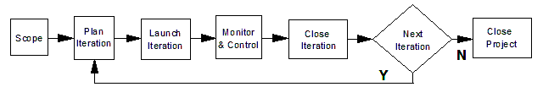
Ch02: What Is Project Management?
Iterative PMLC Model
Figure
02-04

Slide 18
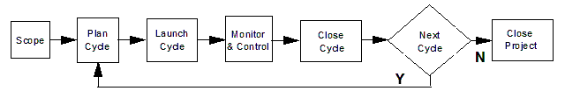
Ch02: What Is Project Management?
Adaptive PMLC Model
Figure
02-05

Slide 19
Ch02: What Is Project Management?
xPM – Extreme Project Management
SOLUTION
Clear
Not Clear
Characteristics
R&D Project
Very High Risk
Not Clear
xPM
GOAL
Clear

Slide 20
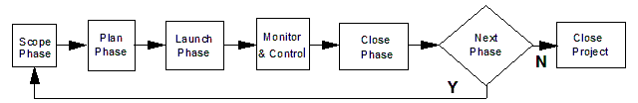
Ch02: What Is Project Management?
Extreme PMLC Model
Figure
02-06

Slide 21
Ch02: What Is Project Management?
Emertxe Project Management
SOLUTION
Clear
Not Clear
Characteristics
A New Technology without a
Known Application
A Solution out Looking for a
Problem to Solve
Not Clear
MPx
GOAL
Clear

Slide 22
Ch02: What Is Project Management?
Examples of Each Project Type
TPM Install an intranet network in field office
APF Put a man on the moon by the end of the
decade and return him safely
xPM Cure the common cold
MPx Give an example
SOLUTION
Clear
Not Clear
Not Clear
MPx
xPM
GOAL
Clear
TPM
APM

Slide 23
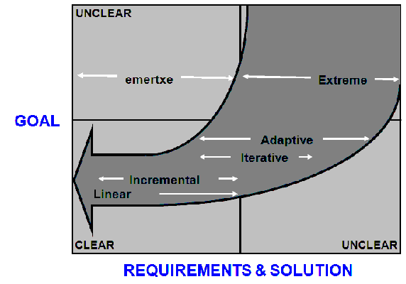
Ch02: What Is Project Management?
Project Management Life Cycle Approaches
Figure
02-07

Slide 24
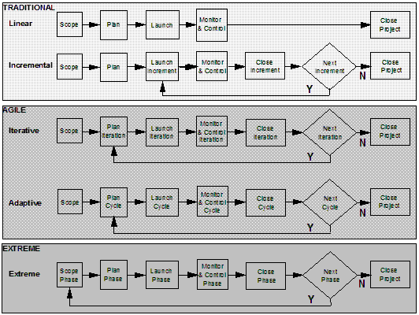
Ch02: What Is Project Management?
The 5 PMLC Models

Slide 25
Ch02: What Is Project Management?
Recap of the PMLC Models
Similarities
  All 5 Process Groups are used in each PMLC Model
  Each PMLC Model begins with a Scope Process Group
  Each PMLC Model ends with a Close Process Group
Differences
  The models form a natural ordering (Linear, Incremental, Iterative, Adaptive, Extreme) by degree of solution uncertainty
  The processes that form repetitive groups recognize the effect of increasing uncertainty as you traverse the natural ordering
  Complete project planning is replaced by just-in-time project planning as the degree of uncertainty increases
  Risk management becomes more significant as degree of solution uncertainty increases
  The need for meaningful client involvement increases as degree of solution uncertainty increases

Slide 26
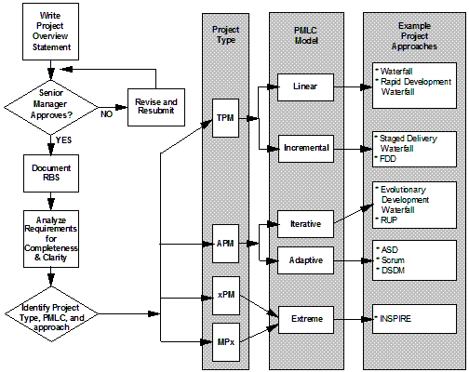
Ch02: What Is Project Management?
Choosing the Best-Fit PMLC Model
Figure
02-08

Slide 27
Ch02: What Is Project Management?
When to Use (1 of 2)
Linear
  Clearly defined solution and requirements
  Not many scope change requests
  Routine and repetitive projects
  Uses established templates
Incremental
  Same as linear but delivers business value early and often
  Some likelihood of scope change requests
Iterative
  Unstable or or incomplete requirements and functionality
  Learn by doing and by discovery

Slide 28
Ch02: What Is Project Management?
When to Use (2 of 2)
Adaptive
  Goal known but solution not known
  Solution highly influenced by expected changes
  New product development and process improvement projects
Extreme
  Goal and solution not known
  Through iteration converge on goal and solution
  Typically for R&D projects

Slide 29
Ch02: What Is Project Management?
Additional Consideration
Total Cost
Duration
Market Stability
Technology
Business Climate
Number of Departments Affected
Organizational Environment
Team Skills and Competencies

