Slide 1
Effective Project Management:
Traditional, Agile, Extreme, Hybrid
8th Edition
Ch03: What is Strategic Project Management?
Presented by
(facilitator name)

Slide 2

Summary of Chapter 3
Ch03: What Is Strategic Project Management?
Understand the complex business environment and the evolving roles and responsibilities of complex project management within that environment.
Discuss the Objectives/Strategies/Tactics Model.
Have a working knowledge of the project landscape, the four types of projects that populate that landscape, and the ability to classify a project into the best quadrant.
Be able to explain the Enterprise-wide Project Portfolio Model (EPPM)
Notes:
Explain how each of these contributes to the growing importance of project management in the business world.

Slide 3
Ch03: What Is Strategic Project Management?
The Fundamentals of Project Management
Project management is a set of tools, templates and processes designed to answer the following six questions:
What business situation is being addressed by this project?
What do you need to do?
What will you do?
How will you do it?
How will you know you did it?
How well did you do?

Slide 4
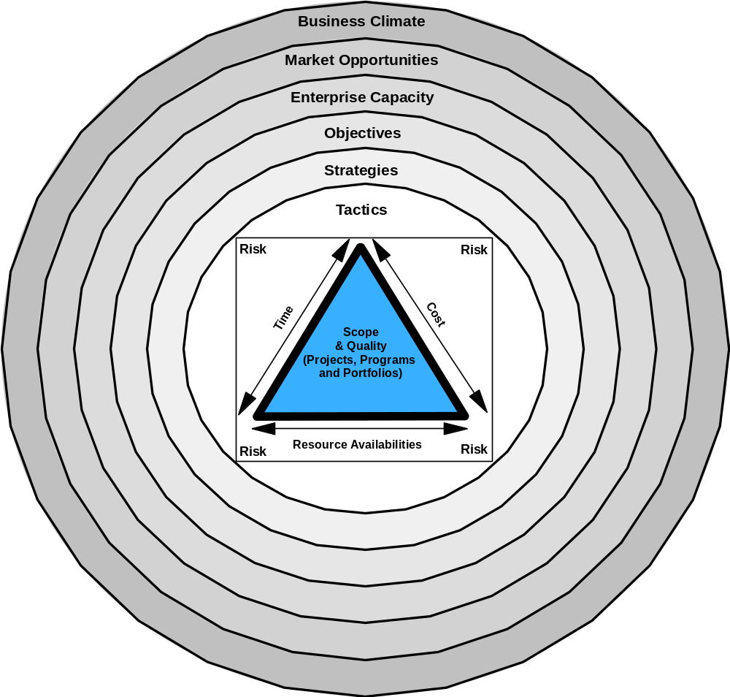
Ch03: What Is Strategic Project Management?
Definition of Project Management

Slide 5
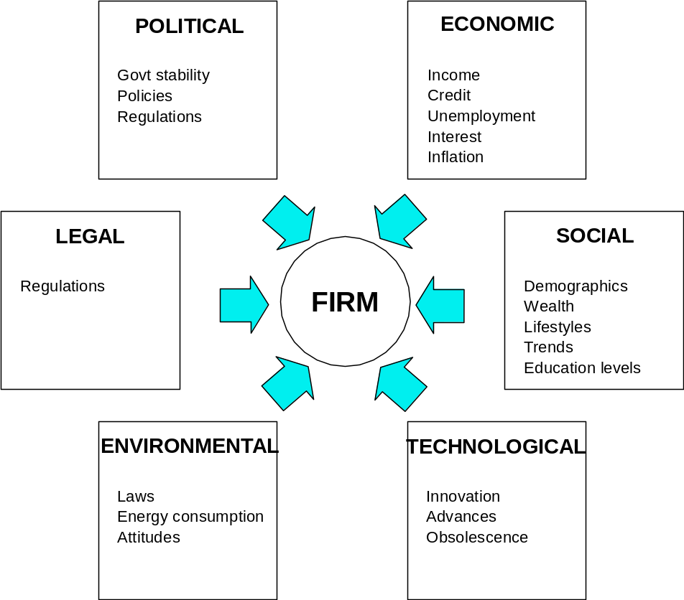
Ch03: What Is Strategic Project Management?
PESTEL

Slide 6
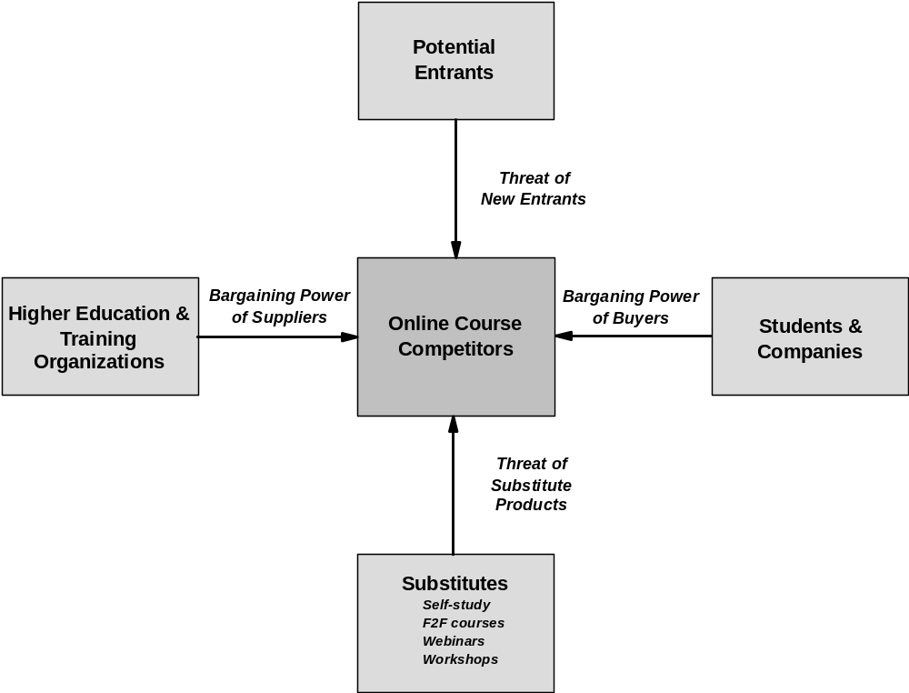
Ch03: What Is Strategic Project Management?
Porter’s Five Forces Model

Slide 7
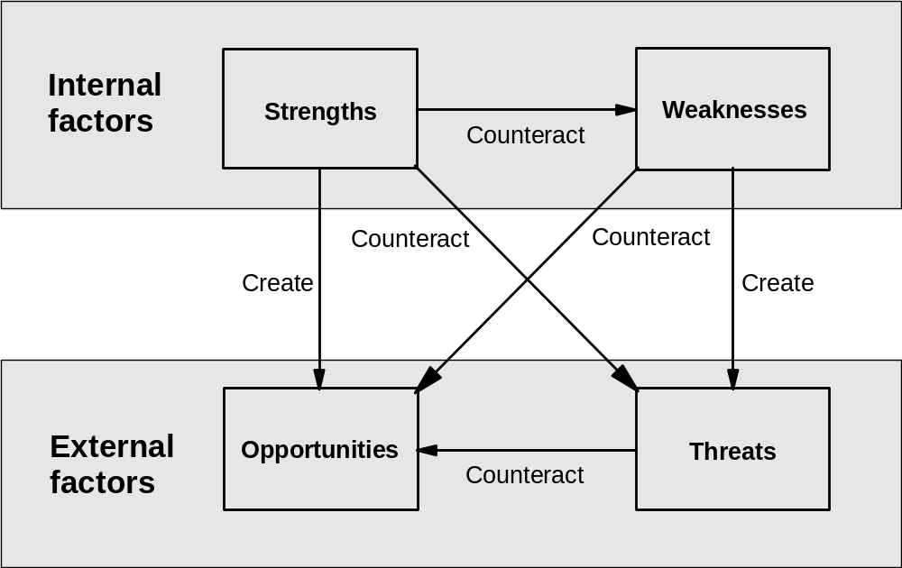
Ch03: What Is Strategic Project Management?
SWOT

Slide 8
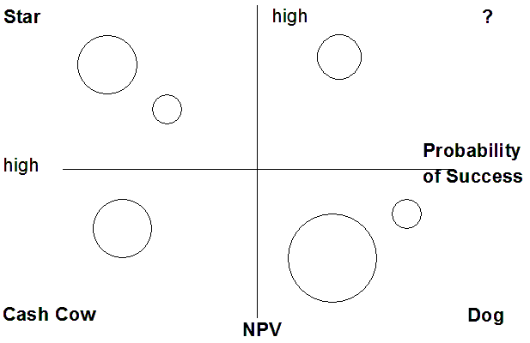
Ch03: What Is Strategic Project Management?
BCG Model

Slide 9
Ch03: What Is Strategic Project Management?
SWOT Analysis

Slide 10
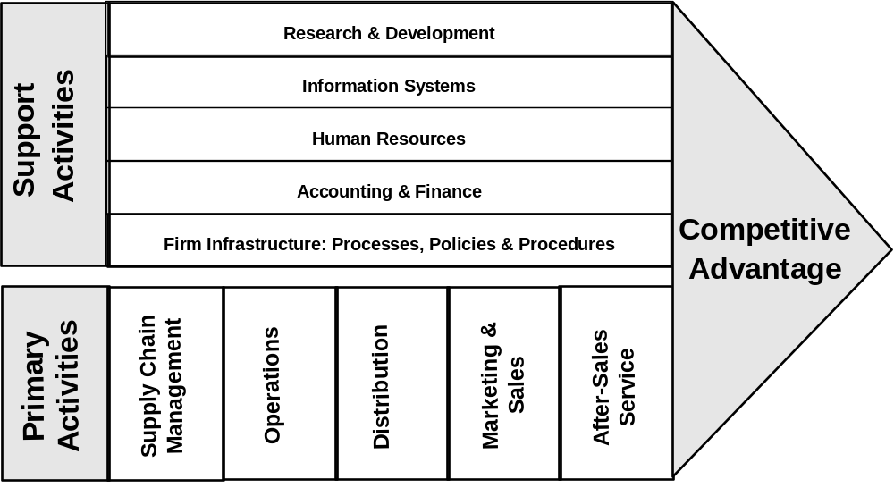
Ch03: What Is Strategic Project Management?
Value Chain Analysis

Slide 11
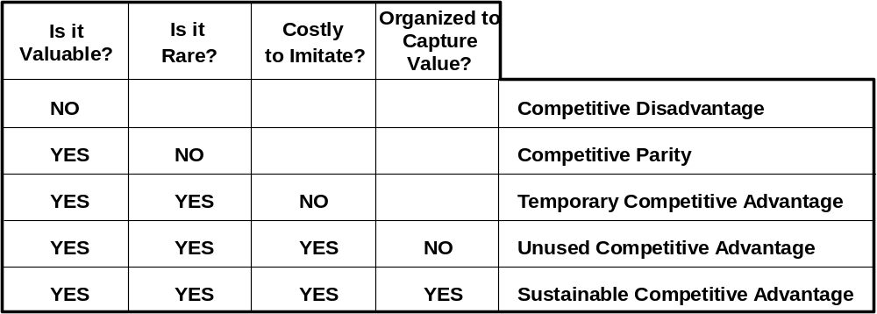
Ch03: What Is Strategic Project Management?
VRIO

Slide 12
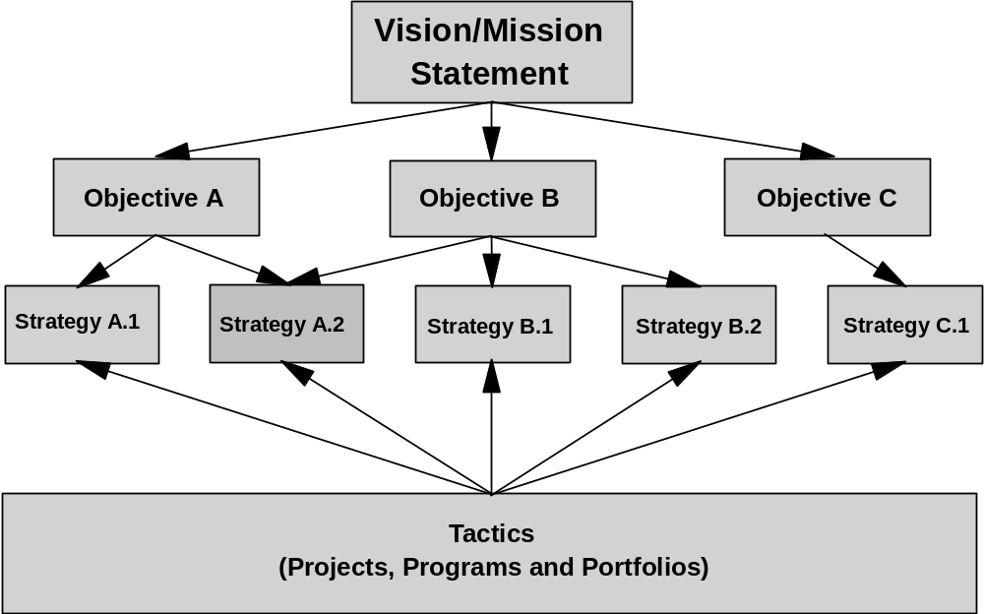
Ch03: What Is Strategic Project Management?
OST Model

Slide 13
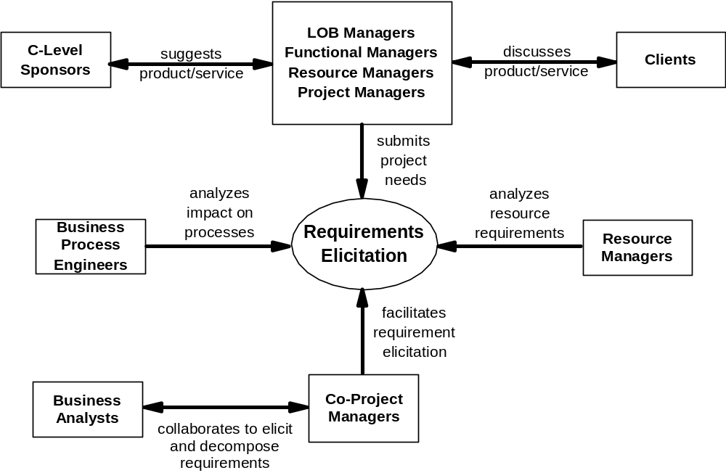
Ch03: What Is Strategic Project Management?
Stakeholder Interaction Model

Slide 14
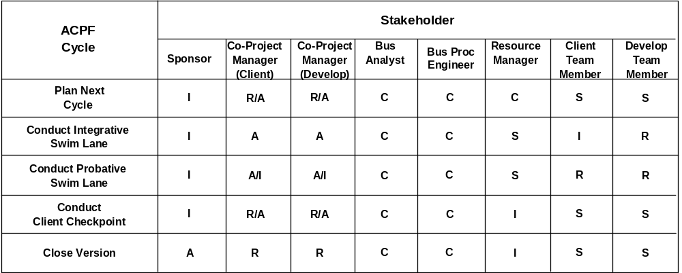
Ch03: What Is Strategic Project Management?
Stakeholder RASCI Model

Slide 15
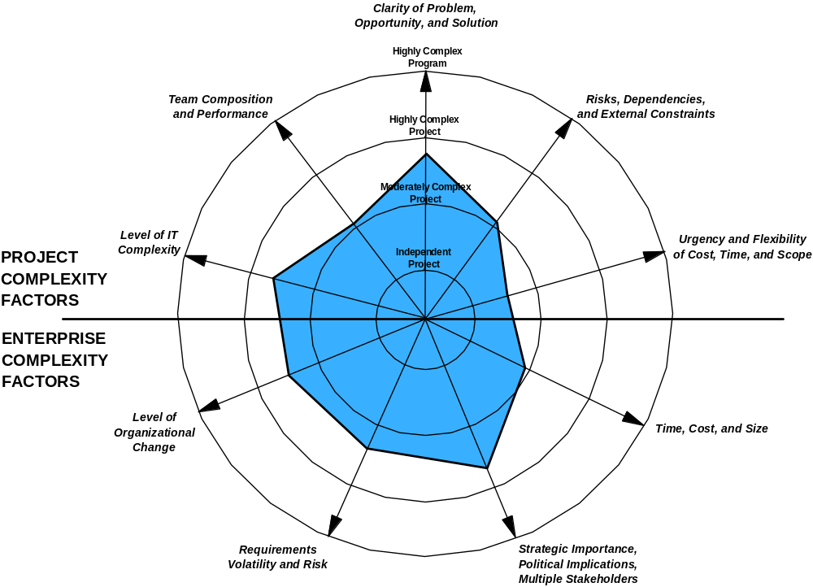
Ch03: What Is Strategic Project Management?
Complex Project Landscape

