Slide 1
Effective Project Management:
Traditional, Agile, Extreme, Hybrid
8th Edition
Ch04: Collaborative Project Team
Presented by
(facilitator name)

Slide 2

Summary of Chapter 4
Ch04: Collaborative Project Team
Understand the project landscape and how it is applied
Know the importance of meaningful client involvement
Understand how a collaborative environment can contribute to the success of a project
Know the benefits of using the co-manager model for your project team
How client ownership relates to project success.
Know who the stakeholders are in an ECPM Framework project.
Understanding the stakeholders’ roles in an ECPM Framework project.
The importance of the co-project manager in complex projects.
Notes:
Explain how each of these contributes to the growing importance of project management in the business world.

Slide 3
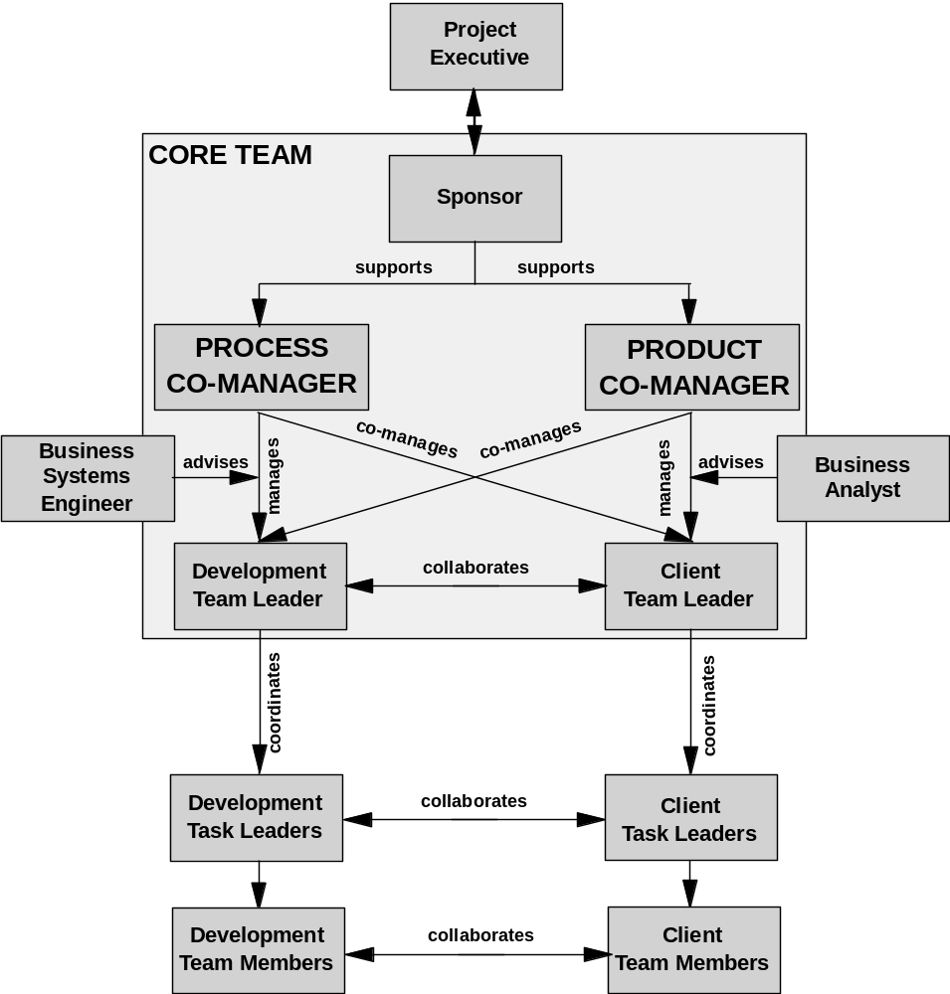
Ch04: Collaborative Project Team
The Collaborative Co-Manager Model

Slide 4
Ch04: Collaborative Project Team
The Effectiveness of the Co-Manager Model
Improved scope planning and requirements management at Client Checkpoints
Early realization of business value through incremental product/service delivery
Leverage client product/service expertise and create client ownership of deliverables
Efficiently support iterative solution discovery and maintain the lean principles

Slide 5
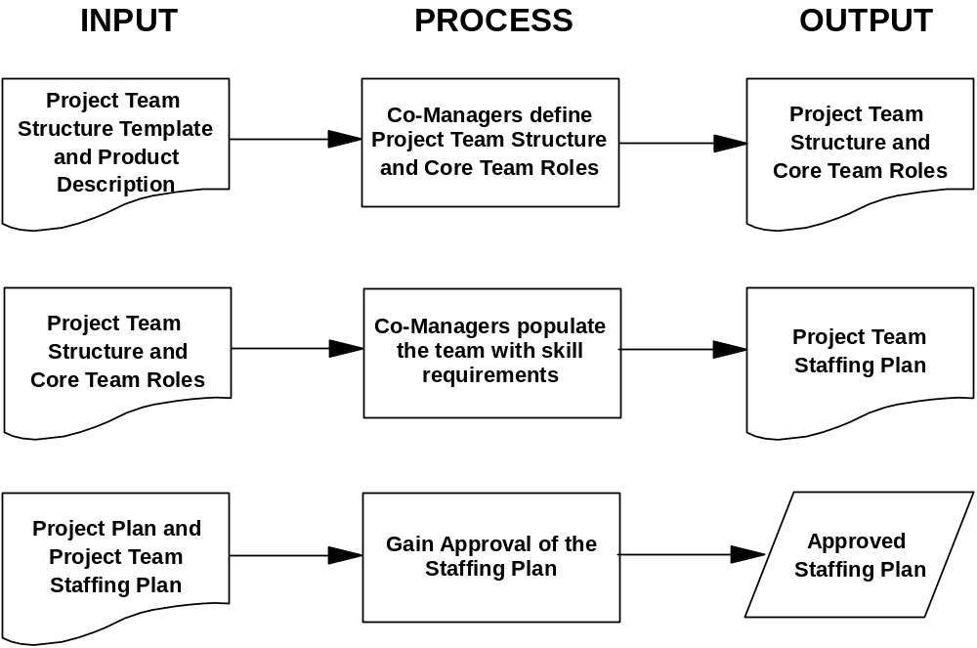
Ch04: Collaborative Project Team
Selecting the Project Team Members

Slide 6
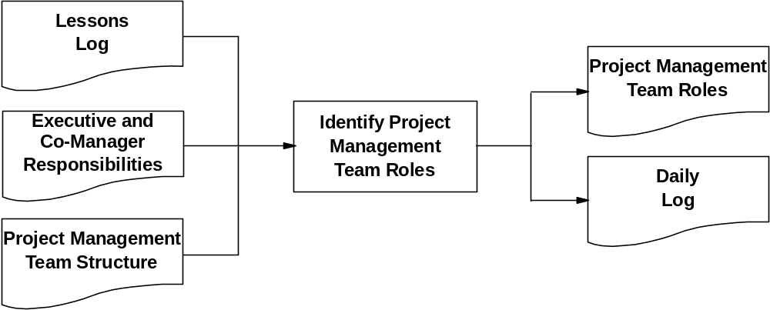
Ch04: Collaborative Project Team
Defining the Team Member Roles

Slide 7
Ch04: Collaborative Project Team
Defining the Team Member Roles
Every project needs someone in charge of each of these areas:
Risk Management
Issues Management
Scope Bank Management
Bundled Change Management
Vetted Portfolio Management
Project Review Management
Communications Management
Project Network Management

Slide 8
Ch04: Collaborative Project Team
Defining the Team Member Roles
To do this effectively requires an infrastructure and several support functions. These are not options they are required:
A Project Manager Position Family must be defined and operational
A Career and Professional Development Program must be in place
A training curriculum must be accessible in in-class and online delivery formats
A comprehensive Human Resource Management Process must be in place

Slide 9
Ch04: Collaborative Project Team
Using the Co-Manager Model
The Product Co-Manager must be operationally involved.
The Product Co-Manager will offer prioritization of alternatives and direct choosing the best approach.

Slide 10
Ch04: Collaborative Project Team
The Challenges to Meaningful Client Involvement
The complex project landscape is populated with unsolved business problems and untapped business opportunities
Technology advances.
Lack of client involvement has been identified by the Standish Group as a major cause of project failure.
Clients may not understand the HPM Framework. Use real-time consultant–led training.
What if you can’t get the client to be meaningfully involved? Or they get too involved.

Slide 11
Ch04: Collaborative Project Team
Benefits of the Co-Manager Model
The Co-Manager Model has five benefits:
Improved scope planning and requirements management at Client Checkpoint
Early realization of business value through Incremental product/service delivery
Leverage client product/service expertise and create client ownership of deliverables
Efficiently support iterative solution discovery and maintain a lean process
Centralize and increase decision making authority of the project team

Slide 12
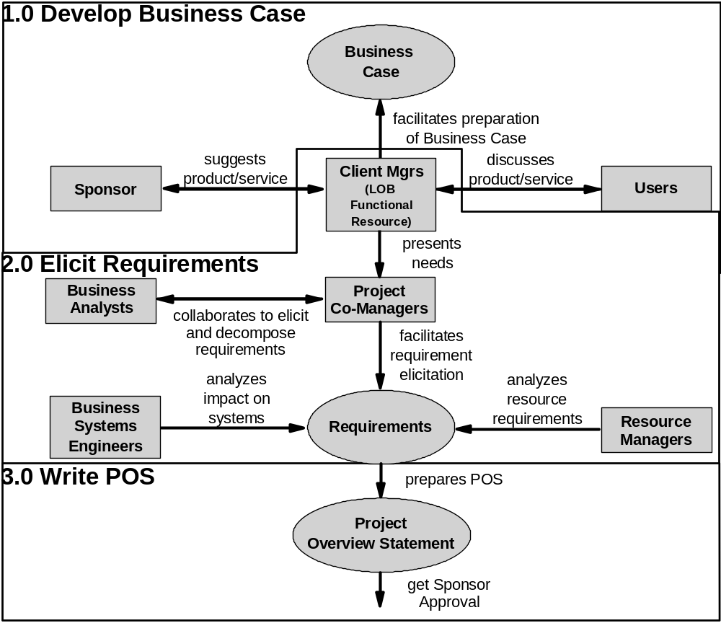
Ch04: Collaborative Project Team
Stakeholder Management

Slide 13
Ch04: Collaborative Project Team
Challenges to Attaining and Sustaining Meaningful Client Involvement
Always use the Language of the Client
Maintain a Continuous Brainstorming Culture
Establish an Open and Honest Team Environment
Use a Co-Manager Model

