Slide 1
Effective Project Management:
Traditional, Agile, Extreme, Hybrid
8th Edition
Ch05: Project Management Process Groups?
Presented by
(facilitator name)

Slide 2

Summary of Chapter 3
Ch03: What are the PM Process Groups?
Defining the five process groups
Defining the ten knowledge areas
Mapping knowledge areas to process groups
Notes:
Explain how each of these contributes to the growing importance of project management in the business world.

Slide 3
Ch03: What are the PM Process Groups?
The Five Project Management Process Groups
Develop and gain approval of a general statement of the goal and business value of the project.
The Scoping Process Group
Identify work to be done and estimate time, cost and resource requirements and gain approval.
The Planning Process Group
The Launching Process Group
Recruit the team and establish team operating rules.
The Monitoring & Controlling Process Group
Respond to change requests and resolve problem situations to maintain project progress.
The Closing Process Group
Assure attainment of client requirements and install deliverables.

Slide 4
Ch03: What are the PM Process Groups?
The Project Management Process Groups
Develop and gain approval of a general statement of the goal and business value of the project.
The Scoping Process Group
Identifying stakeholders
Recruiting the project manager
Eliciting the true needs and high-level requirements of the client
Documenting the client’s needs
Writing a one page description of the project
Gaining senior management approval to plan the project

Slide 5
Ch03: What are the PM Process Groups?
The Project Management Process Groups
Identify work to be done and estimate time, cost and resource requirements and gain approval to do the project.
The Planning Process Group
Defining all of the work of the project
Estimating how long it will take to complete this work
Estimating the resources required to complete the work
Estimating the total cost of the work
Sequencing the work
Building the initial project schedule
Analyzing & adjusting the project schedule
Writing a risk management plan
Documenting the project plan
Gaining senior management approval to launch the project

Slide 6
Ch03: What are the PM Process Groups?
The Project Management Process Groups
The Launching Process Group
Recruit the team and establish team operating rules.
Recruiting the project team
Writing the Project Description Document
Establishing team operating rules
Establishing the scope change management process
Managing team communications
Finalizing the project schedule
Writing work packages
Notes:
The Launching Process Group does not have a PMBOK counterpart. That’s too bad because it is an important part of getting the project off to a good start.

Slide 7
Ch03: What are the PM Process Groups?
The Project Management Process Groups
The Monitoring & Controlling Process Group
Respond to change requests and resolve problem situations to maintain project progress.
Establishing the project performance and reporting system
Monitoring project performance
Monitoring risk
Reporting project status
Processing scope change requests
Discovering and solving problems

Slide 8
Ch03: What are the PM Process Groups?
The Project Management Process Groups
The Closing Process Group
Assure attainment of client requirements and install deliverables.
Gaining client approval of having met project requirements
Planning and installing deliverables
Writing the final project report
Conducting the post-implementation audit

Slide 9
Ch03: What are the PM Process Groups?
The Project Management Life Cycle (PMLC)
Contrary to Public Opinion Process Groups are not a PMLC
Process Groups will be mapped to form Complex PMLCs.
Notes:
This is an important slide. Going to PMBOK looking for a PMLC won’t work. The PMBOK gives you the building blocks and nothing more.

Slide 10
Ch03: What are the PM Process Groups?
The Ten Project Management Knowledge Areas
Project Integration Management
Project Scope Management
Project Time Management
Project Cost Management
Project Quality Management
Project Human Resources Management
Project Communications Management
Project Risk Management
Project Procurement Management
Project Stakeholder Management

Slide 11
Ch03: What are the PM Process Groups?
Project Integration Management
Develop Project Overview Statement
Develop Scope Statement
Develop Project Plan
Launch Project
Monitor and Control Project Work
Integrated Change Control
Close Project

Slide 12

Ch03: What are the PM Process Groups?
Project Scope Management – Client Wants vs. Needs
NEEDS
WANTS
What your client wants may not
be what your client needs.

Slide 13
Ch03: What are the PM Process Groups?
Project Scope Management – Conditions of Satisfaction
Clarify
Request
Request
Response
Agree on
Response
Negotiate agreement and
write Project Overview Statement

Slide 14
Ch03: What are the PM Process Groups?
Project Scope Management – RBS
Project goal
and solution
Requirement 1
Requirement n
Function
1.1
Function
1.2
Function
1.3
Function
n.1
Function
n.2
Function
n.3
Sub-function
1.2.1
Sub-function
1.2.2
Sub-function
1.2.3
Feature
1.2.1.1
Feature
1.2.1.2
Feature
1.2.1.3
Feature
1.2.1.4
Feature
n.3.1
Feature
n.3.2
Feature
n.3.3
Feature
n.3.4

Slide 15
Ch03: What are the PM Process Groups?
Project Scope Management – RBS
Project goal
and solution
Requirement 1
Requirement n
Function
1.1
Function
1.2
Function
1.3
Function
n.1
Function
n.2
Function
n.3
Sub-function
1.2.1
Sub-function
1.2.2
Sub-function
1.2.3
Feature
1.2.1.1
Feature
1.2.1.2
Feature
1.2.1.3
Feature
1.2.1.4
Feature
n.3.1
Feature
n.3.2
Feature
n.3.3
Feature
n.3.4

Slide 16
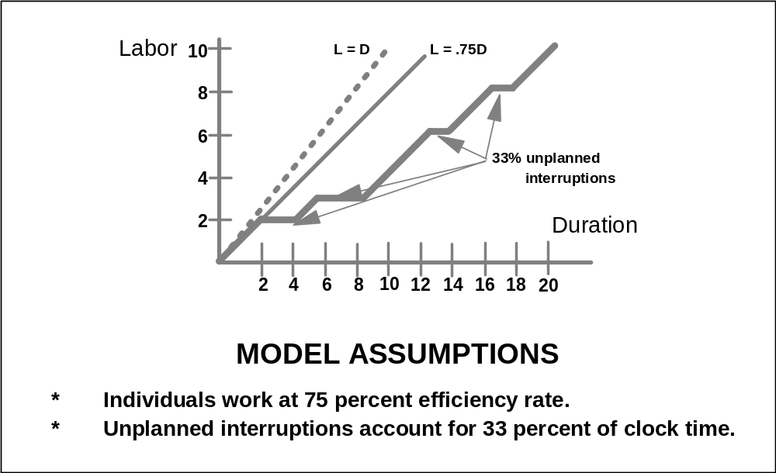
Ch03: What are the PM Process Groups?
Project Time Management – Duration and Labor

Slide 17
Ch03: What are the PM Process Groups?
Project Time Management – Estimate Task Duration
Similarity to other activities
Historical data
Expert advice
Delphi technique
Three-point technique
Wide-band Delphi technique

Slide 18
Ch03: What are the PM Process Groups?
Project Cost Management
Labor Rates
  Single labor rate
  Labor rate by position class
Capital Equipment
Contracted Services

Slide 19
Ch03: What are the PM Process Groups?
Quality Management – Consists of:
Quality planning
Project Quality Management
Quality assurance
Quality control

Slide 20
Ch03: What are the PM Process Groups?
Project Quality Management – Definition of Quality
Fit for use
Meets all client requirements
Delivered on time within budget and according to client specifications
Is there anything about these definitions that surprises you?

Slide 21
Ch03: What are the PM Process Groups?
Project Quality Management – Types of Quality
Process Quality
  The quality of the project management process that produced the product, service or business process
Product Quality
  The quality of the deliverables from the project

Slide 22
Ch03: What are the PM Process Groups?
Quality Planning
Determine relevant quality standards for the project and what
you can do to satisfy them. The inputs to this process are:
Environmental factors such as agency regulations, rules, standards and guidelines
Organizational assets such as quality policies, procedures and guidelines, historical data and lessons learned
Project Overview Statement
Project Management Plan
A Quality Plan documents:
How the quality policies will be met
The metrics that will be used to measure quality
A process improvement program

Slide 23
Ch03: What are the PM Process Groups?
Quality Assurance
Apply quality activities so that the project employs the processes needed to assure that quality requirements are met. These can include:
  Quality Audits
  Process Analysis
  Project Quality Management Tools

Slide 24
Ch03: What are the PM Process Groups?
Quality Control
Monitor project performance to determine compliance to quality standards and how to eliminate non-compliance. This will be accomplished by using project management tools, templates and processes.

Slide 25
Ch03: What are the PM Process Groups?
Project Human Resource Management
Project Team
  Developer co-manager
  Client co-manager
  Core Team
  Task Leaders
  Team Members
Skills and Competencies

Slide 26

Ch03: What are the PM Process Groups?
Project Communications Management – Process
A good Project Communications Management process answers the following questions:
  Who are the project stakeholders?
  What do they need to know about the project?
  How should their needs be met?

Slide 27
Ch03: What are the PM Process Groups?
Project Communications Management – Definition
Communication is the process of passing information
and understanding from one person to another.
  transmitted properly
  message sent is message received
  understood by the receiver
  accepted by the receiver

Slide 28
Ch03: What are the PM Process Groups?
Communications Management – The Process
Sender
Generates
the idea
Encodes
the message
Transmits
through a channel
Decodes
the message
Checks
the meaning
Feedback
Receiver

Slide 29
Ch03: What are the PM Process Groups?
Communications Management – Types
One-to-one
  Conversations (in person and on the phone)
  Meetings
Electronic
  Email messages
  Web sites
  Databases
Written
  Memos
  Letters
  Documents
  Reports
Two-way
One-way

Slide 30
Ch03: What are the PM Process Groups?
Communications Management – Interfaces
Sponsor
Team
Managers
Client
Project
Manager
Project
Team
Members
3rd Parties
Public

Slide 31
Ch03: What are the PM Process Groups?
Project Risk Management – Process
What are the risks?
What is the probability of loss
that results from them?
How much are the losses likely to
cost?
What might the losses be if the
worst happens?
What are the alternatives?
How can the losses be reduced or
eliminated?
Will the alternatives produce other
risks?
risk identification
risk assessment
risk mitigation
risk monitoring & control

Slide 32
Ch03: What are the PM Process Groups?
Risk Management – Risk Identification
Technical risks
Project management risks
Organizational risks
External risks
risk identification
risk assessment
risk mitigation
risk monitoring & control

Slide 33

Ch03: What are the PM Process Groups?
Risk Identification Matrix Template
RISK CATEGORIES AND RISKS | SCOPE TRIANGLE ELEMENTS
 | Scope | Time | Cost | Quality | Resources
Technical
Project Management
Organizational
External
Figure
03-01

Slide 34
Ch03: What are the PM Process Groups?
Project Risk Management – Candidate Risk Driver Template
Risk Category | Scope Triangle | Event # | Event | Y/N | Prob. | Impact | Priority | Mitigate Y/M/N
Tech | Scope | TS01 | Available HW/SW technology limits scope
 |  | TS02 | New technology does not integrate with old
Tech | Time | TT01 | Integrating technologies impacts schedule
Tech | Cost | TC01 | Unexpected need to acquire hardware
Tech | Cost | TC02 | Unexpected need to acquire software
Tech | Quality | TQ01 | Technology limits solution performance
Tech | Res | TR01 | New/unfamiliar technology
Tech | Res | TR02 | Inadequate software sizing
Tech | Res | TR03 | Inadequate hardware sizing
Proj Mgt | Scope | PS01 | Senior scope change request too significant
Proj Mgt | Time | PT01 | Schedule too aggressive
Proj Mgt | Time | PT02 | Interproject dependencies compromise schedule
Proj Mgt | Time | PT03 | Task duration estimates too optimistic
Proj Mgt | Time | PT04 | Difficulty scheduling meetings
Proj Mgt | Quality | PQ01 | Inaccurate assumption
Figure
03-02

Slide 35
Ch03: What are the PM Process Groups?
Risk Management – Risk Assessment
What is the probability of loss
that results from them?
How much are the losses
likely to cost?
What might the losses be if
the worst happens?
risk identification
risk assessment
risk mitigation
risk monitoring & control

Slide 36
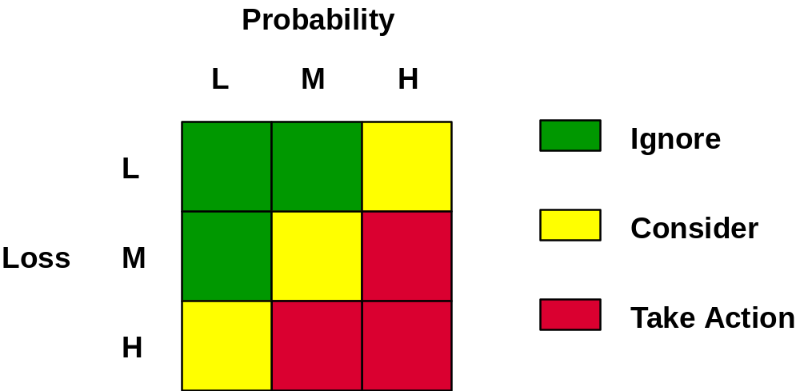
Ch03: What are the PM Process Groups?
Static Risk Assessment Matrix
Figure
03-03

Slide 37
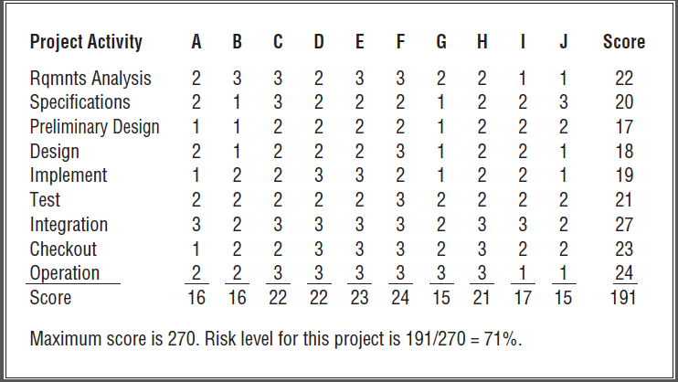
Ch03: What are the PM Process Groups?
Dynamic Risk Assessment Worksheet
Some organizations use a 1-5, or 1-10 metric
Figure
03-04

Slide 38
Ch03: What are the PM Process Groups?
Risk Management – Risk Mitigation
What are the alternatives?
How can the losses be
reduced or eliminated?
  Accept
  Avoid
  Contingency planning
  Mitigate
  Transfer
Will the alternatives produce
other risks?
risk identification
risk assessment
risk mitigation
risk monitoring & control

Slide 39
Ch03: What are the PM Process Groups?
Risk Management – Risk Monitoring & Control
Risk Log
  ID number
  Risk description
  Risk owner
  Action to be taken
  Outcome
risk identification
risk assessment
risk mitigation
risk monitoring & control

Slide 40
Ch03: What are the PM Process Groups?
Risk Log Entry
ID #
Risk Description
P
I
Risk Owner
Action to be Taken
Outcome

Slide 41
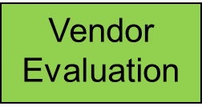
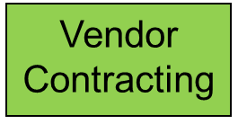
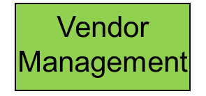
Ch03: What are the PM Process Groups?
Procurement Management – The Life Cycle
Vendor
Solicitation
Vendor
Selection
Notes:
Describe each in detail and talk about the milestones that are the transition points from phase to phase.

Slide 42
Ch03: What are the PM Process Groups?
Procurement Management Life Cycle
Vendor
Solicitation
Develop RBS
Decide to use a vendor
Identify potential vendors
Select procurement management team (PMT)
Determine vendor relationship
Determine the acquisition strategy
Establish vendor evaluation criteria
Develop contract management
Prepare & distribute Request for Proposal (RFP)
Respond to bidder’s questions
Vendor
Evaluation
Vendor
Selection
Vendor
Contracting
Vendor
Management
Notes:
Describe each in detail and talk about the milestones that are the transition points from phase to phase.

Slide 43
Ch03: What are the PM Process Groups?
Procurement Management Life Cycle
Vendor
Solicitation
Evaluate vendors
Evaluate responses to RFP
Reduce list of companies
Conduct onsite presentations (optional)
Vendor
Evaluation
Vendor
Selection
Vendor
Contracting
Vendor
Management
Notes:
Describe each in detail and talk about the milestones that are the transition points from phase to phase.

Slide 44
Ch03: What are the PM Process Groups?
Vendor Solicitation – Evaluation – Forced Ranking
Consultant | A | B | C | D | Rank Sum | Forced Rank
1 | 2 | 3 | 2 | 4 | 11 | 3
2 | 4 | 1 | 1 | 2 | 8 | 1
3 | 6 | 2 | 5 | 5 | 18 | 5
4 | 1 | 5 | 3 | 1 | 10 | 2
5 | 3 | 4 | 4 | 3 | 14 | 4
6 | 5 | 6 | 6 | 6 | 23 | 6
Table
03-01
Notes:
Remind students that it is the customer who determines when the project is done – by agreeing you have met their specifications.
That “doneness criteria” should have been developed as part of detailed project planning. The end of the project is no time to be debating whether or not the project is done. The doneness criteria is a checklist. When all of the boxes have been checked as a result of testing outcomes, the project is done and you move into the closing phase.

Slide 45
Ch03: What are the PM Process Groups?
Vendor Solicitation – Evaluation – Paired Comparison
 | 1 | 2 | 3 | 4 | 5 | 6 | SUM | RANK
1 | X | 1 | 1 | 0 | 1 | 1 | 4 | 2
2 | 0 | X | 1 | 0 | 1 | 1 | 3 | 3
3 | 0 | 0 | X | 0 | 0 | 1 | 1 | 5
4 | 1 | 1 | 1 | X | 1 | 1 | 5 | 1
5 | 0 | 0 | 1 | 0 | X | 1 | 2 | 4
6 | 0 | 0 | 0 | 0 | 0 | X | 0 | 6
Table
03-02
Notes:
Remind students that it is the customer who determines when the project is done – by agreeing you have met their specifications.
That “doneness criteria” should have been developed as part of detailed project planning. The end of the project is no time to be debating whether or not the project is done. The doneness criteria is a checklist. When all of the boxes have been checked as a result of testing outcomes, the project is done and you move into the closing phase.

Slide 46
Ch03: What are the PM Process Groups?
Procurement Management Life Cycle
Vendor
Solicitation
Select the final vendor(s)
Vendor
Evaluation
Vendor
Selection
Vendor
Contracting
Vendor
Management
Notes:
Describe each in detail and talk about the milestones that are the transition points from phase to phase.

Slide 47
Ch03: What are the PM Process Groups?
Procurement Management Life Cycle
Vendor
Solicitation
Negotiate the final contract
  No Award
  Single Award
  Multiple Awards
Vendor
Evaluation
Type of contract
  Fixed Price
  Time and Materials
  Retainer
  Cost Plus
Vendor
Selection
Vendor
Contracting
Vendor
Management
Notes:
Describe each in detail and talk about the milestones that are the transition points from phase to phase.

Slide 48
Ch03: What are the PM Process Groups?
Procurement Management Life Cycle
Vendor
Solicitation
Discussion Points for Negotiating final contract
  Work schedule
  Payment schedule
  Fees
  Personnel assigned to the contract
  Rights in data
  Other terms and conditions
  Ownership
  Warranties
  Cancellation terms
Vendor
Evaluation
Vendor
Selection
Vendor
Contracting
Vendor
Management
Notes:
Describe each in detail and talk about the milestones that are the transition points from phase to phase.

Slide 49
Ch03: What are the PM Process Groups?
Procurement Management Life Cycle
Vendor
Solicitation
Final Contract Negotiation
  Statement of Work (SOW) for the vendor
  Terms and conditions
  List of deliverables, schedule and budget
  Defined acceptance process including
  acceptance criteria
  Identification of the project and supplier
  representatives responsible and authorized
  to agree to changes to the vendor agreement
  Description of the process for handling
  requirements change requests from either
  side
  The processes, procedures, guidelines,
  methods, templates and so on that will be
  followed
Vendor
Evaluation
Vendor
Selection
Vendor
Contracting
Vendor
Management
Notes:
Describe each in detail and talk about the milestones that are the transition points from phase to phase.

Slide 50
Ch03: What are the PM Process Groups?
Procurement Management Life Cycle
Vendor
Solicitation
Final Contract Negotiation (continued)
  Critical dependencies between the project
  and the vendor
  Descriptions of the forms, frequency and
  depth of project oversight that the vendor can
  expect from the project including the
  evaluation criteria to be used in monitoring
  the vendor’s performance
  Clear definition of the vendor’s
  responsibilities for ongoing maintenance and
  support of the acquired products
  Identification of the warranty, ownership and
  usage rights for the acquired products
Vendor
Evaluation
Vendor
Selection
Vendor
Contracting
Vendor
Management
Notes:
Describe each in detail and talk about the milestones that are the transition points from phase to phase.

Slide 51
Ch03: What are the PM Process Groups?
Procurement Management Life Cycle
Vendor
Solicitation
Set vendor expectations
Monitor progress and performance
Monitor requirements change requests
Monitoring the performance of standard
project activities
Transitioning from vendor to client
Closing out a vendor contract
Vendor
Evaluation
Vendor
Selection
Vendor
Contracting
Vendor
Management
Notes:
Describe each in detail and talk about the milestones that are the transition points from phase to phase.

Slide 52
Ch03: What are the PM Process Groups?
Project Stakeholder Management
Sponsors
Clients
Customers
Business process engineers
Resource managers
Project manager
Business analysts

Slide 53
Ch03: What are the PM Process Groups?
Mapping Knowledge Areas to Process Groups
Knowledge Areas | Scoping Process Group | Planning Process Group | Launching Process Group | Monitoring and Controlling Process Group | Closing Process Group
INTEGRATION | X | X | X | X | X
SCOPE |  | X |  | X
TIME |  | X |  | X
COST |  | X |  | X
QUALITY |  | X | X | X
HR |  | X | X | X
COMMUNICATIONS |  | X | X | X
RISK |  | X |  | X
PROCUREMENT |  | X | X | X | X
STAKEHOLDER | X | X | X | X
Table
03-03
Notes:
Describe each in detail and talk about the milestones that are the transition points from phase to phase.

Slide 54
Ch03: What are the PM Process Groups?
Mapping Knowledge Areas to Process Groups
What the mapping means
How to use the mapping
Using process groups to define PMLCs
A look ahead: Mapping process groups
to form complex PMLCs
Notes:
Describe each in detail and talk about the milestones that are the transition points from phase to phase.

