Slide 1
Effective Project Management:
Traditional, Agile, Extreme, Hybrid
8th Edition
Ch06: How to Scope a TPM Project
Presented by
(facilitator name)

Slide 2

Summary of Chapter 6
Ch06: How to Scope a TPM Project
Using tools, templates, and processes to scope a TPM project
Managing client expectations
Project scoping process
Project scoping meeting & deliverables
Requirements breakdown structure (RBS)
Project classification
Choosing the best fit PMLC Model
Project Overview Statement
Notes:
Explain how each of these contributes to the growing importance of project management in the business world.

Slide 3
Ch06: How to Scope a TPM Project
Tools, Templates & Processes used to Scope a Project
Conditions of Satisfaction
Project Scoping Meting
Requirements Elicitation
Brainstorming
Facilitated Group Sessions
Interviews
Prototyping
Requirements Workshops
Project Overview Statement
Approval to Plan the Project

Slide 4

Ch06: How to Scope a TPM Project
Client Wants vs. Client Needs Dilemma
NEEDS
WANTS
What your client wants may not be what your client needs.
Your job is to make sure that what they want is what they need and that you will deliver what they need.

Slide 5
Ch06: How to Scope a TPM Project
Tips to Managing Client Expectations During Scoping
Make sure you understand what your client wants/needs/expects
Make sure the client understands what you will do
Assure yourself that what your client wants is what your client needs
Actively include your client in scoping the project
Put yourself in the shoes of your client
Meaningfully involve your client wherever possible
Keep your client informed of project status

Slide 6
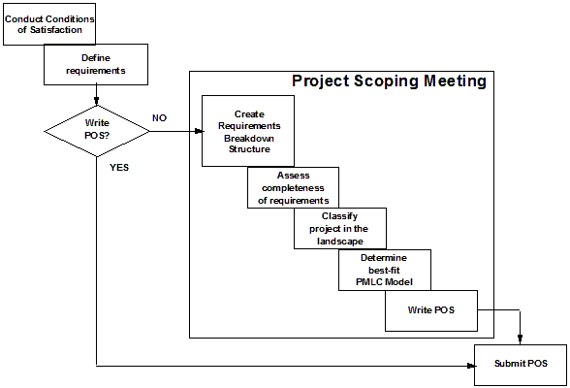
Ch06: How to Scope a TPM Project
Project Scoping Process

Slide 7
Ch06: How to Scope a TPM Project
Establishing Conditions of Satisfaction
Clarify
Request
Request
Response
Agree on
Response
Negotiate agreement and
write Project Overview Statement

Slide 8
Ch06: How to Scope a TPM Project
Planning and Conducting the Project Scoping Meeting
Purpose
  Document requirements
  Project Overview Statement
Attendees
  Project Manager
  Client Group
  Core Team Members
  The Facilitator & Technographer

Slide 9
Ch04
Ch06: How to Scope a TPM Project
Planning and Conducting the Project Scoping Meeting
Agenda
  Introductions
  Purpose of the Meeting (led by Facilitator)
  COS (conduct or review if done earlier)
  Description of current state (led by client representative)
  Description of problem or business opportunity (led by client representative)
  Description of end state (led by client representative)
  Requirements definition and documentation (led by facilitator)
  Discussion of the gap between current and end state (led by project manager)
  Choose best fit project management approach to close the gap (led by project manager)
  Draft and approve the POS (whole scope planning group)
  Adjourn

Slide 10
Ch04
Ch06: How to Scope a TPM Project
Planning and Conducting the Project Scoping Meeting
Deliverables
  RBS creation
  Assessment of completeness of RBS
  Project classification
  Determination of best fit PMLC Model
  The POS

Slide 11

Ch06: How to Scope a TPM Project
What Are Requirements?
A requirement is something the product/project should
do/produce or a quality that it must have.

Slide 12
Ch06: How to Scope a TPM Project
Requirement – A Business Value Perspective
Requirement
A requirement is a desired end-state whose successful integration into the solution meets one or more needs and delivers specific, measurable, and incremental business value to the organization.
Furthermore the set of high-level requirements forms a necessary and sufficient set for the attainment of incremental business value.

Slide 13
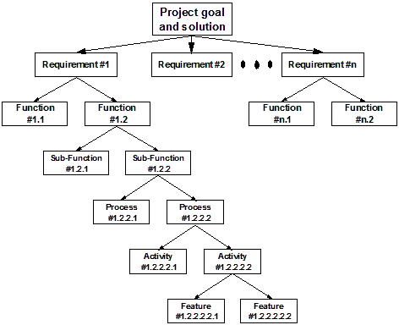
Ch06: How to Scope a TPM Project
Building the Requirements Breakdown Structure
NOTE:
Requirements #1 through #n form
a necessary & sufficient set for
attaining expected business value
Not all levels are required.

Slide 14
Ch06: How to Scope a TPM Project
Building the Requirements Breakdown Structure
Project goal
and solution
Requirement 1
Requirement n
Function
1.1
Function
1.2
Function
1.3
Function
n.1
Function
n.2
Function
n.3
Sub-function
1.2.1
Sub-function
1.2.2
Sub-function
1.2.3
Feature
1.2.1.1
Feature
1.2.1.2
Feature
1.2.1.3
Feature
1.2.1.4
Feature
n.3.1
Feature
n.3.2
Feature
n.3.3
Feature
n.3.4

Slide 15
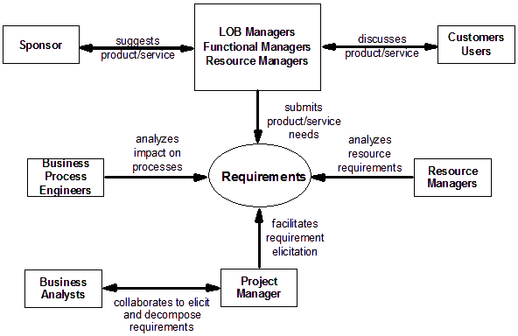
Ch06: How to Scope a TPM Project
Stakeholder Interaction in Requirements

Slide 16
Ch06: How to Scope a TPM Project
Approaches to Requirements Gathering
Brainstorming
Facilitated Group Sessions
Interviews
Prototyping
Requirements Workshop
NOTE: These approaches can be used for decomposition too:
  The RBS is most meaningful to the client
  The RBS is deliverables-based
  The RBS is consistent with the PMBOK
  The RBS is client-facing
  The RBS is the higher order part of the WBS

Slide 17
Ch06: How to Scope a TPM Project
Brainstorming
Strengths
Reduces social inhibitions
Stimulates idea generation
Increases overall creativity of the group
Risks
Can be dominated by a strong individual
Individual fear of being criticized
Evaluation of ideas

Slide 18
Ch06: How to Scope a TPM Project
Facilitated Group Session Method
Strengths
Excellent for cross-functional processes
Detailed requirements are documented and verified immediately
Resolves issues with an impartial facilitator
Risks
Untrained facilitators can lead to negative responses
Time and cost of planning and executing can be high

Slide 19
Ch06: How to Scope a TPM Project
Interview Method
Strengths
End-user participation
High-level description of functions and processes provided
Risks
Descriptions may differ from actual detailed activities
Without structure, stakeholders may not know what information to provide
Real needs ignored if analyst is prejudiced

Slide 20
Ch06: How to Scope a TPM Project
Prototyping
Strengths
Innovative ideas can be generated
Users clarify what they want
Users identify requirements that may be missed
Client –focused
Early proof of concept
Stimulates thought process
Risks
Client may want to implement prototype
Difficult to know when to stop
Specialized skills required
Absence of documentation

Slide 21
Ch06: How to Scope a TPM Project
Requirements Workshop
Strengths
Good way for first-time use
Risks
May overwhelm customer

Slide 22

Ch06: How to Scope a TPM Project
Categories of Requirements
Functional
Non-functional
Global
Product/project constraints

Slide 23
Ch06: How to Scope a TPM Project
Definition: Functional Requirement
Functional requirements specify what the product or
service must do.
Give an example of a functional requirement.

Slide 24
Ch04
Ch06: How to Scope a TPM Project
Definition: Non-Functional Requirement
Non-functional requirements demonstrate properties
that the product or service should have in order to do
what must be done.
Give an example of a non-functional requirement.

Slide 25
Ch06: How to Scope a TPM Project
Definition: Global Requirement
Global requirements describe the highest level of
requirements within the system or product. They can be
thought of as general requirements.
Give an example of a global requirement.

Slide 26
Ch06: How to Scope a TPM Project
Definition: Product/Project Constraints
Product/project constraints are those requirements that,
on the surface, resemble design constraints or project
constraints.
Give an example of a product/project constraint.

Slide 27
Ch06: How to Scope a TPM Project
RBS – The Reality
Project goal
and solution
Requirement 1
Requirement n
Functional
Requirement n
Function
1.1
Function
1.2
Function
1.3
Function
n.1
Function
n.2
Function
n.3
Sub-function
1.2.1
Sub-function
1.2.2
Sub-function
1.2.3
Feature
1.2.1.1
Feature
1.2.1.2
Feature
1.2.1.3
Feature
1.2.1.4
Feature
n.3.1
Feature
n.3.2
Feature
n.3.3
Feature
n.3.4

Slide 28
Ch06: How to Scope a TPM Project
Characteristics of the RBS
The RBS is intuitive and most meaningful to the client
The RBS is a deliverables based approach
The RBS is consistent with the PMI PMBOK
The RBS remains client facing as long as possible into the planning exercise

Slide 29
Ch06: How to Scope a TPM Project
Advantages of using the RBS
Does not require a trained facilitator
Does not require learning one of the contemporary approaches to requirements gathering
Presents an intuitive approach to gathering requirements
Allows the client to work with the project team in an environment familiar to them, i.e., to stay in their own comfort zone
Paints a clear picture of the degree to which the solution is clearly defined
Provides the input needed to choose the best fit PMLC Model

Slide 30
Ch06: How to Scope a TPM Project
The Challenge of Requirements Management
Many different types of requirements at different levels of detail
Requirements are not independent of one another and may create conflict situations
Many interested and responsible parties with different needs
Change as a result of changing business conditions
Can be time-sensitive
Shuttle diplomacy to resolve differences
Assess completeness of requirement decomposition

Slide 31
Ch06: How to Scope a TPM Project
Hints in Deciding which PMLC Model to Use
The degree to which the RBS is complete is the major factor in deciding which PMLC Model to use.
Consider using the highest level of decomposition in the Objective section of the POS and leaving creation of the RBS and WBS for the Planning Phase.
The highest level requirements could be those that deliver business value. Senior managers might prefer this.

Slide 32
Ch06: How to Scope a TPM Project
When to use each PMLC Model
PMLC Model Type | When to Use It
Linear | The solution and requirements are clearly defined.
 | You do not expect too many scope change requests.
 | The project is routine and repetitive.
 | You can use established templates.
Incremental | Same conditions as the Linear approach, but the client wants to deploy business value incrementally.
 | There may be some likelihood of scope change requests.
Iterative | You feel that requirements are not complete or may change.
 | You will learn about remaining requirements in the course of doing the project.
 | Some features of the solution are not yet identified.
Adaptive | The solution and requirements are only partially known.
 | There may be functionality that is not yet identified.
 | There will be a number of scope changes from the client.
 | The project is oriented to new product development or process improvement.
 | The development schedule is tight and you can’t afford rework or re-planning.
Extreme | The goal and solution are not clearly known.
 | The project is an R & D type project.

Slide 33

Ch06: How to Scope a TPM Project
Purpose of the Project Overview Statement
A one-page description that is:
A general statement of the project
A reference for the planning team
A decision aid for the project
To get management approval to plan the project
POSs

Slide 34
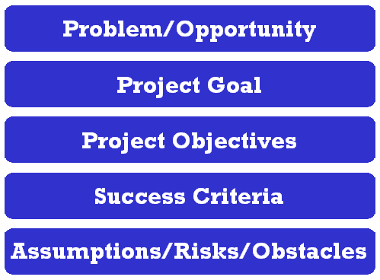
Ch06: How to Scope a TPM Project
Contents of the Project Overview Statement

Slide 35
Ch06: How to Scope a TPM Project
PROJECT
Project Name
Project No.
Project Manager
OVERVIEW
Office Supply Cost Reduction
PAUL BEARER
Example POS
STATEMENT
Problem/Opportunity
Our cost reduction task force reports that office supply expenses have exceeded budget by an
average of 4% for each of the last three fiscal years. In addition an across the board budget cut of
2% has been announced and there is an inflation rate of 3% estimated for the year.
Goal
To implement a cost containment program that will result in office supply expenses being within
budget by the end of the next fiscal year.
Objectives
1. Establish a departmental office supply budgeting and control system.
2. Implement a central stores for office and copying supplies.
3. Standardize the types and brands of office supplies used by the company.
4. Increase employee awareness of copying practices that can reduce the cost of
meeting their copying needs.
Success Criteria
1. The total project cost is less than 4% of the current year office supply budget.
2. At least 98% of office supply requests are filled on demand.
3. At least 90% of the departments have office supply expenses within budget.
4. No department office supply expense exceeds budget by more than 4%.
Assumptions, Risks, Obstacles
1. Central stores can be operated at or below the breakeven point.
2. Users will be sensitive to and supportive of the cost containment initiatives.
3. Equitable office supply budgets can be established.
4. Management will be supportive and consistent.
5. The existing inventory control system can support the central stores operation.
Prepared By
Olive Branch
Date
Approved By
Del E. Lama
Date
9/2/04
9/3/04

Slide 36
Ch06: How to Scope a TPM Project
POS Problem/Opportunity
A problem needing resolution or an
untapped business opportunity.
A statement of fact that everyone
would agree to. It stands on its own.
This is the foundation on which the
proposed project will be based.

Slide 37
Ch06: How to Scope a TPM Project
POS Project Goal
A one or two sentence statement of
how you intend to address the stated
problem/opportunity.
A scoping statement that bounds the
project you are proposing.

Slide 38
Ch06: How to Scope a TPM Project
POS Project Objectives
5 or 6 brief statements that further bound your project goal.
From these statements it is clear what is inthe proposed project.
These statements might identify major project deliverables.
These statements form a necessary and sufficient set of objectives.
Under what conditions might you consider using the high-level requirements as the project objectives?

Slide 39

Ch06: How to Scope a TPM Project
POS Project Success Criteria
IRACIS
IR Increasing Revenue
AC Avoiding Cost
IS Improving Service
Use quantitative metrics only!
How much and by when?

Slide 40
Ch06: How to Scope a TPM Project
POS Assumptions, Risks and Obstacles
Technological
  New to the company
  Obsolescence
Environmental
  Management change
  Staff turnover
Interpersonal
  Working relationships
Cultural
  Fit to the company
Causal Relationships
  Will the solution solve the problem

Slide 41
Ch06: How to Scope a TPM Project
POS Attachments
Risk Analysis
Financial Analyses
  Feasibility studies
  Cost/benefit analysis
  Breakeven analysis
  Return on inverstment

Slide 42
Ch06: How to Scope a TPM Project
Gaining Approval to Plan the Project
Expected Review Questions from Management
  How important is the problem or opportunity to the organization?
  How is the project related to our CSFs?
  Does the goal statement related directly to the problem or opportunity?
  Are the objectives clear representations of the goal statement?
  Is there sufficient business value as measured by the success criteria to warrant further expenditures on this project?
  Is the relationship between the project objectives and the success criteria clearly established?
  Are the risks too high and the business value too low?
  Can senior management mitigate the identified risks?

Slide 43
Ch06: How to Scope a TPM Project
Participants in the Approval Process
Core project team
Project team
Project manager
Resource managers
Function/process managers
Client
Senior management

