Slide 1
Effective Project Management:
Traditional, Agile, Extreme, Hybrid
8th Edition
Ch07: How to Plan a TPM Project
Presented by
(facilitator name)

Slide 2

Summary of Chapter 7
Ch07: How to Plan a TPM Project
Using tools, templates, and processes to plan a TPM project
The importance of planning
Using application software packages to plan projects
Planning & conducting the Joint Project Planning Session (JPPS)
Building the Work Breakdown Structure (WBS)
Estimating task duration
Estimating resource requirements
Estimating cost
Constructing the project network diagram
Writing an effective project proposal
Gaining approval to launch the project
Notes:
Explain how each of these contributes to the growing importance of project management in the business world.

Slide 3
Ch07: How to Plan a TPM Project
The Pain Curve
Pain
Poor
Planning
Good
Planning
Time
18-36%

Slide 4

Ch07: How to Plan a TPM Project
The Importance of Planning
Planning Reduces Uncertainty
Planning Increases Understanding
Planning Improves Efficiency

Slide 5
Ch07: How to Plan a TPM Project
Using Software Packages to Plan a Project
Yes
  Very large projects
  Distributed teams
  Extensive use of vendors and contractors
No
  Small projects
  Short duration project increments
  Adds too much non-value-added work
  Frequent scope and requirements changes

Slide 6

Ch07: How to Plan a TPM Project
Project Planning Tools
Sticky notes (assorted colors)
Marking pens (assorted colors)
Plenty of whiteboard space

Slide 7

Ch07: How to Plan a TPM Project
Uses for Sticky Notes
Task ID
Unique task name
Task duration
Task labor
Resource requirements
Task manager
ES, EF, LS, and LF (calculated values)
Critical Path (calculated)

Slide 8

Ch07: How to Plan a TPM Project
Uses for Marking Pens
Define dependency relationships
Identify the critical path

Slide 9
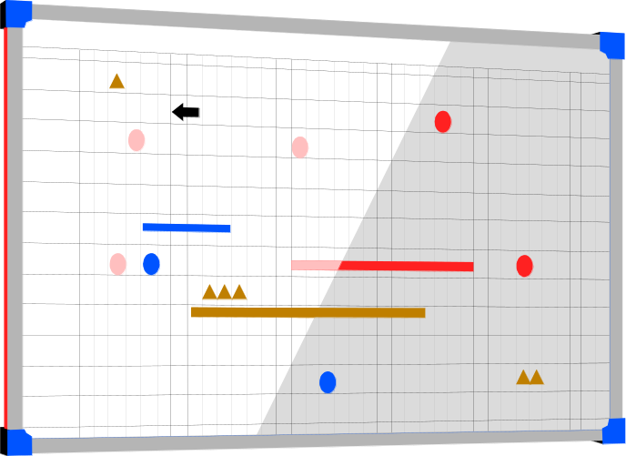
Ch07: How to Plan a TPM Project
Uses for the Whiteboard
Project Overview Statement
Work Breakdown Structure
Dependency Diagram
Initial Project Schedule
Final Project Schedule
Resource Schedule
Issues Log
Updated Project Schedule

Slide 10

Ch07: How to Plan a TPM Project
How Much Time Should Planning Take?
Very small projects < ½ day
Small projects < 1 day
Medium projects 2 days
Large projects 3-4 days
Very large projects ???

Slide 11
Ch07: How to Plan a TPM Project
The JPPS Meeting Components
Attendees
Facilities
Equipment
Agenda
Deliverables
Project Proposal

Slide 12
Ch07: How to Plan a TPM Project
The JPPS Attendees
Facilitator
Project manager
Another project manager
JPP consultant
Technographer
Core project team
Client representative
Resource managers
Project champion
Functional managers
Process owner

Slide 13
Ch07: How to Plan a TPM Project
The JPPS Facilities & Equipment
Facilities
  Comfortable
  Away from interruptions (off-site or on-site)
  Break-out rooms?
Equipment
  Break-out group work areas (table, chairs, flip charts)
  Whiteboards
  Projection equipment

Slide 14
Ch07: How to Plan a TPM Project
The Complete JPPS Agenda
Session #1
  Negotiate the COS
  Build the RBS
Session #2
  Write the POS
Session #3
  Part 1: Kick-off
  Part 2: Working session

Slide 15
Ch07: How to Plan a TPM Project
Who’s Involved in the Planning Process?
Session #1 Project Manager
Client
Session #2 Project Manager
Client
Project Team (known members)
Session #3 Project Manager
Entire Project Team

Slide 16
Ch07: How to Plan a TPM Project
The JPPS Agenda – Session #3 Planning Kick-off
Introduction of Sponsor
Sponsor overview of the project and its importance to the company/division/department
Introduction of the client co-project manager
Introduction of the IT co-project manager
Introduction of the core project team
Introduction of the planning facilitation team (facilitator and technographer)

Slide 17
Ch07: How to Plan a TPM Project
JPPS Agenda – Session #3 Working session
Validation & prioritization of requirements
Overview of the project planning approach to be taken
Generation and validation of the WBS
Estimate duration, labor and resource requirements
Creation of the dependency diagram
Discuss critical path and project completion date
Analysis and schedule compression as needed
Identification of project risks and mitigation plans
Planning team consensus on project plan contents
Adjournment

Slide 18
Ch07: How to Plan a TPM Project
Planning Session Activities
Review the POS for clarity
Create Work Breakdown Structure
Estimate task duration and resource needs
Construct project network diagram
Determine critical path
Revise and approve project schedule
Finalize resource schedule
Gain consensus on the project plan

Slide 19
Ch07: How to Plan a TPM Project
The Role of the Client in the JPPS
The client or their representative must be present.
Validation of requirements and POS
Prioritizing requirements (MoSCoW)
Generating and validating the WBS
Commitment of resources from the client
Agreement on the project plan
Client must own the project plan
Meaningful involvement by the client

Slide 20

Ch07: How to Plan a TPM Project
Definition of the WBS
The Work Breakdown Structure (WBS) is a hierarchical description of all of the work that must be done to meet the needs of the client.

Slide 21
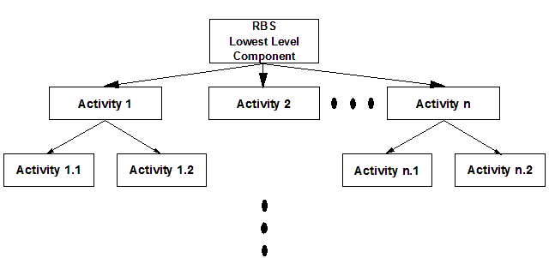
Ch07: How to Plan a TPM Project
The RBS
Each activity is a further decomposition of the WBS.

Slide 22
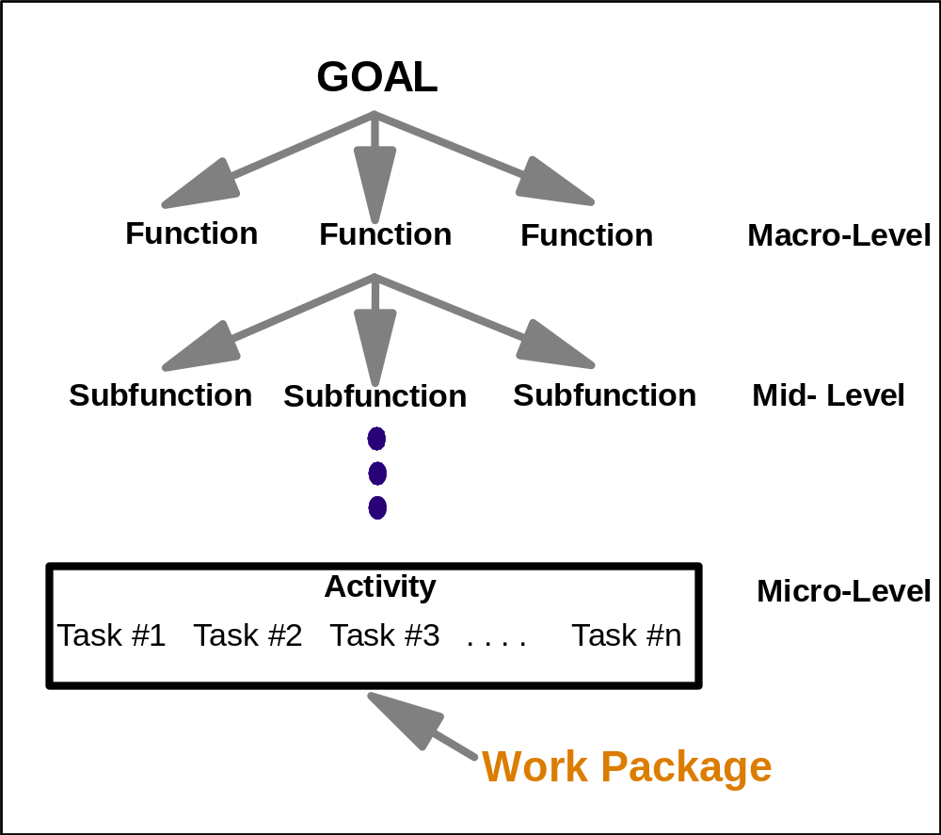
Ch07: How to Plan a TPM Project
Hierarchical visualization of the WBS

Slide 23
Ch07: How to Plan a TPM Project
Uses for the WBS?
Thought process tool
Architectural design tool
Planning tool
Project status reporting tool

Slide 24

Ch07: How to Plan a TPM Project
Generating the WBS
Converting the RBS to the WBS (Figure 5.2)
  Team Approach
  Subteam Approach
Top-Down Approach
  Team Approach
  Subteam Approach
Bottom-Up Approach
Which is best?
When?
Why?

Slide 25
Ch07: How to Plan a TPM Project
WBS Completion Criteria
Status and completion are measurable
The activity is bounded
The activity has a deliverable
Time and cost are easily estimated
Activity duration is within acceptable limits
Work assignments are independent

Slide 26
Ch07: How to Plan a TPM Project
WBS Completion Criteria – The 7th criterion
The client didn’t participate in building the WBS like you expected.
You have an uncomfortable feeling
Scope change is likely to be a big part of the project
Choose a PMLC model that accommodates frequent change

Slide 27
Ch07: How to Plan a TPM Project
WBS Completion Criteria – Exceptions
Stopping Before Completion Criteria Are Met
Decomposing Beyond Completion of the Criteria
  Short duration projects
  High risk activities
  Large duration variance

Slide 28
Ch07: How to Plan a TPM Project
RBS is a subset of the WBS
Project goal
and solution
RBS
WBS
Requirement 1
Requirement n
Function
1.1
Function
1.2
Function
1.3
Function
n.1
Function
n.2
Function
n.3
Sub-function
1.2.1
Sub-function
1.2.2
Sub-function
1.2.3
Feature
1.2.1.1
Feature
1.2.1.2
Feature
1.2.1.3
Feature
1.2.1.4
Feature
n.3.1
Feature
n.3.2
Feature
n.3.3
Feature
n.3.4
Activity
1.2.1.1.1
Activity
1.2.1.1.2
Activity
1.2.1.1.3
Activity
n.3.4.1
Activity
n.3.4.2
Activity
n.3.4.3
Task
1.2.1.1.3.1
Task
1.2.1.1.3.2
Task
1.2.1.1.3.3
Task
n.3.4.3.1
Task
n.3.4.3.2
Task
n.3.4.3.3

Slide 29
Ch07: How to Plan a TPM Project
Approaches to Building the WBS
Noun-type Approaches
  Physical components
  Functional components
Verb-type Approaches
  Design-build-test-implement
  Objectives
Organizational approaches
  Geographic
  Departmental
  Business process
Which is best?
When?
Why?

Slide 30
Ch07: How to Plan a TPM Project
Graphical WBS for a House
HOUSE
SITE
FOUNDATION
FRAMING
WALLS
ROOFING
UTILITIES
LANDSCAPING
FINISH
WORK
Layout
Grade
Excavate
Install
Lay
Sheathing
Shingles
Erect
Pour
Remove
Hang
Tape
ELECT.
GAS
WATER
Forms
Concrete
forms
Sheetrock
& Bed
Do
Do
Do
Rough-in
Rough-in
Rough-in
Work
Work
Work
FLOOR
SUB-
STUD
FRAME
Get
Get
Get
JOISTS
FLOOR
WALLS
ROOF
Building
Building
Building
Inspect.
Inspect.
Inspect.
Install
Install
Install
Do
1st
1st
1st
Finish
Do
Do
Floor
Floor
Floor
Work
Finish
Finish
Work
Work
Install
Install
Install
2nd
2nd
2nd
Floor
Floor
Floor
Install
Install
Install
Lay
Paint
Hang
Lay
Cabinets
Appliances
Furnace
Carpet
Walls &
Wallpaper
Tile
Molding

Slide 31
Ch07: How to Plan a TPM Project
Indented Outline WBS for a House
1.
SITE PREPARATION
1.1.
Layout
1.2.
Grading
1.3.
Excavation
2.
FOUNDATION
2.1.
Erect Forms
2.2.
Pour Concrete
2.3.
Remove Forms
3.
FRAMING
3.1.
Floor Joists
3.1.1.
Install first floor joists
3.1.2.
Install second floor joists
3.2.
Sub-flooring
3.2.1.
Install first floor sub-flooring
3.2.2.
Install second floor sub-flooring
3.3.
Stud Walls
3.3.1.
Erect first floor stud walls
3.3.2.
Erect second floor stud walls
3.4.
Frame the roof

Slide 32
Ch07: How to Plan a TPM Project
WBS for a Waterfall SDM
SYSTEMS DEVELOPMENT PROJECT
Definition
Design
Implementation
State objectives
Functional
Programming
Clarify request
Identify interfaces
Source code
Construct code
Conduct unit test
Establish objectives
Design I/O
JCL
Construct JCL
Conduct system test
Identify key issues
Spec audits/controls
Documentation
Define requirements
Confirm specs
Get approval
Obtain current doc.
Technical
Installation
Finalize test plan
Define new reqmts
Define pgm specs
Testing
Create test data
Conduct test
Choose SDM
Prepare system flow
Training
Conduct operations training
Conduct user training
Get approval
Convert data
Cut-over
Finalize plan
Convert data
Build integration test plan
Get approval
Cut-over to production
Get approval
Operation
Operate system
Review
Establish plan
Review performance
Audit
Get approval
Complete financial analysis
Analyze risks

Slide 33
Ch07: How to Plan a TPM Project
Using WBS Templates
Saves planning time
Builds on prior experience
Standardizes the planning and management of projects using the templates
Provides a structure for collecting and using estimated/actual duration and cost data
Focuses process quality improvement efforts

Slide 34
Ch07: How to Plan a TPM Project
Typical Recurring Projects
Update an application with new functionality
Distribute a new release of a software package
Install a network in a field office
Update training materials
Develop new training materials

Slide 35
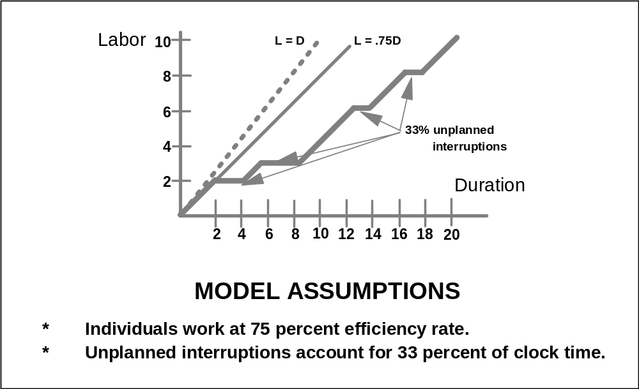
Ch07: How to Plan a TPM Project
Elapsed time (duration) versus work time (labor)

Slide 36

Ch07: How to Plan a TPM Project
Should I Estimate Task Duration or Task Labor?
Estimate duration to build the schedule and determine when the project will be completed
Estimate labor when you have to contain expenses within a budget

Slide 37
Ch07: How to Plan a TPM Project
Resource Loading vs. Task Duration
Pick up the chair
Carry it to the door
Set the chair down
Open the door
Hold the door open with your foot as you pick up the chair
Carry the chair out the door
Set the chair in the hallway
Time
1 2 3 4
# of people on the team

Slide 38
Ch07: How to Plan a TPM Project
Causes of Variation in Duration
Varying skill levels
Unexpected events
Efficiency of work time
Mistakes and misunderstandings
Variation within the capability of the system
Common cause variation

Slide 39
Ch07: How to Plan a TPM Project
Six Methods for Estimating Task Duration
Extrapolating based on similarity to other activities
Studying historical data
Seeking expert advice
Applying the Delphi Technique (Fig 5.9)
Applying the Three-point technique (Fig 5.10)
Applying the Wide-band Delphi technique

Slide 40
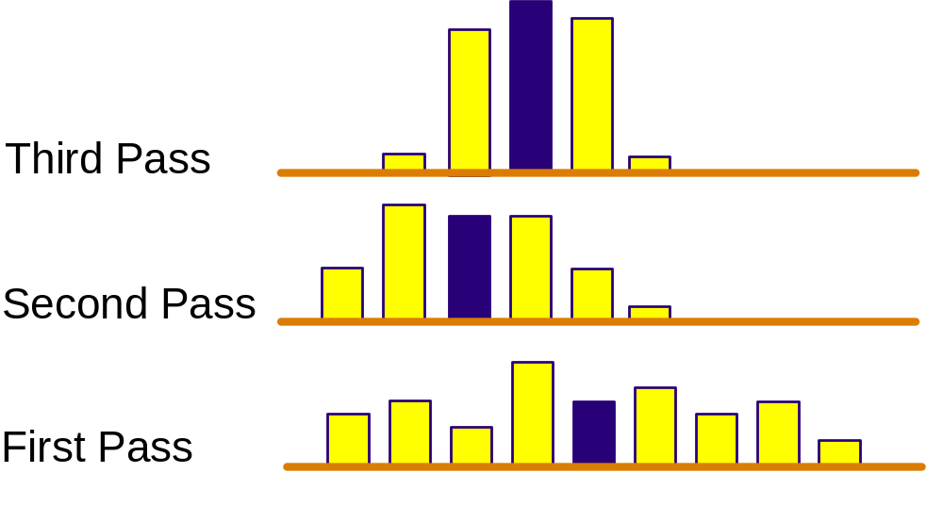
Ch07: How to Plan a TPM Project
The Delphi Technique

Slide 41
Ch07: How to Plan a TPM Project
The Three-Point Method
O
M
E
P
O: Optimistic
O + 4M + P
P: Pessimistic
E =
6
M: Most Likely

Slide 42
Ch07: How to Plan a TPM Project
Estimates Have a Life Cycle Too
range
time
You will be smarter tomorrow
than you are today.

Slide 43
Ch07: How to Plan a TPM Project
Estimating Resource Requirements
People
Facilities
Equipment
Money
Materials

Slide 44
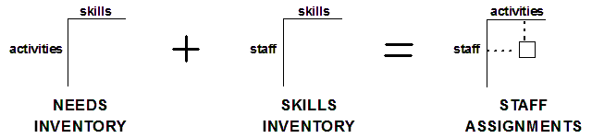
Ch07: How to Plan a TPM Project
Assigning Staff to Activities

Slide 45
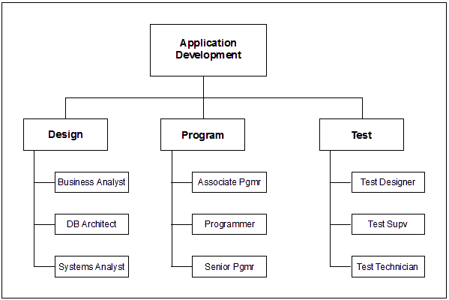
Ch07: How to Plan a TPM Project
Resource Organizational Structure

Slide 46
Ch07: How to Plan a TPM Project
Estimating Cost
Order of magnitude estimate
Budget estimate
Definitive estimate
Cost Budgeting
Cost Control
  Weekly reports
  Baseline versus actual

Slide 47
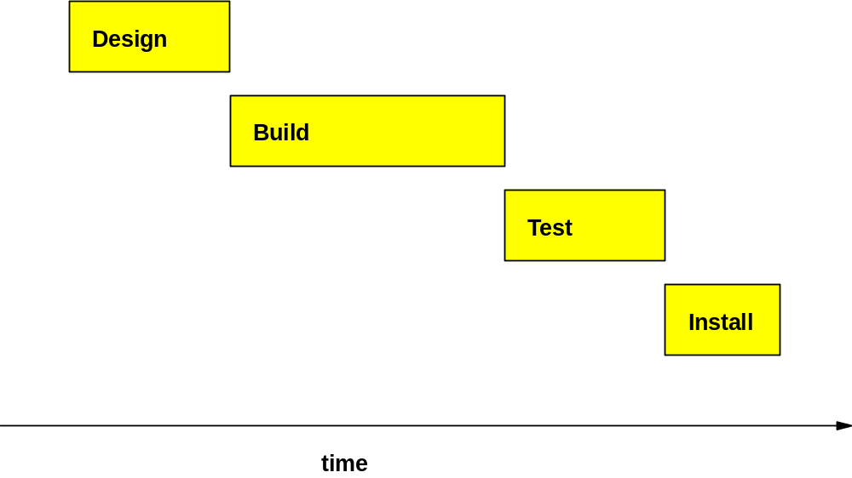
Ch07: How to Plan a TPM Project
Network-based Scheduling – Gantt Charts

Slide 48
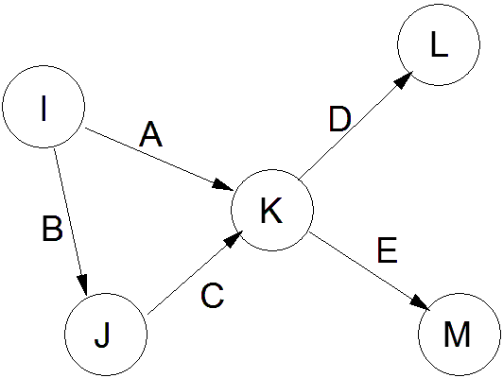
Ch07: How to Plan a TPM Project
Network-based Scheduling – Task on the Arrow

Slide 49
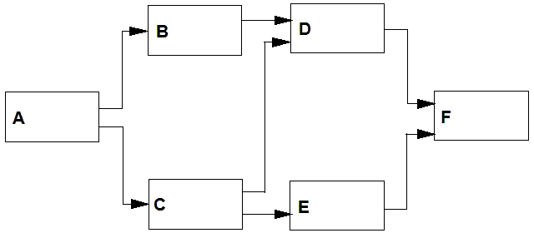
Ch07 How to Plan a TPM Project
Network-based Scheduling – Task on the node format

Slide 50
Ch07: How to Plan a TPM Project
Task Node
ES
EF
ID
SLACK
E
LS
LF

Slide 51
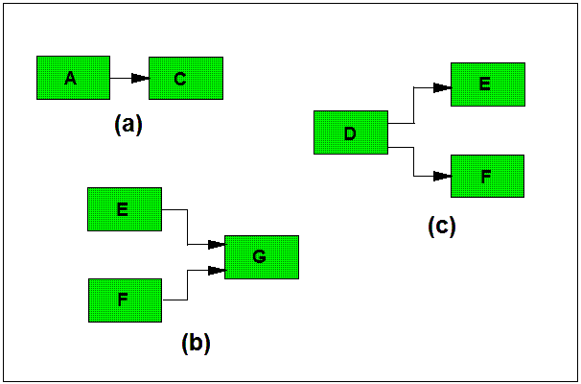
Ch07: How to Plan a TPM Project
Diagramming Conventions

Slide 52
Ch07: How to Plan a TPM Project
Dependency Relationships
A
B
FS: When A finishes, B may start
A
FF: When A finishes, B may finish
B
A
SS: When A starts, B may start
B
A
B
SF: When A starts, B may finish
Notes:
Examples:
FS: When design is complete programming can begin
FF: When data collection is complete data entry can be completed
SS: Once the guests start arriving the food can be brought out
SF: Once your real heart starts beating again the heart lung machine can be turned off

Slide 53

Ch07: How to Plan a TPM Project
Dependency Constraints
Technical constraints
  Discretionary constraints
  Best practice constraints
  Logical constraints
  Unique requirements constraints
Management constraints
Inter-project constraints
Date constraints
  No earlier than
  No later than
  On this date
Lag variables

Slide 54

Ch07: How to Plan a TPM Project
Paths Through the Network
The Forward Pass – Early Schedule
  Left to right (start to finish)
  Determines Early Start and Early Finish
  ES + duration – 1 = EF
Backward Pass – Late Schedule
  Right to left (finish to start)
  Determines Late Start and Late Finish
  LF - duration + 1 = LS

Slide 55
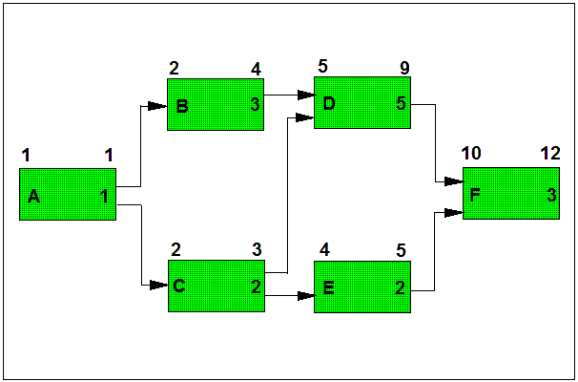
Ch07: How to Plan a TPM Project
Forward Pass Calculations – Early Schedule

Slide 56
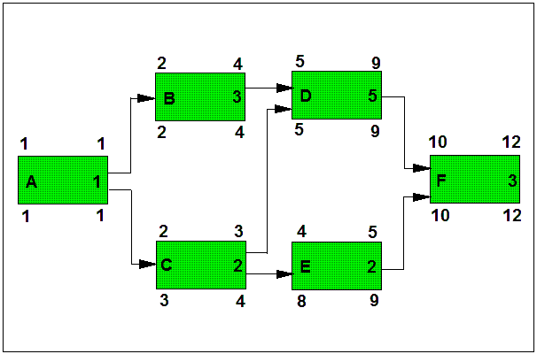
Ch07: How to Plan a TPM Project
Backward Pass Calculations – Late Schedule

Slide 57
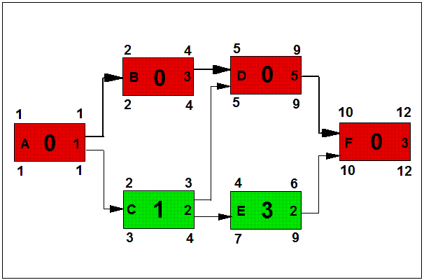
Ch07: How to Plan a TPM Project
Critical Path

Slide 58
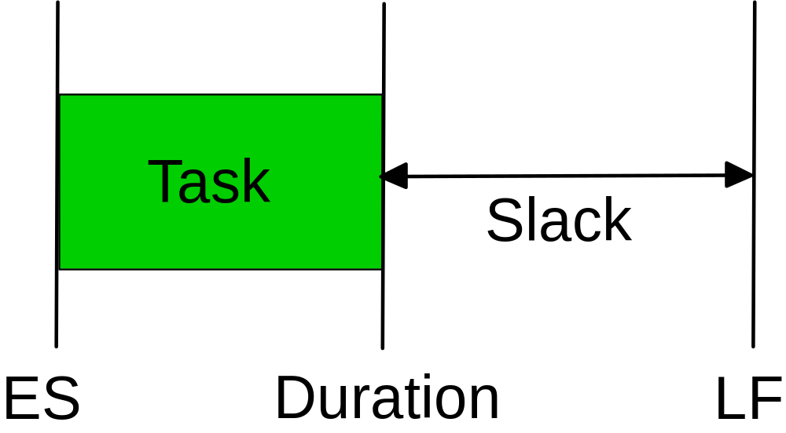
Ch07: How to Plan a TPM Project
Early Start to Late Finish Window

Slide 59


Ch07: How to Plan a TPM Project
Slack Time
Total Slack
  Time that a task can be delayed without impacting the early schedule of the project.
Free Slack
  Time a task can be delayed without impacting the early schedule of its successor tasks.
  Do Not Plan to Use Slack
  to Bail Out the Project!

Slide 60
Ch07: How to Plan a TPM Project
Building the Initial Dependency Diagram
Enter task name and duration into software tool
Print PERT Diagram
Cut out each task node and affix to a Sticky Note
Write task ID # on Post-It Note
Place Sticky Notes on right side of whiteboard
Position start node on left side of whiteboard
Move all tasks with no predecessor to left side and connect to start node
Move all tasks on the right side with predecessors on the left side to the left side and connect with single line
Continue until all task nodes have been moved to left side

Slide 61
Ch07: How to Plan a TPM Project
Schedule Compression Techniques
Replace FS with SS dependencies
Replace a team member with a more skilled person
Add resources
  From non-critical path tasks to critical path tasks
  From other projects
  To where
      critical path tasks
      high-risk tasks
      tasks with large duration variances

Slide 62
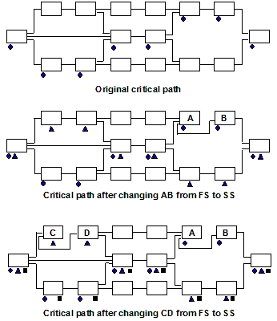
Ch07: How to Plan a TPM Project
Schedule Compression Iterations

Slide 63
Ch07: How to Plan a TPM Project
Schedule Compression
Schedule compression doesn’t come free.
What is the impact on the project due to schedule compression?

Slide 64
Ch07: How to Plan a TPM Project
Management Reserve
DO NOT PAD ACTIVITY DURATION
A percentage (5 – 10) of total project work hours
The last activity in the project
A schedule contingency for the unexpected
Make it visible and manage it

Slide 65
Ch07: How to Plan a TPM Project
Contents of the Project Proposal
Executive Summary
Background
Objective
Overview of the approach to be taken
Detailed statement of work
Time and cost summary
Appendices

Slide 66
Ch07: How to Plan a TPM Project
Gaining Approval to Launch the Project
The cost/benefit is not in your favor
The risks of failure are too high
The total project cost exceeds available funding
There are other projects competing for the same resources

