Slide 1
Effective Project Management:
Traditional, Agile, Extreme, Hybrid
8th Edition
Ch08: How to Launch a TPM Project
Presented by
(facilitator name)

Slide 2

Summary of Chapter 8
Ch08: How to Launch a TPM Project
Using tools, templates, and processes to launch a TPM project
Recruiting the project team
Conducting the project kick–off meeting
Establishing team operating rules
Managing scope changes
Managing team communications
Assigning resources
Resource – leveling strategies
Finalizing the project schedule
Writing work packages
Notes:
Explain how each of these contributes to the growing importance of project management in the business world.

Slide 3
Tools, Templates & Processes Used to Launch a Project
Ch08: How to Launch a TPM Project
Recruiting the Project Team
Team Operating Rules
  Problem Solving
  Decision Making
  Conflict Resolution
  Consensus Building
  Brainstorming
  Team Meetings
Scope Change Management Process
Communications Management Planning
Work Packages
Resource assignment
Finalize the project schedule
Notes:
Explain how each of these contributes to the growing importance of project management in the business world.

Slide 4

Ch08: How to Launch a TPM Project
What is a Project Team?
A project team is a group of professionals committed to achieving common objectives, who work well together and who relate directly and openly with one another to get things done.
Project team membership
  Co-Project manager – developer (chosen before Scoping)
  Co-Project manager – client (chosen before Scoping)
  Core team (chosen before Planning)
  Developer team (chosen before Launching)
  Client team (chosen before Launching)
  Contracted team (chosen after Launching)

Slide 5
Ch08: How to Launch a TPM Project
Characteristics of the core team
Commitment
Shared responsibility
Flexibility
Task-oriented
Ability to work within schedules and constraints
Willingness for trust and mutual support
Team-oriented
Open-minded
Ability to work across structure and authorities
Ability to use project management tools

Slide 6
Ch08: How to Launch a TPM Project
Client Team Members
Must understand their business unit processes
Must be able to make decisions and commitments for their business unit

Slide 7
Ch08: How to Launch a TPM Project
Contract Team Members - Implications
Little variance in times they are available
Know how their tasks relate to the project
Commitment can be a problem
Quality of work may be poor
May require more supervision than core team

Slide 8

Ch08: How to Launch a TPM Project
Balancing a Team
Developing a team deployment strategy
Developing a team development plan

Slide 9
Ch08: How to Launch a TPM Project
Where Project Teams Can Improve
Work methods and procedures
Knows appropriate technology
Associate attraction and retention
Staffing flexibility
Service and product quality use
Rate of output
Decision making
Reduced staff support level
Reduced supervision

Slide 10

Ch06: How to Launch a TPM Project
Team Member Responsibilities
Open communication
Good listening skills
Shared goals
Positive outlook
Creativity
Respect for others
Growth and learning

Slide 11
Ch08: How to Launch a TPM Project
Kick-Off Meeting Agenda
Sponsor-led part
Introduce the sponsor to the project team
Introduce the importance of the project by the sponsor
Introduce the project (client)
Introduce the project (project manager)

Slide 12
Ch08: How to Launch a TPM Project
The Working Session Project Manager-led Agenda
Introduce the project team members to each other
Write the Project Definition Statement
Establish team operating rules
  Problem solving
  Decision making
  Conflict resolution
  Consensus building
  Brainstorming
  Team meetings
Review the project plan
Finalize the project schedule
Write work packages

Slide 13
Ch08: How to Launch a TPM Project
Project Definition Statement – Contents
Expands the POS
  Project objectives
  Assumptions, risks and obstacles

Slide 14
Ch08: How to Launch a TPM Project
Project Definition Statement – Purpose
As a basis for continued project planning
To clarify the project for the project team
As a reference that keeps the team focused in the right direction
As an orientation for new team members
As a method for discovery by the team

Slide 15
Ch08: How to Launch a TPM Project
Establishing Team Operating Rules
Problem solving
Decision making
Conflict resolution
Consensus building
Brainstorming
Team meetings

Slide 16

Ch08: How to Launch a TPM Project
Five Steps to Solving a Problem
Define the problem & the owner
Gather relevant data and analyze causes
Generate ideas
Evaluate and prioritize ideas
Develop an action plan
Source: Creative Problem Solving and Opportunity Finding
J. Daniel Couger, 1995

Slide 17
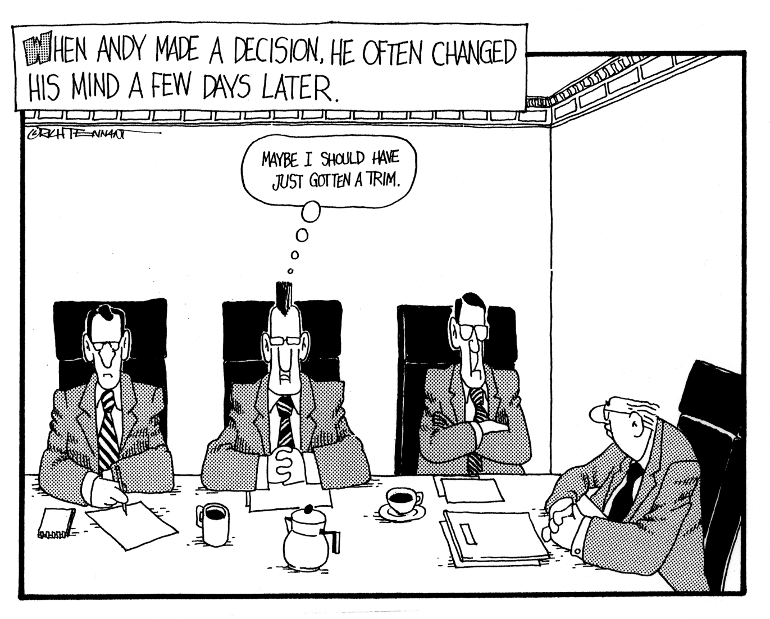
Ch08: How to Launch a TPM Project
Decision Making Styles
Directive
Participative
Consultative

Slide 18


Ch08: How to Launch a TPM Project
Conflict Resolution
I have a differentidea!
I’ll win at any cost!
Conflict is good.
Conflict is bad.

Slide 19
Ch08: How to Launch a TPM Project
Conflict Resolution
Avoidant
Combative
Collaborative

Slide 20
Ch08: How to Launch a TPM Project
Consensus Building
Be careful--a consensus decision that equally satisfies all parties may be a bad decision after all.

Slide 21

Ch08: How to Launch a TPM Project
Brainstorming Method
Assemble individuals with knowledge of problem area
Throw any/all ideas on the table
Continue until no new ideas are uncovered
Discuss items on the list
Solutions begin to emerge
Test each idea with an open mind
Look for solutions that no individual could identify but the group may identify.

Slide 22
Ch08: How to Launch a TPM Project
Team Meetings
What is your purpose?
How often? How long?
Who should attend?
Do we need an agenda?
Are there minutes? Who takes them? Who gets them?

Slide 23
Ch08: How to Launch a TPM Project
Guidelines for Managing Meetings
Before the Meeting
  Is the meeting necessary?
  Determine the purpose of the meeting
  Set the ground rules for the discussion
  Determine who really needs to be present and only invite those people
  Make notes and rehearse your presentation
  Start and end the meeting on time

Slide 24

Ch08: How to Launch a TPM Project
Guidelines for Managing Meetings
During the Meeting
  Specify a time limit and stick to it
  Identifying the specific objectives
  Gather input from the participants
  Keep things moving
  Use visual aids
  Periodically summarize the results of the discussion in terms of consensus achieved or disagreements still in progress
  Assign action items to team members

Slide 25
Ch08: How to Launch a TPM Project
Guidelines for Managing Meetings
After the Meeting
  Time, place and instructions for the next meeting
  Time and place of the meeting and list of attendees with their project role
  Agenda items discussed
  Decisions reached or held for further studies
  Action items and persons responsible for follow up and reporting back to the team at the next meeting

Slide 26
Ch08: How to Launch a TPM Project
Project Meetings
  Daily status meetings
  Problem resolution meetings
  Project review meetings
Frequency
Length
Purpose
Team Room

Slide 27
Ch08: How to Launch a TPM Project
Daily Status Meetings
15 minutes
Everyone stands
Only reporting on tasks open for work and not yet done
Status
  I’m on plan
  I am x hours behind schedule but have a plan to be caught up by this time tomorrow
  I am x hours behind plan and need help
  I am x hours ahead of plan and available to help

Slide 28
Ch08: How to Launch a TPM Project
Problem Resolution Meeting Agenda
Only attended by those involved in the problem
Who owns the problem?
What is the resolution?
When will it be completed?

Slide 29
Ch08: How to Launch a TPM Project
Project Review Meetings
Held at project milestone events
Project review panel
Formal presentation of project performance to date

Slide 30
Ch08: How to Launch a TPM Project
Team War Room
Physical layout
Variations
Operational uses

Slide 31
Ch08: How to Launch a TPM Project
Typical Scope Change Management Process
Submit
change
request
Review
change
request
Reject
Rework & Resubmit
Request
impact study
Review
impact
study
Reject
Rework & Resubmit
Change
approved for
implementation

Slide 32
Ch08: How to Launch a TPM Project
Project Impact Statement - Contents
What is the expected benefit of the change?
How would the change affect the project’s cost?
How would the change affect the project’s schedule?
How would the change affect the software’s quality?
How would the change affect the project’s resource allocation?
Can the change be deferred to a later stage of the project or a later version of the software?
Is the project at a point when making the change would risk destabilizing the software?

Slide 33
Ch08: How to Launch a TPM Project
Project Impact Statement – Possible Outcomes
It can be accommodated within project resources and time lines
It can be accommodated but will require extension of deliverable schedule
It can be accommodated within the current deliverable schedule but additional resources will be needed
It can be accommodated but additional resources and extension of deliverable schedule will be required
It can be accommodated with a multiple release strategy and by prioritizing the deliverables across the release dates
It cannot be accommodated without a significant change to the project

Slide 34
Ch08: How to Launch a TPM Project
Scope Change Request Form
Project Name
Change Requested By
Date Change Requested
Description of Change
Business Justification
Action
Approved By
Date

Slide 35
Ch08: How to Launch a TPM Project
Tips to help the client understand scope change
Business needs change or are discovered during the project
Scope change requests are expected
Project team will analyze the request’s impact on the project plan
Project impact statement will define alternatives for accommodating the request
Client will choose the alternative to be followed
Project manager will adjust project plan accordingly and inform the client

Slide 36
Ch08: How to Launch a TPM Project
Management Reserve
A percentage (5-10%) of the project duration is set aside as a time contingency for processing and incorporating scope change requests.
Utilizing a Scope Bank to store prioritized functions and features not yet integrated into the solution will help manage Management Reserve.

Slide 37
Ch08: How to Launch a TPM Project
Scope Bank
Set up a scope request bank account with an initial deposit of time (5-10 percent of total project work time) to be used to process cope changes and adjust the schedule.
Utilize the Scope Bank to store prioritized change requests not yet integrated into the solution.
Change requests can be handled at the end of a project cycle or as needed.

Slide 38
Ch08: How to Launch a TPM Project
Managing Team Communications
Establishing a Communications Model Including:
  Timing
  Content
  Choosing Effective Channels

Slide 39
Ch08: How to Launch a TPM Project
Communications Management – The Process
Sender
Generates
the idea
Encodes
the message
Transmits
through a channel
Decodes
the message
Checks
the meaning
Feedback
Receiver

Slide 40
Ch08: How to Launch a TPM Project
Communications Management – Types
One-to-one
  Conversations (in person and on the phone)
  Meetings
Electronic
  Email messages
  Web sites
  Databases
Written
  Memos
  Letters
  Documents
  Reports
Two-way
One-way

Slide 41
Ch08: How to Launch a TPM Project
Communications Management – Interfaces
Sponsor
Team
Managers
Client
Project
Manager
Project
Team
Members
3rd Parties
Public

Slide 42

Ch08: How to Launch a TPM Project
Delegation: RASCI Matrix
Jack
Bob
Cheryl
Confirm customer approval of scope
R
S
Choose project team
R
I
A
TASKS
S
R
Plan project
C
R
I
Define Budget
Plan Kick-Off Meeting
I
R
R= Responsible, accountable for successful completion
A= Needs to Approve decisions
S= Will provide Support for the “R”
C= Available to Coach and Consult
I= Needs to be kept informed of status

Slide 43
Ch08: How to Launch a TPM Project
Expanded Variation of the RASCI Matrix
Tasks
Task Lead
Start Date
End Date
Est. End
Pred.
Succ.
CP?
Comments
A
Jack
7/1/08
7/3/08
7/2/08
Start
B
Y
B
Bob
7/5/08
XXXX
7/13/08
A
D
Y
C
Cheryl
7/5/08
7/10/08
7/13/08
A
D
N
D
Harry
7/14/048
7/16/08
7/14/08
B C
End
Y

Slide 44

Ch08: How to Launch a TPM Project
Assigning Resources

Slide 45
Ch08: How to Launch a TPM Project
Resource-Leveling Strategies
Utilizing available slack
Shifting the project finish date
Smoothing

Slide 46
Ch08: How to Launch a TPM Project
Alternative Methods of Scheduling Tasks
Further decomposition of tasks
Stretching tasks
Assigning substitute resources

Slide 47
Ch08: How to Launch a TPM Project
Launch the Project – Finalize Resources & Schedule
C1
3
C2
2
A1
3
B1
2
B2
2
C3
1
A2
2
M
T
W
R
F
S
S
M
T
W
R
F
S
S
Duffy
a1
a1
a1
a2
a2
Ernie
b1
b1
b2
b2
b2
Fran
c1
c1
c1
c2
c2
c2
c3
c3

Slide 48
Ch08: How to Launch a TPM Project
Launch the Project – Work Packages
A Work Package is a brief description at the subtask level that describes how a task will be completed. It is a primitive project plan.
Work Packages should be written for:
Critical path tasks
High-risk tasks
Tasks requiring scarce resources
Tasks with large duration variances

Slide 49
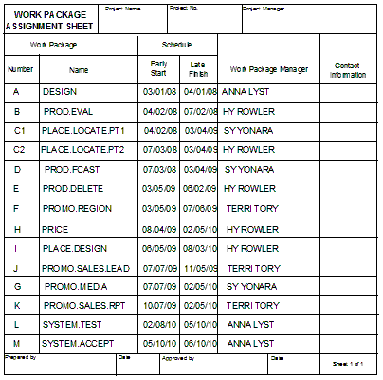
Ch08: How to Launch a TPM Project
Launch the Project – Work Package Assignment Sheet

Slide 50
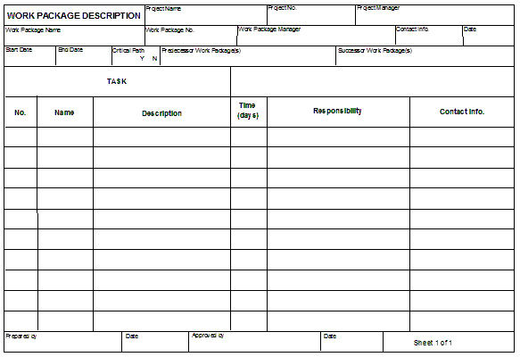
Ch08: How to Launch a TPM Project
Launch the Project – Work Package Description Form

