Slide 1
Effective Project Management:
Traditional, Agile, Extreme, Hybrid
8th Edition
Ch09: How to Execute a TPM Project
Presented by
(facilitator name)

Slide 2

Summary of Chapter 9
Ch09: How to Execute a TPM Project
Using tools, templates, and processes to monitor & control a TPM project
Establishing your progress reporting system
Applying graphical reporting tools
Managing the Scope Bank
Building and maintaining the Issues Log
Managing project status meetings
Defining a problem escalation strategy
Gaining approval to close the project
Notes:
Explain how each of these contributes to the growing importance of project management in the business world.

Slide 3
Ch09: How to Execute a TPM Project
Tools, Templates & Processes Used to Monitor & Control
Current period reports
Cumulative reports
Exception reports
Stoplight reports
Variance reports
Gantt charts
Burn charts
Milestone trend charts
Earned value analysis (EVA)
Integrated milestone trend charts and EVA
Project status meetings
Problem escalation strategies

Slide 4
Ch09: How to Execute a TPM Project
Characteristics of Effective Progress Reporting
Timely, complete, accurate and intuitive
Isn’t burdensome and counterproductive
Readily acceptable to senior management
An effective early warning system
Easily understood by those who need to know

Slide 5
Ch09: How to Execute a TPM Project
Five Types of Project Status Reports
Current period reports
Cumulative reports
Exception reports
Stoplight reports
Variance reports

Slide 6
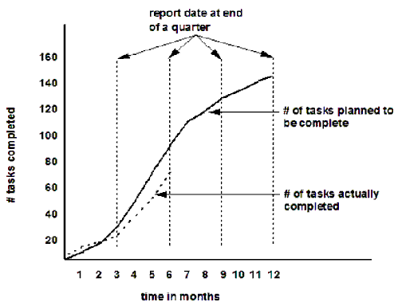
Ch09: How to Execute a TPM Project
Gantt Chart Project Status Report

Slide 7
Ch09: How to Execute a TPM Project
Why Measure Duration and Cost Variances
Catch deviations from the curve early
Dampen oscillation
Allow early corrective action
Determine weekly schedule variance
Determine weekly effort (person hours/day) variances

Slide 8
Ch09: How to Execute a TPM Project
How and What Information to Update
Determine a set period of time and day of week
Report actual work accomplished during this period
Record historical and re-estimate remaining
Report start and finish dates
Record days of duration accomplished and remaining
Report resource effort spent and remaining
Report percent complete

Slide 9
Ch09: How to Execute a TPM Project
How to Keep a Project on Schedule
Hold daily team meetings
Complete tasks ASAP
Report problems ASAP
Don’t fall victim to the “creeps”
Don’t guess – ask questions
Good enough is good enough
Meet but do not exceed requirements
Be open and honest with your team mates

Slide 10
Ch09: How to Execute a TPM Project
Variances
Positive Variances – deviations from the plan indicating that an ahead-of-schedule or a cost less than budgeted has occurred
Negative Variances – deviations from the plan indicating that a behind-schedule or cost greater than the budgeted has occurred

Slide 11
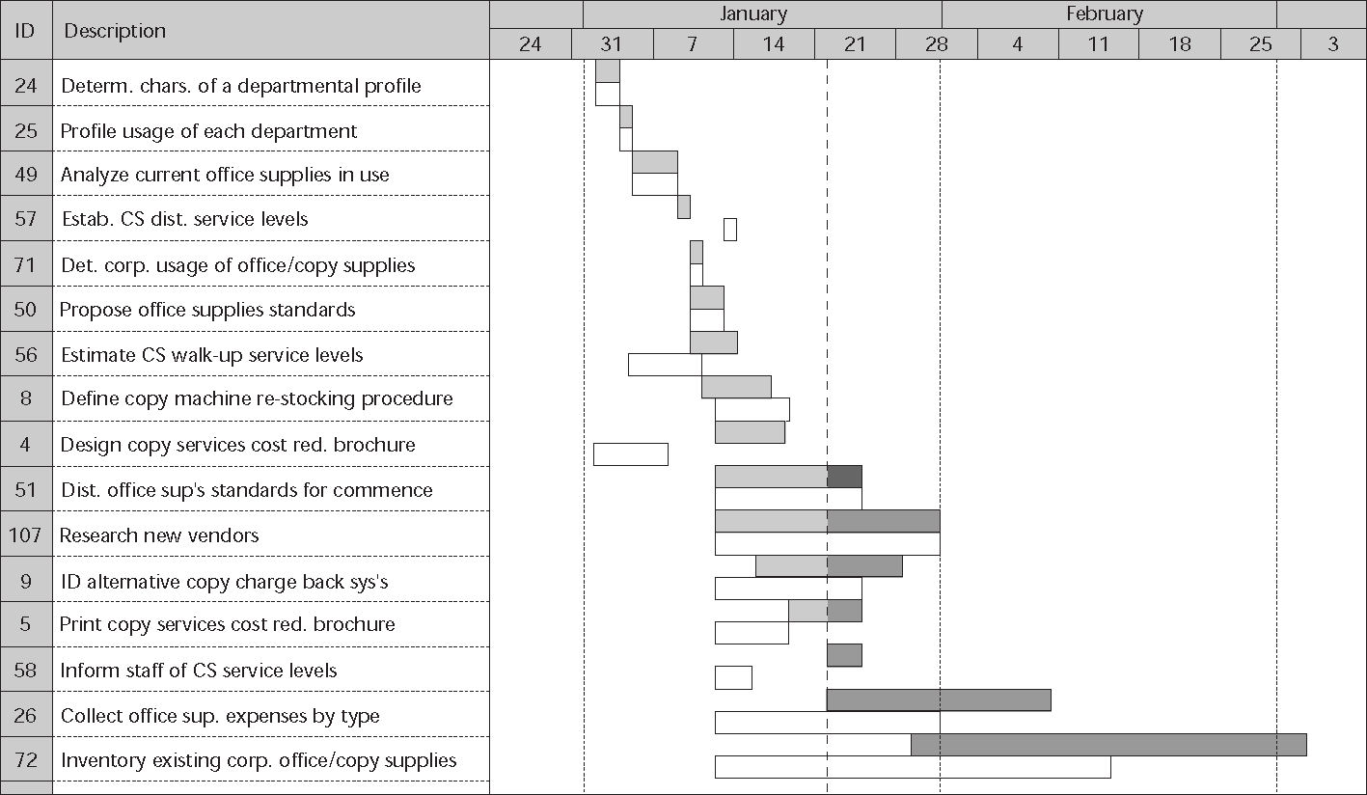
Ch09: How to Execute a TPM Project
Gantt Chart Project Status Report

Slide 12
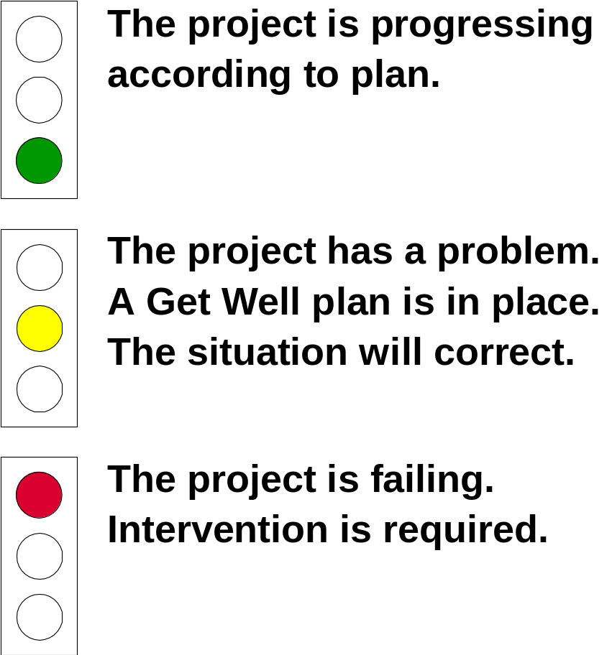
Ch09: How to Execute a TPM Project
Exception Report – Stoplight Reports

Slide 13
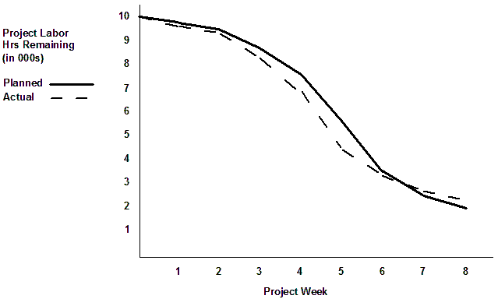
Ch09: How to Execute a TPM Project
Burn Charts

Slide 14
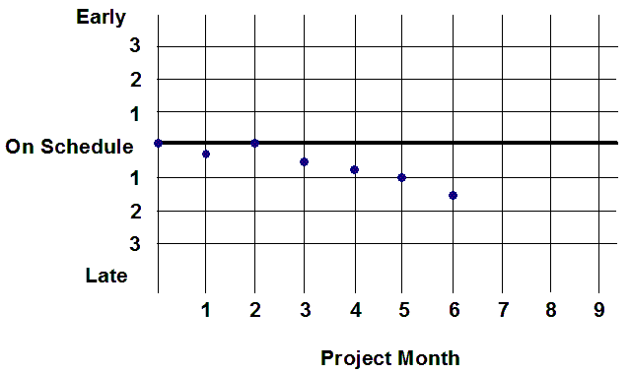
Ch09: How to Execute a TPM Project
Cumulative Reports - Milestone Trend Charts

Slide 15
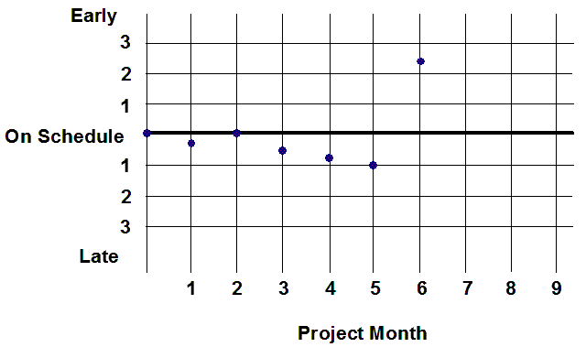
Ch09: How to Execute a TPM Project
Cumulative Reports - Milestone Trend Charts

Slide 16
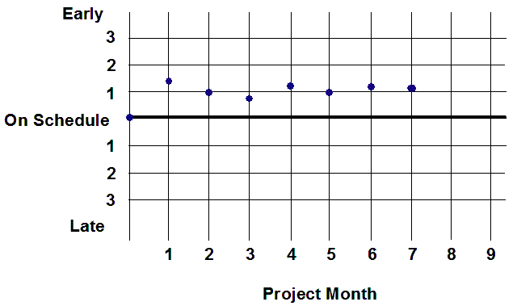
Ch09: How to Execute a TPM Project
Cumulative Reports - Milestone Trend Charts

Slide 17
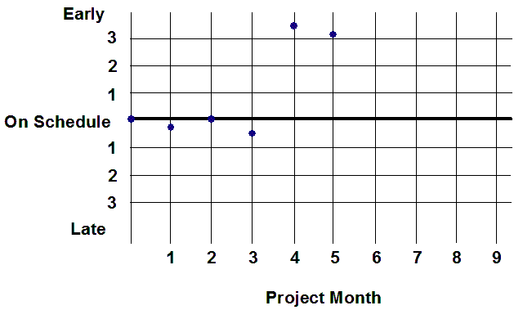
Ch09: How to Execute a TPM Project
Cumulative Reports - Milestone Trend Charts

Slide 18
Ch09: How to Execute a TPM Project
Earned Value – The Standard S-Curve
2/3 Time - 3/4 Progress
Progress
1/3 Time - 1/4 Progress
Time

Slide 19
Ch09: How to Execute a TPM Project
Earned Value – The Aggressive Curve
Progress
No ramp up - no learning time
Time

Slide 20
Ch09: How to Execute a TPM Project
Earned Value – The Curve to Avoid
Progress
About 30% of the work done
70% to 80% of the time gone by
Time

Slide 21
Ch09: How to Execute a TPM Project
How to Measure Percent of Value Earned
100 – 0
0 – 100
50 – 50
Proportion of tasks completed
Report date
Work in process
100 - 0
0 - 100
50 - 50
10 tasks complete 4 tasks not complete
10/14

Slide 22
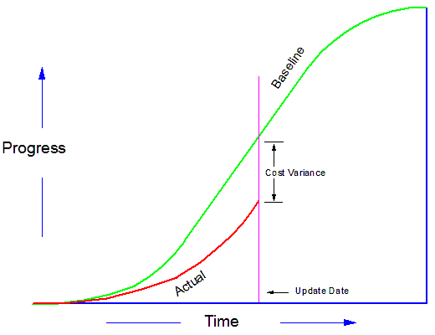
Ch09: How to Execute a TPM Project
Earned Value – Cost Variance

Slide 23
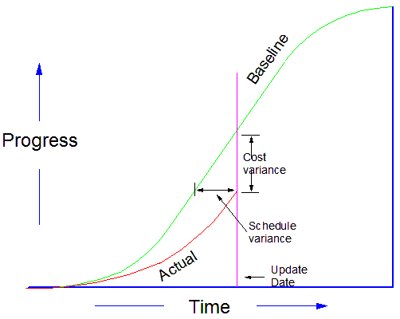
Ch09: How to Execute a TPM Project
Earned Value – Schedule Variance

Slide 24
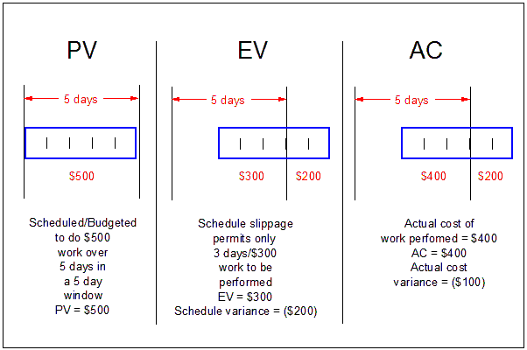
Ch09: How to Execute a TPM Project
How to Measure Earned Value

Slide 25
Ch09: How to Execute a TPM Project
Earned Value – The Full Story
Progress
Schedule
Variance
PV
AC
Cost Variance
EV
Time

Slide 26
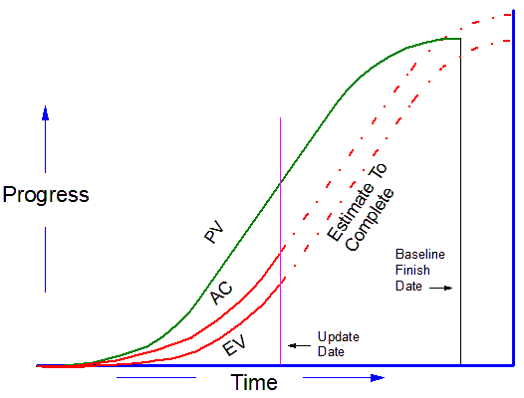
Ch09: How to Execute a TPM Project
Earned Value – PV, EV and AC curves

Slide 27


Ch09: How to Execute a TPM Project
Earned Value – Basic Performance Indices
Schedule Performance Index (SPI)
A measure of how close the project is to performing work as it was actually scheduled.
SPI = EV/PV
Cost Performance Index (CPI)
A measure of how close the project is to spending on the work performed to what was planned to have been spent.
CPI = EV/AC
INDEX VALUES
< 1: over budget or behind schedule
> 1: under budget or ahead of schedule

Slide 28
Ch09: How to Execute a TPM Project
Earned Value – Performance Indices
Project: ALPHA
1.6
1.4
1.2
under budget
ahead of schedule
1.0
S
S
C
S
C
C
C
C
S
C
over budget
behind schedule
0.8
S
0.6
S
0.4
1
2
3
4
5
6
7
8
9
Project Week

Slide 29
Ch09: How to Execute a TPM Project
Earned Value – Performance Indices
Project: ALPHA
1.6
1.4
S
1.2
S
under budget
ahead of schedule
S
S
C
C
1.0
S
S
C
S
C
C
C
C
S
C
over budget
behind schedule
0.8
0.6
0.4
1
2
3
4
5
6
7
8
9
Project Week

Slide 30
Ch09: How to Execute a TPM Project
Earned Value – Performance Indices
Project: ALPHA
1.6
1.4
1.2
under budget
ahead of schedule
1.0
S
S
C
S
C
C
S
C
C
over budget
behind schedule
0.8
S
C
S
C
0.6
S
0.4
1
2
3
4
5
6
7
8
9
Project Week

Slide 31
Ch09: How to Execute a TPM Project
Earned Value – Performance Indices
Portfolio: BETA Program
1.6
1.4
1.2
ahead of schedule
1.0
0.8
behind schedule
0.6
0.4
1
2
3
4
5
6
7
8
9
Project Week
Portfolio average

Slide 32
Ch09: How to Execute a TPM Project
Managing the Scope Bank
Initial deposit of 10% of total labor days
All of the unfinished functions and features and the labor time to develop them are also deposited in the Scope Bank.
The time to process and integrate a Scope Change request draws time from the Scope Bank.
To add time to the Scope Bank remove unfinished functions and features and deposit their labor time in the Scope Bank.
Client should continuously reprioritize contents of the Scope Bank

Slide 33
Ch09: How to Execute a TPM Project
Maintaining the Issues Log
ID Number
Date logged
Description of the problem
Impact if not resolved
The problem owner
Action to be taken
Status
Outcome

Slide 34
Ch09: How to Execute a TPM Project
Managing Project Status Meetings
Who Should Attend?
When Are They Held?
What Is Their Purpose?
What Is Their Format?

Slide 35
Ch09: How to Execute a TPM Project
The 15 Minute Daily Status Meeting
Entire team or Task Managers for tasks open for work
Everyone stands up
Rotate the meeting facilitator
Status of each task is reported
  On schedule
  Ahead of schedule (by how much)
  Behind schedule (by how much and get well plan)
Update Scope Bank
Update Issues Log

Slide 36
Problem Management Meeting
Affected parties only
Agree on problem
Agree on who owns the problem
Brainstorm solutions
Prioritize solutions
Update Issues Log
Schedule next meeting

Slide 37
Ch09: How to Execute a TPM Project
Problem Escalation Strategies – Who Controls What?
Scope and Quality
Time
Cost
Resource Availability

Slide 38
Ch09: How to Execute a TPM Project
Problem Escalation Strategies
Project Manager-Based Strategies
  No action required. Problem will self-correct
  Examine dependency relationships
  Reassign resources
Resource Manager-Based Strategies
  Negotiate additional resources
Client-Based Strategies
  Negotiate multiple release strategies
  Request schedule extension

Slide 39
Ch09: How to Execute a TPM Project
Escalation Strategy Hierarchy
No action required (schedule slack will correct the problem)
Examines FS dependencies for schedule compression opportunities
Reassign resources from non-critical path tasks to cover the slippage.
Negotiate additional resources
Negotiate multiple release strategies
Request schedule extension from the client

Slide 40
Ch09: How to Execute a TPM Project
Gaining approval to close the project
When the client is satisfied that the acceptance criteria have been met the project enters the closing phase

