Slide 1
Effective Project Management:
Traditional, Agile, Extreme, Hybrid
8th Edition
Ch11: Complexity and Uncertainty
Presented by
(facilitator name)

Slide 2

Summary of Chapter 11
Ch11: Complexity and Uncertainty …
Know how complexity and uncertainty affect the project landscape
Incorporate requirements, flexibility, adaptability, change, risk, team cohesiveness, communications, client involvement, specifications, and business value into how you will choose and use a project management life cycle (PMLC) model
Use a two-level Requirements Elicitation process as the key to a best-fit decision model
Notes:
Explain how each of these contributes to the growing importance of project management in the business world.

Slide 3
Ch11: Complexity and Uncertainty …
What is Complex Project Management?
The Agile Manifesto
″We are uncovering better ways of developing [products] by doing it and helping others do it. Through this work we have come to value:
Individuals and interactions over processes and tools
Working software over comprehensive documentation
Customer collaboration over contract negotiations
Responding to change over following a plan
That is, while there is value in the items on the right, we value the items on the left more.″

Slide 4
Ch11: Complexity and Uncertainty …
Implementing a CPM Project
Fully Supported Production Versions of Partial Solutions are Released to the End User Quarterly or Semi-Annual
Intermediate or Non-Production Versions are Released to a Focus Group every 2-4 Weeks
Co-Located CPM Project Teams
Cross-Project Dependencies
Project Portfolio Management
What should we do?
What can we do?
What will we do?
How will we do it?

Slide 5
Ch11: Complexity and Uncertainty …
What is Lean Agile Project Management?
Eliminate Waste
Amplify Learning
Decide as Late as Possible
Deliver as Fast as Possible
Empower the Team
Build Integrity in
See the Whole

Slide 6
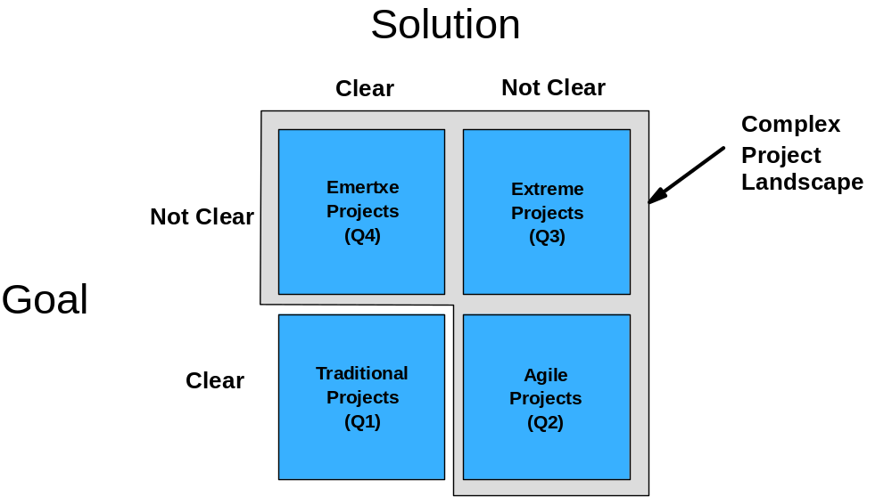
Ch11: Complexity and Uncertainty …
Contemporary Project Landscape

Slide 7
Ch11: Complexity and Uncertainty …
The Complexity/Uncertainty Domain
Not
Clear
Q4
Q3
Complexity
Goal
Uncertainty
Clear
Q1
Q2
Clear
Not
Clear
Requirements
Flexibility
Adaptability
Solution

Slide 8
Ch11: Complexity and Uncertainty …
Risk
Not
Clear
Q4
Q3
Goal
Risk
Clear
Q1
Q2
Clear
Not
Clear
Solution

Slide 9
Ch11: Complexity and Uncertainty …
Team Cohesiveness
Not
Clear
Q4
Q3
Goal
Cohesiveness
Team
Clear
Q1
Q2
Clear
Not
Clear
Solution

Slide 10
Ch11: Complexity and Uncertainty …
Communications
Not
Clear
Q4
Q3
Goal
Communications
Clear
Q1
Q2
Clear
Not
Clear
Solution

Slide 11
Ch11: Complexity and Uncertainty …
Client Involvement
Not
Clear
Q4
Q3
Goal
Client
Involvement
Clear
Q1
Q2
Clear
Not
Clear
Solution
Client comfort zone
Ownership by the client
Client sign-off

Slide 12
Ch11: Complexity and Uncertainty …
Specification
Not
Clear
Q4
Q3
Goal
Specification
Clear
Q1
Q2
Clear
Not
Clear
Solution

Slide 13
Ch11: Complexity and Uncertainty …
The Requirements Breakdown Structure
Project goal
and solution
Requirement 1
Requirement n
Function
1.1
Function
1.2
Function
1.3
Function
n.1
Function
n.2
Function
n.3
Sub-function
1.2.1
Sub-function
1.2.2
Sub-function
1.2.3
Feature
1.2.1.1
Feature
1.2.1.2
Feature
1.2.1.3
Feature
1.2.1.4
Feature
n.3.1
Feature
n.3.2
Feature
n.3.3
Feature
n.3.4

Slide 14
Ch11: Complexity and Uncertainty …
Change
Not
Clear
Q4
Q3
Goal
Change
Clear
Q1
Q2
Clear
Not
Clear
Solution

Slide 15
Ch11: Complexity and Uncertainty …
Business Value
Not
Clear
Q4
Q3
Goal
Business Value
Clear
Q1
Q2
Clear
Not
Clear
Solution

