Slide 1
Effective Project Management:
Traditional, Agile, Extreme, Hybrid
8th Edition
Ch14: Hybrid PM Framework
Presented by
(facilitator name)

Slide 2

Summary of Chapter 11
Ch11: Extreme Project Management
Have a working understanding of a hybrid project
Know the concepts of the 3-phase hybrid project management framework
Know the two types of hybrid project managers
Know the expectations of a hybrid project manager
Use the 12 steps of the Effective Complex Project Management (ECPM) Framework
Be able to imbed the ECPM Framework into a TPM Project
Know the importance of the co-manager model
Know the role of the Project Support Office
Notes:
Explain how each of these contributes to the growing importance of project management in the business world.

Slide 3
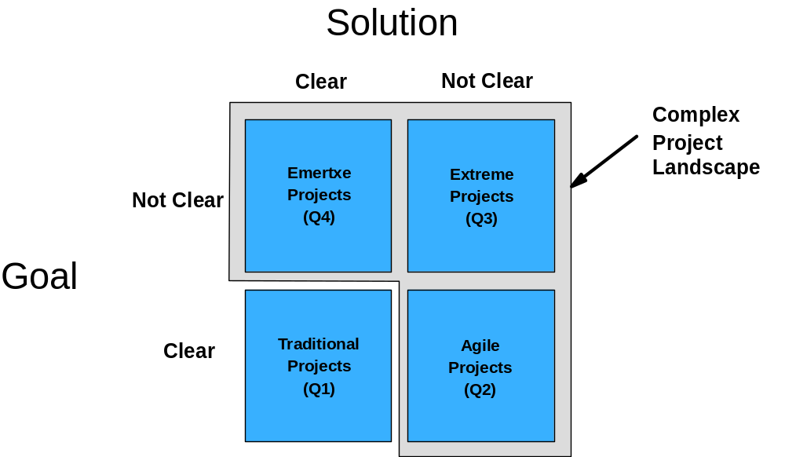
Ch14: Hybrid PM Framework
What is a Hybrid Project?
Many complex projects do not fit PMLC Models

Slide 4
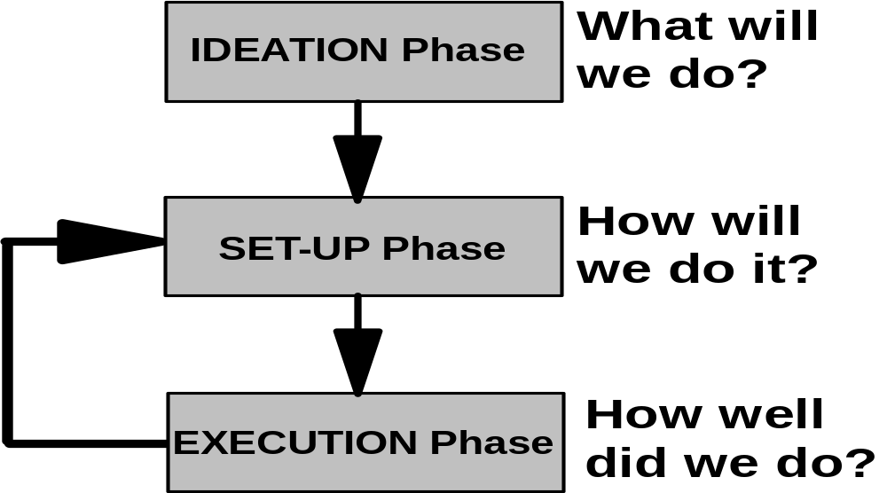
Ch14: Hybrid PM Framework
Three Phase Hybrid Project Framework

Slide 5
Ch14: Hybrid PM Framework
Ideation Phase
What Business Situation is being Addressed by this Project?
What does the Business need to do?
What are you Proposing to do?
How will you do it?
How will you know you did it?

Slide 6
Ch14: Hybrid PM Framework
Set-Up Phase
Any changes to the Project or its Performance?
What is the current Environment in which the Project is being conducted?
Any competitor changes, emerging technologies, new products or services, shifts in demand

Slide 7
Ch14: Hybrid PM Framework
Execution Phase
Establishing team operating rules
Defining the decision-making process
Defining the conflict management process
Defining the problem solving process
Oversight of the controlling and monitoring functions
Executing the change management process
Validation of having reached the success criteria
Installation of deliverables
Lessons learned
Post-project audit

Slide 8

Ch14: Hybrid PM Framework
What is a Hybrid Project Manager?
Occasional Project Manager
Project management is a support tool in their skills portfolio. They use and adapt it to their needs.
Career Project Manager
Project management is their major skill and they have received professional certification of their skills. They use and adapt it to their needs.

Slide 9
Ch14: Hybrid PM Framework
What does a Hybrid Project Manager Want?
A portfolio of tools, templates and processes
Minimal documentation and reporting
Minimal non-value added work and waste avoidance
A lean systems perspective
Flexibility and adaptability of tools, templates and processes to meet project needs
Available coaches, consultants and mentors as required and when requested
A supportive PSO and not a compliance monitoring PMO
Meaningful stakeholder involvement
A collaborative engagement with subject matter experts

Slide 10
Ch14: Hybrid PM Framework
What does the ECPM contain?
The statement of an unsolved business problem
A business case to validate investment in the project
The high-level requirements of an acceptable solution
Chooses a best fit PMLC Model
Assesses the characteristics of the business problem/opportunity
Assesses the characteristics of the internal and external situation
Executes the project
Maintains the alignment of the adapted PMLC Model Template to the changing nature of the project until the project is complete

Slide 11
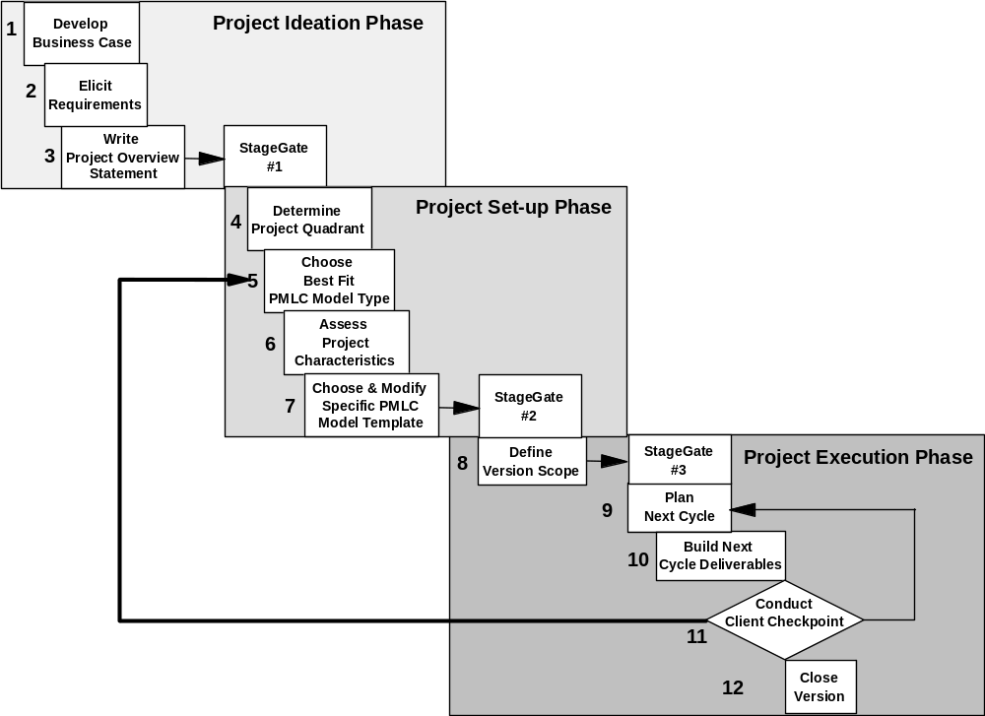
Ch14: Hybrid PM Framework
12 Step Hybrid PM Framework

Slide 12
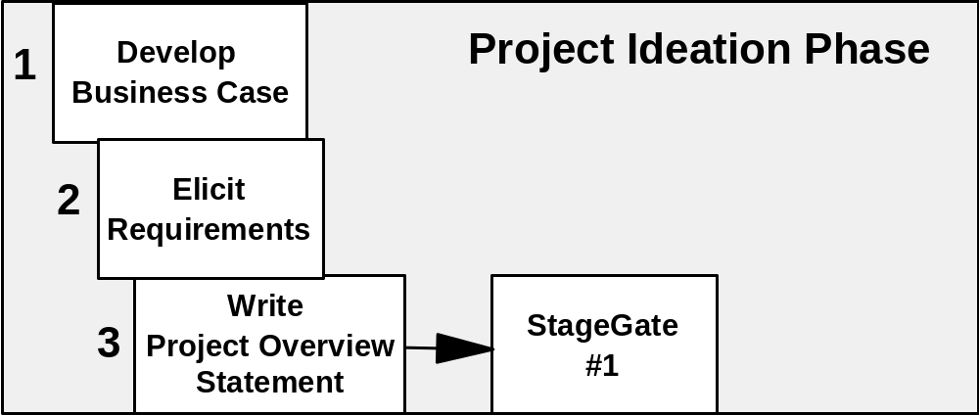
Ch14: Hybrid PM Framework
Project Ideation Phase

Slide 13
Ch14: Hybrid PM Framework
Step 1: Develop Business Case
Define the problem or untapped business opportunity.
Identify alternative solutions.
Gather data relevant to each alternative solution.
Analyze, prioritize and choose an alternative.
Document the chosen alternative.

Slide 14
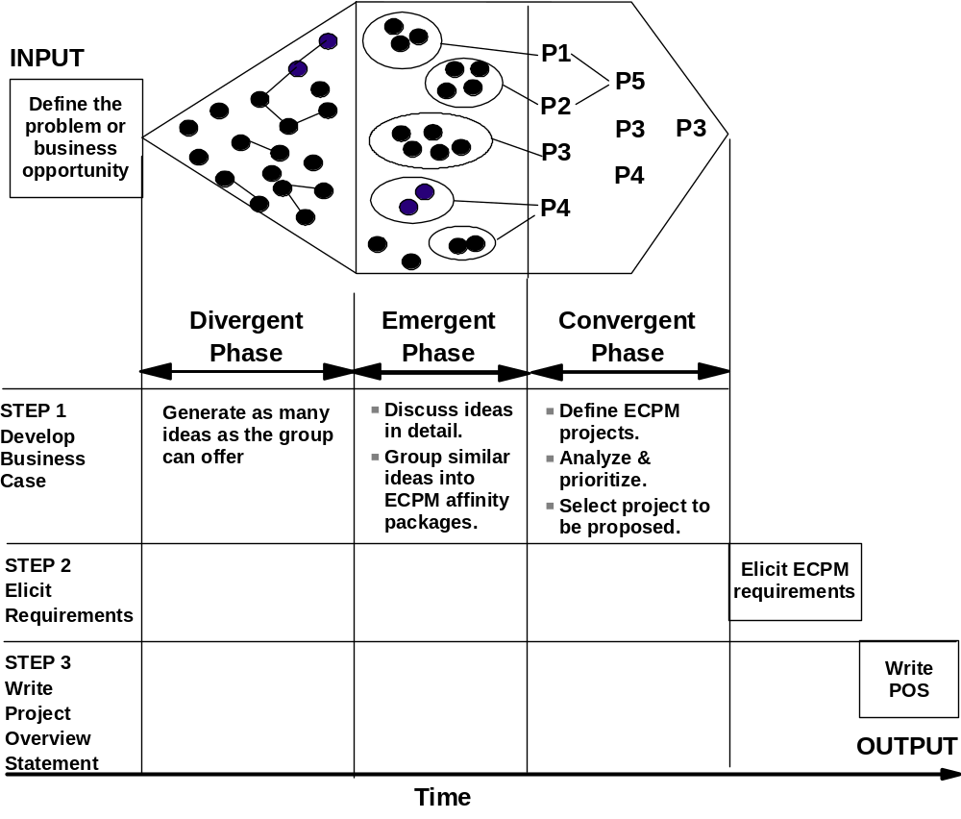
Ch14: Hybrid PM Framework
Step 2: Elicit Requirements

Slide 15
Ch14: Hybrid PM Framework
Step 3: Write Project Overview Statement
This is a five-part one-page document that includes:
Statement of business problem or untapped opportunity
Project Goal
Project objectives or high level requirements
Quantitative business value or success criteria metrics
Risks, assumptions, obstacles

Slide 16
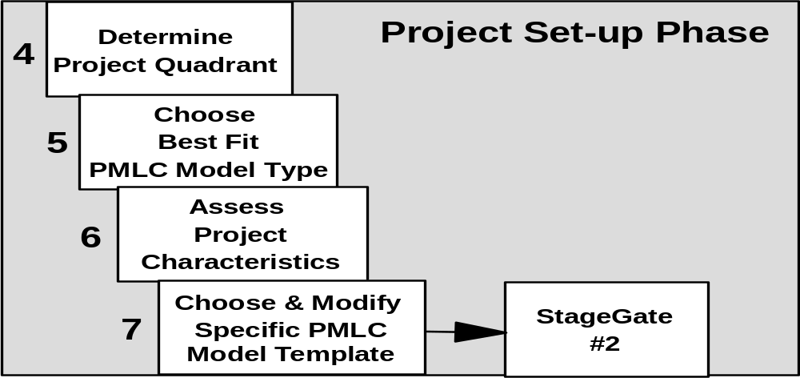
Ch14: Hybrid PM Framework
Project Set-Up Phase

Slide 17
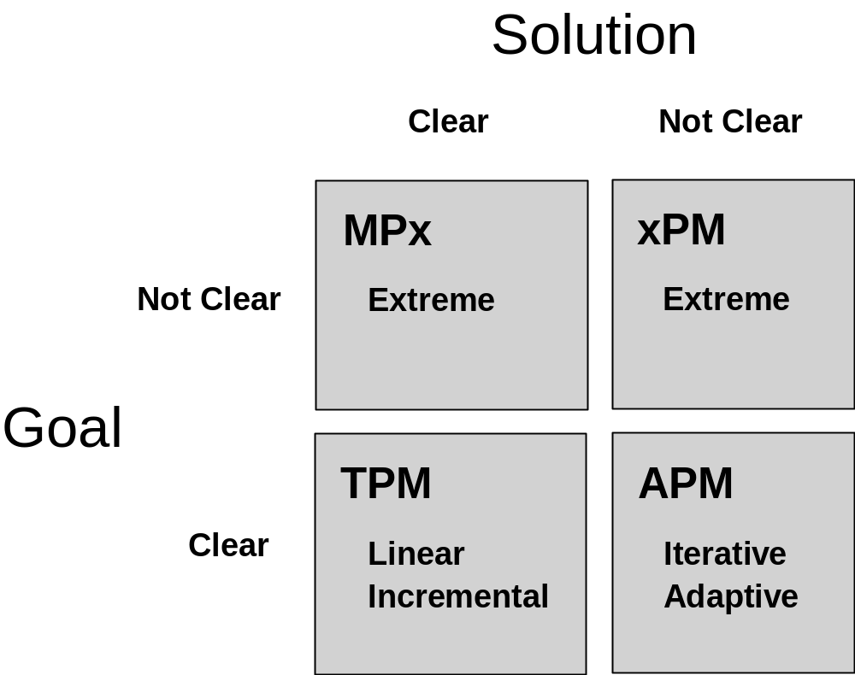
Ch14: Hybrid PM Framework
Step 4: Determine Project Quadrant
The Goal and Solution statements will be used to determine the project quadrant.

Slide 18
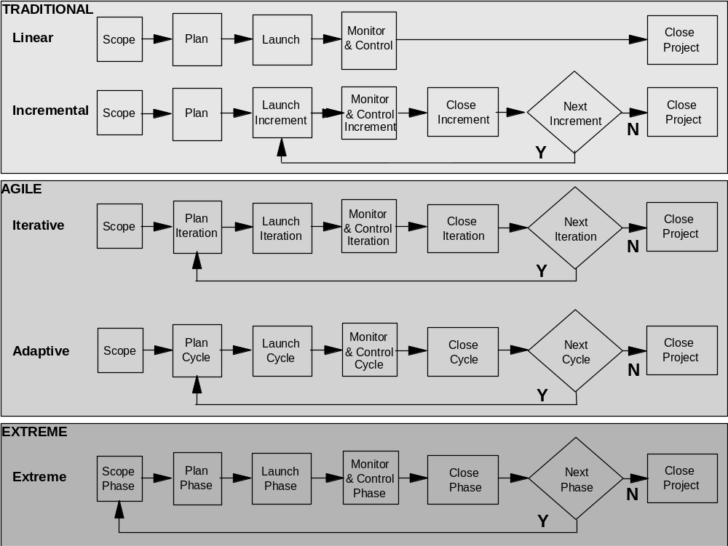
Ch14: Hybrid PM Framework
Step 5: Choose Best Fit PMLC Model Type

Slide 19
Ch14: Hybrid PM Framework
Step 6: Assess Project Characteristics
Project characteristics
Internal business environment
External marketing environment

Slide 20
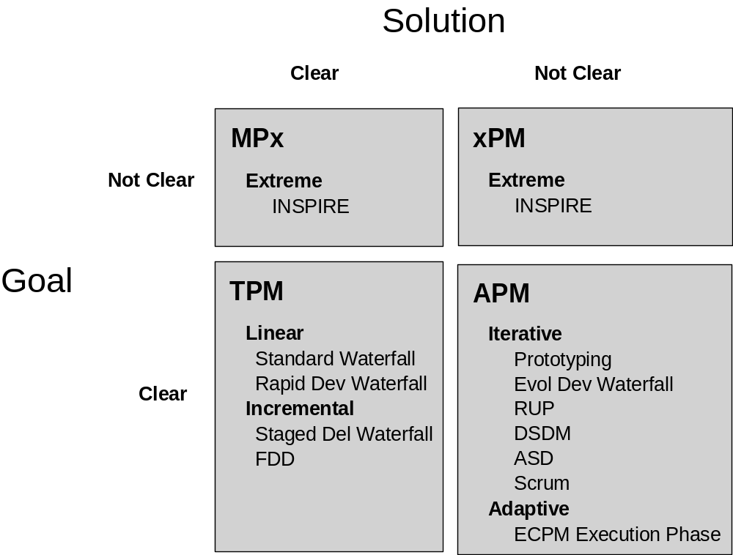
Ch14: Hybrid PM Framework
Step 7: Choose & Modify Specific PMLC Model Template

Slide 21
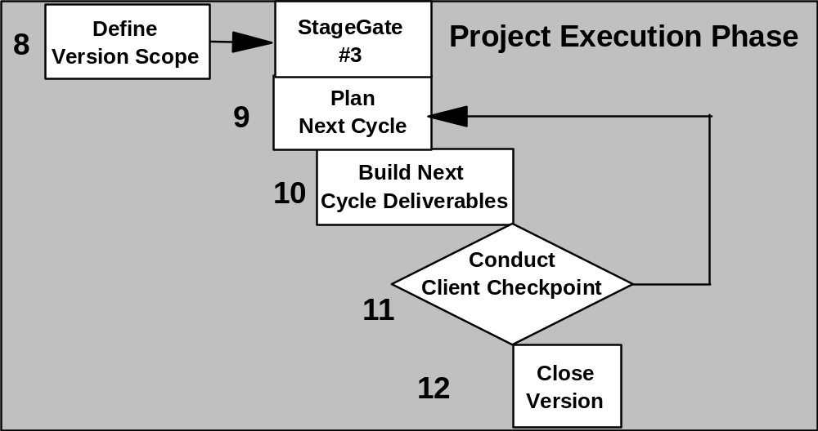
Ch14: Hybrid PM Framework
Project Execution Phase
The Project Execution Phase is a standard with one exception – Client Checkpoint.

Slide 22
Ch14: Hybrid PM Framework
Step 11: Client Checkpoint – Critical Milestone
The cumulative planned versus actual requirements delivered from all completed cycles.
The Scope Bank, which contains the prioritized list of requirements not yet met.
Separate prioritized lists of future Probative Swim Lanes and Integrative Swim Lanes.
A review of the adapted PMLC Model Template for any needed changes.
The decision about the next cycle and its requirement content.

Slide 23
Ch14: Hybrid PM Framework
Step 11: Client Checkpoint – The Details
ECPM feedback loop from Client Checkpoint to Choose PMLC Model Type
A radical change in the priority of the project
A significant proposed scope change
The loss of a scarce resource
Actions of a competitor
The entry of a new competitor
The release of a new technology
Adapting or changing a PMLC Model Template During Project Execution
The cost of abandonment
The impact on resource requirements and schedules
The impact on the schedules of other projects

Slide 24
Ch14: Hybrid PM Framework
Step 11: Client Checkpoint – Benefits
The use of a simpler PMLC Model Template
The use of less experienced and skilled team members
Risk reduction

Slide 25
Ch14: Hybrid PM Framework
Variations
Proof of Concept
Revising the Version Plan
Imbedding ECPM is a TPM Project

Slide 26
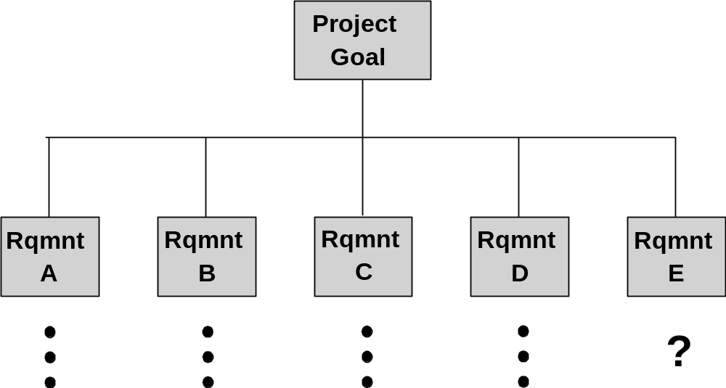
Ch11: Extreme Project Management
Imbedding ECPM in a TPM Project

Slide 27
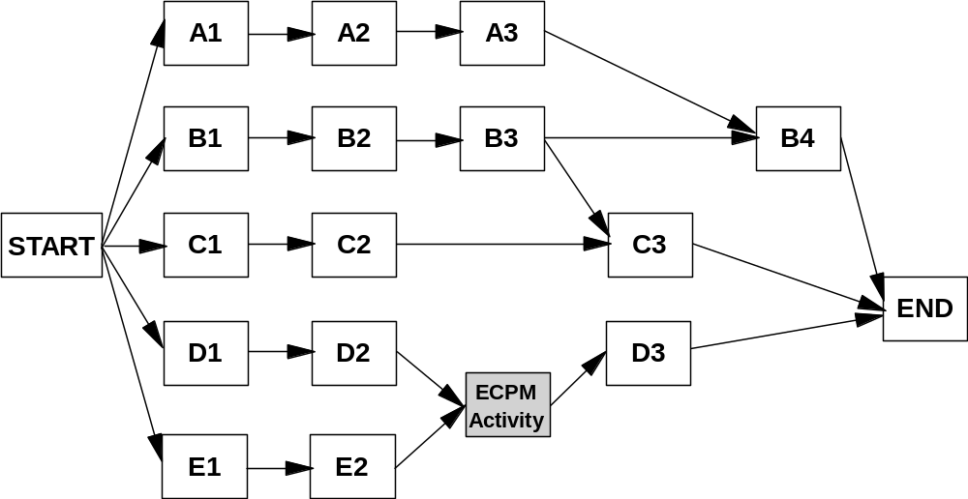
Ch14: Hybrid PM Framework
Imbedding ECPM in a TPM Project

Slide 28
Ch14: Hybrid PM Framework
The Hybrid PMLC Project Types

Slide 29
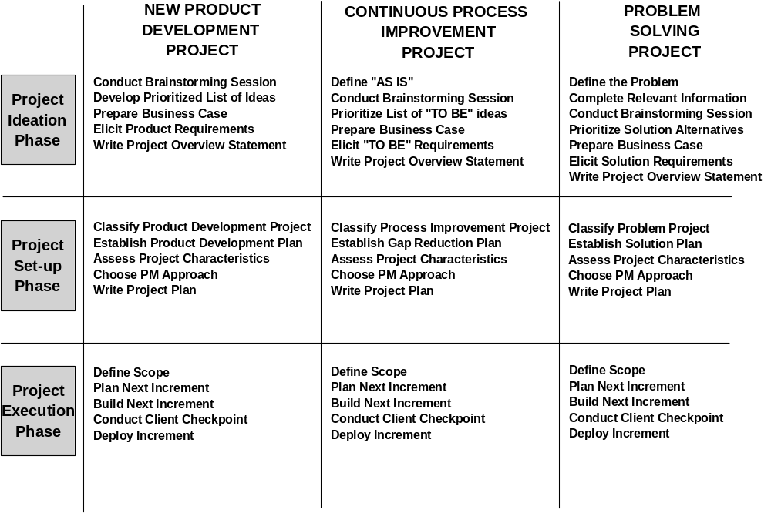
Ch14: Hybrid PM Framework
Precedence Diagram for a TPM Project

Slide 30
Ch14: Hybrid PM Framework
Project Ideation: What are we going to do?

Slide 31
Ch14: Hybrid PM Framework
Project Set-Up: How will we do it?
Project classification
HPM Project Characteristics
Adjusted HPM Model Template

Slide 32
Ch14: Hybrid PM Framework
Project Execution: How well did we do?
An analysis of actual project performance against planned project performance

Slide 33
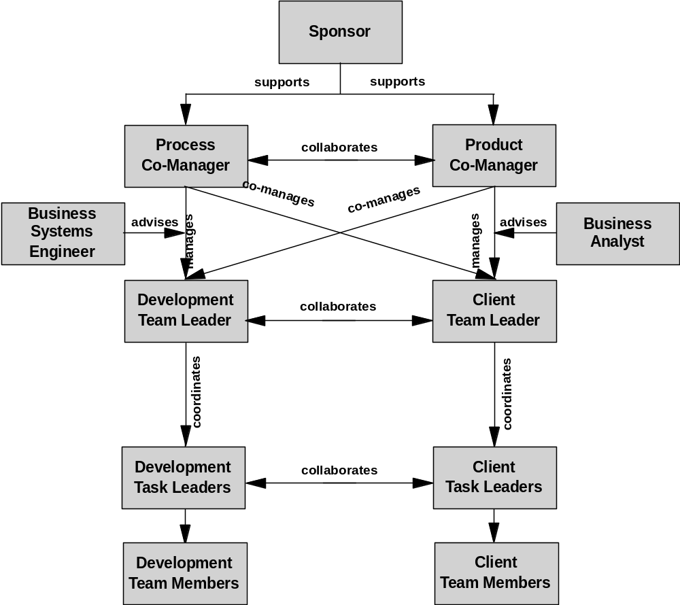
Ch14: Hybrid PM Framework
The Hybrid Project Team Structure

Slide 34
Ch14: Hybrid PM Framework
The OPM PSO
Project Administrative Support and Resource Allocation
Methods and Standards
Software Tools and Training
Consulting and Mentoring
PM Training and Education
Ensuring project management protocols are followed
Creating organizational project management policies and procedures
Project Manager Professional Development (in partnership with HR)

