Slide 1
Effective Project Management:
Traditional, Agile, Extreme, Hybrid
8th Edition
Ch15: Comparing TPM and CPM Models
Presented by
(facilitator name)

Slide 2

Summary of Chapter 12
Ch12: Specific PMLC Models
Traditional Project Management
  Linear PMLC Models
  Incremental PMLC Models
Agile Project Management
  Iterative PMLC Models
  Adaptive PMLC Models
Extreme Project Management
  Extreme PMLC Model
Challenges to Project Set-Up and Execution
Notes:
Explain how each of these contributes to the growing importance of project management in the business world.

Slide 3
Ch12: Specific PMLC Models
What is Traditional Project Management (TPM)?
Traditional Project Management is a set of tools, templates and processes for managing projects whose goal and solution are both clearly understood.
NOTE: There are two types of TPM Models:
    Linear
    Incremental

Slide 4

Ch12: Specific PMLC Models
Linear Project Management Life Cycle (PMLC) Model
Definition
  A Linear PMLC Model consists of a number of dependent phases that are executed in a sequential order with no feedback loops.
  The complete solution is not released until the final phase.
Linear
Linear
Linear
Figure
12-01

Slide 5
Ch12: Specific PMLC Models
Linear PMLC Model
Characteristics
  Complete and clearly defined goal, solution, requirements, functions and features
  Few expected scope change requests
  Routine and repetitive activities
  Use established templates
Linear
Linear
Linear

Slide 6
Ch12: Specific PMLC Models
Linear PMLC Model
Routine and Repetitive Activities
  Build and use a library of templates
  Keep and post the history of lessons learned
  Keep a history of estimated and actual task durations
  Keep a history of risks, your mitigation plans, and the results
  Templates
  Increases standard practices
  Provides learning modules for new project managers
  Establishes an archive of project artifacts
  Provides input for process and practice improvement programs

Slide 7
Ch12: Specific PMLC Models
Linear PMLC Model
Strengths
  Entire project is scheduled up front
  Resource requirements are known
  Does not require the most skilled resources
  Team members do not have to be co-located
Linear
Linear
Linear

Slide 8
Ch12: Specific PMLC Models
Linear PMLC Model
Weaknesses
  Does not accommodate change very well
  Costs too much
  Takes too long before any deliverables are produced
  Requires complete and detailed plans
  Must follow a rigid sequence of processes
  Is not focused on client value
Linear
Linear
Linear

Slide 9
Ch12: Specific PMLC Models
Linear PMLC Model
When to use a Linear Approach
  Projects that are repetitive
  Simple, short duration projects
  Projects contained totally within a single department and use no outside resources
Linear
Linear
Linear

Slide 10
Ch12: Specific PMLC Models
Specific Linear PMLC Models
Linear
Linear
Linear
  Standard Waterfall Model
  Rapid Development Waterfall Model

Slide 11
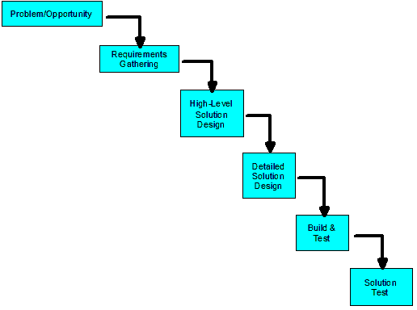
Ch12: Specific PMLC Models
Variations to the Linear PMLC Model
Standard Waterfall Model
Linear
Linear
Linear
Figure
12-02

Slide 12
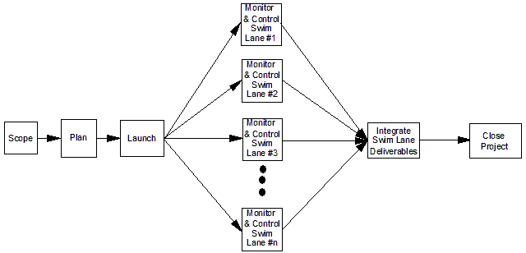
Ch12: Specific PMLC Models
Variations to the Linear PMLC Model
Rapid Development Waterfall Model
Linear
Linear
Linear
Figure
12-03

Slide 13
Ch12: Specific PMLC Models
Linear PMLC Model
Considerations in choosing a variation
  Decomposing the project into parallel and independent swim lanes
  Swim lane cohesiveness
  Increased risk
Linear
Linear
Linear

Slide 14
Ch12: Specific PMLC Models
Linear PMLC Model
Adapting & Integrating the Toolkits for Maximum Effectiveness
  The functions and features of a swim lane can be built independently of the functions and features of any other swim lane
  There are no resource dependencies across swim lanes
  There are no schedule dependencies across swim lanes
  The total duration of each swim lane must be nearly equal
Linear
Linear
Linear

Slide 15
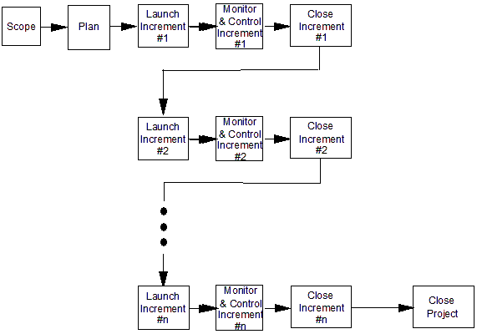
Ch12: Specific PMLC Models
Incremental PMLC Model
Definition
  An Incremental PMLC Model consists of a number of dependent phases repeated in sequential order with no feedback loops.
Linear
Linear
Incremental
Figure
12-04

Slide 16
Ch12: Specific PMLC Models
Incremental PMLC Model
Characteristics
  Same as Linear PMLC Model
  Need to release deliverables against a more aggressive schedule
Linear
Linear
Incremental

Slide 17
Ch12: Specific PMLC Models
Incremental PMLC Model
Strengths
  Produces business value early in the project
  Enables you to better schedule scarce resources
  Can accommodate minor scope change requests between increments
  Offers a product improvement opportunity
  More focused on client value than the linear PMLC Model
Linear
Linear
Incremental

Slide 18
Ch12: Specific PMLC Models
Incremental PMLC Model
Weaknesses
  The team may not remain intact between increments
  Requires hand-off documentation between increments
  Must follow a defined set of processes
  Must define increments based on function and feature dependencies rather than business value
  Requires more client involvement than Linear PMLC Models
  An Incremental PMLC Model takes longer than the Linear PMLC Model
  Partitioning the functions and features may be problematic
Linear
Linear
Incremental

Slide 19
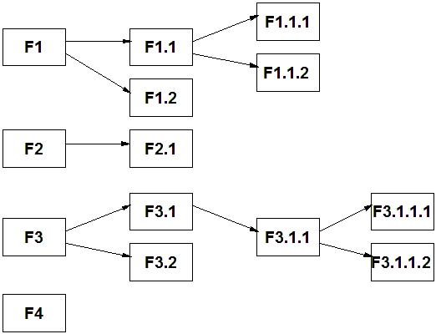
Ch12: Specific PMLC Models
Incremental PMLC Model
Linear
Linear
Incremental
Figure
12-05

Slide 20
Ch12: Specific PMLC Models
Incremental PMLC Model
When to use an Incremental PMLC Model
  To get to a partial product or service to market sooner
  To get partial solution to the end user sooner
Linear
Linear
Incremental

Slide 21
Ch12: Specific PMLC Models
Incremental PMLC Model
Adapting & Integrating the Toolkits for Maximum Effectiveness
  An increase in management time to handle between increment issues
  An increase in the total amount of work as compared to the Linear PMLC Model
  The likelihood of between increment scope change requests
  An increased likelihood of losing resources between increments
  The possibility of project delays between increments
  Potential for overlooking increment dependencies
  Hand-off documentation of requirements between increments
Linear
Linear
Incremental

Slide 22
Ch12: Specific PMLC Models
Specific Incremental PMLC Models
Linear
Linear
Incremental
  Staged Delivery Waterfall Model
  Feature-Driven Development Model

Slide 23
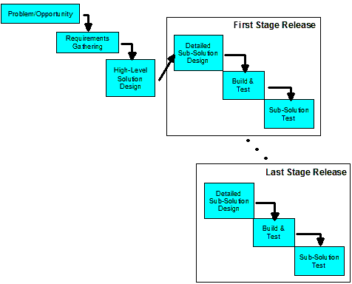
Ch12: Specific PMLC Models
Variations to the Incremental PMLC Model
Staged Delivery Waterfall Model
Linear
Linear
Incremental
Figure
12-06

Slide 24
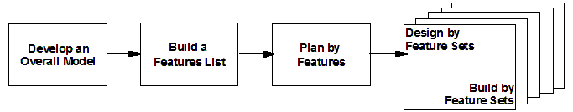
Ch12: Specific PMLC Models
Variations to the Incremental PMLC Model
FDD Incremental PMLC Model
Linear
Incremental
Linear
NOTE: The feature sets are prioritized based on technical dependencies in order to determine the build sequence.
Figure
12-07

Slide 25
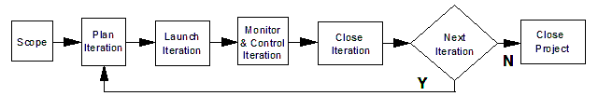
Ch12: Specific PMLC Models
What is Agile Project Management?
Agile Project Management is a set of tools, templates and processes for managing projects whose goal is clearly known but whose solution ranges from partially unknown to almost totally unknown.

Slide 26
Ch12: Specific PMLC Models
Implementing Agile Projects
Fully supported production versions of partial
solutions are released to the end user
quarterly or semi-annually
Intermediate versions are released to a focus
group every 2-4 weeks
Co-located agile project teams
Cross project dependencies
Project portfolio management

Slide 27
Ch12: Specific PMLC Models
The Agile Manifesto
“We are uncovering better ways of developing [products]
by doing it and helping others do it. Through this work we
have come to value:
Individuals and interactions over processes and tools
Working [products] over comprehensive documentation
Customer collaboration over contract negotiations
Responding to change over following a plan
That is, while there is value in the items on the right, we
value the items on the left more.”
Martin Fowler & Jim Highsmith, “The Agile Manifesto.” Software Development Vol. 9, No. 8 (August 2001) pgs 28-32

Slide 28
Ch12: Specific PMLC Models
Implementing Agile Projects
Fully supported production versions of partial
solutions are released to the end user
quarterly or semi-annually
Intermediate versions are released to a focus
group every 2-4 weeks
Co-located agile project teams
Cross project dependencies
Project portfolio management

Slide 29
Ch12: Specific PMLC Models
Iterative Project Management Life Cycle Model
Definition
    An Iterative Project Management Life Cycle (PMLC) Model consists of a number of phases that are repeated in groups with a feedback loop after each group is completed. At the discretion of the client the last phase in a group may release a partial solution.
Linear
Linear
Iterative
Figure
12-08

Slide 30
Ch12: Specific PMLC Models
When to use an Iterative PMLC Model
Most but not all of the solution is clearly known
You might otherwise have chosen the Incremental PMLC model but have a strong suspicion that there will be more than a minimum number of scope change requests
You might otherwise have chosen an Adaptive PMLC model but are concerned about lack of client involvement
Linear
Linear
Iterative

Slide 31
Ch12: Specific PMLC Models
Iterative PMLC Model
Scope Phase
  Implementation of intermediate solutions can be problematic
  Final solution cannot be defined at the start of the project
Plan Phase
  The complete plan for building the known solution
  The partial plan for the high priority functions
Linear
Linear
Iterative

Slide 32
Ch12: Specific PMLC Models
Iterative PMLC Model
Characteristics
  The solution is known but not to the expected depth (i.e., features are not complete)
  Often uses iconic or simulated prototypes to discover the complete solution
Linear
Linear
Iterative

Slide 33
Ch12: Specific PMLC Models
Iterative PMLC Model
Strengths
  Client can review current partial solution for suggested improvements
  Scope changes can be processed between iterations
  You can adapt it to changing business conditions
Linear
Linear
Iterative

Slide 34
Ch12: Specific PMLC Models
Iterative PMLC Model
Weaknesses
  Requires a more actively involved client than Linear and Incremental PMLC models require
  Requires co-located teams
  Implementation of intermediate solutions can be problematic
  Final solution cannot be specified at the start of the project
Linear
Linear
Iterative

Slide 35
Ch12: Specific PMLC Models
Specific Iterative PMLC Models
Linear
Linear
Iterative
  Prototyping Model
  Evolutionary Development Waterfall Model
  Rational Unified Process (RUP) Model
  Dynamic Systems Development Model (DSDM)
  Adaptive Software Development (ASD) Model
  Scrum

Slide 36
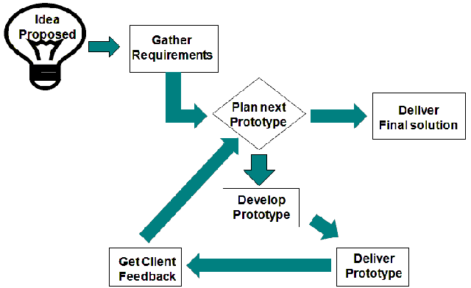
Ch12: Specific PMLC Models
Types of Iterative PMLC Models
Prototyping
Linear
Linear
Iterative
Figure
12-09

Slide 37
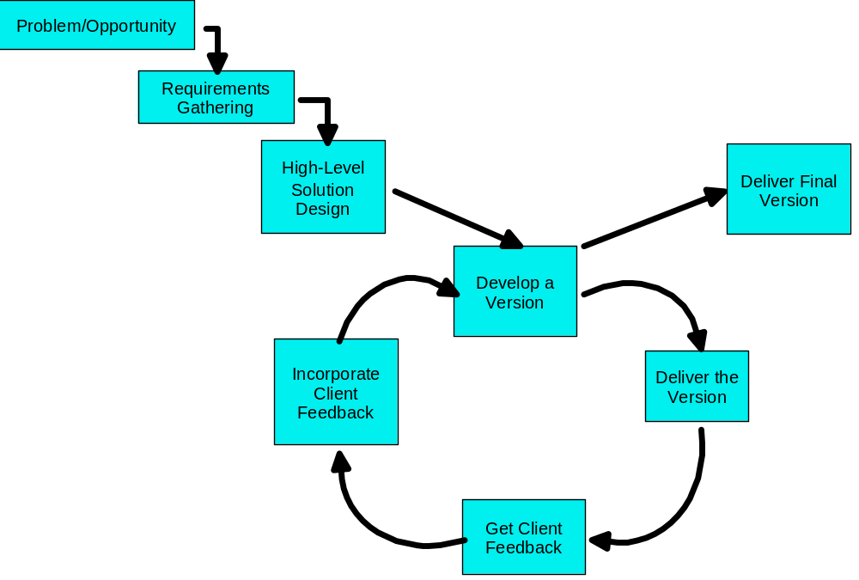
Ch12: Specific PMLC Models
Types of Iterative PMLC Models
Evolutionary Development Waterfall Model
Linear
Linear
Iterative
Figure
12-10

Slide 38
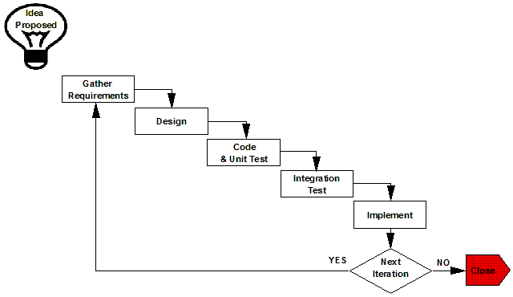
Ch12: Specific PMLC Models
Types of Iterative PMLC Models
RUP
Linear
Linear
Iterative
Figure
12-11

Slide 39
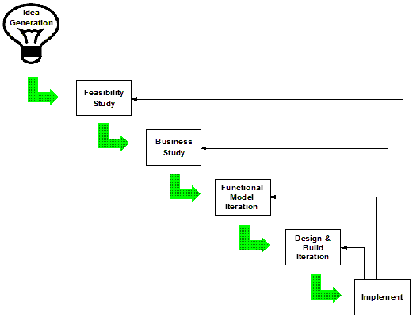
Ch12: Specific PMLC Models
Types of Iterative PMLC Models
Dynamic Systems Development Method (DSDM)
Linear
Linear
Iterative
Figure
12-12

Slide 40
Ch12: Specific PMLC Models
Types of Iterative PMLC Models
Dynamic Systems Development Method (DSDM)
Linear
Linear
Iterative
DSDM key principles:
Active client involvement is imperative
DSDM teams must be empowered to make decisions
The focus is on frequent delivery of product
Fitness for business purpose is the essential criterion for
acceptance of deliverables
Iterative and incremental development is necessary to converge
on an acceptable business solution
All changes during development are reversible
Requirements are baselined at a high level
Testing is integrated throughout the life cycle
A collaborative and cooperative approach between all
stakeholders is essential
Jennifer Stapleton “DSDM: Dynamic Systems Development Method” Addison-Wesley, 1997

Slide 41
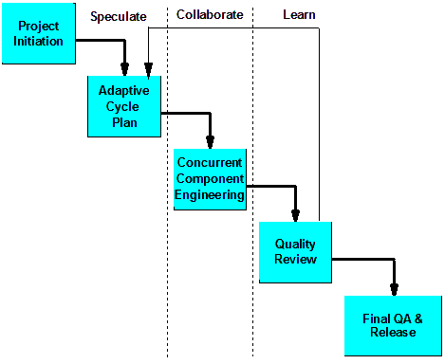
Ch12: Specific PMLC Models
Types of Iterative PMLC Models
  Adaptive Software Development (ASD)
Linear
Linear
Iterative
Figure
12-13

Slide 42
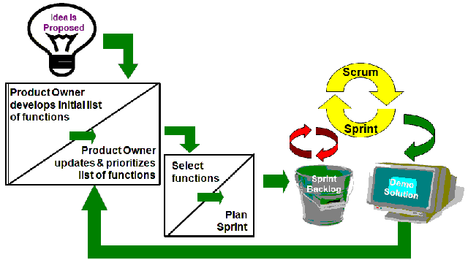
Ch12: Specific PMLC Models
Types of Iterative PMLC Models
Scrum
Linear
Linear
Iterative
Figure
12-14

Slide 43
Ch12: Specific PMLC Models
Iterative PMLC Model
When to Use an Iterative PMLC Model
  Intuitive to the client
  Easily engage the client
  Immediate feedback on the effect of solution changes
  Tolerant of assessing and evaluating the impact of alternatives
  No fixed deadline for completion
Linear
Linear
Iterative

Slide 44
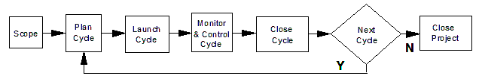
Ch12: Specific PMLC Models
Adaptive PMLC Model
Definition
  Adaptive PMLC Models are those that proceed from iteration to iteration based on very limited specification of solution. Each cycle learns from the proceeding ones and redirects the next cycle in an attempt to converge on an acceptable solution. At the discretion of the client a cycle may release a partial solution.
Linear
Linear
Adaptive
Figure
12-15

Slide 45
Ch12: Specific PMLC Models
Adaptive PMLC Model
Linear
Scope Phase
  Sets the boundaries and high-level parameters for the project
  Specify number of cycles and cycle length
  Tentatively map out cycle objectives
Plan Phase
  Uses the Planning Process Group tools, templates and processes for the coming cycle functionality
Launch Phase
  Same as Iterative PMLC Model
  Establish sub-teams to work on concurrent swim lanes
Linear
Adaptive

Slide 46
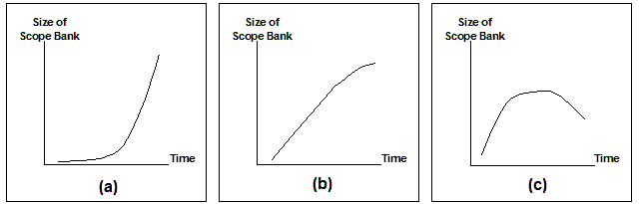
Ch12: Specific PMLC Models
Adaptive PMLC Model
Linear
Monitor & Control Phase
Close Phase
Linear
Adaptive

Slide 47
Ch12: Specific PMLC Models
Adaptive PMLC Model
Characteristics
  Iterative structure
  Just-in-time planning
  Critical mission projects
  Thrives on change through learning and discovery
Linear
Linear
Adaptive

Slide 48
Ch12: Specific PMLC Models
Adaptive PMLC Model
Strengths
  Continuously realigns the project management process to accommodate changing conditions
  Does not waste time on non-value added work
  Avoids all management issues processing scope change requests
  Does not waste time planning uncertainty
  Provides maximum business value within the given time and cost constraints
Linear
Linear
Adaptive

Slide 49
Ch12: Specific PMLC Models
Adaptive PMLC Model
Weaknesses
  Must have meaningful client involvement
  Cannot identify exactly what will be delivered at the end of the project
Linear
Linear
Adaptive

Slide 50
Ch12: Specific PMLC Models
Types of Adaptive PMLC Models
APF Characteristics
Linear
Linear
Adaptive
APF project team
APF roots
Scope is variable
APF just-in-time planning
Change is expected
APF project contract
APF project is mission critical
The role of the client
APF is not a recipe to be blindly followed
Why do we need APF?

Slide 51
Ch12: Specific PMLC Models
Adaptive PMLC Model
Benefits of APF vs other Approaches
  APF projects always finish sooner than TPM projects
  APF projects are less expensive than TPM projects
  APF projects have a better business termination policy than TPM projects
  APF projects produce higher quality deliverables than TPM projects
  APF projects deliver maximum business value for the time and cost invested
Linear
Linear
Adaptive

Slide 52
Ch12: Specific PMLC Models
Adaptive PMLC Model
APF Core Values
  Client-focused
  Client-driven
  Incremental results early and often
  Continuous questioning and introspection
  Change is progress to a better solution
  Don’t speculate on the future
Linear
Linear
Adaptive

Slide 53
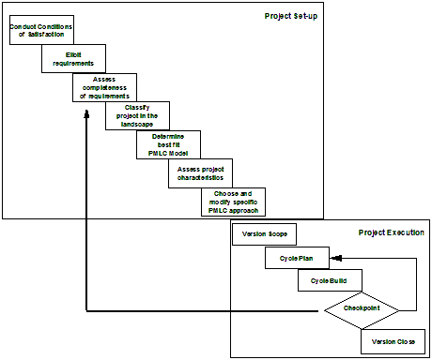
Ch12: Specific PMLC Models
Types of Adaptive PMLC Models
Adaptive Project Framework (APF)
Linear
Linear
Adaptive
Figure
12-16

Slide 54
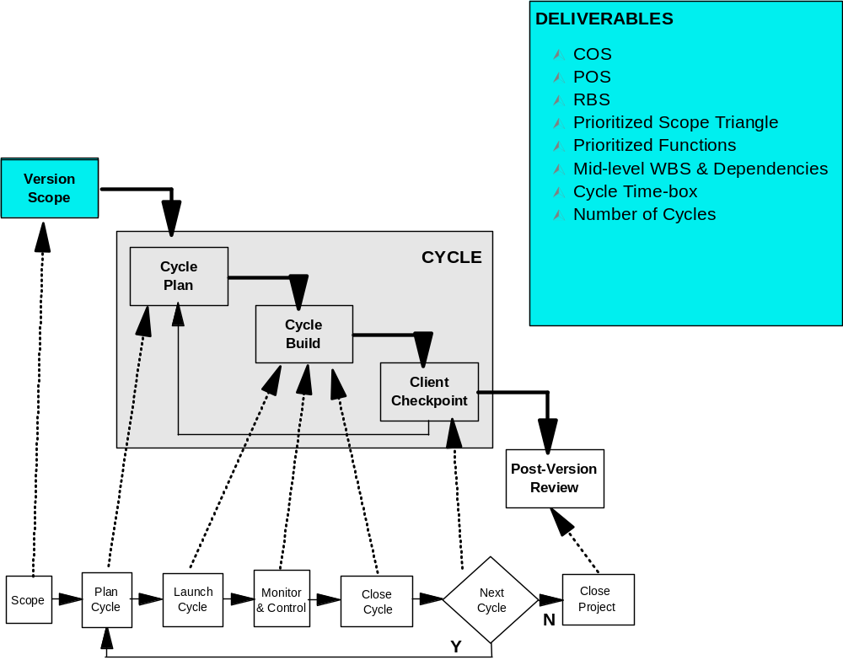
Ch12: Specific PMLC Models
Adaptive PMLC Model
APF – Version Scope
Linear
Linear
Adaptive
Figure
11-10

Slide 55
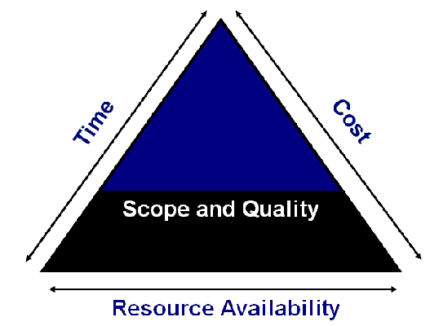
Ch12: Specific PMLC Models
Adaptive PMLC Model
APF – Cycle Plan – Scope Triangle
Linear
Linear
Adaptive
Figure
11-11

Slide 56
Ch12: Specific PMLC Models
Adaptive PMLC Model
APF – Cycle Plan – Prioritization Approaches
Linear
Linear
Adaptive
Forced Ranking
Paired Comparison
MoSCoW

Slide 57
Ch12: Specific PMLC Models
Adaptive PMLC Model
Prioritization Approaches – Forced Ranking
Linear
Linear
Adaptive
MANAGER FUNCTION | A | B | C | D | RANK SUM | FORCED RANK
1 | 2 | 3 | 2 | 4 | 11 | 3
2 | 4 | 1 | 1 | 2 | 8 | 1
3 | 6 | 2 | 5 | 5 | 18 | 5
4 | 1 | 5 | 3 | 1 | 10 | 2
5 | 3 | 4 | 4 | 3 | 14 | 4
6 | 5 | 6 | 6 | 6 | 23 | 6
Table
11-02

Slide 58
Ch12: Specific PMLC Models
Adaptive PMLC Model
Prioritization Approaches – Paired Comparison
Linear
Linear
Adaptive
 | 1 | 2 | 3 | 4 | 5 | 6 | SUM | RANK
1 | X | 1 | 1 | 0 | 1 | 1 | 4 | 2
2 | 0 | X | 1 | 0 | 1 | 1 | 3 | 3
3 | 0 | 0 | X | 0 | 0 | 1 | 1 | 5
4 | 1 | 1 | 1 | X | 1 | 1 | 5 | 1
5 | 0 | 0 | 1 | 0 | X | 1 | 2 | 4
6 | 0 | 0 | 0 | 0 | 0 | X | 0 | 6
Table
11-03

Slide 59
Ch12: Specific PMLC Models
Adaptive PMLC Model
Prioritization Approaches - MoSCoW
Linear
Linear
Adaptive
M: Must Have
S: Should Have
C: Could Have
W: Would be Nice to Have

Slide 60
Ch12: Specific PMLC Models
Adaptive PMLC Model
APF – Cycle Plan Scope Triangle Ranking
Linear
Linear
Adaptive
Priority Variable | Critical (1) | (2) | (3) | (4) | Flexible (5)
Scope |  |  |  | X
Quality |  |  | X
Time | X
Cost |  |  |  |  | X
Resource Availability |  | X
Table
11-04

Slide 61
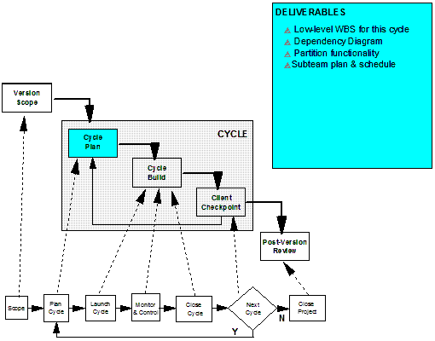
Ch12: Specific PMLC Models
Adaptive PMLC Model
APF – Cycle Plan
Linear
Linear
Adaptive
Figure
11-12

Slide 62
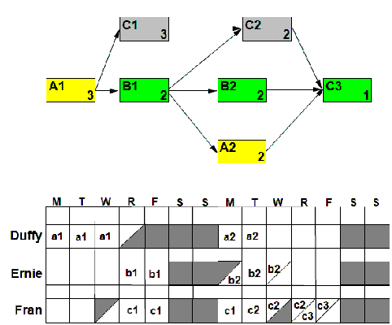
Ch12: Specific PMLC Models
Adaptive PMLC Model
APF – Cycle Plan – Resource Loaded Schedule
Linear
Linear
Adaptive
Figure
11-13

Slide 63
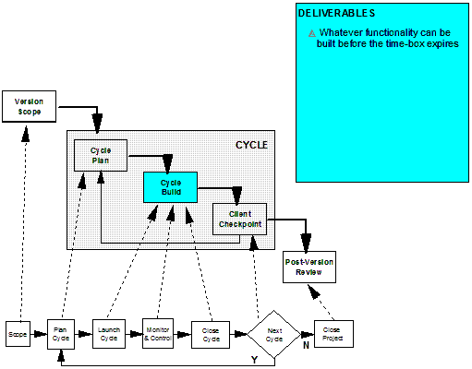
Ch12: Specific PMLC Models
Adaptive PMLC Model
APF – Cycle Build
Linear
Linear
Adaptive
Figure
11-14

Slide 64
Ch12: Specific PMLC Models
Adaptive PMLC Model
APF Cycle Build – Ending the Cycle
Linear
Linear
Adaptive
A cycle may end for any of the following reasons:
The timebox expires
All swim lanes completed early
A major problem occurs

Slide 65
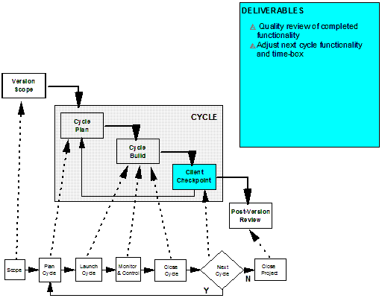
Ch12: Specific PMLC Models
Adaptive PMLC Model
APF – Client Checkpoint
Linear
Linear
Adaptive
Figure
11-15

Slide 66
Ch12: Specific PMLC Models
Adaptive PMLC Model
APF – Client Checkpoint – Inputs
Linear
Linear
Adaptive
Functionality completed in the previous cycle
Functionality planned but not completed in the previous cycle
Functionality originally planned for this cycle
Functionality planned for all cycles beyond the next one
All learning and discovery that took place in all previous cycles
Any changes that took place in the business environment
during the previous cycles
The extent to which the current solution is converging on the
final solution
The current contents of the Scope Bank

Slide 67
Ch12: Specific PMLC Models
Adaptive PMLC Model
APF – Client Checkpoint – Ouputs
Linear
Linear
Adaptive
Review the COS and make any adjustments to
solution requirements
Prioritize the items in the Scope Bank
Identify and Prioritize Probative Swim Lane contents
Identify and prioritize Integrative Swim Lane contents
Select the items to be developed in the next cycle
Determine the next cycle time-box

Slide 68
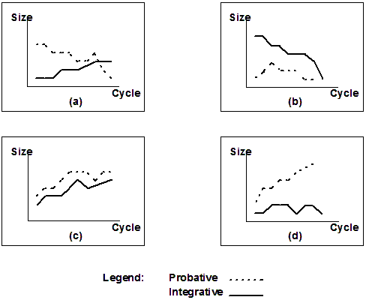
Ch12: Specific PMLC Models
Adaptive PMLC Model
APF – Client Checkpoint – Probative versus Integrative Swim Lane sizes over time
Linear
Linear
Adaptive
Figure
11-16

Slide 69
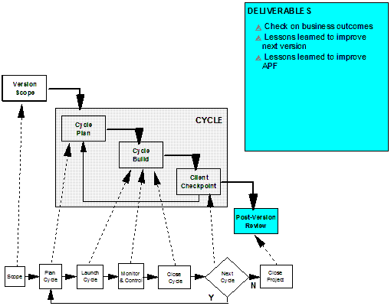
Ch12: Specific PMLC Models
Adaptive PMLC Model
APF – Post-Version Review
Linear
Linear
Adaptive
Figure
11-17

Slide 70
Ch12: Specific PMLC Models
Adaptive PMLC Model
APF – Post-Version Review – Questions to be answered
Linear
Linear
Adaptive
Was the expected business outcome realized?
What was learned that can be used to improve
the solution?
What was learned that can be used to improve
the effectiveness of APF?

Slide 71
Ch12: Specific PMLC Models
Adaptive PMLC Model
Adapting APF
Linear
Linear
Adaptive
Proof of Concept
Revising the Version Scope
Embedding APF in other PMLC models

Slide 72
Ch12: Specific PMLC Models
Adaptive PMLC Model
Implementing APF
Linear
Linear
Adaptive
Bottom Up Approach
Top Down Approach

Slide 73
Ch12: Specific PMLC Models
Adaptive PMLC Model
When to Use an Adaptive PMLC Model
  Have you or a trusted colleague had successful adaptive project experience with this client before?
  If this is the first adaptive experience for this client, have you assured yourself that they will be meaningfully involved throughout the entire project.
  Has the client appointed a qualified and respected co-project manager for this project?
Linear
Linear
Adaptive

Slide 74
Ch12: Specific PMLC Models
Adaptive PMLC Model
Adapting & Integrating the Toolkits for Maximum Effectiveness
  Scope the Next Iteration/Cycle
    Elicit the true needs of the client
    Documenting the client’s needs
    Negotiating with the client how those needs will be met
    Writing a one page description of the project
    Gaining senior management approval to plan the project
Linear
Linear
Adaptive

Slide 75
Ch12: Specific PMLC Models
Adaptive PMLC Model
Adapting & Integrating the Toolkits for Maximum Effectiveness
  Planning the Next Iteration/Cycle
    Defining all of the work of the next iteration/cycle
    Estimating how long it will take to complete the work
    Estimating the resources required to complete the work
    Estimating the total cost of the work
    Sequencing the work
    Building the initial iteration/cycle schedule
    Analyzing and adjusting the iteration/cycle schedule
    Writing the risk management plan
    Documenting the iteration/cycle plan
    Gaining senior management approval to launch the iteration/cycle
Linear
Linear
Adaptive

Slide 76
Ch12: Specific PMLC Models
Adaptive PMLC Model
Adapting & Integrating the Toolkits for Maximum Effectiveness
  Launching the Next Iteration/Cycle
    Recruiting the project manager
    Recruiting the project team
    Writing the Project Description Document
    Establishing team operating rules
    Establishing the scope change management process
    Managing team communications
    Writing work packages
Linear
Linear
Adaptive

Slide 77
Ch12: Specific PMLC Models
Adaptive PMLC Model
Adapting & Integrating the Toolkits for Maximum Effectiveness
  Monitoring & Controlling the Next Iteration/Cycle
    Establishing the iteration/cycle performance and
    reporting system
    Monitoring the iteration/cycle performance
    Monitoring risk
    Reporting project status
    Processing scope change requests
    Discovering and solving problems
Linear
Linear
Adaptive

Slide 78
Ch12: Specific PMLC Models
Adaptive PMLC Model
Adapting & Integrating the Toolkits for Maximum Effectiveness
  Close the Next Iteration/Cycle
    Gaining client approval of having met iteration/cycle requirements
    Planning and installing deliverables
    Writing the final iteration/cycle report
    Conducting the post-iteration/cycle audit
  An APM project ends when
    The time and budget are expended
    An acceptable solution with the expected business value is found
    The project is abandoned
Linear
Linear
Adaptive

Slide 79
Ch12: Specific PMLC Models
What is Extreme Project Management ?
Linear
Linear
Extreme
Extreme Project Management is a set of tools, templates and processes for managing projects whose goal expresses an ideal state but whose solution for reaching that goal is unknown or unlikely.

Slide 80
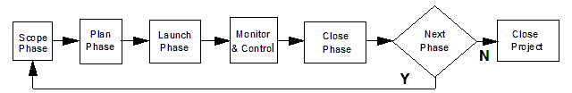
Ch12: Specific PMLC Models
Extreme Project Management Life Cycle Model
Linear
Linear
Extreme
Definition
  An Extreme PMLC Model is one that proceeds from phase to phase based on very limited knowledge of goal and solution. Each phase learns from the proceeding ones and redirects the next phase in an attempt to converge on an acceptable goal and solution. At the discretion of the client a phase may release a partial solution.
Figure
12-17

Slide 81
Ch12: Specific PMLC Models
Extreme PMLC Model
Linear
Characteristics
  High speed
  High change
  High uncertainty
Linear
Extreme

Slide 82
Ch12: Specific PMLC Models
Extreme PMLC Model
Linear
Linear
Extreme
Strengths
  Keeps options open as late as possible
  Offers an early look at a number of partial solutions

Slide 83
Ch12: Specific PMLC Models
Extreme PMLC Model
Linear
Weaknesses
  May be looking for solutions in all the wrong places
  No guarantee that any business value will result from the project
Linear
Extreme

Slide 84
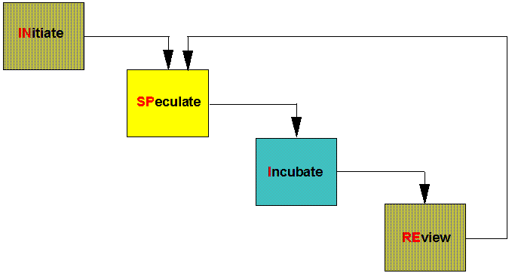
Ch12: Specific PMLC Models
Extreme PMLC Model – INSPIRE
Linear
Linear
Extreme
Figure
12-18

Slide 85
Ch12: Specific PMLC Models
Extreme PMLC Model – INSPIRE
Linear
Linear
Extreme
Initiate
  Defining the project goal
  INSPIRE POS
  Establishing a project time-box and cost
  Establishing the number of phases and length
  Trade-offs in the Scope Triangle

Slide 86
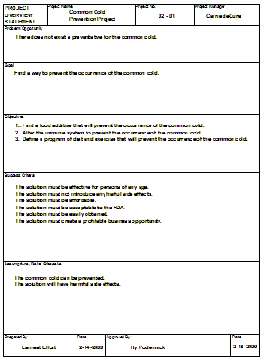
Ch12: Specific PMLC Models
Extreme PMLC Model – Example POS
Linear
Linear
Extreme
Figure
12-19

Slide 87
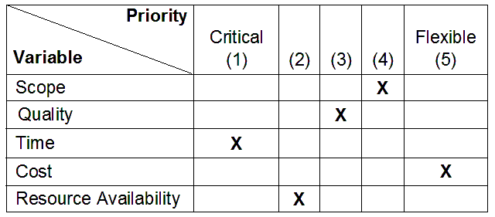
Ch12: Specific PMLC Models
Extreme PMLC Model – Prioritized Scope Triangle
Linear
Linear
Extreme
Figure
12-20

Slide 88
Ch12: Specific PMLC Models
Extreme PMLC Model – INSPIRE
Linear
Linear
Extreme
Speculate
  Defining how the project will be done
  Conditions of Satisfaction (COS)
  Scenarios, stories and use cases
  Prioritizing requirements
  Identifying the first phase deliverables
  Go/No-Go decision
  Planning for later phases

Slide 89
Ch12: Specific PMLC Models
Extreme PMLC Model – INSPIRE
Linear
Linear
Extreme
Incubate
  Assigning resources
  Establishing phase plan
  Collaboratively producing deliverables

Slide 90
Ch12: Specific PMLC Models
Extreme PMLC Model – INSPIRE
Linear
Linear
Extreme
Review
  Applying learning and discovery from the
  previous phase
  Revising the project goal
  Reprioritizing requirements
  Making the Go/No-Go decision for the
  next phase

Slide 91
Ch12: Specific PMLC Models
Challenges to Project Set-Up and Execution
Sponsors have a hard time accepting variable scope.
Achieving and sustaining meaningful client
involvement through the phases of the chosen PMLC
model.
Adapting the chosen PMLC model to changing
conditions.

