Slide 1

Projection of provenance vector sequence
Project presentation
supervisor: Kai Xu
Yu Hao

Slide 2
1
Relevent Concepts
2
Description of Work
Contents
3
Data and Processing
4
Visualisation
5
Results Analysis

Slide 3

No. 1
Concepts

Slide 4
Concepts
Projection: usually used for vectors
In this project, projection refers to the plot in 2D space generated by the vectors
Provenance: the place of origin or earliest known history of something
In this project, provenance encapsulates origin, history, transformations, and relationships of the raw data

Slide 5
Definitions
task(highest level): what to do in the process, such as “the top 3 interested universities in Europe”
action(medium level): the behaviour in each task, such as “highlight the name”
event(lowest level): the interaction event, such as “click the mouse”

Slide 6
No.2
Description of Work

Slide 7
Description of Work
1
2
3
Data processing
Visualisation
Results Analysis
Data pre-processing
Vectorization
Dimensionality reduction
Function
Interface
How to use
The plot of results
Analysis and conclusion

Slide 8
No.3
Data & Processing

Slide 9
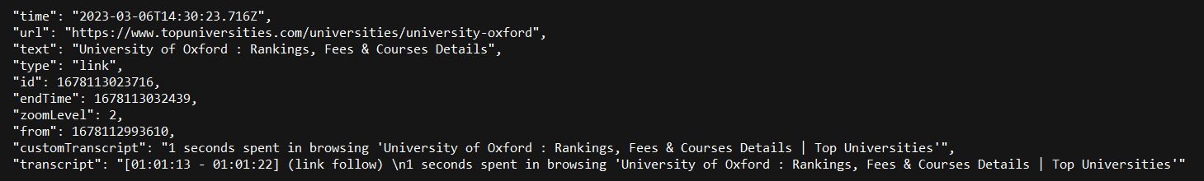
Data
Here is the data we used:

Slide 10
Processing
pre-processing
vectorization
dimensionality reduciton
Delete the data we may not use
simplify the data that are less important
For text data, we transform them into vectors, using LangChain or BERT
Use t-SNE and UMAP to reduce the dimension of the data, making them can be projected on a 2D space

Slide 11
No.4
Visualisation

Slide 12
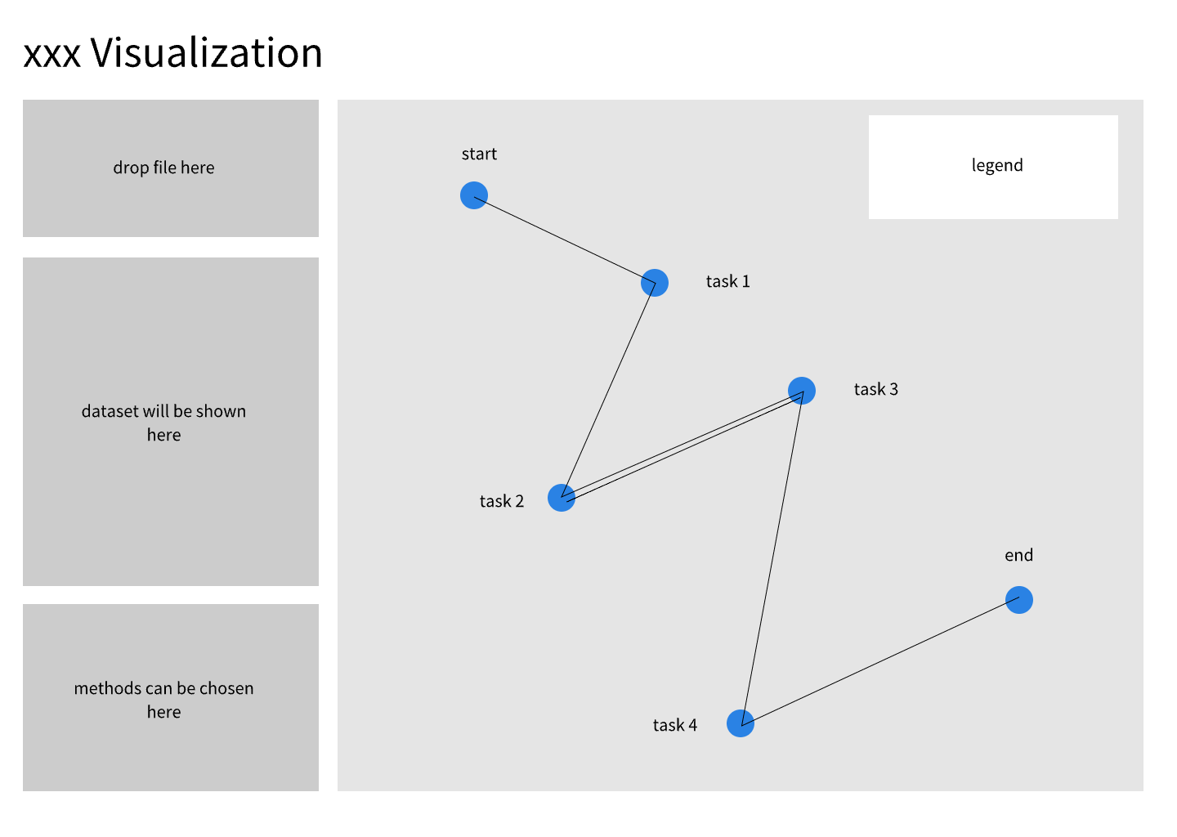
Visualisation -- Sketch

Slide 13
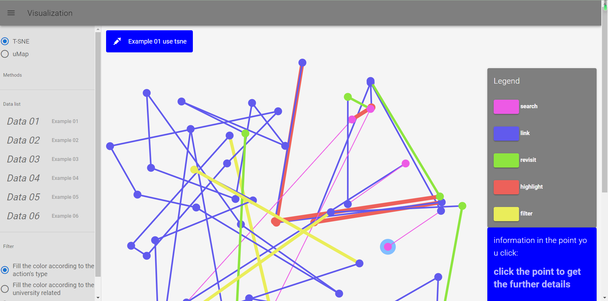
Visualisation -- Final version

Slide 14
No.5
Results Analysis

Slide 15
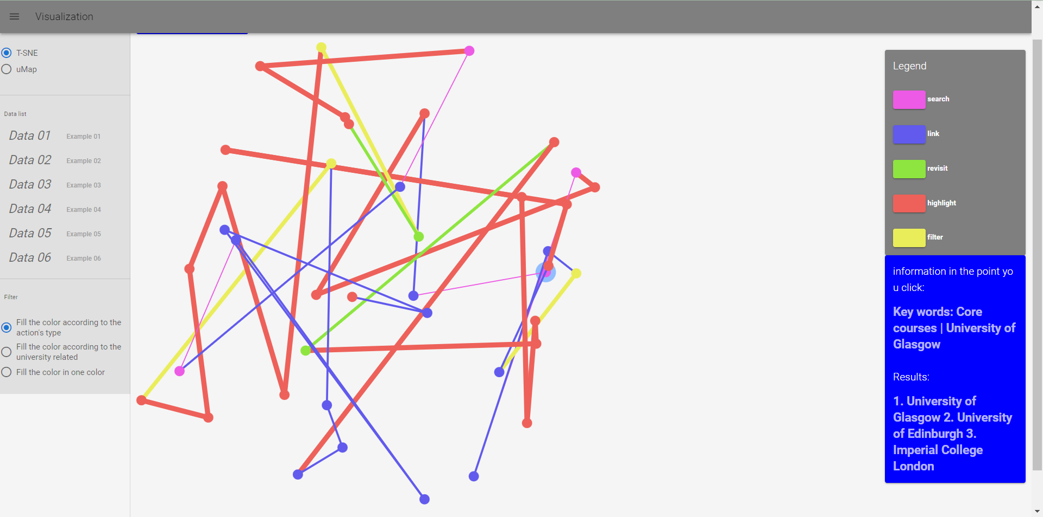
Results Analysis -- Condition 1
Analysis
This is a condition that we already know the results of the process
the start point and the end point, as well as the information of each point
the flow of the information
the action we are concerned

Slide 16
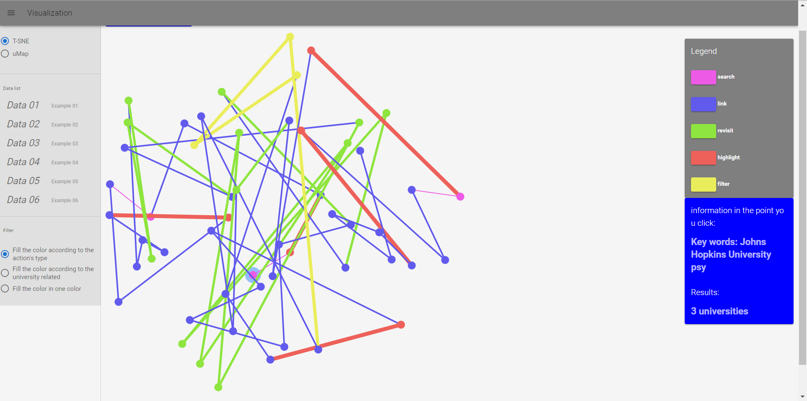
Results Analysis -- Condition 2
Analysis
This is the other condition that we do not know the results
start point and end point, as well as the information of each point
the flow of information
through the point of the action we are concerned, we can know the results

Slide 17
Thank you!

