Slide 1
SOFTWARE PROJECT MANAGEMENT
Smart Library Manager
مكتبتي الذكية
A Personal Library Management Web App — React · TypeScript · Tailwind CSS
Omnia Muhammed ID: 24030099
Menna Mahmoud ID: 24030153
Haneen Ibrahim ID: 24030152
1

Slide 2
Agenda
1
Project Overview & Objectives
2
Scope & Key Features
3
Technology Stack
4
Work Breakdown & Schedule (Gantt / Network / CPM)
5
Cost Estimation & Earned Value Management
6
Risk Analysis
7
Conclusion & Results
2

Slide 3
The Problem & Our Objectives
The Problem
Our Objectives
Readers struggle to track which books they own, are reading, have finished, or wish to read — especially across physical and digital collections. There is no single, simple place to organize a personal library.
Full CRUD book & reading-status management
Smart dual search + Open Library import
Interactive stats dashboard & activity log
Persistent, zero-cost local storage
3

Slide 4
Project Scope
✓ In Scope
✕ Out of Scope
• Book cataloguing & CRUD operations
• Multi-user accounts / authentication
• Dual search (local + Open Library API)
• Cloud database or server backend
• Statistics dashboard & activity log (CSV/JSON export)
• Native mobile application
• Card/table views, filtering, keyboard shortcuts
• Payment / subscription features
• LocalStorage persistence
• Arabic educational section
4

Slide 5
Key Features
1
2
3
Book CRUD & Status
Smart Dual Search
Stats Dashboard
Track Reading, Finished, Available, or Wishlist for every book.
Search locally or import instantly from the Open Library API.
Bento Grid dashboard with live counts and status breakdown.
4
5
6
Activity Log & Export
Flexible Views
Shortcuts & Storage
Every action logged; export as CSV/JSON or print.
Switch card/table views; filter by category or status.
Ctrl+K to search, Ctrl+B to add; data saved via LocalStorage.
5

Slide 6
Technology Stack
React
TypeScript
Tailwind CSS
Open Library API
LocalStorage
UI component library for a fast, interactive frontend
Type-safe JavaScript for fewer runtime bugs
Utility-first styling for rapid, consistent UI design
Free public API for book metadata & cover images
Zero-cost, built-in browser persistence
6

Slide 7
Work Breakdown Structure
1.0
Project Management
Initiation, planning, monitoring & closure
2.0
Requirements & Design
UI/UX design + system architecture
3.0
Development
CRUD, search/API, dashboard, log, views, storage
4.0
Testing
Unit/integration testing + bug fixing
5.0
Deployment & Documentation
GitHub setup + final report & presentation
7

Slide 8
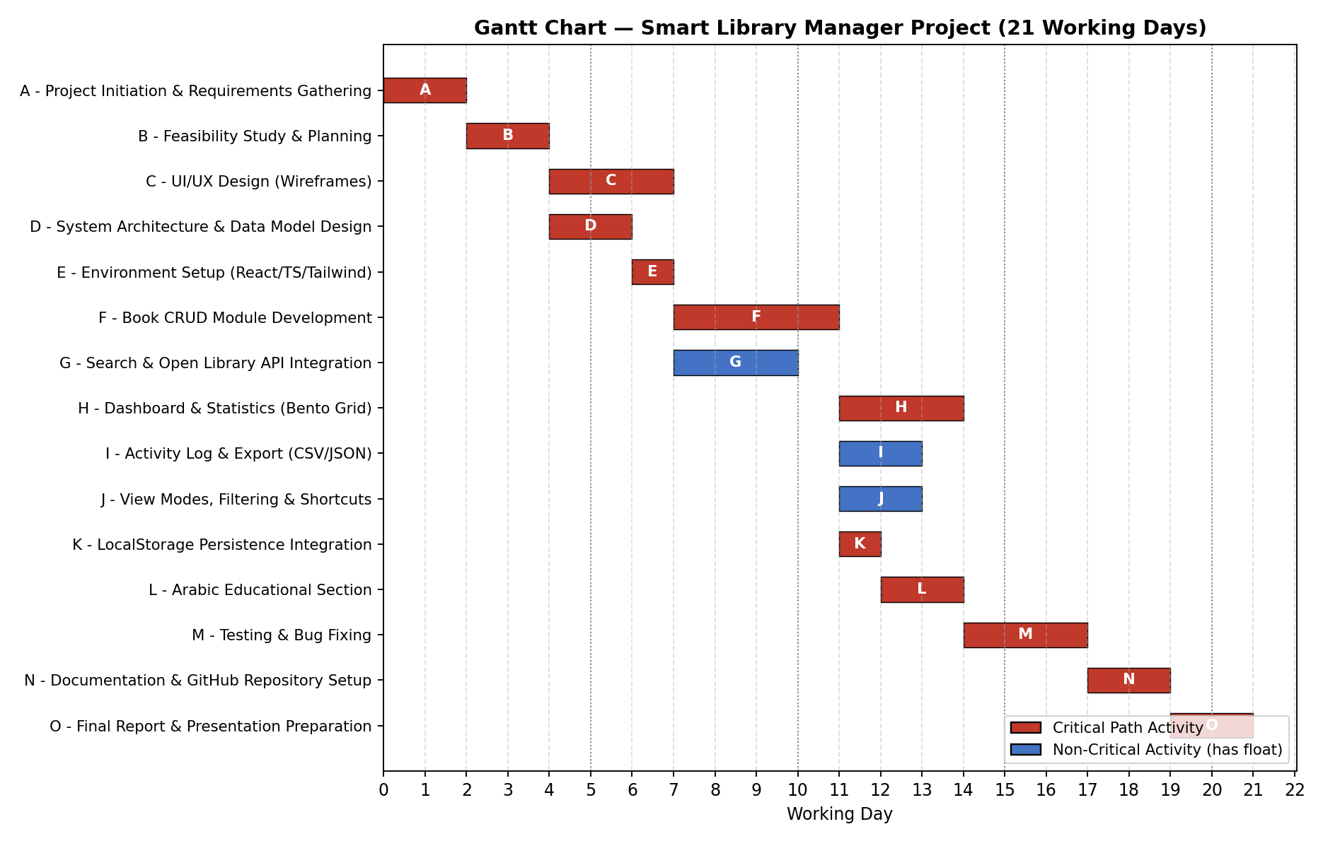
Project Schedule — Gantt Chart
8

Slide 9
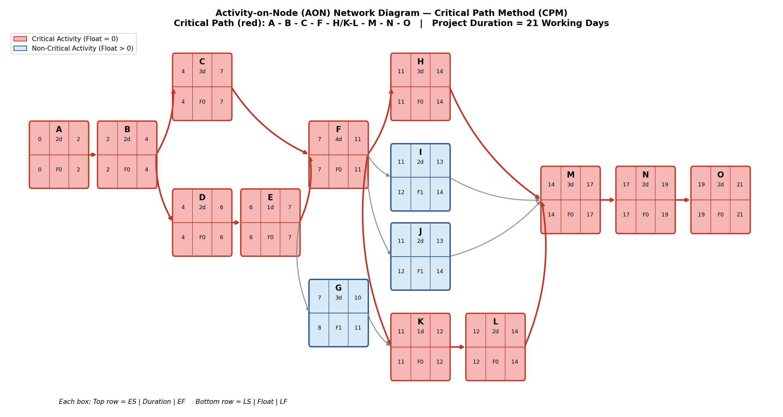
Network Diagram & Critical Path
Critical Path Duration: 21 Working Days
9

Slide 10
Cost Estimation & EVM
$594
0.97
1.00
45
Budget at Completion (BAC)
Final CPI (Cost Performance)
Final SPI — delivered on time
Person-Days of Effort
At the Week-3 checkpoint the project was briefly behind schedule and slightly over budget (CPI ≈ 0.94, SPI ≈ 0.90) due to a longer-than-planned API integration. The team recovered fully by the final deadline, delivering on schedule at a final CPI of ~0.97.
10

Slide 11
Risk Analysis
Risk
Impact
Mitigation
Data loss from cleared browser storage
CSV/JSON export as manual backup
High
TypeScript learning curve
Early prototyping + official docs
High
GitHub repo not public at deadline
Set up & verify repo early
High
Open Library API downtime/limits
Local caching + manual fallback entry
Medium
Scope creep
Enforce agreed Scope Statement
Medium
11

Slide 12
Delivered On Time. On Scope. Close to Budget.
21/21 working days — schedule met
All 6 core feature groups fully implemented
Final CPI ≈ 0.97 — within 3% of budget
Thank You
Questions & Discussion
12

