Slide 1
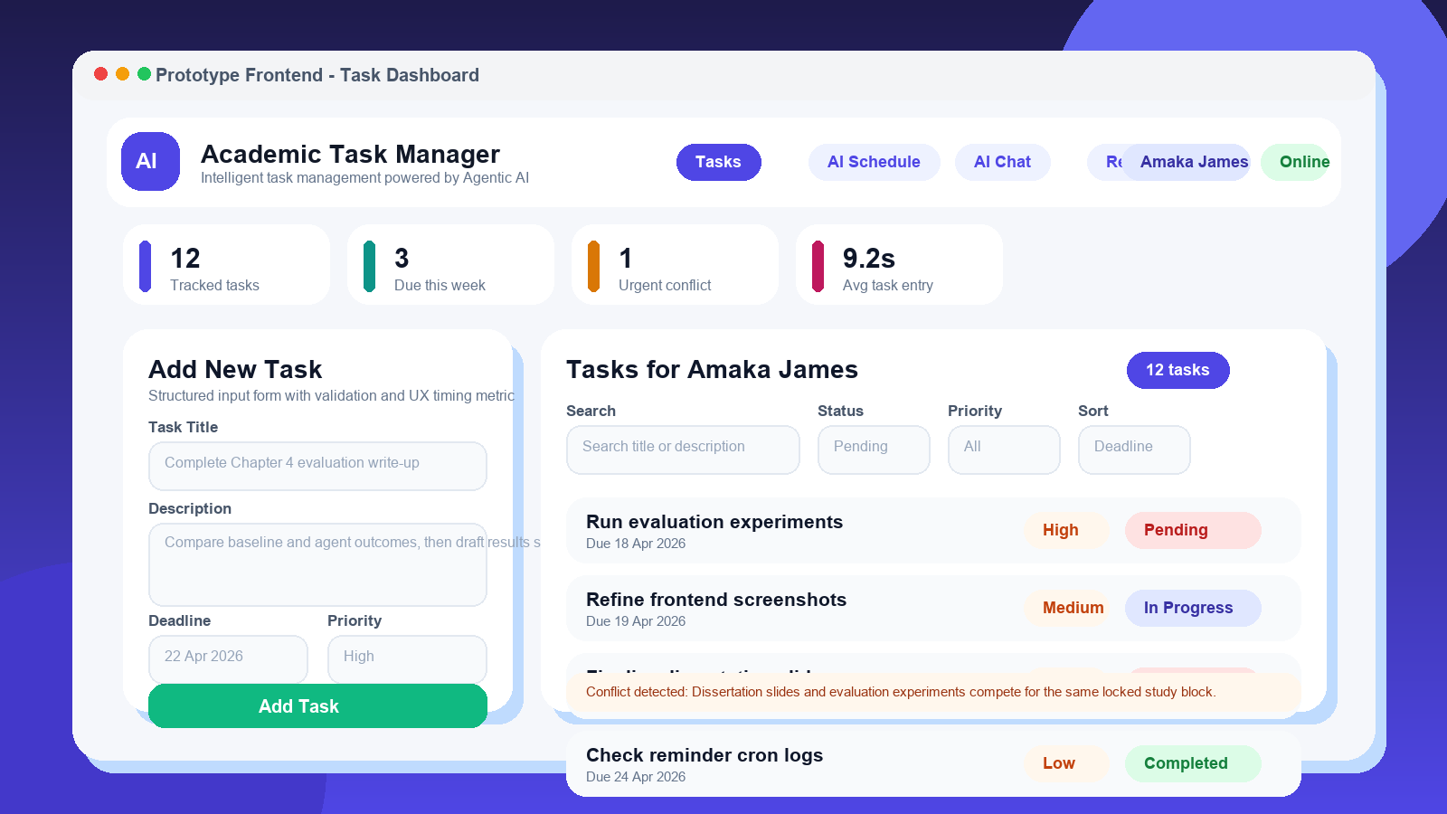
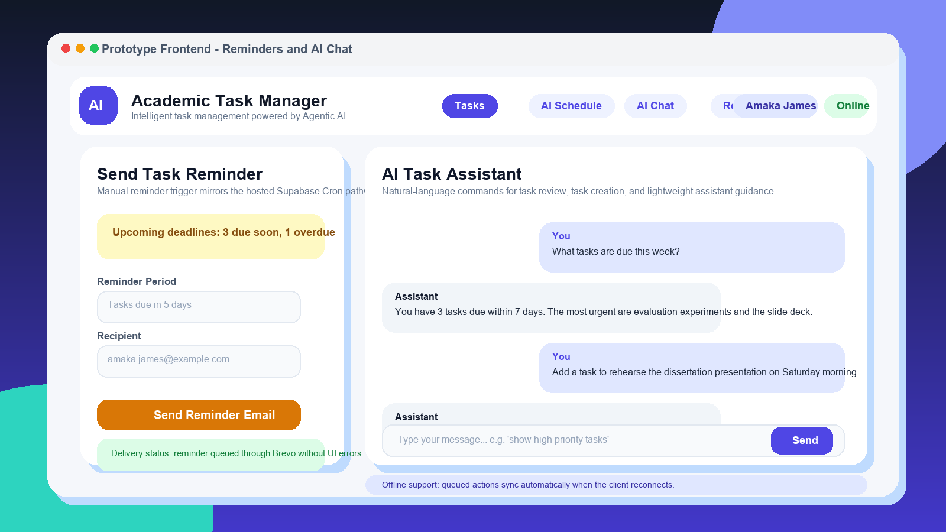
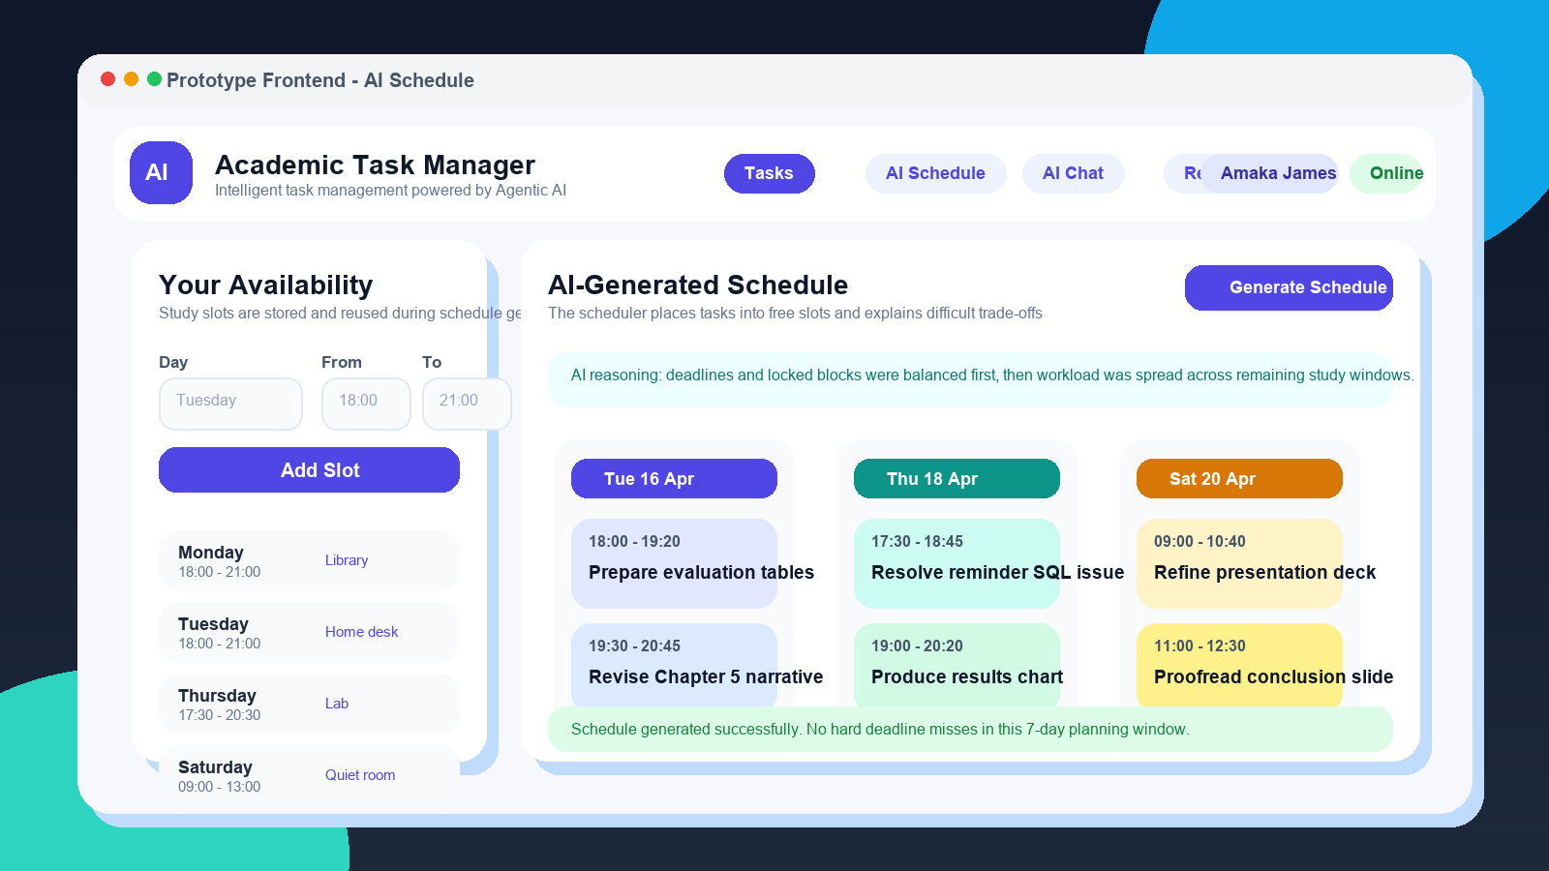
MSC DISSERTATION PROJECT
Agentic AI for Education
Design, implementation and evaluation of a learner-support system
• A working prototype that supports task capture, AI scheduling, replanning, reminders, and natural-language interaction.
• Evaluation framed around stable scheduling, dynamic change, and severe workload saturation rather than inflated claims.
• Presentation refreshed with interface visuals and a more dissertation-appropriate narrative structure.
Stack
Claim
React PWA, Flask, PostgreSQL, LangGraph, Supabase, Brevo
Active learner support is demonstrated, but optimisation limits remain visible.
1
Agentic AI for Education | MSc Dissertation Presentation

Slide 2
RESEARCH FRAMING
Problem, aim and research questions
Why passive study tools are not enough for a dissertation-level systems project
• Most academic productivity tools record tasks, but they do not actively schedule work, replan after disruption, or sustain follow-through.
• This project asks whether an agentic learner-support system can deliver dependable scheduling, adaptation, explanation, and proactive reminders.
• The dissertation contribution is the system as a whole: frontend, backend, orchestration logic, evaluation framework, and hosted reminder workflow.
Aim
Design and evaluate a learner-support system that does more than store deadlines: it should actively plan, adapt, and remind.
Research questions
RQ1: Can the system generate viable schedules? RQ2: Does agentic behaviour improve schedule quality over a baseline? RQ3: Can it adapt credibly when tasks or time windows change?
Why it is MSc-worthy
The work combines implementation, system integration, debugging, evaluation, and a bounded research claim rather than a simple CRUD application.
2
Agentic AI for Education | MSc Dissertation Presentation

Slide 3
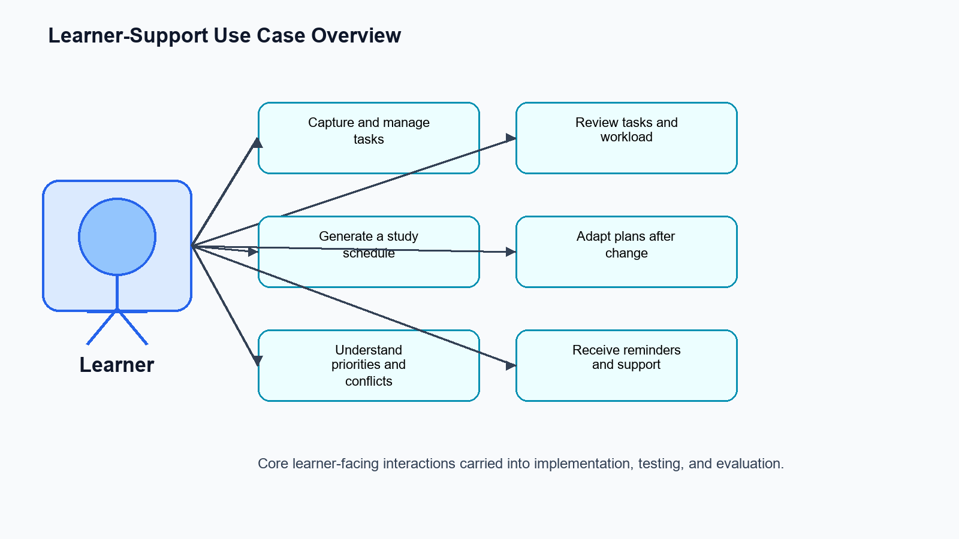
PROTOTYPE SCOPE
What was actually built
Core features are framed as system contributions, not marketing claims
Task capture
AI scheduling
Structured forms, validation, deadline tracking, filterable task views, and offline queue awareness.
Availability-aware schedule generation with reasoning, conflict visibility, and dynamic replanning triggers.
Natural-language support
Hosted reminders
Chat commands for task review, task creation, and lightweight assistant guidance inside the prototype.
Supabase Cron invokes an Edge Function that queries due tasks and delivers email through Brevo.
These features matter because they expose agentic behaviour in concrete user-facing workflows.
Use-case coverage keeps the talk grounded in what the system supports, not only how it is implemented.
3
Agentic AI for Education | MSc Dissertation Presentation

Slide 4
FRONTEND EVIDENCE
Prototype UI: task management dashboard
Adding interface visuals makes the deck substantially more credible for a dissertation presentation
Why keep this slide
Examiners can see that the work is implemented, not only described abstractly.
What the image shows
Task creation, filtering, priority cues, conflict surfacing, and user-state indicators.
Presentation tip
Talk through one realistic workflow: create task, inspect priority, then show how the system surfaces a scheduling issue.
4
Agentic AI for Education | MSc Dissertation Presentation

Slide 5
FRONTEND EVIDENCE
Prototype UI: scheduling, reminders and assistant support
These screens connect the UI to the dissertation claim about active learner support
Left: availability-aware schedule generation with reasoning and visible day-by-day slots.
Right: reminder dispatch controls, assistant conversation, and offline-safe UX cues.
Why it helps in the viva
Bounded claim
Key message
It demonstrates that the system supports planning, follow-through, and intervention, not just record-keeping.
These are prototype screenshots. The argument is implementation credibility, not production polish.
The frontend operationalises the research idea so the agentic behaviour is visible and testable.
5
Agentic AI for Education | MSc Dissertation Presentation

Slide 6
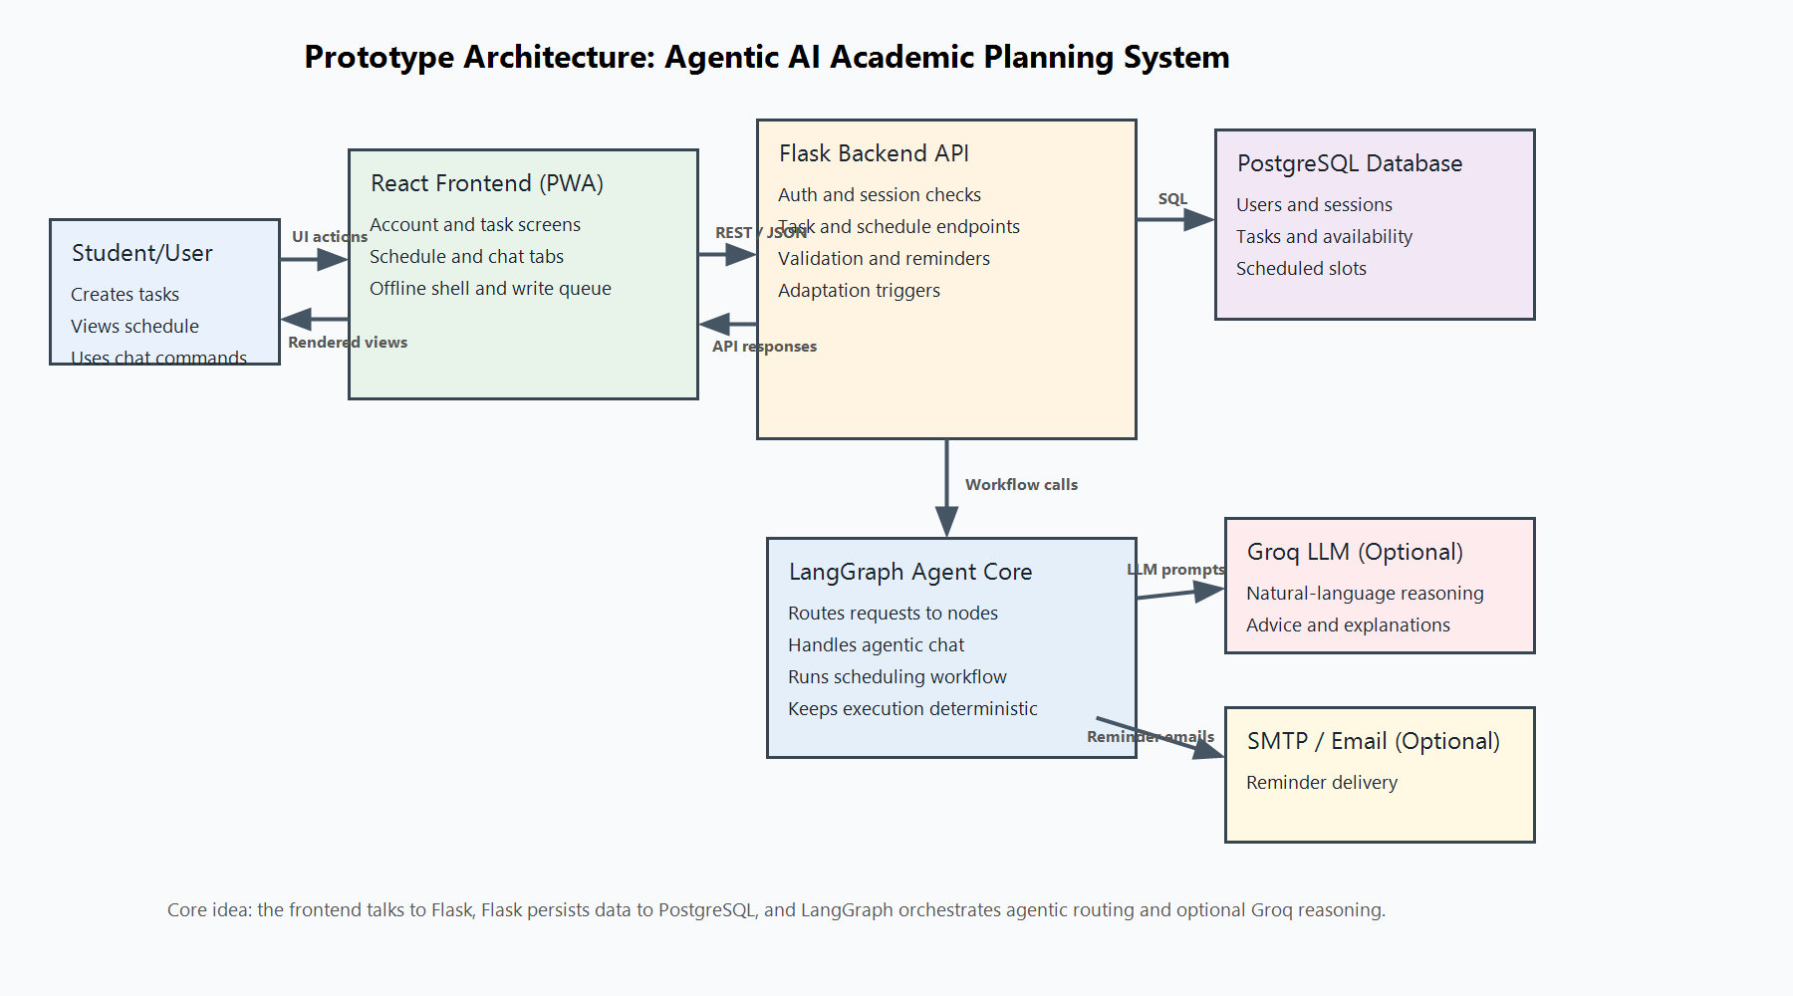
SYSTEM DESIGN
Architecture and integration story
Explain the software boundary clearly: client, backend logic, orchestration, and hosted services
Frontend
React PWA manages user interaction, session state, offline queue feedback, and feature tabs.
Backend
Flask routes requests to task operations, schedule generation, evaluation support, and conflict analysis.
Hosted path
Supabase stores operational data and executes the deadline-reminder Edge Function on a daily cron.
The architecture slide is stronger when you talk about why each boundary exists, not when you simply list technologies.
6
Agentic AI for Education | MSc Dissertation Presentation

Slide 7
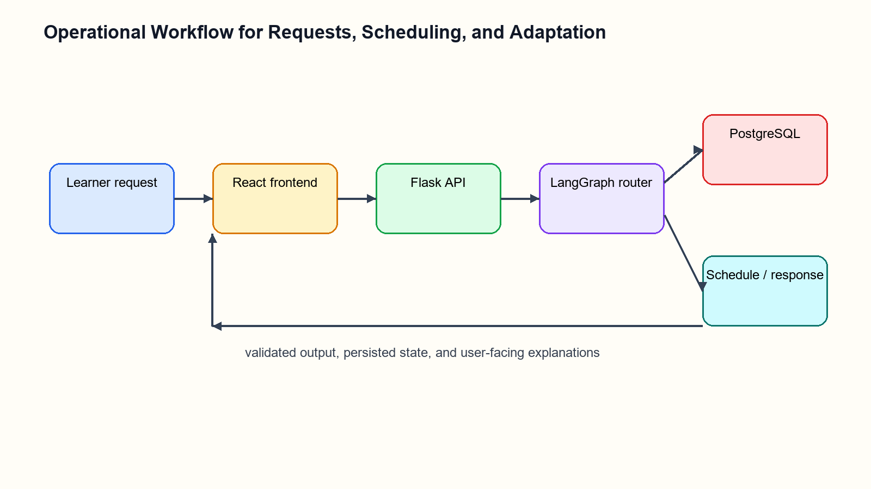
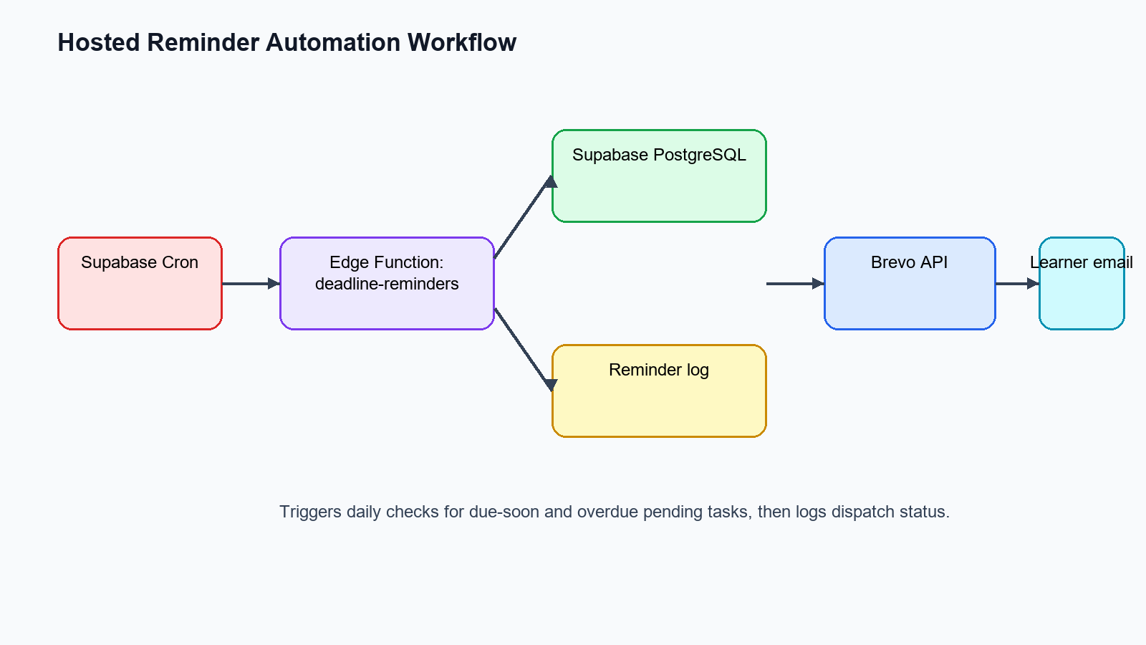
SYSTEM OPERATION
Operational workflow and hosted reminder automation
Two diagrams are enough here: one for request flow and one for proactive intervention
Request workflow: task input, scheduling logic, conflict analysis, and response generation.
Reminder workflow: Supabase Cron, Edge Function execution, overdue detection, and Brevo delivery.
Presentation tip
Use this slide to show that the reminder capability is not hypothetical. It exists as a hosted path with concrete failure diagnosis and logging.
7
Agentic AI for Education | MSc Dissertation Presentation

Slide 8
EVALUATION
Evaluation design and scenario coverage
The deck should show a disciplined evaluation method, not only screenshots and architecture
Scenario | Simulation | Purpose
A | Standard week | Baseline scheduling quality under ordinary workload
B | Deadline compression | Behaviour under clustered urgent deadlines
C | Disruption | Adaptation after time blocks are removed
D | Dynamic addition | Replanning when urgent new tasks arrive
E | Five-week project | Extended workload with visible saturation risk
Metrics
Generation time, conflict rate, deadline compliance, workload spread, adaptation speed, and efficiency.
Comparator
A rule-based earliest-deadline-first baseline scheduler provides a defensible reference point.
Why it matters
This evaluation design supports a bounded academic claim rather than vague statements about intelligence.
8
Agentic AI for Education | MSc Dissertation Presentation

Slide 9
EVALUATION
Results and dissertation claim
The key is to present evidence honestly: gains in some areas, limits in others
H1 speed: Not supported
The agent is slower than the baseline, so the dissertation should not claim raw performance superiority.
H2 schedule quality: Supported
Conflict handling improves modestly in the better scenarios, which supports a limited quality claim.
H3 adaptation: Supported
Dynamic-change scenarios provide the most defensible evidence for agentic behaviour.
Scenario A conflict rate: 34.0% baseline vs 31.0% agent
Defensible conclusion
Scenario D conflict rate: 30.0% baseline vs 28.2% agent
The prototype demonstrates active learner support, especially for replanning and user-facing intervention. Severe overload remains unresolved, with Scenario E compliance at 18.8%.
9
Agentic AI for Education | MSc Dissertation Presentation

Slide 10
REFLECTION
Limitations, critical reflection and next steps
This slide matters because dissertation presentations are judged partly on how honestly they handle limits
Current limitations
Method limits
Engineering reflection
The prototype is not a production planner. Scenario E exposes feasibility limits, and reminder logic depends on keeping hosted SQL aligned with intended behaviour.
The evaluation is simulation-based. A stronger future study would include real students, perceived usefulness, and sustained usage data.
Much of the value lies in integration, debugging, deployment, and test coverage across several moving parts.
• Add task decomposition and workload-feasibility warnings before trying to optimise every scenario.
• Expand observability around reminder dispatch, failure logging, and hosted environment drift.
• Refine interface polish later; the immediate academic value is in demonstrable behaviour and evaluation evidence.
Why the deck now works better
It no longer looks like a generic software demo. It now foregrounds research framing, interface evidence, architecture, evaluation, limitations, and a bounded conclusion.
10
Agentic AI for Education | MSc Dissertation Presentation

Slide 11
Closing Position
A credible MSc dissertation presentation should show both system substance and critical judgement.
Answer to your question
• The project produced a working learner-support prototype with scheduling, adaptation, reminders, and assistant features.
• The evidence is strongest in implementation depth, system integration, and bounded evaluation results.
• The right final claim is not 'perfect planner' but 'implemented and evaluated agentic learner-support system with visible strengths and visible limits'.
Before this refresh: not quite. With UI visuals, cleaner structure, Century Gothic body text, and stronger academic framing: much closer to something that can fly.
What to rehearse
Explain the contribution, then show one UI workflow, one architecture slide, one evaluation slide, and one limitation slide.
Questions
11
Agentic AI for Education | MSc Dissertation Presentation

