Slide 1

Welcome!
Code for Climate
Please sit in alphabetical order based on the letter you have received

Slide 2

Introductions Dr. Somesh Roy
Historian of soot

Slide 3

Introductions
Khaled Mosharraf Mukut, PhD Computational Combustion Lab (CCL) Marquette University
From Bangladesh
Curious to learn new things
Love travel and photography
Gets bored quick doing repetitive things

Slide 4
Now it’s your turn!
Tell us how you want us to call you
Tell us something – other than which school or grade you are in – about yourself. Maybe …
some interesting facts
what you did this summer
what’s your favorite food
something else, altogether!
Tell us of two things that start with the letter you received.
And, if you can and you’re comfortable, tell us why these two words popped up in your head?
Ask me something – anything!

Slide 5

Logistics
Will you have access to a computer / laptop at home?
Will you be able to do some homework each day?
Will you be able to install some stuff at the laptop/computer at home?

Slide 6

How well do you know your computer?
Can you find out the following for the laptop you are using?
OS version
RAM
Processor type and speed
ThePhoto by PhotoAuthor is licensed under CCYYSA.

Slide 7
Code for Climate
How can we help fight climate change via coding

Slide 8
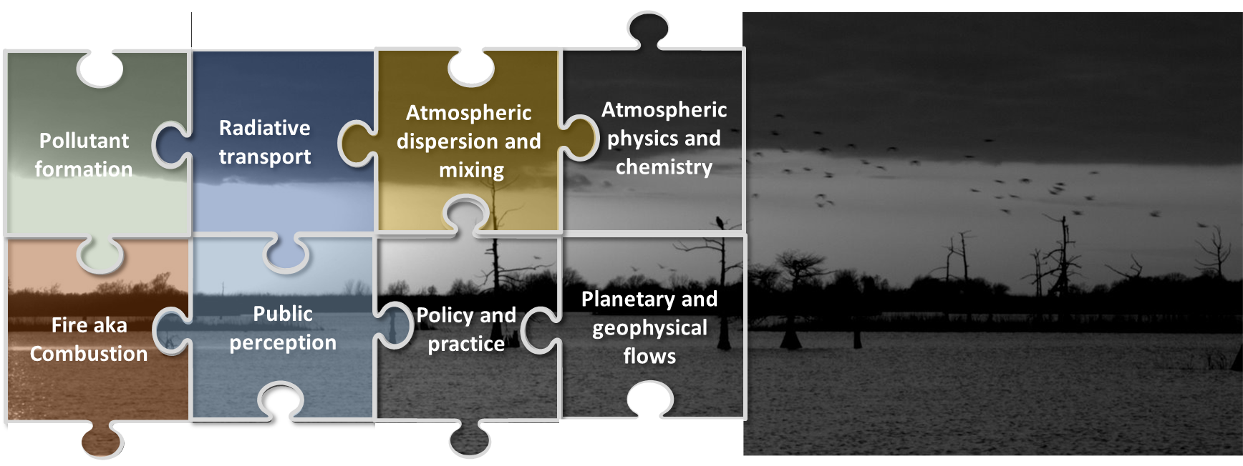
Climate is a big puzzle
It’s complex and multifaceted.

Slide 9
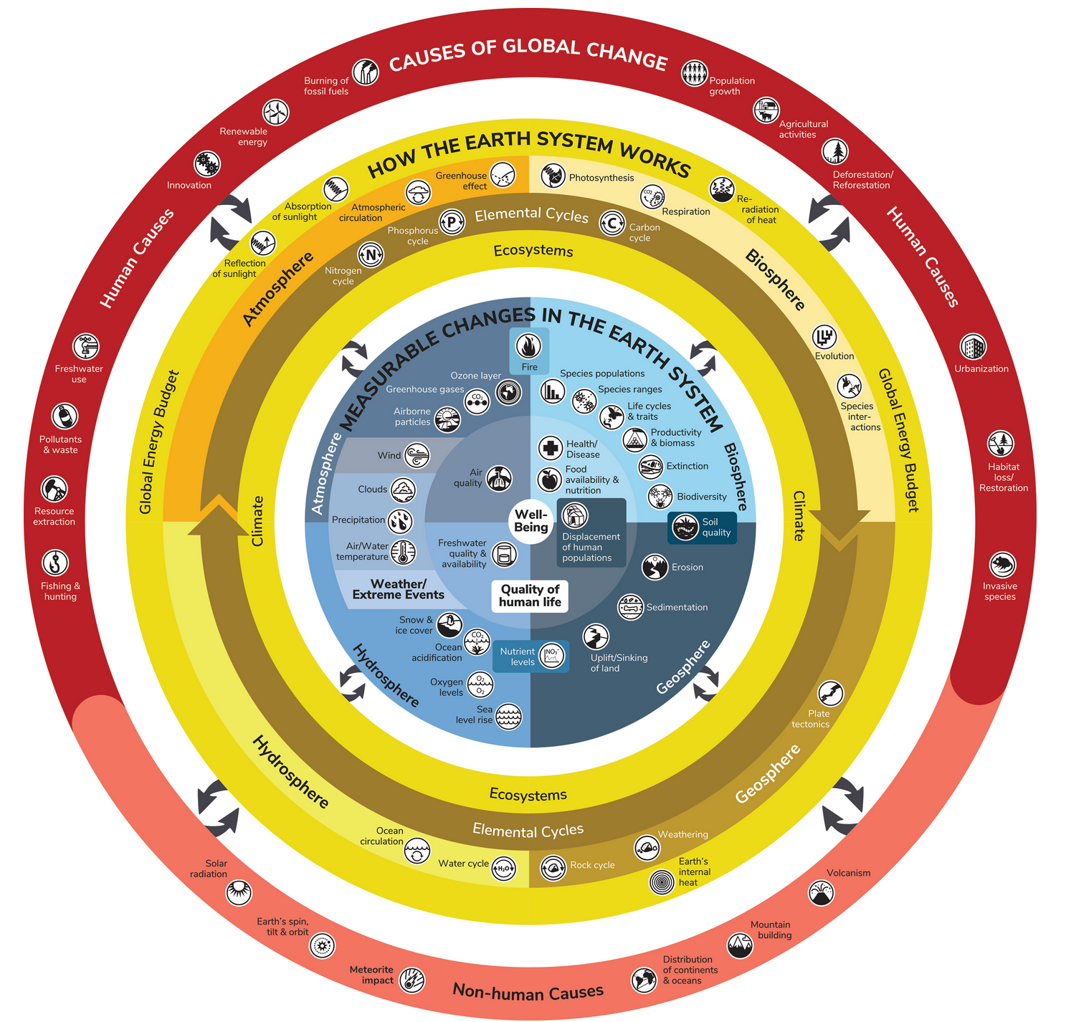
It affects our lives in many perceptible and imperceptible ways.
Some things such as health effects can be immediate
Other things such as loss of biodiversity is a slow process
https://ugc.berkeley.edu/what-is-global-change/infographic/

Slide 10


Air Quality Index (AQI)
6 Dec 1952, London at 2 pm
Definition
Units of Measure
Reporting
The AQI is an index used to indicate how polluted the air is in a certain location. It takes into account several air pollutants deemed harmful to human health.
AQI values range from 0 to 500. A low number means the air quality is good while a high number indicates serious health risks.
AQI is reported in real-time on environmental agencies' websites and apps, and it's usually color-coded to indicate how hazardous it is.

Slide 11
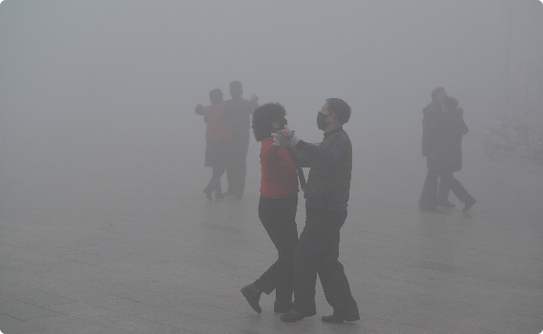

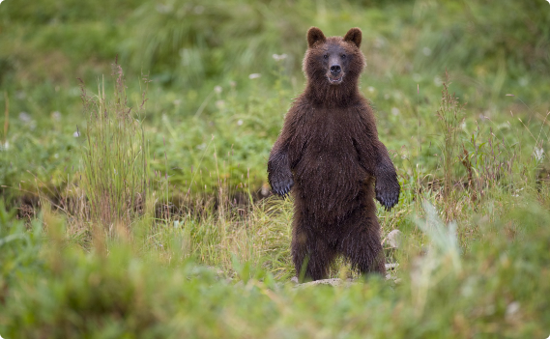
The Importance of AQI
Health
Economic
Environment
AQI is crucial to safeguarding public health as high AQI indicate polluted air and can cause respiratory diseases and other chronic illnesses.
AQI has an immense effect on economies, as polluted cities receive fewer tourists and have higher healthcare costs.
Although AQI is a metric based on public health, it’s connection to pollutants mean high AQI will harm the ecosystem and the climate.

Slide 12
The Common Air Pollutants
1
2
3
4
Carbon Monoxide
Particulate Matter
Nitrogen Dioxide
Ozone
A poisonous gas produced by cars and other vehicles that can cause headaches and dizziness when inhaled.
A mixture of tiny particles that can be inhaled, including dust, dirt, soot, and smoke that comes from fires.
A gas from burning fossil fuels that can harm the respiratory system and weaken the immune system.
A gas that can be harmful to people with respiratory problems in high concentrations. It's formed by a reaction between sunlight and certain pollutants.

Slide 13
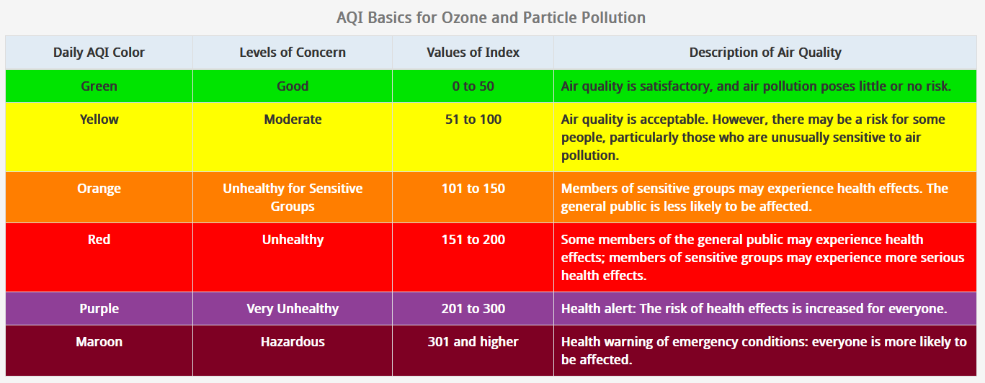

Slide 14
Responsibilities
Stay Informed
Take Action
Spread the Word
Be aware of AQI updates in your area and how they might impact your health and daily routine.
Take steps to reduce your personal contribution to air pollution, such as recycling, using public transport, and running your home energy efficiently.
Help raise awareness about AQI and its impact on human health and the environment.

Slide 15
At the end of this week
We will know something about air quality index and learn to visualize some real air quality data

Slide 16

Let’s take a break
Let’s reconvene in 10 minutes

Slide 17
Let’s shuffle: The anagram game
Look at the letter you have received. See what letters did others receive. Now, work as a group and re-seat yourself in a way that the letters are arranged in two words.
Hint: I am already sitting at an appropriate position with a letter already!

Slide 18

What is Coding?
Do you think there was any coding involved in the anagram game we played?

Slide 19

How computer programs work

Slide 20
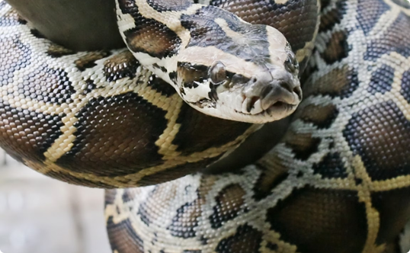
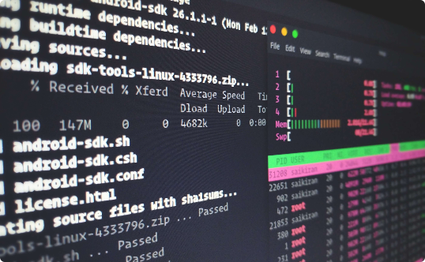
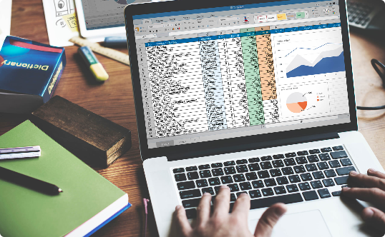
What is Python?
It’s not a snake 🐍
It's easy to learn 💻
It's versatile 🤹‍♀️
Python is a coding language used to create software, games, and websites.
Python has a simple vocabulary and is not bogged down with complex syntax. It’s easy for beginners to understand and use.
Python can be used for web development, game programming, data analysis and more.

Slide 21
Why Python is a Great Language for Beginners
Readability 📖
Simple Syntax 🤩
Community 😊
Python is easy to read and understand, making it accessible to beginners.
Python’s syntax is clean and straightforward, with fewer rules than other languages.
The Python community is supportive and welcoming to new learners. There are forums, blogs, and free resources available.

Slide 22
Running locally or remotely?
What is Google Colab?

Slide 23
What is Google Colab?
Colab, or ‘Colaboratory’, allows you to write and execute Python in your browser, with
Zero setup required
Easily share your code with others
You can also install python locally on your computer. However, we would not be exploring that option in this summer school.
Colab FAQ

Slide 24
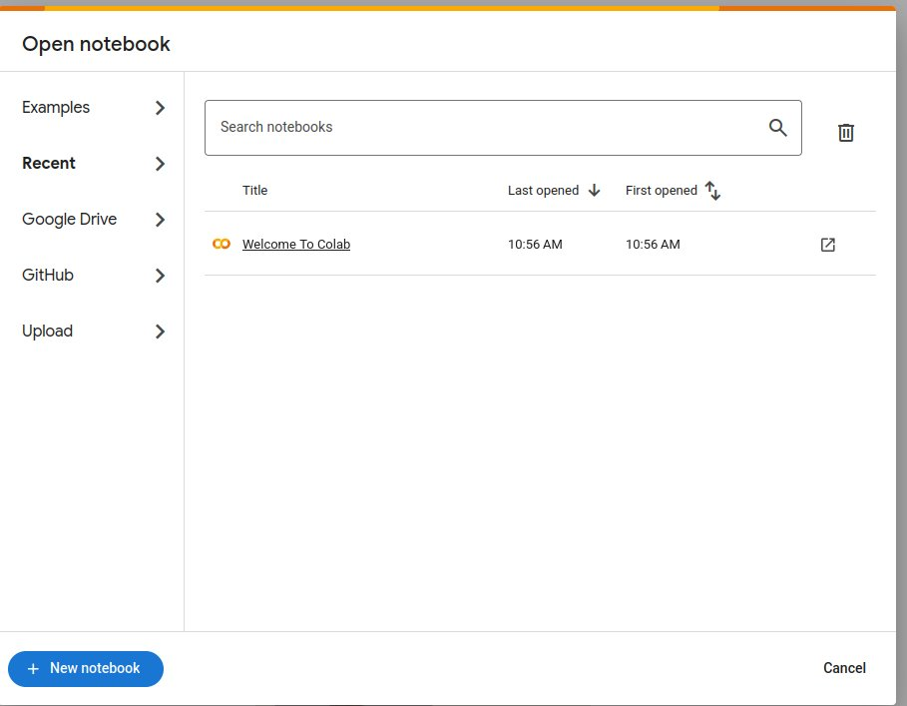
Getting started with Google colab
Go to Google colab workspace
Sign in with your Google account.
Use an existing google account if possible
Create a new Notebook
Click on the ‘New Notebook’ button in the bottom left of the popup

Slide 25
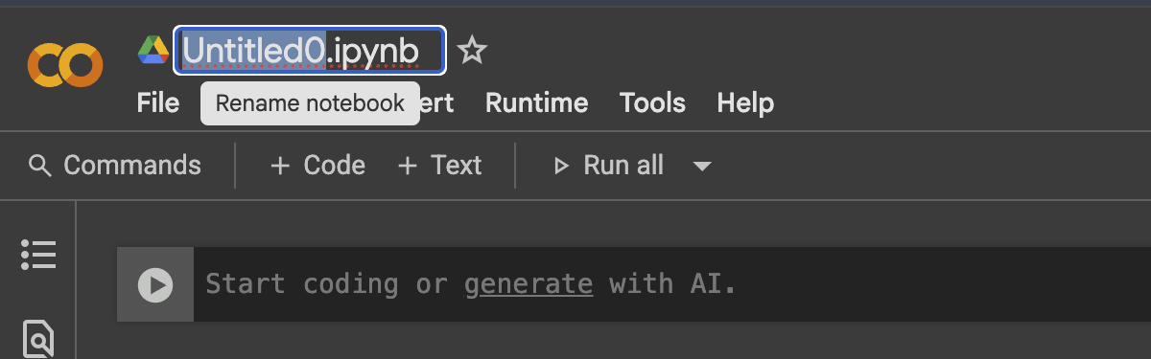
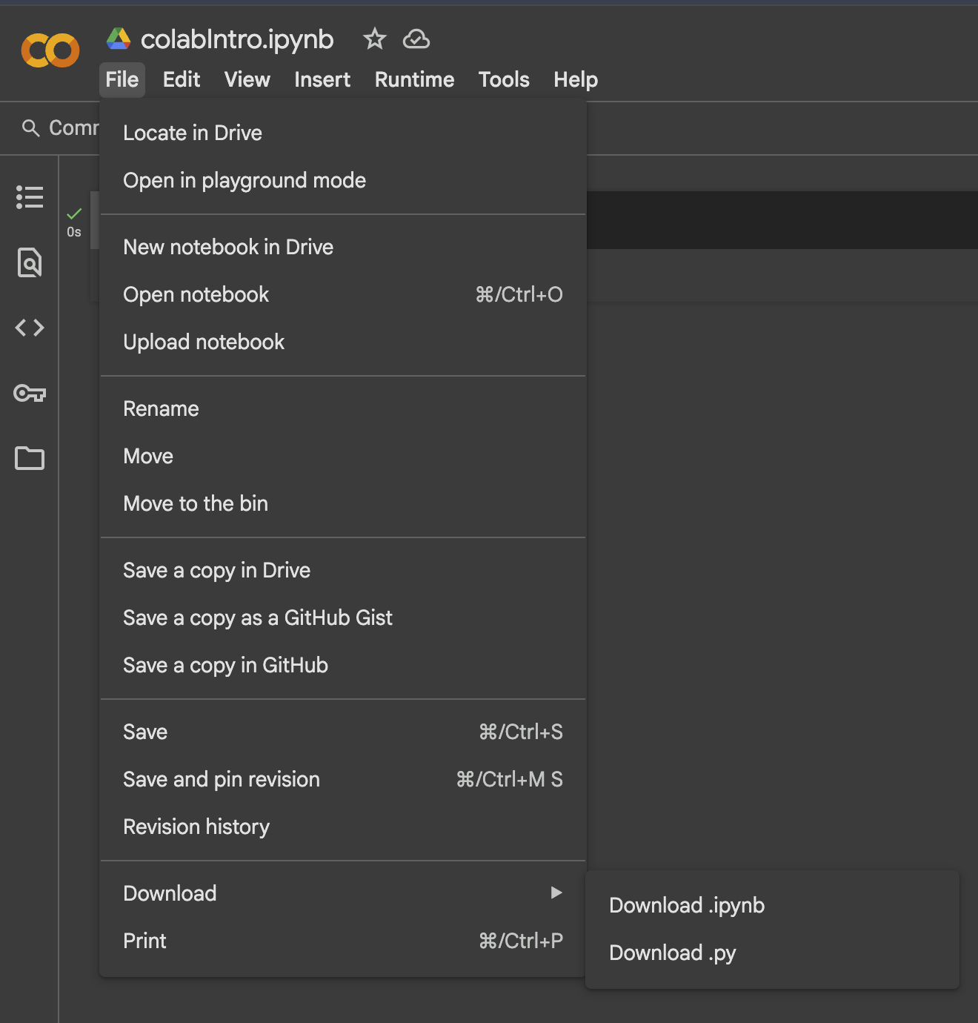
File Management
Save your files with easy intuitive names.
e.g colabIntro.ipynb
Save your notebooks to google drive
If you open a new notebook in drive, It automatically saves to your drive.
File > Save a copy in Drive
Download your notebooks
File > Download > Download .ipynb

Slide 26
Working with other notebooks
Import other notebooks
Clicking directly on the link for each notebook
Provide link

Slide 27
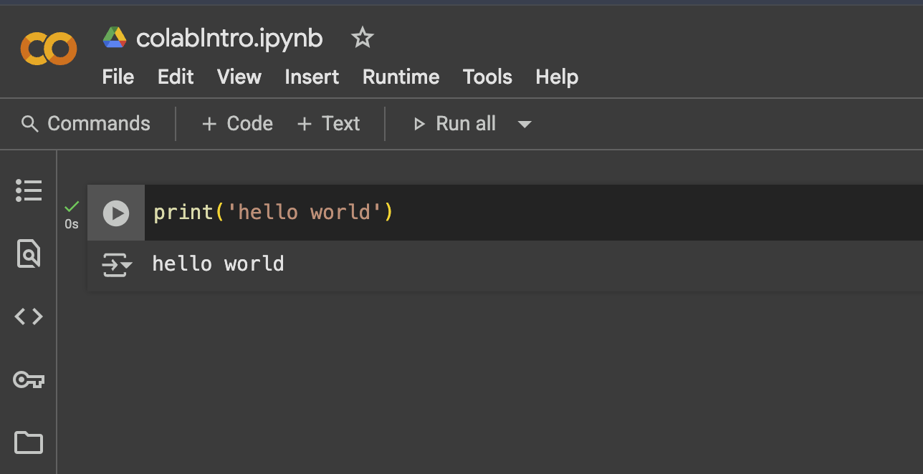
Hello, World!
Create a new notebook
Type
print(‘hello world’)
Click play
Now modify the code to add your name, like
Hello, World!
This is <your-name>

Slide 28
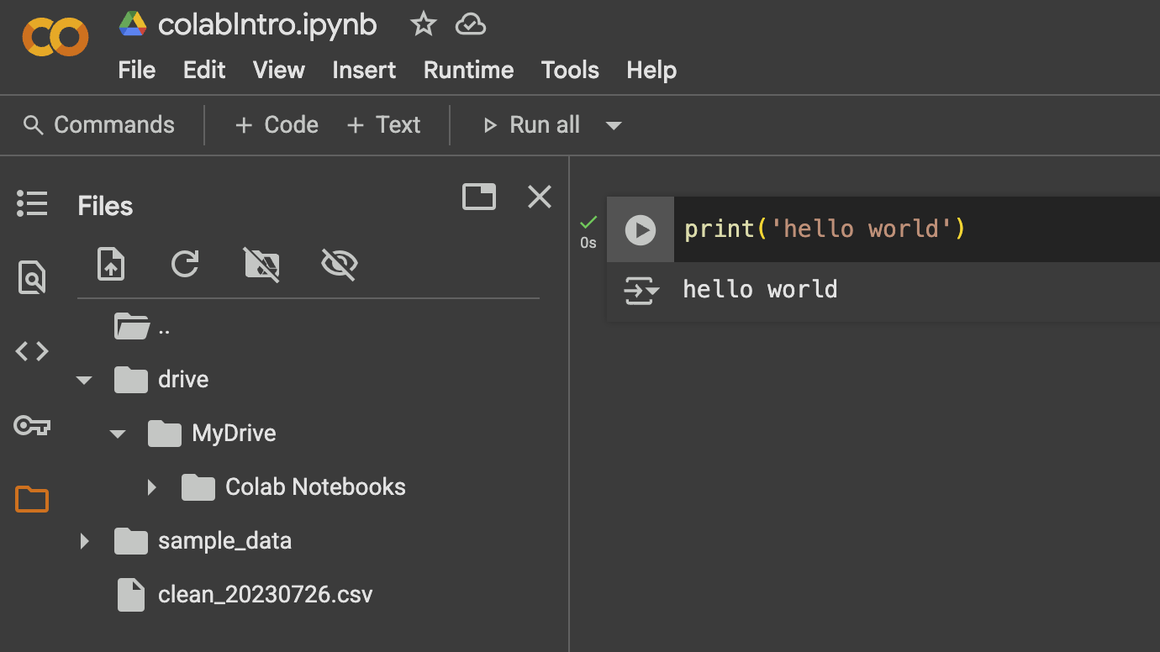
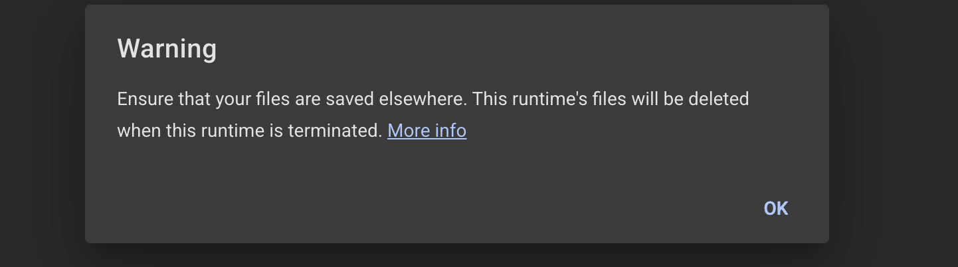
Working with External files
Import files to session storage
Files get deleted when runtime is terminated
Mount Google Drive

Slide 29
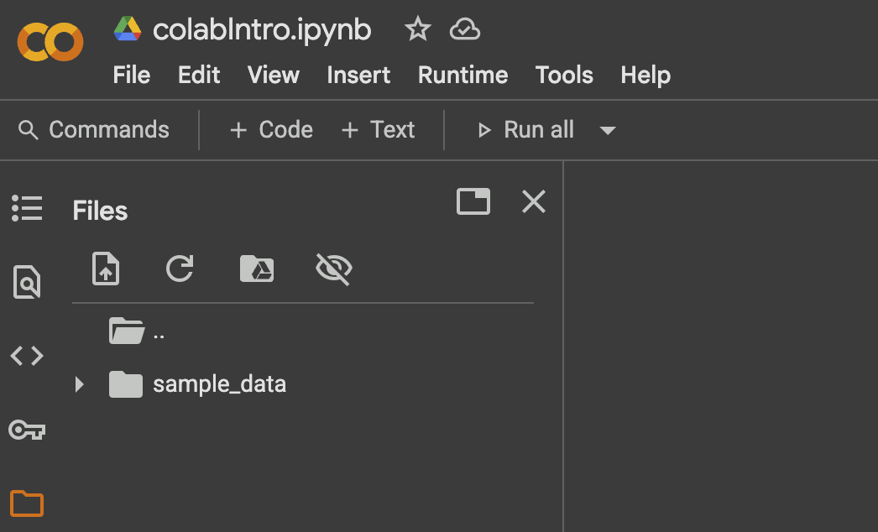
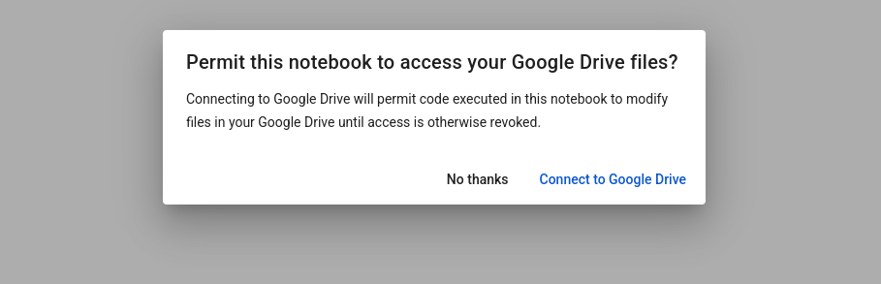
Connect to Google Drive
2
Easily access files
Prevent losing files on runtime disconnection
Best Practice for external files
Connect Google Drive
Add path to the file in your google drive.
1
3

Slide 30
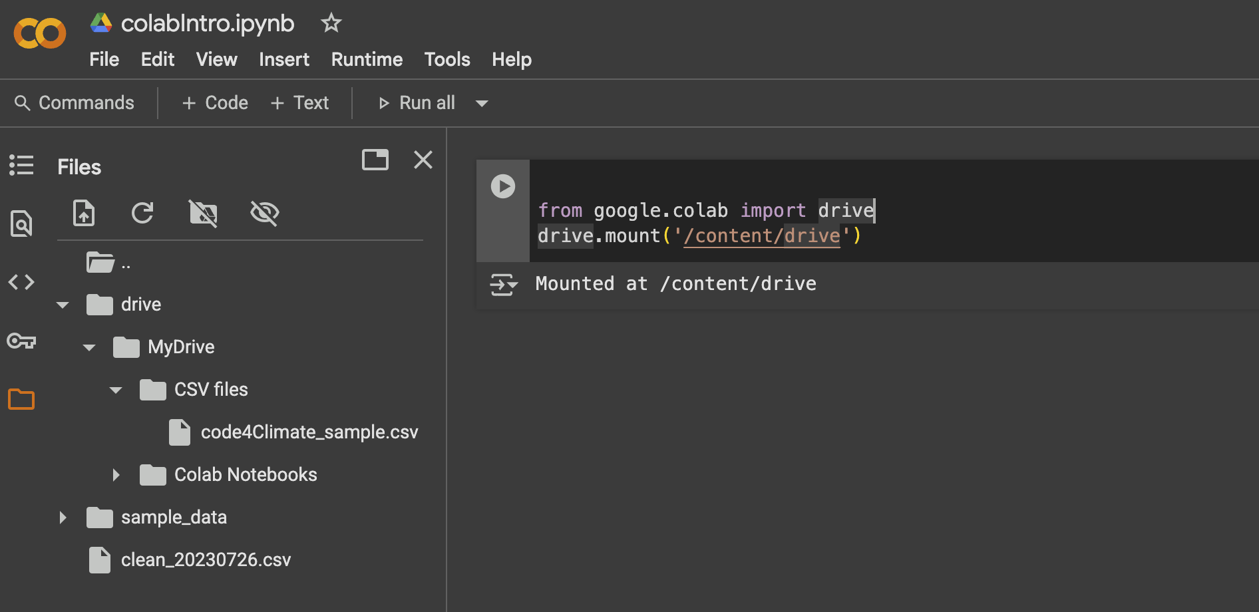
Connect Google drive using code
Best Practice for external files
Connect Google Drive
Add path to the file in your google drive.
from google.colab import drive
drive.mount('/content/drive’)

Slide 31
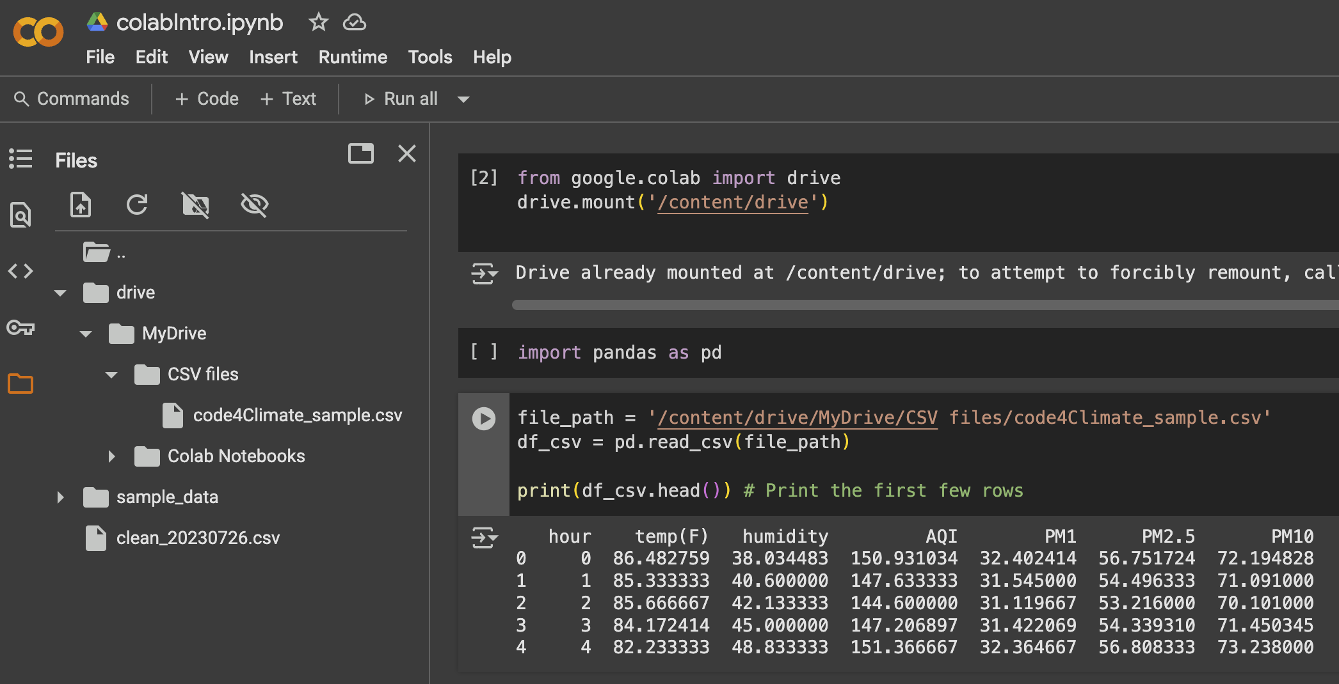
Working with External files
Import files to session
Files get deleted when runtime is terminated
Best Practice
Connect Google Drive
Add path to the file in your google drive.
from google.colab import drive
drive.mount('/content/drive’)
file_path = '/content/drive/MyDrive/path\to\folder’
Import pandas as pd
df_csv = pd.read_csv(file_path) print(df_csv.head()) # Print the first few rows

Slide 32

Let’s play a game
We need some words!

Slide 33

Now is your chance to create your mad libs game
Follow the instruction given on the paper.

Slide 34

Save your work
Save your work and commit it to git
Finally push this to your forked repo
Note: You will have to add a comment to indicate why you pushed this commit

Slide 35
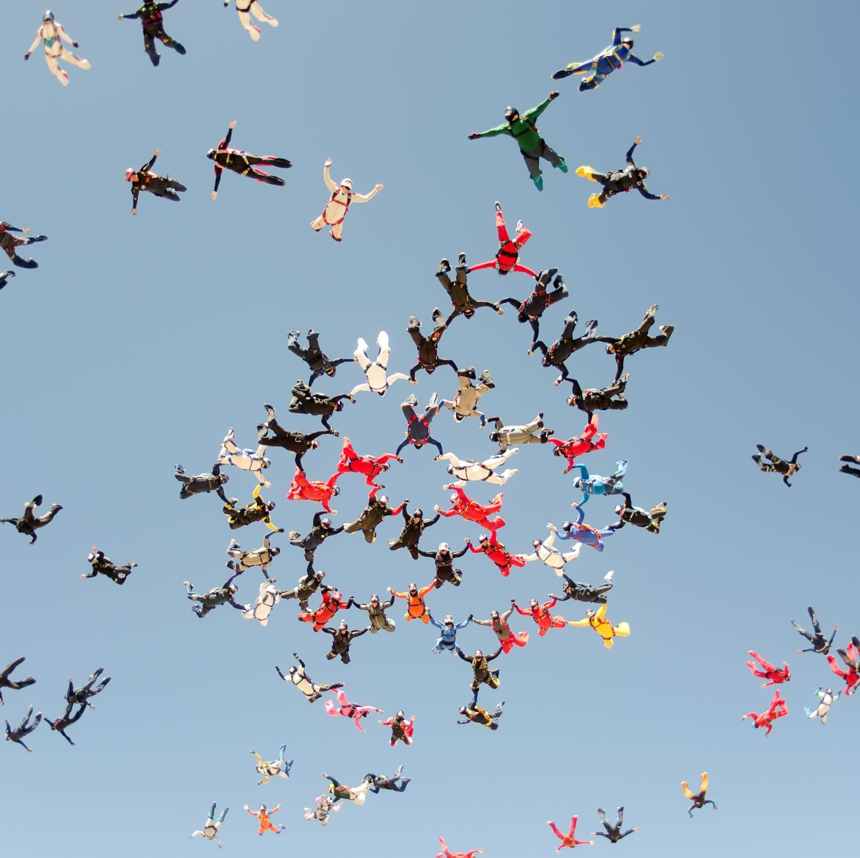
Closure
We learned a bit about git and github
We accessed and navigated through a git repository
We learned a bit about air quality index
We wrote a couple of Python programs
And, we made some new friends!

Slide 36

Coming up…
Share your experience with installation or attempt to write some new Python code in the forum
Tomorrow we will delve into the structure of Python codes

