Slide 1
Telecom Customer Churn Prediction & Analysis
By Shem Omondi

Slide 2
Business Problem
Overview
Customer churn is costly and retaining is cheaper than acquiring.
SyriaTel needs to identify at‑risk customers before they leave.
Goal: Predict churn risk and guide targeted retention campaigns by building models.

Slide 3
Data understanding
Historical customer records of about 3,300 rows.
Some features included:
Customer demographics (state, area code).
Service plans (international plan, voicemail plan).
Usage patterns (day, evening, night, international minutes & calls).
Customer service interactions (number of service calls).
Target variable: Churn (whether the customer left or stayed).

Slide 4
Modeling
We built 3 models to try and capture the relationships In the dataset:
Logistic regression model which acts as a baseline for comparison.
Untuned decision tree classifier: decision trees capture nonlinear relationships better.
Tuned decision tree classifier: To reduce overfitting.

Slide 5
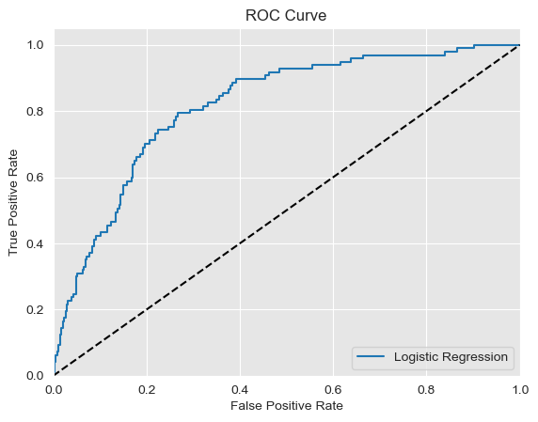

Slide 6
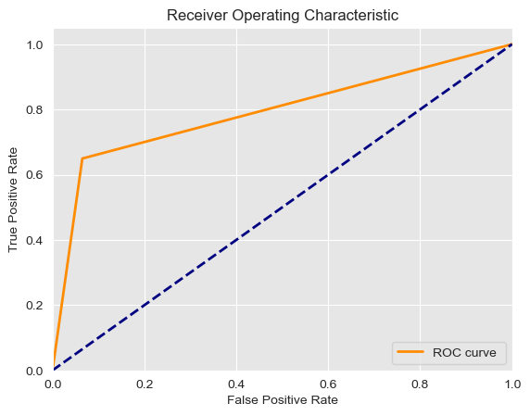

Slide 7
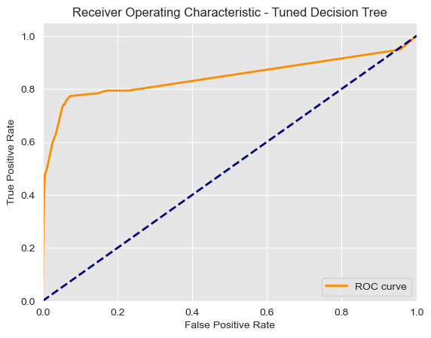

Slide 8
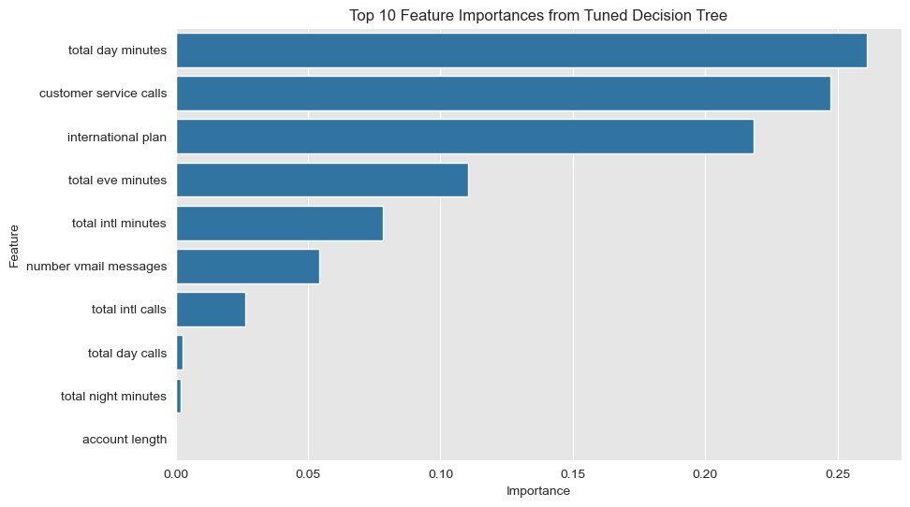

Slide 9
Model Evaluation
Results:
Logistic Regression: caught around 7 of 10 churners, but flagged many who did not churn as churners.
Decision Tree (untuned): moderate performance.
Tuned Decision Tree: best balance since it catches 3 of 4 churners, around 7 of 10 flagged are true churners.

Slide 10
Recommendations
Offer loyalty bundles to international plan users.
Improve customer support for repeated customer service callers.
Proactively recommend plans for heavy day users.

Slide 11
Next Steps
Deploy the tuned decision model for operation.
Retrain the model with recent data to adjust to current markets.

Slide 12
THANK YOU!

