Slide 1
CloudDrop
Our Team
Samuel Ayodele Olukayode
Secure Cloud-Based File Storage
and Sharing Using AWS
CLC/2026/TC-8/0151
Adewuyi Eunice Aduramigba
CLC/2026/TC-8/0187
Oladayo Temitope Lawal
Store, access, manage and share files securely through cloud infrastructure.
CLC/2026/TC-8/0181
Jeremiah Bioseh
CLC/2026/TC-8/0179
TechCrush Cohort 8, Group 3
Kizito Nnamdi Ugwu
CLC/2026/TC-8/0234
Capstone Presentation
Ife Abraham Omoniyi (Team Lead)
CLC/2026/TC-8/0008
Live: https://clouddrop-c8.duckdns.org
GitHub: https://github.com/OmoniyiIfeAbraham/CLOUDDROP
Notes:
Target speaking time: 30 seconds.
Introduce CloudDrop and TechCrush Cohort 8, Group 3. The application gives users a private workspace to upload, retrieve, manage and temporarily share files. Mention the team lead and acknowledge the six contributors. Point to the live application and repository. Total prepared speaking time across 11 slides is 8 minutes 20 seconds, excluding an extended live demonstration.
Sources:
https://github.com/OmoniyiIfeAbraham/CLOUDDROP
https://clouddrop-c8.duckdns.org

Slide 2
Why CloudDrop?
Device loss or failure can put local files at risk.
Sharing files securely can be inconvenient.
Users need access to their files across devices.
Shared access should expire when it is no longer needed.
Project objective
Build and deploy a working AWS application for secure file management and temporary sharing.
A personal workspace with controlled access
02
Notes:
Target speaking time: 40 seconds.
Explain the four practical problems. A device can fail or disappear, while sending an unrestricted permanent link makes access difficult to control. CloudDrop moves storage into cloud infrastructure and provides a private workspace with expiring sharing. The goal was a working application and deployment, not simply an infrastructure diagram.
Sources:
C:/Users/DELL/Documents/clouddrop/docs/REQUIREMENTS.md
C:/Users/DELL/Documents/clouddrop/backend/src/lib/share-policy.ts

Slide 3
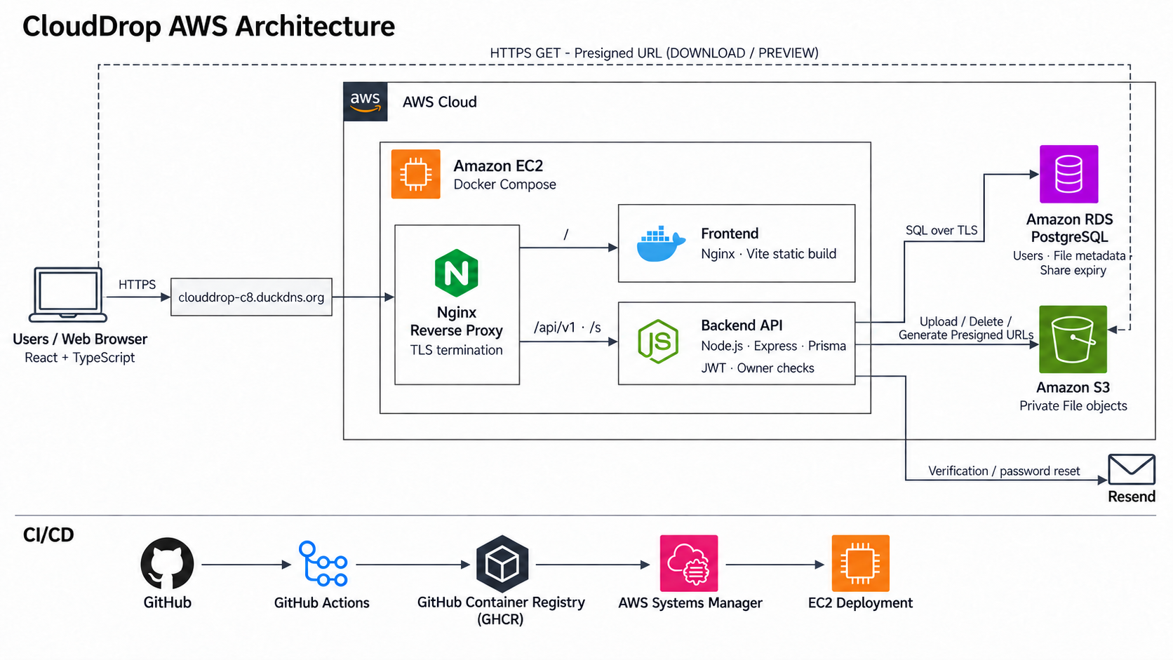
Notes:
Target speaking time: 90 seconds.
How CloudDrop works. Start at the browser: HTTPS reaches the DuckDNS domain and the edge Nginx container on EC2. Nginx serves the application through the frontend container and sends /api/v1 and /s requests to the Express backend. The React application executes in the browser. PostgreSQL on RDS stores users, file metadata and share expiry. S3 stores the actual file bytes. The backend validates JWTs and file ownership, uploads or deletes objects, and signs temporary retrieval URLs. The browser then fetches download or preview content directly from S3 using HTTPS. Presigning happens locally in the backend using AWS credentials; it is not an extra S3 network request. The supplied diagram combines that responsibility in its backend-to-S3 label. Public share-token resolution checks PostgreSQL expiry before redirecting to a short-lived S3 URL. Resend handles verification and reset emails. GitHub Actions, GHCR and SSM form the operational deployment path. The diagram reflects repository configuration, while effective IAM and network settings need AWS verification.
Sources:
C:/Users/DELL/Documents/clouddrop/docs/architecture/clouddrop-aws-slide-v4.png
C:/Users/DELL/Documents/clouddrop/docker-compose.prod.yml
C:/Users/DELL/Documents/clouddrop/nginx/default.conf
C:/Users/DELL/Documents/clouddrop/backend/src/server.ts
C:/Users/DELL/Documents/clouddrop/backend/src/controllers/files.controller.ts
C:/Users/DELL/Documents/clouddrop/backend/src/services/s3-download.service.ts
C:/Users/DELL/Documents/clouddrop/backend/src/services/auth.service.ts
C:/Users/DELL/Documents/clouddrop/.github/workflows/deploy.yml

Slide 4
Technologies Powering CloudDrop
Layer | Technology
Frontend | React, Vite, TypeScript
Backend | Node.js, Express, TypeScript
Database | PostgreSQL, Prisma
Cloud | AWS EC2, RDS, S3
Infrastructure | Docker, Nginx
CI/CD | GitHub Actions, GHCR
Email | Resend
Why this stack?
TypeScript supports consistent application contracts.
AWS separates compute, metadata and file storage.
Containers and CI make releases repeatable.
04
Notes:
Target speaking time: 40 seconds.
React and Vite provide the browser interface and static production build. TypeScript is used across both applications. Express provides the API, while Prisma maps application operations to PostgreSQL. EC2 hosts containers, RDS manages the relational database, and S3 stores file objects. Docker standardizes runtime packaging; Nginx handles routing and HTTPS. GitHub Actions and GHCR automate validation and image publishing. Resend supplies transactional email. These are practical reasons the stack fits the project, not an assertion that alternative technologies were formally benchmarked.
Sources:
C:/Users/DELL/Documents/clouddrop/frontend/package.json
C:/Users/DELL/Documents/clouddrop/backend/package.json
C:/Users/DELL/Documents/clouddrop/frontend/Dockerfile
C:/Users/DELL/Documents/clouddrop/backend/Dockerfile
C:/Users/DELL/Documents/clouddrop/docker-compose.prod.yml
C:/Users/DELL/Documents/clouddrop/backend/src/services/email.service.ts

Slide 5
From Code to Cloud
GitHub
GitHub Actions
GHCR
Deployment
Amazon EC2
Code and pull requests
Validate and test
Build and publish images
AWS SSM Run Command
Docker Compose release
Automatic deployment on main
Both backend and frontend CI must pass for the same commit before deployment selects matching image tags.
Manual deployment with selected image tags is also available.
05
Notes:
Target speaking time: 50 seconds.
Changes enter GitHub through team branches and pull requests. Backend CI installs dependencies, generates Prisma, migrates a PostgreSQL test database, builds and tests the API, then builds images. Frontend CI checks types and lint, runs unit tests, builds the app and exercises browser suites. Main publishes frontend and backend Docker images to GitHub Container Registry with commit-SHA and latest tags. The current deployment workflow is automatic on successful workflow completion for main, and the resolver checks that both workflows succeeded for the same SHA before using matching images. A merge produces the main push that runs these workflows. GitHub uses OIDC to assume an AWS deployment role, and Systems Manager runs scripts on EC2. Manual dispatch remains available and can select tags independently. This confirms configured automation, not the success of a particular production run.
Sources:
C:/Users/DELL/Documents/clouddrop/.github/workflows/ci.yml
C:/Users/DELL/Documents/clouddrop/.github/workflows/frontend.yml
C:/Users/DELL/Documents/clouddrop/.github/workflows/deploy.yml
C:/Users/DELL/Documents/clouddrop/scripts/deploy.sh
C:/Users/DELL/Documents/clouddrop/scripts/verify-deployment.sh

Slide 6
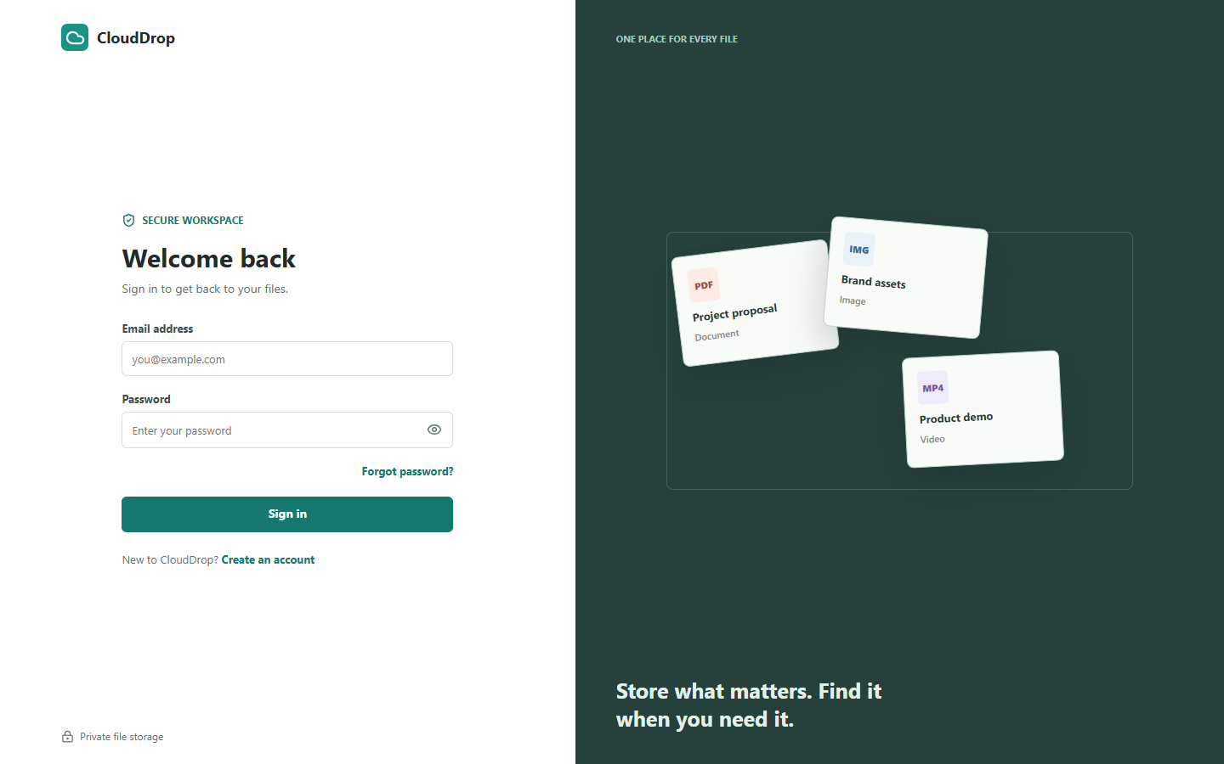
Deploying CloudDrop on AWS
01
Provision EC2, RDS and S3
02
Configure database and storage access
03
Containerize frontend and backend
04
Configure Nginx and HTTPS
05
Connect the DuckDNS domain
06
Verify the application and core flows
Deployed website, HTTPS login page
Captured 16 October 2026
06
Notes:
Target speaking time: 50 seconds.
Describe the implementation sequence shown here. The team provisioned the AWS resources and configured application access. The frontend and backend run as Docker images, with edge Nginx terminating HTTPS and routing requests. DuckDNS provides the public hostname. This screenshot is a fresh capture of the real public login page: HTTP 200 at https://clouddrop-c8.duckdns.org/login on 16 October 2026. The existing project QA report records core-workflow testing and earlier release mismatches. The current workflow pulls images into an existing EC2 checkout; it does not automatically synchronize host configuration or run production Prisma migrations. Confirm these operational steps separately when preparing a release. The screenshot proves public login availability, not successful authentication or every current cloud setting.
Sources:
C:/Users/DELL/Documents/clouddrop/docs/aws-infrastructure.md
C:/Users/DELL/Documents/clouddrop/docs/DEPLOYMENT.md
C:/Users/DELL/Documents/clouddrop/docker-compose.prod.yml
C:/Users/DELL/Documents/clouddrop/nginx/default.conf
C:/Users/DELL/Documents/clouddrop/scripts/deploy.sh
C:/Users/DELL/Documents/clouddrop/frontend/docs/final-qa-report.md
https://clouddrop-c8.duckdns.org/login

Slide 7
Challenges We Faced
AWS access
Aligning EC2, RDS and S3 access permissions
Configuration
Coordinating environment variables and email delivery
API coordination
Keeping frontend and backend response contracts aligned
File behavior
Separating preview from download across browsers
Deployment
Diagnosing image, proxy and release mismatches
Team integration
Combining contributions and resolving merge conflicts
07
Notes:
Target speaking time: 40 seconds.
Present these as specific project engineering issues. AWS access depends on both service permissions and network configuration. The application also needs consistent database, JWT, email and public URL settings. Frontend and backend contracts needed coordination for file categories, branded short links and URL response fields. The QA report reproduced preview/download header issues, Unicode filename problems and an older deployed frontend. Deployment troubleshooting involved image versions and Nginx routing. Git history contains merged contributions and merge-conflict work across the team. Avoid implying that every historical failure remains in current source or that all infrastructure settings were independently verified today.
Sources:
C:/Users/DELL/Documents/clouddrop/frontend/docs/final-qa-report.md
C:/Users/DELL/Documents/clouddrop/frontend/docs/backend-download-handoff.md
C:/Users/DELL/Documents/clouddrop/frontend/docs/backend-short-links-handoff.md
C:/Users/DELL/Documents/clouddrop/docs/DEVOPS-WORKFLOW.md
C:/Users/DELL/Documents/clouddrop/.github/workflows/deploy.yml
C:/Users/DELL/Documents/clouddrop/backend/src/services/auth.service.ts

Slide 8
How We Solved the Challenges
Challenge
Solution implemented
Service access and configuration
AWS access setup and server environment configuration
Different runtime environments
Docker images and a shared Compose deployment
Frontend/backend mismatches
Defined API contracts and integration checks
File access and browser behavior
JWT ownership checks and signed retrieval URLs
Release and team integration
Automated tests, pull-request reviews and deployment checks
08
Notes:
Target speaking time: 40 seconds.
Connect each engineering challenge to the corresponding implementation. The team configured AWS access and application settings, packaged both services with Docker and coordinated API response contracts. The backend makes authorization decisions and signs URLs for private file retrieval. Testing covers owner isolation, validation, file links, share policy and browser download behavior. Pull requests and CI provide review and integration checkpoints. Deployment scripts pull both images before replacing containers, check health and validate Nginx configuration. These measures improve consistency; the current script still has limitations such as no production migration step and manual backend-only rollback. Do not claim full automatic rollback or infrastructure policy enforcement from this slide.
Sources:
C:/Users/DELL/Documents/clouddrop/docker-compose.prod.yml
C:/Users/DELL/Documents/clouddrop/scripts/deploy.sh
C:/Users/DELL/Documents/clouddrop/backend/src/middleware/auth.middleware.ts
C:/Users/DELL/Documents/clouddrop/backend/src/services/file.service.ts
C:/Users/DELL/Documents/clouddrop/backend/src/controllers/files.controller.ts
C:/Users/DELL/Documents/clouddrop/backend/tests/access-control.test.ts
C:/Users/DELL/Documents/clouddrop/backend/tests/share-policy.test.ts
C:/Users/DELL/Documents/clouddrop/.github/workflows/ci.yml
C:/Users/DELL/Documents/clouddrop/.github/workflows/frontend.yml

Slide 9
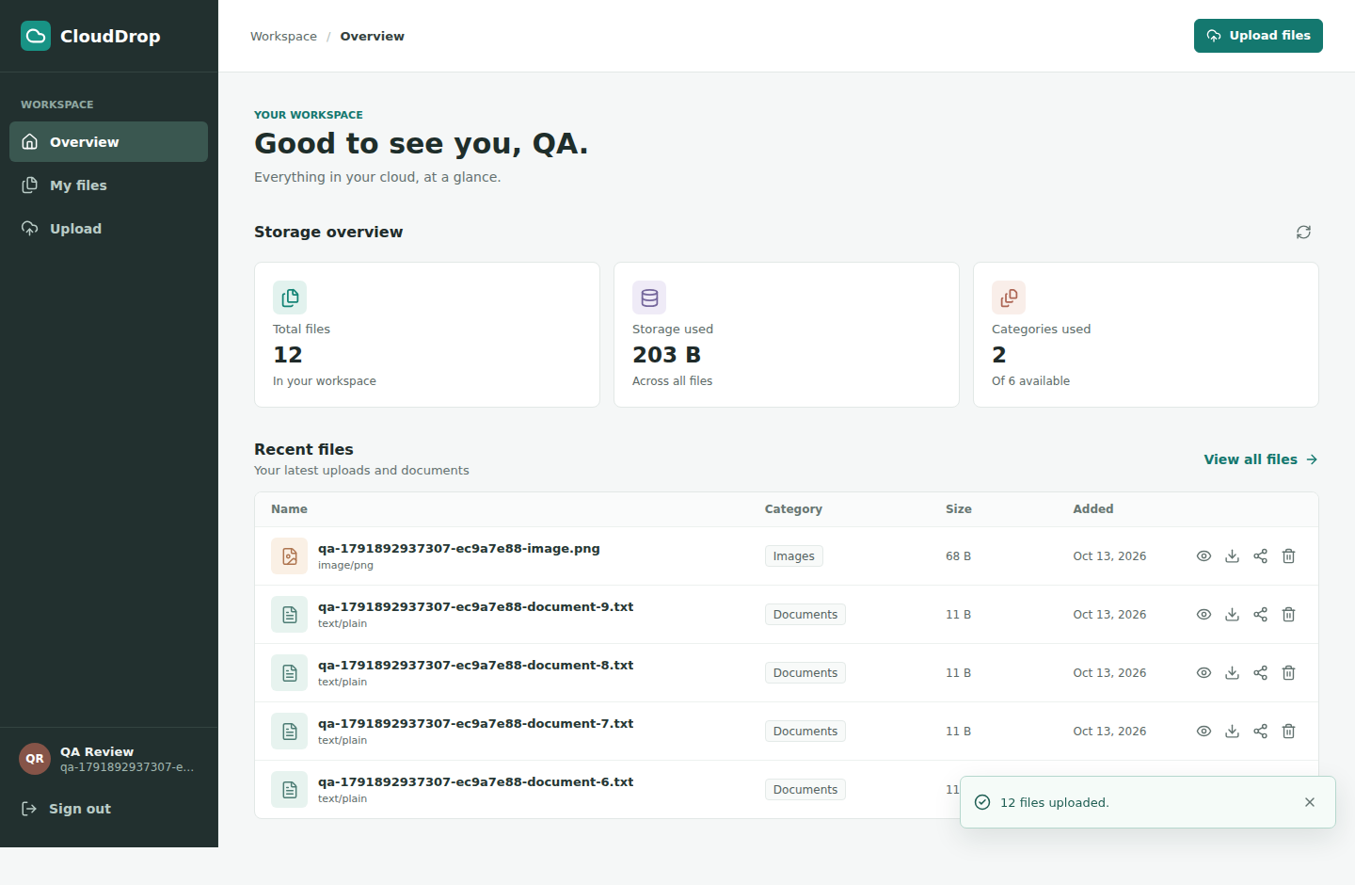
What We Achieved
Public HTTPS application
Registration and authentication
Upload, preview, download and deletion
Temporary sharing with expiry
EC2, RDS and S3 integration
Shared application and deployment repository
1-hour expiry test: team-reported success
CloudDrop dashboard
QA frontend connected to the live backend
09
Notes:
Target speaking time: 45 seconds.
Summarize the implemented outcomes and point to the dashboard. The public login page was reachable during preparation. Current source implements registration with email verification, login, owner-scoped file management, private S3 retrieval and token-backed temporary sharing. Current frontend preview is limited to PDF, JPEG, PNG, GIF and WebP, with a native PDF viewer requirement. The backend accepts additional inline preview types, but those are not enabled through the frontend gate. This real QA dashboard screenshot comes from the source frontend connected to the actual deployed API on 13 October, not a newly authenticated dashboard capture. The project QA report says the group reported a successful one-hour elapsed-expiry test, which was not independently repeated in that audit or for this deck. Repository policy tests cover expiration logic and invalid TTLs. Earlier QA also recorded release mismatches; do not claim all latest live workflows were rerun today.
Sources:
C:/Users/DELL/Documents/clouddrop/frontend/docs/qa-evidence/source-dashboard.png
C:/Users/DELL/Documents/clouddrop/frontend/docs/final-qa-report.md
C:/Users/DELL/Documents/clouddrop/backend/tests/share-policy.test.ts
C:/Users/DELL/Documents/clouddrop/backend/src/lib/share-policy.ts
C:/Users/DELL/Documents/clouddrop/backend/src/controllers/files.controller.ts
C:/Users/DELL/Documents/clouddrop/frontend/src/features/files/model/file.types.ts
https://clouddrop-c8.duckdns.org/login

Slide 10
What's Next for CloudDrop?
Advanced search, folders and richer organization
File version history and recovery
Centralized monitoring and alerting
Broader performance and load testing
Horizontal scaling and improved availability
More file management and collaboration features
Proposed enhancements
10
Notes:
Target speaking time: 30 seconds.
These are proposed enhancements, not delivered features. Basic filename search, category filtering and server pagination already exist. Future work would extend that into richer organization and search. Version history would add recovery beyond the current delete behavior. Monitoring and alerting would improve operational visibility, while performance testing would inform capacity decisions. Horizontal scaling and greater availability would require design work beyond the current single-EC2 container deployment. Additional collaboration features can build on the current temporary links.
Sources:
C:/Users/DELL/Documents/clouddrop/frontend/src/pages/FilesPage.tsx
C:/Users/DELL/Documents/clouddrop/backend/src/services/file.service.ts
C:/Users/DELL/Documents/clouddrop/docker-compose.prod.yml
C:/Users/DELL/Documents/clouddrop/docs/REQUIREMENTS.md

Slide 11
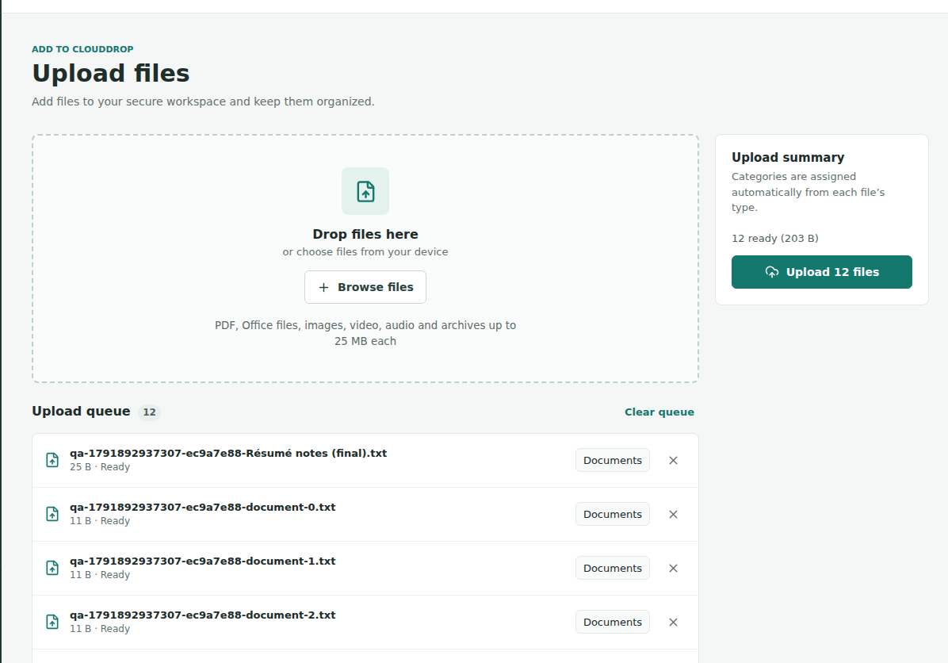
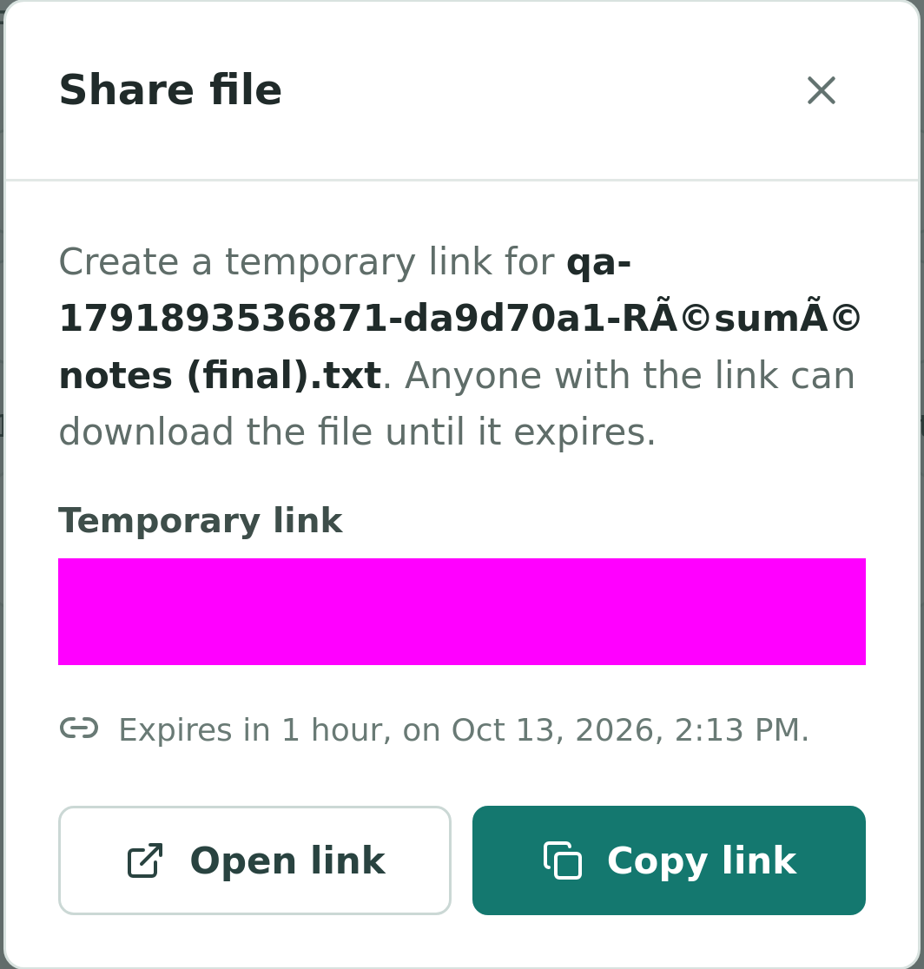
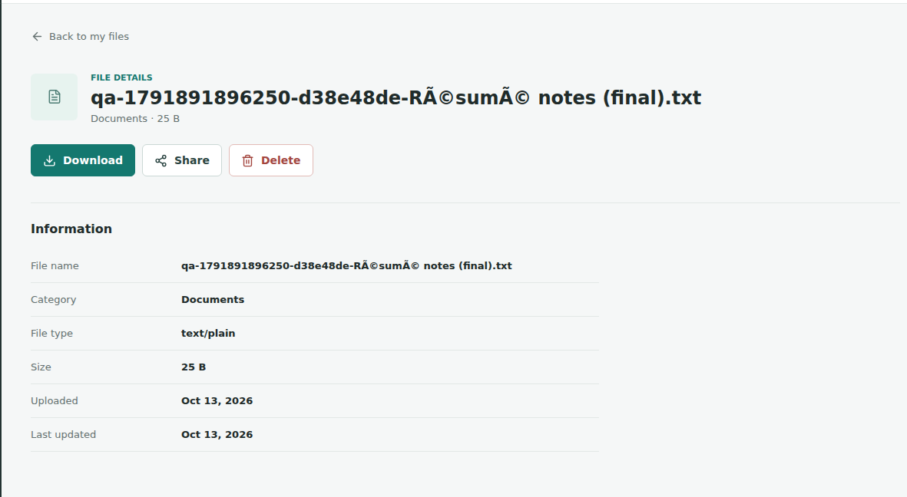
CloudDrop: From Cloud Architecture
to a Working Application
AWS compute, private object storage, managed data, application security and deployment automation in one working application.
Upload queue
File details and download
Temporary share link
Live Application: https://clouddrop-c8.duckdns.org
GitHub: https://github.com/OmoniyiIfeAbraham/CLOUDDROP
Thank You — Live Demonstration
11
Notes:
Target speaking time: 45 seconds.
Conclude that CloudDrop integrates AWS compute, object storage and a managed relational database with application security and deployment automation. The screenshots show real project UI: upload queue, deployed file details with download action, and a sharing dialog with the URL masked. The upload/share captures are from the source frontend connected to the live backend; the details capture is from the deployed frontend in the 13 October QA evidence. The filename encoding shown in that historical details capture was one of the documented issues addressed later in code. The login page is shown on slide 6 and dashboard on slide 9, avoiding repeating screenshots here. Thank the assessors and move to the live application. Suggested demonstration: sign in, upload a small image/PDF, preview it, download it, create a one-hour link and open it as a recipient. Expiry can be explained using prior test evidence rather than waiting an hour during the demo. Target 45 seconds for this closing slide, excluding the live demo.
Sources:
C:/Users/DELL/Documents/clouddrop/frontend/docs/qa-evidence/source-upload-categories.png
C:/Users/DELL/Documents/clouddrop/frontend/docs/qa-evidence/production-unicode-file.png
C:/Users/DELL/Documents/clouddrop/frontend/docs/qa-evidence/source-share-masked.png
C:/Users/DELL/Documents/clouddrop/frontend/docs/final-qa-report.md
https://clouddrop-c8.duckdns.org
https://github.com/OmoniyiIfeAbraham/CLOUDDROP

