Slide 1
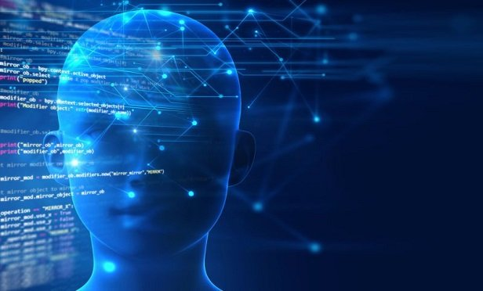
ARTIFICIAL INTELLIGENCE IN THE INSURANCE INDUSTRY
P R E S E N T E D B Y
OMOYENI OGUNDIPE & OLAYEMI SHITTU
D E P AR T M E N T O F M AT H E M AT I C S AN D S T AT I S T I C S
SUPERVISOR : D R . S AH I . K. R AM AN J I T DECEM B E R 1st 2022

Slide 2
TABLE OF CONTENT
Introduction
Key Areas
Traditional Ways Vs Artificial Intelligence
Methodology
Data Analysis
Results & Model Comparison
Conclusion and Further research
References

Slide 3
INTRODUCTION
Artificial intelligence is the simulation of human intelligence processes by machines, especially computer systems.
With the power of the cloud and today’s rapidly changing technologies, forward-thinking insurers can leverage Artificial Intelligence to drive faster and more personalized customer experiences, increasing satisfaction with claimants and generating significant efficiencies in insurance underwriting.
Insurance companies are already experimenting new ways to incorporate AI into their day-to-day operations in anticipation of further technological development.

Slide 4
KEY AREAS
AI and its related technologies will have a seismic impact on all aspects of the insurance industry, from distribution, underwriting and pricing to claims. Some of the key areas include:
Claim processing
Client Journey
Fraud Detection
Customer retention and churn prediction
Operation process optimization
Risk Assessment

Slide 5
TRADITIONAL WAYS VS AI
TRADITIONAL | ARTIFICIAL INTELLIGENCE
MANUAL ANALYSIS OF CLAIM HISTORY | PREDICTIVE ANALYTICS
HIRING PRIVATE INVESTIGATORS | NATURAL LANGUAGE PROCESS (NLP)
HANDING CASES TO SPECIAL INVESTIGATION UNITS | DATA MINING
MANUALLY EVALUATE CREDIT HISTORY | REAL TIME NOTIFICATION

Slide 6
METHODOLOGY
Historical insurance claim data including normal and fraudulent ones, Was used to investigate the normal/fraud behavior features
Based on ML techniques, and using these features, we checked if a claim is fraudulent or not
A comparative study was performed to decide which Machine Learning classifier performed best.

Slide 7
Algorithms
Some of the 12 Machine Learning Algorithms used in building models for fraud detection are:
Support Vector Classifier
KNN
Decision Tree Classifier
Random Forest Classifier
Ada Boost Classifier
Gradient Boosting Classifier

Slide 8
DATA ANALYSIS
The data used for this study is an open data gotten from Kaggle and is extracted from insurance claim settlement.
The Data Analysis and modeling are subdivided into two steps:
Data Preprocessing: In this stage, we prepared our data for modeling by treating null values, carrying out feature engineering and scaling the data for modeling
Modeling: After preparing the data, we were able to models for fraud prediction

Slide 9
RESULTS & MODEL COMPARISON
Using the Test accuracy score, we are going to graph a table and plot in descending order from highest score to the lowest test accuracy score.
 | Model | Score
4 | Ada Boost | 0.812
10 | XgBoost | 0.812
11 | Voting Classifier | 0.772
2 | Decision Tree | 0.752
3 | Random Forest | 0.732
8 | Extra trees | 0.724
0 | SVC | 0.720
1 | KNN | 0.720
9 | LGBM | 0.652
7 | Cat Boost | 0.640
6 | SGB | 0.308
5 | Gradient Boost | 0.288

Slide 10
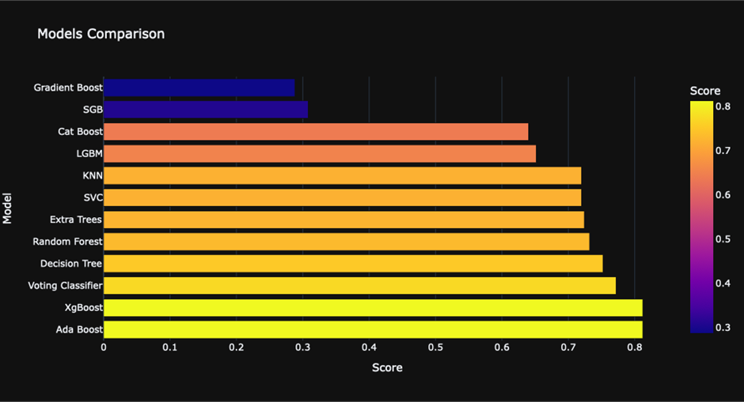

Slide 11
Conclusion
Rapid advances in technologies are already leading to disruptive changes in the insurance industry. The winning Insurance companies will be those that use new technologies to create innovative products, streamline processes, build automated powerful fraud detection systems and exceed customer expectations.
With the massive number of financial transactions taking place every day, the volume of fraudulent transactions is also increasing. It also means that the old techniques are no more useful.
The good news is that there are sophisticated algorithms that can take advantage of the massive datasets for training and solving these problems.

Slide 12
Further research
Moving on in this research, we would like to investigate how AI can be used to transform other areas in the insurance industry like we highlighted above. For example, how AI can be used to predict and prevent customer churn

Slide 13
References
Accenture. (2022, September 5). Transforming claims and underwriting with AI.
https://www.accenture.com/us-en/insightsnew/insurance/ai-transforming-claims-underwriting
Accern, T. (2022, September 12). How AI is Transforming Insurance Claims Fraud Detection. Accern. https://accern.com/blog/how-ai-is-transforming-insurance-claims-fraud-detection
Background on: Insurance fraud | III. (n.d.). Retrieved October 25, 2022, from https://www.iii.org/article/background-on-insurance-fraud
Balasubramanian, R., Libarikian, A., & McElhaney, D. (2021, July 1). Insurance 2030—The impact of AI on the future of insurance. McKinsey & Company.
https://www.mckinsey.com/industries/financial-services/our-insights/insurance-2030-the-impact-of-ai-on-the-future-of-insurance
Joudaki, H., Rashidian, A., Minaei-Bidgoli, B., Mahmoodi, M., Geraili, B., Nasiri, M., & Arab, M. (2014). Using Data Mining to Detect Health Care Fraud and Abuse: A Review of Literature. Global Journal of Health Science, 7(1).
https://doi.org/10.5539/gjhs.v7n1p194

Slide 14
THANKS FOR LISTENING

