Slide 1


Slide 2



CODE VERSE HACKATHON 2025
Problem Statement Title – Lack of Real-Time KPI Visibility
Track – 2
Stmt No - 7
Team Name – 405Found
Team Members – 1. Om Varma (TL)
2. Om Patil
3. Anway Shimpne
4. Pralhad Chape

Slide 3
Lack of Real-Time KPI Visibility
Current Challenge:
Campaign performance data is scattered across multiple tools.
Issue:
Fragmented reporting leads to delayed insights.
Absence of centralized metrics slows down decision-making.
Hard to track KPIs like clicks, impressions, conversions, and ROI in real time.
Impact:
Marketing teams struggle to optimize campaigns efficiently.
Risk of overspending or underperforming campaigns due to delayed insights.

Slide 4
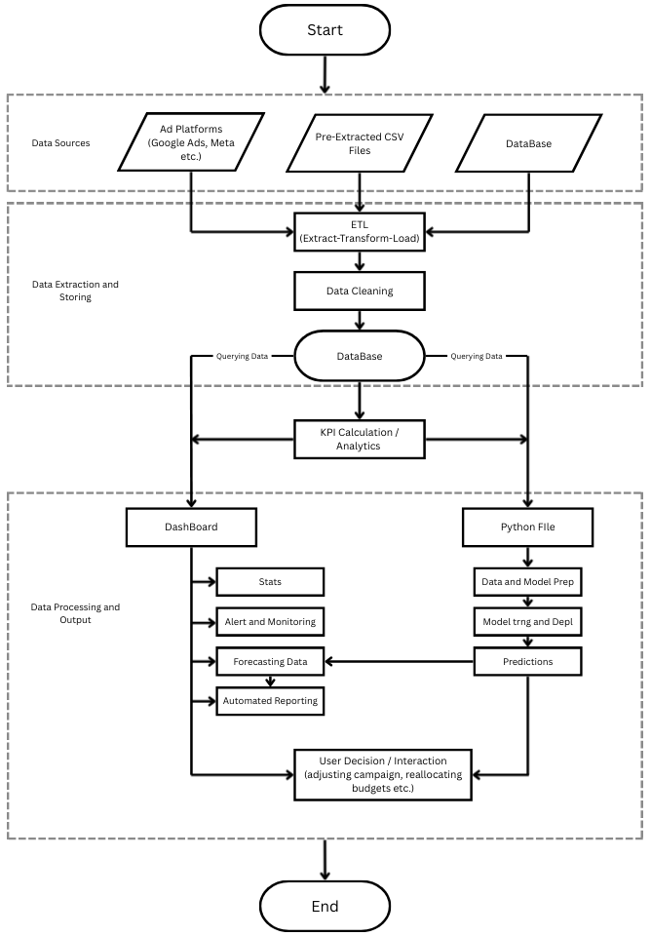
Lack of Real-Time KPI Visibility
Proposed Solution:
Centralized Real-Time KPI Dashboard
Idea:
Build a centralized dashboard that consolidates campaign data from all sources in real time.
Key Features:
Collect data from CSV files, APIs (Google Ads, Facebook Ads, etc.), and internal tools.
Clean and validate data for accuracy.
Compute KPIs like CTR, conversions, spend efficiency, and ROI.
Visualize insights with charts, tables, and filters for easy decision-making.
Predict campaign performance using ML/analytics.

Slide 5
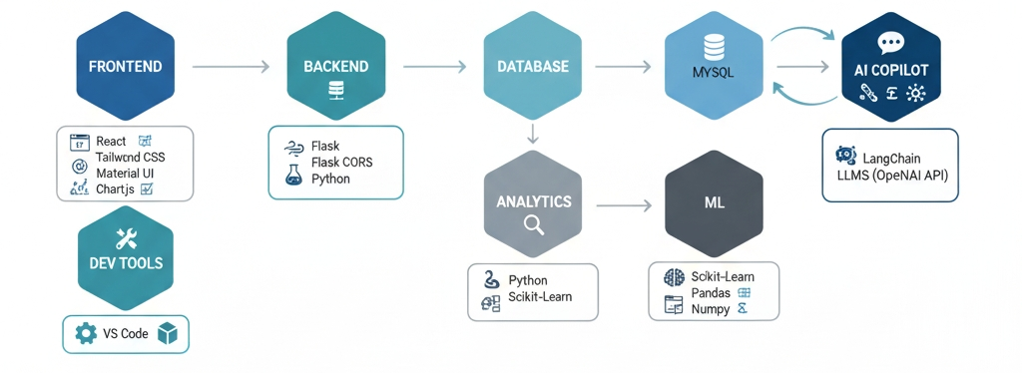
TECHNICAL APPROACH
Tech Stack
Methodology:
Requirement & Data Analysis: Identify data sources, KPIs, and collect via ETL into MySQL.
Data Cleaning & KPI Calculation: Handle missing values, duplicates, and compute CTR, ROI, conversions, CPC.
Predictive Insights: Forecast performance using ML.
Dashboard & Deployment: Build React-based real-time visualizations, validate, and automate updates.

Slide 6
FEASIBILITY AND VIABILITY
Feasibility:
Centralizing campaign data is practical with ETL, MySQL, and React; existing APIs support
Challenges:
Data inconsistency, API limitations, large data volume, real-time update delay.
Strategies:
Implement robust data cleaning and validation.
Use sandbox/test environments for APIs.
Schedule incremental ETL updates and optimize database queries.
Provide fallback mechanisms for missing or delayed data.

Slide 7
IMPACT AND BENEFITS
Potential Impact:
Real-time KPI visibility enables faster, data-driven decisions and improves campaign performance.
Benefits:
Centralized dashboard for all campaigns
Accurate and consistent metrics
Reduced reporting delays
Improved ROI and optimization of marketing efforts

