Slide 1
AI & Innovation Sprint
YUKTI
Smart Air Quality Index Monitoring & Forecasting
98%
15+
48h
Forecast Accuracy
Sensor Zones
AQI Predictions
Team B246 · B.Tech C.E. & MBA Tech C.E. · 3rd Year · 26 Feb 2026

Slide 2
01 / PROBLEM STATEMENT
Resolution Gap
Single AQI value for a 10km radius
Ignores street-level variations entirely
Predictive Gap
Only shows historical city-level data
No hyperlocal short-term forecasts
Interaction Gap
No simulation or What-If tools
Admins can't test pollution scenarios
🏙 Urban air pollution causes 1.67 million deaths annually in India — yet most citizens have NO real-time street-level data.

Slide 3
02 / EXISTING GAPS & COMPETITIVE ANALYSIS
Feature | SAFAR-India | AQI.in | PurpleAir | Yukti ✦
Street-Level Resolution | ✗ City | ✗ City | ✓ Partial | ✓✓ Street
AI Forecasting (48h) | ✗ None | ✗ None | ✗ None | ✓ 98% R²
Digital Twin Simulation | ✗ | ✗ | ✗ | ✓ Simulation Mode
Real-Time Alerts | ✓ Basic | ✓ Basic | ✗ | ✓✓ Hyperlocal
Open-Source / Low Cost | ✗ Govt | ✗ | ✓ Partial | ✓✓ Zero Cost
KEY INSIGHT
No existing platform combines street-level sensor simulation + ML forecasting + hyperlocal push notifications in one integrated system.

Slide 4
03 / PROPOSED AI SOLUTION — YUKTI
📡 INPUT
⚙️ PROCESSING
📊 OUTPUT
IoT Sensors (PM2.5, PM10, CO, NO2)
24h Moving Average Smoothing
6h / 24h / 48h AQI Forecast
Historical Delhi-NCR Dataset
Random Forest Regressor
Color-coded Map Zones
▶
▶
Temporal Features (Hour, Month)
Lag Feature Engineering
Push Notifications
0.9822 R² Accuracy
Digital Twin Simulation
Yukti = Digital Twin Layer + AI Predictive Engine + Hyperlocal Notification System

Slide 5
04 / SYSTEM ARCHITECTURE
LAYER 1 — IoT / DATA INGESTION
Real Sensors
(PMS5003)
Simulated Environment
Controller (Flask)
Historical
Dataset (OGD)
Manual
Injection API
→
→
→
↕
LAYER 2 — SERVER / AI ENGINE
Flask REST
API
Random Forest
Regressor (sklearn)
SQLite
Database
Web Push
Notification API
→
→
→
↕
LAYER 3 — USER INTERFACE
React.js
Dashboard
Leaflet.js
Map + Radar Zones
Recharts
Forecast Graph
Mobile
Alerts
→
→
→
All layers communicate via RESTful APIs — designed for Docker containerization and horizontal scaling.

Slide 6
05 / TECHNICAL METHODOLOGY & MODEL PERFORMANCE
Dataset
Delhi-NCR Hourly AQI
2019–2024 (OGD + Kaggle)
Algorithm
Random Forest Regressor
(Scikit-Learn)
Train/Test Split
80% Training / 20% Testing
Chronological (no data leakage)
Preprocessing
24h Moving Average · Linear Interpolation
Min-Max Normalization
R² = 0.9822 · RMSE ≈ 4.5 AQI units · MAE: Minimal Deviation from Ground Truth

Slide 7
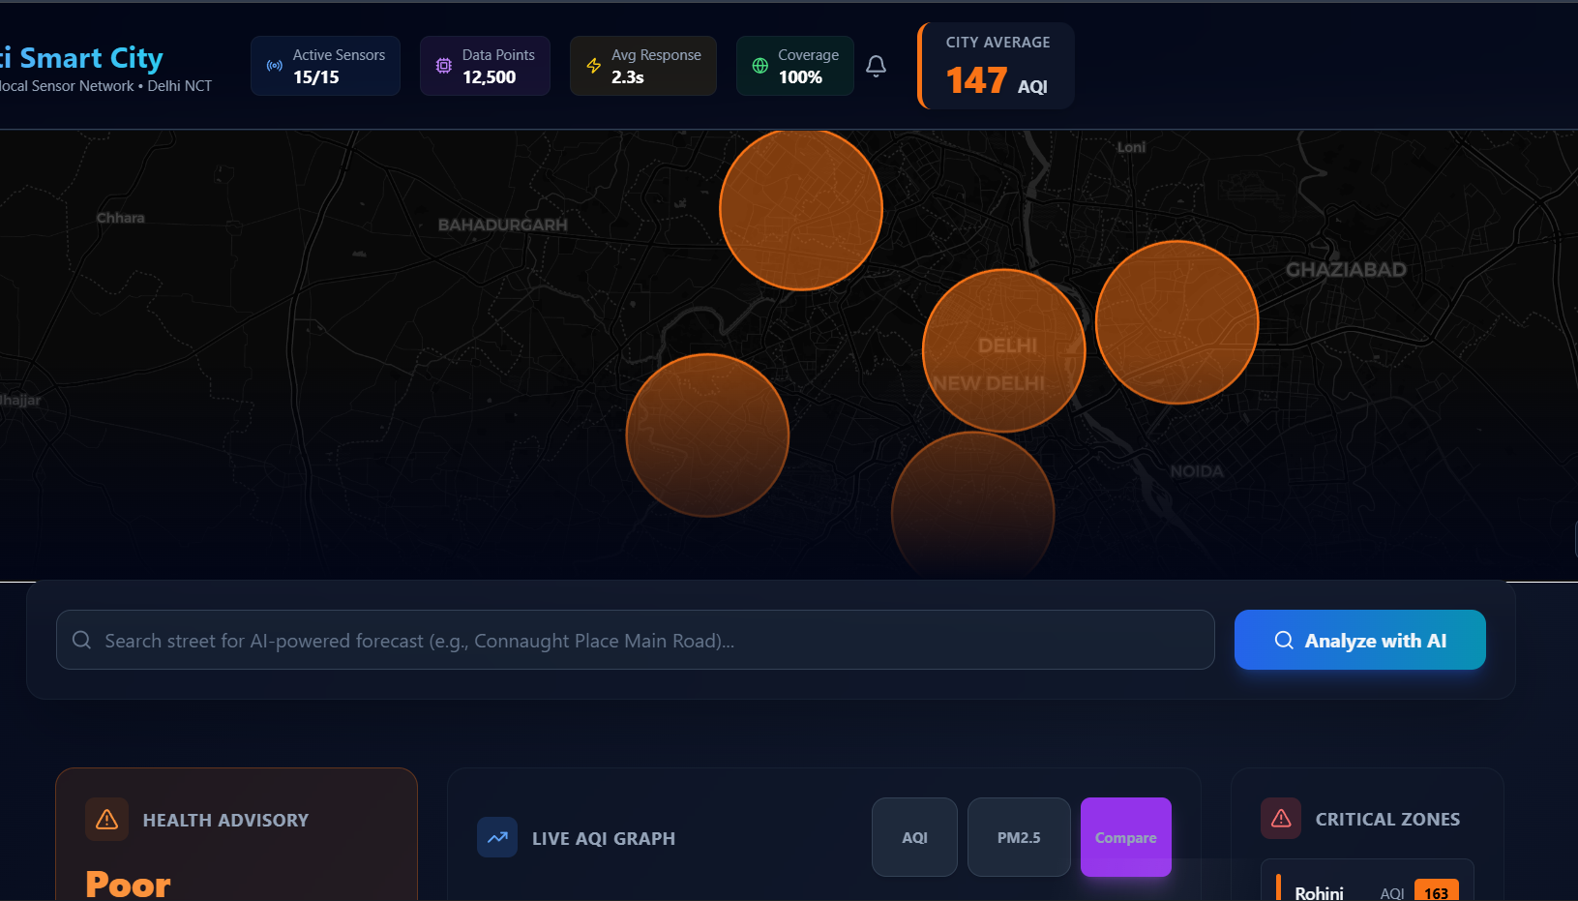
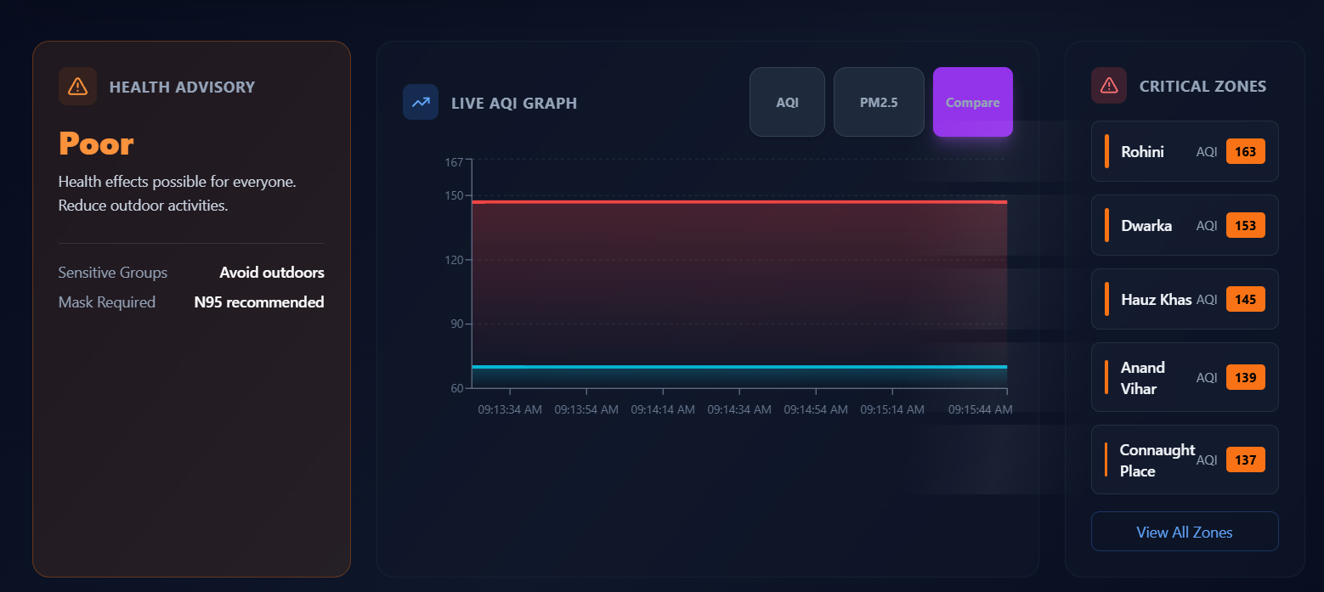
06 / PROTOTYPE DEMO — LIVE SYSTEM
🔗 GitHub: github.com/Ompatil9021/Smart-AQI-Network · Live prototype available for demo

Slide 8
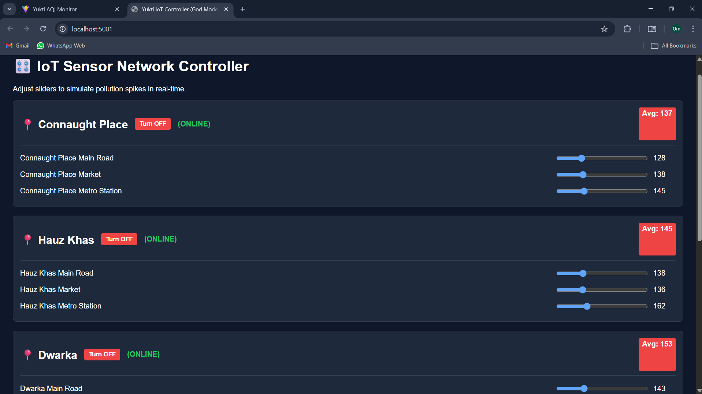
06 / PROTOTYPE DEMO — LIVE SYSTEM
🔗 GitHub: github.com/Ompatil9021/Smart-AQI-Network · Live prototype available for demo

Slide 9
07 / SUSTAINABILITY & ENVIRONMENTAL IMPACT
🌿
Personal Exposure Reduction
↓ 30%
via Clean Air Window alerts
💰
Infrastructure Cost Saving
10×
cheaper than govt stations
♻️
License Cost
₹ 0
100% open-source stack
🚗
Behavioral Change
Nudge
EV/transit on high-AQI days
🌱 Sector-replicable: Water Quality, Industrial Waste, Smart Agriculture — same Digital Twin + AI architecture.

Slide 10
08 / TECHNOLOGY STACK
⚛️
React.js
🎨
Tailwind CSS
🗺️
Leaflet.js
📊
Recharts
Frontend
Styling
Mapping
Data Viz
🐍
Python
🌶️
Flask
🤖
Scikit-Learn
🔢
Pandas & NumPy
Backend
API Framework
Machine Learning
Data Processing
🗄️
SQLite3
🔔
Web Push API
🐙
Git & GitHub
💻
VS Code
Database
Notifications
DevOps
IDE

Slide 11
09 / SCALABILITY & FUTURE SCOPE
TRL LEVEL
📡 SCALABILITY PLAN
4
🏙️
City-Scale Ready
💰
Economic Viability
🔓
Open Architecture
25 ESP32 IoT node pilot and framework scales to any major metro area.
10× cheaper than govt CAAQMS stations. Cloud hosting: ~₹2K/month only.
100% open-source (Python + React). Cities can deploy, fork & extend freely.
Lab Validation Prototype tested in Controlled Environment
🚀 FUTURE IMPROVEMENTS
TRL 1 TRL 4 ✓ TRL 9
🏥
Clinical Integration
CURRENT STATUS
HL7 FHIR APIs for automated health alerts via Apple Health & Google Fit for vulnerable populations.
Prototype tested in Controlled Environment using historical Delhi-NCR datasets.
MAE: 12.1 AQI @ 6hr | 22.6 AQI @ 24hr on holdout data.
🌬️
Environmental Expansion
Multi-modal sensors: noise pollution, humidity, wind-speed to further enhance Random Forest accuracy.
⚖️ PATENT & COMMERCIAL
Utility patent: synchronized IoT simulation + predictive health-alert triggers
⚡
Edge AI
B2B/B2G SaaS for municipal corps & real-estate developers
Lightweight model deployment directly onto ESP32 nodes to eliminate server latency bottlenecks.

Slide 12
THANK YOU
Yukti: Smart Air Quality Index Monitoring & Forecasting
Team B246
Om Patil
Prem Pawar
Sumit Vyas
Keshav Birle
🔗 github.com/Ompatil9021/Smart-AQI-Network · Team B246 · B.Tech C.E. · 3rd Year · 2026

