Slide 1



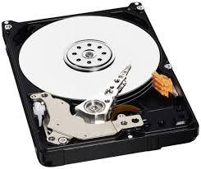
Exercise 1
Build an abstraction

Slide 2
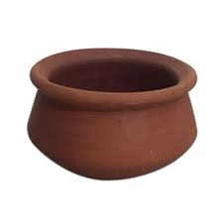
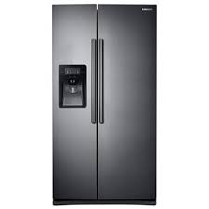
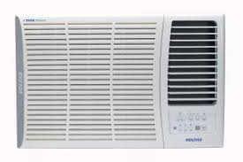
Exercise 2
Build an abstraction

Slide 3
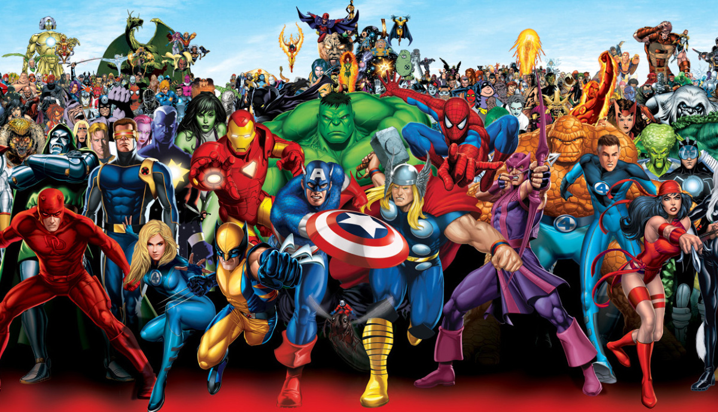
Exercise 3
Build an abstraction

Slide 4



Exercise 4
Build an abstraction

