Slide 1
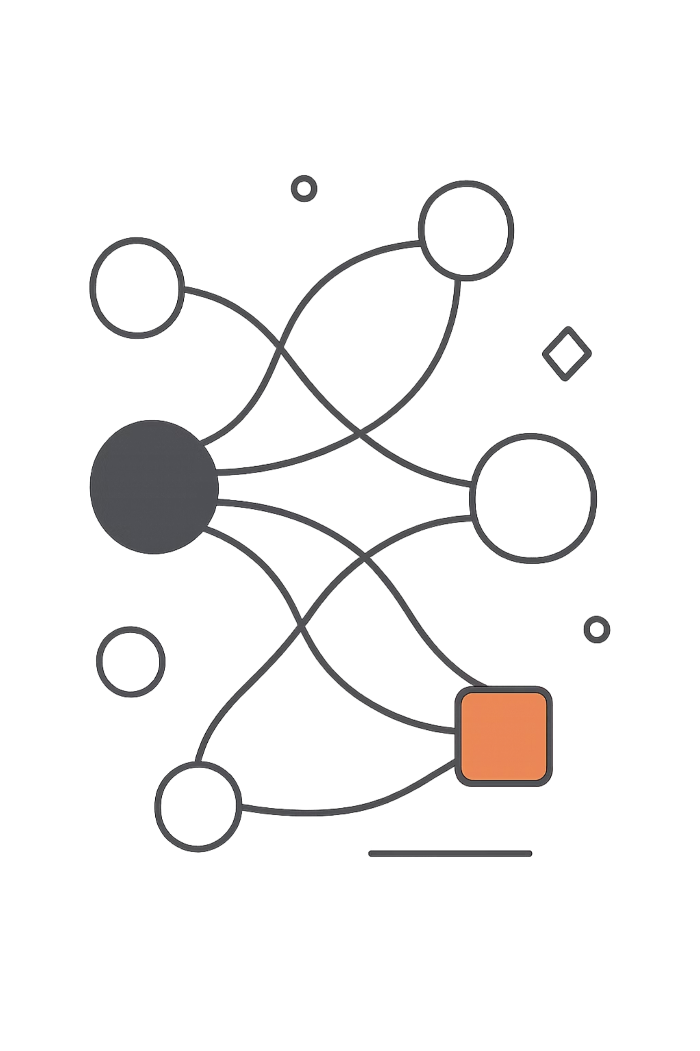
Deep Learning: From Research to Production
A practical journey through the tools, architectures, and pipelines that transform a deep learning experiment into a reliable, scalable production system.
DEEP LEARNING
PYTORCH
TRANSFORMERS
MLOPS
DOCKER

Slide 2
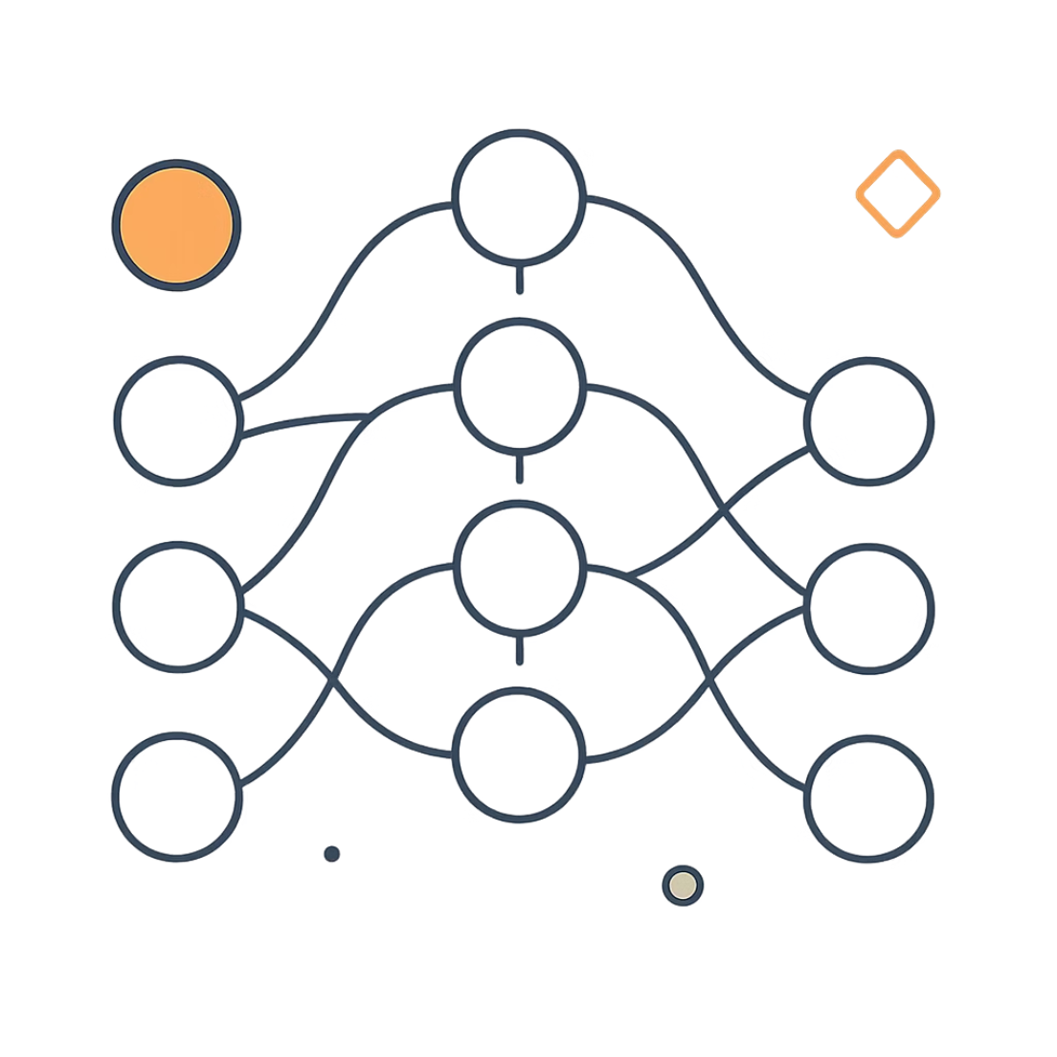

Deep Learning Fundamentals
What is Deep Learning?
A subset of machine learning that uses multi-layer neural networks to automatically learn patterns from large volumes of data — without hand-crafted features.
Key insight: Deep learning automatically learns useful representations from raw data, eliminating manual feature engineering.
Images
Text
Speech
Video

Slide 3
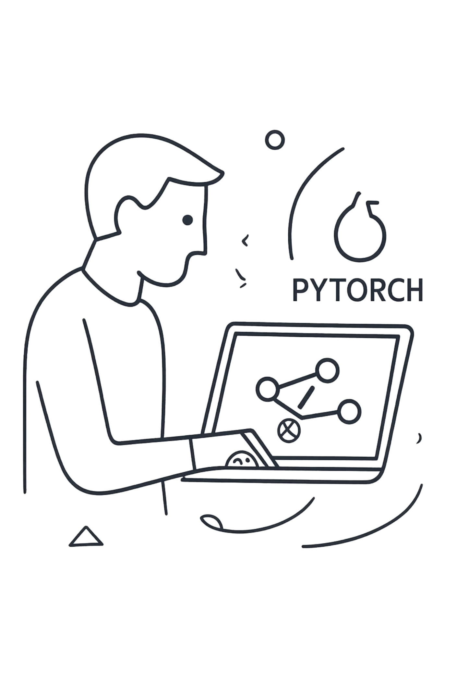


PyTorch
PyTorch is the dominant framework for deep learning research and production, offering dynamic computation graphs, seamless GPU support, and a rich ecosystem.
Dataset & DataLoaders
Load, transform, and batch data efficiently for training loops.
Model & Loss
Define architectures with nn.Module and compute gradients via a loss function.
Backpropagation & Optimizer
Update weights using loss.backward() and an optimizer like Adam or SGD.
Trained Model
Export via TorchScript or ONNX for inference serving.

Slide 4
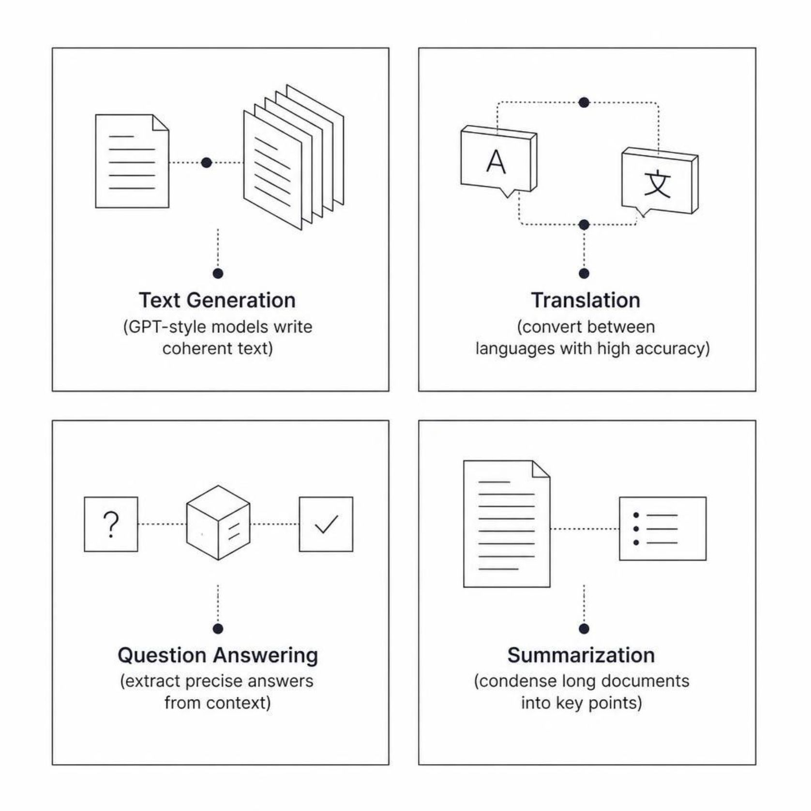

Transformers
What are Transformers?
A neural architecture built on self-attention, enabling models to capture long-range dependencies in sequences with high parallelism.
Self-Attention
Parallelizable
Foundation Models
Weighs the importance of every token relative to every other.
Processes entire sequences simultaneously, unlike RNNs.
GPT, BERT, and T5 all derive from this architecture.

Slide 5
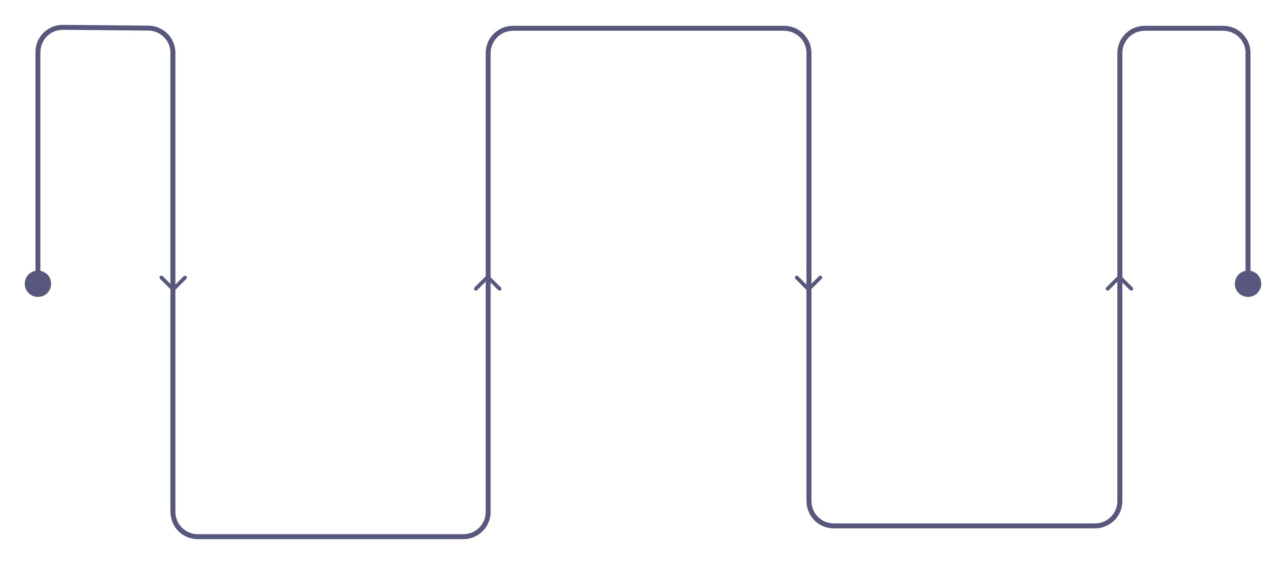
Transfer Learning & Hugging Face
Instead of training from scratch, start from a pretrained model and fine-tune on your specific task — saving time, data, and compute.
Fine-Tune
Adapt final layers to your dataset
Pretrained Model
Task Model
Learned general features on massive data
Ready for deployment with strong baseline
Why Transfer Learning?
Hugging Face Ecosystem
Less Data
Faster Training
Thousands of pretrained models across NLP, vision, and audio
Unified tokenizers and dataset libraries
Model Hub for sharing and versioning
transformers and accelerate for fine-tuning
Lower Compute

Slide 6
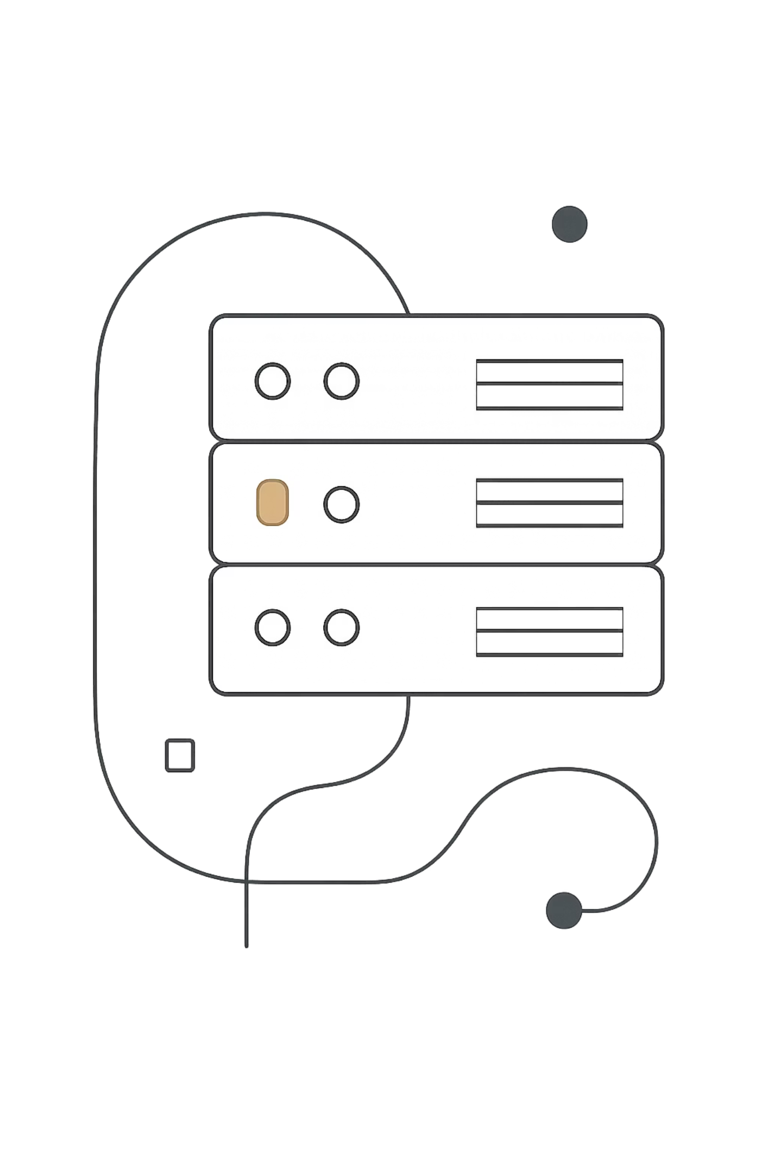




Distributed Training
Modern models are too large for a single GPU. Distributed strategies split the workload across devices to train faster and at greater scale.
Data Parallelism
Split batches across GPUs; each holds a full model copy.
Model Parallelism
Split model layers across GPUs for models that don't fit in memory.
Pipeline Parallelism
Divide the model into stages processed sequentially across devices.
FSDP / ZeRO
Shard optimizer states and gradients to dramatically reduce memory footprint.

Slide 7
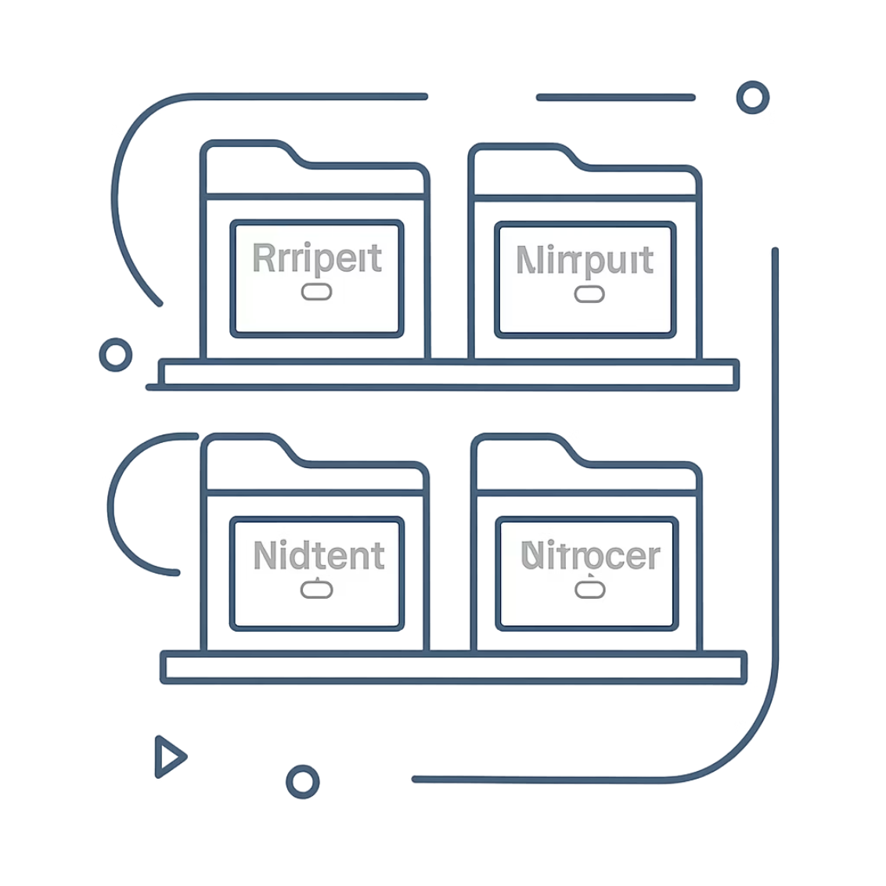


Model Registry
What is a Model Registry?
A centralized system to store, version, and govern ML models throughout their lifecycle — from experiment to production.
Flow: Train → Evaluate → Register → Approve → Deploy
1
2
3
Version
Metrics
Governance
Track model, dataset, and code commit together.
Store evaluation scores, hyperparameters, and owner info.
Approval workflows, deployment status, and rollback capability.

Slide 8
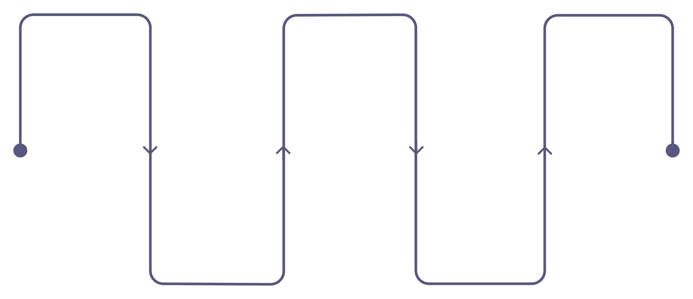
CI/CD for Machine Learning
ML pipelines extend traditional CI/CD by adding data validation, model training, and performance gates before any deployment proceeds.
Data Validation
Model Training
Quality Gate
Retrain on validated data
Metrics must meet thresholds
Check schema, quality, and drift
Performance Eval
Unit Tests
Code and data tests must pass
Compute accuracy, F1, AUC
Quality Gate Examples
Key Difference from Traditional CI/CD
Accuracy ≥ 90%
F1 ≥ 85%
Standard pipelines test code only. ML CI/CD must also validate data quality and model performance — a failing metric blocks deployment automatically.
AUC ≥ 90%

Slide 9
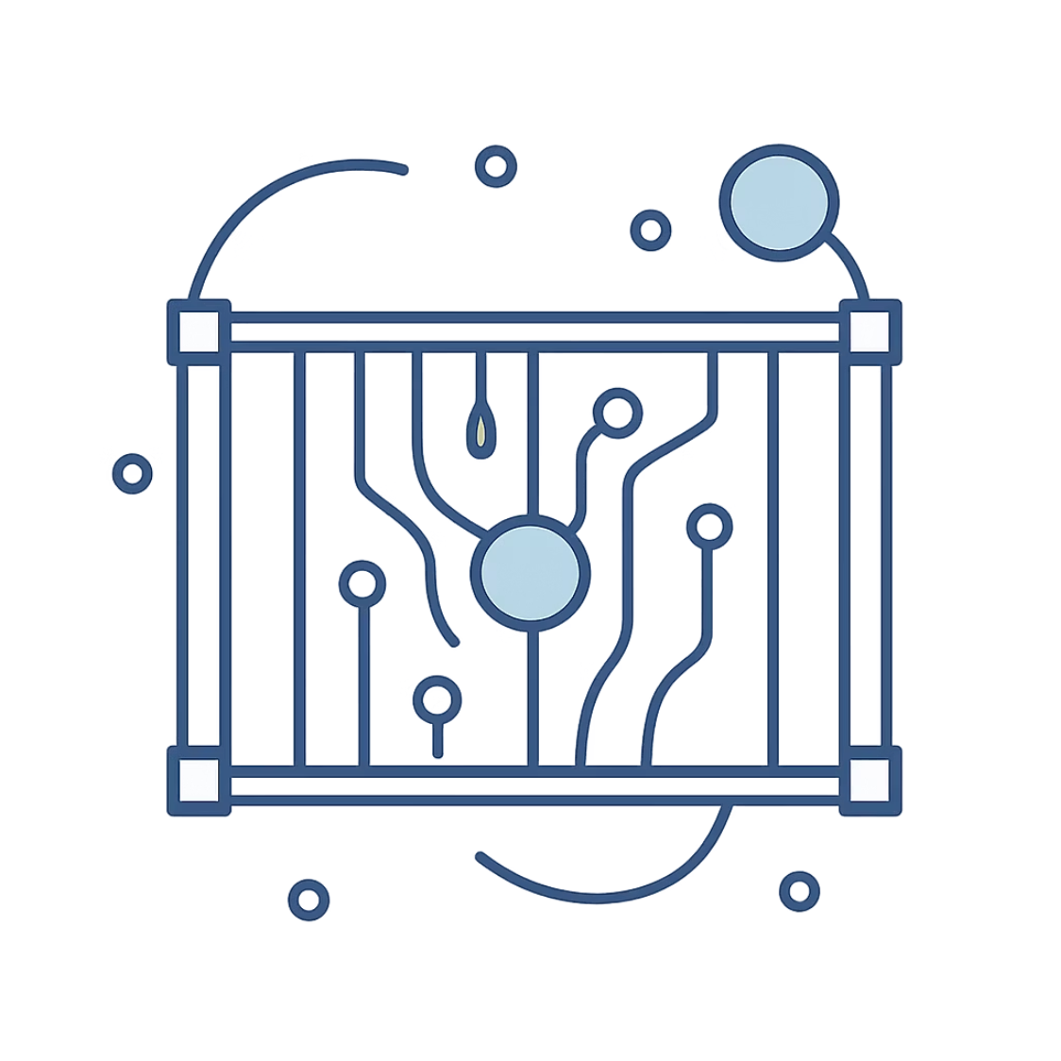
Docker for ML
Solving "It Works on My Machine"
Docker packages your application, Python runtime, PyTorch, dependencies, and model artifacts into a single portable container — eliminating environment drift between development and production.
Images are stored in Docker Hub, Amazon ECR, or a private registry.
01
02
03
Write Dockerfile
Build Docker Image
Run Container
Define base image, dependencies, and entry point.
Creates a reproducible snapshot of the environment.
Deploy consistently across any host or cloud.

Slide 10

End-to-End Deep Learning Lifecycle
Production AI is not a single model — it is an automated, governed lifecycle connecting every stage from raw data to continuous improvement.
01
02
Data
Deep Learning & PyTorch
Collect, clean, and version datasets.
Design and train neural network models.
03
04
Transformers
Distributed Training
Apply self-attention architectures for NLP, vision, and multimodal tasks.
Scale across multiple GPUs for large models.
05
06
Model Evaluation
Model Registry
Measure accuracy, F1, AUC, and other metrics.
Version, track, and govern model artifacts.
07
08
CI/CD
Docker
Automate testing, quality gates, and deployment pipelines.
Package models into reproducible containers.
09
10
Deployment
Monitoring & Continuous Improvement
Serve models to production environments.
Track drift, retrain, and iterate.
Takeaway: Every tool in this stack serves a purpose — together they form a reliable, scalable path from experiment to production AI.

