Slide 1
Welcome to Harbinger Group Ticketing System Mobile App

Slide 2
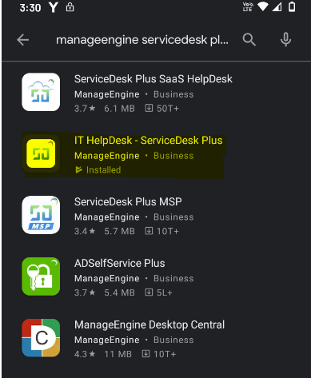
Download Ticket system App from Play store / App store!

Slide 3
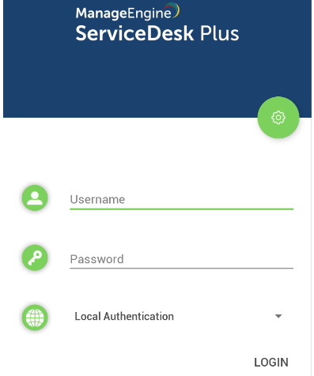
After opening App this page will be displayed . Click on Settings icon at the right-hand side.

Slide 4
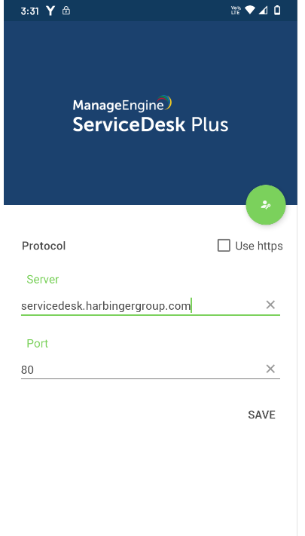
Set the server port as 443 . Check “Use https” option. Click on “SAVE” button after doing changes

Slide 5
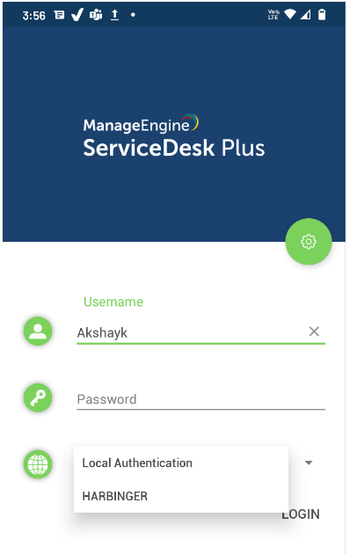
Insert your LDAP credentials and select “HARBINGER” from drop-down list. Click on “LOGIN” after inserting the LDAP credentials

Slide 6
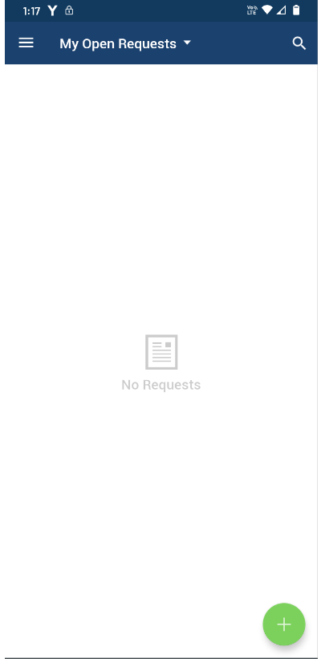
After the successful login, this page will be get displayed on your screen. Your presently open requests will be visible here. Click on “+ “sign to open new request

Slide 7
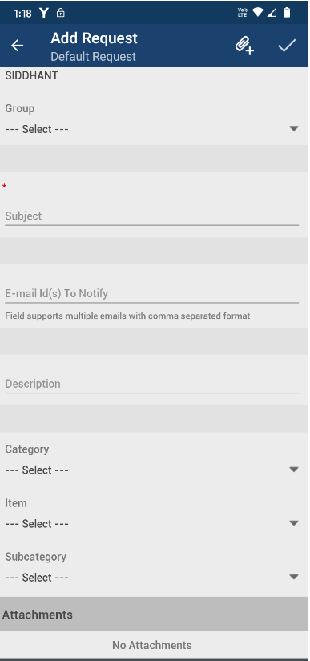
Add Request page will be displayed on your screen with various option.
Select your work location from the drop-down list, if not appeared by default.
Select the appropriate “Group” followed by “Category".
After filling up all the tabs, click on “tick” sign to complete the process.
Your ticket will get generated and will be visible under “My Open Request” tab.

Slide 8
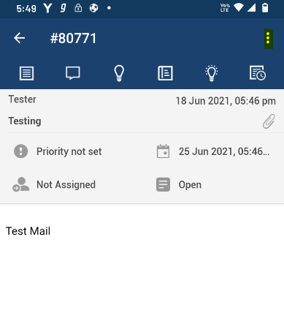
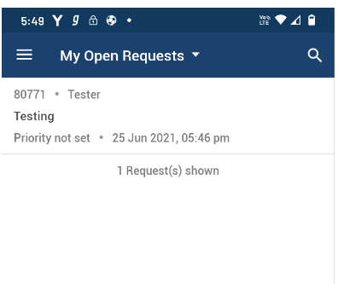
Click on ticket for more details
Go to highlighted option at the right side and click on “Reply” to update /Post comment on the ticket .

Slide 9
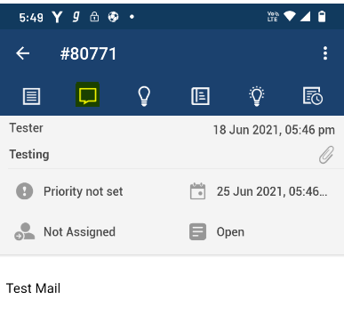
To view all the conversation on the ticket , click on second tab .
Click on back arrow to visit home page.

Slide 10
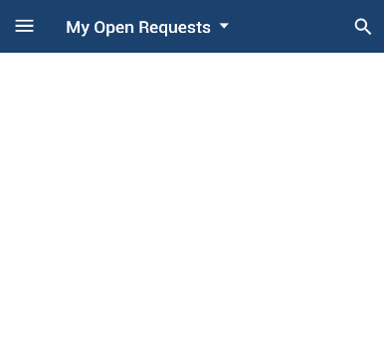
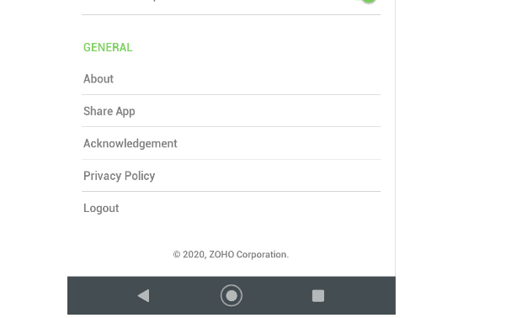
To sign-out the App. Click Three Parallel lines at left side on home page.
Go to settings Option. Click Logout.

Slide 11
Thank You

