Slide 1



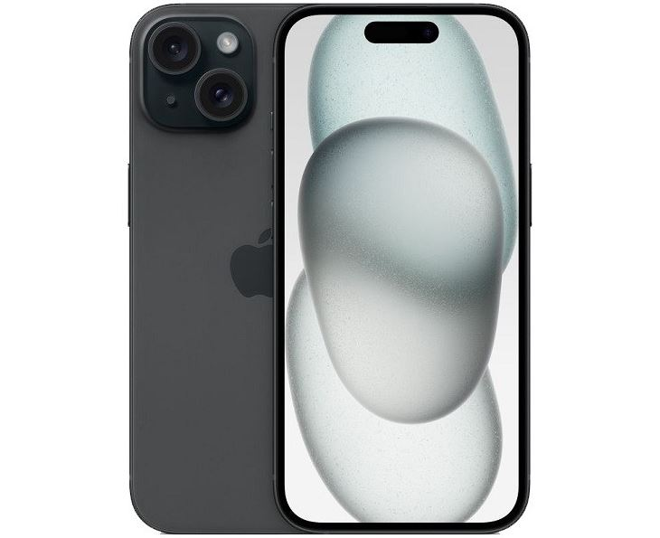
Mobilex0
Login
Register
Logoff
State – Grand A
State - New
State - New
Mobilex0 – DW UAL 2024

