Slide 1
Cloud Computing -CH - 1
Introduction of Cloud Computing

Slide 2
Content :-
What is Cloud Computing?
How it works?
Types of Cloud
Goals & Challenges
Leveraging Cloud Computing
Cloud Economics and Total Cost of Ownership

Slide 3
What is Cloud Computing?
Cloud Definition: The cloud in cloud computing provides the means through which everything from computing power to computing infrastructure, applications, business processes to personal collaboration — can be delivered to a user as a service wherever and whenever the user needs.
The cloud itself is a set of hardware, networks, storage, services, and interfaces that enable the delivery of computing as a service.
Cloud services include the delivery of software,infrastructure, and storage over the Internet (either as separate components or a complete platform) based on user demand.

Slide 4
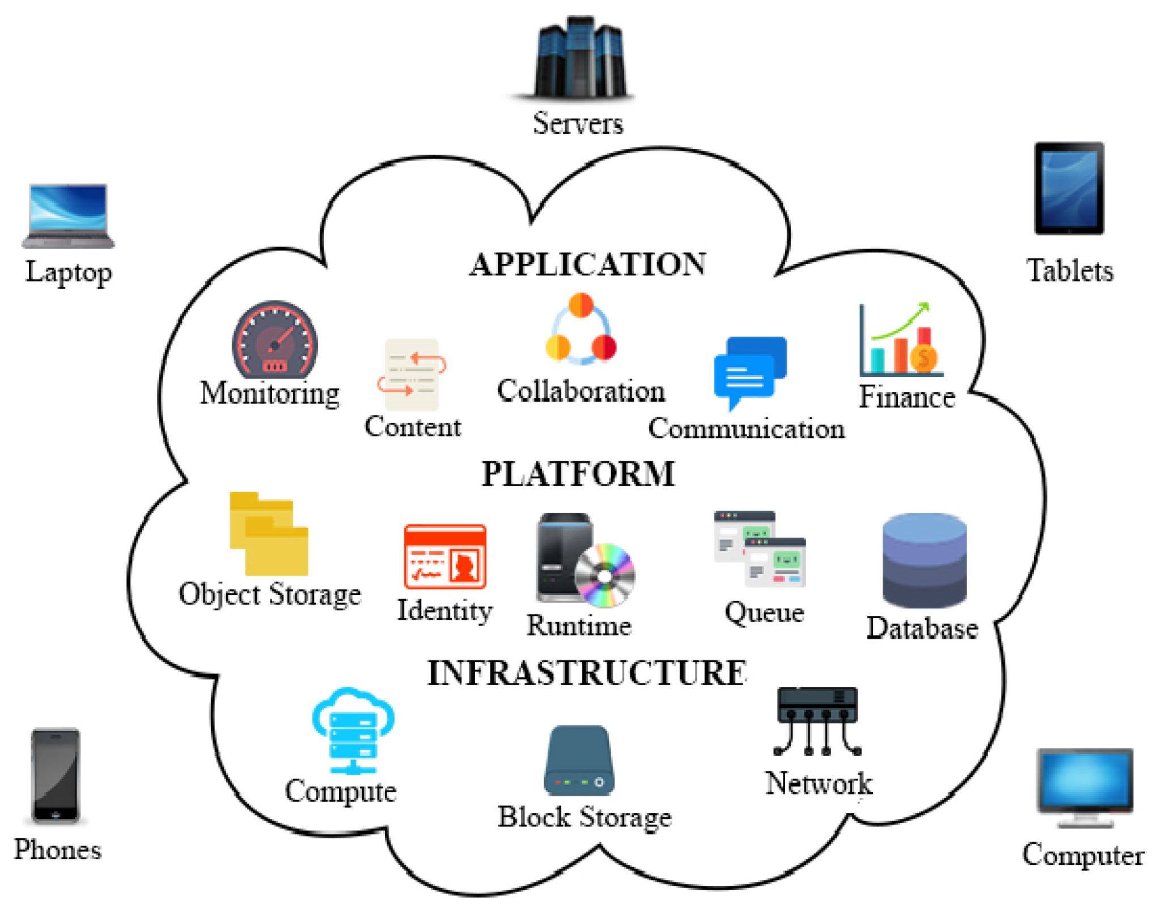

Slide 5
What is cloud computing ? … II
Cloud computing is a model for enabling ubiquitous, convenient, on-demand network access to a shared pool of configurable computing resources (e.g., networks, servers, storage, applications, and services) that can be rapidly provisioned and released with minimal management effort or service provider interaction.
Cloud computing refers to both the applications delivered as services over the Internet and the hardware and system software in the data centers that provide those services.

Slide 6
Why Cloud Computing ?
Elasticity and scalability
The service provider can‘t anticipate how customers will use the service.
One customer might use the service three times a year during peak selling seasons, whereas another might use it as a primary development platform for all of its applications.
Therefore, the service needs to be available all the time (7 days a week, 24 hours a day) and it has to be designed to scale upward for high periods of demand and downward for lighter ones.
Scalability also means that an application can scale when additional users are added and when the application requirements change.
This ability to scale is achieved by providing elasticity.

Slide 7
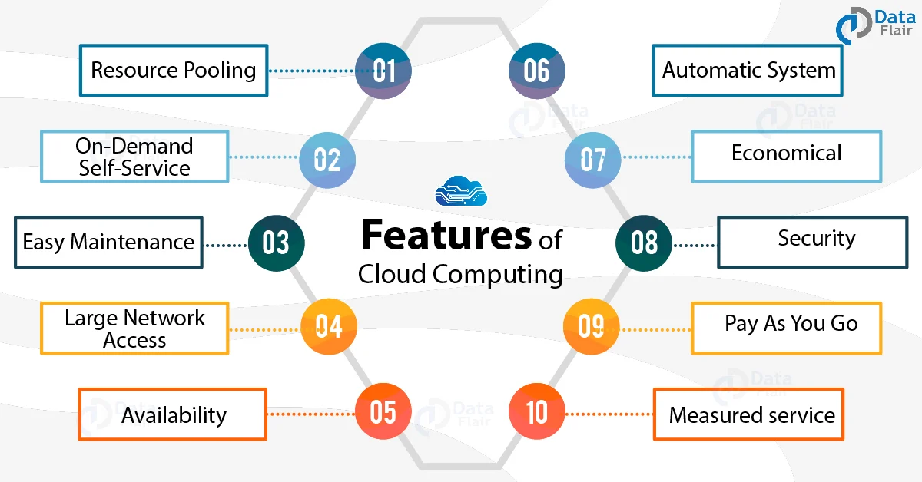

Slide 8
Why Cloud Computing ? … II
Self-service provisioning
Customers can easily get cloud services without going through a lengthy process.
The customer simply requests an amount of computing, storage, software, process, or other resources from the service provider.
While the on-demand provisioning capabilities of cloud services eliminate many time delays, an organization still needs to do its homework.
These services aren‘t free; needs and requirements must be determined before capability is automatically provisioned.

Slide 9
Why Cloud Computing ? … III
Application programming interfaces (APIs)
Cloud services need to have standardized APIs.
These interfaces provide the instructions on how two application or data sources can communicate with each other.
A standardized interface lets the customer more easily link a cloud service, such as a customer relationship management system with a financial accounts management system, without having to resort to custom programming.

Slide 10
Why Cloud Computing ? … IV
Billing and metering of services
A cloud environment needs a built-in service that bills customers. And, of course, to calculate that bill, usage has to be metered (tracked).
Even free cloud services (such as Google‘s Gmail or Zoho‘s Internet-based office applications) are metered.
In addition to these characteristics, cloud computing must have two overarching requirements to be effective:
A comprehensive approach to service management
A well-defined process for security management

Slide 11
Why Cloud Computing ? … V
Performance monitoring and measuring
A cloud service provider must include a service management environment.
A service management environment is an integrated approach for managing the physical environments and IT systems.
This environment must be able to maintain the required service level for that Organization.
In other words, service management has to monitor and optimize the service or sets of services.
Service management has to consider key issues, such as performance of the overall system, including security and performance.

Slide 12
Why Cloud Computing ? … VI
Security
Many customers must take a leap of faith to trust that the cloud service is safe.
Turning over critical data or application infrastructure to a cloud-based service provider requires making sure that the information can‘t be accidentally accessed by another company (or maliciously accessed by a hacker).
Many companies have compliance requirements for securing both internal and external information.
Without the right level of security, one might not be able to use a provider‘s offerings.

Slide 13
How cloud computing works?
The cloud is basically a decentralized place to share information through satellite networks.
Every cloud application has a host, and the hosting company is responsible for maintaining the massive data centers that provide the security, storage capacity and computing power needed to maintain all of the information users send to the cloud.
In a cloud computing system, there is a significant workload shift.
Local computers have no longer to do all the heavy lifting when it comes to run applications. But cloud computing can handle that much heavy load easily and automatically.
Hardware and software demands on the user's side decrease.
The only thing the user's computer requires to be able to run is the cloud computing interface software of the system, which can be as simple as a Web browser and the cloud's network takes care of the rest.

Slide 14
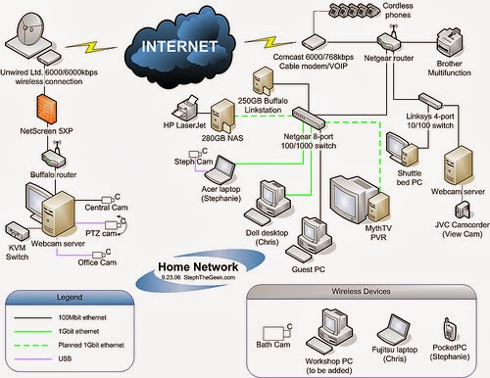
How cloud computing works ? …II

Slide 15
Types of cloud
Cloud computing is offered in different forms:
Public clouds: in a public cloud, a business rents the capability and they pay for what they use on-demand. Example- Amazon, Google and IBM
Private clouds: cloud computing environment in which all hardware and software resources are dedicated exclusively to, and accessible only by, a single customer
Hybrid clouds: it is combination of public and private making advantage of both
Community cloud: Allows sharing of resources costing less for resource usage

Slide 16
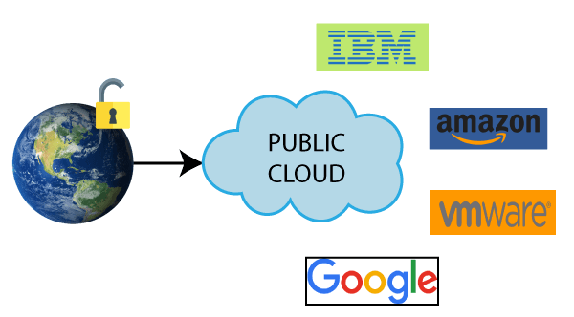
Public cloud
Public Cloud is an IT model where on-demand computing services and infrastructure are managed by a third-party provider and shared with multiple organizations using the public Internet.

Slide 17
Advantages of Public Cloud
1) Low Cost
Public cloud has a lower cost than private, or hybrid cloud, as it shares the same resources with a large number of consumers.
2) Location Independent
Public cloud is location independent because its services are offered through the internet.
3) Save Time
In Public cloud, the cloud service provider is responsible for the manage and maintain data centers in which data is stored, so the cloud user can save their time to establish connectivity, deploying new products, release product updates, configure, and assemble servers.
4) Scalability and reliability
Public cloud offers scalable (easy to add and remove) and reliable (24*7 available) services to the users at an affordable cost.

Slide 18
Disadvantages of Public Cloud
1) Low Security
Public Cloud is less secure because resources are shared publicly.
2) Performance
In the public cloud, performance depends upon the speed of internet connectivity.
3) Less customizable
Public cloud is less customizable than the private cloud.

Slide 19
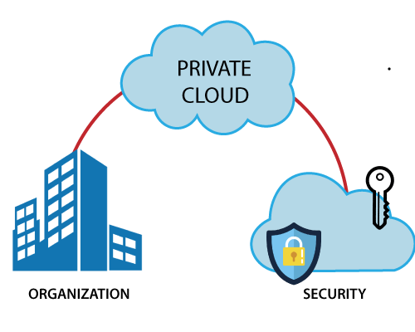
Private cloud
In private clouds, a business essentially turns its IT environment into a cloud and uses it to deliver services to their users.

Slide 20
Private cloud
Private cloud is also known as an internal cloud or corporate cloud.
Private cloud provides computing services to a private internal network (within the organization) and selected users instead of the general public.
Private cloud provides a high level of security and privacy to data through firewalls and internal hosting. It also ensures that operational and sensitive data are not accessible to third-party providers.
HP Data Centers, Microsoft, Elastra-private cloud, and Ubuntu are the example of a private cloud.

Slide 21
Advantages of Private cloud
1) More Control
Private clouds have more control over their resources and hardware than public clouds because it is only accessed by selected users.
2) Security & privacy
Security & privacy are one of the big advantages of cloud computing. Private cloud improved the security level as compared to the public cloud.
3) Improved performance
Private cloud offers better performance with improved speed and space capacity.

Slide 22
Disadvantages of Private Cloud
1) High cost
The cost is higher than a public cloud because set up and maintain hardware resources are costly.
2) Restricted area of operations
As we know, private cloud is accessible within the organization, so the area of operations is limited.
3) Limited scalability
Private clouds are scaled only within the capacity of internal hosted resources.
4) Skilled people
Skilled people are required to manage and operate cloud services.

Slide 23
Hybrid cloud
Hybrid cloud is a combination of public and private clouds.
Hybrid cloud = public cloud + private cloud
The main aim to combine these cloud (Public and Private) is to create a unified, automated, and well-managed computing environment.
In the Hybrid cloud, non-critical activities are performed by the public cloud and critical activities are performed by the private cloud.
Mainly, a hybrid cloud is used in finance, healthcare, and Universities.
The best hybrid cloud provider companies are Amazon, Microsoft, Google, Cisco, and NetApp.

Slide 24
Advantages of Hybrid Cloud
1) Flexible and secure
It provides flexible resources because of the public cloud and secure resources because of the private cloud.
2) Cost effective
Hybrid cloud costs less than the private cloud. It helps organizations to save costs for both infrastructure and application support.
3) Cost effective
It offers the features of both the public as well as the private cloud. A hybrid cloud is capable of adapting to the demands that each company needs for space, memory, and system.

Slide 25
Disadvantages of Hybrid Cloud
1) Networking issues
In the Hybrid Cloud, networking becomes complex because of the private and the public cloud.
2) Infrastructure Compatibility
Infrastructure compatibility is the major issue in a hybrid cloud. With dual-levels of infrastructure, a private cloud controls the company, and a public cloud does not, so there is a possibility that they are running in separate stacks.
3) Reliability
The reliability of the services depends on cloud service providers.

Slide 26
Community Cloud
Community cloud is a cloud infrastructure that allows systems and services to be accessible by a group of several organizations to share the information.
It is owned, managed, and operated by one or more organizations in the community, a third party, or a combination of them.

Slide 27
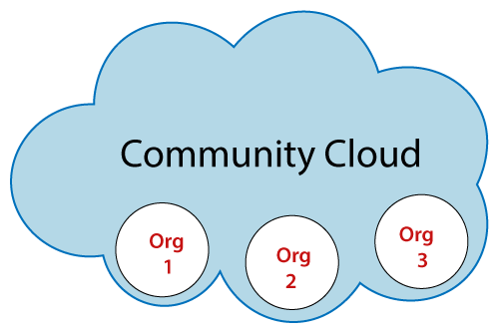
Community Cloud

Slide 28
Advantages of Community Cloud
Cost effective
Community cloud is cost effective because the whole cloud is shared between several organizations or a community.
Flexible and Scalable
The community cloud is flexible and scalable because it is compatible with every user. It allows the users to modify the documents as per their needs and requirement.
Security
Community cloud is more secure than the public cloud but less secure than the private cloud.
Sharing infrastructure
Community cloud allows us to share cloud resources, infrastructure, and other capabilities among various organizations.

Slide 29
Disadvantages of Community Cloud
Community cloud is not a good choice for every organization
Slow adoption to data
The fixed amount of data storage and bandwidth is shared among all community members
Community Cloud is costly than the public cloud
Sharing responsibilities among organizations is difficult.

Slide 30
Goals of cloud computing
Reduced operational cost
Adhering to service level agreement(SLA)
Failure of recovery and backup
Increased processing power
Collaborative tools utilization
Achieving energy efficiency

Slide 31
Challenges of cloud computing
Security
Cost Management
Lack of expertise
Internet Connectivity
Control or Governance
Compliance
Multiple Cloud management
Performance
Migration
Interoperability and Portability
Reliability and High Availability
Hybrid-Cloud Complexity
Mobile interactive applications

Slide 32
Leveraging Cloud Computing
Leveraging cloud technologies to reduce costs and overall impact of using an organisation’s own resources/data centres is now commonplace in the market.
Cloud enables organisations to leverage highly available cloud infrastructure to deliver business value without the need to consider underlying physical infrastructure.
Ordering servers/equipment, space planning for infrastructure and expensive server/cabinet co-location costs are increasingly becoming something of the past.

Slide 33
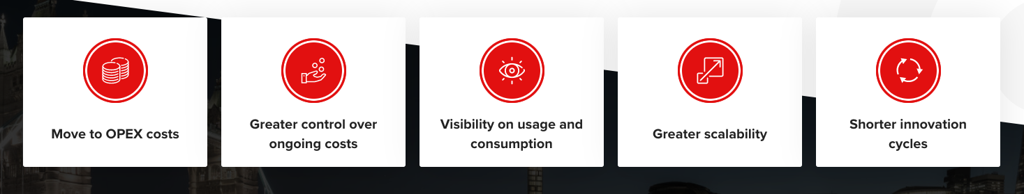
Leveraging Cloud Computing

Slide 34
Cloud Economics
Cloud economics is the study of cloud computing costs and benefits and the economic principles that underpin them.
As a discipline, it explores key questions for businesses: What is the return on investment (ROI) of migrating to the cloud or switching current cloud providers?
And what is the total cost of ownership (TCO) of a cloud solution versus a traditional on-premises solution?

Slide 35
Return on investment(ROI)
Cloud ROI is the measure in cloud economics of the impact a cloud investment has on an organization.
For most businesses, return on investment (ROI) is a success indicator for any project – signifying that a business decision led to a positive impact on the organization’s bottom line.
The measure of ROI is simply the increase in the value of an investment over a period of time. If the financial benefit outweighs the original investment the result is a positive ROI.

Slide 36
Total cost of ownership(TCO)
Total cost of ownership (TCO) is the sum of all costs involved in the purchase, operation, and maintenance of a given asset during its lifetime.
TCO helps businesses understand the cost of a tool beyond the initial purchase price and is extremely helpful for understanding ROI.

Slide 37
Toc … II
The total cost of ownership in cloud computing refers to the total cost of adopting, operating, and provisioning cloud infrastructure.
Organizations often find it necessary to perform a cloud TCO analysis when they are considering moving to the cloud because it allows them to weigh the cost of cloud adoption against the cost of running their current on-premise systems.

Slide 38
Toc … iii
Cloud TCO involves calculating the costs required to host, run, integrate, secure and manage workloads in the cloud over their lifetime.
These include fees associated with the underlying infrastructure, such as compute, data transfer and storage.
It also includes the cost of supporting cloud services, ranging from security and management tools to data analytics.
Manpower costs for cloud engineers should also be part of a cloud TCO equation.

Slide 39
How to calculate TCO for on-premise servers?
On-premise servers are physical machines that you own and operate in your own data center or office.
You have full control over the hardware, software, and configuration of your servers, but also the responsibility and risk of maintaining them.
To calculate the TCO for on-premise servers, you need to estimate acquisition costs (such as servers, racks, switches, licenses, and operating systems), installation costs (cabling, networking, testing, and security), operation costs (electricity, cooling, repairs, upgrades, and replacements), staffing costs (administrators, technicians, and engineers), and downtime costs (lost productivity, revenue, or reputation due to server failures).

Slide 40
How to compare TCO for cloud vs on-premise servers?
When comparing the Total Cost of Ownership (TCO) for cloud vs on-premise servers, you should consider the time horizon, scalability, security, and performance.
In the short term, cloud servers are more cost-effective due to lower upfront and fixed costs.
On the other hand, on-premise servers are more cost-effective in the long term, with lower variable and recurring costs.
Cloud servers are more scalable as they allow you to adjust your resources on demand, while on-premise servers are more rigid as they require capacity to be planned and purchased in advance.

Slide 41
How to compare TCO for cloud vs on-premise servers? … II
Additionally, cloud servers are more secure as they benefit from the CSP's expertise and infrastructure, but on-premise servers offer more privacy as they give you control over access to your data. Lastly, cloud servers are more performant due to leveraging of the CSP's network and redundancy, while on-premise servers provide more consistency by avoiding potential issues of internet connectivity and shared resources.

Slide 42

Thats all folks for this chapter !!!!

