Slide 1
Cloud Computing -CH-2
Cloud Service Models

Slide 2
Topics
Software as a Service (SaaS)
SaaS Integration Services
Advantages and Disadvantages
Infrastructure As a Services (IaaS)
Introduction to Virtual Machines
VM Migration
Advantages and Disadvantages
Platform As a service (PaaS)
Integration of Private and Public Cloud
Advantages and Disadvantages

Slide 3
Cloud services / Business models
Cloud services are infrastructure, platforms, or software that are hosted by third-party providers and made available to users through the internet.
They are basically divided into 5 parts:
Software as a service (SaaS)
Platform as a service (PaaS)
Infrastructure as a service (IaaS)
Anything/Everything as a service (XaaS)
Function as a Service (FaaS)

Slide 4
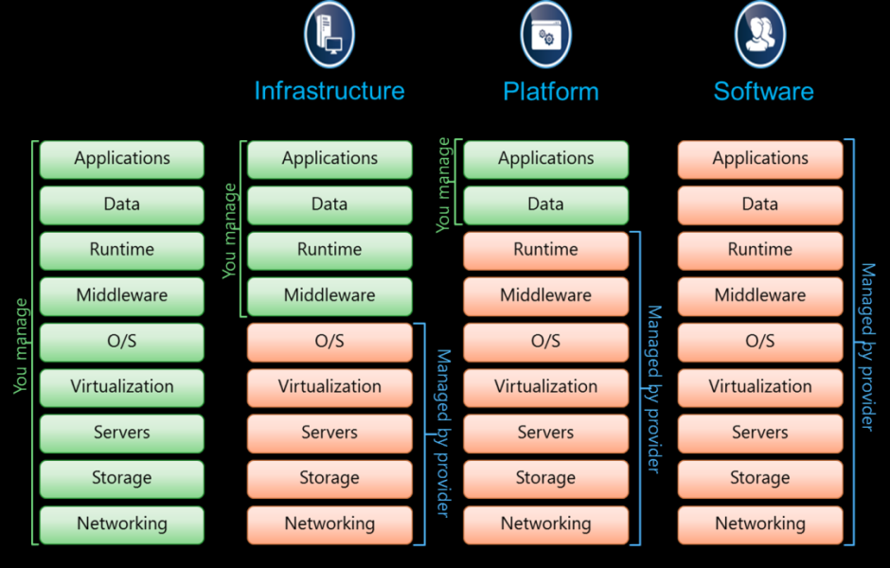

Slide 5
Software as a Service(SaaS)
Software-as-a-Service (SaaS) is a way of delivering services and applications over the Internet.
Instead of installing and maintaining software, we simply access it via the Internet, freeing ourselves from the complex software and hardware management.
It removes the need to install and run applications on our own computers or in the data centers eliminating the expenses of hardware as well as software maintenance.

Slide 6
Software as a Service(SaaS) .. II
SaaS provides a complete software solution that you purchase on a pay-as-you-go basis from a cloud service provider.
Most SaaS applications can be run directly from a web browser without any downloads or installations required.
The SaaS applications are sometimes called Web-based software, on-demand software, or hosted software

Slide 7
Advantages of SaaS
Cost-Effective: Pay only for what you use.
Reduced time: Users can run most SaaS apps directly from their web browser without needing to download and install any software.
Accessibility: We can Access app data from anywhere.
Automatic updates: Rather than purchasing new software, customers rely on a SaaS provider to automatically perform the updates.

Slide 8
Disadvantages of Saas
Limited customization: SaaS solutions are typically not as customizable as on-premises software, meaning that users may have to work within the constraints of the SaaS provider’s platform and may not be able to tailor the software to their specific needs.
Dependence on internet connectivity: SaaS solutions are typically cloud-based, which means that they require a stable internet connection to function properly.
Security concerns: SaaS providers are responsible for maintaining the security of the data stored on their servers, but there is still a risk of data breaches or other security incidents.
Limited control over data: SaaS providers may have access to a user’s data, which can be a concern for organizations that need to maintain strict control over their data for regulatory or other reasons.

Slide 9
Platform as a Service
PaaS is a category of cloud computing that provides a platform and environment to allow developers to build applications and services over the internet.
PaaS services are hosted in the cloud and accessed by users simply via their web browser.
A PaaS provider hosts the hardware and software on its own infrastructure.

Slide 10
Platform as a Service (PAAS) ..II
PaaS makes users free from having to install in-house hardware and software to develop or run a new application. Thus, the development and deployment of the application take place independent of the hardware.
The consumer does not manage or control the underlying cloud infrastructure including network, servers, operating systems, or storage, but has control over the deployed applications and possibly configuration settings for the application-hosting environment.

Slide 11
Advantages of PaaS
Simple and convenient for users: It provides much of the infrastructure and other IT services, which users can access anywhere via a web browser.
Cost-Effective: It charges for the services provided on a per-use basis thus eliminating the expenses one may have for on-premises hardware and software.
Efficiently managing the lifecycle: It is designed to support the complete web application lifecycle: building, testing, deploying, managing, and updating.
Efficiency: It allows for higher-level programming with reduced complexity thus, the overall development of the application can be more effective

Slide 12
Disadvantages of Paas
Limited control over infrastructure: PaaS providers typically manage the underlying infrastructure and take care of maintenance and updates, but this can also mean that users have less control over the environment and may not be able to make certain customizations.
Dependence on the provider: Users are dependent on the PaaS provider for the availability, scalability, and reliability of the platform, which can be a risk if the provider experiences outages or other issues.
Limited flexibility: PaaS solutions may not be able to accommodate certain types of workloads or applications, which can limit the value of the solution for certain organizations.

Slide 13
Infrastructure as a Service (IAAS)
Infrastructure as a service (IaaS) is a service model that delivers computer infrastructure on an outsourced basis to support various operations.
Typically IaaS is a service where infrastructure is provided as outsourcing to enterprises such as networking equipment, devices, database, and web servers.
It is also known as Hardware as a Service (HaaS). IaaS customers pay on a per-user basis, typically by the hour, week, or month.
Some providers also charge customers based on the amount of virtual machine space they use.

Slide 14
Advantages of IaaS
Cost-Effective: Eliminates capital expense and reduces ongoing cost and IaaS customers pay on a per-user basis, typically by the hour, week, or month.
Website hosting: Running websites using IaaS can be less expensive than traditional web hosting.
Security: The IaaS Cloud Provider may provide better security than your existing software.
Maintenance: There is no need to manage the underlying data center or the introduction of new releases of the development or underlying software. This is all handled by the IaaS Cloud Provider.

Slide 15
Disadvantages of IaaS
Limited control over infrastructure: IaaS providers typically manage the underlying infrastructure and take care of maintenance and updates, but this can also mean that users have less control over the environment and may not be able to make certain customizations.
Security concerns: Users are responsible for securing their own data and applications, which can be a significant undertaking.
Limited access: Cloud computing may not be accessible in certain regions and countries due to legal policies.

Slide 16
Anything as a Service
It is also known as Everything as a Service. Most of the cloud service providers nowadays offer anything as a service that is a compilation of all of the above services including some additional services.

Slide 17
Function as a Service
FaaS is a type of cloud computing service.
It provides a platform for its users or customers to develop, compute, run and deploy the code or entire application as functions.
It allows the user to entirely develop the code and update it at any time without worrying about the maintenance of the underlying infrastructure.
The developed code can be executed with response to the specific event.

Slide 18
VIRTUALIZATION

Slide 19
VIRTUALIZATION
Virtualization is a kind of technology that is rapidly transforming the IT landscape and has changed the way people compute.
It reduces hardware utilization, saves energy and costs and makes it possible to run multiple applications and various operating systems on the same SERVER at the same time.
It increases the utilization, efficiency and flexibility of existing computer hardware

Slide 20
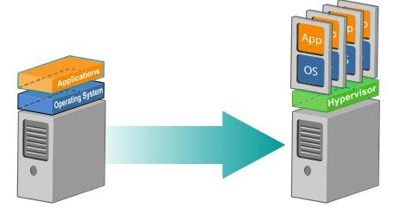
VIRTUALIZATION ..II

Slide 21
VIRTUALIZATION ..III
Virtualization is technology that allows you to create multiple simulated environments or dedicated resources from a single, physical hardware system.
Software called a hypervisor connects directly to that hardware and allows you to split 1 system into separate, distinct, and secure environments known as virtual machines (VMs).
These VMs rely on the hypervisor’s ability to separate the machine’s resources from the hardware and distribute them appropriately.

Slide 22
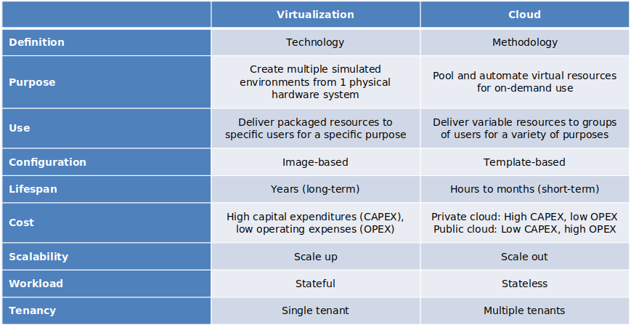

Slide 23
Need for Virtualization
Virtualization provides various benefits including saving time and energy, decreasing costs and minimizing overall risk.
• Provides ability to manage resources effectively.
• Increases productivity, as it provides secure remote access.
• Provides for data loss prevention.

Slide 24
Need for Virtualization ..II
Partitioning: In virtualization, many applications and operating systems (OSes) are supported in a single physical system by partitioning (separating) the available resources.
Isolation: Each virtual machine is isolated from its host physical system and other virtualized machines. Because of this isolation, if one virtual-instance crashes, it doesn’t affect the other virtual machines. In addition,data isn’t shared between one virtual container and another.
Encapsulation: A virtual machine can be represented (and even stored)as a single file, so you can identify it easily based on the service it provides.In essence, the encapsulated process could be a business service. This encapsulated virtual machine can be presented to an application as a complete entity. Therefore, encapsulation can protect each application so that it doesn’t interfere with another application.

Slide 25
VM Migration
Migration service is the process of moving a virtual machine from one host server or storage location to another
Different techniques of VM migration
Hot/life migration, cold/regular migration, and live storage migration of a virtual machine
In this process, all key machines’ components, are completely virtualized
For e.g., CPU, storage disks, networking, memory
Facilitating the entire state of a virtual machine to be captured by a set of easily moved data files

Slide 26
Migrations Techniques
Live migration
Also called hot or real-time migration
The movement of a virtual machine from one physical host to another while being powered on
Without any noticeable effect from the end user’s point of view (a matter of milliseconds)
Facilitates proactive maintenance upon failure
The potential problem can be resolved before the disruption of service occurs
Used for load balancing
Work is shared among computers optimize the utilization of available CPU resources

Slide 27
Migrations Techniques (cont.)
Live migration mechanism
How memory and virtual machine states are being transferred through the network from one host A to another host B
For e.g., the Xen hypervisor
The process has been viewed as a transactional interaction between the two hosts involved
Stage 0: Pre-Migration
An active virtual machine exists on the physical host A
Stage 1: Reservation
A request is issued to migrate an OS from host A to B
The necessary resources exist on B and on a VM container of that size

Slide 28
Migrations Techniques (cont.)
Stage 2: Iterative Pre-Copy
During the first iteration, all pages are transferred from A to B
Iterations copy only those pages dirtied during the previous transfer phase
Stage 3: Stop-and-Copy
Running OS instance at A is suspended
The network traffic is redirected to B
CPU state and any remaining inconsistent memory pages are then transferred
Stage 4: Commitment
Host B indicates to A that it has successfully received a consistent OS image

Slide 29
Migrations Techniques (cont.)
Host A acknowledges this message as a commitment of the migration transaction
Host A may now discard the original VM
Host B becomes the primary host
Stage 5: Activation
The migrated VM on B is now activated
Post-migration code runs to reattach the device’s drivers to the new machine and advertise moved IP addresses
An approach to failure management
At least one host has a consistent VM image at all times during migration
The original host remains stable until the migration commits

Slide 30
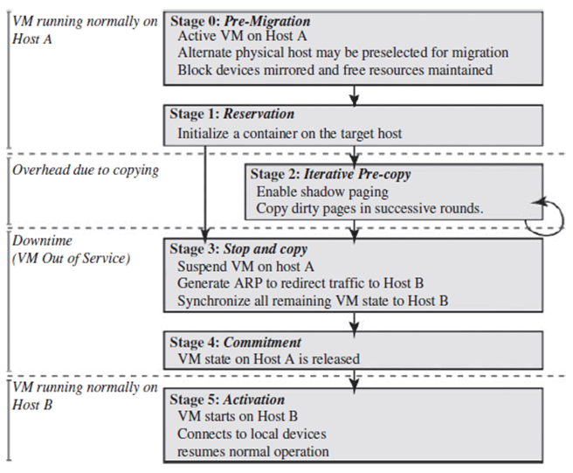

Slide 31
Migrations Techniques (cont.)
The cold migration process is simple
The configuration files are moved from the source host to the destination host associated storage area
Including the NVRAM file (BIOS settings), log files, as well as the disks of the virtual machine
The virtual machine is registered with the new host
After the migration is completed, the old version of the virtual machine is deleted from the source host

Slide 32
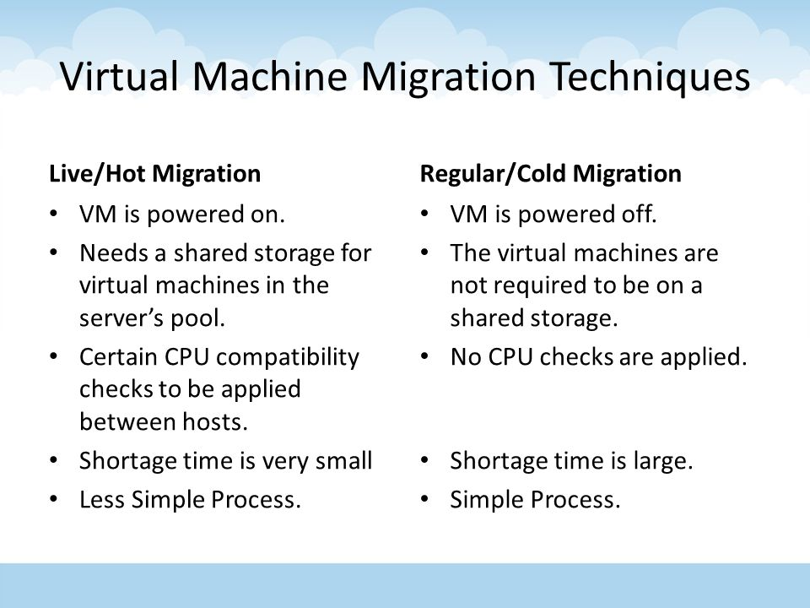

Slide 33
Integration of Private and Public Cloud
Hybrid Cloud:
Hybrid Cloud is an integration of both Private and Public Cloud for high efficiency in performing distinct functions in an organisation. For example, an environment created mixing On-premise, private cloud and public cloud (i.e GCP, AWS, Azure). This framework efficiently utilises the advantages of public resources to upscale their internal resources without risking an overload in case of unexpected spikes in usage.
Ease of scalability.
Cost efficiency much greater than private cloud
Enables more private functions to run on Private framework and sensitive functions to run on Public.
Highly secure and flexible according to organisational needs.

Slide 34

That's all folks for this chapter !!!!

