Slide 1
WEB SCRAPPING AND ANALYSIS ON
ACKO DRIVE FOR OPTIMIZING INVENTORY AND SALES

Slide 2

web platform expertise
Acko Drive is an online automotive platform, part of Acko General Insurance, focused on making car buying and ownership easier.
ACKO Drive is a digital-first platform simplifying the car buying and ownership experience
Online Car Buying: The platform allows users to buy new cars online, eliminating the need for multiple dealership visits and negotiations.Unbeatable Pricing and Value.
Competitive Pricing: Acko Drive partners with a network of dealers to offer transparent, upfront pricing and guarantees competitive rates, with a promise to match lower prices found elsewhere.
Comprehensive Services: Beyond just selling cars, Acko Drive provides a full ecosystem of services, including financing, insurance, and the sale of pre-owned cars.
Maintenance and Repair: Acko Drive operates service centers that offer a range of car maintenance and repair services, from periodic servicing to denting and painting.

Slide 3
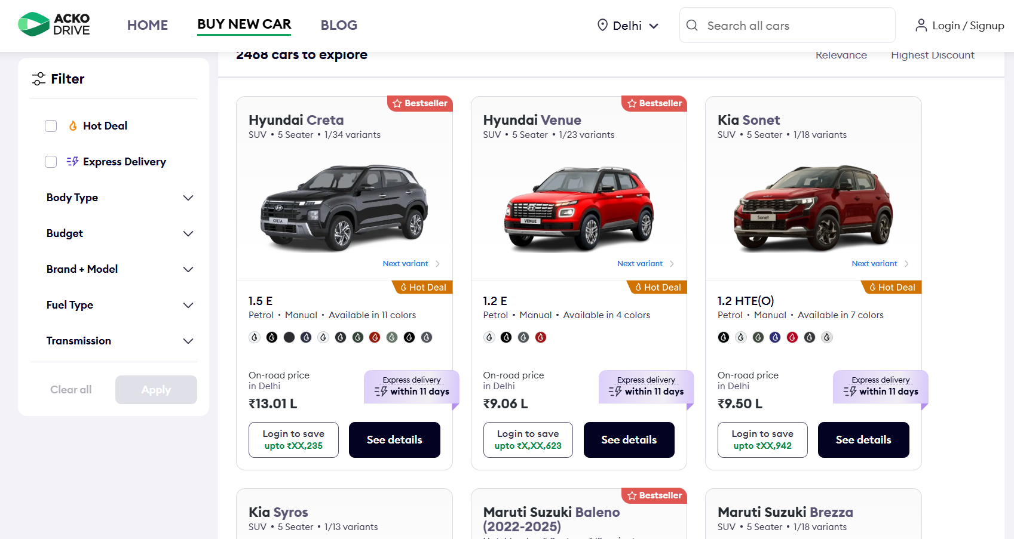
Acko Drive Website UI - ackodrive.com

Slide 4
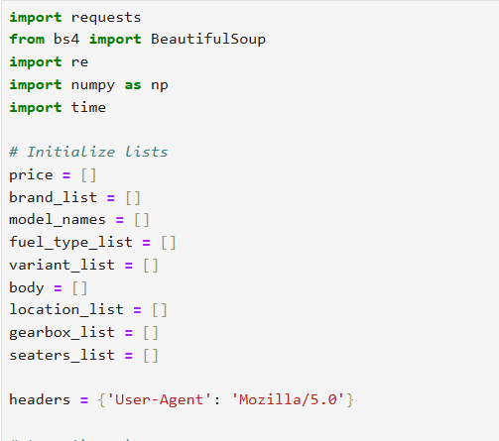
Data Sourcing and Collection
The data was collected by web scraping the ackodrive.com website
Libraries Used:
Requests: Used to make HTTP requests to fetch the webpage content.
BeautifulSoup4: The core library used to parse the HTML and XML documents of the website.
pandas: Used for data manipulation and storing the scraped data in a Data Frame.
The web scraper looped through pages 1 to 100 of the website to extract car data. The HTML structure was analyzed to locate specific tags and classes containing information on the car's brand, model, seating, price, and other details. The extracted data was then stored in individual lists and converted into a pandas Data Frame

Slide 5
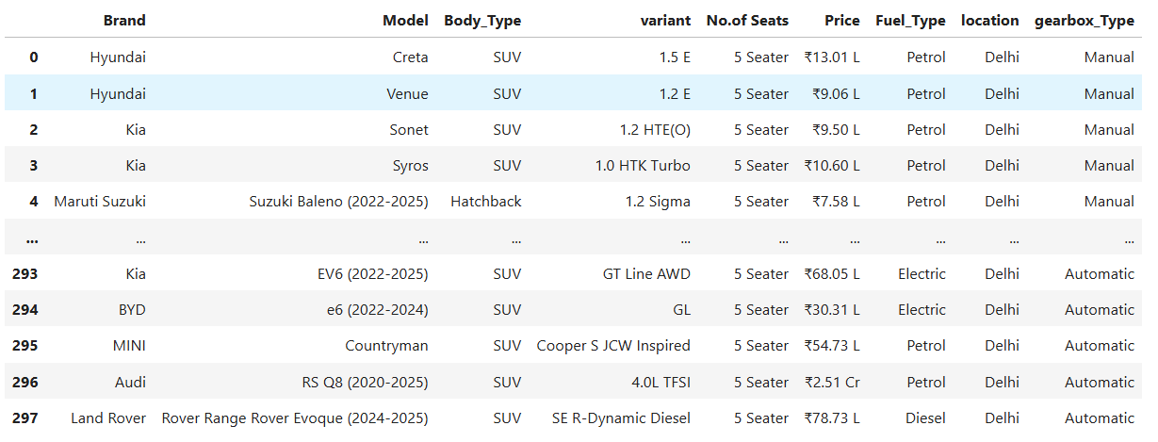
The Extracted Data Frame

Slide 6
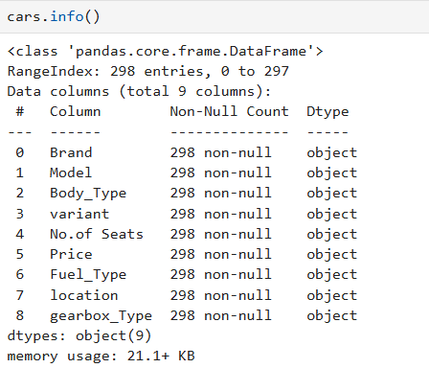
Summary of the Table
Initially, the raw data had 298 rows and 9 columns, with no missing values. The data types were mostly object (strings).
Initial Columns:
Brand
Model
Body_Type
variant
No.of Seats
Price
Fuel_Type
location
gearbox_Type

Slide 7
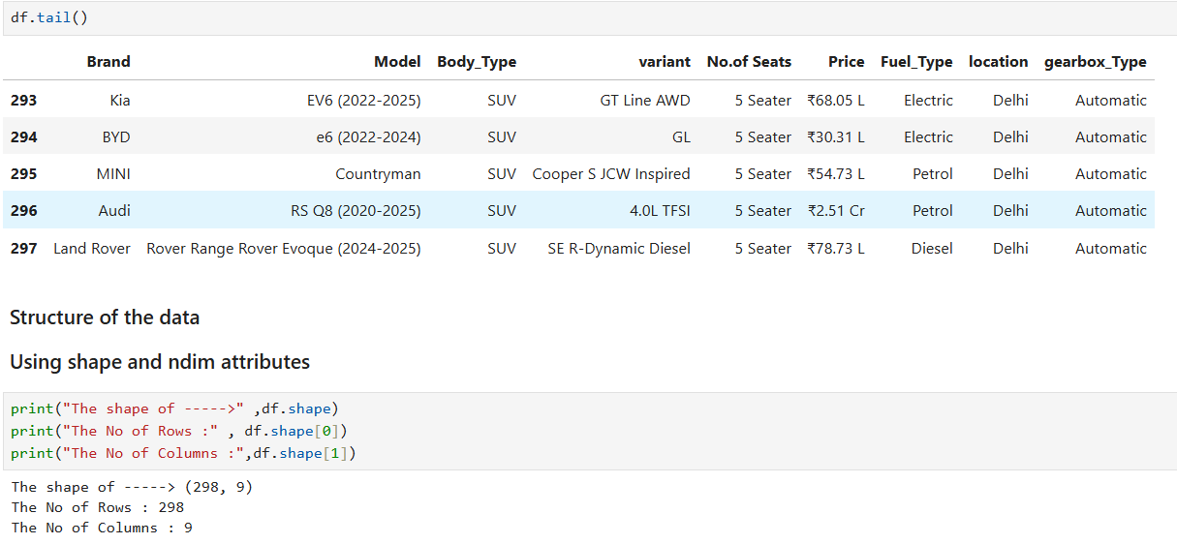
Data Exploration
df.head(): Displays the first 5 rows of the DataFrame, providing a quick look at the data.
df.tail(): Shows the last 5 rows of the DataFrame.
df.sample(): Returns a random sample of rows, useful for getting a non-biased look at the data.
df.info(): Prints a concise summary of the DataFrame, including the index dtype, column dtypes, non-null values, and memory usage. This is crucial for identifying data types and missing values.
df.shape: Returns a tuple representing the dimensionality of the DataFrame (rows, columns).
df.columns: Returns the names of all columns in the DataFrame.

Slide 8
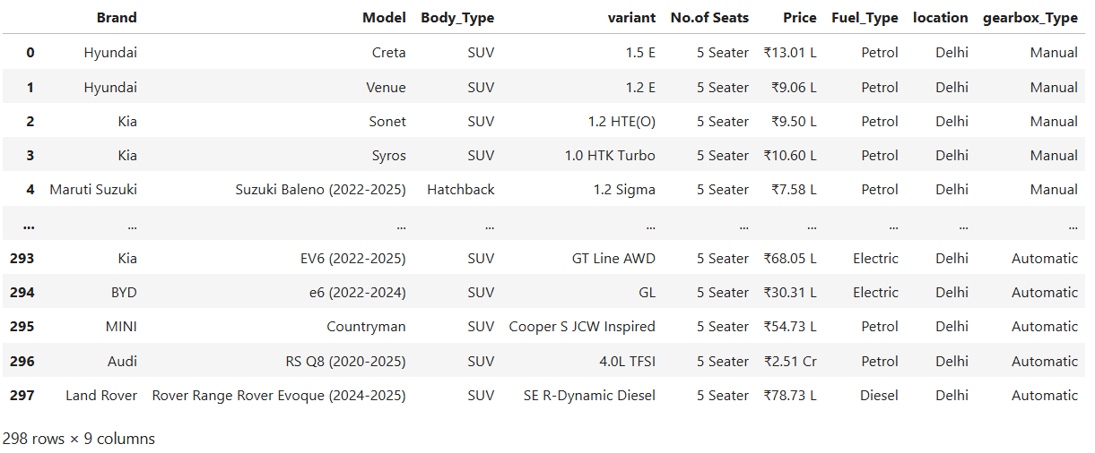
Data Cleaning
The data was cleaned and standardized to prepare it for analysis. Steps:
Column names were standardized by capitalizing the first letter, such as changing 'gearbox_Type' to 'Gearbox_Type'.
The No.of Seats column, which was of object type, had its text 'Seater' removed and was converted to an integer type, and renamed to 'Seater'.
The Price column was cleaned by removing symbols like '₹', 'L', and 'Cr' and then converted to a float data type for numerical analysis.
Year information was removed from the Model column using a regular expression

Slide 9
Data Cleaning Summary – Before vs After
Aspect | Before Cleaning | After Cleaning
Rows × Columns | 298 × 9 | 298 × 9
Column Names | Mixed formatting (e.g., gearbox_Type) | Standardized (e.g., Gearbox_Type)
Seater Column | ‘5 Seater’ (text) | 5 (integer)
Price Column | ‘₹ 12.34 L’, ‘₹ 1.2 Cr’ | 1234000.0 (float)
Model Column | ‘Creta 2021’ | ‘Creta’
Data Types | Mostly object | Proper int / float types

Slide 10
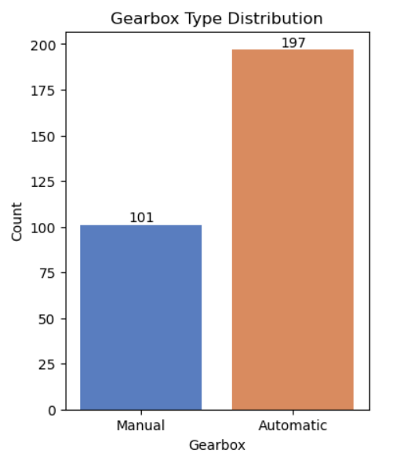
Univariate Analysis – Gearbox Type
Gearbox Type: The dataset shows a higher number of cars with
Automatic gearboxes (197), compared to Manual (101).
Automatic transmission is more prevalent than Manual since ease of use and convenience.
Customer Preference: This distribution could indicate that the target audience or the market for these cars has a slight preference for manual transmission, possibly due to factors like cost, fuel efficiency, or driving control.

Slide 11
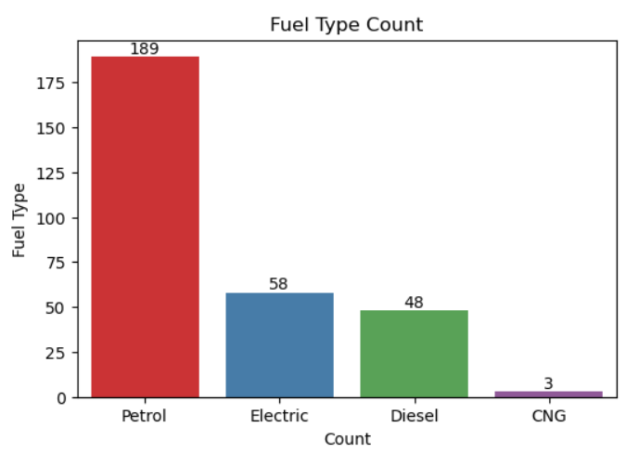
Fuel Type
Dominance of Petrol Cars: Petrol is the most prevalent fuel type, with the highest count. This indicates that the majority of cars in the dataset are petrol-powered.
Next Strong Presence of Electric Cars: Electric car the second most common fuel type. Due to a combination of environmental concerns, cost savings, and advancements in technology. Especially government initiatives, more futuristic and single transmission with no clutch.
Niche Market for Diesel and CNG: Electric and CNG cars have limited availability.

Slide 12
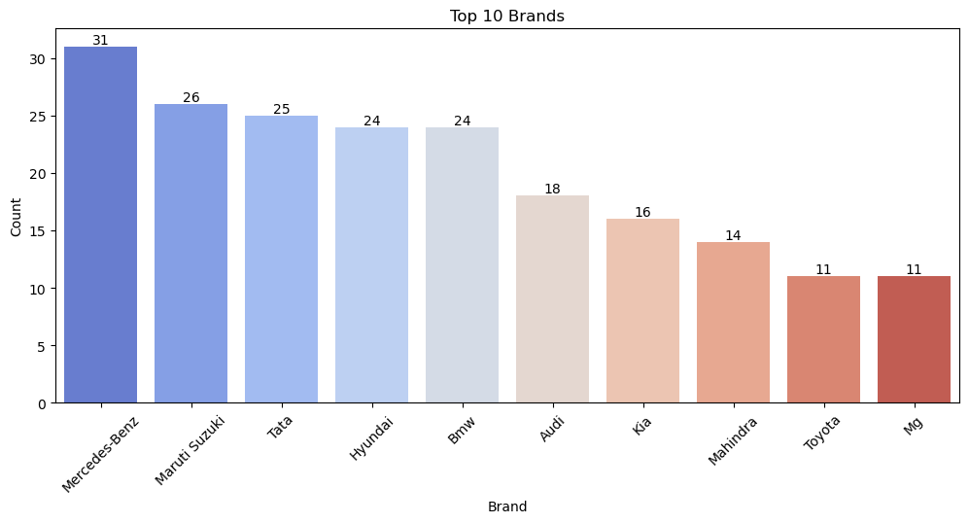
Brands
Mercedes-Benz dominates the top 10 brand followed by Maruthi Suzuki, Tata, Hyundai.
Strong Second Tier: Maruti Suzuki and Tata form the next tier of highly represented brands. Together with Maruti Suzuki, they make up the majority of the car listings.
Solid Mid-Tier: Mahindra, kia and toyota have a moderate and similar number of listings, indicating a strong presence but not on the same level as the top three.
Emerging or Niche Brands: Brands like Kia, MG, Renault, and Skoda rank lower in the top 10, indicating a niche presence or smaller platform inventory.

Slide 13
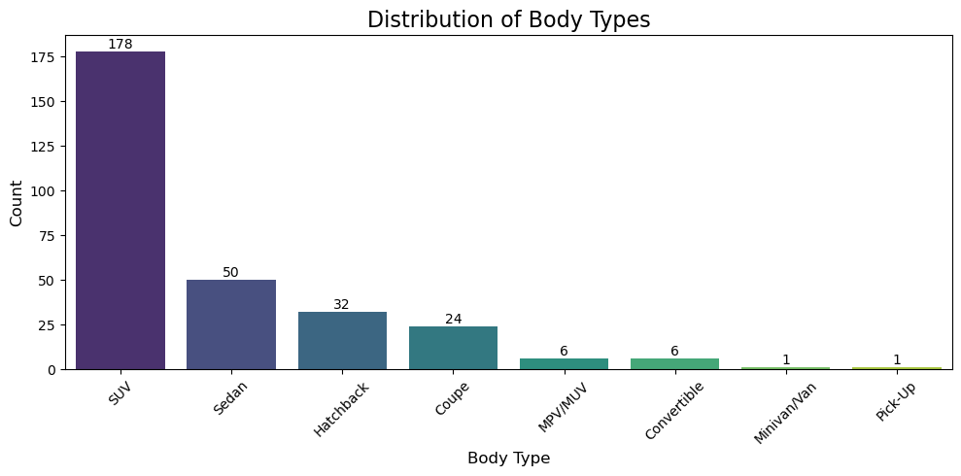
Distribution of Body Type
SUV Dominance: SUVs have the highest count, indicating they are either the most popular and in-demand car type or the main focus of the inventory.
Hatchback and Sedan are Also Popular: Hatchbacks and sedans follow SUVs in count, showing these traditional car types still hold a strong market position.
MPVs and Luxury Cars are Niche: MPVs and luxury cars have far fewer listings, indicating they serve a niche audience and smaller market segment.

Slide 14
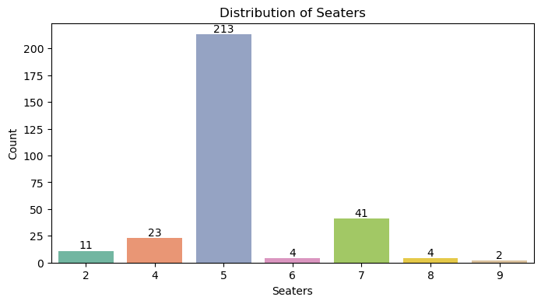
Distribution of Seaters
Dominance of 5-Seater Cars: The 5-seater category has the highest count by a significant margin. This indicates that 5-seater cars are the most common type of vehicle in this dataset
Moderate Presence of 7-Seater Cars: The 7-seater category has a substantial, though much lower, count than the 5-seater. This suggests that while less common, 7-seater vehicles are still a significant part of the inventory.
Niche Market for 8-Seater Cars: The 8-seater category has the lowest count, indicating that these larger vehicles are a niche offering or less frequently listed in this dataset.

Slide 15
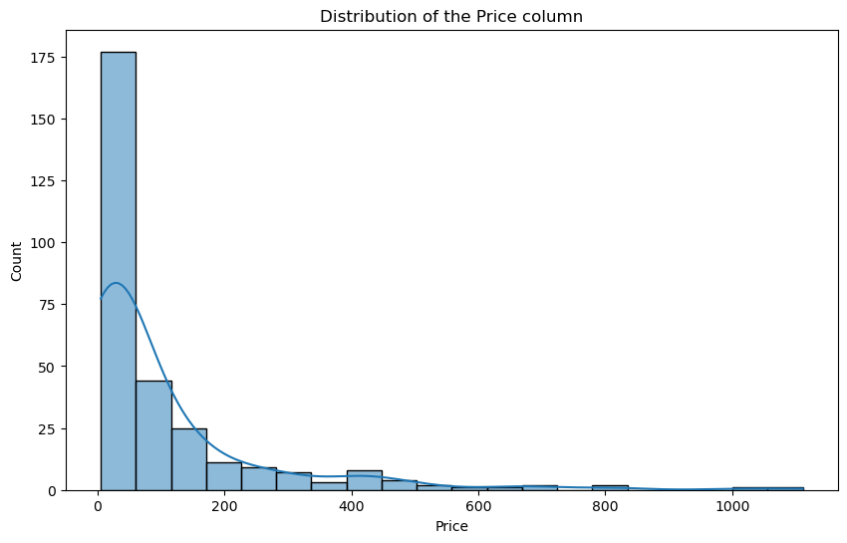
Distribution of Price Column
Right-Skewed Distribution: The histogram is right-skewed, with most car prices clustered in the lower range and a long tail toward higher prices.
Focus on Affordable Cars: Most cars fall in the 13–20 lakh range, indicating the dataset is dominated by budget-friendly, mass-market vehicles.
Presence of Premium Cars: The long tail of prices shows a small number of expensive luxury cars, which are rare and considered outliers in the distribution.

Slide 16
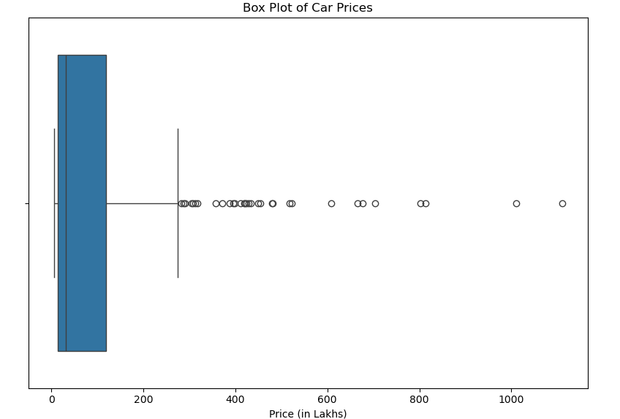
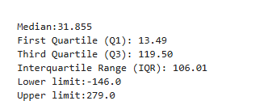
Box Plot of Car Price Column
Median Price: The boxplot’s median line is around 32 lakhs, indicating half the cars are priced below and half above this value.
Central Price Range: The box itself represents the IQR. The box appears to span from roughly 13 lakhs (Q1) to 110 lakhs (Q3). IQR stand at 106 lakhs.
The upper limit states any car price beyond 2.79 Cr to be consider as outliers. Since price cannot be negative any price less than min to be consider as outliers.
Presence of Outliers: The dots on the plot’s right represent outliers—high-end luxury cars priced well above most of the inventory, raising the average price.

Slide 17
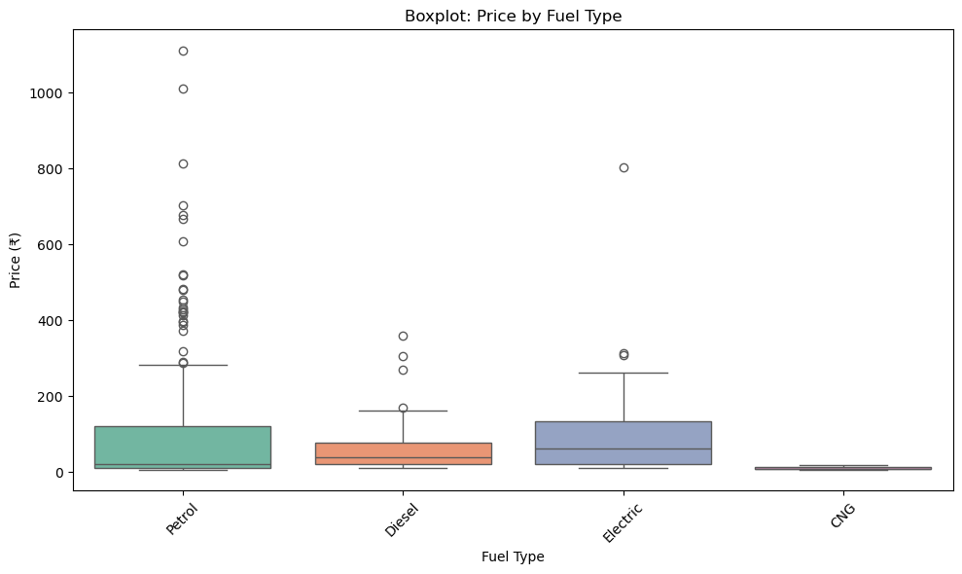
Bivariate Analysis – Price Vs Fuel Type
Electric Cars Are the Most Expensive: Electric vehicles have the highest median price, with a significantly higher price range compared to all other fuel types. This indicates that electric cars are positioned in the premium segment of the market.
CNG Cars Are the Most Affordable: CNG vehicles have the lowest median price and the most compact price range. This suggests that CNG cars are primarily focused on the budget and entry-level segments.
Diesel and Petrol Have Wide Price Ranges: Both Diesel and Petrol cars have a broad price distribution, covering a mix of affordable and mid-range models.
Presence of Premium Outliers: The boxplots for both diesel and petrol show numerous high-end outliers, indicating that while most cars fall within a common price band, there are also several luxury models present. This diversity in pricing appeals to both budget-conscious and premium buyers.

Slide 18
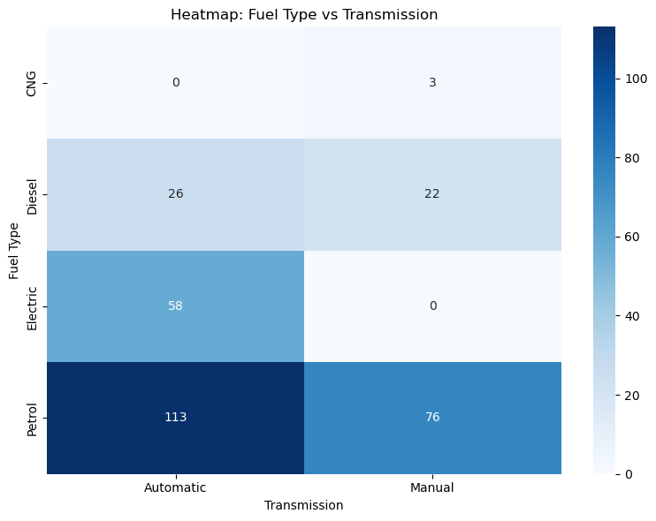
Fuel Type vs Transmission
Manual is More Common: Manual transmission cars have a significantly higher count than automatic cars. This indicates that the majority of the vehicles in this dataset are equipped with a manual gearbox.
Uneven Distribution: The distribution is not a 50/50 split. The data shows a clear preference or a larger inventory for Automatic transmission petrol vehicles .

Slide 19
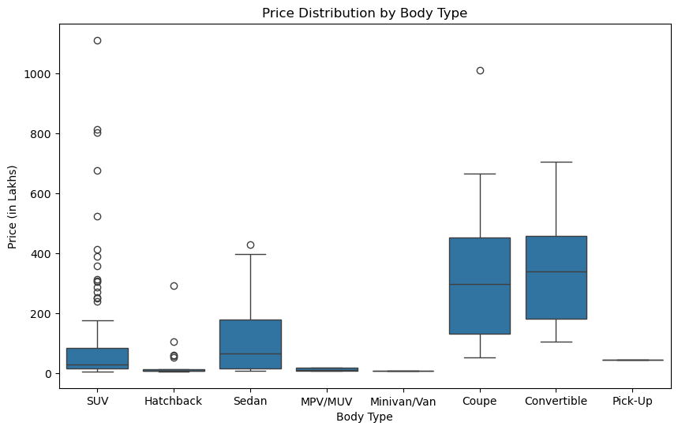
Price Distribution by Body Type
Luxury Cars Are the Most Expensive: As expected, the Luxury body type has the highest median price and price range, positioning them as the most expensive category.
Hatchbacks Are the Most Affordable: The Hatchback category has the lowest median price and the smallest Interquartile Range (IQR), indicating that they are the most budget-friendly cars in the dataset.
SUVs and Sedans Have a Wide Price Range: Both SUV and Sedan body types show a wide distribution of prices, with many outliers at the high end. This suggests that while a significant portion of these vehicles are in the mid-range segment, there are also expensive, premium models available.
MPVs are Priced Between Mid-Range and Luxury: The median price for MPV cars is higher than that of Sedan and Hatchback but lower than Luxury, placing them in a distinct mid-to-high price segment

Slide 20
Recommendations
1. Focus on the Budget-to-Mid-Range Market
Insight: The histogram and box plot of the Price column show that the majority of cars are clustered in the affordable price range (approximately 5-10 lakhs).
Recommendation: Prioritize budget-friendly and mid-range cars to match market demand. Keep listings competitive in both price and features. Focus promotions on this largest inventory segment.
2. Emphasize SUV and Hatchback Segments
Insight: The Body Type analysis reveals that SUVs and Hatchbacks are the most dominant car types.
Recommendation: Highlight SUVs and hatchbacks in marketing to leverage high demand. Showcase key models and features to attract buyers. For SUVs, target both budget and premium segments with tailored content.

Slide 21
Insights
Data-Driven Decision Making Analysis showed SUVs and hatchbacks are most demanded, with Maruti Suzuki, Hyundai, and Tata as top-selling brands. This guides the business to focus on high-demand segments for better stocking and promotion.
Targeted Marketing Identifying popular brands, fuel types, and body types enables precise campaigns—e.g., promoting CNG cars to budget buyers or premium SUVs to high-end customers.
Enhanced Customer Experience Insights on price range and preference for Automatic transmission allow the platform to highlight relevant features, making car searches more tailored and efficient.

Slide 22

THANK YOU

