Slide 1
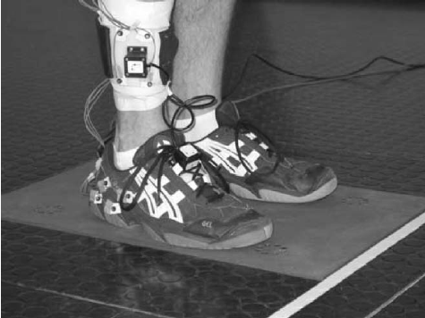
IMU
Accelerometers Step Modeling
ניתוח, עיבוד ומידול של צעדים
מתוך נתוני דגימות של מדי תאוצה
Name: Omri Weiss
Id: 308248657

Slide 2
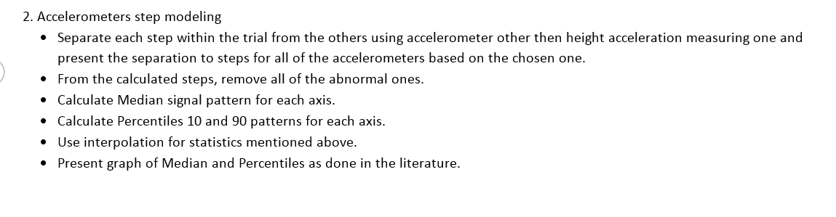
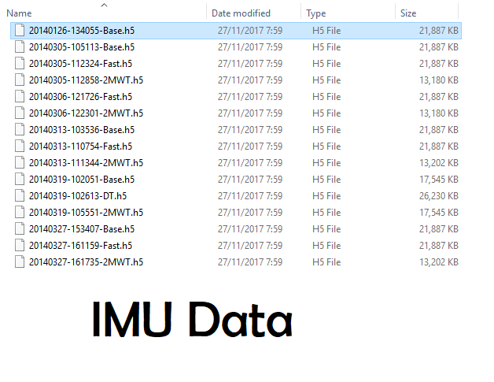
Task
I Chose this file
To work with
6 Steps of Analyzing Data
.h5 Files given,
containing
Data Samples(double numbers)
to analyze and
calculate

Slide 3
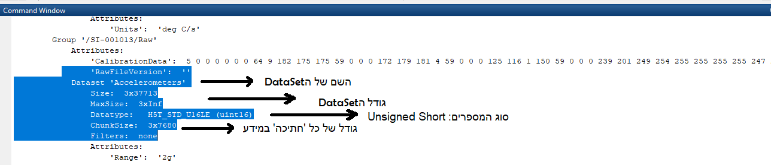
General Data Explain

Slide 4
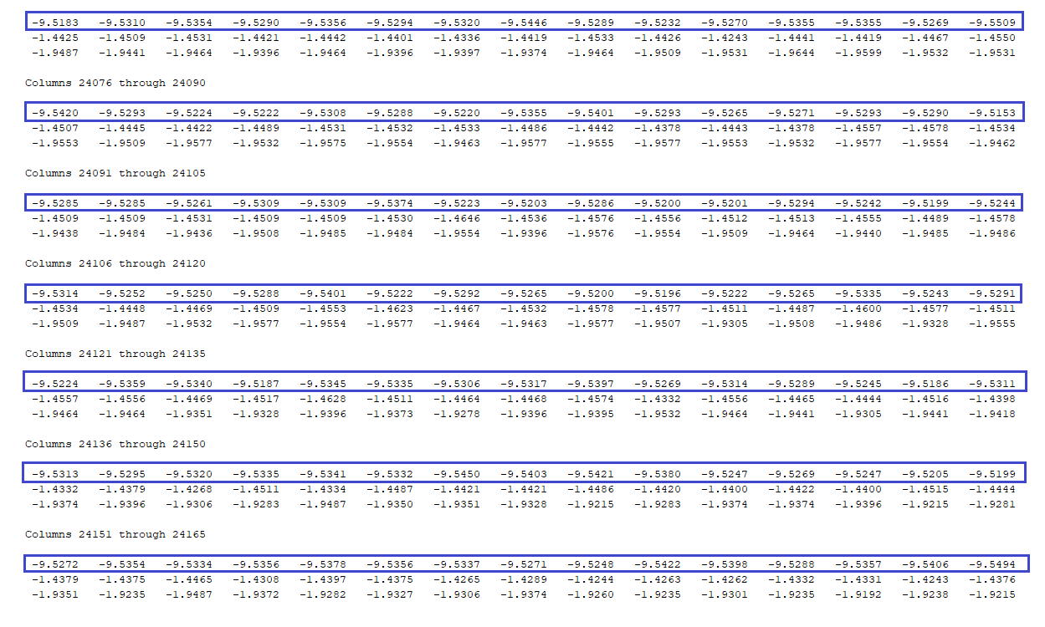

First Step
.h5 data presented as text
Which Samples belong to the height acceleration?!
All blue marked rows
Are ≈ -9.8 m/$s^{2}$
Which is the gravity of earth acceleration (denoted by G) downwards, acting on the foot measured at the height axis.
Therefore we will not use them to analyze steps.

Slide 5
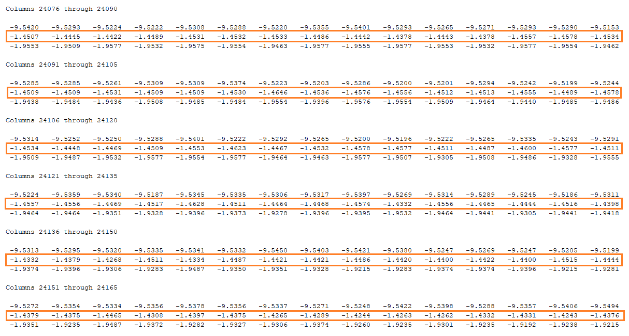
So we are using the 2nd rows, determining by their numbers where each step of the walk begins and where it ends.
We will call this data Width, because the width changes less than the length axis during the walk.

Slide 6
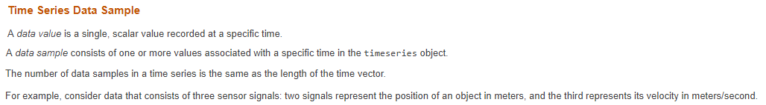
Concepts
The whole IMU Accelerometer data in .h5 is called ‘timeseries Object’ :
The width samples are a ‘data value’ in Matlab.
And each step we need to separate is a ‘data sample’ in Matlab :
The specific time here: 37,713
Data Sample time here: 7,680
Number of Data Samples: 5

Slide 7
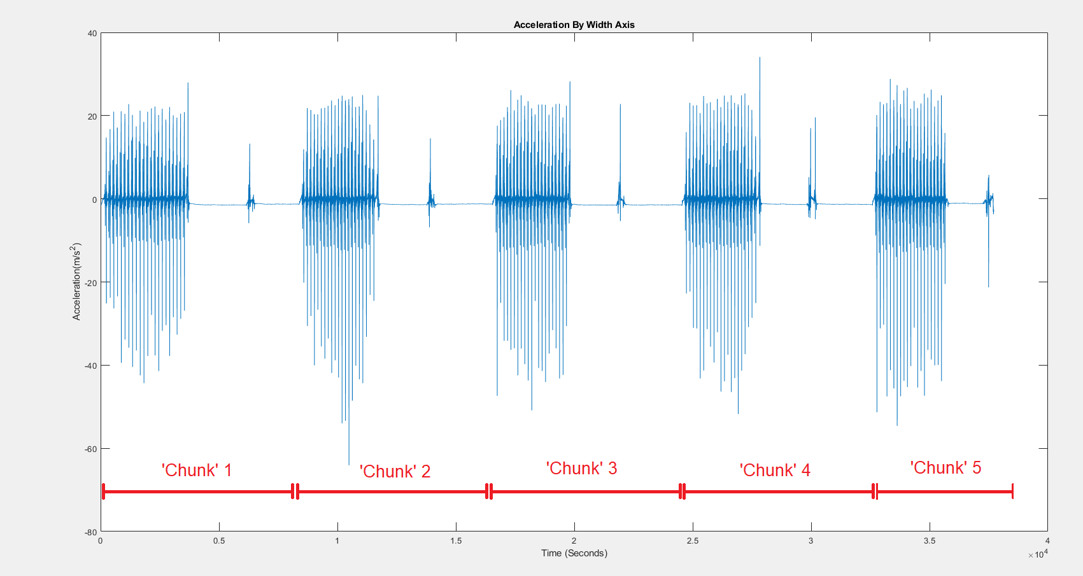

Dividing steps visually
Each of their size
was defined in data as: 7680
5 * 7680 = 38,400 ≈ 37,713
As I was plotting the width samples on screen,
I noticed there are 5 ‘chunks’= Steps in this Movement Data
(marked in Red).

Slide 8
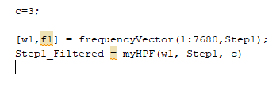
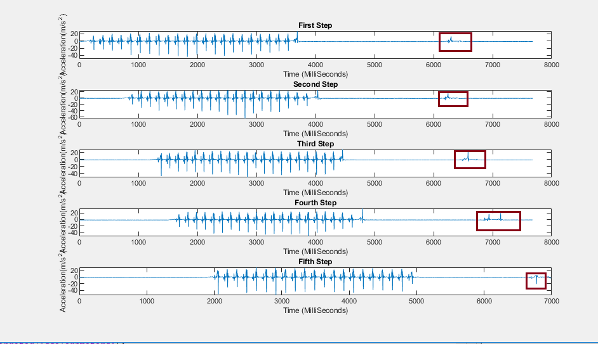
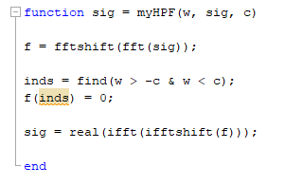
Step 2:removing abnormal steps
Using High Pass Filter(HPF) Function as done in course, I filtered out these abnormal noises:
Resets all signals that
are not within frequencies
range of |c|

Slide 9
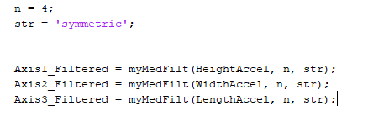
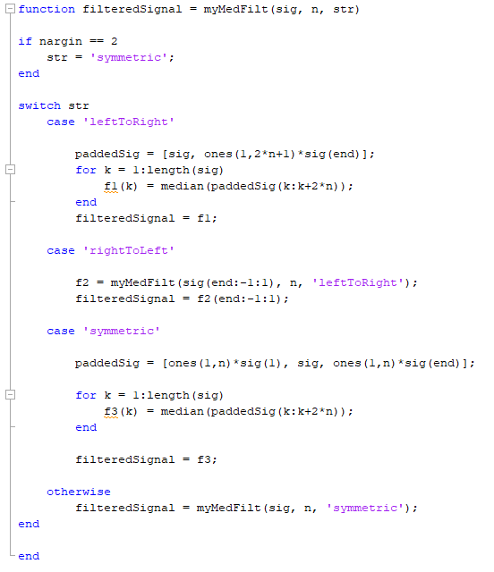
Step 3: Median signal pattern
We use median function(as practiced in lectures) on each one of the 3 Axises we got:
Median Filter function:

Slide 10

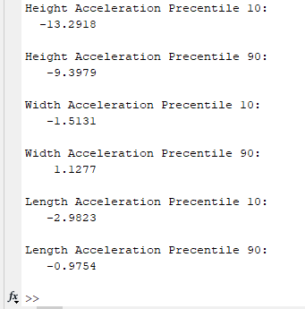
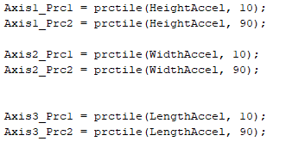
Step 4:Calculating Percentiles
What is a Percentile?
Percentile is a value below which a certain percentage of observations lie.
Percentile 10 is a number that under it there are 10% of the samples in the data.
It doesn’t have to be one of the data samples(like in this case).
Prctile is a Matlab Built-in Function:
I Used it with values 10 and 90:

Slide 11
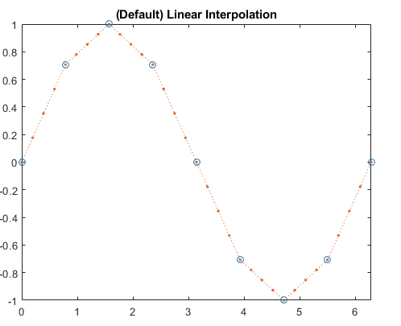
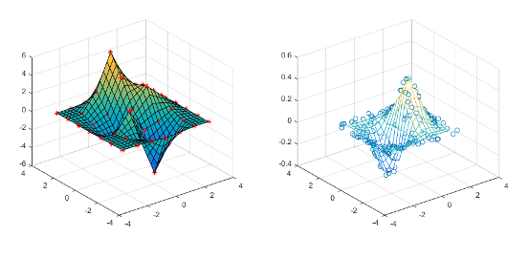
Step 5:Interpolation
Interpolation Is used for adding new data points within a range, in this case it is 3 Dimensions data points.
Given Points
to interpolate to
3D
2D
Given Points to interpolate to

Slide 12



Step 5:Interpolation
אוסף הדגימות הנתון
למשל -
לא הכרחי,שדה שמציין
שיטת אינטרפולציה חלופית לשיטת ברירת המחדל
Height Acceleration
משתנה שמכיל את הדגימות שאנחנו רוצים לקרב אליהן
x
וקטור דגימות זהה בגודלו ל-
שאליו אנחנו רוצים לקרב את הדגימות החדשות
וקטור שמכיל את האחוזונים
10,90 של דגימות תאוצת הגובה
מסוננות לפי
דגימות תאוצת הגובה
מסוננות לפי
Median Filter
Median Filter
Code Implementation:

Slide 13
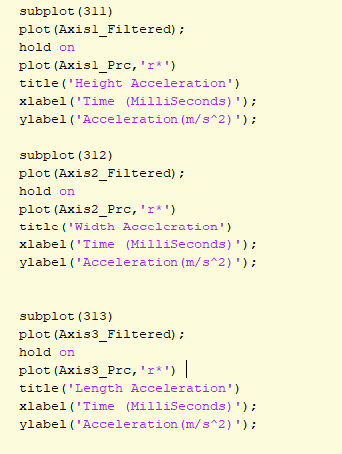
Step 6:Plot Graph of Median&Perecentiles
Showing Percentiles over the
Median filtered graphs

