Slide 1
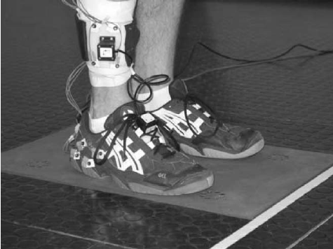
IMU
Accelerometers Step Modeling
ניתוח, עיבוד ומידול של צעדים
מתוך נתוני דגימות של מדי תאוצה
Name: Omri Weiss
Id: 308248657

Slide 2
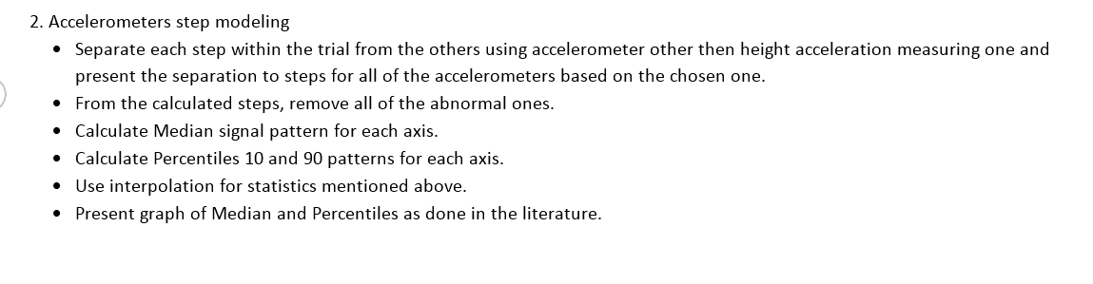
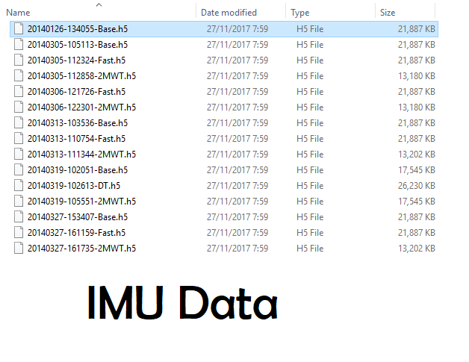
Task
I Chose this file
To work with
6 Steps of Analyzing Data
.h5 Files given,
containing
Data Samples(double numbers)
to analyze and
calculate

Slide 3
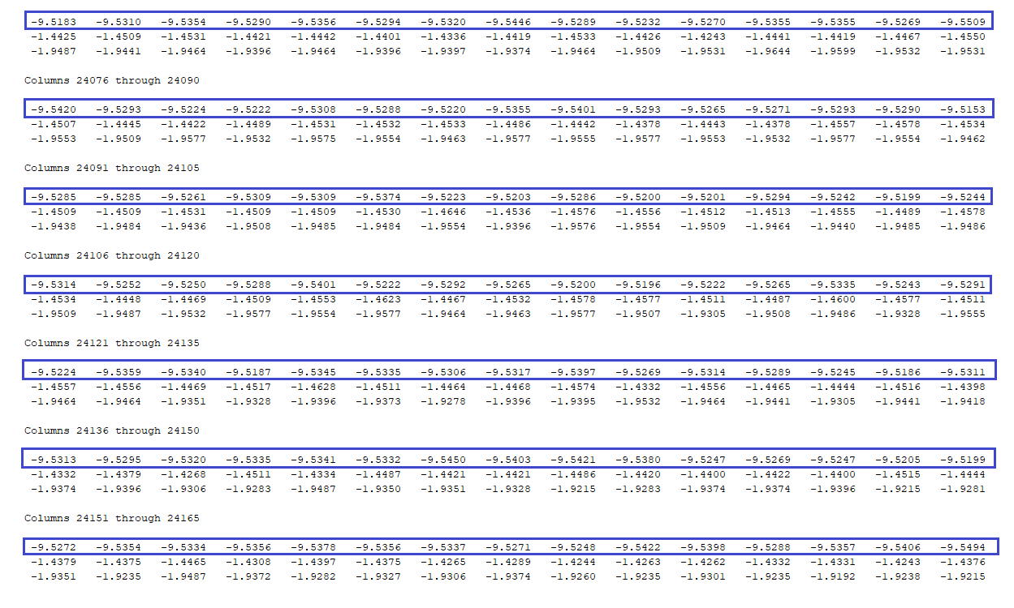

First Step
.h5 data presented as text
Which Samples belong to the height acceleration?!
All blue marked rows
Are ≈ -9.8 m/$s^{2}$
Which is the gravity of earth acceleration (denoted by G) downwards, acting on the foot measured at the height axis.
Therefore we will not use them to analyze steps.

Slide 4
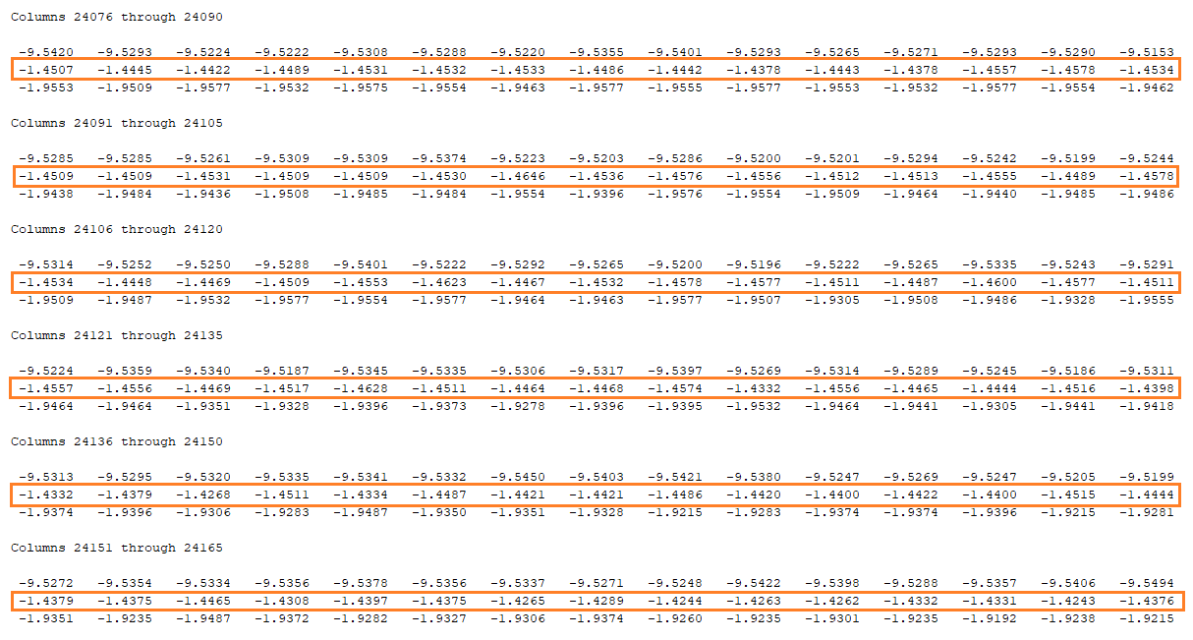
So we are using the 2nd rows, determining by their numbers where each step of the walk begins and where it ends.
We will call this data Width, because the width changes less than the length axis during the walk.

Slide 5
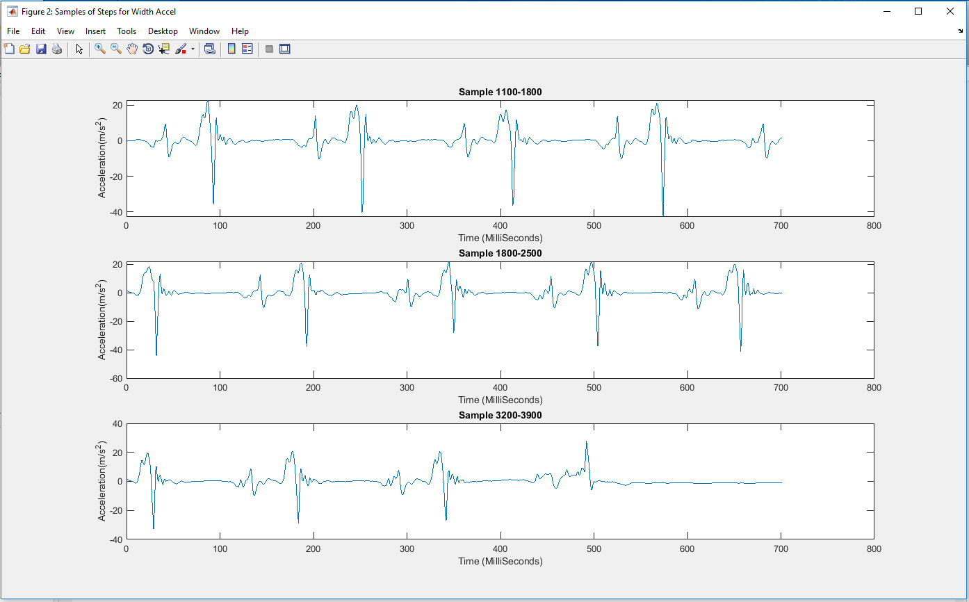
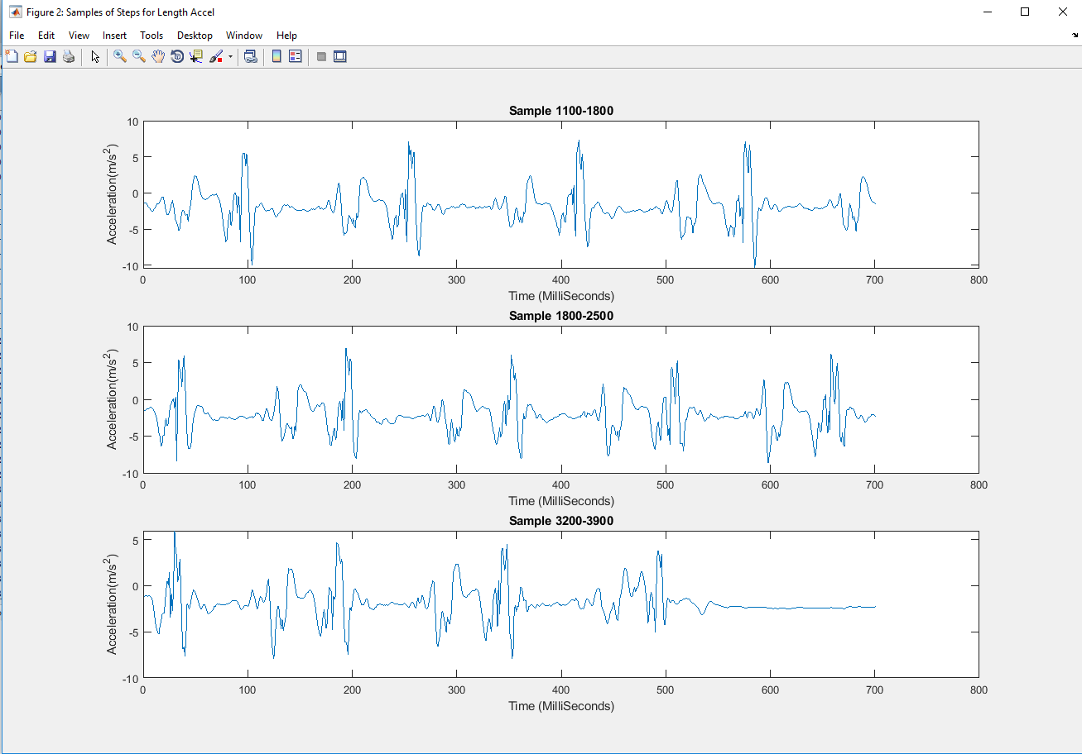
Identifying steps pattern
I was plotting a few ranges of data for the 2 Axes on screen to see if there is a certain pattern.

Slide 6
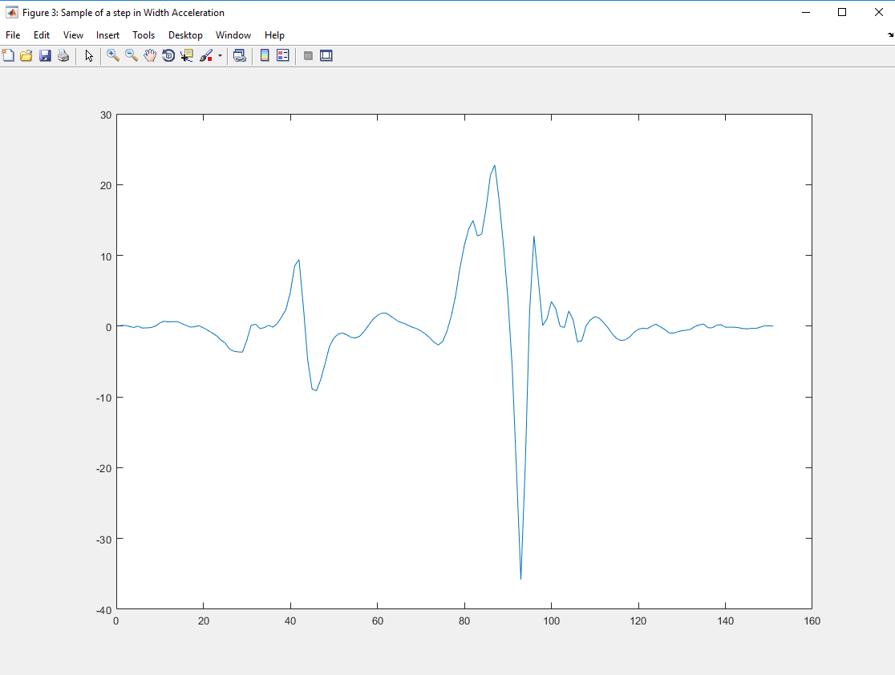
How to determine if a pattern in my data is a step?
This is the most common pattern I found.
You can see about 4-5 local
maximum points
1 maximum point is very radical
(18-25 range amplitude usually)
You can see about 2 local
minimum points,
1 minimum point is very radical

Slide 7
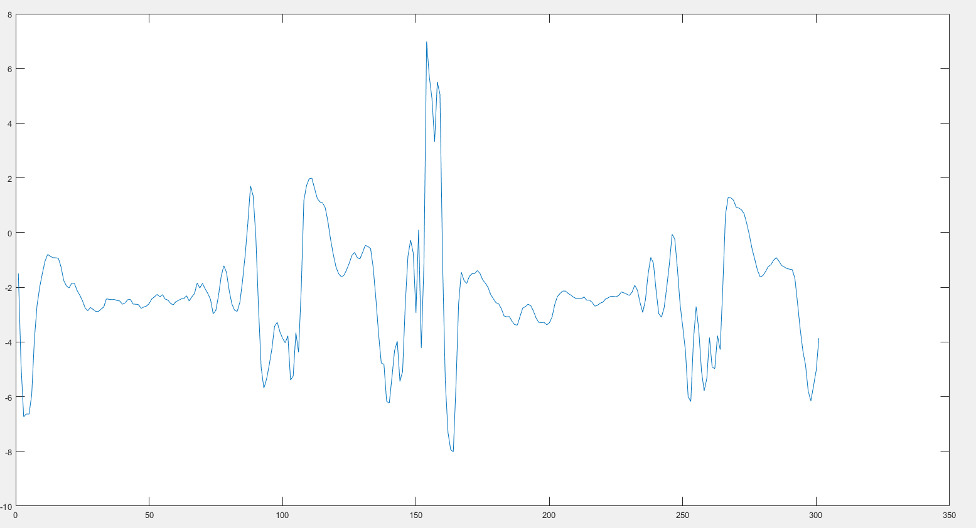
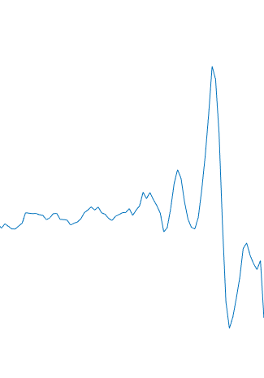
Before and after each step pattern there is a 20-70 Milliseconds
part with Amplitude in -3 to 2 range(purple).
After this the function goes down to minimum local point(orange)
After this the function goes down to maximum local point(green)
After this the function goes down to another maximum local point(red)

Slide 8
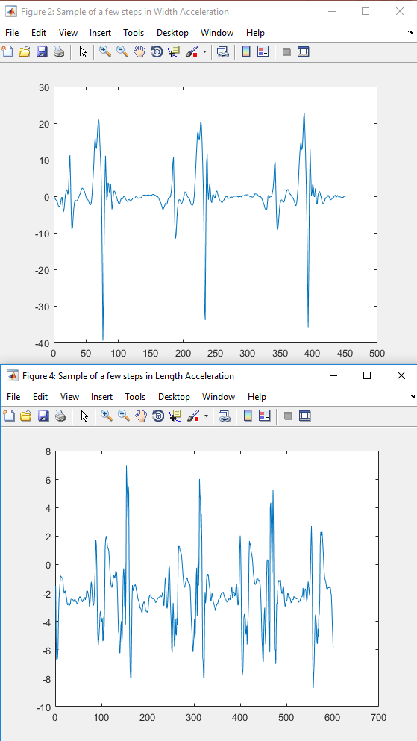
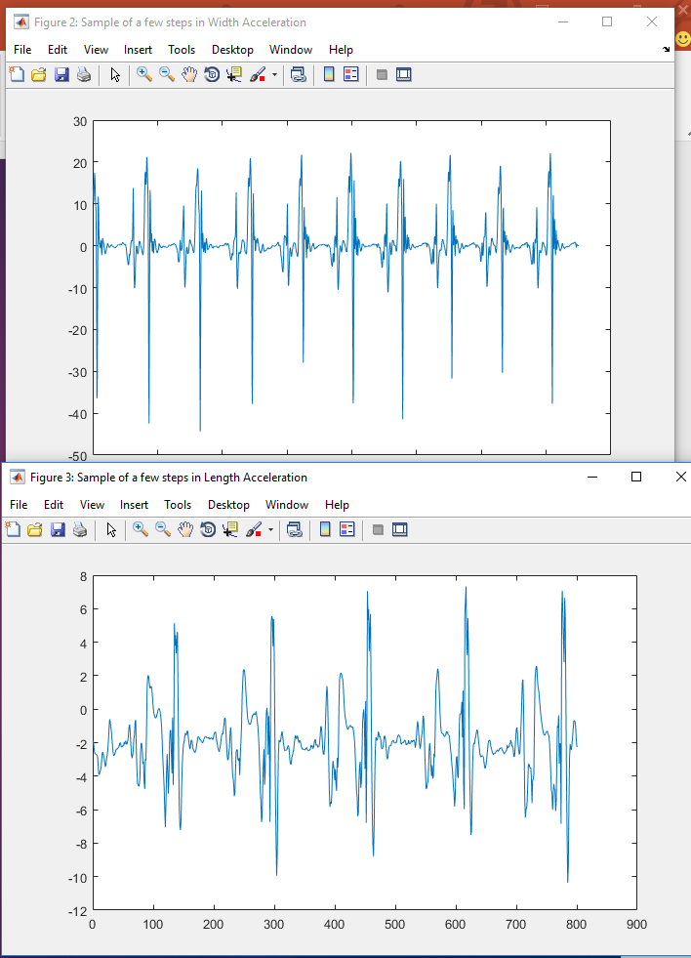

Slide 9
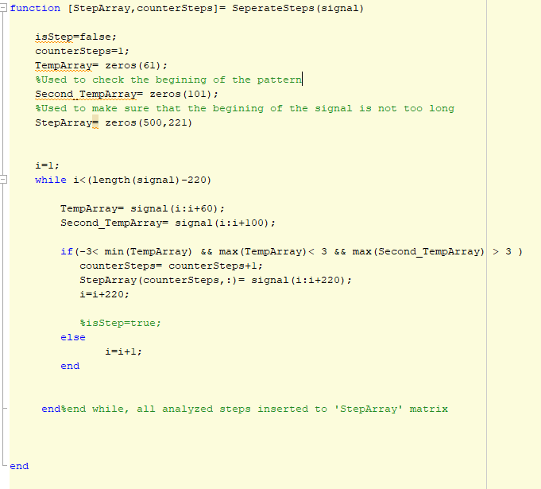
Separating steps algorithm
The idea of the algorithm is to
check the first repetitive part which is
Supposed to be within a range of -3 to 3
I also used an Auxiliary Array to make sure
That the cut of the beginning is not too
Long(more than 100).

Slide 10
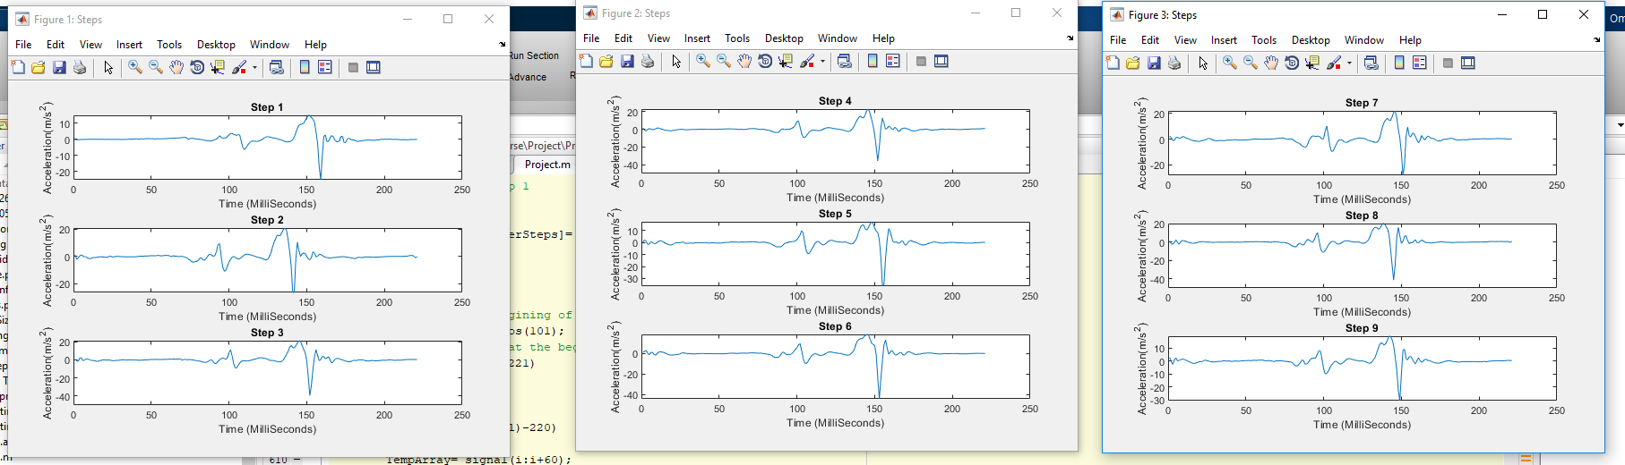
9 Steps result

Slide 11
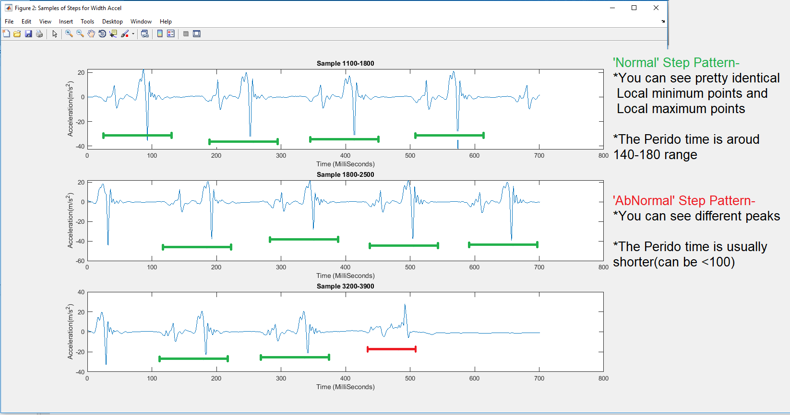
Step 2:Abnormal steps

Slide 12
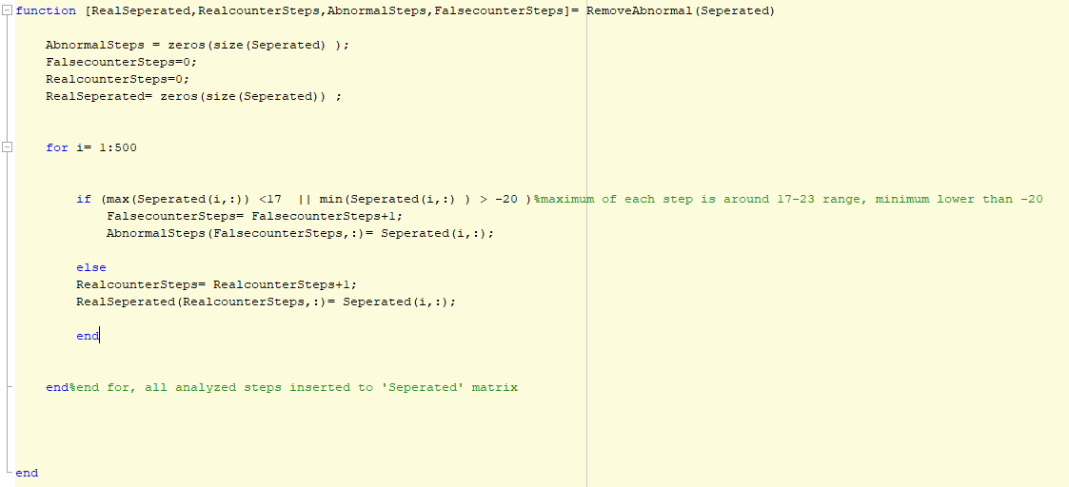

Removing Abnormal algorithm

Slide 13
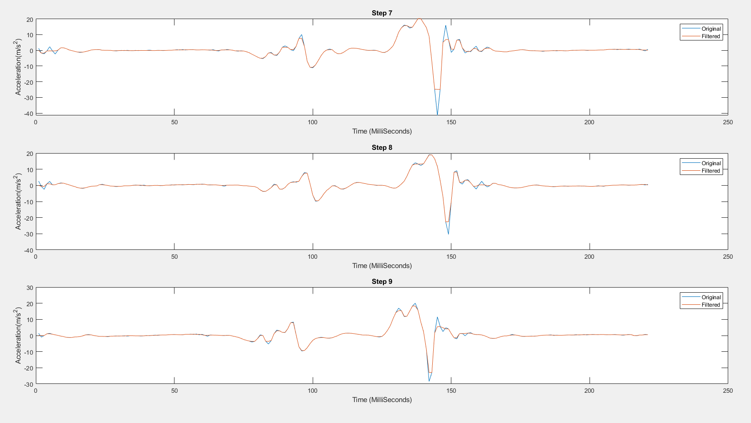
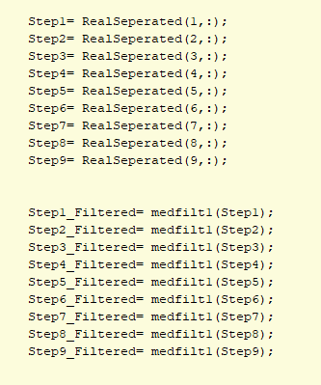
Step 3: Median signal pattern
I used medfilt1() function on each one of steps in the matrix I got after removing the abnormal ones, to create this pattern(orange):
Example:

Slide 14
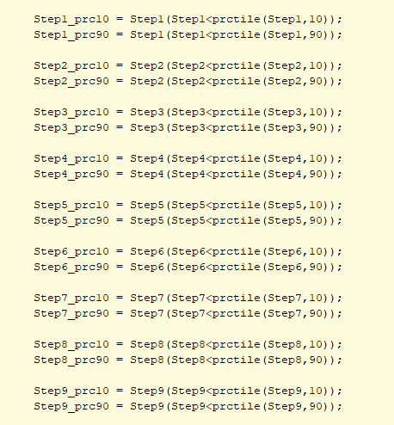

Step 4:Calculating Percentiles
What is a Percentile?
Percentile is a value below which a certain percentage of observations lie.
Percentile 10 is a number that under it there are 10% of the samples in the data.
It doesn’t have to be one of the data samples(like in this case).
Prctile is a Matlab Built-in Function:
I Used it with values 10 and 90 and added a condition to
get all the numbers that are under this percentile:

Slide 15
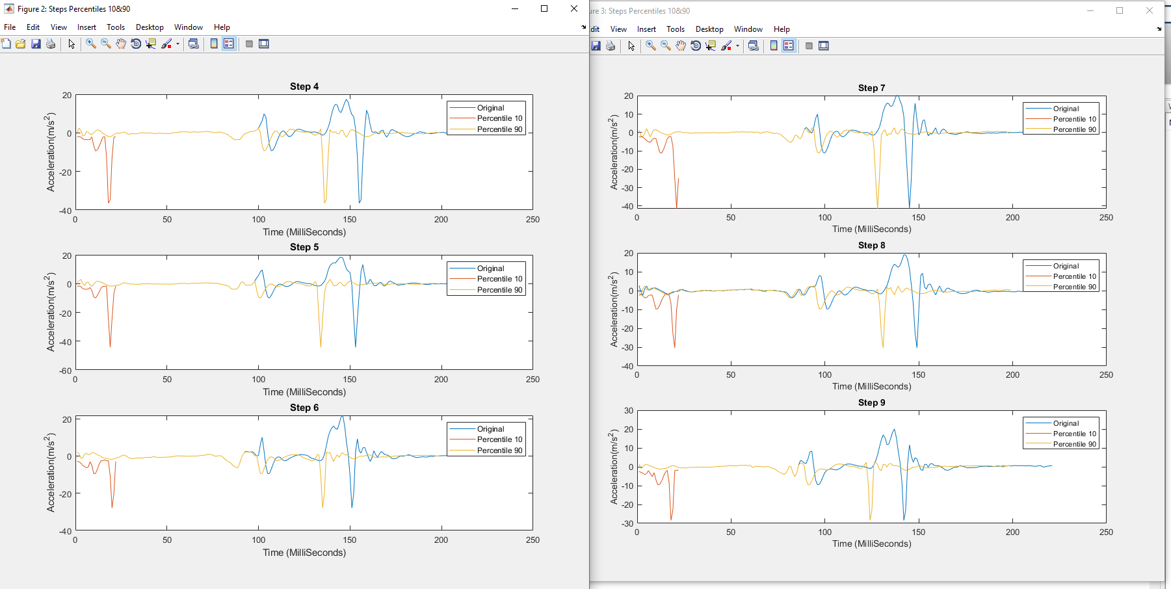
Result

Slide 16
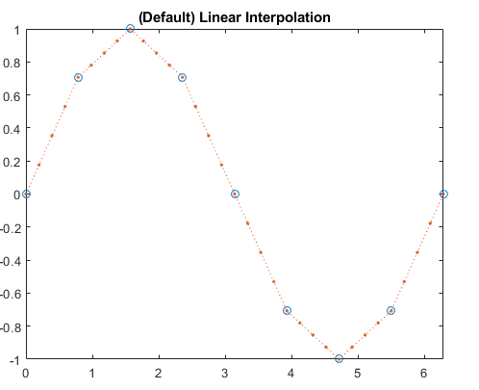
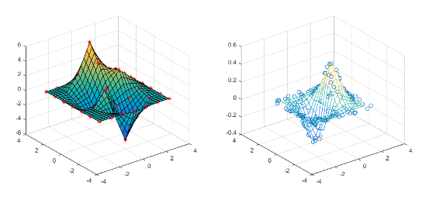
Step 5:Interpolation
Interpolation Is used for adding new data points within a range, in this case it is 3 Dimensions data points.
Given Points
to interpolate to
3D
2D
Given Points to interpolate to

Slide 17

Step 5:Interpolation
לא הכרחי,שדה שמציין
שיטת אינטרפולציה חלופית לשיטת ברירת המחדל
x
וקטור דגימות זהה בגודלו ל-
משתנה שמכיל את היחס בין גודל הצעד הספציפי הזה לגודל צעד מקסימאלי שנמדד
דגימה מסויימת שרוצים
לשנות -
Step 1 Filtered
Code Implementation:

Slide 18
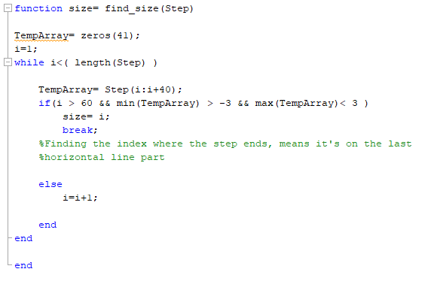
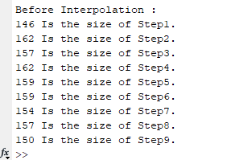
Interpolation parameters
I used my own designed find_size(Step) function to find size of each step:

Slide 19
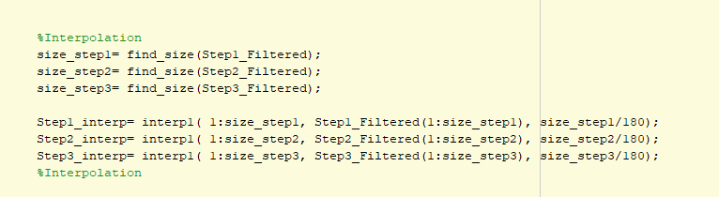
Interpolation
Code Implementation:

Slide 20
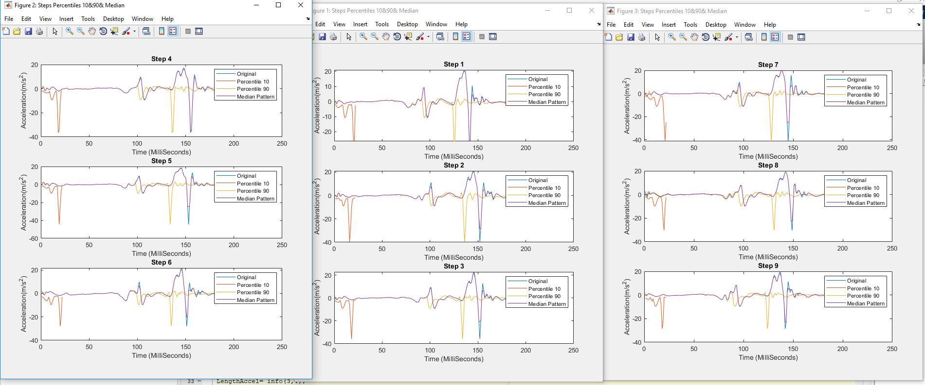
Step 6:Plot Graph of Median&Perecentiles
Showing Median filtered over the Percentiles graphs

