Slide 1

GitHub
Katkov Michelle

Slide 2
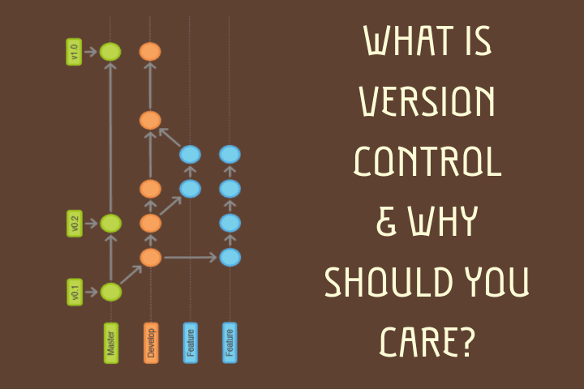

Slide 3
Version Control - Motivation
You won't lose your code by accident. Having a version control system, preferably with a remote service, will mean you're going to have another place where your code is stored. If several developers are working on the code simultaneously, then each one of them will have a copy of the entire code (or, in some cases, even the entire history).

Slide 4
Version Control - Motivation
You won't lose your code, the code is stored for many developers.
It allows you to keep historical versions of the code, for easy reverting, comparison and investigation.

Slide 5
Version Control - Motivation
You won't lose your code, the code is stored for many developers.
It allows to keep historical versions of the code.
Let's say you introduced a bug. With a version control system you can easily revert to a previous version of the code where the bug was not present to verify that it did not exist there. Then you can diff the results, or even bisect the history to find the exact check-in that introduced this bug.

Slide 6
Version Control - Motivation
You won't lose your code, the code is stored for many developers.
It allows to keep historical versions of the code.
You can easily revert to a previous version.
It allows one to maintain several simultaneous lines of code (normally called "branches") and to easily compare between them and merge them.

Slide 7
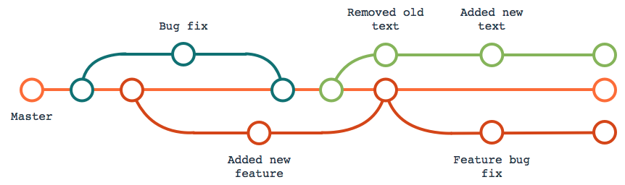
Version Control – Main Idea

Slide 8
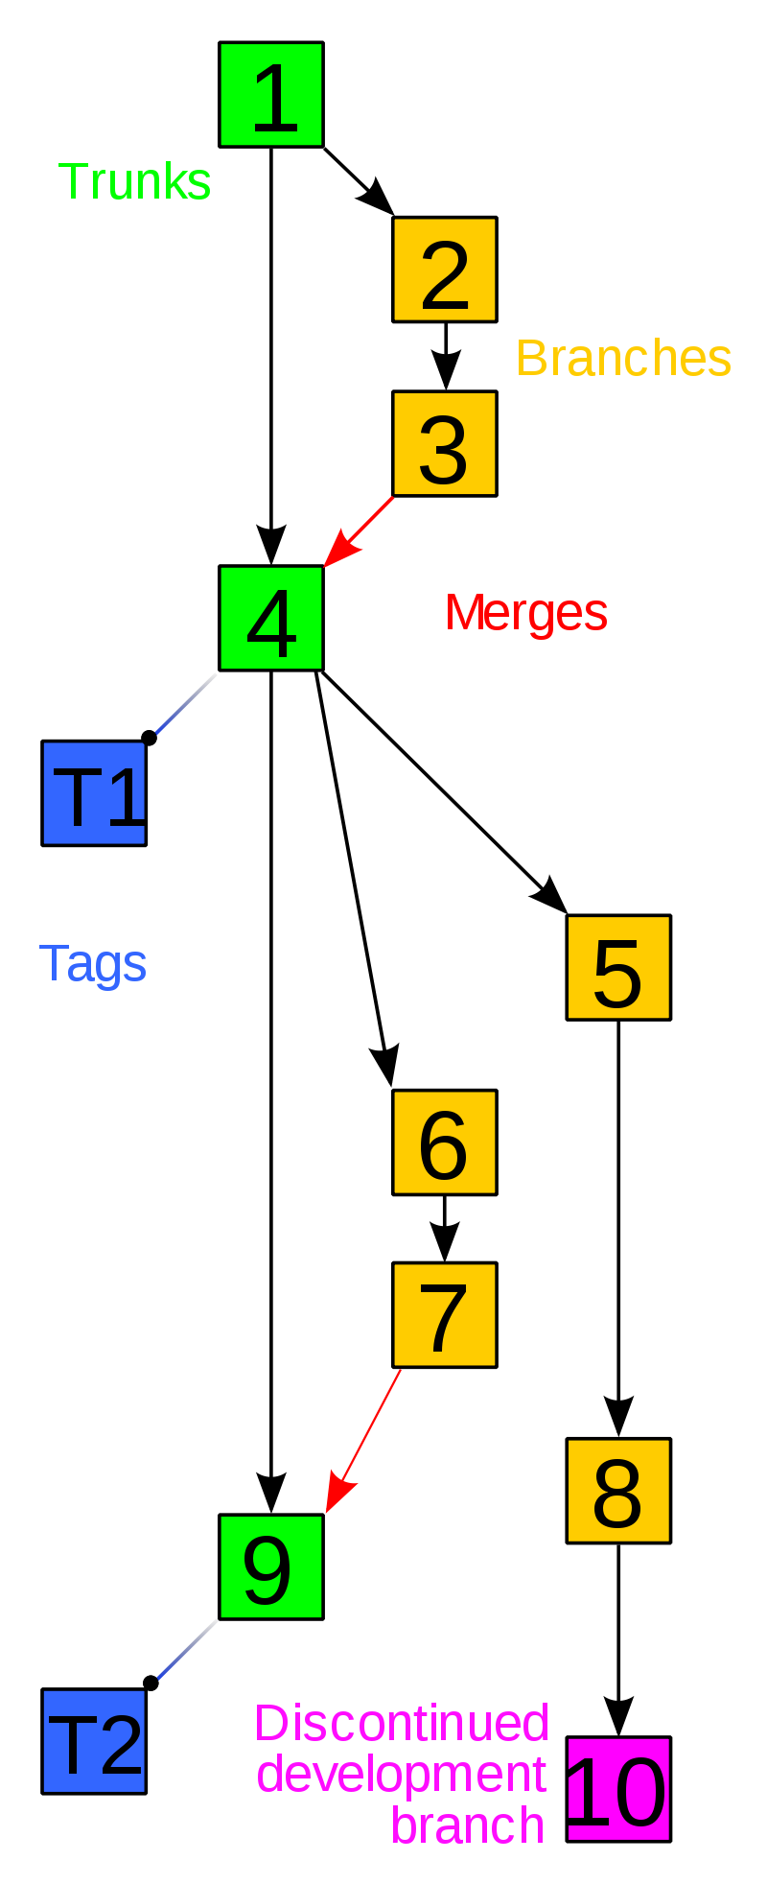
Version Control – Main Idea
Trunk ( a line of development )
Branches ( new features, bug fixes, testing crazy ideas)
Baseline, label, or tag ( a snapshot – a working version with ) ( a name associated with it )
Discontinued ( everybody got tired and went home )

Slide 9
Version Control – Development of Linux
Linux is huge.
1991–2002 - patches and archived files.
2002-2005 - the Linux kernel project began using a proprietary DVCS called BitKeeper.
2005 - Linux and BitKeeper broke down
2005 – now - Linux community develops its own tool - Git with goals of:
Speed
Simple design
Strong support for non-linear development (thousands of parallel branches)
Fully distributed
Able to handle large projects like the Linux kernel efficiently (speed and data size)

Slide 10
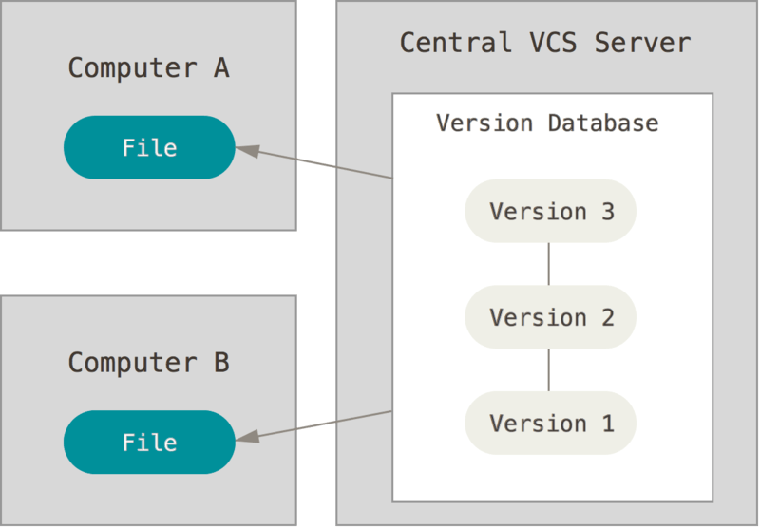
Version Control – Git
Git is one of the implementations
SAVE on server
WORK at home
Amazingly fast
Very efficient with large projects

Slide 11
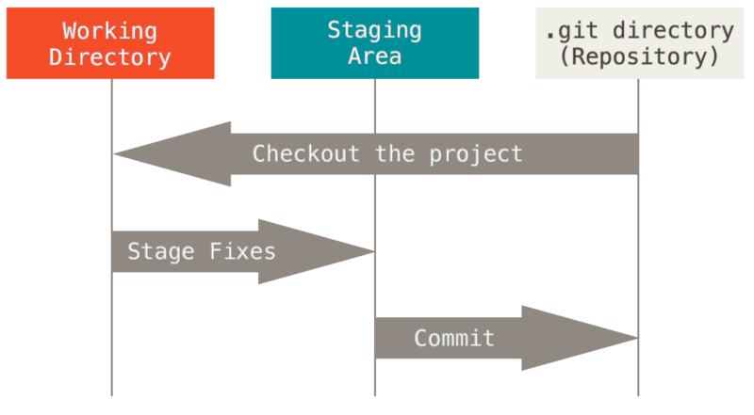
Version Control – Git
REPOSITORY – Version Database
Reading from server – Checkout
WORKING DIRECTORY – Computer A,B
Change files in working directories
Inform git of changes – Stage Fixes
Store to server - Commit

Slide 12
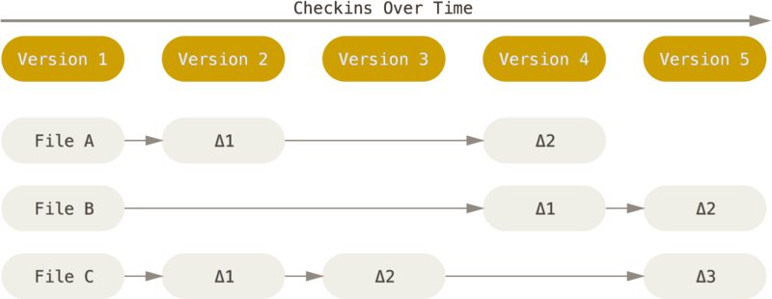
Version Control – Git
Previous version controls stored incremental information

Slide 13
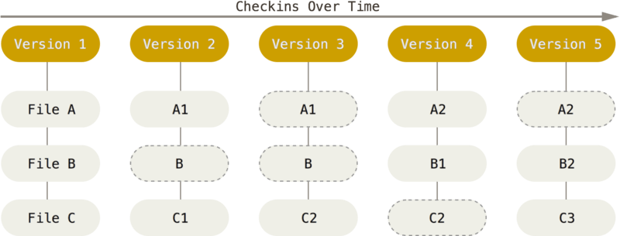
Version Control - Git
Git stores last version

Slide 14
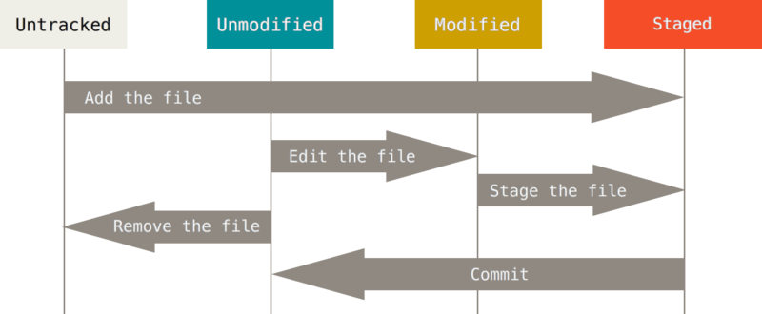
Git - Editing Workflow
Working Directory - > Staging Area
Untracked files - files in your working directory that were not in your last snapshot and are not in your staging area
Inform Git of file – Add to staging area.
You modify files in your working tree (change them since your last commit) – Edit the file.
Selectively stage just those changes you want to be part of your next commit – Stage the file.

Slide 15
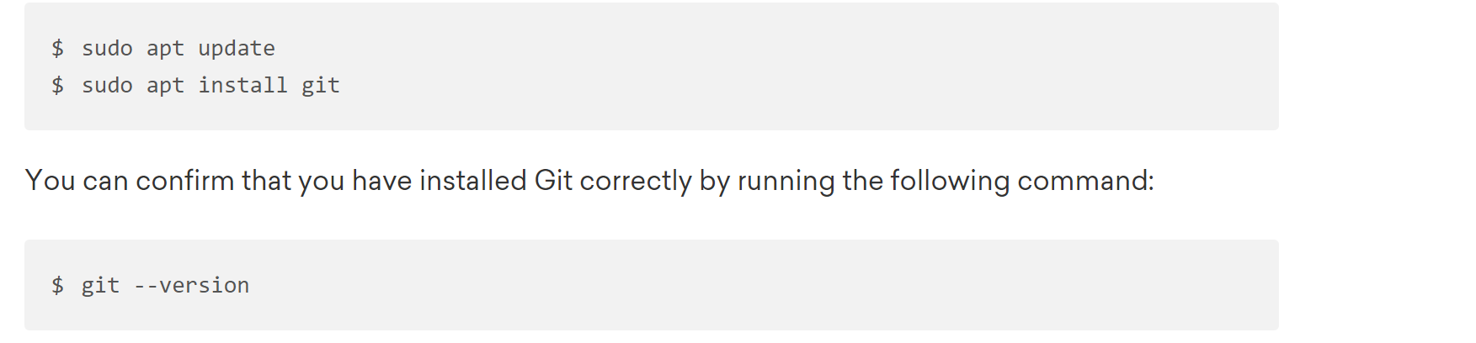
אוקיי, אפשר להוריד git כמו שיש בשקף הבא וזה סבבה אבל אולי זה רק המחשב שלי - כשאני משתמש בgit for windows זה מידי פעם קורס.
קיצר הורדתי git ל ubuntu subsystem וזה סבבה.
איך לעשות את זה:
התקנת linux https://www.windowscentral.com/install-windows-subsystem-linux-windows-10
התקנת git:

Slide 16
Git - First-Time Setup
Hello Git!
git config --global user.name "Michelle Katkov“
git config --global user.email mkatkov01@gmail.com
git config --global core.editor "'C:/Program Files/Notepad++/notepad++.exe' -multiInst -notabbar -nosession -noPlugin"\
בנוסף, אתם מוזמנים להוריד את GitHub for windows - זה gui נוח. שמאפשר עבודה עם shell built in.
https://git-scm.com/downloads (Mac OS X, Windows, Linux/Unix)

Slide 17
Git - Initializing a Repository and Adding Files
git init
Creates .git directory and initializes the local repository there.
git clone https://github.com/libgit2/libgit2 <directory>
Initializes repository with a code from another project.
Copies repository from internet address to directory.
git add (*.py)
Adds specified files to staged .
“git add .” > (adds all files in directory)
git commit -m <description of changes>
Adds the current project version to the repository
Saves your description for the current version
git status
Displays status of tracked files.
git status -s (shorter status)
אם לא משתמשים ב-m אז זה פותח עורך טקסט כדי שתכניסו את התיאור של הקומיט.

Slide 18
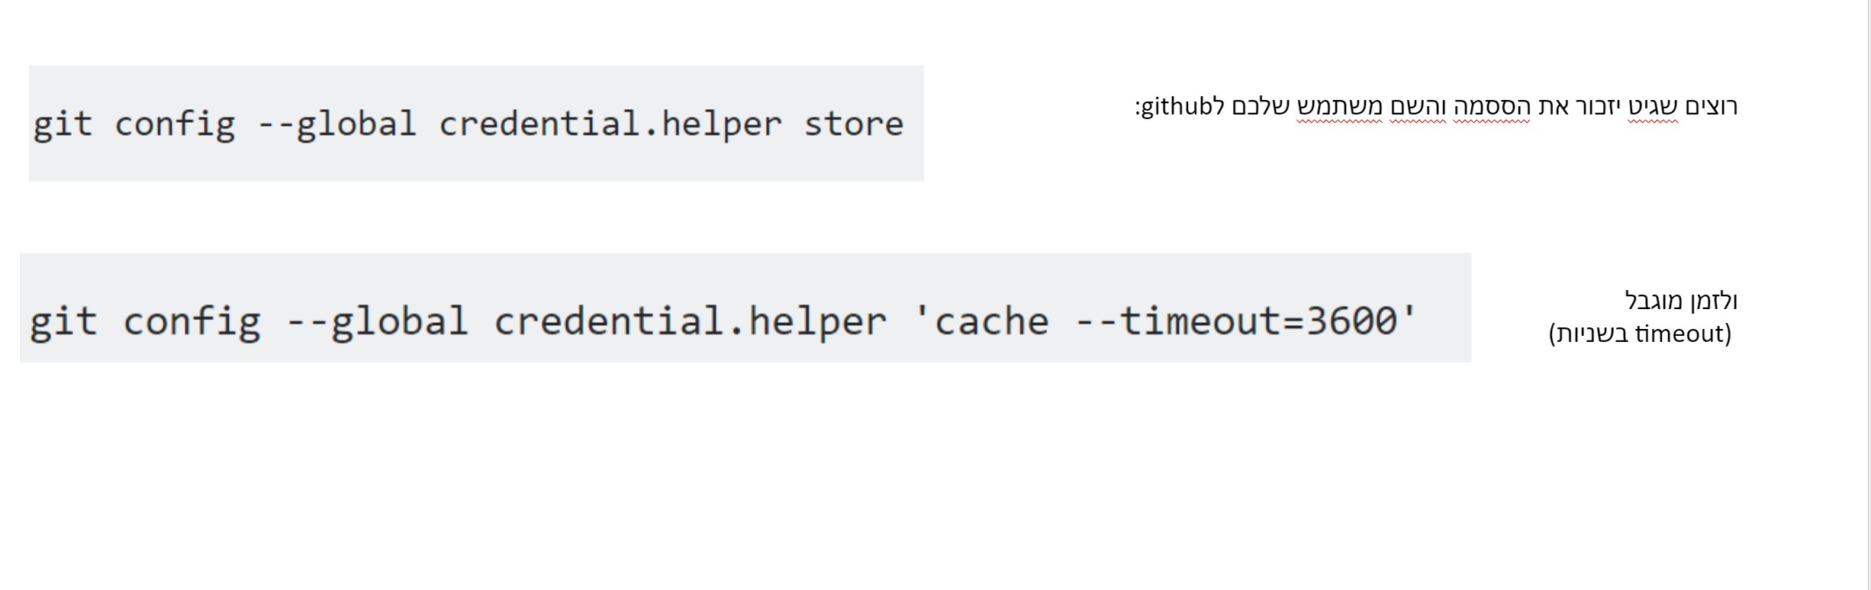
Git and Github:
git is local, however Github allows web based collaboration and git works with github.
so in order to clone the Github “byteme” repo we will use the following command:
על מנת שלא תצטרכו לספק סיסמה ושם משתמש כל פעם שתיגשו לrepo בgithub.
לאחר מכן הכניסו את הפקודה הבאה:
שתעתיק את הrepo למחשב.
git clone https://github.com/orkinyo/codegurubyteme
לאחר מכן הכניסו שם משתמש וסיסמה והם ישמרו להמשך.

Slide 19
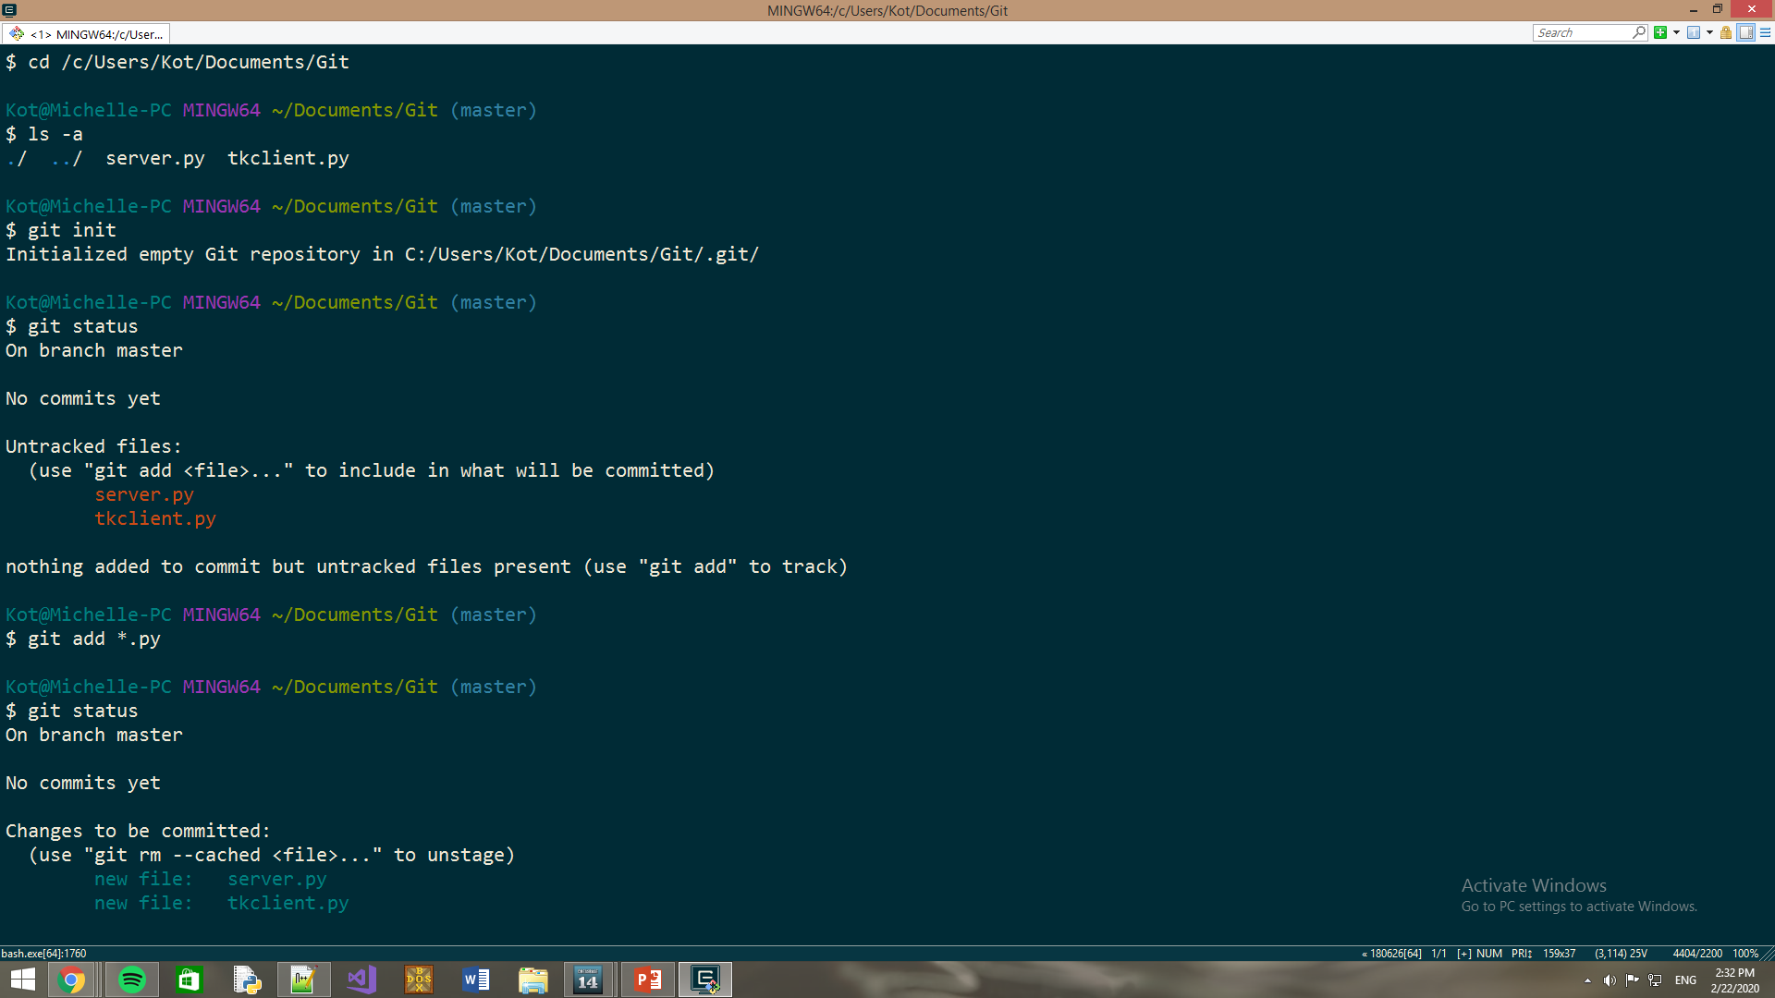

Slide 20
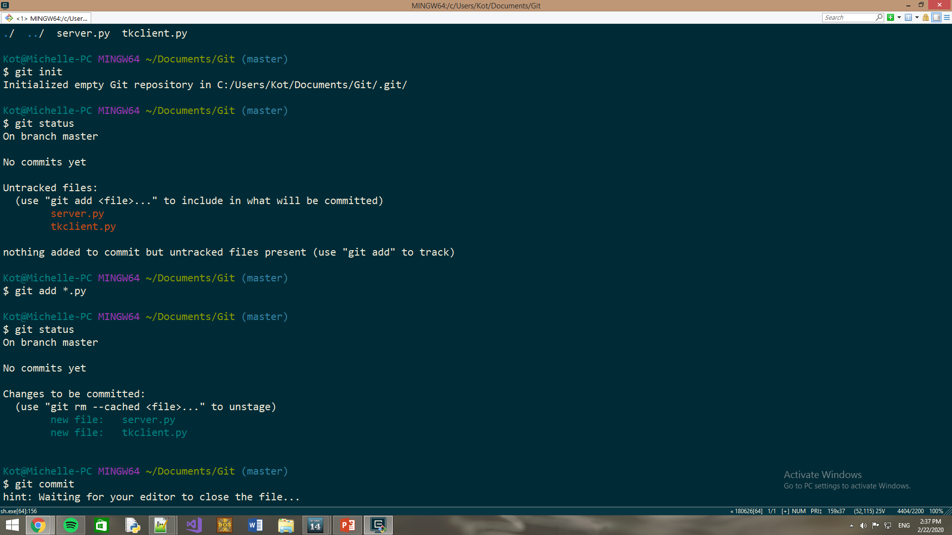
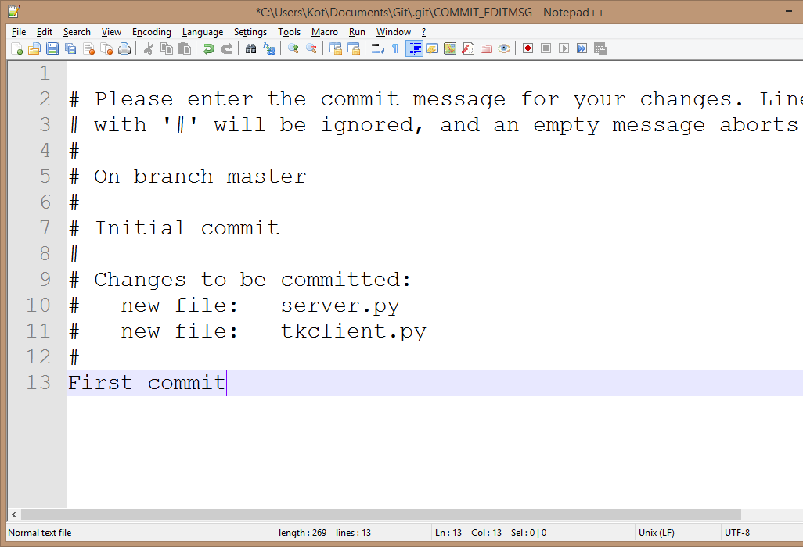

Slide 21
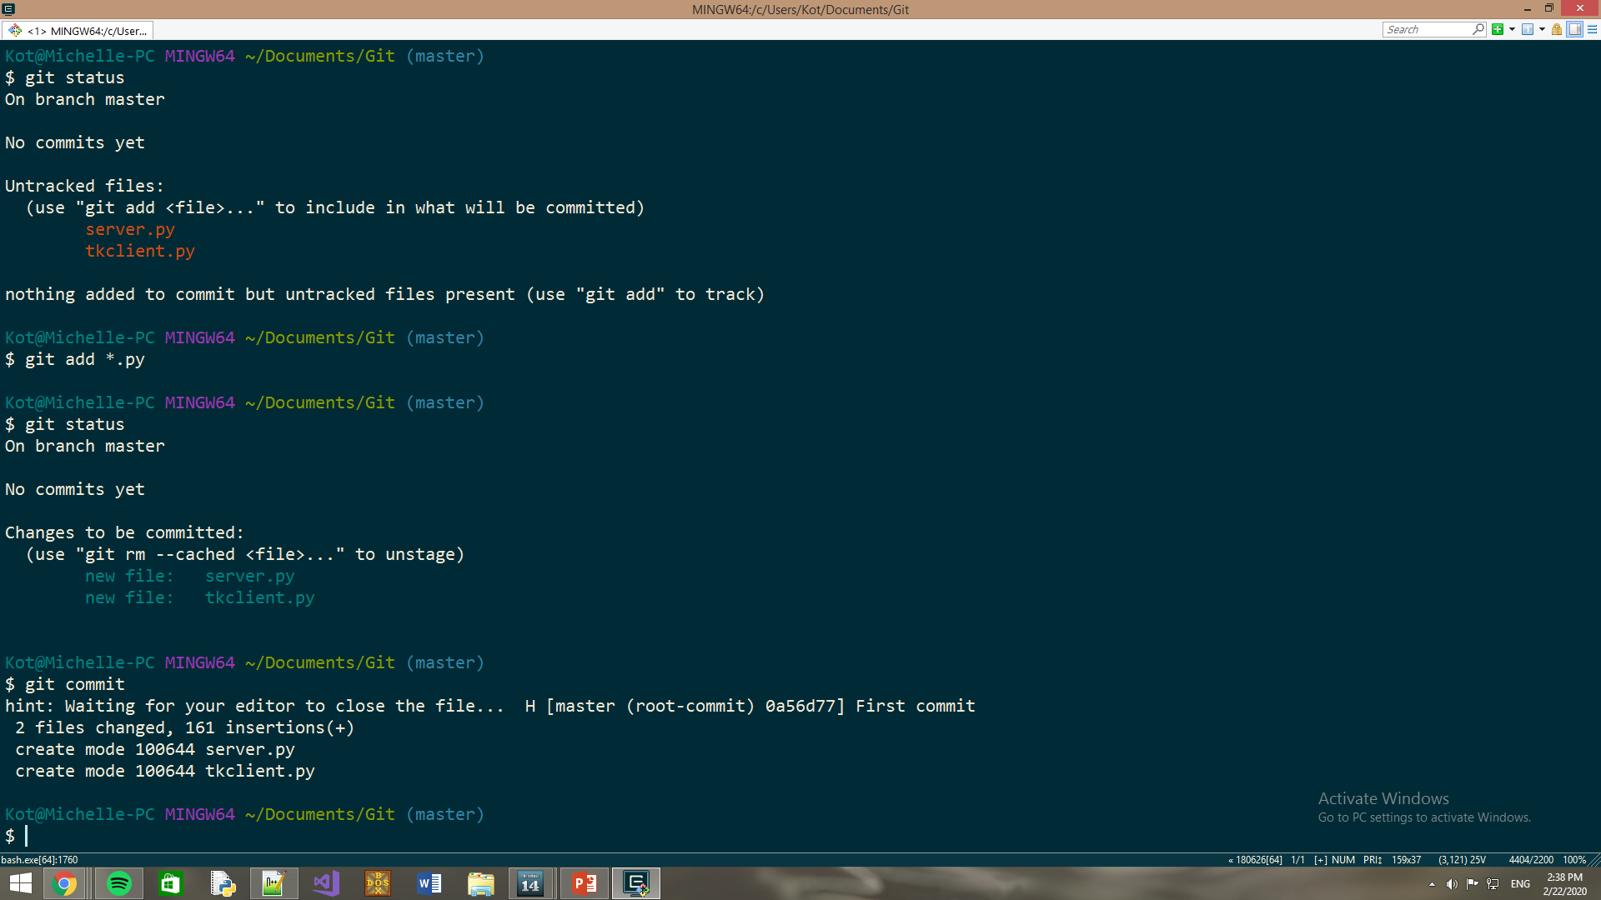

Slide 22
Git - Working With the Repository
git diff
Displays changes in tracked files. If you modified a tracked file but didn’t stage it. That command compares what is in your working directory with what is in your staging area.
git log
Lists the commits made in that repository in reverse chronological order.
git commit --amend
Overwrites the last commit.
git reset HEAD <file>
Unstages a staged file (staged->modified).
git checkout -- <file>
Restores last committed version.

Slide 23
Git - Working With the Repository pt. 2
git diff --staged
If you want to commit all files (in their current state) and skip the staging area:
To remove a file from Git and disk use “git rm” and then commit (if you instead remove the file from disk (rm <file>) git will view this as an unstaged change.
If you’d like to untrack a file use:
git rm --cached <file>
rename file: git mv <file1> <file2> rename file1 to file2
כאילו כי נגיד שכל הקבצים ששיניתם הם staged אז git diff לא יראה כלום.

Slide 24

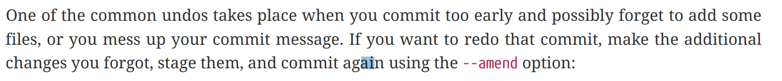
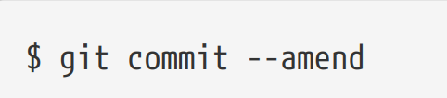
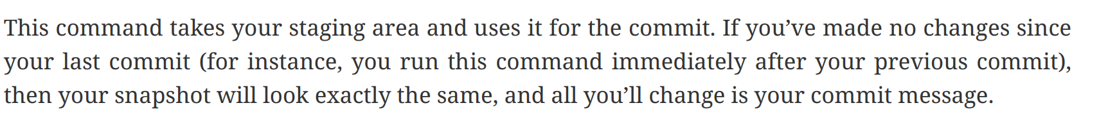
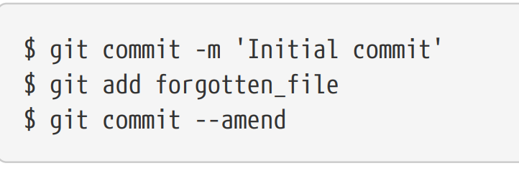
התחתנת בווגאס? התחתנת עם לסבית? אמרת שם לא נכון בחופה?
אבל עשית commit לפני כל חתונה?
אז הכל טוב
spot the error in this slide (:

Slide 25
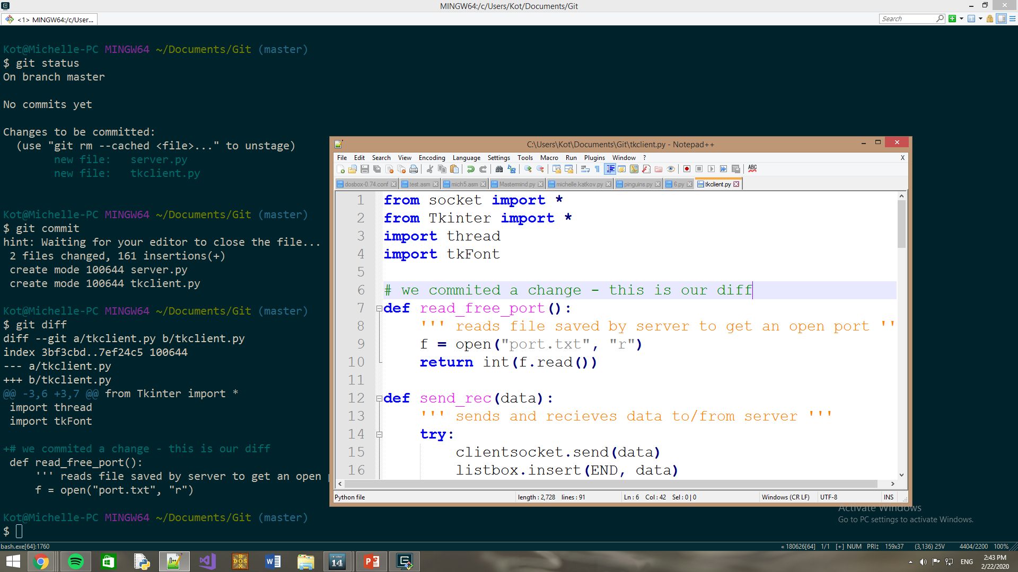

Slide 26
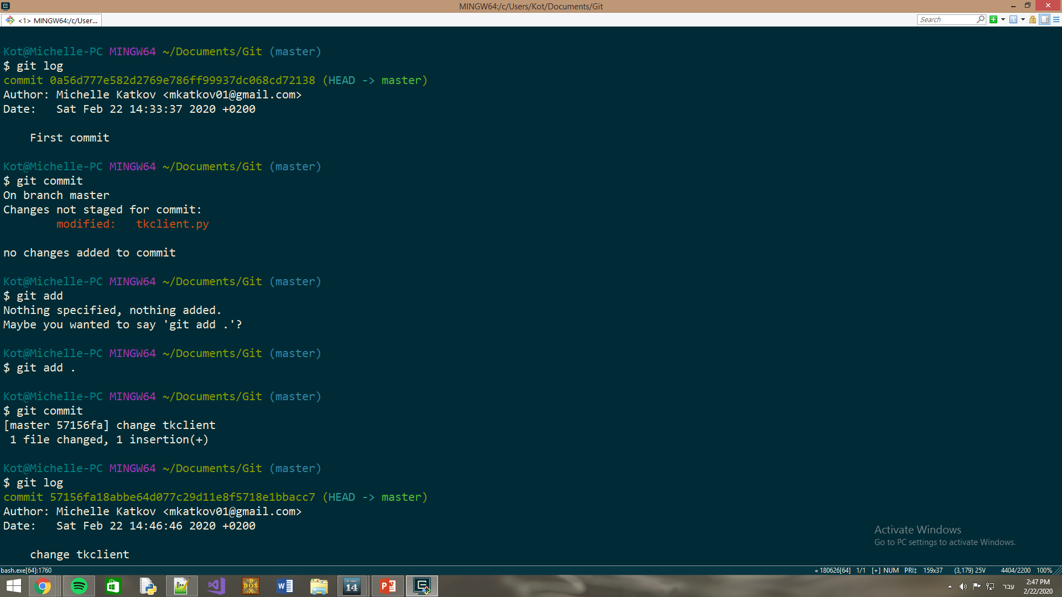

Slide 27
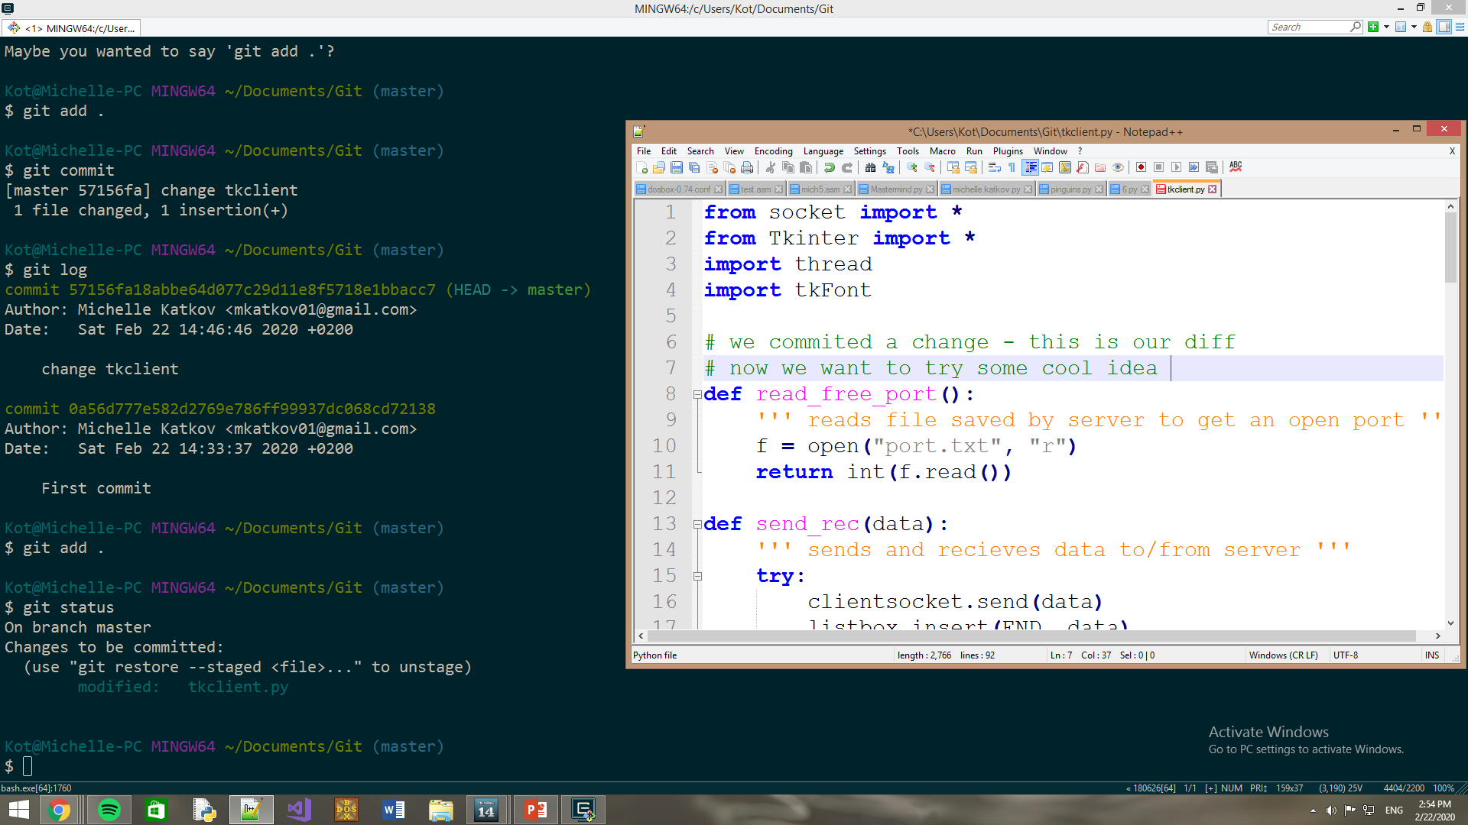

Slide 28
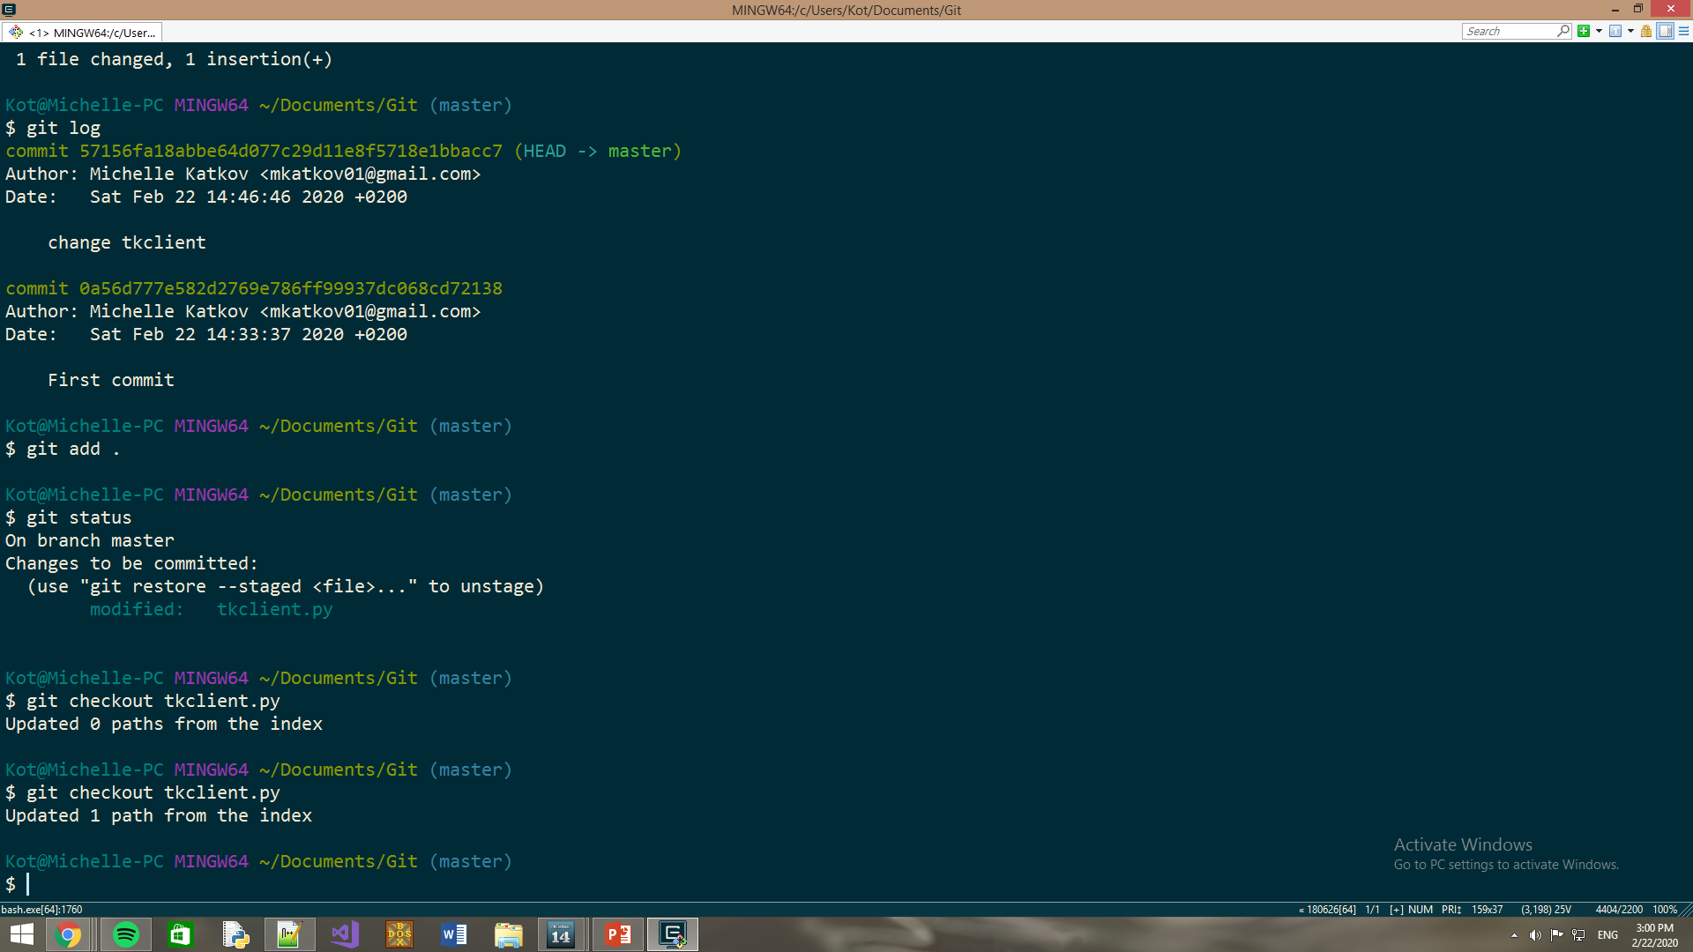
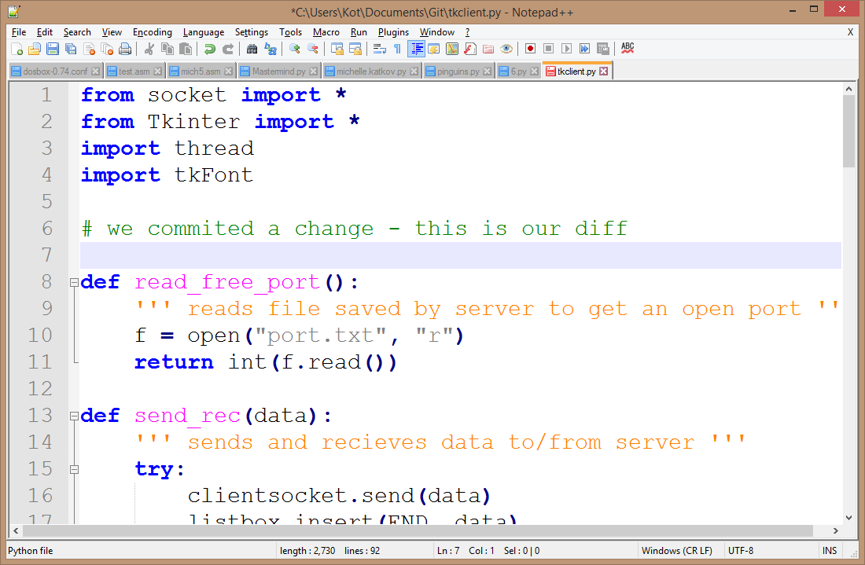
Don’t forget to save!

Slide 29
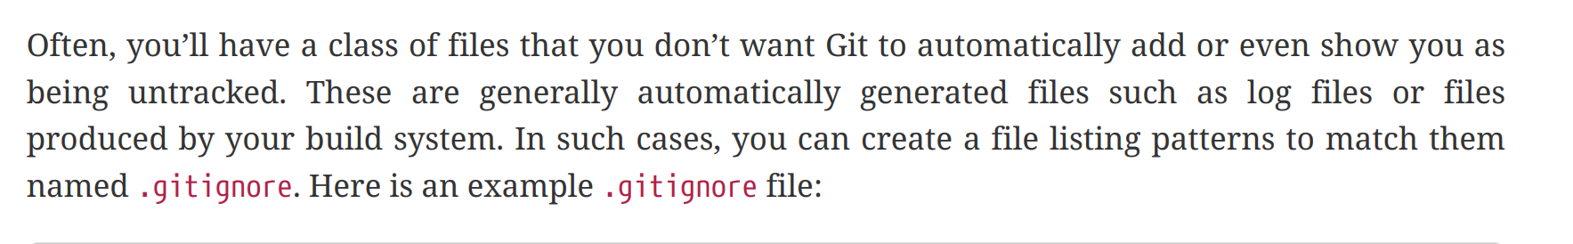
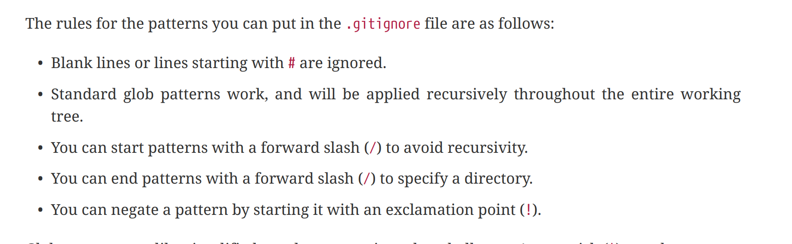
Git - Ignoring Files:

Slide 30
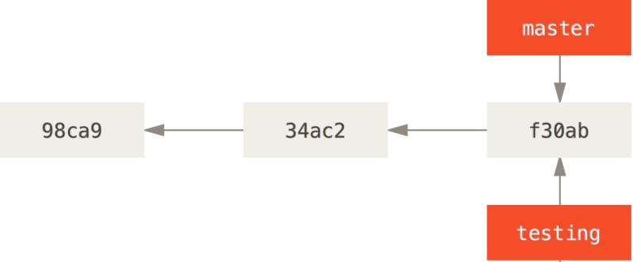
Git - Working with Branches
Branches – New development lines.
git branch [-d]<branch_name>
Creates a new pointer to the same commit you’re currently on.
[-d] – Deletes pointer.
Two branches (master, testing) pointing into the same series of commits

Slide 31
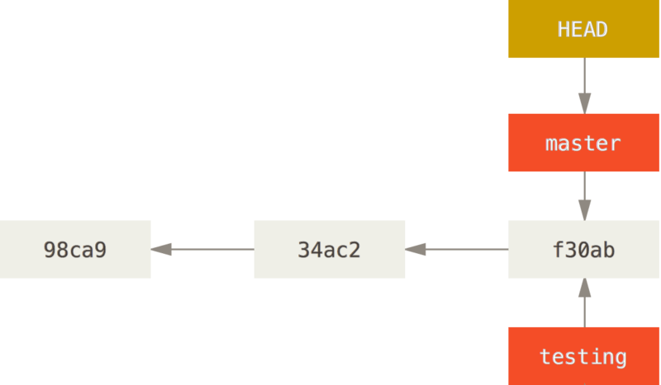
Git - Working with Branches
git checkout [–b] <branch_name>
Start working on the specified branch (testing).
Else, you will be working with last branch (master).
[-b] - Syntax sugar (branch + checkout)
How does Git know what branch you’re currently on? It keeps a special pointer called HEAD.

Slide 32
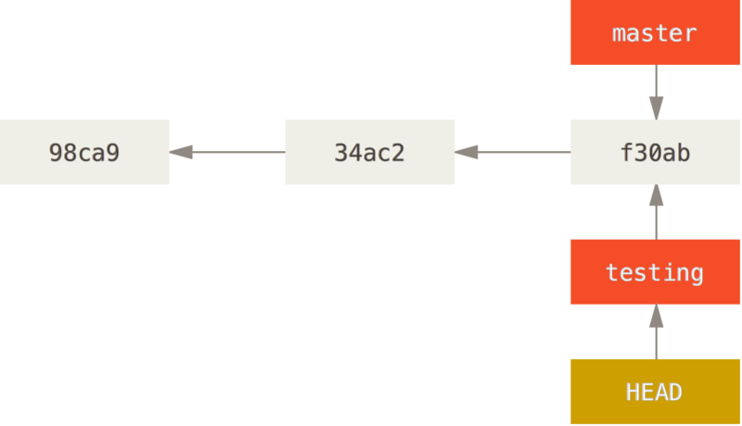
Git - Working with Branches
git checkout testing

Slide 33
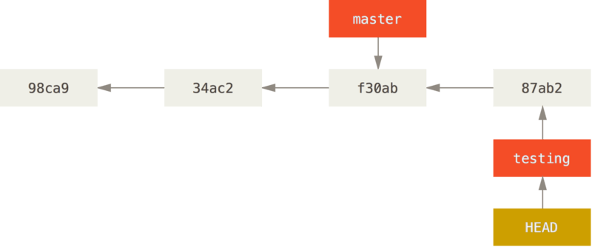
Git - Working with Branches
git commit -a -m 'made a change'

Slide 34
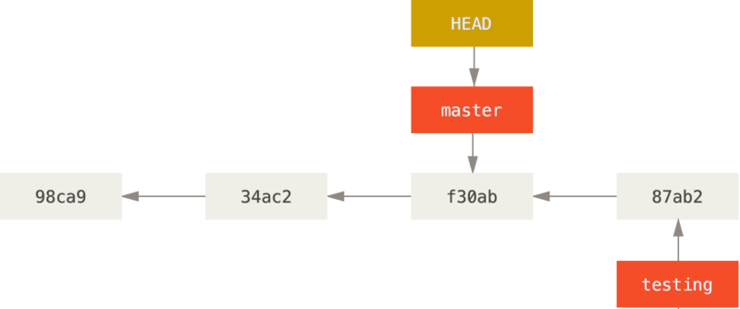
Git - Working with Branches
git checkout master

Slide 35
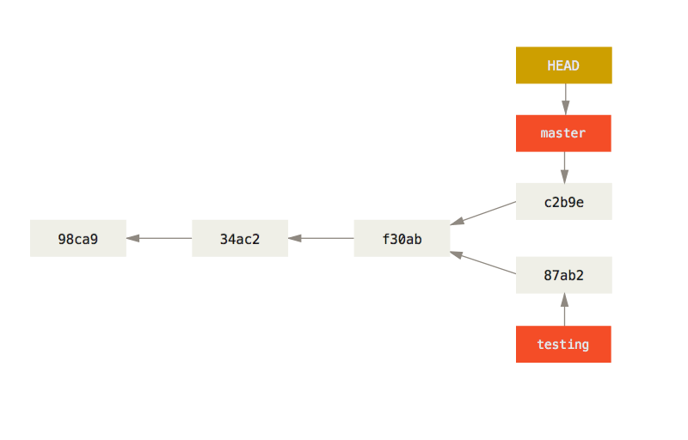
Git - Working with Branches
git commit -a -m 'made other changes'

Slide 36
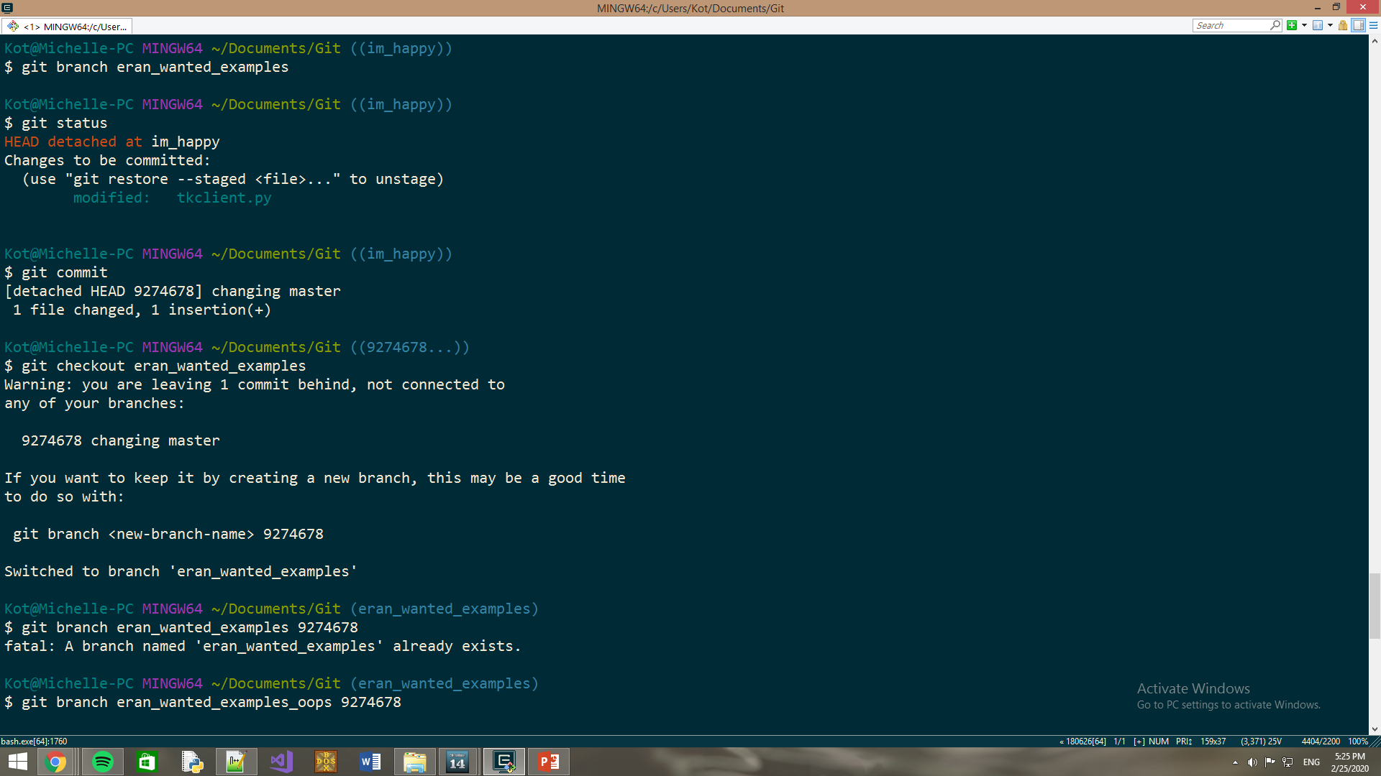

Slide 37
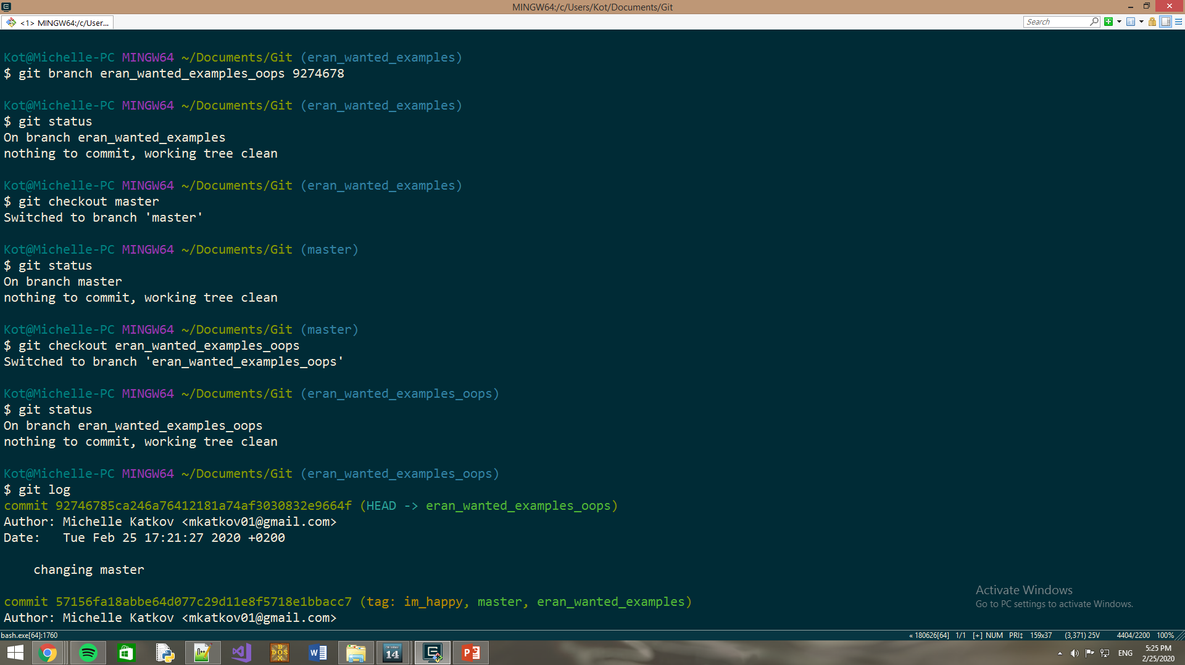

Slide 38
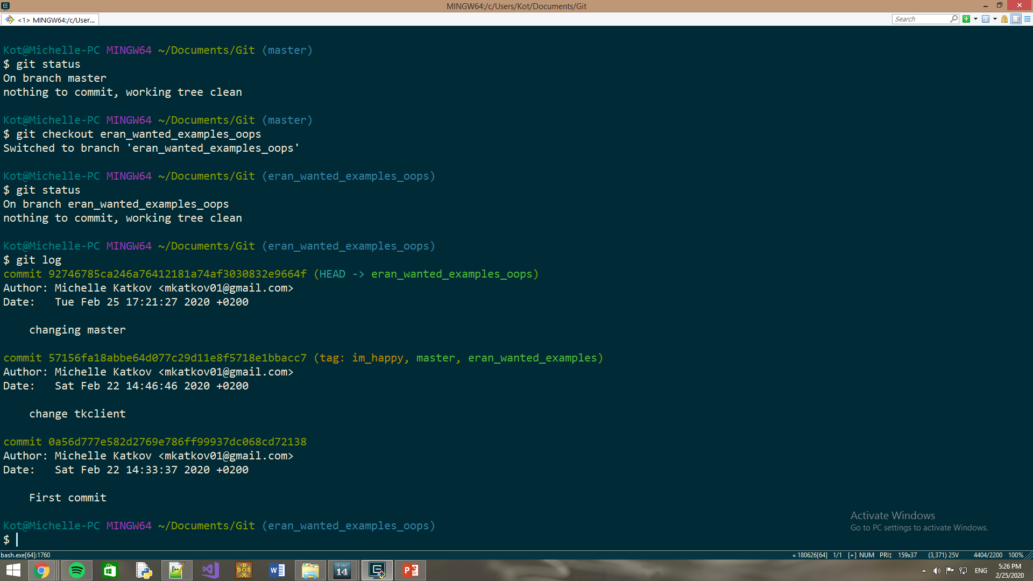

Slide 39
Git - Working with Branches
Branches –
git merge <branch_name>
Adds changes made in the specified branch to current branch.
If you changed the same part of the same file differently in the two branches you’re merging, Git won’t be able to merge them cleanly. You should resolve the conflict manually by merging the contents yourself.
git mergetool
Graphical tool to resolve merge conflicts.
git stash
Temporary save current modifications without commiting.
git stash apply
Restore stashed modification.

Slide 40
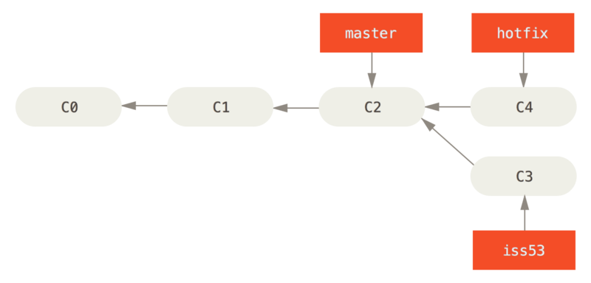
Git - Working with Branches
git checkout master
git merge hotfix

Slide 41
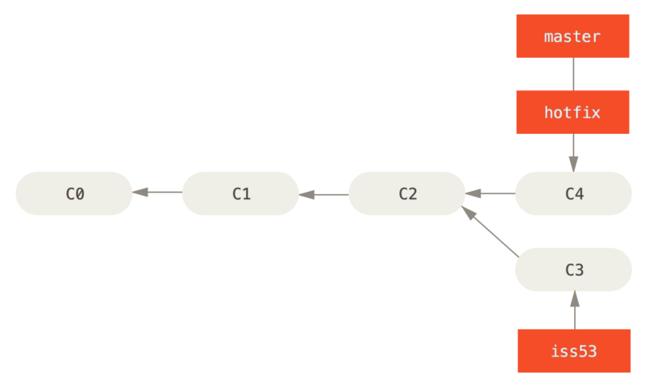
Git - Working with Branches
git checkout master
git merge hotfix
Updating f42c576..3a0874c
Fast-forward
index.html | 2 ++
1 file changed, 2 insertions(+)

Slide 42
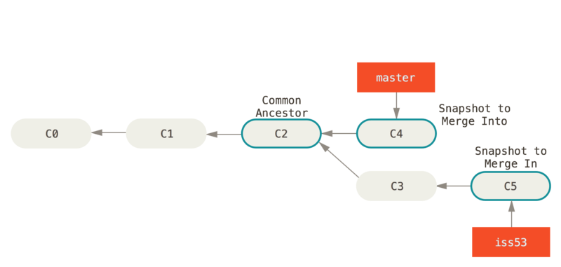
Git - Working with Branches
git checkout master
git merge iss53
A fast forward merge isn’t possible if the branches have diverged

Slide 43
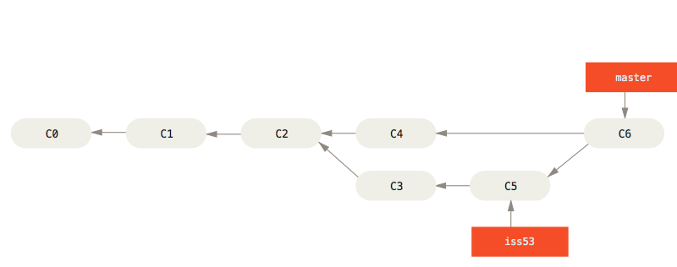
Git - Working with Branches
3WAY DEDICATED merge

Slide 44
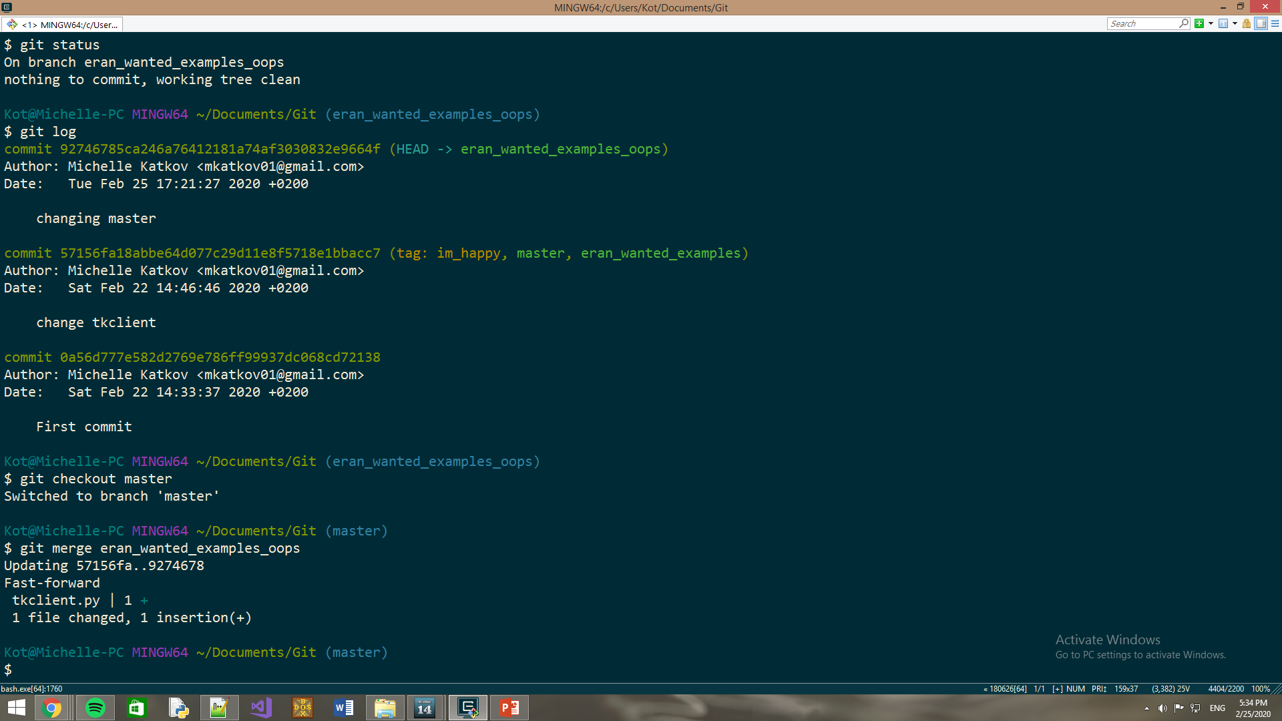

Slide 45
Git - Working with Tags
Tags – easy to remember name for a specific version.
git tag -a v1.4 -m "my version 1.4“
Creates a tag so that this version will be easy to find.
git push <remotename> <tagname>
You can use the tag name instead of the version! ☺
git tag -d <tagname>
Removes specified tag.

Slide 46
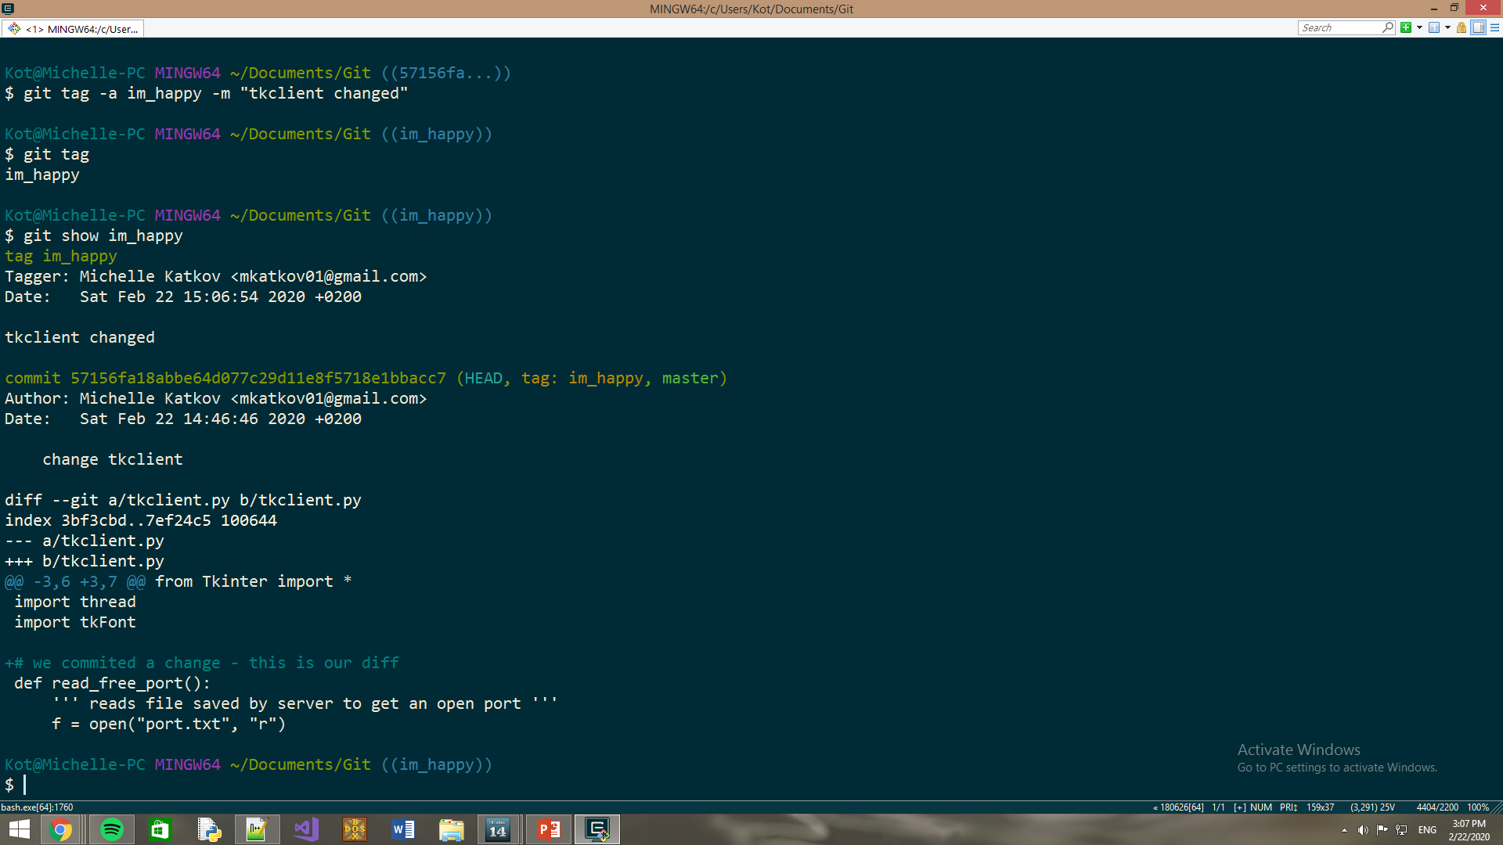

Slide 47
Git - Working with Remotes
Remotes - versions of your project that are hosted on the Internet or network.
git remote
Lists the names of specified remotes (origin-master).
git remote add < remotename > <url>
Adds a new remote server explicitly from specified url.
git fetch < remotename >
Downloads the data from that remote project that you don’t have yet.
git pull
Downloads and merges downloaded data into your code (fetch and merge).
git push <remotename> <branch>
Updates specific branch on specified remote server with the current version.
remote name will be origin always for us
git request-pull
Opens a pull-request where you can discuss the code before merging.

Slide 48
GitHub.com – Getting Started
https://desktop.github.com
Remote server, available for everyone.
Sign Up
Create a new repository
Remote is ready
git clone https://github.com/michellekatkov/test test
Git vs. GitHub
Git | GitHub
Can be completely private (nobody knows…) | Can be public or private but the data is on the internet (intelligence can come…)
You need a server for collaboration | GitHub provides a server
Open source licensed | Includes free and pay-for-use tiers
No user management features | Built-in user management features.

Slide 49
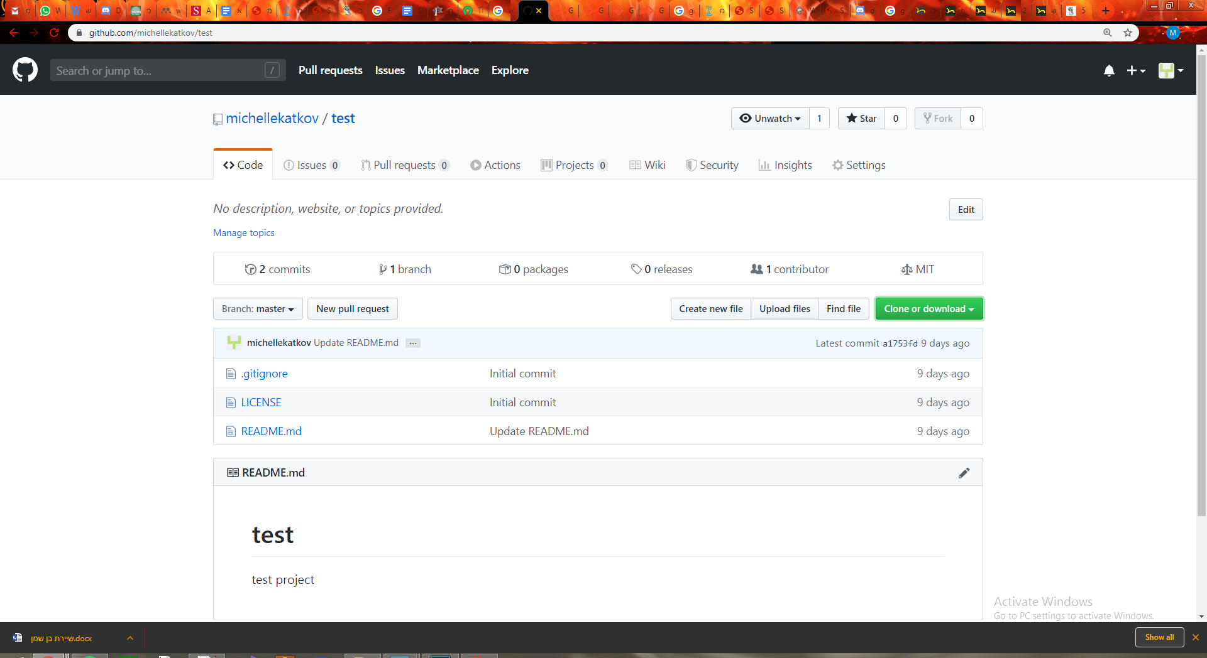
GitHub.com – Getting Started

Slide 50
GitHub.com - Great features!
Webhooks
Allow external services to be notified when certain events happen.
.gitignore
Specifies intentionally untracked files that Git should ignore.
Each line in the file specifies a pattern to be ignored.
For example:
*.obj
ignores all object files in ASM project

Slide 51
Thank you !

Slide 52
https://git-scm.com/book/en/v2 דרך אגב

