Slide 1

DBMS INNOVATIVE METHOD(Group Project)
TOPIC: HOSPITAL MANAGEMENT DATABASE

Slide 2

GROUP MEMBERS
Achal Gawande – 101
Chaitali Nagbhidkar – 104
Himani Gawande – 108
Manaswi Padole – 111
Om Sadawarti - 160

Slide 3
SQL Queries
-- Table for Patients CREATE TABLE Patients ( PatientID INT PRIMARY KEY AUTO_INCREMENT, FirstName VARCHAR(50) NOT NULL, LastName VARCHAR(50) NOT NULL, Gender ENUM('Male', 'Female', 'Other') NOT NULL, Age INT, ContactNumber VARCHAR(15), Address VARCHAR(255) );
-- Table for Doctors CREATE TABLE Doctors ( DoctorID INT PRIMARY KEY AUTO_INCREMENT, FirstName VARCHAR(50) NOT NULL, LastName VARCHAR(50) NOT NULL, Specialization VARCHAR(100), ContactNumber VARCHAR(15), Email VARCHAR(100) );

Slide 4
SQL Queries
-- Table for Appointments CREATE TABLE Appointments ( AppointmentID INT PRIMARY KEY AUTO_INCREMENT, PatientID INT, DoctorID INT, AppointmentDate DATE, StartTime TIME, EndTime TIME, FOREIGN KEY (PatientID) REFERENCES Patients(PatientID), FOREIGN KEY (DoctorID) REFERENCES Doctors(DoctorID) );
-- Table for Medical Records CREATE TABLE MedicalRecords ( RecordID INT PRIMARY KEY AUTO_INCREMENT, PatientID INT, DoctorID INT, RecordDate DATE, Diagnosis VARCHAR(255), Prescription VARCHAR(255), FOREIGN KEY (PatientID) REFERENCES Patients(PatientID), FOREIGN KEY (DoctorID) REFERENCES Doctors(DoctorID) );

Slide 5
SQL Queries
-- Table for Billing CREATE TABLE Billing ( BillID INT PRIMARY KEY AUTO_INCREMENT, PatientID INT, DoctorID INT, BillDate DATE, Amount DECIMAL(10, 2), FOREIGN KEY (PatientID) REFERENCES Patients(PatientID), FOREIGN KEY (DoctorID) REFERENCES Doctors(DoctorID) );
-- Insert 5 records into Patients table INSERT INTO Patients (FirstName, LastName, Gender, Age, ContactNumber, Address) VALUES ('John', 'Doe', 'Male', 30, '1234567890', '123 Main St'), ('Jane', 'Smith', 'Female', 25, '9876543210', '456 Oak St'), ('Michael', 'Johnson', 'Male', 45, '5551112233', '789 Pine St'), ('Emily', 'Williams', 'Female', 28, '4443332222', '101 Elm St'), ('David', 'Brown', 'Male', 35, '6667778888', '202 Maple St');

Slide 6
SQL Queries
INSERT INTO Doctors (FirstName, LastName, Specialization, ContactNumber, Email) VALUES ('Dr. Sarah', 'Jones', 'Cardiology', '1112223344', 'sarah.jones@example.com'), ('Dr. Robert', 'Miller', 'Orthopedics', '5556667788', 'robert.miller@example.com'), ('Dr. Maria', 'Garcia', 'Pediatrics', '9998887766', 'maria.garcia@example.com'), ('Dr. James', 'Anderson', 'Oncology', '3334445566', 'james.anderson@example.com'), ('Dr. Linda', 'Clark', 'Dermatology', '7778889999', 'linda.clark@example.com');
-- Insert 5 records into Appointments table INSERT INTO Appointments (PatientID, DoctorID, AppointmentDate, StartTime, EndTime) VALUES (1, 1, '2023-10-10', '10:00:00', '11:00:00'), (2, 2, '2023-10-11', '14:00:00', '15:00:00'), (3, 3, '2023-10-12', '11:30:00', '12:30:00'), (4, 4, '2023-10-13', '09:00:00', '10:00:00'), (5, 5, '2023-10-14', '16:00:00', '17:00:00');

Slide 7
SQL Queries
-- Insert 5 records into MedicalRecords table INSERT INTO MedicalRecords (PatientID, DoctorID, RecordDate, Diagnosis, Prescription) VALUES (1, 1, '2023-10-10', 'Hypertension', 'Medication A'), (2, 2, '2023-10-11', 'Fractured Arm', 'Rest and Painkillers'), (3, 3, '2023-10-12', 'Common Cold', 'Antibiotics'), (4, 4, '2023-10-13', 'Cancer Screening', 'Refer to Oncologist'), (5, 5, '2023-10-14', 'Skin Allergy', 'Topical Cream');
-- Insert 5 records into Billing table INSERT INTO Billing (PatientID, DoctorID, BillDate, Amount) VALUES (1, 1, '2023-10-10', 150.00), (2, 2, '2023-10-11', 200.00), (3, 3, '2023-10-12', 75.50), (4, 4, '2023-10-13', 300.00), (5, 5, '2023-10-14', 50.00);

Slide 8
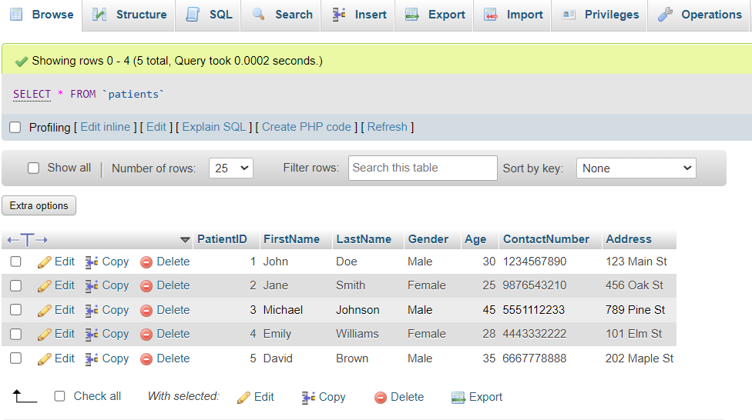
Patients Table

Slide 9
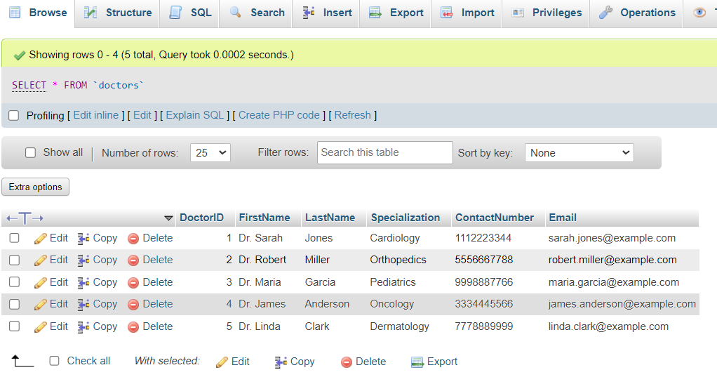
Doctors Table

Slide 10
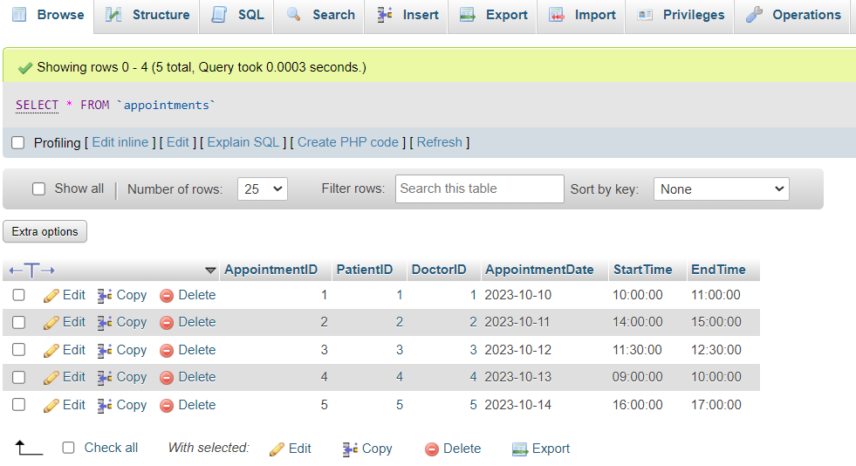
Appointments Table

Slide 11
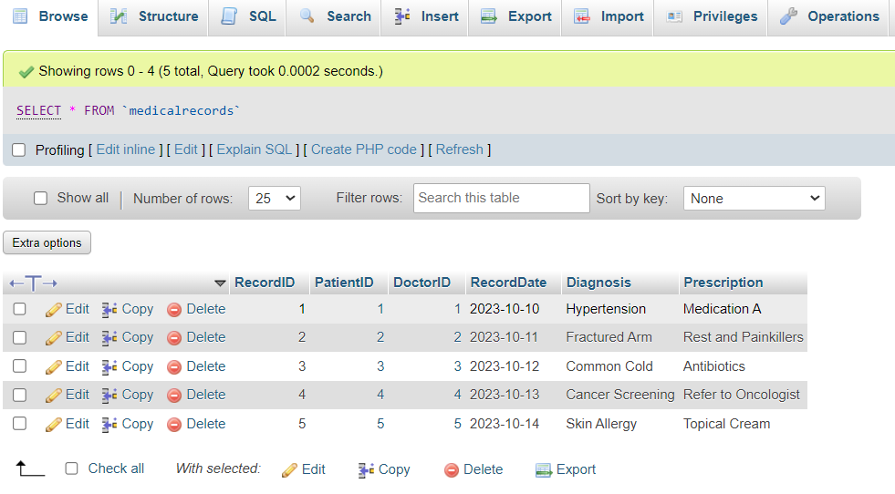
Medical Records Table

Slide 12
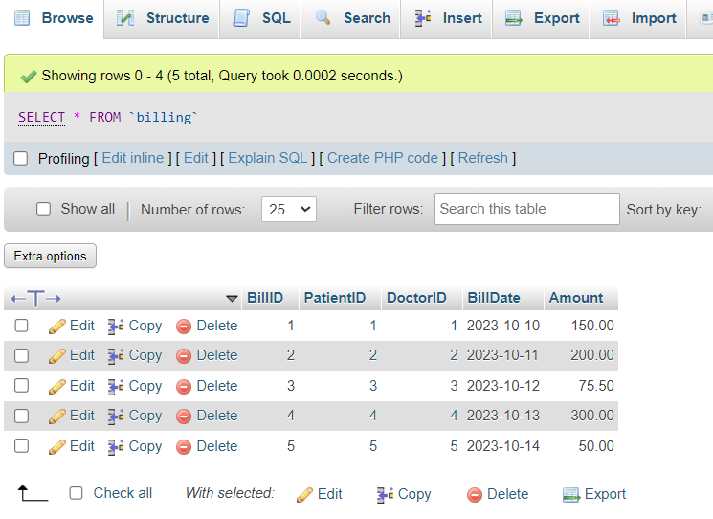
Billing Table

Slide 13
Thank You !!

