Slide 1
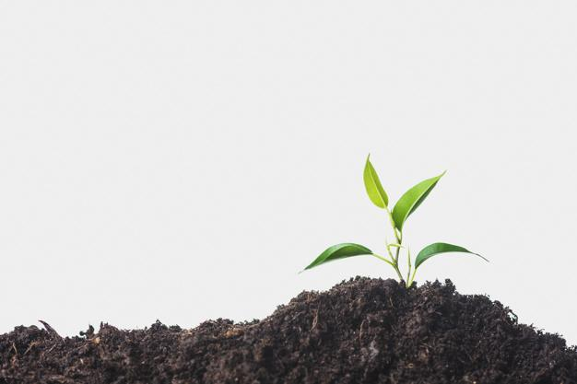
Smart website for connecting farmers and Agricultural Authorities.
“Farmy -A Better approach For Farming.”
Have a question? Connect and get it solved!

Slide 2

Project Guide
Prof. Mr. N. S. Gajjam.
Project Members
Mr. Bura Venu Devidas. (Roll No. 56)
Mr. Dyavarkonda Hemant Vasudev. (Roll No. 57)
Mr. Kalekar Omsai Gopal. (Roll No. 58)
Mr. Rachha Mahesh Sanjiv. (Roll No. 59)
Walchand Institute of Technology, Solapur
(www.witsolapur.org)
Project Group: O

Slide 3
Table of contents
01
Idea behind project.
04
Technology.
Objectives.
Conclusion.
02
05
03
Methodology.
06
Future Scope.

Slide 4


Idea Behind The Project
To develop a smart web application for solving issues of farmers by connecting them to agricultural authorities.

Slide 5
Objectives:
To make farmers aware about latest feeds related to farming.
MiddleMan Elimination.
1
2
3
4
5
To resolve Queries of farmers by connecting them to agricultural authorities.
To Inform farmers about weather Forecast.
To provide a chatbot for smooth interface.

Slide 6
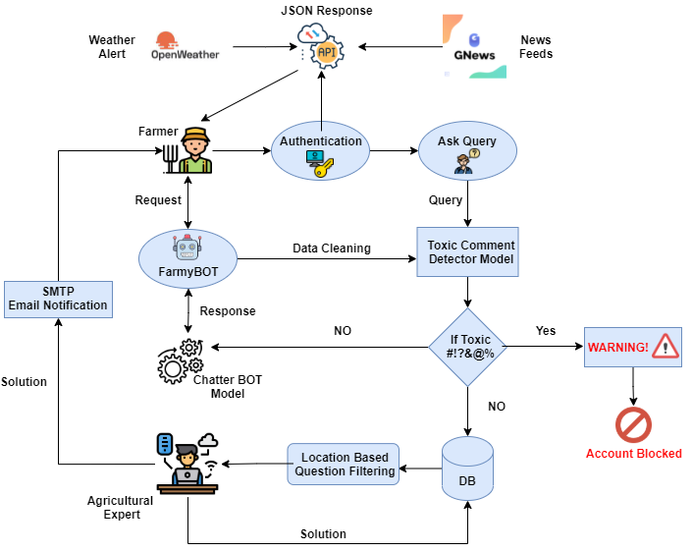
System Architecture:

Slide 7
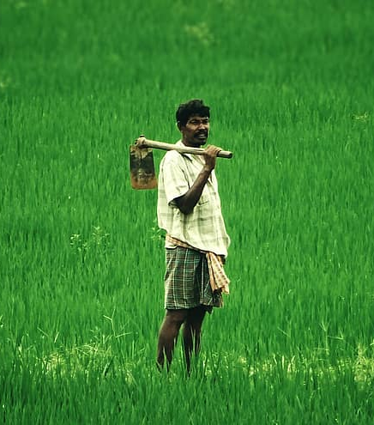
Farmer
What does
Do?
Putting issues on platform.
Latest news and Amendment bills.
Weather Forecast.

Slide 8
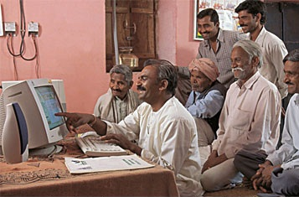
Agricultural Authority
What does
Do?
Answering the queries of farmers.
Provide suggestion about farming.
Add/Remove latest amendment bills issued by government.

Slide 9

Admin
What does
Do ?
Add/Remove YouTube Videos Related to Farming.
Add/Remove News Feeds.
Manages website Infrastructure.
Monitor Performance.
Provides technical Support.
Create and update web pages
Fixes bugs and issues.

Slide 10
Some key features of Our Project!!
Supports Multilinguality
Mobile Responsiveness
Weather Forecast + Feeds
Current + 5-day weather + bad weather alert.
For latest news and amendment bills.
Compatible with all the languages.
Work on any of the devices.

Slide 11
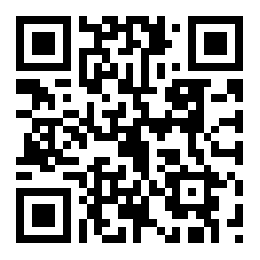
Results and Discussion:
OR
http://bizzfarmy.pythonanywhere.com/
Scan Above QR Code
Copy & paste the link given above!

Slide 12
Technology Stack
Python
Django
HTML / CSS / Bootstrap
Mysql
Machine Learning
API’s
For Business logic/ Chatbot.
For Backend Development.
For Frontend Development.
JavaScript / Jquery / Ajax
For Validations and verifications.
For Toxic comment removal.
For Data Storage.
Application Programming Interfaces.

Slide 13
Machine Learning
Toxic Comment Removal
Chatbot
Where
Will HELP?
Answers All the Questions Related To Platform.
Removes comments which falls under category of toxic , obscene, insult, threat , hate etc

Slide 14

Conclusion :
Smart web application has been designed in such a way that it can fulfill the needs of the farmers.
It has many features which can be used in different environments and scenarios. For instance, Farmers had to visit agricultural offices if they had any issues which would cost their time and money,so this web application will help farmers to connect them to the agricultural officers from their remote places..
Notifications will provide status of their queries and keep them updated..

Slide 15
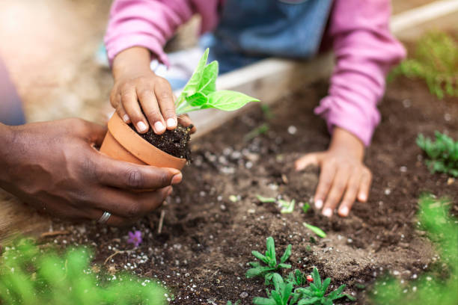
Future Scope:
We Can add many New Features to help and attract farmers towards this platform like,
1. Convert website to mobile Application.
2. Voice Based Question Answering Scheme.
3. Can provide a video tour of project.
4. Can Add E-marketing Feature.

Slide 16
References
[1] A. M. Rahman, A. A. Mamun and A. Islam, "Programming challenges of chatbot: Current and future prospective," 2017 IEEE Region 10 Humanitarian Technology Conference (R10-HTC), Dhaka, 2017, pp. 75-78, doi: 10.1109/R10-HTC.2017.8288910.
[2] Reddy, S. K. Farmer Producers Organizations: An initiative to eliminate middlemen. INDiAN FARmER, 223.
[3] Ozoh, P., MO, O., & Adigun, A. A. (2019). Identification and Classification of Toxic Comments on Social Media using Machine Learning Techniques. International Journal of Research and Innovation in Applied Science (IJRIAS).
[4] Jackson, W. (2019). Watch Face Weather Design: Using Weather APIs. In SmartWatch Design Fundamentals (pp. 345-383). Apress, Berkeley, CA.
[5] Plekhanova, J.. Evaluating web development frameworks: Django, Ruby on Rails and CakePHP. Institute for Business and Information Technology.

Slide 17
Thank You!

