Slide 1
Automated Multidisciplinary Design Optimization (MDO) of an Aerospace Wing Rib
OM SHEDAGE

Slide 2
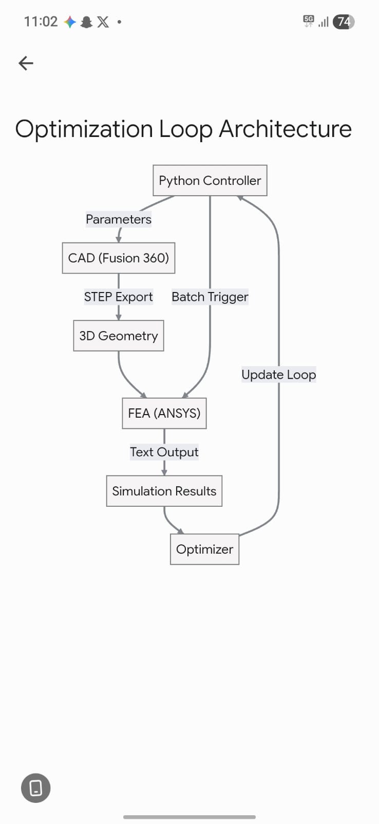
Introduction
Team A
Project Objective
Main Goal
To engineer a fully autonomous software pipeline that eliminates manual CAD-to-FEA iteration, maximizing the mass reduction of a wing rib while strictly adhering to a structural safety limit
Supporting Objectives
  Software Integration: Establish a reliable "data bridge" between Fusion 360 and ANSYS Mechanical using Python GUI automation and programmatic file-handling.
  Algorithmic Control: Implement a proportional control logic loop that intelligently calculates geometric changes based on real-time stress feedback, preventing the simulation from overshooting
3

Slide 3
Background Research
What We Found
1
2
3
A single manual CAD-to-FEA optimization loop takes 10-15 minutes of active, repetitive clicking, wasting valuable engineering hours
Without mathematical control logic, engineers must rely on "guess and check" sizing, which is highly prone to human error.
Because the manual process is so slow, optimization is often stopped early, leaving excess "dead weight" on the final aircraft.
Key Insight
Engineers don't lack powerful simulation tools — they lack the automated pipelines required to let those tools communicate.
4

Slide 4



INDUSTRY APPLICATION
Who We Designed For
Target User
Their Challenges
  Struggle with the massive time sink of manually updating parametric CAD models and constantly bridging files between different software environments.
  Rely on inefficient "guess and check" methods to determine how much material to remove without exceeding strict stress limits
Aerospace Structural Engineers & CAD/FEA Analysts
Professionals responsible for light-weighting aircraft components (reducing mass to save fuel) while ensuring the parts can safely survive extreme aerodynamic flight loads.
5

Slide 5
SYSTEM ARCHITECTURE
Methodology
Research
Prototyping
Final Build
The main Python script calculates the required target hole diameter and writes it to a local text file, acting as the "brain" of the operation.
Python GUI automation takes control of the mouse to update the ANSYS geometry from the source, remesh the wing rib, and run the physics simulation.
Ideation
Feedback & Revisions
An internal API script reads the text file, updates the parametric 2D sketch, regenerates the solid body, and exports a fresh 3D STEP file.
An IronPython script inside ANSYS extracts the calculated mass and maximum equivalent stress, writing them to a new text file for the orchestrator to read
7

Slide 6

Project Summary
The Engineering Solution
A fully autonomous Multidisciplinary Design Optimization (MDO) pipeline that successfully minimizes aerospace component mass without human intervention, bridging parametric CAD and FEA solvers via Python.
Performance Metrics
  Mass Reduction: Successfully shaved 160 grams of dead weight per rib (an 11% reduction from the baseline 1.40 kg model).
  Structural Integrity: Perfectly converged just under the strict 50.0 MPa maximum equivalent stress limit without overshooting.
  Time Savings: Completely eliminated the 15-minute manual bottleneck, reducing engineering cycle time to a fraction of the cost.
8

Slide 7

Key Features
PIPELINE CAPABILITIES
Our final pipeline includes a set of intelligent features designed to fully automate the CAD-to-FEA iteration cycle. The core of this system is a proportional control algorithm that dynamically calculates geometric step sizes based on real-time stress feedback. This ensures the design rapidly approaches the 50 MPa safety limit when far away, but takes microscopic steps near the target to prevent overshooting. Additionally, the system utilizes programmatic file bridging (via .txt and .step formats) and GUI automation for seamless data transfer between Fusion 360 and ANSYS Mechanical, guaranteeing a completely hands-free, mathematically convergent loop
9

Slide 8
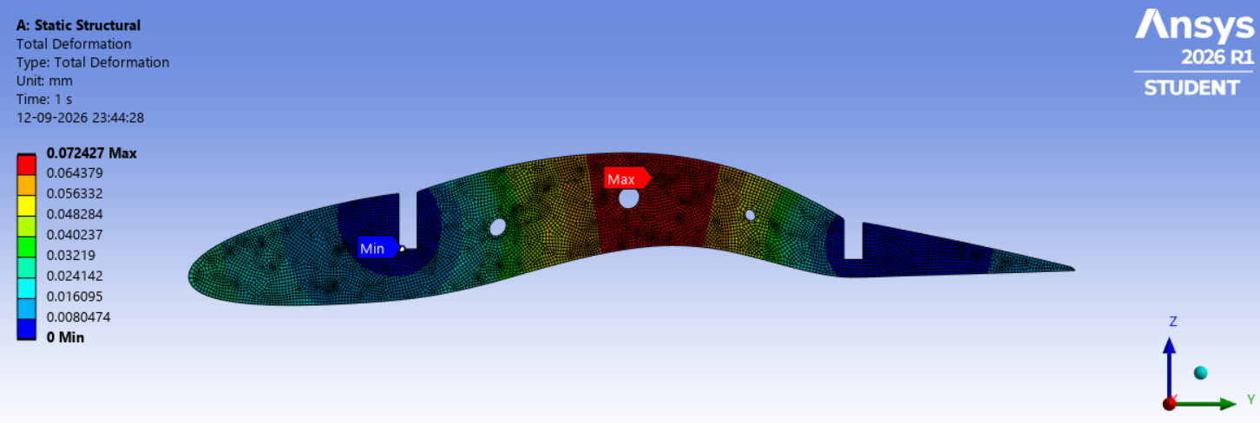
Multi-Variable Control
Advanced Physics Constraints
Assembly-Level Scaling
10

Slide 9
PROJECT CHALLENGES
GUI Synchronization
Software Ecosystems
Timing the Handoff
Bridging Closed Systems
Because ANSYS meshing and solving times vary on every run, the Python "ghost mouse" occasionally misfired. We had to implement strategic wait times (time.sleep) and robust window-focusing algorithms to ensure perfect synchronization between software state changes.
Fusion 360 and ANSYS Mechanical do not natively communicate. We overcame this by engineering a custom text-based "data bridge" (using .txt and .step files) that allowed Python to seamlessly pass target dimensions and extract stress results across both platforms.
11

Slide 10

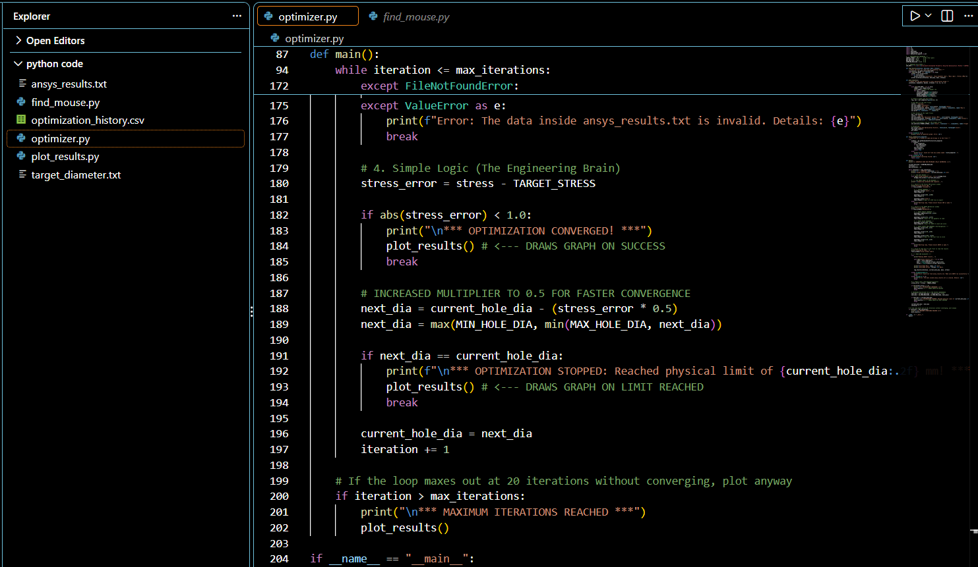
The Smart Optimizer
•
Proportional Control: Dynamically calculates geometric step sizes based on real-time stress feedback, preventing the simulation from overshooting the limit.
•
Seamless Data Transfer: Utilizes programmatic file bridging (.txt and .step formats) to pass data between closed systems.
•
GUI Automation: Implements PyAutoGUI to physically command the mouse and keyboard, removing the human entirely from the repetitive clicking cycle.
•
Autonomous Convergence: Ensures the design rapidly approaches the safety limit when far away, and takes microscopic steps near the target.

Slide 11
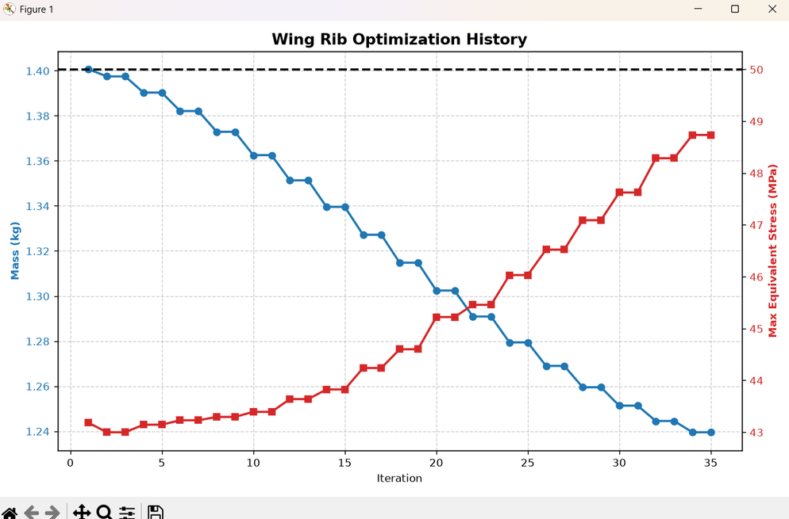
Final Optimization Results
  Mass Reduction: Successfully shaved 160 grams of dead weight per rib (an 11% reduction from the baseline 1.40 kg model).
  Structural Integrity: Perfectly converged just under the strict 50.0 MPa maximum equivalent stress limit without ever overshooting.
  Autonomous Execution: Executed 35 complete CAD-to-FEA design iterations entirely hands-free.
  Time Savings: Completely eliminated the 15-minute manual bottleneck, reducing engineering cycle time to a fraction of the cost.

Slide 12






Next Steps & Future Scope
Multi-Variable Control
Advanced Constraints
Assembly-Level Scaling
Integrate optimization libraries like Scipy to allow Python to control the diameter of each individual hole independently for absolute maximum mass reduction.
Expand the ANSYS automation script to evaluate secondary failure modes, such as maximum structural deflection and Eigenvalue Buckling.
Transition the pipeline from optimizing a single 2D rib to optimizing a full 3D wing box assembly, dynamically adjusting spacing and skin panels.

Slide 13
The End

