Slide 1
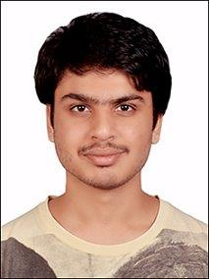
Studying Food Wasting Behaviour of College Mess Users
Om Vaknalli (18376)

Slide 2
Introduction

Slide 3
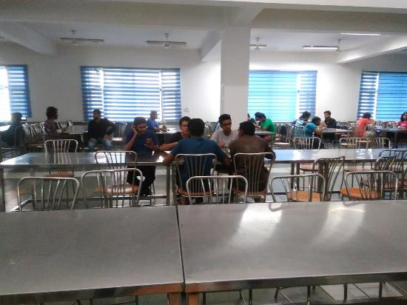
Introduction
Food is a big concern today’s world from economic, environmental and social justice viewpoint
Mess provides a scarce option of healthy food in a hostel environment.
Wood wastage seems to be a contrarian ideology from an behavioral payoff point of view.
Anecdotal information suggests detrimental food quality to be the driving factor towards wastage.
We try to analyse the patterns and reasons behind this behavior.

Slide 4
Hypotheses

Slide 5
Hypotheses and Questions
Arguments against participants who say they waste food due to its poor quality
Regional Bias Hypothesis
Monetary Source Hypothesis
Effect of Oversight on Wastage

Slide 6
The Experiment

Slide 7
Methodology
Data collected through 2 questionnaires
Collected data was analysed using excel and chi-square test
Introduction of supernormal stimulus in the existing system
and data analysis...

Slide 8
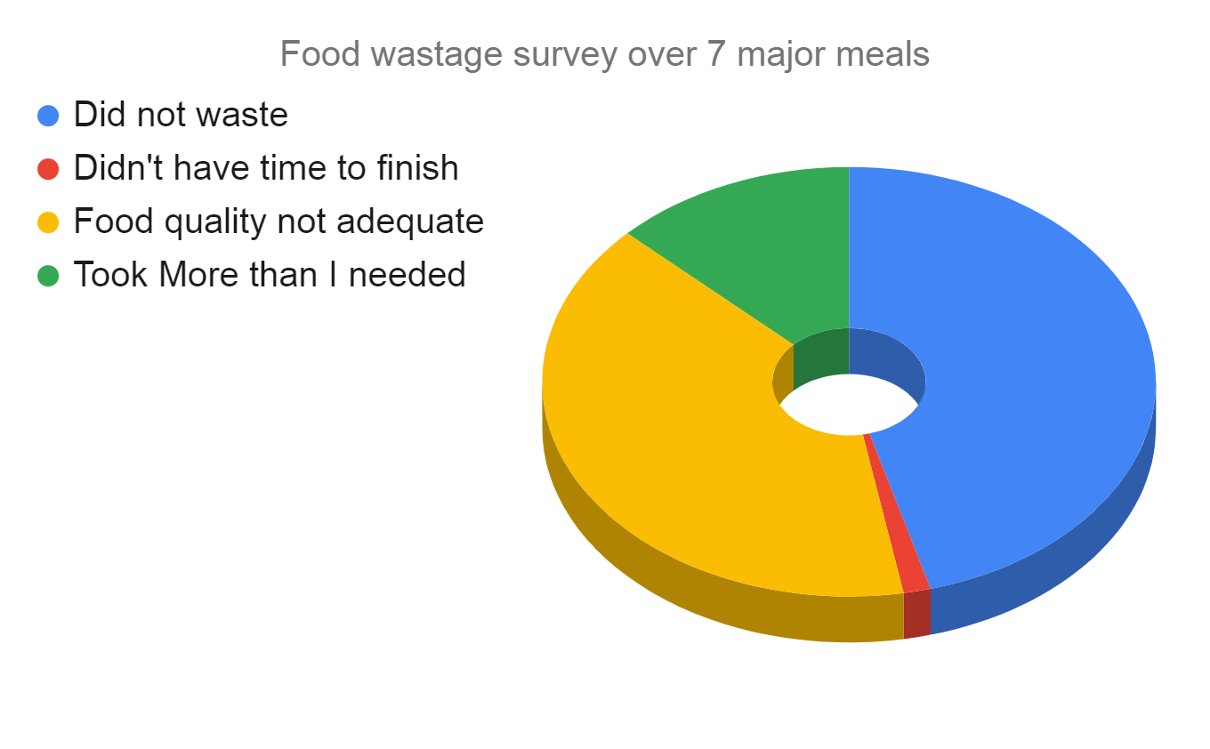
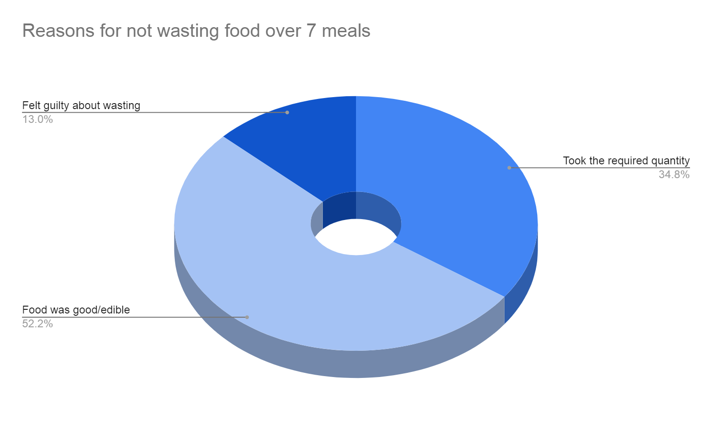
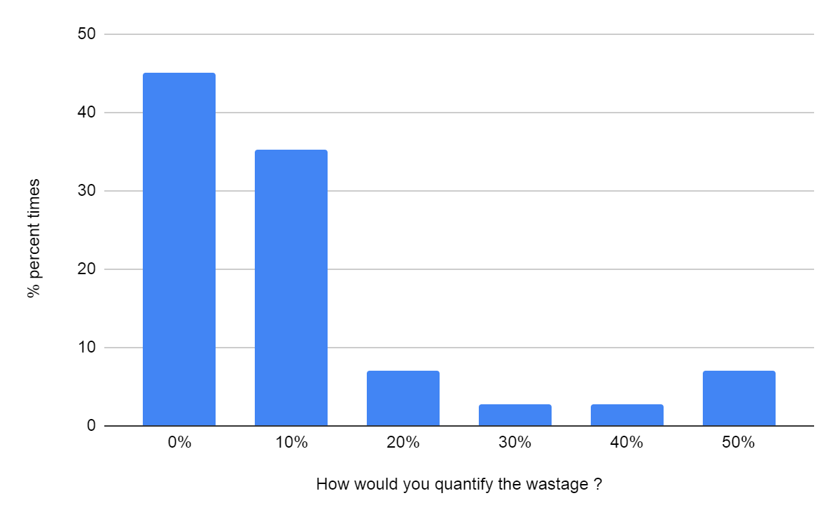
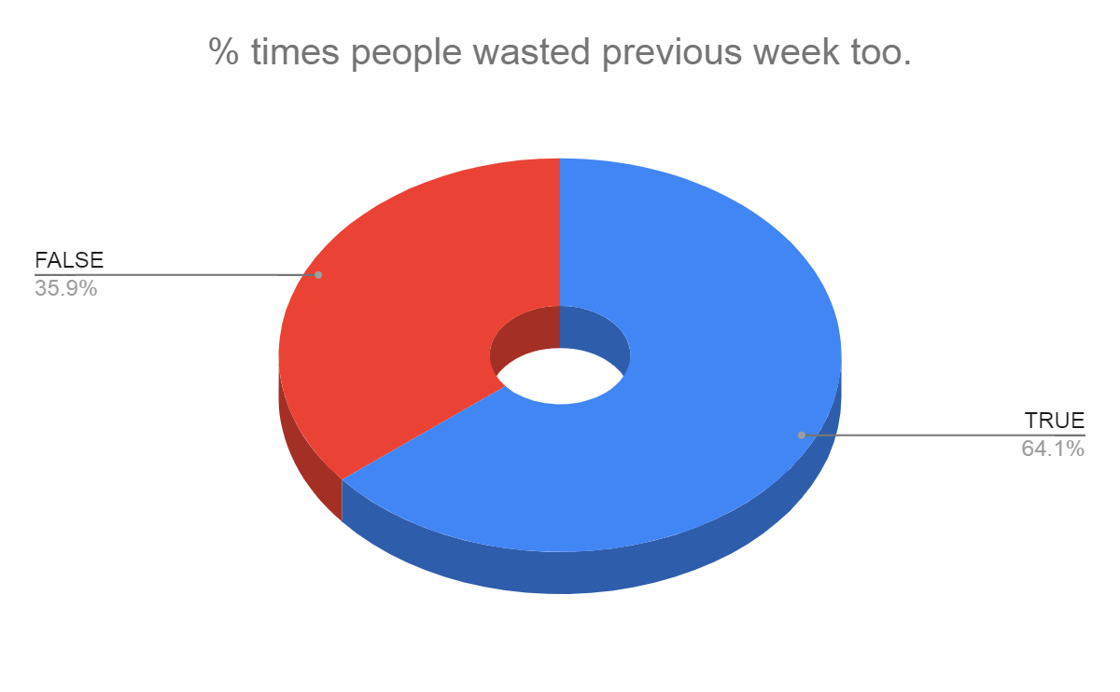
Data Analysis and Statistics

Slide 9
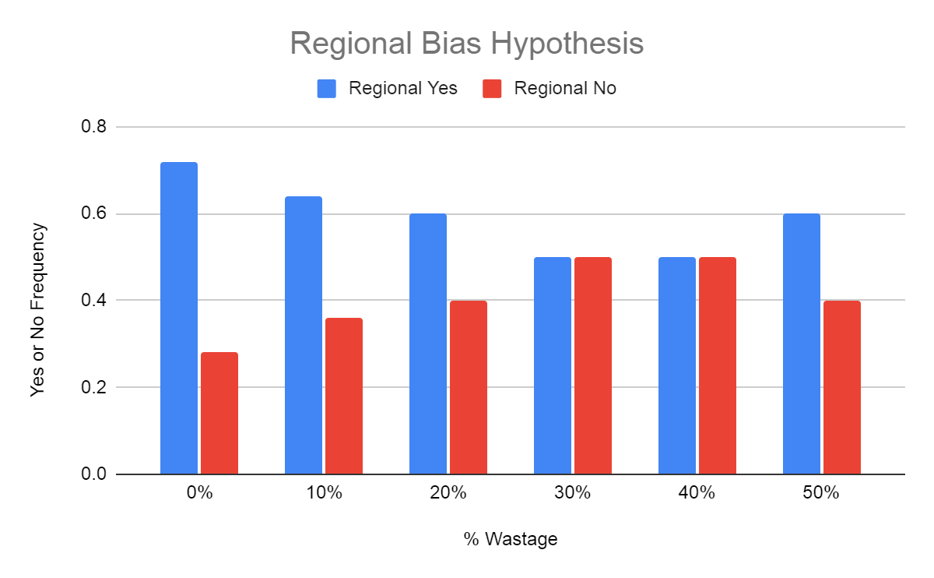
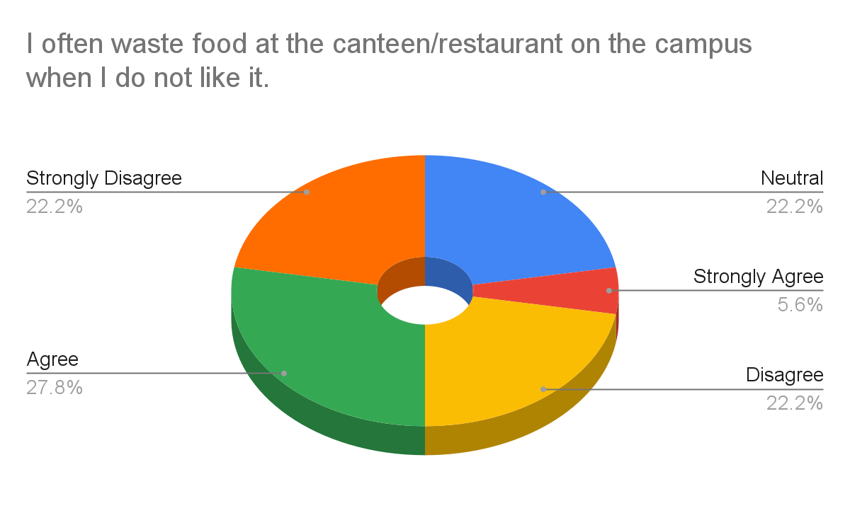
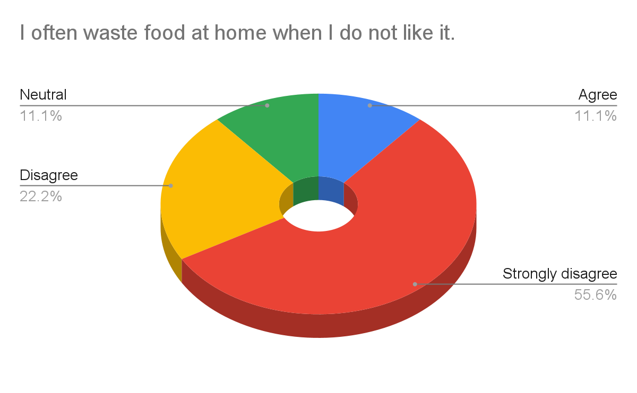
----- | wastage | no wastage
Regional(yes) | 24 | 23
One way Chi-Square table to reject null hypothesis for regional bias
Sample size for wastage: 39 Sample size for no wastage: 32
Degrees of freedom: 1 Chi-Square value (𝞆²) ~ 4.101

Slide 10
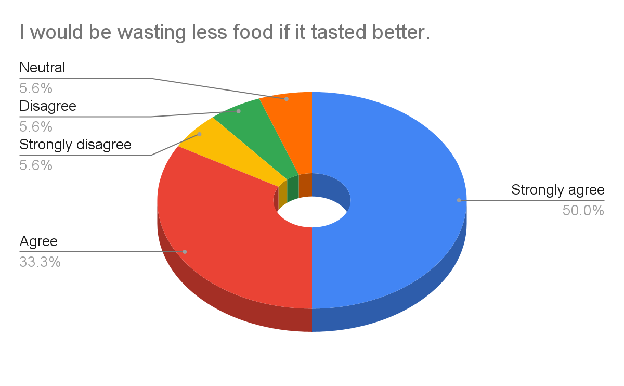
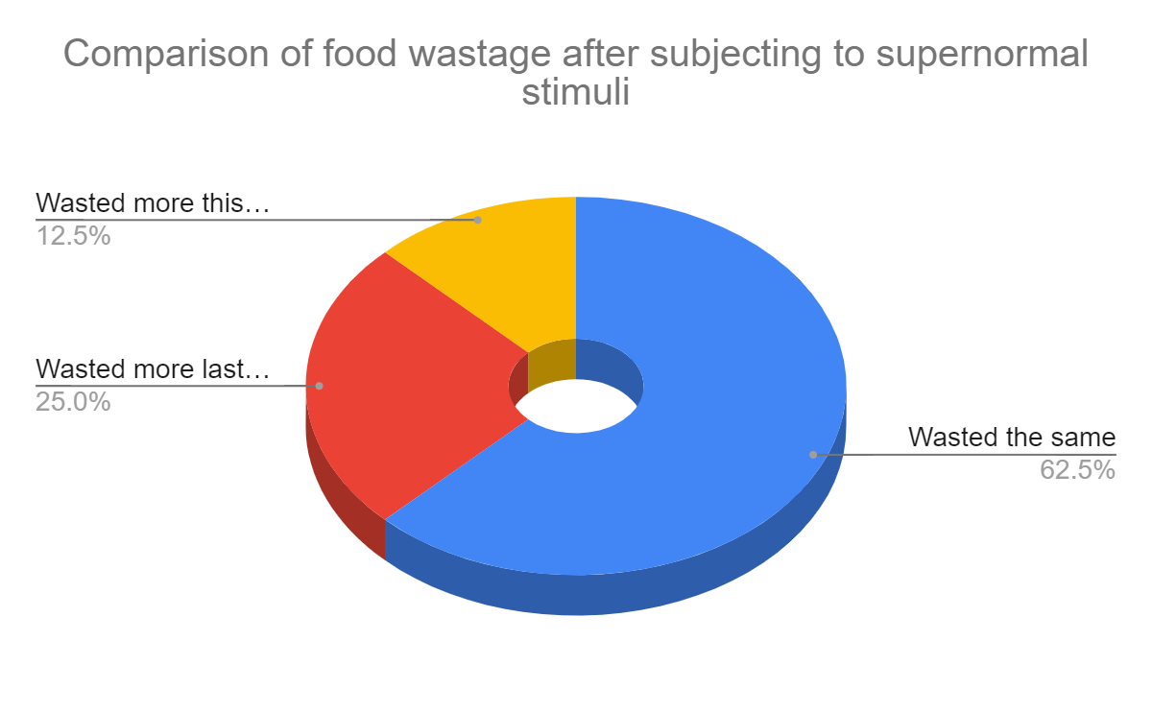
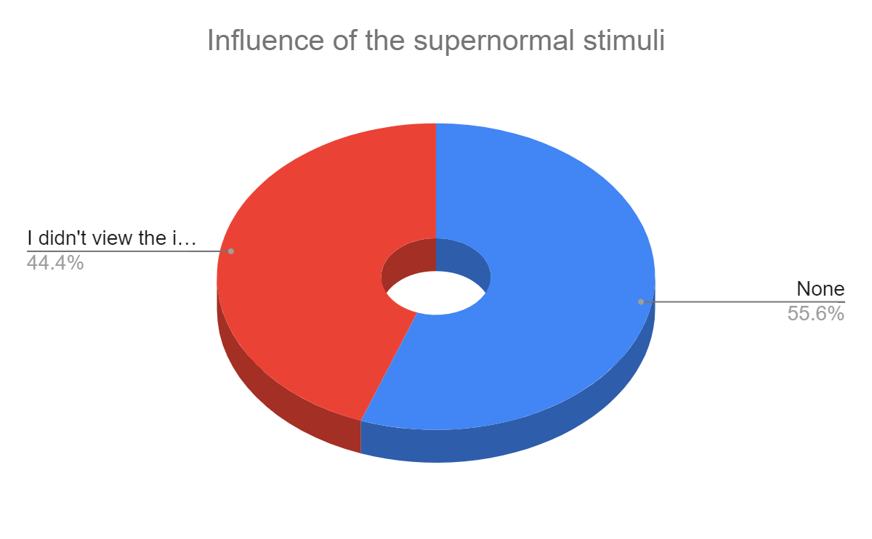

Slide 11
Results and Conclusion

Slide 12
Results and Conclusion
Self-contradiction by survey respondents over food behavior patterns was observed. 64% students accept wasting the same meal for 2 consecutive weeks.
The regional bias hypothesis appears to be true when overall wastage is considered.
Observations of the monetary source hypothesis were too scattered to derive any fruitful conclusions. A better attempt should have been made at framing the survey question.
Hypothesis regarding location-based wastage was in strong agreement with the results as more than 80% students admit the not wasting food at home, irrespective of the taste.

Slide 13
Results and Conclusion
References
Results of the supernormal stimulus experiment proved inconclusive.
Results of this behavioral study cannot be generalised elsewhere. This project is oversimplifying several practical limitations such as irregular sample sizes, misinformed answers, smaller temporal scale etc.
Experimental approaches such as hiring special cooks for regional dishes, changes in mess fee collection system and deploying carrot/stick methodologies.
Preliminary Study Reference [1]
Chi-Square Calculation Reference [2]
Supernormal Stimulus Experiment Reference [3]

Slide 14
THANK YOU !

Slide 15
Questions?

