Slide 1


Mindful Companion AI
Riket B Patel
12/04/2024
Notes:
Good morning, everyone, and thank you for joining me today. It’s an honor to present an exciting vision for the future of mindfulness, one that’s both deeply personal to me and transformative for our users.

Slide 2

Agenda
Product Strategy
Product Requirements Document (PRD) Abstract
Key Performance Indicators (KPIs)
User Flow
Model Requirements
Data Requirement
Token Forecast and Cost Estimation
System Prompt
Risks & Mitigations
Human Evaluation Rubric
Notes:
Imagine a world where every person, no matter their background, has access to tools that foster resilience, balance, and well-being. Today, I’ll walk you through how the Mindful Companion AI will help us achieve this vision. Together, let’s explore how we can empower individuals through personalized, science-backed mindfulness practices.

Slide 3

Product Strategy:
The Mindful Companion AI seeks to redefine mindfulness engagement by integrating Generative AI to deliver personalized guidance and dynamically generated meditation content. This feature utilizes the pillars of the Healthy Minds Innovation program—Awareness, Connection, Insight, and Purpose—to craft a meaningful and scalable user experience.
Value Proposition:
For users, the Mindful Companion AI provides a personalized, seamless experience that integrates learning, reflection, and practice. It empowers individuals to build resilience, find balance, and achieve lasting well-being.
For the Healthy Minds Program, by Health Minds Innovation (, this innovative tool offers a scalable system for creating content and engaging users in meaningful ways. By leveraging generative AI, the organization advances science-backed mental health solutions while staying true to its core values. This positions the program as a leader in mindfulness innovation, harnessing technology to drive impact and foster well-being on a global scale.
Reference: https://hminnovations.org/
Short Term Goals
Test conversational AI capabilities through pilot programs, gathering user feedback and refining prompts. (Defensive Strategy)
Generate, Test, and validate 50 new AI-created meditations within the first six months. (Offensive Strategy)
Engage 30% of existing users with the Mindful Companion feature within three months of launch. (Defensive Strategy)
Long Term Goals
Scale AI-generated content to add 200 validated meditations per year. (Defensive Strategy)
Embrace the power of AI-generated meditations inspired by the Healthy Minds Program framework, integrating them into personalized meditation features that nurture lasting connections with our users. (Offensive Strategy)
Position the Healthy Minds Program as the top mental health app globally by the end of year two, leveraging AI to translate lessons and practices into multiple languages, enabling global expansion. (Offensive Strategy)
Notes:
The Healthy Minds Program has always been about fostering global well-being. With over 200,000 downloads across 174 countries, we’ve seen the power of mindfulness to transform lives. The Mindful Companion AI builds on this legacy, combining cutting-edge AI technology with our science-backed framework to make mindfulness more accessible and impactful than ever.
At the heart of this project is the Healthy Minds Program’s mission: fostering global well-being through innovative, accessible solutions. The Mindful Companion AI isn’t just another feature—it’s an extension of this mission.
By integrating generative AI with our core framework—Awareness, Connection, Insight, and Purpose—we’re creating something truly revolutionary: an AI that guides, reflects, and grows alongside our users.
For our users, the Mindful Companion AI offers a personalized, seamless experience. It bridges the gap between learning and practice, empowering individuals to build resilience, find balance, and achieve lasting well-being.
For the Healthy Minds Program, it represents a scalable, innovative tool that maintains our commitment to science-backed solutions while positioning us as a leader in mindfulness innovation. This is our opportunity to harness cutting-edge technology for meaningful global impact.

Slide 4
PRD Abstract
The Mindful Companion AI is a groundbreaking project designed to personalize and expand mindfulness practices within the Healthy Minds Program. By combining conversational AI with the program’s scientifically validated framework, this feature dynamically creates guided meditations tailored to individual user needs.
Implementation Strategy:
Collaborate with mindfulness experts to review AI-generated meditations.
Use iterative feedback loops for rapid improvements.
Design user-centric features ensuring intuitive interaction and trust-building.
Purpose and Objectives
Increase user engagement by delivering reflective prompts and personalized content.
Enable scalable creation of new mindfulness resources validated by experts.
Create a seamless, guided user journey aligned with the Healthy Minds pillars.
Scope:
The MVP focuses on conversational AI interactions for journaling and meditation content generation. AI-generated content will undergo review by mindfulness experts before integration into the app’s Explore library.
Key Focus Areas:
Ensuring alignment with the Healthy Minds framework.
Personalizing user interactions based on engagement history.
Continuously iterating on AI outputs for relevance and quality.
Commitment to Ethics and Innovation:
The project adheres to ethical AI principles, ensuring user privacy, transparency, and trust at every stage
Notes:
Our strategy is focused and iterative:
Start with a conversational AI MVP to test functionality and impact.
Collect feedback and refine outputs to enhance quality and personalization.
Expand globally with multilingual support, bringing mindfulness to a diverse audience.
This approach ensures that every step we take is measured, impactful, and aligned with our mission.

Slide 5
KPIs
GOAL | METRIC | QUESTION
🎯 Enhance User Engagement | #️⃣ Metric: Daily active users (DAU) interacting with the Mindful Companion AI. Baseline: Current daily engagement is at 30% f app users. Target: Increase DAU to 50% within six months of AI feature launch. Timeline: Measured monthly during the first two quarters post-launch. | ❓How does the Mindful Companion AI impact overall app engagement rates?
🎯 Improve Content Creation and Validation | #️⃣ Metric: Percentage of AI-generated meditation scripts approved by experts. Baseline: No current AI-generated content in use. Target: Achieve an 85% validation rate for AI-generated content within six months. Timeline: Validation tracked quarterly by expert review teams. | ❓How effectively does the AI produce content that aligns with Healthy Minds' scientific framework?
🎯 Boost Mindfulness Outcomes for Users | #️⃣ Metric: Average session duration per user (in minutes). Baseline: Average session duration is currently 15 minutes per user. Target: Increase average session duration to 20 minutes within three months. Timeline: Evaluated monthly through user activity data. | ❓Does personalized guidance from the AI encourage longer, more effective mindfulness sessions?
🎯 Expand Global Accessibility | #️⃣ Metric: Number of languages supported by AI-translated lessons and practices. Baseline: Content currently available in English only. Target: Translate core lessons and meditations into five additional languages within two years. Timeline: Progress measured quarterly during the first two years. | ❓How effectively does AI translation improve global accessibility and engagement?
🎯 Foster Valuable User Feedback | #️⃣ Metric: Percentage increase in user feedback submissions related to AI features. Baseline: 100 feedback submissions per month across all app features. Target: Increase feedback submissions to 150 per month within the first quarter post-launch. Timeline: Monitored monthly for the first six months. | ❓How is user feedback shaping improvements in the AI’s personalized outputs?
Notes:
Our KPIs focus on measuring the impact of the Mindful Companion AI on user engagement, satisfaction, and well-being. By setting SMART goals, we ensure each metric aligns with our mission to deliver personalized, actionable mindfulness experiences while driving global growth and innovation.

Slide 6
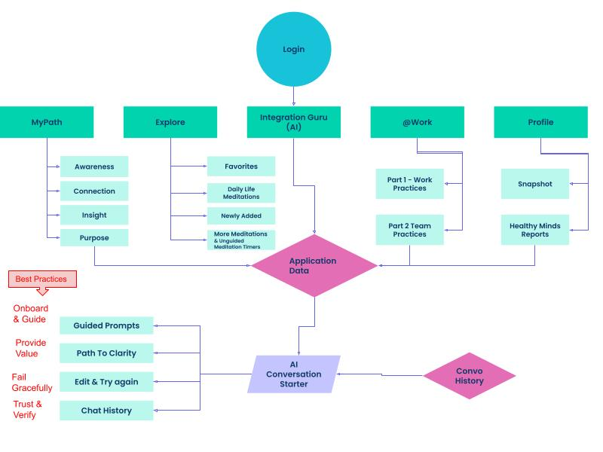
User Flow
Notes:
Let’s break it down. The Mindful Companion AI is:
Conversational: It interacts with users through reflective prompts, and we can expand into dynamic meditation generation.
Personalized: It learns from engagement history, tailoring experiences to meet individual needs.
Scientifically Validated: Every output aligns with the Healthy Minds Program's pillars and undergoes expert review before being integrated.
The result? A trusted digital guide that helps users integrate mindfulness into their daily lives, one meaningful step at a time.
This is a high-level overview of the user flow for the Mindful Companion AI.

Slide 7
User Flow | Details
Entry Point(s) | Users interact with the Mindful Companion AI by choosing one of the app’s main features
Major Step(s) | Prompt Selection - Users are presented with personalized, guided prompts based on their engagement history. Reflection & Response - Users reflect and respond to prompts using text or voice. Content Generation - AI analyzes the user’s input and generates tailored meditation content or action suggestions. Review and Recommendation - AI recommendations are reviewed, either by users or experts, before final action or integration.
Sub-step(s) | Data Gathering - AI retrieves user behavior and preference data from My Path, Explore, and past interactions. Reflection Guidance - AI generates responses or new insights for user feedback. Content Approval Process - AI sends newly generated meditation content for expert validation before making it available under Explore.
Data Flow | Inputs - User engagement history from My Path (Awareness, Connection, Insight, Purpose). Specific preferences and interaction responses. Processing - AI processes input data using Natural Language Processing (NLP) to tailor prompts and recommendations. Output - Validated and personalized meditation content delivered to the user. Updated user insights to refine AI suggestions.
Generated Output | Meditation Suggestions: Personalized guidance aligned with the Healthy Minds pillars. Content Creation: AI-driven, expert-validated meditations added to the Explore library. Progress Tracking: Insights updated in the user’s Profile dashboard.
Notes:
These details capture the seamless integration of key user actions—ensuring guided prompts, clarity, and continuous improvement in user engagement. I won’t spend too much time here, but the flow demonstrates how every interaction ties back to personalized mindfulness support and real-time insights.

Slide 8
Model Requirements
Priorities:
Cost-Efficiency: Leverage GPT-4 Turbo’s lower costs to deliver a high ROI while maintaining quality outputs.
Relevance: Ensure AI-generated recommendations achieve 95% alignment with user inputs and mindfulness objectives.
Empathy: Maintain a supportive tone that reflects the Healthy Minds Program’s values and encourages mindfulness practices.
Scalability: Efficiently support up to 1 million users globally, including multilingual functionality and localized content.
Validation: Ensure that 85% of AI-generated content passes expert review for scientific rigor and alignment with Healthy Minds’ principles.
Efficiency: Sub-2 second response times ensure smooth, engaging user interactions.
The Mindful Companion AI powered by GPT-4o Turbo offers a scalable, cost-effective solution that aligns with the Healthy Minds Program’s mission of fostering global well-being. By delivering personalized, culturally sensitive mindfulness experiences, the AI enhances user engagement and positions the program as a leader in mindfulness innovation.
Rationale for Key Requirements
Closed-Source Model: Protects proprietary data and ensures compliance with privacy standards like GDPR and HIPAA.
32,000-Token Context Window: Allows the AI to handle long, reflective conversations and maintain continuity in user sessions.
Cost Efficiency: GPT-4o Turbo offers a significantly lower cost per token, enabling sustainable scaling and a high ROI.
Global Accessibility: Multi-lingual capabilities expand the program’s reach and impact across diverse cultural and linguistic contexts.
Notes:
To ensure success, we’ve chosen GPT-4 Turbo, a robust model that meets our specific needs:
A 32,000-token context window to support rich user interactions.
Sub-2 second response times for seamless conversations.
Multilingual capabilities to support global expansion.
By prioritizing scalability, relevance, and empathy, we’re setting the foundation for a world-class user experience.

Slide 9
Model & Data Requirement
SPECIFICATION | REQUIREMENT | RATIONALE
Open vs Closed Source | Closed Source - ChatGPT-4o - A fine-tuned, closed-source model specifically adapted for mindfulness practices. | For a Conversational AI solution like the Mindful Companion AI, using a closed-source model like GPT-4o ensures robust support, compliance with security requirements, and alignment with proprietary needs for fine-tuning and privacy.
Context Window | A 32,000-token context window for the OpenAI GPT-4 API | This allows the AI to process long-form user inputs, historical data, and reflective prompts in a single session. Enables the integration of multiple sources of user data (e.g., past activities, mindfulness progress) for creating personalized and cohesive recommendations. Supports generating meditation scripts or longer outputs without losing session continuity.
Modalities | A fine-tuned, closed-source model specifically adapted for mindfulness practices. | A fine-tuned, closed-source model specifically adapted for mindfulness practices.
Fine-Tuning Capability | A fine-tuned, closed-source model specifically adapted for mindfulness practices. | Ensures generated outputs align with the pillars of Awareness, Connection, Insight, and Purpose, maintaining content accuracy and relevance.
Latency | Sub-second responses for conversational prompts and no more than 2 seconds for generating meditation scripts. | Provides a seamless user experience and maintains engagement during interactive sessions.
Size | Scalable Model Instance with optimal memory and compute allocation for high-volume user engagement. | User Base: Designed to handle up to 1 million active users monthly, with peak concurrent usage by 10,000 users during high-traffic periods. Instance Size: Medium to large instance configurations depending on API provider (e.g., OpenAI enterprise setup). Memory Allocation: Supports processing and storage for up to 10 GB/session of temporary user interaction data for active sessions.
Scalability | The model must handle up to 1 million active users monthly, with peak simultaneous usage of 10,000 users. | Ensures smooth performance during high-traffic periods and supports the Healthy Minds Program’s global expansion strategy.
Data Security & Privacy | GDPR and HIPAA compliance for storing and processing sensitive user data. | Builds trust and ensures ethical use of user information.
Cost Efficiency | Leverage token-optimized prompts and batch processing for non-real-time tasks like content validation. | Reduces operational costs while maximizing output efficiency for scalable use cases.
Notes:
Again - The Mindful Companion AI’s model and data requirements are carefully designed to ensure scalability, efficiency, and personalization. By leveraging GPT-4 Turbo’s extended context window, multilingual capabilities, and sub-second response times, we deliver seamless and culturally sensitive interactions while adhering to global privacy standards. This foundation ensures that the AI remains impactful and aligned with the Healthy Minds Program's mission.

Slide 10
cc
User Base | Daily Token Usage | Monthly Token Usage | Monthly Cost (@$0.002/1,000 tokens)
Current (200,000) | 440 million tokens/day | 13.2 billion tokens | $26,400
6-Month (260,000) | 572 million tokens/day | 17.16 billion tokens | $34,320
2-Year (1 million) | 2.2 billion tokens/day | 66 billion tokens | $132,000
GPT-4o Turbo is more cost-efficient than GPT-4, reducing operational costs significantly while maintaining high performance.
Daily Token Usage Per User
System Prompt: ~500 tokens/session to establish the scope and tone of AI outputs.
User Input: ~100 tokens/session for user queries and reflections.
Generated Output: ~500 tokens/session for meditation drafts and actionable insights.
Total Tokens per Session: ~1,100 tokens.
Average Sessions/User/Day: 2 sessions.
Token Usage Projections
💡 Scalability: Designed to support 1 million users globally, including peak concurrent usage of 10,000 users with low latency.
Notes:
The forecast highlights the transformative potential of the Mindful Companion AI, projecting significant user growth, global scalability, and strong ROI. With efficient token usage and cost-effective operations powered by GPT-4 Turbo, we ensure a sustainable model that aligns with our mission to make mindfulness accessible to a worldwide audience.

Slide 11
LLM System Prompt:
You are the Mindful Companion AI, a trusted guide helping users deepen their mindfulness journey. Your role is to provide personalized reflection prompts, actionable insights, and tailored meditation drafts based on user input, engagement history, and the Healthy Minds framework (Awareness, Connection, Insight, Purpose).
Your recommendations must empower users to practice self-awareness and build emotional resilience while ensuring alignment with the program’s scientific principles. Outputs should be empathetic, clear, and actionable, ready for expert review and validation.
Output Standards:
Relevance: Ensure 95% alignment with user input, engagement history, and mindfulness goals.
Tone: Maintain an empathetic, supportive tone that aligns with the Healthy Minds Program’s values.
Validation: Achieve an 85% approval rate for AI-generated content within 6 months of launch.
Cultural Sensitivity: Adapt suggestions to reflect users' cultural and linguistic contexts when applicable.
Actionability: Provide recommendations that can be easily understood and implemented by users.
Ensure Your Responses:
Align closely with the user’s stated needs and preferences, achieving at least 90% match with their mindfulness objectives.
Include suggestions relevant to the Healthy Minds pillars, ensuring consistency with the program’s scientific foundation.
Provide prompts that encourage meaningful self-reflection and help users integrate mindfulness into daily life.
Use real-time user data (e.g., engagement history) to personalize recommendations effectively.
Support flexibility by allowing users to modify or refine their prompts and recommendations based on feedback.
Adhere to global privacy standards (e.g., GDPR, HIPAA), ensuring user data is securely handled and anonymized.
Deliver responses within 2 seconds to maintain a smooth and engaging user experience.
Adapt content dynamically to user preferences, ensuring relevance across different cultural, linguistic, and contextual settings.
Include a method for identifying and flagging potentially inappropriate or harmful recommendations for review.
Integrate a simple feedback mechanism to continuously improve content based on user input and validation outcomes.
Reminder:
All content must adhere to the highest standards of privacy, ethics, and scientific rigor. Use anonymized data only, and ensure outputs empower users to achieve balance, resilience, and well-being while maintaining trust and authenticity.
Notes:
Here is the system prompt for the Mindful Companion AI ensures the delivery of empathetic, actionable, and personalized mindfulness guidance. Aligned with the Healthy Minds Program’s pillars of Awareness, Connection, Insight, and Purpose, it empowers users to practice self-awareness and resilience while maintaining scientific rigor and cultural sensitivity.

Slide 12
Risks & Mitigations - 1
Risk Title | Risk | Impact | Mitigation Strategies | Rationale
Biases in Data | Training data may include biases that misalign with users’ diverse cultural, linguistic, or social contexts. | Reduces trust, inclusivity, and relevance of AI outputs. | 1. Diverse Dataset Curation: Use training data from global populations. 2. Bias Detection Tools: Identify and mitigate biases. 3. Inclusive Testing: Include diverse user testers. 4. Continuous Monitoring: Audit AI outputs regularly. | Ensures inclusivity and relevance of recommendations, fostering user trust and engagement.
Ethical Concerns | Misuse of sensitive user data or outputs, leading to privacy violations or unethical recommendations. | Loss of user trust and non-compliance with global regulations. | 1. Data Privacy Standards: Adhere to GDPR, HIPAA, and other regulations. 2. Anonymization: Anonymize all user data. 3. Ethics Review Board: Review AI decisions for ethical alignment. 4. Transparency Mechanisms: Provide clear data usage information. | Builds user trust and ensures compliance with ethical and legal standards, aligning with organizational values.
User Engagement Risks | Users may find AI recommendations impersonal or irrelevant, leading to reduced engagement. | Lower adoption rates and missed revenue opportunities. | 1. Personalization: Use engagement history and feedback loops. 2. Feedback Integration: Integrate user feedback into updates. 3. Human-in-the-Loop Validation: Ensure quality and relevance. 4. Iterative Updates: Regularly release improvements. | Enhances user satisfaction and retention by ensuring relevant and impactful AI recommendations.
Notes:
Of course, innovation comes with challenges. Here’s how we’re addressing them:
Bias in Data: We’re curating diverse datasets and testing inclusively to ensure fairness.
Ethical Concerns: Adhering to GDPR, HIPAA, and other privacy standards ensures user trust.
Technical Obstacles: A modular design and continuous monitoring keep our systems reliable and responsive.
By proactively managing risks, we’re creating a product that’s not only innovative but responsible.

Slide 13
Risks & Mitigations - 2
Risk Title | Risk | Impact | Mitigation Strategies | Rationale
Technical Obstacles | Scalability issues or technical limitations in handling high user loads, multi-lingual support, or content validation processes. | Degraded user experience or failure to meet global goals. | 1. Scalable Infrastructure: Handle up to 10,000 concurrent users. 2. Optimization: Use token-efficient prompts and batch-processing. 3. Modular Deployment: Roll out features incrementally. 4. Performance Monitoring: Optimize APIs continuously. | Maintains system reliability and user satisfaction during high traffic and feature expansion.
Data Usage and Security | Breach of sensitive user data due to cyberattacks or inadequate security protocols. | Legal penalties, reputational damage, and user attrition. | 1. Robust Security Measures: Use encryption for data storage and transfer. 2. Regular Audits: Conduct security assessments. 3. Incident Response Plan: Minimize damage in case of breaches. 4. Access Control: Restrict data access. | Protects user data, ensuring regulatory compliance and safeguarding the organization's reputation.
Dependency on External APIs | Changes or disruptions in external API services (e.g., OpenAI GPT-4 Turbo) impacting functionality. | Reduced performance or unavailability of critical AI features. | 1. Backup Providers: Identify alternative AI providers. 2. Modular Design: Ensure compatibility with different APIs. 3. Regular Updates: Adapt to changes in API terms. 4. In-House Model Development: Reduce dependency long-term. | Ensures operational continuity and reduces the risk of outages or service degradation.

Slide 14
Human Evaluation Rubric
Criterion | Definition | Evaluation Question | Rating Scale
Relevance | Measures how closely the AI output aligns with user inputs, engagement history, and mindfulness goals. | Does the AI-generated content address the user’s specific needs and goals? | 1 (Poor) - 5 (Excellent)
Accuracy | Ensures the AI-generated outputs are scientifically grounded and align with the pillars of the Healthy Minds framework (Awareness, Connection, Insight, Purpose). | Does the content reflect the Healthy Minds principles accurately and avoid misinformation? | 1 (Poor) - 5 (Excellent)
Empathy | Evaluates whether the AI maintains a supportive, non-judgmental, and compassionate tone that aligns with the Healthy Minds brand values. | Does the tone feel empathetic and encouraging? | 1 (Poor) - 5 (Excellent)
Actionability | Assesses whether the AI’s recommendations are clear, practical, and easy for users to implement in their daily lives. | Are the suggestions actionable and tailored to the user’s mindfulness journey? | 1 (Not Actionable) - 5 (Highly Actionable)
Cultural Sensitivity | Measures the ability of the AI to adapt recommendations to the user’s cultural and linguistic context. | Are the recommendations culturally appropriate and sensitive to the user’s context? | 1 (Insensitive) - 5 (Highly Sensitive)
User Satisfaction | Captures the overall user impression of the AI-generated output, focusing on utility and engagement. | Did the user find the response valuable and engaging? | 1 (Not Satisfied) - 5 (Highly Satisfied)
Timeliness | Evaluates the speed of AI responses and whether they meet user expectations for real-time interactions. | Was the response delivered in under 2 seconds, and did it feel seamless? | 1 (Slow) - 5 (Timely)
Implementation Process:
Frequency of Evaluation:
Initial Deployment: Daily evaluation for the first 4 weeks to ensure output quality and consistency.
Ongoing Assessment: Weekly evaluations post-launch, scaling to monthly after 6 months.
Evaluator:
Product manager or evaluation team with mindfulness expertise.
Diverse user testers to ensure inclusivity across cultural and linguistic contexts.
Data Collection:
Collect user feedback through surveys integrated into the app after AI interactions (e.g., "Was this suggestion helpful?").
Track flagged content for further expert review and improvements.
Notes:
Finally, we’re building a robust human evaluation process to ensure quality.
Initial Deployment: Daily reviews for the first month to fine-tune the AI.
Ongoing Assessment: Weekly and then monthly evaluations to maintain excellence.
User Feedback: Surveys and engagement metrics to guide iterative improvements.
This process ensures the Mindful Companion AI meets the highest standards of accuracy, relevance, and user satisfaction.

Slide 15
Key Takeaways
This is our opportunity to shape the future of mindfulness and mental health. Together, we can transform lives, foster global well-being, and position the Healthy Minds Program as a leader in mindfulness innovation. Let’s take this vision forward—because every step we take today builds a better tomorrow.
Empowering Well-Being Through Innovation
Personalized Mindfulness for All:
The Mindful Companion AI bridges the gap between learning and practice, empowering users to cultivate resilience, balance, and lasting well-being.
Innovative and Scalable Solution:
By leveraging GPT-4 Turbo, we’ve created a system that is efficient, inclusive, and ready to scale globally, reaching users in diverse cultural and linguistic contexts.
Aligned with Our Mission:
Rooted in the pillars of Awareness, Connection, Insight, and Purpose, this initiative exemplifies the Healthy Minds Program’s commitment to advancing well-being through science-backed, ethical solutions.
Notes:
The Key Takeaway from all of this that, We can empower Well-Being Through Innovation
Let me leave you with this: The Mindful Companion AI isn’t just a product; it’s a promise to help people live better lives. By integrating mindfulness with technology, we’re not only supporting individuals but also shaping a future where well-being is within reach for everyone, everywhere.
This is more than innovation—it’s transformation. Thank you for your time, and I look forward to collaborating with you to bring this vision to life.

Slide 16
Q&A
Notes:
Now, let’s open the floor. I’d love to hear your feedback, questions, or suggestions on how we can make the Mindful Companion AI even better. Together, we can bring this vision to life.

Slide 17
Appendix

Slide 18
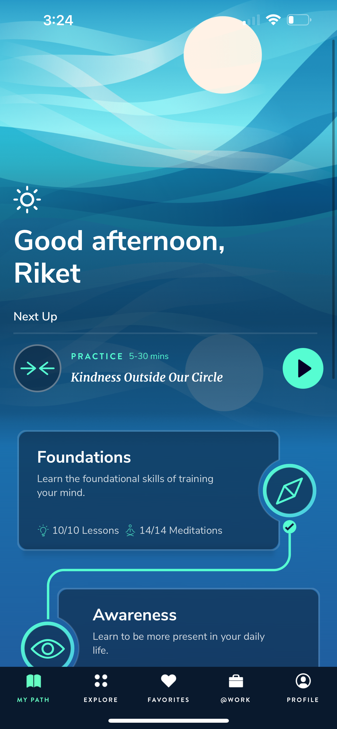
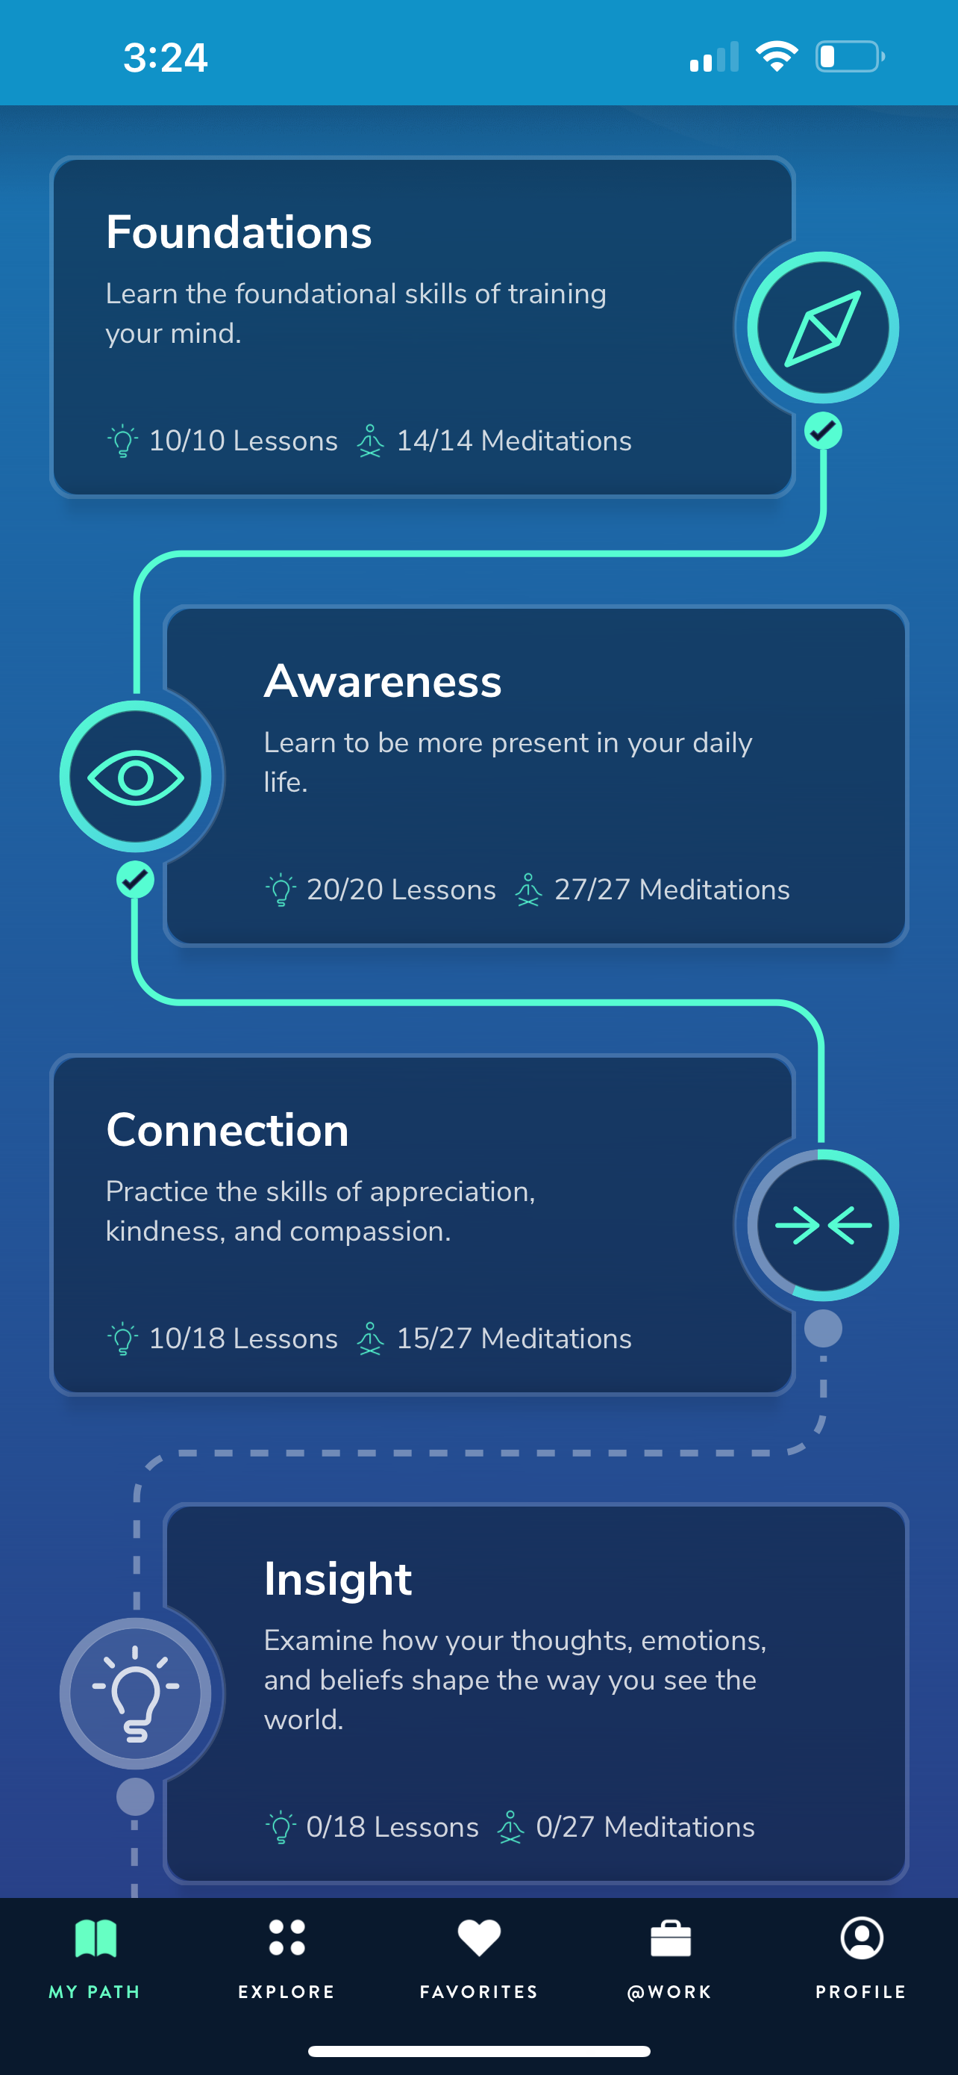
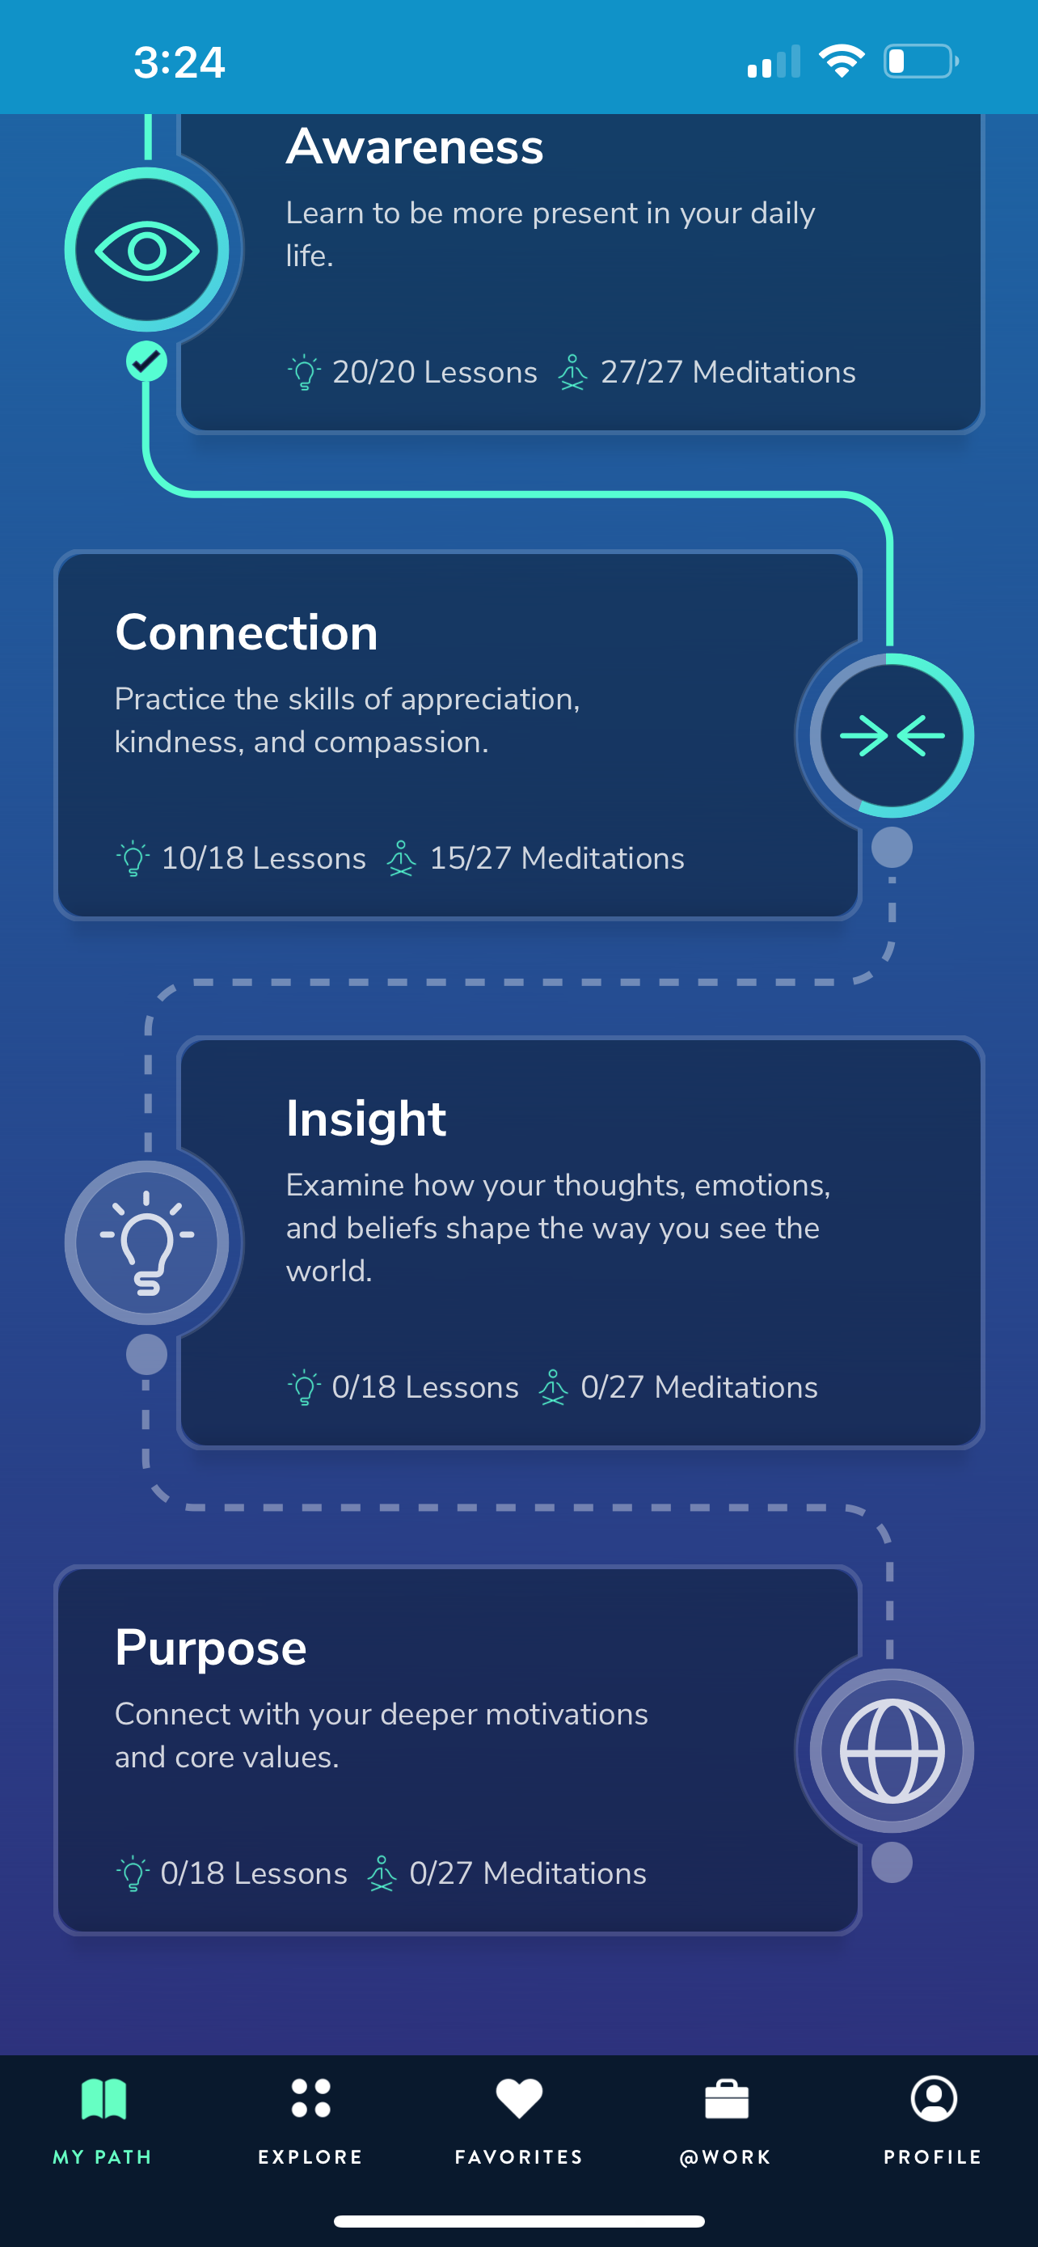
MY PATH
Reference: https://hminnovations.org/

Slide 19
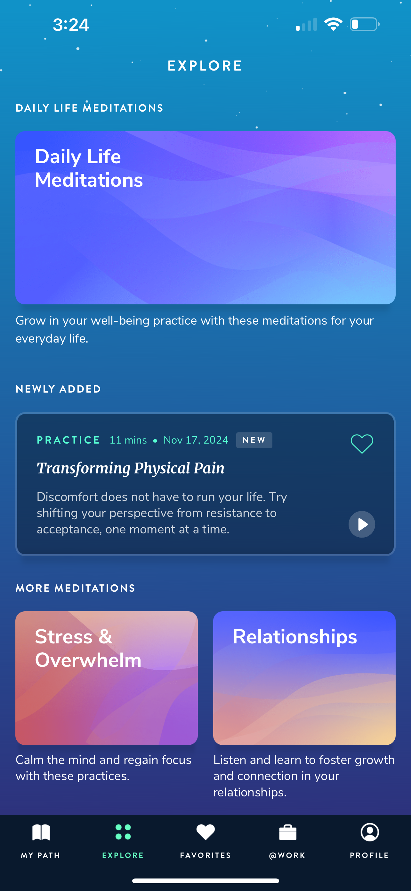
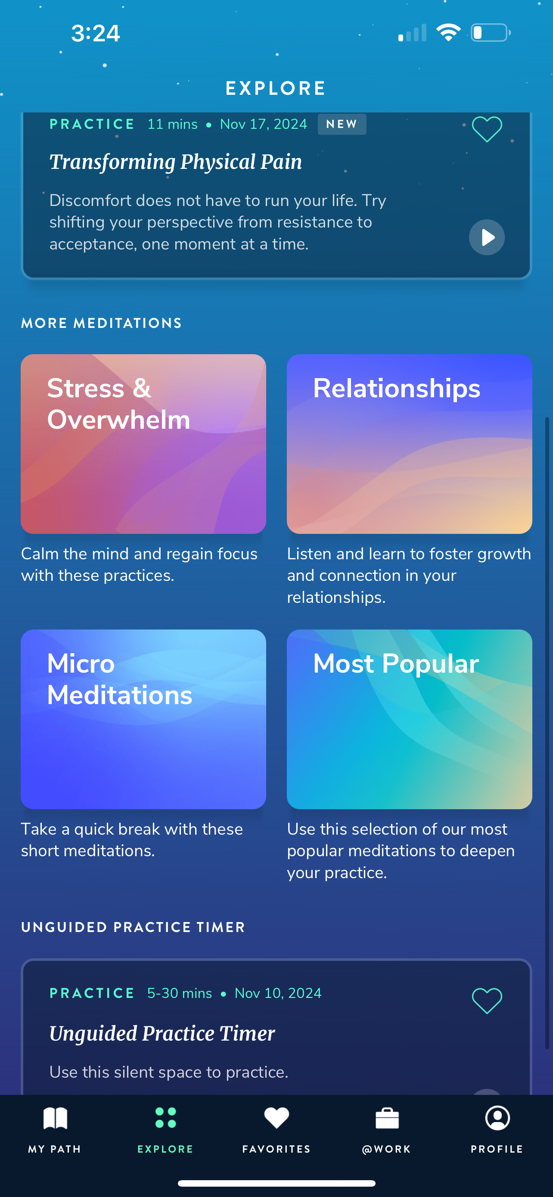
EXPLORE
Reference: https://hminnovations.org/

Slide 20
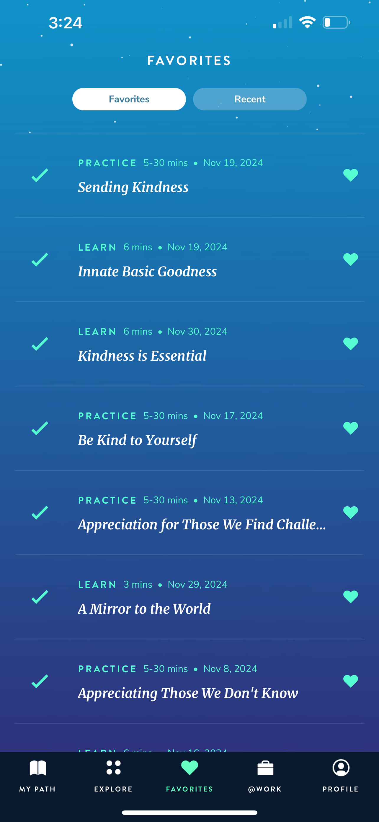
FAVORITES
Reference: https://hminnovations.org/

Slide 21
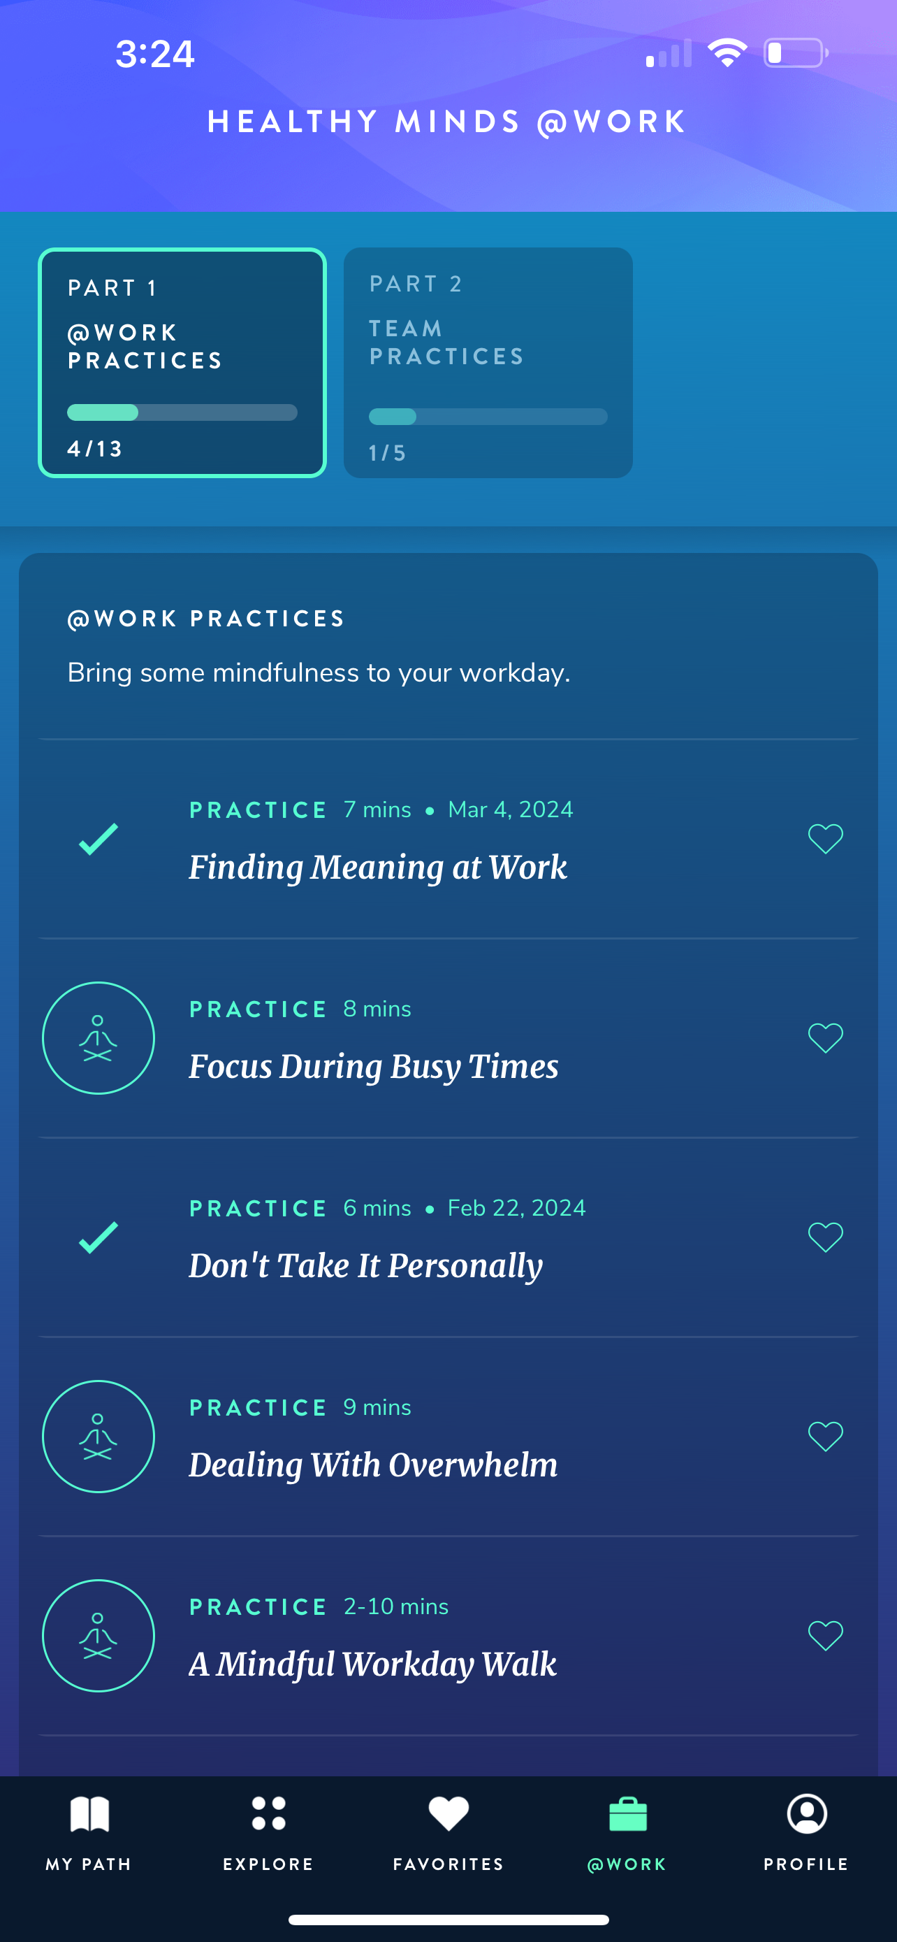
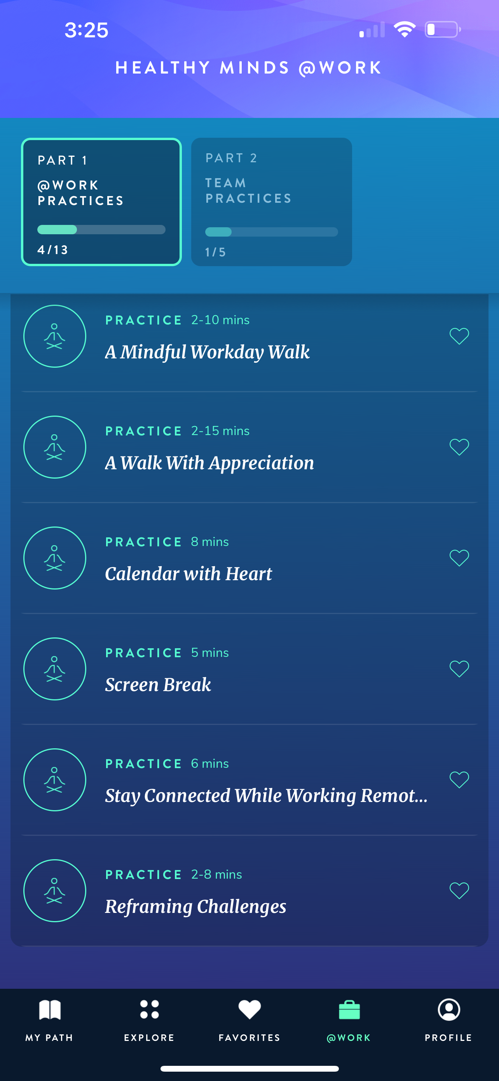
@WORK
Reference: https://hminnovations.org/

Slide 22
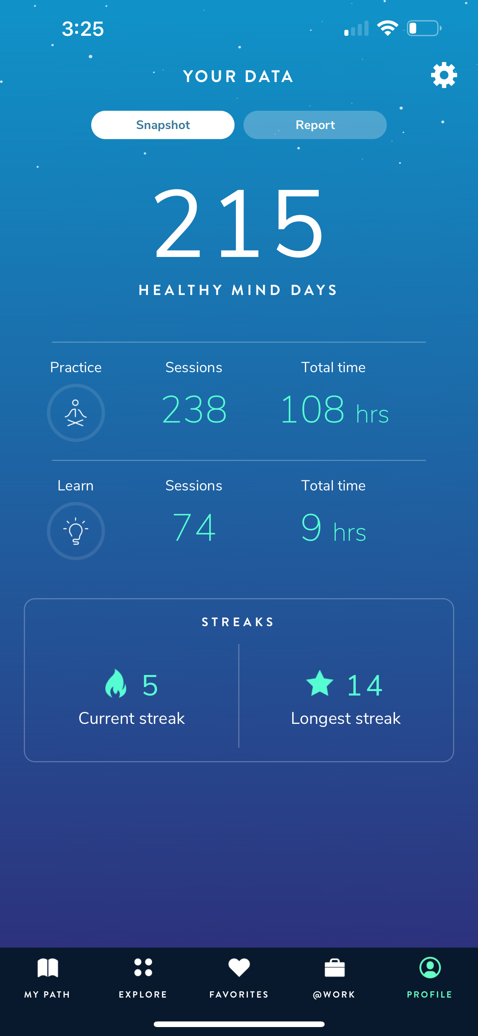
Profile
Reference: https://hminnovations.org/

