Slide 1
University of Delaware
Credit Card Customer
Course
Introduction to Data Mining
Segmentation
Team
Team Member 1
Using Clustering Techniques
Team Member 2
Team Member 3
Team Member 4
Dataset
CC_GENERAL.csv
8,950 customers · 17 features
University of Delaware · Introduction to Data Mining · May 2026

Slide 2
Problem Statement & Objective
2
Why segmentation matters — and what we aim to do
MOTIVATION
The Problem
Our Objective
✗
Banks serve millions of customers with very different needs.
Apply unsupervised machine learning to group credit card customers into meaningful behavioral segments based on their spending, payment, and borrowing patterns — without any predefined labels.
✗
A single product strategy fails to address diverse financial behaviors.
✗
Without segmentation, marketing spend is wasted on the wrong audience.
✗
Credit risk cannot be managed effectively without knowing customer types.
Our Approach
1
Explore and clean the CC_GENERAL dataset
✗
Low-engagement customers churn silently with no targeted intervention.
2
Apply K-Means, DBSCAN, GMM & Agglomerative
✗
High-value customers receive the same treatment as low-activity ones.
3
Compare algorithms using 3 internal metrics
4
Interpret and name the final customer segments
Slide 2

Slide 3
Real-World Applications
3
How customer segmentation creates business value
IMPACT
Marketing Personalization
Credit Risk Monitoring
Customer Retention
Product Recommendation
Reward Program Targeting
→
Tailor messaging to each segment's spending habits
→
Cash-Advance Revolvers carry the highest default risk
→
Identify Dormant customers before they close accounts
→
Revolvers → balance-transfer & consolidation loans
→
Match reward type to spending behaviour
→
Send credit limit upgrade offers to Premium Transactors
→
Set differentiated credit limits per segment
→
Offer loyalty perks to Premium Transactors
→
Transactors → rewards & cashback credit cards
→
Travel miles for high-spend transactors
→
Re-engagement emails to Dormant customers
→
Flag high-balance revolvers for early intervention
→
Prevent churn with segment-specific incentives
→
Instalment Buyers → BNPL & low-interest plans
→
Instalment discounts for frequent instalment users
Slide 3

Slide 4
Data Information
4
CC_GENERAL.csv — Kaggle Credit Card Dataset
DATASET
Customers
Raw Features
After Cleaning
Missing Values
8,950
18
17
314
Key Features
Dataset Notes
Feature | Type | Description
BALANCE | Float | Avg monthly outstanding balance ($)
PURCHASES | Float | Total purchases made in period ($)
ONEOFF_PURCHASES | Float | One-off (single) purchase amount ($)
INSTALLMENTS_PURCH. | Float | Instalment purchase amount ($)
CASH_ADVANCE | Float | Total cash advance amount ($)
CREDIT_LIMIT | Float | Customer credit limit ($)
PAYMENTS | Float | Total payments made ($)
MINIMUM_PAYMENTS | Float | Minimum payments required ($)
PRC_FULL_PAYMENT | Float [0,1] | Fraction of months paid in full
PURCHASES_FREQUENCY | Float [0,1] | Fraction of months with purchases
CASH_ADV_FREQUENCY | Float [0,1] | Fraction of months with advances
TENURE | Integer | Months as a customer
Source: Kaggle (CC_GENERAL Dataset)
One row per customer (6-month window)
CUST_ID dropped — not a feature
Missing: MINIMUM_PAYMENTS (313 rows)
Missing: CREDIT_LIMIT (1 row)
→ Both filled with column median
10 monetary features are right-skewed
→ log₁p transform applied before scaling
6 frequency features already in [0, 1]
→ Kept on original scale
Slide 4

Slide 5
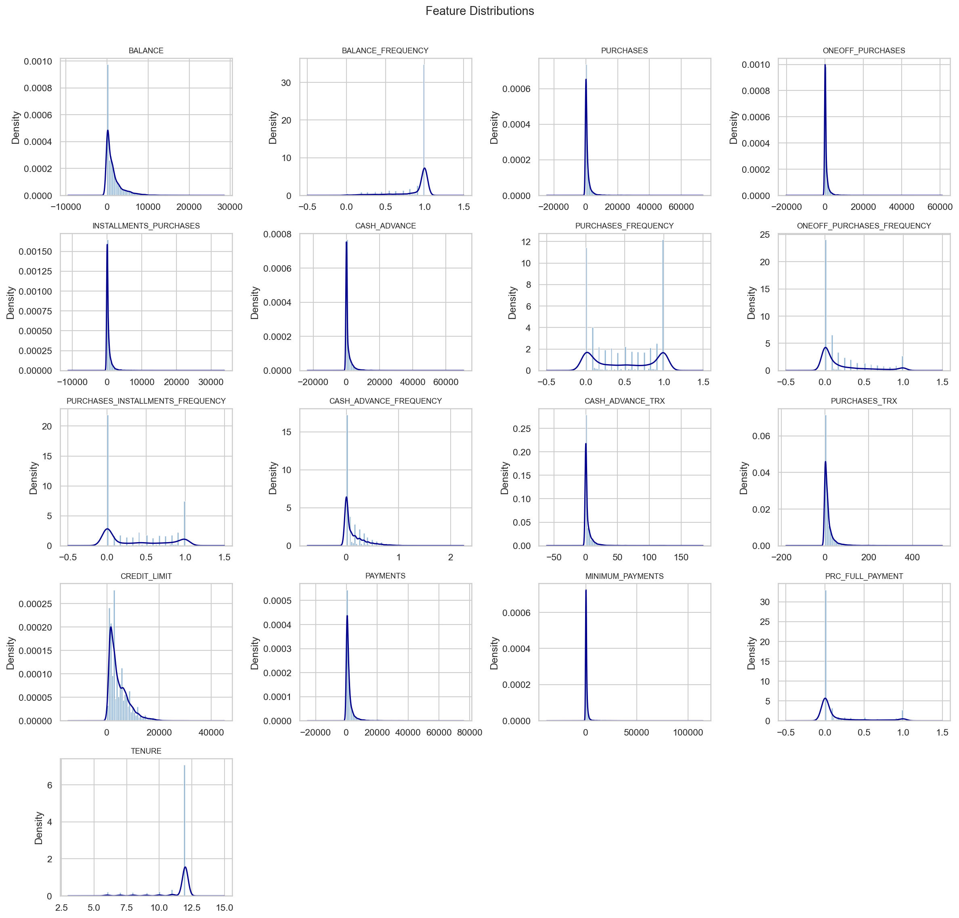
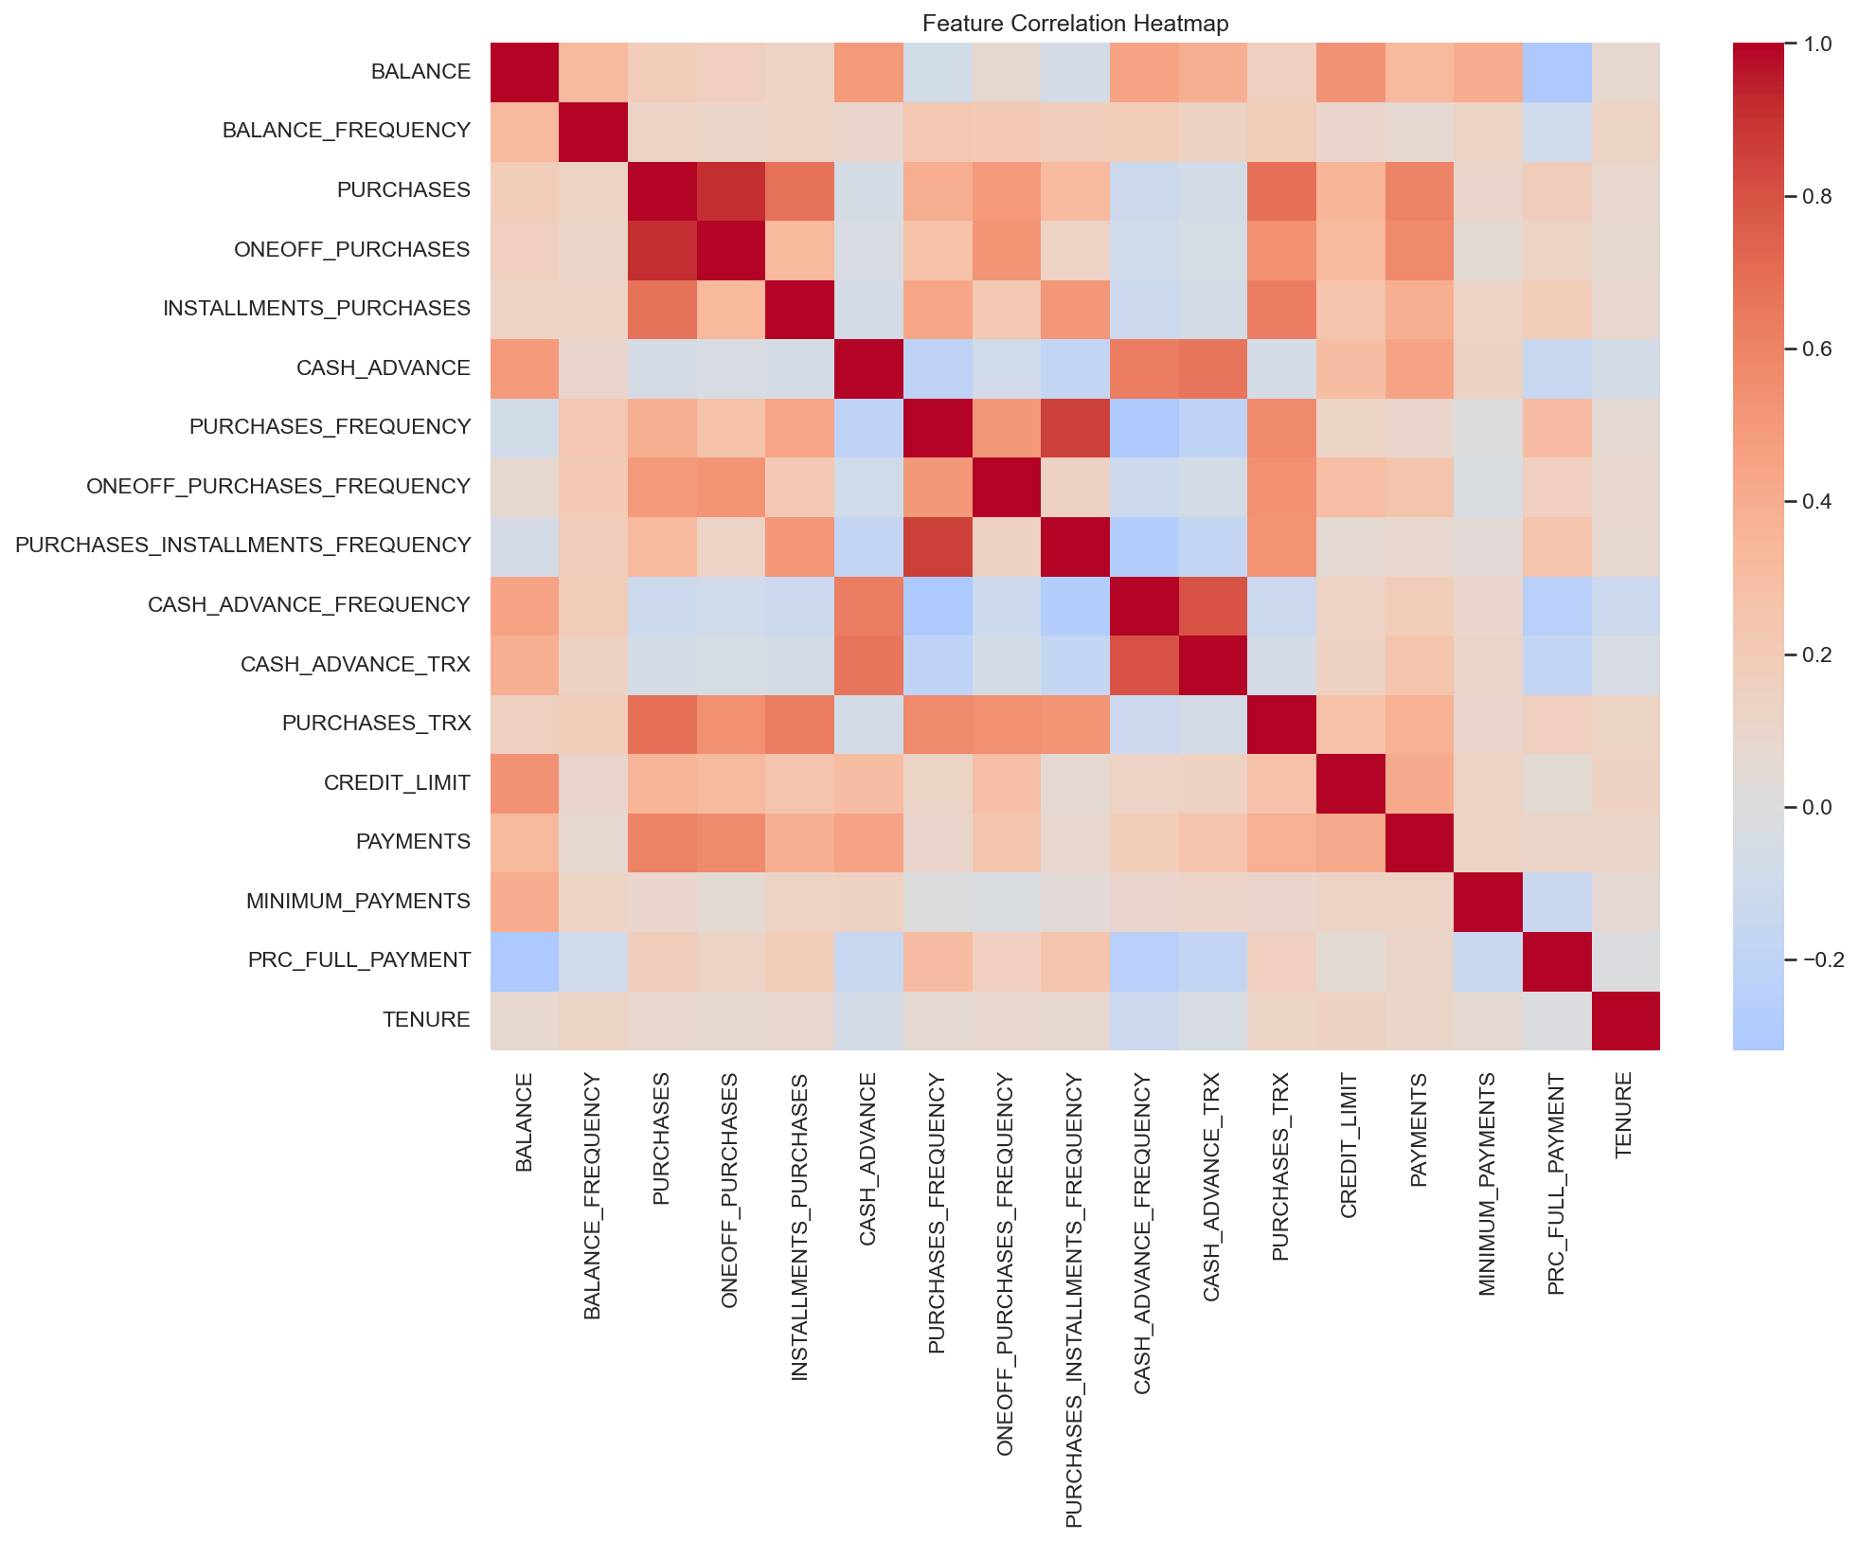
How the Data Looks
5
Feature distributions, missing values, and correlations
EXPLORATORY DATA ANALYSIS
Feature Distributions
Correlation Heatmap
Missing Values:
MINIMUM_PAYMENTS: 313 rows (3.5%) — imputed with median | CREDIT_LIMIT: 1 row (<0.01%) — imputed with median | All other features: complete | No rows removed
Slide 5

Slide 6
Methodology
6
End-to-end pipeline for customer segmentation
PIPELINE
1 Data Loading
2 Exploratory Data Analysis
3 Missing Value Handling
4 Feature Scaling
5 Clustering Comparison
6 Final Model Selection
7 Segment Interpretation
→
→
→
→
→
→
• Load CC_GENERAL.csv
• Distributions & KDE
• Identify nulls
• log₁p on skewed cols
• K-Means (k=2–10)
• Pick best by silhouette
• Profile each cluster
• Inspect shape & dtypes
• Boxplot outlier check
• Median imputation
• StandardScaler (z-score)
• Agg., DBSCAN, GMM
• Interpretability override
• Name the archetypes
• Check missing values
• Correlation heatmap
• Verify 0 nulls remain
• Save scaler to disk
• Score 3 metrics each
• Refit on full data
• Business insights
Tools: Python 3 · pandas · NumPy · scikit-learn · SciPy · Matplotlib · Seaborn · Joblib | RANDOM_STATE = 42
Slide 6

Slide 7
Preprocessing
7
Cleaning and preparing the data for clustering
DATA PREPARATION
Step 1 — Drop Identifier
Step 2 — Missing Value Imputation
Step 3 — Outlier Analysis (No Removal)
Step 4 — log₁p Transform + StandardScaler
• CUST_ID is an arbitrary string ID (e.g., 'C10001') with no predictive signal
• MINIMUM_PAYMENTS: 313 nulls (3.5%)
• Boxplots reveal extreme outliers in monetary columns (cash-advance, purchases)
• log₁p applied to 10 skewed monetary cols: (BALANCE, PURCHASES, CASH_ADVANCE…)
• Keeping it would confuse distance-based algorithms
• CREDIT_LIMIT: 1 null (<0.01%)
• We do NOT remove outlier rows: → Tails often = most interesting customers
• log₁p(0) = 0 → zeros are preserved exactly
• After dropping: 17 numeric features remain
• Both columns are right-skewed → median is more robust than mean
• StandardScaler: zero mean, unit variance on all 17 features after log transform
• High-spenders and heavy cash-advance users are valuable segments themselves
• Shape: 8,950 rows × 17 columns
• Verified: 0 nulls remain after imputation
• Fitted scaler saved → reusable for new data
• Handled via log₁p transform + scaling
Result: 8,950 × 17 scaled matrix (cc_scaled.npy) · Scaler saved to models/scaler.joblib
Slide 7

Slide 8
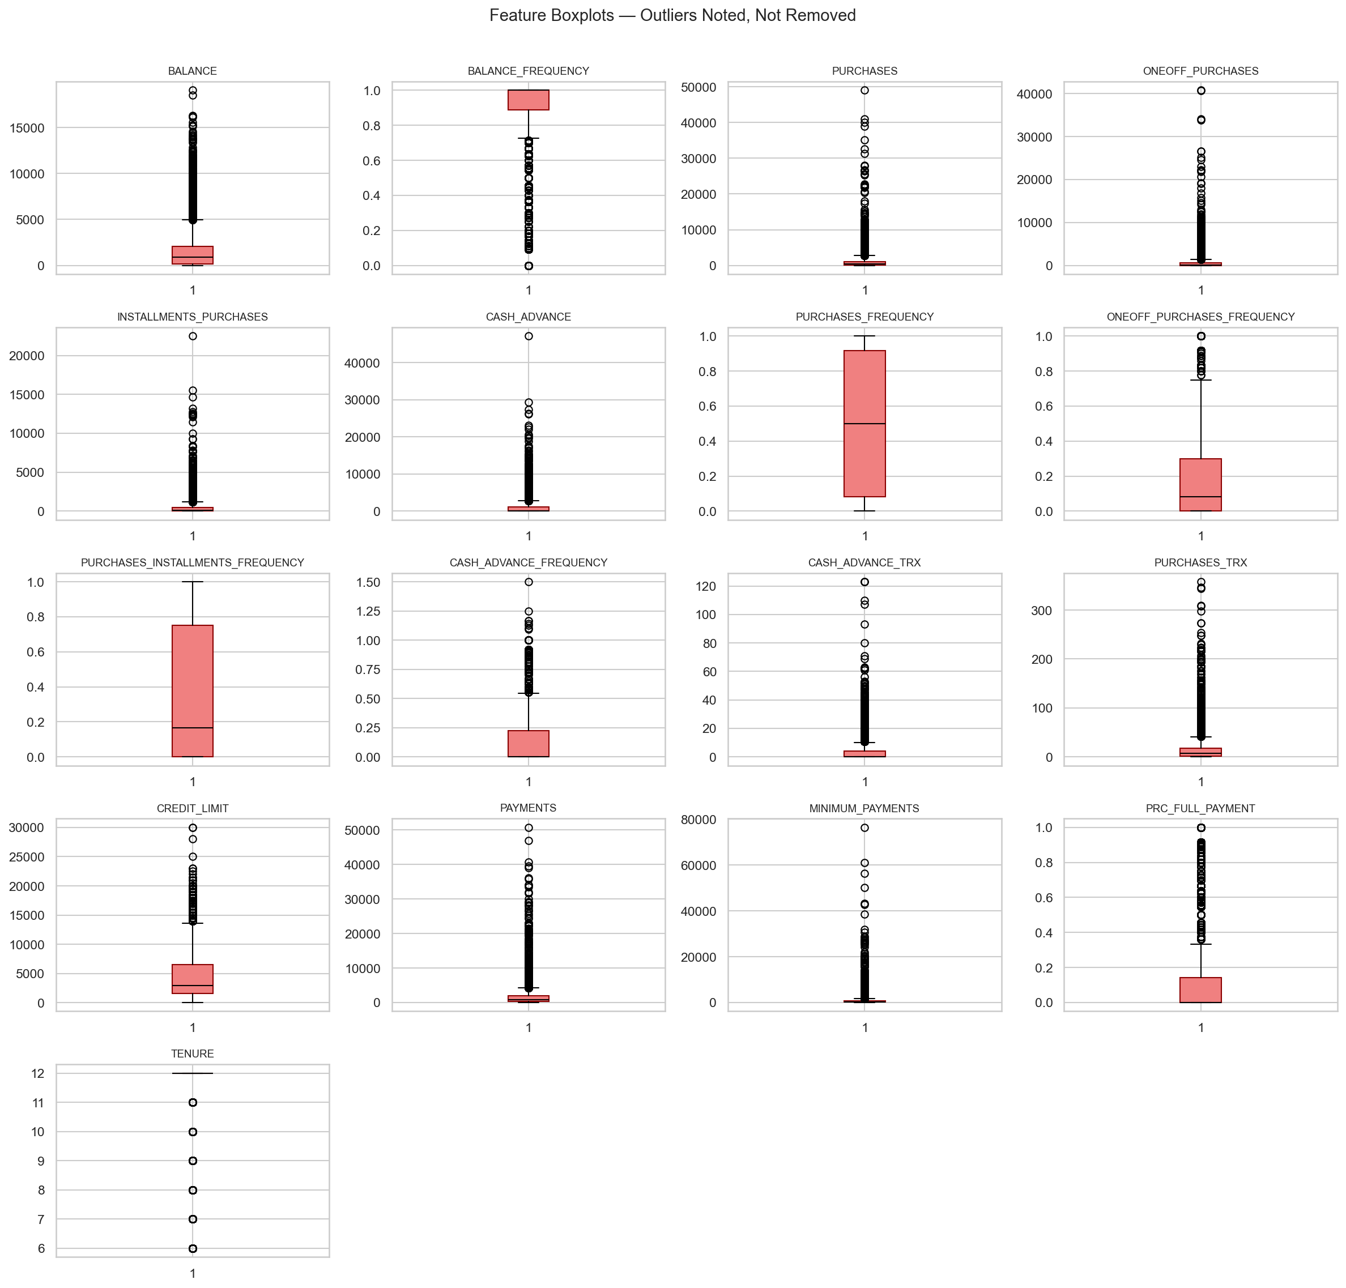
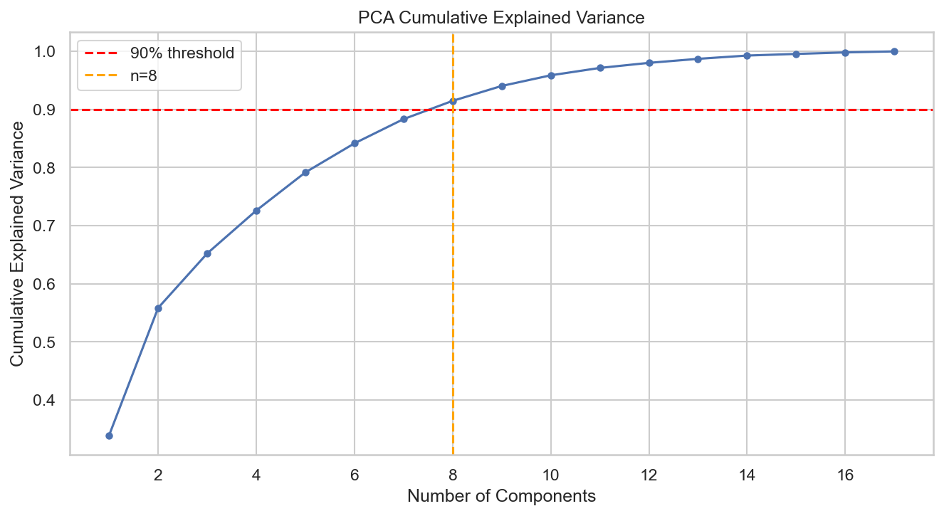
Graphs After Preprocessing
8
Visualising the cleaned, scaled, and transformed data
POST-PROCESSING VISUALISATION
Feature Boxplots (Outlier Profile)
PCA Cumulative Explained Variance
Key Takeaways:
Boxplots confirm heavy right tails — extreme high-value customers in every monetary column. PCA shows ~7 components capture 90 % of variance. We cluster on all 17 scaled features (not on PCA output) to preserve full information.
Slide 8

Slide 9
What Is K-Means Clustering?
9
A centroid-based partitional clustering algorithm
ALGORITHM EXPLANATION
Core Concept
Key Parameters
K-Means partitions n data points into k non-overlapping clusters by iteratively minimising the total within-cluster sum of squared distances (inertia / WCSS) from each point to its assigned centroid.
k
Number of clusters to form. We sweep k = 2 … 10.
1
Randomly initialise k centroids in feature space
n_init
How many times to run with different random seeds (= 10).
2
Assign each point to the nearest centroid (Euclidean distance)
Inertia (WCSS)
Sum of squared distances from each point to its centroid. Lower = tighter clusters.
3
Recompute each centroid as the mean of its assigned points
4
Repeat steps 2–3 until centroids no longer move (convergence)
Silhouette Score
Measures how much more tightly a point fits its own cluster vs. the nearest other cluster.
5
Repeat with multiple random seeds; keep the best-inertia result
⚠ Assumes spherical, similarly-sized clusters. Sensitive to outliers and random initialisation. Results vary with k choice.
random_state
Fixed at 42 for reproducibility.
Slide 9

Slide 10
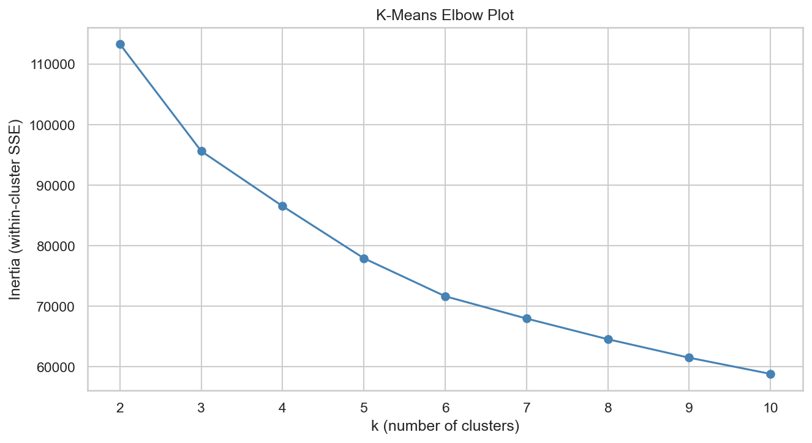
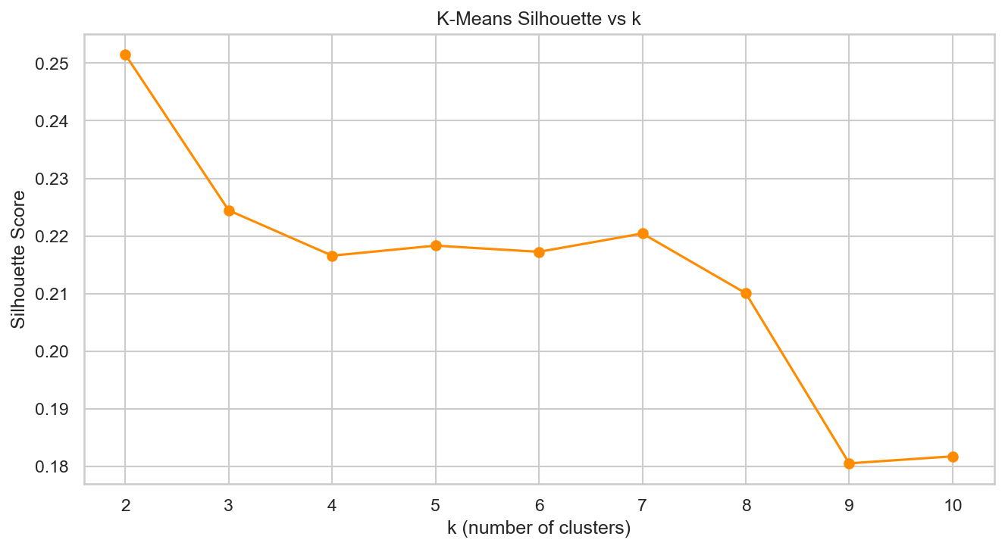
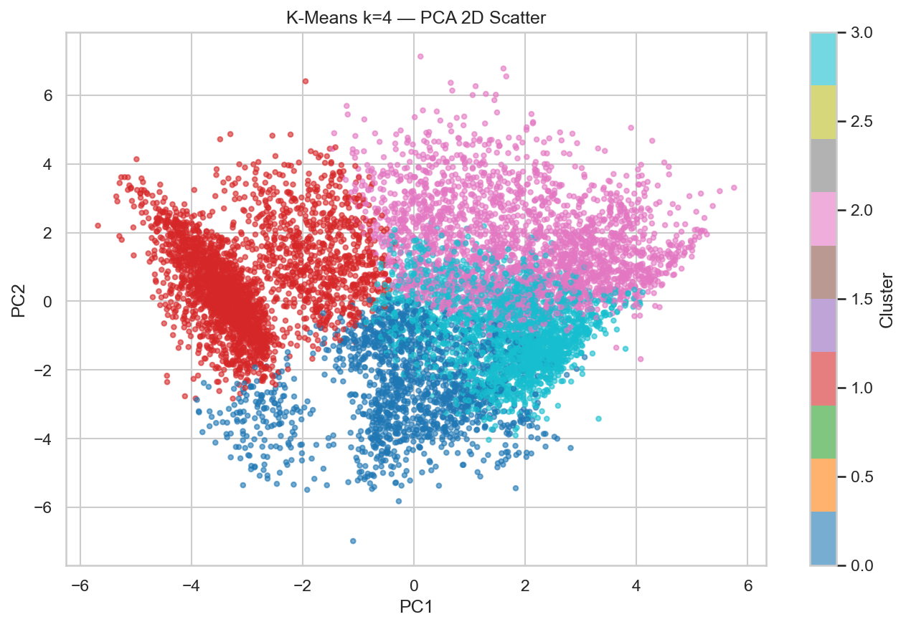
K-Means — Results & Model Selection
10
Elbow method, silhouette analysis, and final k selection
K-MEANS OUTPUT
Inertia (Elbow Curve)
Silhouette Score vs k
PCA-2D Scatter (k = 4)
K-Means Metrics per k (best = k=4, selected for interpretability)
Why k = 4?
k | Silhouette ↑ | Davies-Bouldin ↓ | Calinski-Harabasz ↑ | Note
2 | 0.2515 | 1.507 | 3,064.9 | Auto peak — too coarse
3 | 0.2244 | 1.681 | 2,642.9
4 ★ | 0.2166 | 1.688 | 2,260.4 | Selected — inertia elbow + interpretability
5 | 0.2183 | 1.601 | 2,129.6
9 | 0.2204 | 1.424 | 1,845.8 | Metric best (excluding k=2) — too many segments
• Silhouette peaks at k=2 — but 2 clusters masks distinct customer types
• k=4 sits at the inertia elbow
• 4 clusters → 4 interpretable archetypes: Dormant, Revolvers, Transactors, Instalment Buyers
Slide 10

Slide 11
What Is DBSCAN?
11
Density-Based Spatial Clustering of Applications with Noise
ALGORITHM EXPLANATION
Core Concept
Key Parameters
DBSCAN discovers clusters as dense regions of points separated by low-density gaps. It does NOT require specifying k in advance. Instead, it defines clusters by two parameters (ε and min_samples) and automatically labels points in sparse regions as noise (label = –1).
ε (eps)
Maximum neighbourhood radius. Chosen from k-distance plot elbow. We swept: 1.55, 1.88, 2.21, 2.65
Core Point
Has ≥ min_samples neighbours within radius ε
min_samples
Min. points to form a core point. Set to 5 throughout.
Border Point
Within ε of a core point, but fewer neighbours
label = –1
Points that are noise — not assigned to any cluster. Problematic for business use.
Noise Point
Not reachable from any core point → label = –1
Cluster
All density-connected core + border points together
k-Distance Plot
Sort the 5th-nearest-neighbour distance for every point. Elbow → good ε candidate.
⚠ Struggles in high-dimensional, uniformly dense data (like financial features). ε is hard to tune — too small = everything is noise, too large = one giant cluster.
Slide 11

Slide 12
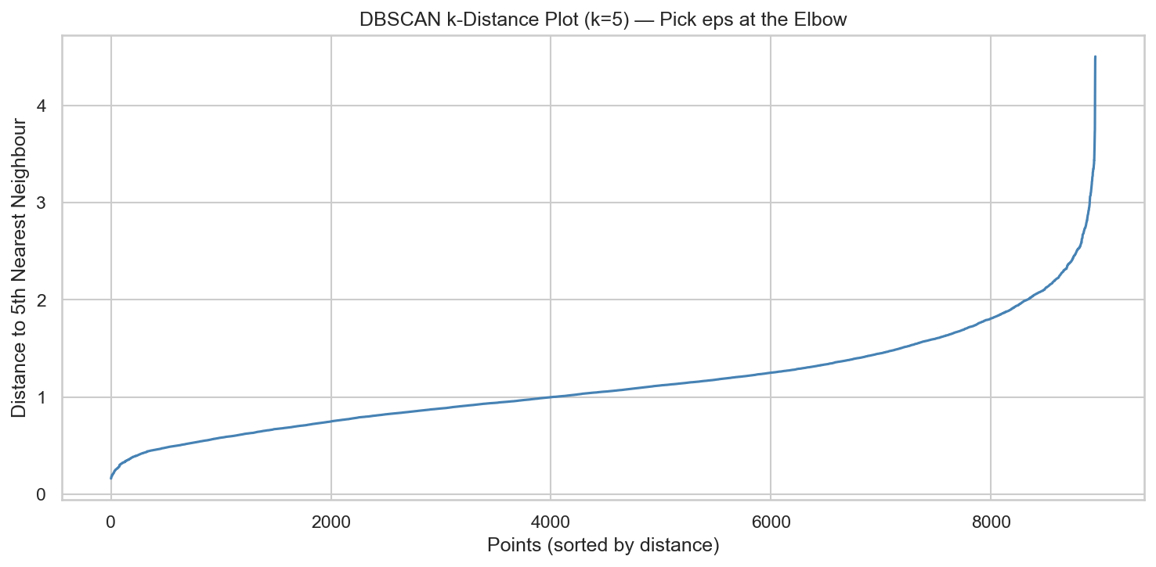
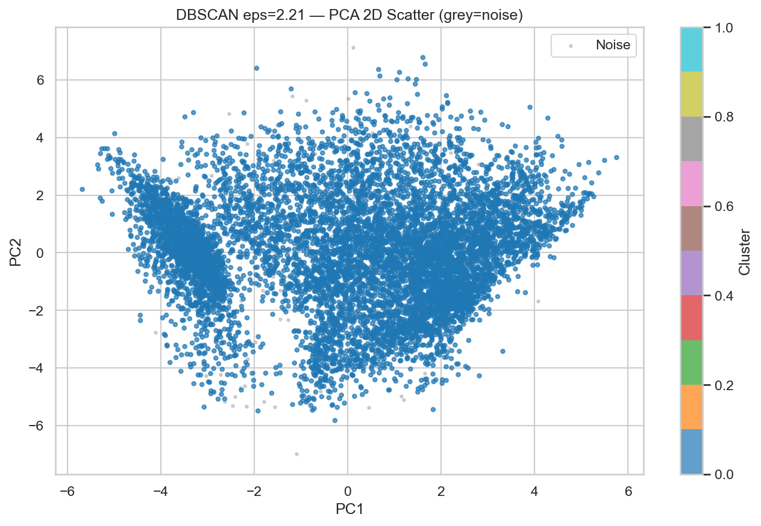
DBSCAN — Results
12
k-distance elbow, parameter sweep, and PCA visualisation
DBSCAN OUTPUT
k-Distance Plot (k=5) → choosing ε
PCA-2D Scatter (ε = 2.21, grey = noise)
ε Sweep Results (min_samples = 5)
Honest Assessment
ε | Clusters Found | Noise Points | Silhouette ↑ | Davies-Bouldin ↓
1.55 | 20 | 1,029 (11.5%) | −0.211 | n/a
1.88 | 12 | 419 (4.7%) | −0.123 | n/a
2.21 ★ | 2 | 153 (1.7%) | 0.063 | 1.251
2.65 | 1 | 34 (0.4%) | n/a | n/a
✗ Best silhouette 0.063 — far below K-Means (0.217)
✗ Credit card data has no geometric density structure
✗ ~1.7 % of customers labelled 'noise' — unusable
✗ ε is very hard to tune in 17-D feature space
→ DBSCAN not selected as final model
Slide 12

Slide 13
What Is Gaussian Mixture Model (GMM)?
13
Probabilistic soft-assignment clustering
ALGORITHM EXPLANATION
Core Concept
Key Parameters
GMM models the data as a mixture of k multivariate Gaussian distributions (ellipsoidal clusters). Unlike K-Means which makes hard assignments, GMM gives each point a probability of belonging to each component — this is called soft clustering. The EM algorithm is used to fit the model.
n_components
Number of Gaussian components. We sweep n = 2 … 8.
covariance type
Shape of each cluster ellipsoid. 'full' = each has own covariance.
Component
One Gaussian (ellipsoid) in the mixture — each has its own mean, covariance, and weight
Soft Assignment
Each point gets a probability vector across all k components. Final label = component with highest probability
BIC
Bayesian Information Criterion. Lower BIC = better fit with complexity penalty.
EM Algorithm
Expectation-Maximisation iteratively estimates component parameters until convergence
AIC
Akaike Information Criterion. Similar to BIC but weaker complexity penalty.
covariance type='full'
Each component has its own full covariance matrix — the most flexible but expensive option
⚠ More expressive than K-Means but uses far more parameters. BIC and AIC penalise complexity and help select the right number of components.
max_iter
Max EM iterations = 200. random_state = 42.
Slide 13

Slide 14
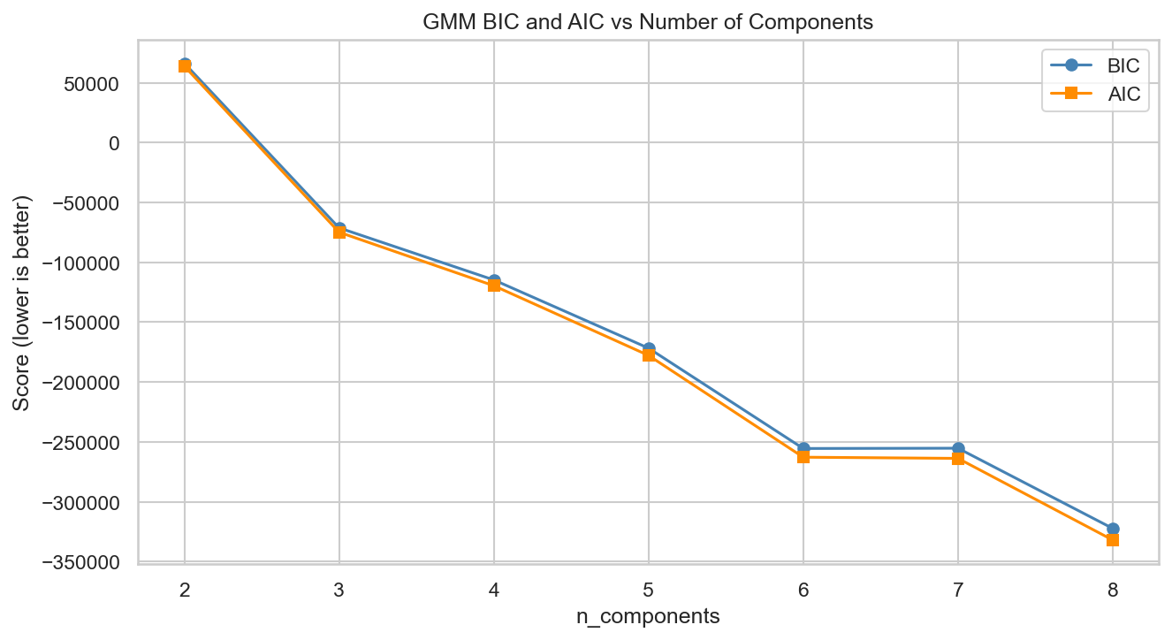
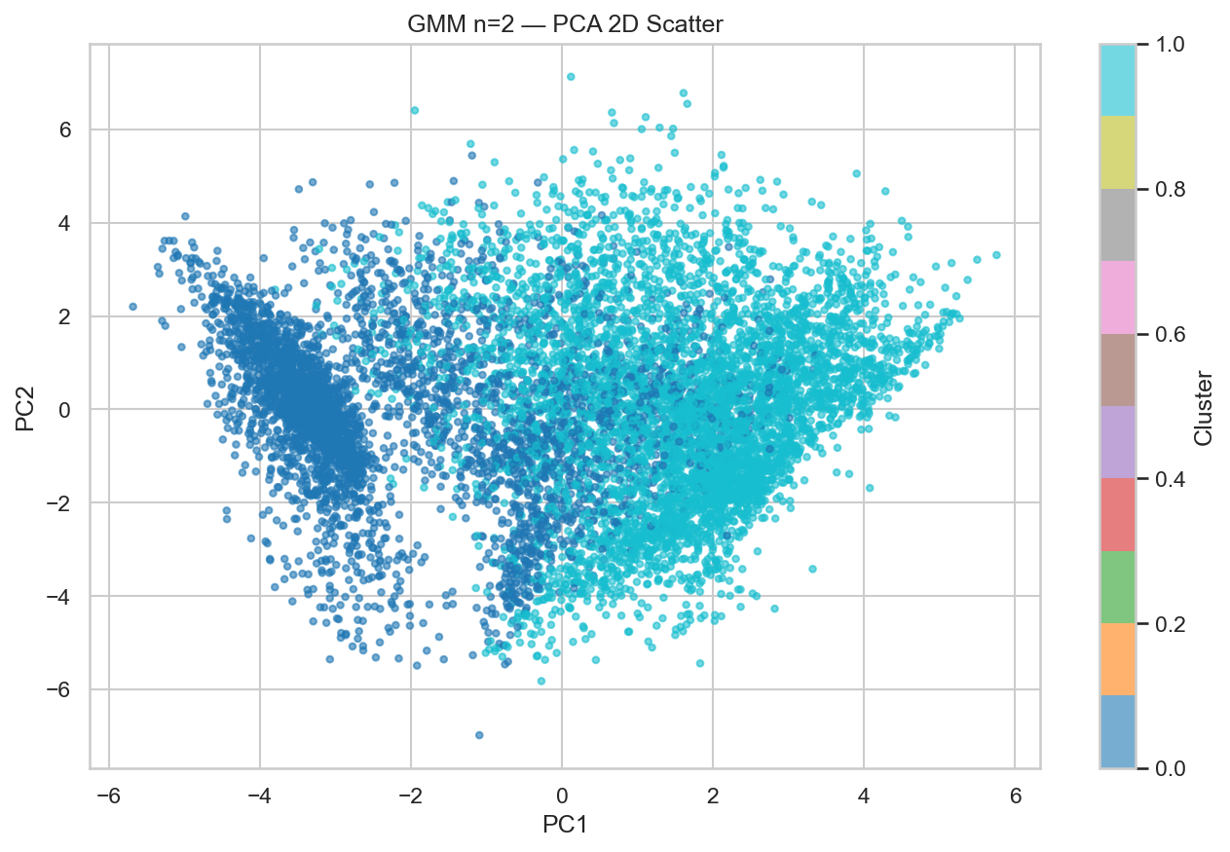
GMM — Results
14
BIC/AIC curves, metrics, and PCA visualisation
GMM OUTPUT
BIC and AIC vs n_components
PCA-2D Scatter (n = 2, best silhouette)
GMM Metrics per n_components
GMM vs. K-Means
n | Silhouette ↑ | Davies-Bouldin ↓ | Calinski-Harabasz ↑ | BIC ↓
2 ★ | 0.2105 | 1.826 | 2,382 | 66,352
3 | 0.1666 | 2.168 | 2,209 | −71,190
4 | 0.1537 | 1.954 | 1,956 | −114,683
6 | 0.1703 | 1.745 | 1,888 | −255,534
8 | 0.1449 | 1.901 | 1,642 | −322,300
• Best silhouette 0.2105 at n=2 (vs K-Means 0.2166)
• BIC decreases monotonically — no clear optimum
• Soft assignments add no interpretability benefit here
• K-Means centroids are more readable as profiles
★ → GMM competitive but K-Means wins on interpretability
Slide 14

Slide 15
What Is Agglomerative Clustering?
15
Hierarchical bottom-up clustering with Ward linkage
ALGORITHM EXPLANATION
Core Concept
Key Parameters
Agglomerative Clustering builds a hierarchy of clusters from the bottom up. It starts with every point as its own cluster, then iteratively merges the two closest clusters until only k clusters remain. The merge history can be visualised as a dendrogram, which helps choose k visually.
n_clusters
Number of clusters to cut the hierarchy at. We sweep n = 2 … 8.
linkage = 'ward'
How to measure distance between clusters. Ward minimises total within-cluster variance.
1
Start: each of the 8,950 customers is its own cluster
2
Find the pair of clusters with the smallest merge distance
3
Merge them into one cluster (Ward: minimise total within-cluster variance)
Dendrogram
Tree diagram of merge history. Large vertical jumps indicate natural cluster boundaries.
4
Repeat until exactly k clusters remain
5
The dendrogram records every merge — large jumps = natural cut points
Affinity
Distance metric (default: Euclidean). Ward linkage requires Euclidean.
⚠ Does not scale well to very large datasets (O(n²) memory). No predict() method — labels come from labels_ attribute only.
Slide 15

Slide 16
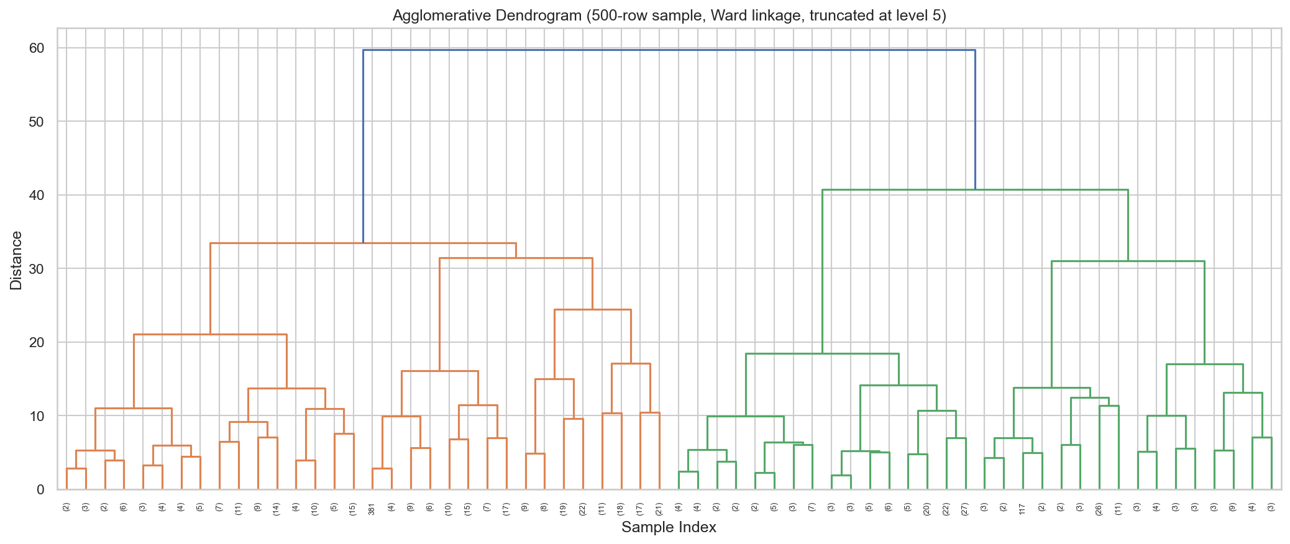
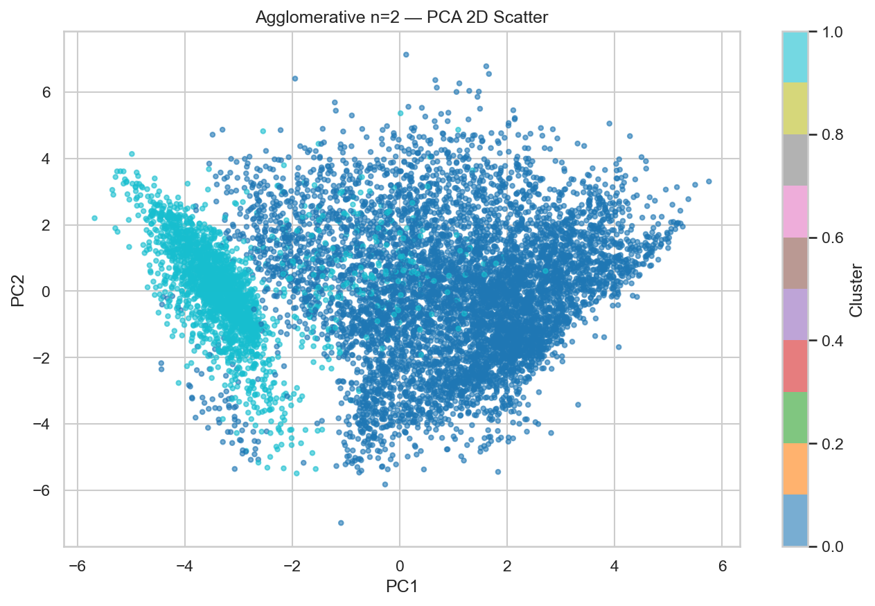
Agglomerative Clustering — Results
16
Ward-linkage dendrogram and PCA visualisation
AGGLOMERATIVE OUTPUT
Dendrogram (500-row sample, Ward linkage)
PCA-2D Scatter (n = 2, best silhouette)
Agglomerative Metrics per n
Assessment
n | Silhouette ↑ | Davies-Bouldin ↓ | Calinski-Harabasz ↑
2 ★ | 0.2154 | 1.522 | 2,251
3 | 0.1745 | 1.896 | 1,978
4 | 0.1658 | 1.733 | 1,734
7 | 0.1535 | 1.744 | 1,521
8 | 0.1632 | 1.678 | 1,498
• Best silhouette 0.2154 at n=2 — close to K-Means
• Ward linkage gives clean, balanced dendrogram
• Best DB (1.522) — clusters are well-separated
• But n=2 is too coarse; n=4 silhouette drops to 0.166
★ → K-Means k=4 preferred for interpretable segments
Slide 16

Slide 17
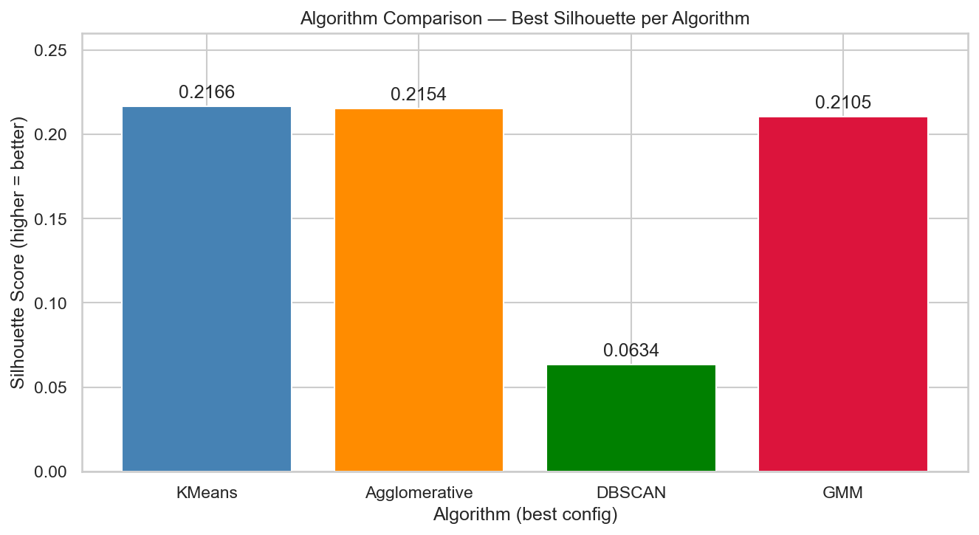
Algorithm Comparison & Final Selection
17
Choosing the winner using metrics + interpretability
MODEL SELECTION
Best Configuration per Algorithm
Algorithm | Config | Silhouette ↑ | Davies-Bouldin ↓ | Calinski-Harabasz ↑ | Noise | BIC
K-Means ★ | k = 4 | 0.2166 | 1.688 | 2,260 | — | —
Agglomerative | n=2, Ward | 0.2154 | 1.522 | 2,251 | — | —
GMM | n=2, full cov. | 0.2105 | 1.826 | 2,382 | — | 66,352
DBSCAN | ε=2.21, min=5 | 0.0634 | 1.251 | 3 | 153 | —
K-Means Wins on Metrics
DBSCAN Eliminated
GMM Competitive but Rejected
Agglomerative — Good DB, Wrong k
Highest silhouette (0.2166) + Highest Calinski-Harabasz (2,260). Centroids are directly readable as average customer behaviour.
Silhouette 0.063 — far below all others. Labels 153 customers as noise — unusable for business.
Silhouette slightly lower than K-Means. No interpretability advantage from soft assignments here.
Best Davies-Bouldin (1.522) at n=2, but n=4 drops to 0.166. No clear elbow to justify 4 segments.
★ Final model: K-Means k = 4 (silhouette=0.2166, DB=1.688, CH=2,260) — interpretability override from auto-peak at k=2
Slide 17

Slide 18
Modeling — Fitting the Final Model
18
Refitting K-Means k=4 cleanly on the full dataset
FINAL MODEL
1. Load Best Choice
2. Instantiate Model
3. Fit on Full Data
4. Get Labels
5. Compute Final Metrics
6. Persist Results
Read outputs/results/best_model_choice.json Confirm: algorithm=KMeans, params='k=4'
KMeans(n_clusters=4, random_state=42, n_init=10)
model.fit(X_scaled) X_scaled = cc_scaled.npy (8,950 × 17 matrix)
labels = model.predict(X) Returns cluster ID (0,1,2,3) for each of 8,950 customers
Silhouette: 0.2166 Davies-Bouldin: 1.688 Calinski-Harabasz: 2,260
models/final_model.joblib models/cluster_labels.npy outputs/results/final_metrics.json
→
→
→
→
→
Outcome
Each of the 8,950 customers receives a cluster label (0 – 3). Labels attached to cc_clean.csv (original un-scaled values) for interpretable profiling. Model and scaler persisted for scoring new customers.
Slide 18

Slide 19
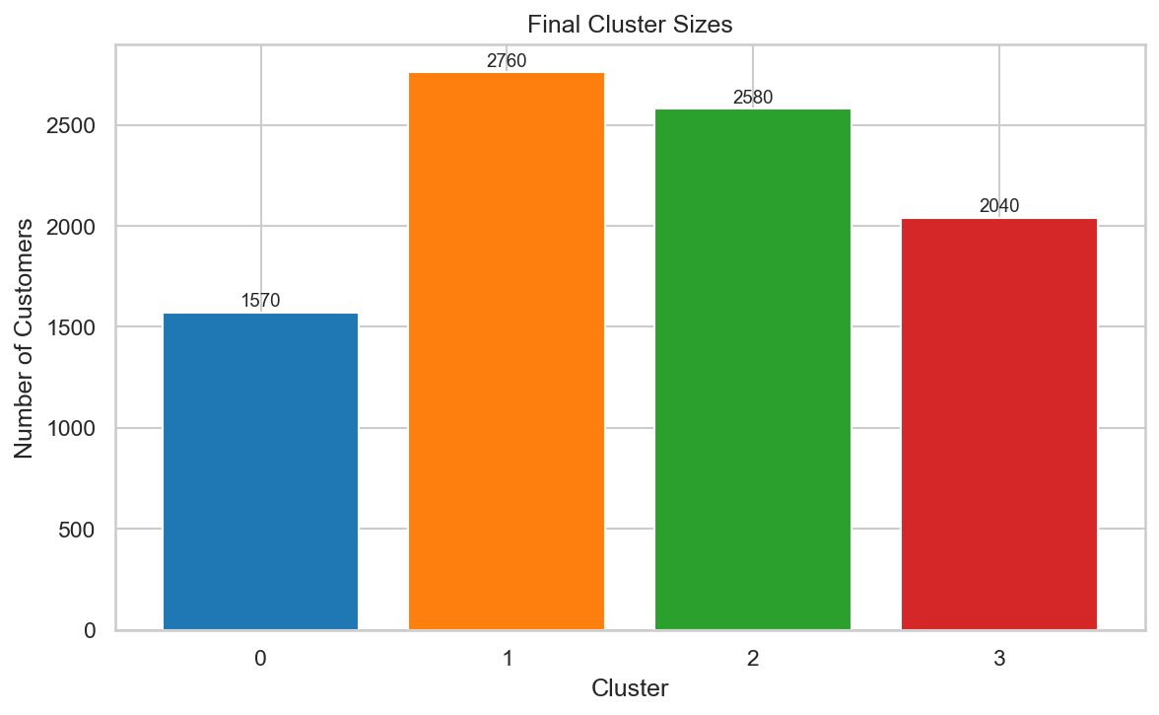
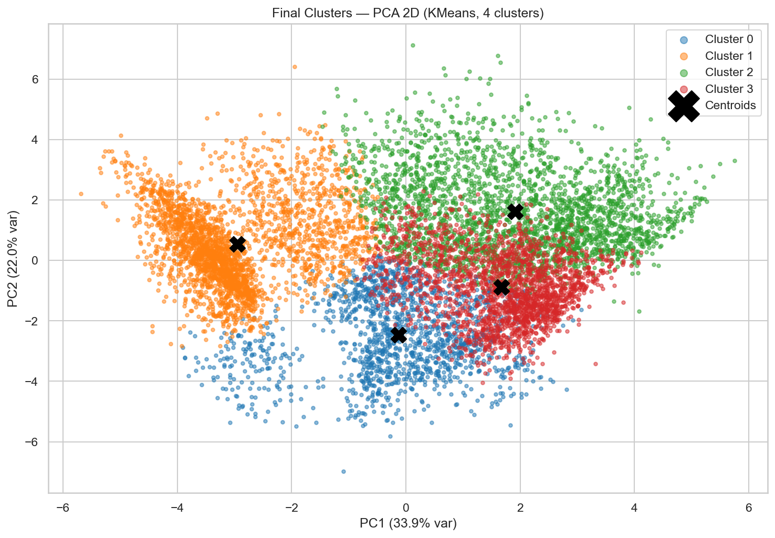
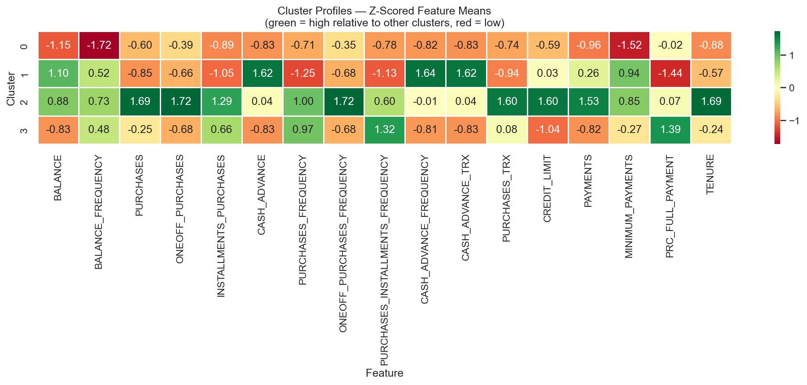
Final Results — Customer Segments
19
Four interpretable archetypes from K-Means k=4
RESULTS
Cluster Sizes
PCA-2D Cluster Visualization
Cluster Profile Heatmap
Cluster 0
Cluster 1
Cluster 2
Cluster 3
Dormant / Light Users
Cash-Advance Revolvers
Premium Transactors
Instalment Buyers
~48% · ~4,300 customers
~13% · ~1,200 customers
~19% · ~1,730 customers
~19% · ~1,720 customers
Avg Balance: $214
Cash Advance: $2,220
Purchases: $2,604
Instalment Spend: $631
Avg Purchases: $351
Full-Pay Rate: 0.03
Credit Limit: $6,393
Instalment Freq: 0.76
Purchase Freq: 0.25
Balance: $2,461
~35 TRX/month
Full-Pay Rate: 0.29
→ Rarely use the card
→ Card used as a loan
→ High-value, high-spend
→ Disciplined spenders
Slide 19

Slide 20
Conclusion
What We Achieved
Business Value
✓
Applied 4 clustering algorithms to 8,950 credit card customers
C0 Dormant
Re-engagement campaigns, fee waivers
✓
Evaluated each with Silhouette, Davies-Bouldin, and Calinski-Harabasz
C1 Revolvers
Balance-transfer, risk monitoring
✓
Selected K-Means k=4 — best metrics + highest interpretability
C2 Transactors
Premium rewards, credit limit upgrades
✓
Discovered 4 distinct behavioral archetypes in the customer base
C3 Instalment
BNPL cross-sell, low-rate plans
✓
Mapped each segment to specific banking products and strategies
Future Improvements
✓
Persisted fitted model and scaler for deployment on new customers
→ Apply log₁p transform as part of the pipeline (already done in this project)
→ Experiment with outlier capping (IQR method) before scaling
→ Try more advanced metrics: Gap Statistic, Hopkins test for clusterability
→ Enrich with demographic data (age, income, region) for richer segments
→ Deploy model as REST API — score new customers at onboarding
→ Re-run segmentation quarterly to detect segment migration over time
University of Delaware · Introduction to Data Mining · May 2026 · K-Means k=4 · Silhouette = 0.2166 · 4 Customer Segments

