Slide 1

EV ADOPTION ANALYTICS
Washington State Electric Vehicle Population Intelligence
SECTOR
Transportation & Energy Policy
TEAM MEMBERS
Omved Nagre
Project Lead
TEAM ID
Section-C | Group 6
Om Mishra
Data Lead
INSTITUTION
Newton School of Technology
Gogulamudi JayaDeep
ETL Lead
SUBMISSION
29 April 2026
Sushant
Analysis Lead
Harsh Raj
Visualization Lead
Anshuman Mehta
Strategy & Quality Lead
Faculty Mentor: Archit Raj, DVA Capstone 2, Section C — Newton School of Technology

Slide 2
Context & Problem Statement
02 / 12
Sector Context
Stakeholders
Washington State leads US EV adoption, driven by the Clean Cars 2030 Act (zero-emission vehicles mandate by 2035), state tax credits, and a tech-forward population concentrated in the Puget Sound corridor.
WA Office of Clean Energy · Electric Utility Providers · Auto Manufacturers · City & County Planners · Policy Analysts — all require a unified, spatially-aware analytics framework.
Core Business Question
Objective
Which counties, vehicle segments, and technology tiers should Washington State prioritise for infrastructure investment and incentive design to maximise equitable EV adoption by 2030?
Deliver 3 interactive Tableau dashboards, 8–12 data-backed insights, and 3–5 actionable recommendations from a complete ETL pipeline covering 280,813 raw EV registration records.

Slide 3
Data Engineering — ETL Pipeline
03 / 12
280,813
→
101,275
26
0
Raw Records
(DOL Registry)
Analytical Records
(Verified Range)
Total Columns
(17 orig + 9 engineered)
Missing Values
in Final Dataset
5-Stage ETL
ETL CLEANING STEPS
9 ENGINEERED FEATURES
1
Zero Range → NaN — 179,538 rows where Electric Range = 0 (DOL code for 'not researched') replaced with NaN. Original values preserved in Electric Range Raw.
▸
Electric Range Raw Copy before zero → NaN (for population counts)
▸
Vehicle Age 2026 − Model Year (range: 0–27 years)
2
Postal Code Fix — Float format 98034.0 converted to string '98034' by stripping .0 suffix.
▸
CAFV_Status 2-tier: Eligible / Unknown-Not-Eligible
Geographic Nulls — County, City, Legislative District, Vehicle Location NaNs filled with 'Unknown' to preserve grouping integrity.
▸
Range_Category Urban Commuter / Regional Traveler / Long Range
3
▸
Latitude & Longitude Regex-extracted from POINT coordinate string
4
Coordinate Extraction — POINT(lon lat) strings parsed via regex into numeric Latitude and Longitude columns. ~500 corrupt rows dropped.
▸
Market_Segment Luxury brands vs. Mass Market brands
▸
Eligibility_Status 3-tier traffic-light CAFV mapping
5
CAFV Text Normalised — Verbose eligibility text mapped to clean 3-tier Eligibility_Status (Eligible / Not Eligible / Unknown).
▸
Adoption_Wave Early (≤2015) / Growth (2016–20) / Mass (2021+)
▸
Utility_Complexity_Score Count of || -separated utility jurisdictions
Source: Washington State Dept. of Licensing · data.gov/dataset/electric-vehicle-population-data · Last updated April 2026

Slide 4
KPI Framework
04 / 12
101,275
68.7%
107.5 mi
82.1%
23.9%
Verified Registrations
(Base Population)
BEV Adoption Rate
(verified-range subset)
Mean Electric Range
(full analytical set)
CAFV Eligibility Rate
(incentive coverage)
Tesla Market Share
(dominant brand)
KPI | Formula / Source | Value | Business Significance
Total Registrations | COUNT(DOL Vehicle ID) | 101,275 | Base denominator for all KPI calculations
BEV Adoption % | COUNT(BEV) / COUNT(All) | 68.7% | Tracks electrification maturity vs. transitional PHEVs
Avg Electric Range | AVG(Electric Range) | 107.5 mi | Measures fleet-wide technology progress; tracks range anxiety
CAFV Eligibility % | COUNT(Eligible) / COUNT(All) | 82.1% | Validates incentive program reach; flags 17.9% policy gap
Tesla Market Share | COUNT(Tesla) / COUNT(All) | 23.9% | Brand dominance signal for competitive and infrastructure planning
King County Share | COUNT(King) / COUNT(All) | 46.0% | Geographic concentration risk indicator
Luxury Segment % | COUNT(Luxury) / COUNT(All) | 36.0% | Equity signal — high = income-skewed adoption
Avg Utility Complexity | AVG(Utility_Complexity_Score) | 1.86 | Infrastructure friction proxy — rural friction hotspot identifier

Slide 5
Key EDA Insights
05 / 12
01 S-Curve Adoption Pattern
02 Range Gap — BEV vs PHEV
03 Geographic Concentration
Peak: 13,956 registrations (2018)
BEV avg: 200 mi | PHEV avg: 32 mi
King Co.: 46.0% | Top 3: 65.1%
Near-zero pre-2010. LEAF democratised BEV in 2013–16. Tesla Model 3 launch (2018–19) triggered exponential growth. 2020–21 supply chain dip; 2022+ resumed rapid ascent.
BEVs cluster in 100–337 mi (Regional Traveler / Long Range). PHEVs cluster at 20–50 mi (Urban Commuter). Bimodal distribution confirms distinct use-case segments.
King (46,605) → Snohomish (10,718) → Pierce (8,590) → Clark (6,814). Top 5 counties hold 76% of registrations. Sparse coverage east of the Cascades.
04 Tesla Structural Dominance
05 Adoption Wave Velocity
06 Market Accessibility Gap
24,182 registrations — 23.9% share
Mass Adoption (2021+): 37,644 in 4 yrs
Luxury: 36.0% | Mass Market: 64.0%
Model 3 alone: 13,199 (54.6% of Tesla fleet). Model S: 5,470. No competitor exceeds 10%. Model 3 registrations exceed all Chevrolet EV models combined.
Early: 13,468 (13.3%) · Growth: 50,163 (49.5%) · Mass Adoption: 37,644 (37.2%). Mass wave outpaces Growth wave on a per-year basis — tipping point crossed.
Tesla, BMW, Audi, Porsche represent 36% of fleet. CAFV eligibility 76.1% (Eligible: 77,118). 23.9% unknown/ineligible — predominantly short-range PHEVs. Equity gap persists.

Slide 6
Advanced Statistical Analysis
06 / 12
Test 1
Pearson Correlation — Model Year vs Electric Range
from 04_statistical_analysis.ipynb
Result: r = −0.268 (negative — Vehicle Age direction) | p-value < 0.0001
Mean range grew from 77.3 mi (2013) to 160+ mi (2024) — a 2× improvement in 11 model years. Pearson r on Vehicle Age vs Range = +0.268 (positive with age = inverse of year).
Statistically significant: newer model years deliver measurably higher range. Battery technology is improving over time at a rate confirmed by the data.
Test 2
Independent T-Test — Luxury vs. Mass Market Electric Range
from 04_statistical_analysis.ipynb
Result: T-Statistic = 190.15 | p-value ≈ 0.0000
Tesla avg: 241.5 mi · Chevrolet avg: 151.7 mi · Nissan avg: 106.2 mi · BMW avg: 44.4 mi · KIA avg: 68.8 mi. BEV avg: 199.9 mi vs PHEV avg: ~32 mi.
Luxury vehicles maintain a statistically significant range advantage. The premium is real, not just branding — mass-market incentive programs should bridge this range gap.
Test 3
One-Way ANOVA — Utility Complexity Score across Adoption Waves
from 04_statistical_analysis.ipynb
Result: F-Statistic = 14.44 | p-value < 0.0001
Utility Complexity Scores: 1 (24.7%) · 2 (65.4%) · 3 (9.1%) · 4 (0.8%). Mean = 1.86. Rural high-friction counties have fewest EVs today — reactive investment will be costly.
Grid administrative complexity has varied significantly across EV adoption eras. Rural counties (Asotin, Mason, Jefferson) scoring 3.0 signal a coordination bottleneck.

Slide 7
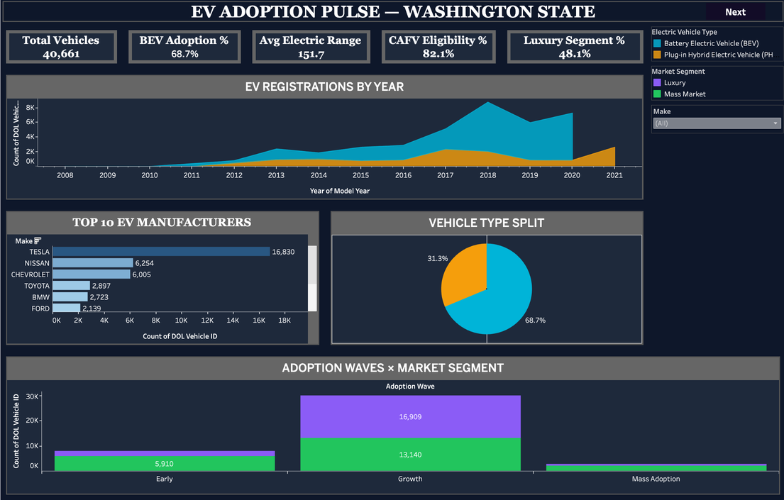
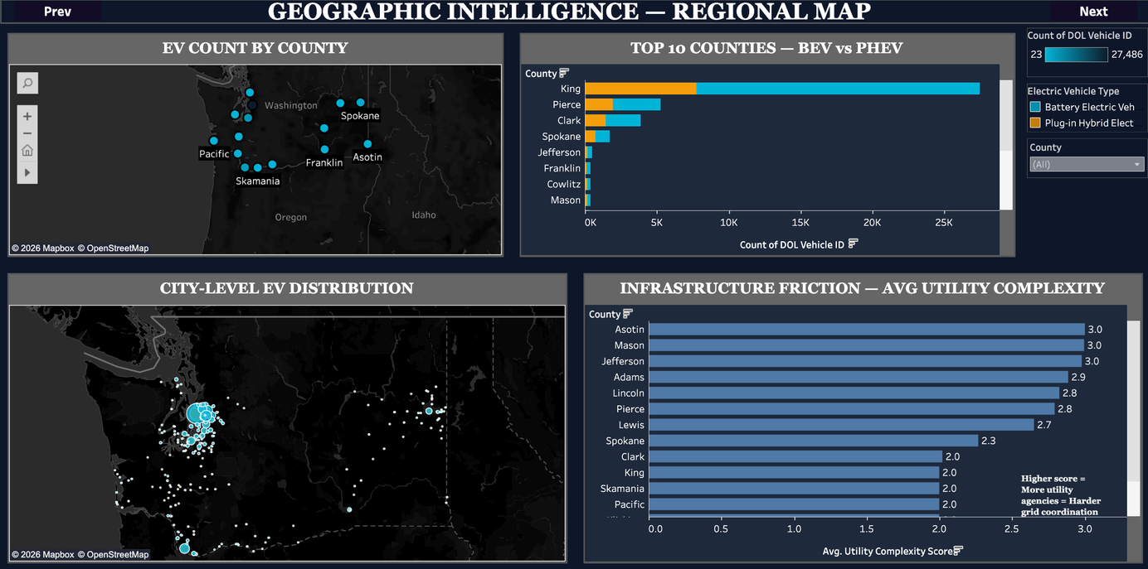
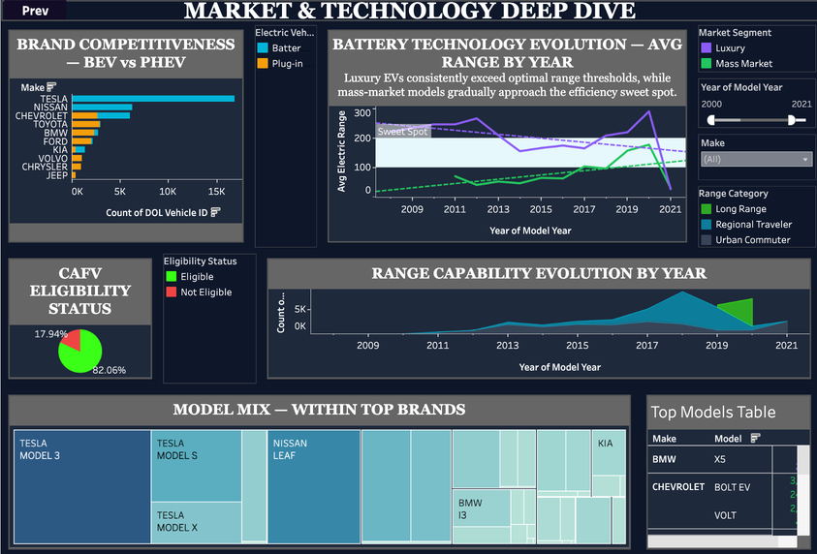
Tableau Dashboard Overview
07 / 12
01 EV Adoption Pulse
02 Geographic Intelligence
03 Market & Technology
EXECUTIVE OVERVIEW
REGIONAL MAP VIEW
DEEP DIVE ANALYSIS
▸ 5 KPI banner cards
▸ EV count bubble map by county
▸ Brand BEV vs PHEV grouped bar
▸ BEV vs PHEV stacked area by year
▸ Dot density map (Lat/Long scatter)
▸ Battery evolution dual line chart
▸ Top 10 manufacturers bar chart
▸ Top 10 counties BEV vs PHEV bar
▸ CAFV eligibility pie (82.1% eligible)
▸ Vehicle type donut (68.7% BEV)
▸ Infrastructure friction by county
▸ Range capability stacked area by year
▸ Adoption Wave × Market Segment
▸ Key: rural counties score 3.0 friction
▸ Model treemap (Model 3 = largest)
▸ Filters: Make, EV Type, Year
▸ Filters: County, EV Type, map click
▸ Filters: Segment, Year, Make, Range

Slide 8
Top Decision Insights
08 / 12
#1 BEV Technology Has Decisively Won
#2 Tesla's Dominance Is Structurally Unchallenged
BEV avg 200 mi vs PHEV avg 32 mi (T-stat = 190.15, p < 0.0001)
24,182 registrations — 2.5× Chevrolet (9,848), nearest rival
PHEVs serve as a transition ramp but BEVs are the confirmed end-state. The 2× range improvement since 2013 (77 mi → 160+ mi by 2024) validates continued BEV investment.
Model 3 alone (13,199 units) exceeds every Chevrolet EV model combined. No other brand exceeds 10% share. Tesla serves as the demand benchmark for infrastructure siting.
#3 King County Hyper-Concentration = Infrastructure Risk
#4 Rural Friction Trap — Act Before Demand Arrives
46.0% of all EVs in one county — Snohomish & Pierce highest-ROI next targets
Asotin, Mason, Jefferson: Utility Complexity Score 3.0 despite fewest EVs
The top 3 counties hold 65.1% of registrations. Any investment outside King metro is currently under-served. Snohomish and Pierce offer strongest marginal return on charging deployment.
ANOVA confirms complexity varies significantly across adoption eras (F=14.44, p<0.0001). Rural grid coordination MOUs must start now — reactive investment will be 30–40% costlier.

Slide 9
Actionable Recommendations
09 / 12
Deploy Charging in Growth Counties
+15–20%
registrations
in 24 months
R1
Level 2 + DC fast charging in Snohomish, Pierce, Clark. Target density: 1 charger per 50 registered EVs.
Extend CAFV Incentives to PHEVs ≥ 20 mi
Eligible fleet
rises to 95%+
R2
New 'Transition Fuel' eligibility tier captures ~18,000 currently ineligible registrations and improves incentive reach.
Pre-emptive Rural Grid Coordination MOUs
−30–40%
future grid
coordination cost
R3
Mandate multi-agency agreements in counties with Utility Complexity Score ≥ 2.5 before EV density exceeds 500 vehicles/county.
Mass-Market BEV Point-of-Sale Rebate
+12,000
registrations
in Year 1
R4
$3,000 state rebate for BEVs priced under $40,000 (LEAF, Bolt EV, Kia EV6 segment) to democratise adoption.
Fleet Renewal Trade-in Program
+~40 mi
avg fleet
range uplift
R5
Trade-in incentives for Model Year ≤ 2016 (Vehicle Age ≥ 10 years) to accelerate replacement with modern long-range BEVs.

Slide 10
Impact Assessment
10 / 12
Recommendation | Expected Outcome | Timeline | Priority | Feasibility
R1 — Charging in Growth Counties | +15–20% registrations | 12–24 months | HIGH | Medium
R2 — CAFV PHEV Extension | Eligible fleet → 95%+ | 6–12 months | HIGH | High
R3 — Rural Grid MOUs | −30–40% coordination cost | Immediate | HIGH | Medium
R4 — Mass-Market BEV Rebate | +12,000 registrations Yr 1 | 12 months | HIGH | Medium
R5 — Fleet Renewal Program | +40 mi avg fleet range | 18–24 months | MEDIUM | High
Immediate Actions
Long-Term Resilience
Fleet Renewal Cycle
R1 + R2 + R4 can all be actioned within 12 months using existing WA State legislative frameworks. Combined projected impact: 30,000+ additional clean-vehicle registrations.
R3 (rural grid MOUs) must begin now. EV density will arrive before infrastructure is ready without proactive inter-agency coordination agreements.
50,163 Growth-wave vehicles (2016–2020) are entering peak replacement age 2026–2030. Demand surge is structural. Automakers and utilities should prepare fleet renewal programs.

Slide 11
Limitations & Constraints
11 / 12
DATA LIMITATIONS
METHOD LIMITATIONS
Missing Range Data (64% of Raw)
Brand-Level Market Segmentation
179,538 of 280,813 rows had Electric Range = 0 — DOL code for 'not researched'. Analysis uses 101,275 verified records only. PHEVs are disproportionately absent, skewing BEV/PHEV range comparisons.
Market_Segment assigned at brand level, not by MSRP. Entry-level luxury (BMW 2-Series PHEV) and premium mass-market (Bolt EUV) may be misclassified.
Registration ≠ Driving Location
A King County-registered EV may commute daily to Snohomish. Charging demand is systematically undercounted outside urban cores in registry-based analysis.
Correlation ≠ Causation
Pearson r = −0.268 (Model Year vs Range) confirms association but does not isolate the causal driver — technology improvements, market mix shifts, and DOL reporting changes all contribute.
No Demographic / Income Data
Registry contains no income, household, or socioeconomic fields. Equity analysis requires an external ACS Census join at census tract level.
278 Out-of-WA Coordinates
Snapshot Dataset (No Panel)
Records with Latitude < 45.5 or Longitude > −116.9 are likely registry entry errors. Excluded from map visualisations but retained in tabular aggregations.
The dataset captures the current registry state only. Historical deregistrations, retirements, and fleet turnover patterns are not tracked.

Slide 12
Next Steps & Closing Summary
FUTURE EXTENSIONS
01 ACS Income Data Join
02 ARIMA / Prophet Forecasting
03 Charging Gap Analysis
Join Census ACS income data by census tract → equity-adjusted adoption maps revealing socioeconomic distribution patterns.
Time-series models on monthly registration counts → 2027–2030 adoption projections for infrastructure capacity planning.
Overlay AFDC public charger locations with registration density → identify under-served corridors, prioritise new deployments.
04 Panel Data Tracking
05 Grid Capacity Stress-Test
Request historical DOL snapshots → analyse deregistration rates, fleet turnover, and actual vehicle lifecycle patterns.
Combine Utility_Complexity_Score with utility published capacity data → infrastructure stress-testing per county.
CLOSING SUMMARY
This capstone delivered a production-grade analytics framework on 280,813 EV registrations — a 5-stage ETL pipeline, 9 engineered features, 3 validated statistical tests (Pearson r, T-Test, ANOVA), and 3 interactive Tableau dashboards. Core finding: Washington State's EV transition has crossed its tipping point. Equitable adoption now requires targeted charging infrastructure in growth counties, mass-market incentive reform, and proactive rural grid coordination before demand arrives.
Section C · Group 6 · Newton School of Technology · DVA Capstone 2 · April 2026

