Slide 1
CSS Bootstrap
Thai Bao Long
05/05/2014
Notes:
This template can be used as a starter file for presenting training materials in a group setting.
Sections
Right-click on a slide to add sections. Sections can help to organize your slides or facilitate collaboration between multiple authors.
Notes
Use the Notes section for delivery notes or to provide additional details for the audience. View these notes in Presentation View during your presentation.
Keep in mind the font size (important for accessibility, visibility, videotaping, and online production)
Coordinated colors
Pay particular attention to the graphs, charts, and text boxes.
Consider that attendees will print in black and white or grayscale. Run a test print to make sure your colors work when printed in pure black and white and grayscale.
Graphics, tables, and graphs
Keep it simple: If possible, use consistent, non-distracting styles and colors.
Label all graphs and tables.

Slide 2
CSS Bootstrap
What is CSS Bootstrap
Features
Why Using bootstrap
Cons
Notes:
Give a brief overview of the presentation. Describe the major focus of the presentation and why it is important.
Introduce each of the major topics.
To provide a road map for the audience, you can repeat this Overview slide throughout the presentation, highlighting the particular topic you will discuss next.

Slide 3

What is CSS Bootstrap
Twitter Bootstrap is the most popular front end frameworks currently
It is sleek, intuitive, and powerful mobile first front-end framework for faster and easier web development.
Bootstrap is compatible with the latest versions of all major browsers
Bootstrap was developed by Mark Otto and Jacob Thornton at Twitter as a framework to encourage consistency across internal tools
Notes:
Twitter Bootstrap is the most popular front end frameworks currently. It is sleek, intuitive, and powerful mobile first front-end framework for faster and easier web development. It uses HTML, CSS and Javascript
Bootstrap is compatible with the latest versions of all major browsers. It gracefully degrades when used on older browsers such as Internet Explorer 8.
Since version 2.0 it also supports responsive design. This means the layout of web pages adjusts dynamically, taking into account the characteristics of the device used (desktop, tablet, mobile phone).
Bootstrap was developed by Mark Otto and Jacob Thornton at Twitter as a framework to encourage consistency across internal tools. Before Bootstrap, various libraries were used for interface development, which led to inconsistencies and a high maintenance burden.
In August, 2011 Twitter released Bootstrap as open source. In February 2012, it was the most popular GitHub development project.

Slide 4
Features
Scaffolding: background, link style, grid system
CSS: common style for HTML elements like typography, code, tables, form and icon set
Components: basic styles for common interface, like tabs, navbars, page headers,
Javascript plugins – Jquery plugin as interactive components like popovers, modals
Notes:
Twitter Bootstrap is the most popular front end frameworks currently. It is sleek, intuitive, and powerful mobile first front-end framework for faster and easier web development. It uses HTML, CSS and Javascript
Bootstrap is compatible with the latest versions of all major browsers. It gracefully degrades when used on older browsers such as Internet Explorer 8.
Since version 2.0 it also supports responsive design. This means the layout of web pages adjusts dynamically, taking into account the characteristics of the device used (desktop, tablet, mobile phone).
Bootstrap was developed by Mark Otto and Jacob Thornton at Twitter as a framework to encourage consistency across internal tools. Before Bootstrap, various libraries were used for interface development, which led to inconsistencies and a high maintenance burden.
In August, 2011 Twitter released Bootstrap as open source. In February 2012, it was the most popular GitHub development project.

Slide 5
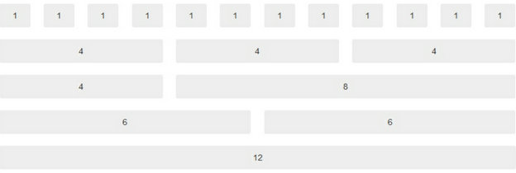
Grid
Grid systems are used for creating page layouts through a series of rows and columns that house your content

Slide 6
Grid
12 columns system
<div class="container">
<div class="row">
<div class="col-md-6 col-lg-6" style="background-color:gray">6</div>
<div class="col-md-6 col-lg-6" style="background-color:silver">6</div>
</div>
</div>

Slide 7
CSS
Global CSS settings, fundamental HTML elements styled and enhanced with extensible classes
Typography
Tables
Forms
Buttons
…
Notes:
http://getbootstrap.com/css
http://getbootstrap.com/css/#type
http://getbootstrap.com/css/#tables
http://getbootstrap.com/css/#forms

Slide 8
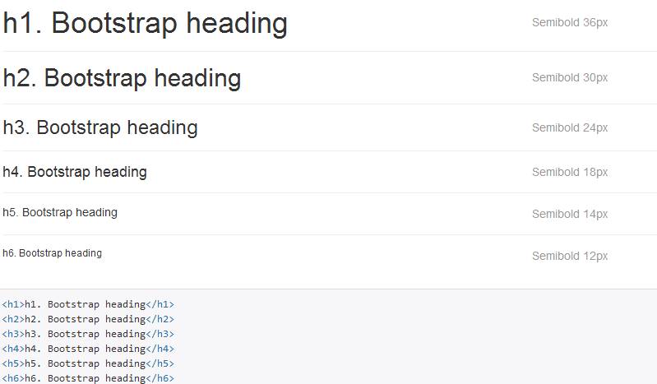
CSS
Typography Example:
Notes:
http://getbootstrap.com/css
http://getbootstrap.com/css/#type
http://getbootstrap.com/css/#tables
http://getbootstrap.com/css/#forms

Slide 9
Components
Over a dozen reusable components built to provide iconography, dropdowns, input groups, navigation, alerts, and much more
Notes:
http://getbootstrap.com/css
http://getbootstrap.com/css/#type
http://getbootstrap.com/css/#tables
http://getbootstrap.com/css/#forms

Slide 10
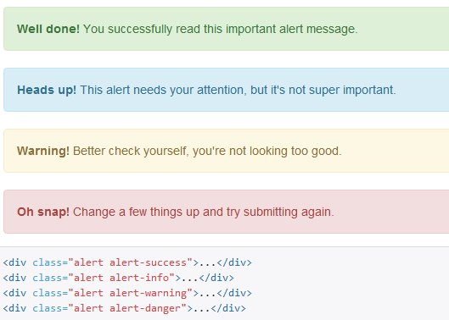
Components
Example
Alert:
Notes:
http://getbootstrap.com/css
http://getbootstrap.com/css/#type
http://getbootstrap.com/css/#tables
http://getbootstrap.com/css/#forms

Slide 11
Plugins
Bring Bootstrap's components to life with over a dozen custom jQuery plugins. Easily include them all, or one by one
Notes:
http://getbootstrap.com/css
http://getbootstrap.com/css/#type
http://getbootstrap.com/css/#tables
http://getbootstrap.com/css/#forms

Slide 12
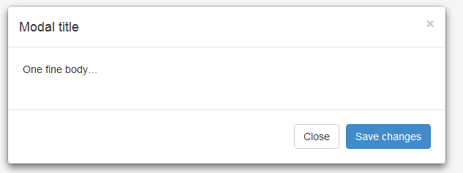
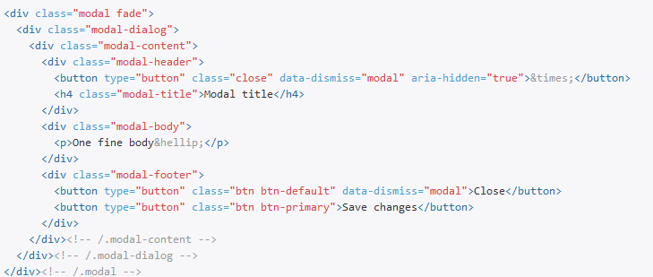
Plugins
Example
Alert:
Notes:
http://getbootstrap.com/css
http://getbootstrap.com/css/#type
http://getbootstrap.com/css/#tables
http://getbootstrap.com/css/#forms
http://getbootstrap.com/javascript/#modals-examples

Slide 13
Why Using bootstrap?
Great features:
Grid System – easy layout support responsive design
Dozens of CSS components & Javascript Plugins
Customizer -> esay customize with LESS
Live mockup: Bootstrap in design also ready to developer (copy/paste). Suite fro scrum
Notes:
http://getbootstrap.com/customize

Slide 14
Well known bootstrap using
Riot Design
Method
OpenDesk
20jeans
Unroll.Me
Notes:
http://expo.getbootstrap.com/

Slide 15
Cons:
It doesn’t follow best practices
It’s going to collide with my existing set-up
Twitter Bootstrap is heavy
No SASS support
Hey! My new website looks just like everyone else’s!
Notes:
http://www.zingdesign.com/5-reasons-not-to-use-twitter-bootstrap/
when we use bootstrap: http://www.zingdesign.com/twitter-bootstrap-decision-time/

Slide 16
When we use bootstrap:
http://www.zingdesign.com/twitter-bootstrap-decision-time/
Notes:
http://www.zingdesign.com/5-reasons-not-to-use-twitter-bootstrap/
when we use bootstrap: http://www.zingdesign.com/twitter-bootstrap-decision-time/

Slide 17


Q&A

