Slide 1
Polkadot JS
& Subql
Ian He
Jan 2021

Slide 2
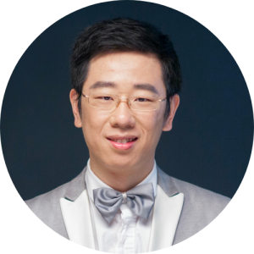

Introduction
OnFinality
Subquery.network
Ian He

Slide 3
Chain is ready
What’s Next Stop of our Journey ?
A: Build your DAPP

Slide 4
Contents
Overview of PolkadotJs
rpc, query, tx, derive
ws/http provider
Connect to your own chain
Type injection
Metadata cache
Extension
Subquery

Slide 5
api.rpc.* - Low-level methods
Some useful rpc methods
rpc.rpc.methods()
rpc.chain.*
rpc.system.*
https://polkadot.js.org/docs/substrate/rpc/

Slide 6
api.query.* - Storage queries
Some tips (api.query.*.*):
# query historical states
.at(hash: Hash, arg1?: Arg, arg2?: Arg)
# get the storage key (not perform query)
.key(arg1?: Arg, arg2?: Arg)
# batch query
.multi() [see multi.js]

Slide 7
api.tx.* - Submit Transaction
Need to use a signer,
On browsers, can use polkadot-extension
On mobile, you might need to implement your own.

Slide 8
Signer & PolkadotJS Chrome Extension
[see signer.js]

Slide 9
api.derive.* - Treasure-house
See [derives.js]

Slide 10
Debug polkadot-api
env DEBUG=api-ws

Slide 11
Difference between WsProvider and HttpProvider
WsProvider
.hasSubscriptions => true
.query callback => trigger times >= 1
.tx =>
1. use rpc.author. submitAndWatchExtrinsic
2. can receive extrinsic status
.multi and .query.xxx.yyy.multi() =>
use rpc.state.subscribeStorage
HttpProvider
.hasSubscriptions => false
.query callback => trigger times = 1
.tx =>
1. use rpc.author.submitExtrinsic
2. can NOT receive extrinsic status
.multi and .query.xxx.yyy.multi() =>
use rpc.state.queryStorageAt

Slide 12
Customize polkadot api into kitty’s own
Generate Types
Metadata cache
Extend derives

Slide 13
Resources
https://polkadot.js.org/docs/api
https://polkadot.js.org/docs/substrate

Slide 14
Advanced Queries
Q: How to find a kitty
if I only know KittyId?
A: Use Subquery

Slide 15
Subquery supported by web3 foundation grants program
https://github.com/OnFinality-io/subql
https://github.com/OnFinality-io/subql-examples
https://doc.subquery.network/

Slide 16
