Slide 1
Polkadot JS
& Subql
Ian He
Jan 2021

Slide 2
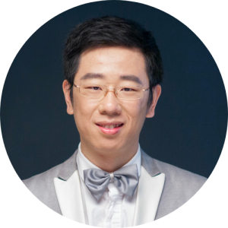

Introduction
OnFinality
Subquery.network
Ian He

Slide 3
Chain is ready
What’s Next Stop of our Journey ?
A: Build your DAPP

Slide 4
Assignment 5 Kitty NFT
https://github.com/SubstrateDevAcademy/assignment-5-template
Source code can be found
https://github.com/OnFinality-io/substrate-acad-workshop-polkadot-js

Slide 5
Connect to your chain
Type definitions
Metadata
Generation Interfaces
Init ApiPromise with types
More
Metadata cache
Extend derives

Slide 6
Query Basic Chain Informations
Chain Name api.runtimeChain
Genesis block api.genesisHash
Block time api.consts.babe.expectedBlockTime
RuntimeVersion api.runtimeVersion
Node Infomations
Peers api.rpc.system.peers()
Network api.rpc.system.networkState()
Node Role api.rpc.system.nodeRoles()
Health api.rpc.system.health()

Slide 7
More
api.rpc.* - Low-level methods
api.derive.* - Cookbook

Slide 8
api.tx.* - Submit Transaction
Need to use a signer,
On browsers, can use polkadot-extension
On mobile, you might need to implement your own.

Slide 9
Signer & PolkadotJS Chrome Extension
[see signer.js]

Slide 10
Query Kittens
Direct storage query
Derived queries
Indexed queries - Subquery ™️
Notes:
How to find a kitty if I only know KittyId?

Slide 11
api.query.* - Storage queries
Some tips (api.query.*.*):
# query historical states
.at(hash: Hash, arg1?: Arg, arg2?: Arg)
# get the storage key (not perform query)
.key(arg1?: Arg, arg2?: Arg)
# batch query
.multi() [see multi.js]

Slide 12
Subquery supported by web3 foundation grants program
https://github.com/subquery/subql
https://github.com/subquery/subql-examples
https://doc.subquery.network/

Slide 13
Tips

Slide 14
Debug polkadot-api
env DEBUG=api-ws

Slide 15
Multi Query
api.query.xxx.yyy.multi()
api.queryMulti()

Slide 16
Resources
https://polkadot.js.org/docs/api
https://polkadot.js.org/docs/substrate

Slide 17
