Slide 1

Introduction to Programming
Master Program in Data Science and Advanced Analytics 2018/19
Predicting Customer’s Churn
¹first author student number and e-mail contact
²second author student number and e-mail contact
³third author student number and e-mail contact
⁴fourth author student number and e-mail contact

Slide 2
Problem Description

Slide 3
Model prediction (applying the campaign or not)
Customer does not leave
Customer leaves
Reality
Customer does not leave
no loss or gain
loss of 140€
Customer leaves
loss of 450€
gain of 500€

Slide 4
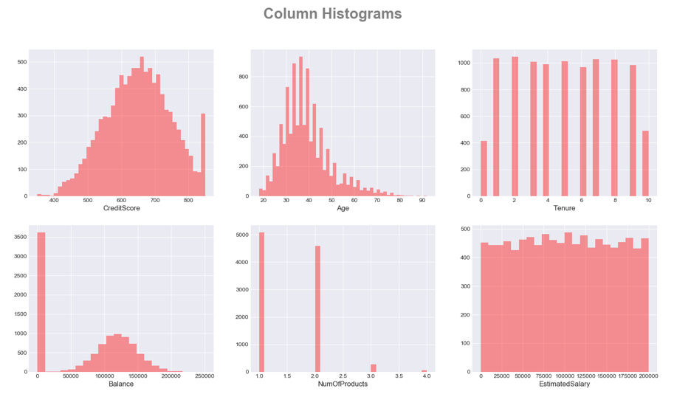
Single Variable Histograms

Slide 5
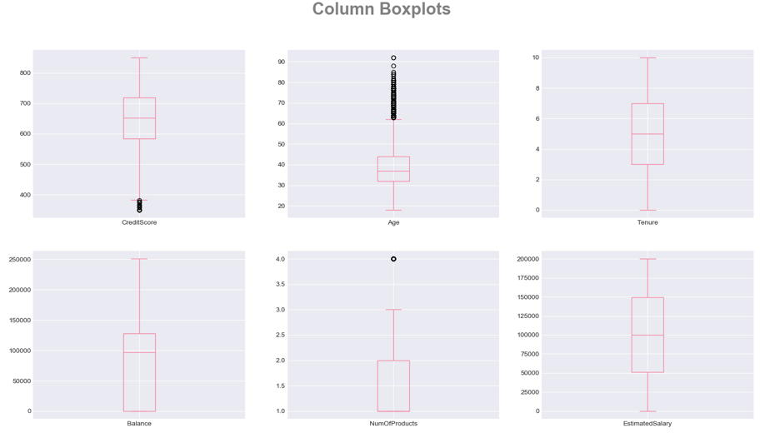
Column Boxplots

Slide 6
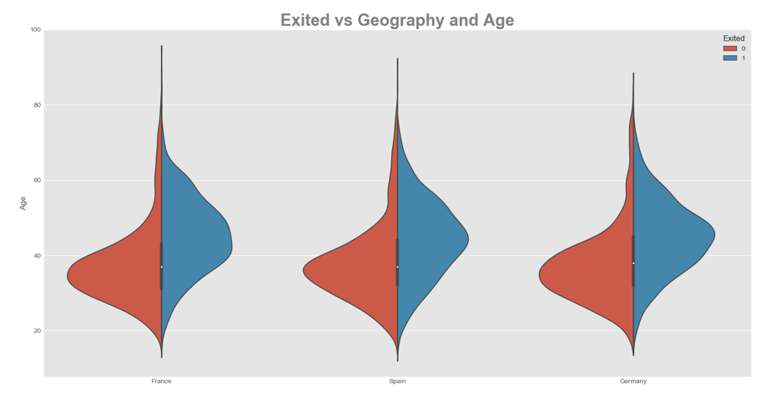
Exited vs Location and Age
hidden

Slide 7
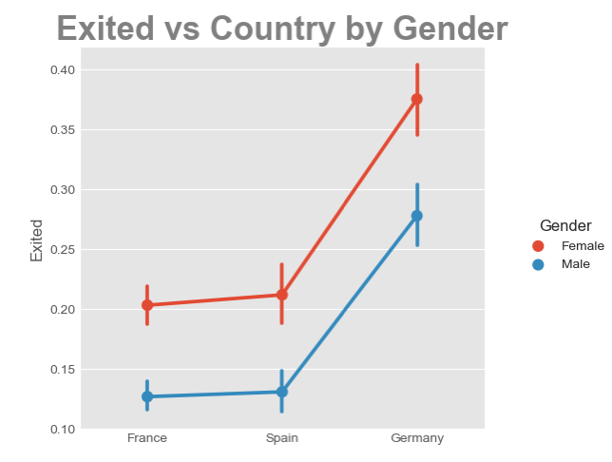
Exited vs Country by Gender

Slide 8
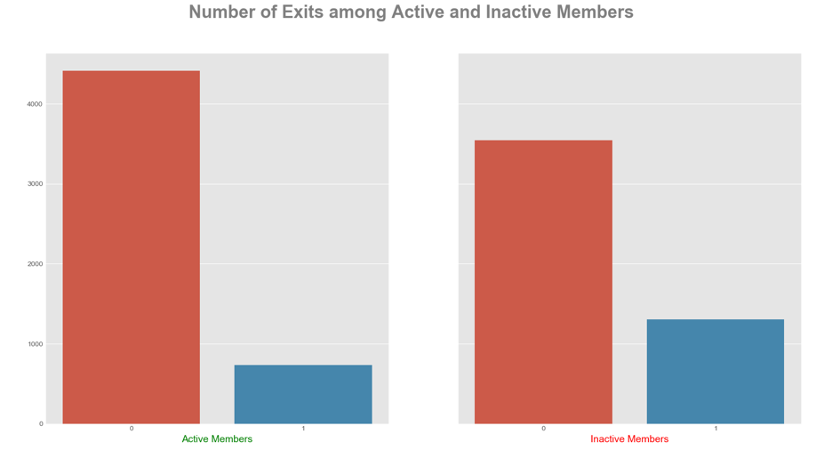
Number of Exits among Active and Inactive Members

Slide 9
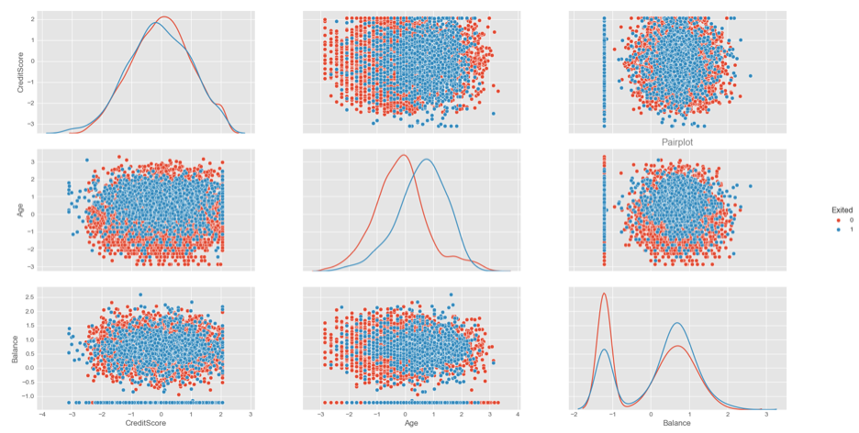
Pair Plot
hidden

Slide 10
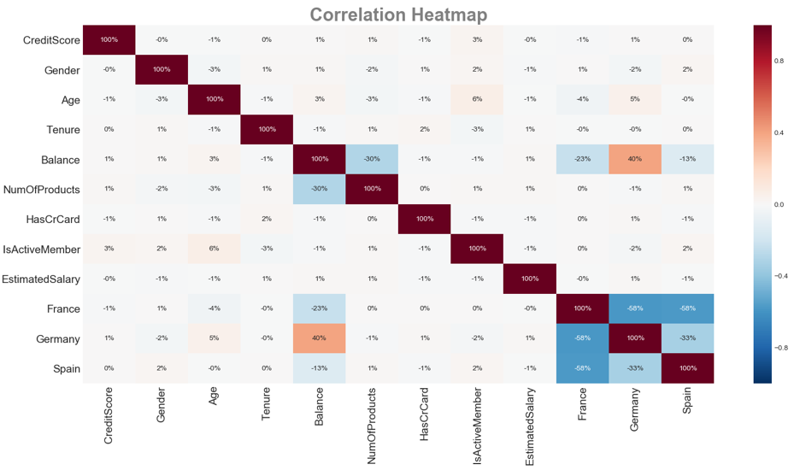
Correlation Heatmap

Slide 11
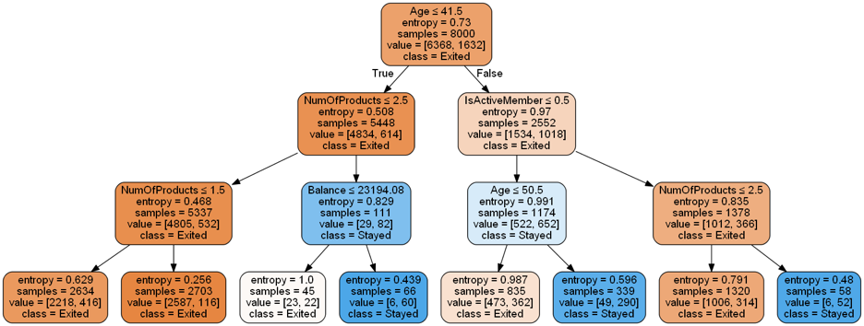
Decision Tree Example

Slide 12
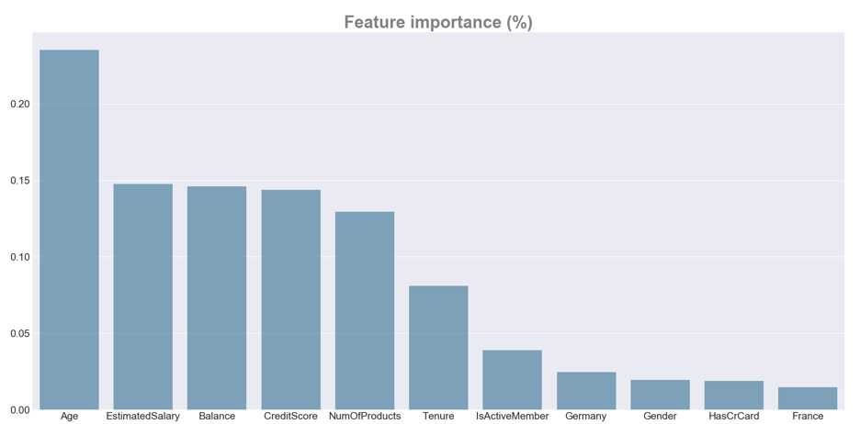
Feature Importance (%)

Slide 13
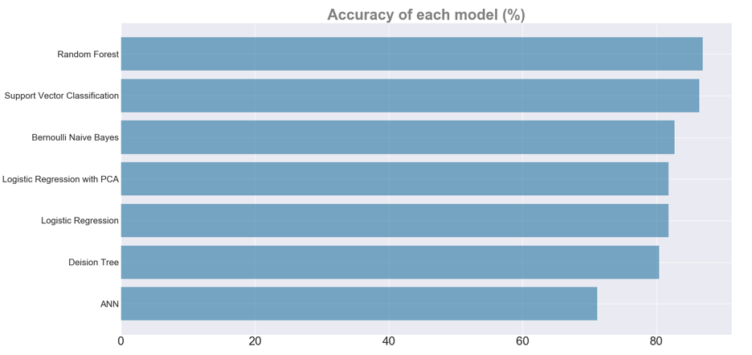
Accuracy of Each Model (%)

Slide 14
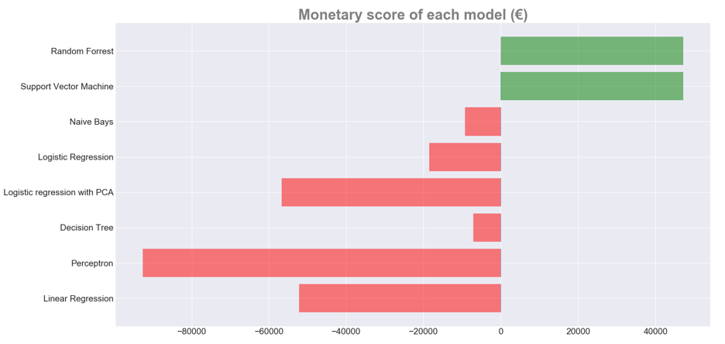
Monetary Score of Each Model (€)

Slide 15
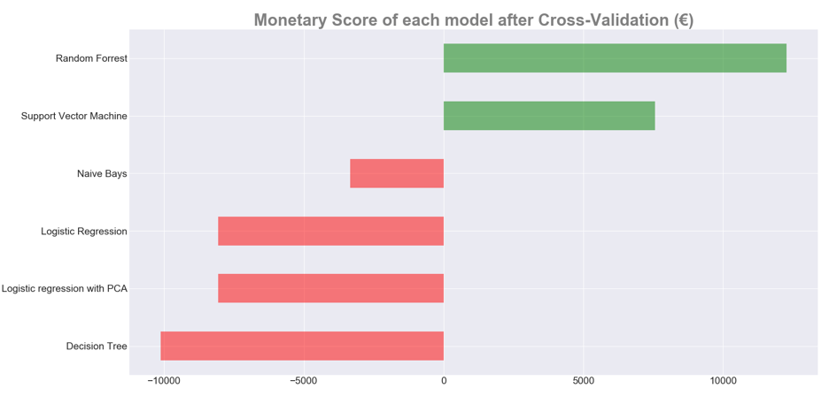
Monetary Score of Each Model after Cross-Validation (€)

Slide 16
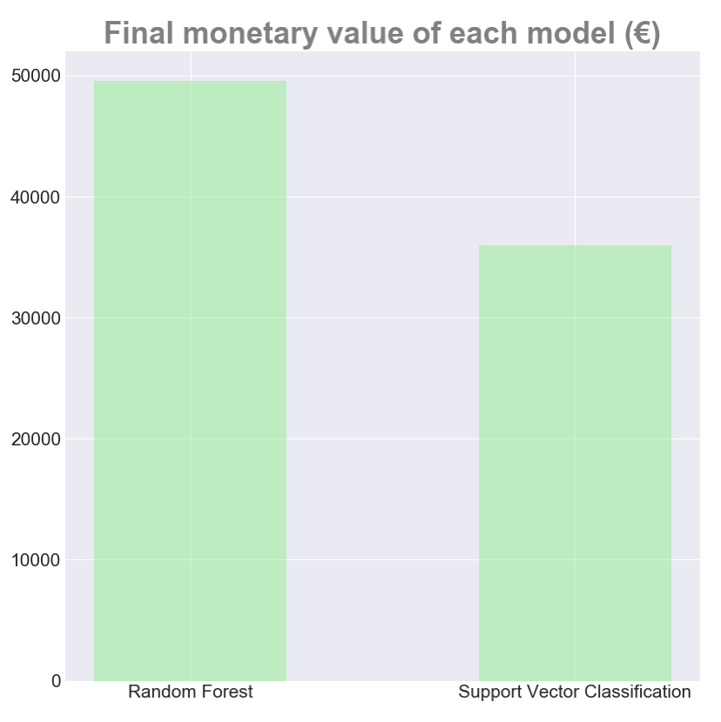
Final Monetary Value of Each Model (€)

