Slide 1
Data, Linked Data and Ontologies
Emanuele Massaro
João Vitor Meirelles de Miranda
HERUS Retreat
Dec 7-8 2017

Slide 2
Outline
Semantic Technologies & how they add value
Resource Description Framework (RDF), RDF syntaxes
RDF Schema, OWL and other commonly used ontologies
From .csv to RDF
Querying data with SPARQL

Slide 3
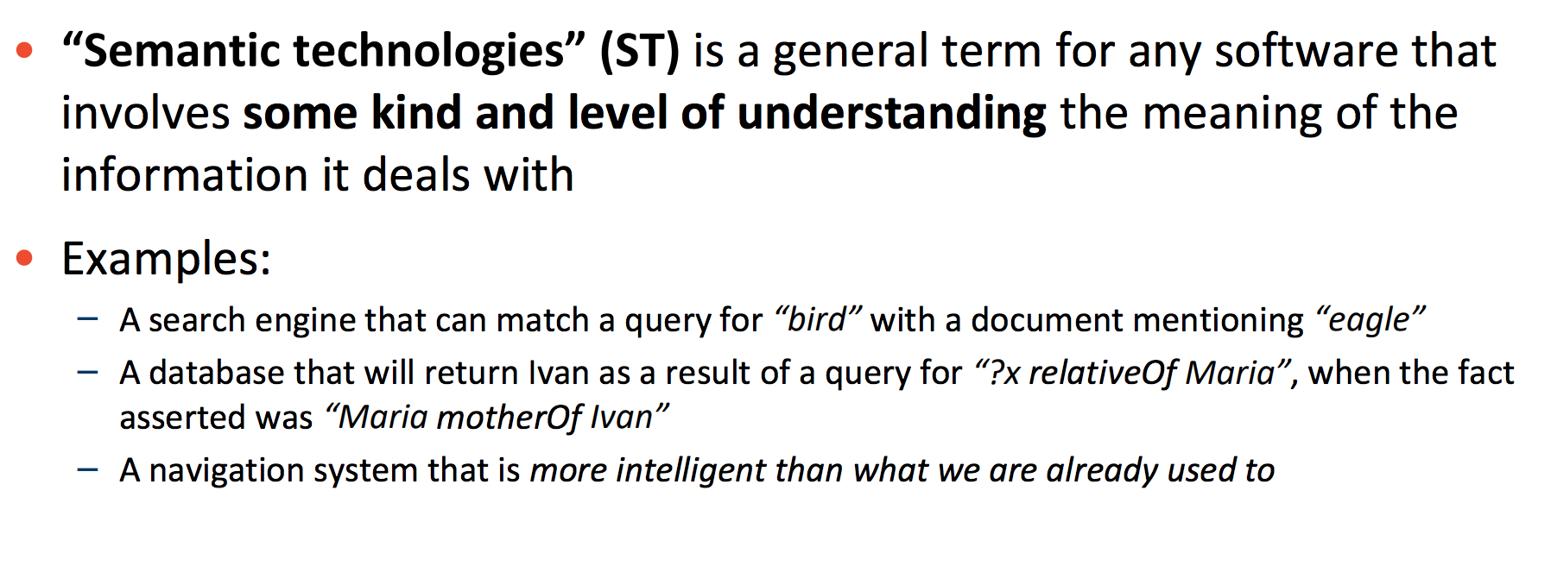
Semantic Technologies

Slide 4
OWL: Ontology Web Language
Common components of ontologies include:
Individuals: instances or objects (the basic or "ground level" objects)
Classes: sets, collections, concepts, types of objects, or kinds of things.
Attributes: aspects, properties, features, characteristics, or parameters that objects (and classes) can have.
Relations: ways in which classes and individuals can be related to one another.
Function terms: complex structures formed from certain relations that can be used in place of an individual term in a statement.
Restrictions: formally stated descriptions of what must be true in order for some assertion to be accepted as input.
Rules: statements in the form of an if-then (antecedent-consequent) sentence that describe the logical inferences that can be drawn from an assertion in a particular form.
Axioms: assertions (including rules) in a logical form that together comprise the overall theory that the ontology describes in its domain of application. This definition differs from that of "axioms" in generative grammar and formal logic. In these disciplines, axioms include only statements asserted as a priori knowledge. As used here, "axioms" also include the theory derived from axiomatic statements.
Events: the changing of attributes or relations.

Slide 5
Ontology Specification Example
class Person
class Woman
subClassOf #Person
class Man
subClassOf #Person
complementOf #Woman
property hasParent
domain #Person
domain #Person
maxCardinality 2
property hasChild
inverseOf #hasParent
property hasSpouce
domain #Person
range #Person
maxCardinality 1
symmetric
individual John
instanceOf #Man
individual Mary
instanceOf #Woman
hasSpouce #John
individual Jane
instanceOf #Woman
hasParent #John
hasParent #Mary

Slide 6
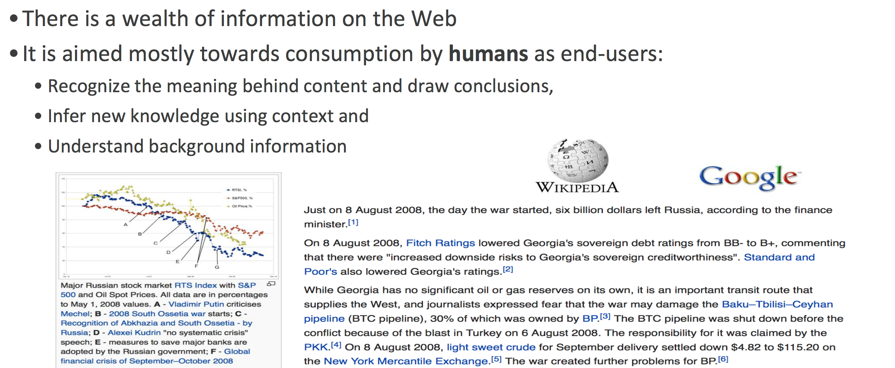
The Web

Slide 7
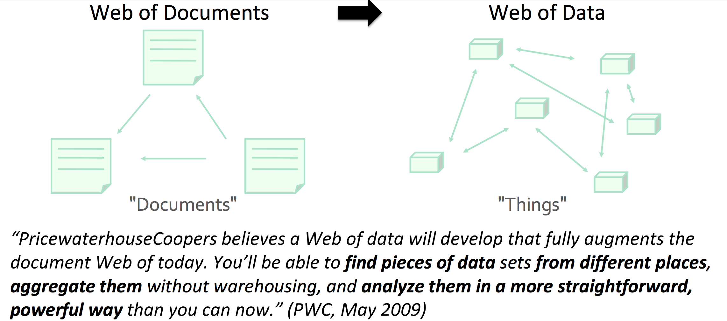
The Web of Data

Slide 8
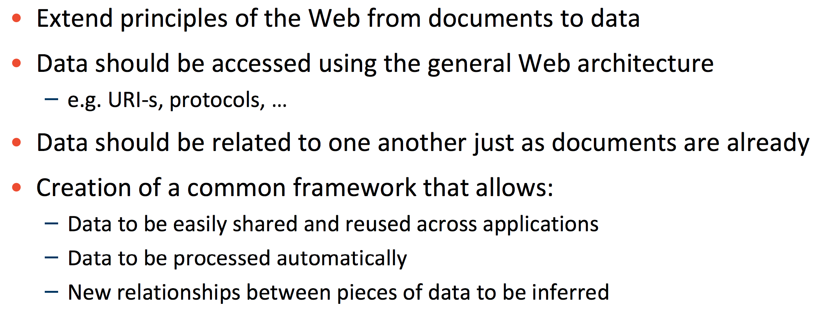
The Semantic Web Vision

Slide 9
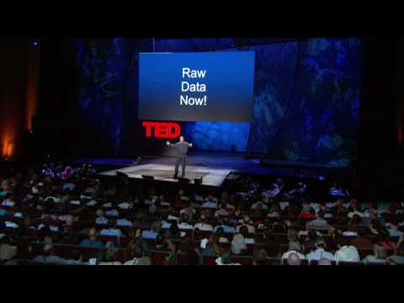

Slide 10
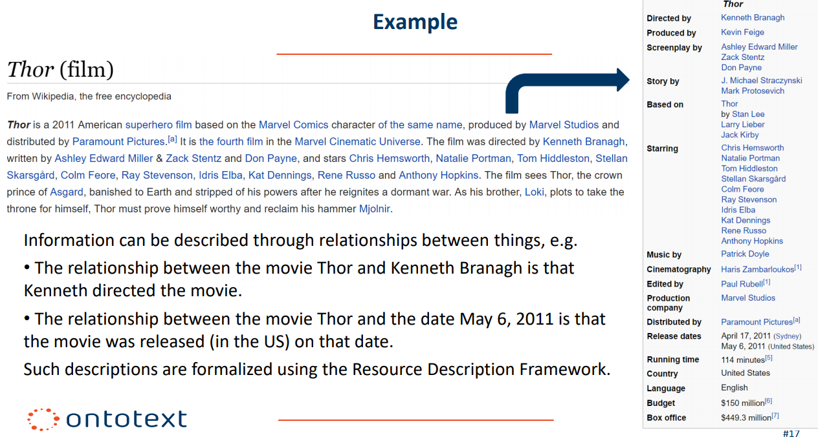
From data to RDF

Slide 11
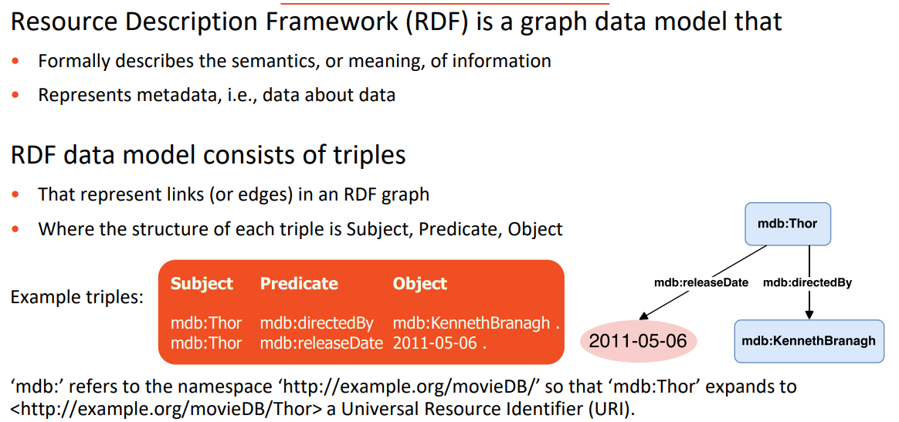
RDF: Resource Description Framework

Slide 12
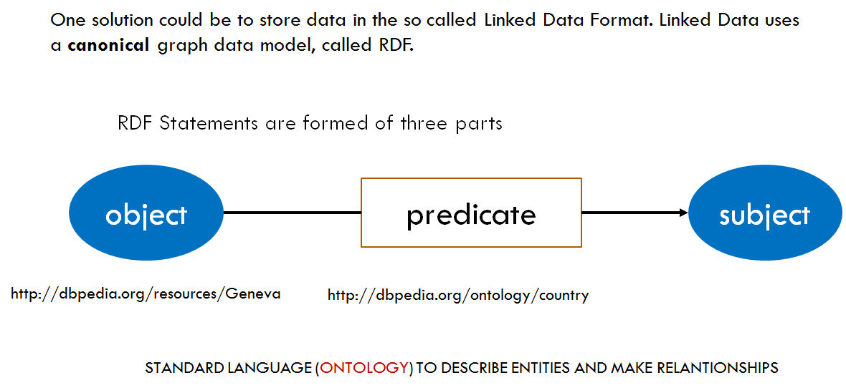
RDF

Slide 13
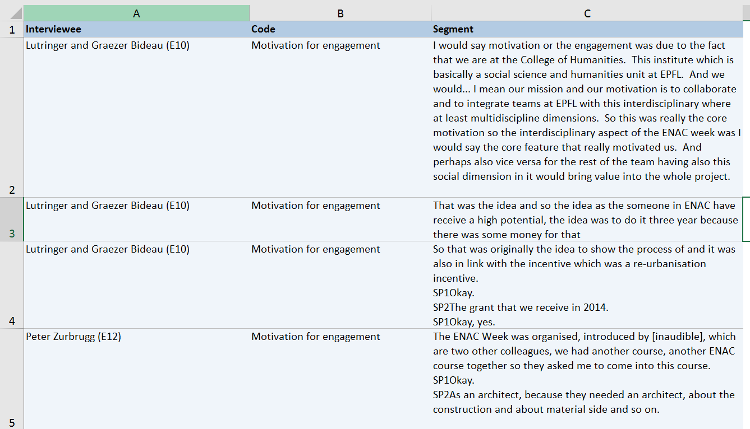
From .csv to RDF
Interview Data
TOPIC:
Teaching experience with ENAC week
INTERVIEWER:
Schilling Thorsten
DATE:
13/03/2016
PLACE:
EPFL
INTERVIEWEES
CODES
CONTENTS

Slide 14
From .csv to RDF
Interview Data
TOPIC:
Teaching experience with ENAC week
INTERVIEWER:
Schilling Thorsten
DATE
13/03/2016
PLACE:
EPFL
TABULAR
GRAPH
INTERVIEWEES
CODES
CONTENTS

Slide 15
is a Scientist at
Schilling Thorsten
Lutringer and Graezer Bideau (E10)
has Name
has Name
is a Student at
interviewer1
Interviewee 1
EPFL
Lausanne
has Location
has Interviewer
has Interviewee
That was the idea and so the idea as the someone in ENAC have receive a high potential, the idea was to do it three year because there was some money for that
has Place
Teaching Experience with Enac Week
has Topic
interview1
has Date
has ID
13 March 2016
INTERVIEW

Slide 16
From .csv to RDF
Interview Data
TOPIC:
Teaching experience with ENAC week
INTERVIEWER:
Schilling Thorsten
DATE
13/03/2016
PLACE:
EPFL
There are different tools we can use:
Protege
Python
GraphDB
INTERVIEWEES
CODES
CONTENTS

Slide 17
From .csv to RDF
Interview Data
TOPIC:
Teaching experience with ENAC week
INTERVIEWER:
Schilling Thorsten
DATE
13/03/2016
PLACE:
EPFL
INTERVIEWEES
CODES
CONTENTS

Slide 18
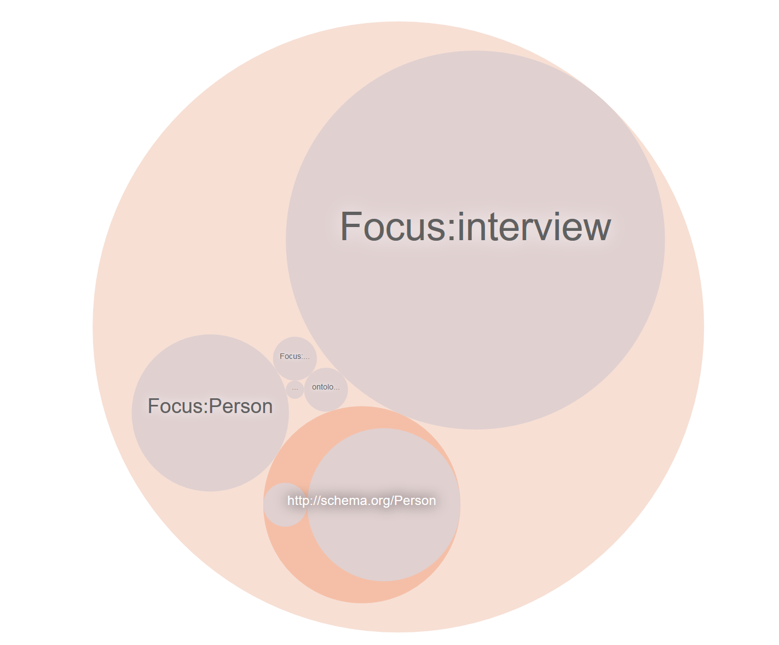
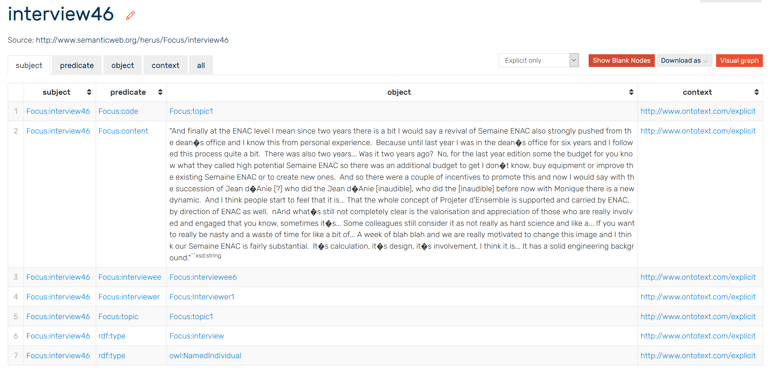
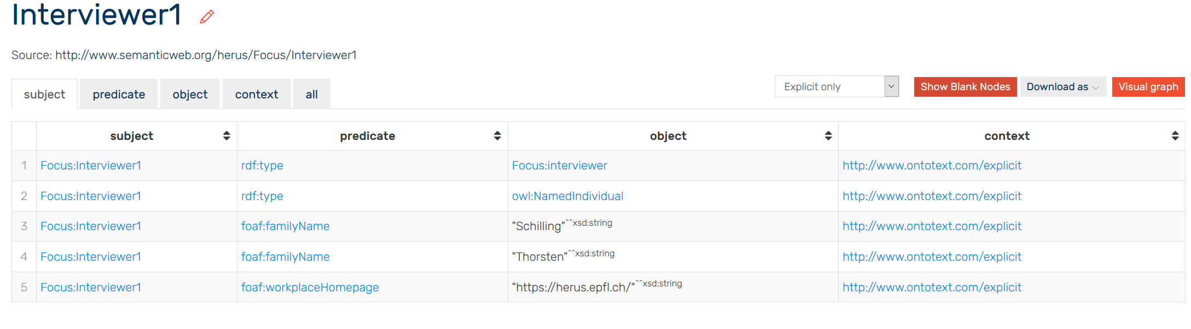
Our Ontology

