Slide 1
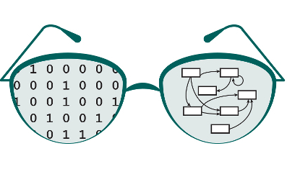

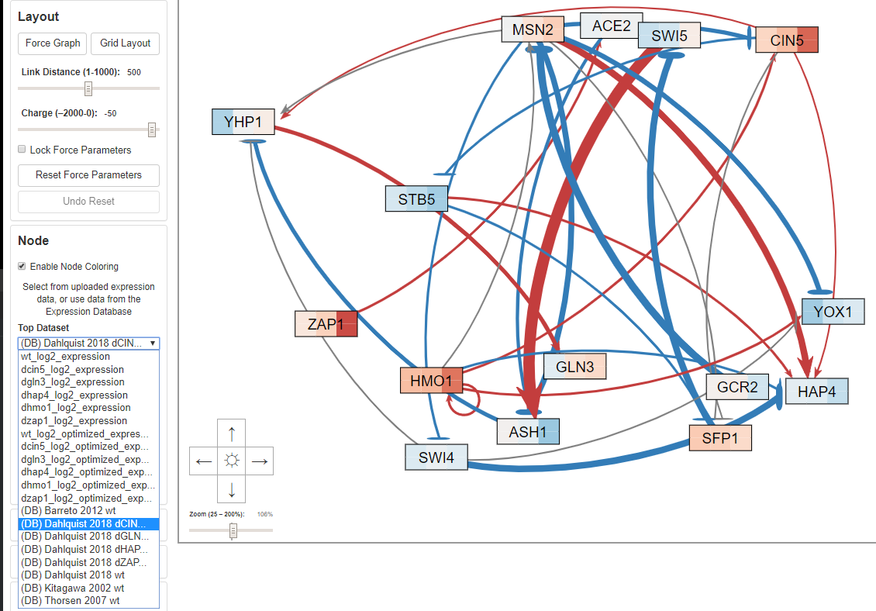



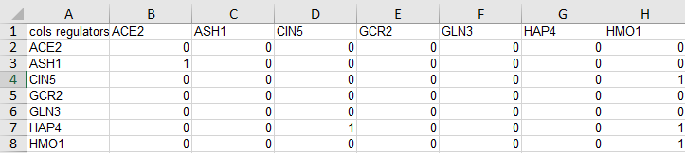

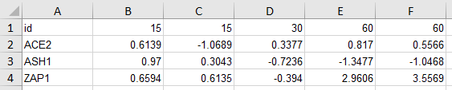



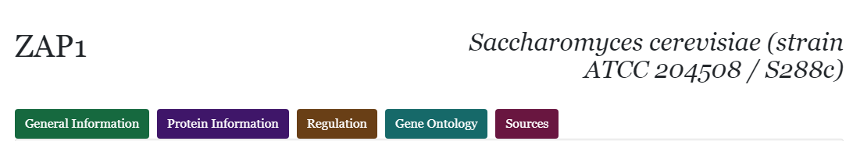
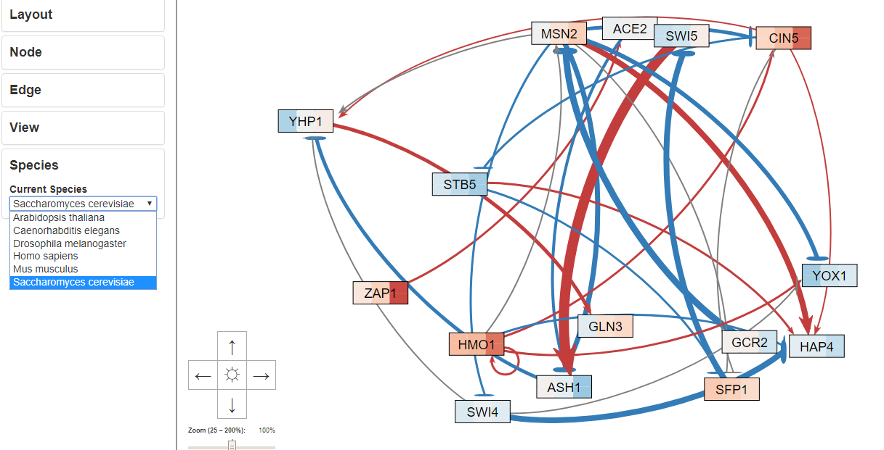
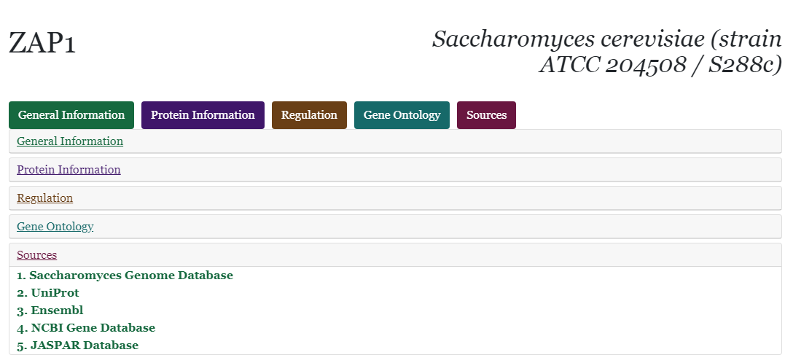
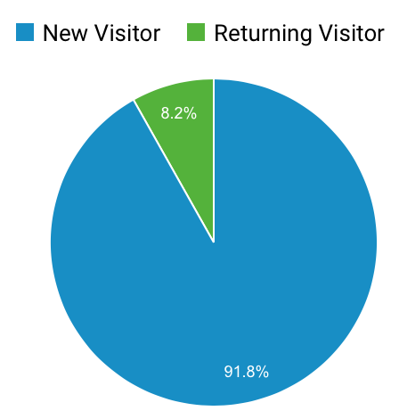
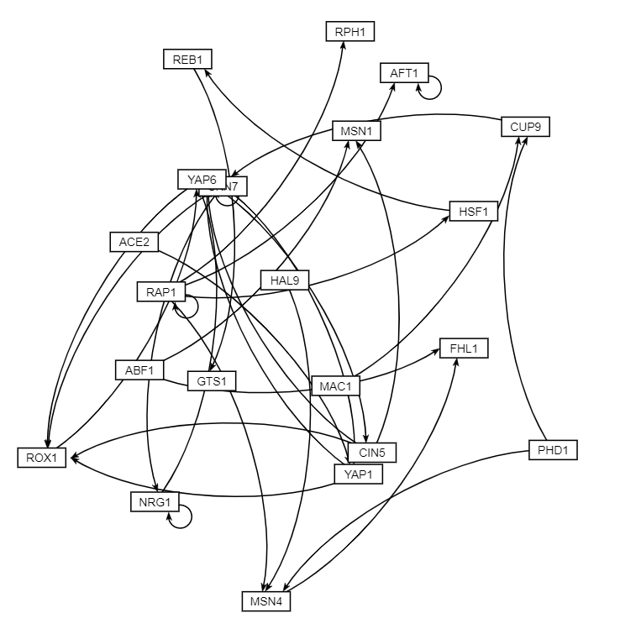
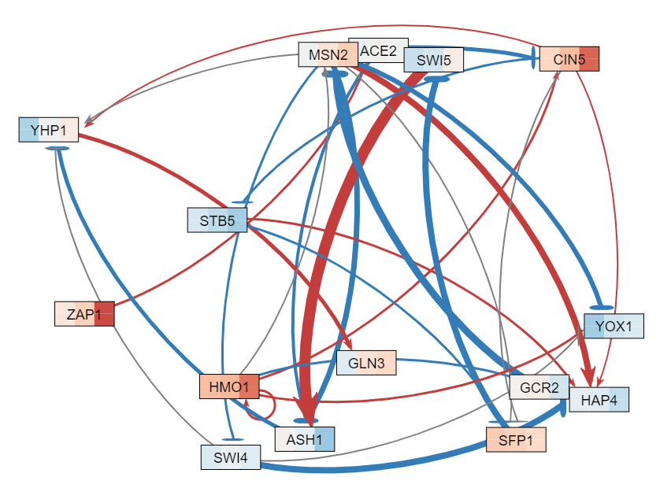
An Expression Database for Node Coloring and Expansion
of Species for Gene Pages of GRNsight: a Web Application
for Visualizing Models of Gene Regulatory Networks
Alexia M. Filler**, Kevin Patterson**, John David N. Dionisio**, Kam D. Dahlquist*
*Department of Biology, **Department of Electrical Engineering and Computer Science, Loyola Marymount University, 1 LMU Drive, Los Angeles, CA 90045
http://dondi.github.io/GRNsight/
GRNsight Overview
A Database for Expression Data
Technologies
GRNsight is an open source web application that allows users to better visualize the connections in gene regulatory networks
Uses spreadsheets of data that show these connections
Node/connection coloring shows how strongly and in what way genes affect each other
Network data shows which genes are connected
aaa
Node coloring is based on expression data, which shows the strength of the expression of genes at different time points
Right clicking on a node in the generated graph brings the user to the gene page, which displays information about the selected protein from multiple different biological database APIs
.
s
Data comes from various publications, including Dr. Dahlquist’s Biological Databases class
Data is stored in an AWS RDS instance with a PostgreSQL engine
Data is accessed through a network tunnel using an EC2 instance
APIs make calls to the database with queries that are based on user input, access the data using this tunnel
API then formats the query response in the JSON format used by GRNsight
With the data in this format, GRNsight can color the nodes of the GRN
Selecting/deselecting this checkbox turns node coloring on/off
Some dataset options come from what the user has uploaded
The options would be all that are available if the user were to upload network data without any expression data
Other dataset options come from what is available in the Expression Database
With this feature, users can apply node coloring to their GRNs whether or not they have their own expression data to upload.
Use Case 1:
User uploads their own data, which includes expression data
The user automatically views the GRN with node coloring using their expression data
The user opts to see their network using expression data from the Expression Database to color the nodes
The user selects a database dataset, and their network is colored based on the data from the Expression Database
Use Case 2:
User uploads their own data, which does not include expression data
The user views the GRN without node coloring
The user opts to see their network using expression data from the Expression Database to color the nodes
The user selects a database dataset and selects “Enable Node Coloring,” and their network is colored based on the data from the Expression Database
//should we include test stuff like mocha or
//travis?
Project Justification
Expansion of Species for Gene Page Feature
Future Directions
Expression Database Project
Allows users to color their networks without requiring them to have/collect their own expression data
Node coloring provides helpful insight to the user as to how the genes in the network are expressed
Gene Page Species Expansion
Allows users access to protein specific information from multiple biological databases in one place
Currently the gene pages are hardcoded to support only yeast, but an expansion of the supported species adds functionality for the users
Added features that allow users to upload files with species information so the program can automatically detect it, as well as a dropdown menu for manual input
When users upload a GRNmap workbook the program will automatically check to see if they have included species information
If detected, the program will update the species menu to reflect the recognized species, otherwise it will default to yeast, which also means that any older workbooks will still have the same functionality
The species can be updated at any time in the added species section using the dropdown menu
Right clicking on a node once the graph is generated will bring the user to the gene page
The gene page will take data about the selected species' Latin name and taxon IDs which are passed through the URL, and create API calls
TBD
Without Node Coloring
With Node Coloring
Availability
GRNsight is free and open to all users and there is no login requirement.
Web site content is available under the Creative Commons Attribution Non-Commercial Share Alike license.
GRNsight code is available under the open source BSD license.
Usage is being tracked through Google Analytics.
GRNsight has been tested with and confirmed to be working in Chrome version 58 or higher and Firefox version 53 or higher on Windows 7 and Mac OS X.
6236 total visitors and
4521 files uploaded as of
14 March 2018
NEED TO UPDATE
Acknowledgments
Right clicking on a node opens the gene page
This work is partially supported by NSF award 0921038 (K.D.D., B.G.F.), a Kadner-Pitts Research Grant (K.D.D.), the Loyola Marymount University Rains Research Assistant Program (M.S.) ← Need to update ?
Use Case 1:
User uploads their own data, which includes species data, but only the species' taxon id
The program will be able to detect the species based off the taxon ID and displays the correct species
The user right clicks on a protein to see more information
Use Case 2:
User uploads their own data, but does not include species data
The user opens the species section and, using the dropdown menu, changes the species from the default yeast to humans
The user right clicks on a protein to see more information
Return to GRNsight and update the species to fruit fly to compare the differences between the two species' proteins
The user right clicks on a protein to see more information
References
Cytoscape: http://cytoscape.org
Dahlquist, K.D., Dionisio, J.D.N., Fitzpatrick, B.G., Anguiano, N.A., Varshneya, A., Southwick, B.J., Samdarshi, M. (2016) GRNsight: a web application and service for visualizing models of small- to medium-scale gene regulatory networks. PeerJ Computer Science 2:e85. DOI: 10.7717/peerj-cs.85).
Dahlquist, K.D., Fitzpatrick, B.G., Camacho, E.T., Entzminger, S.D., and Wanner, N.C. (2015) Parameter Estimation for Gene Regulatory Networks from Microarray Data: Cold Shock Response in Saccharomyces cerevisiae. Bulletin of Mathematical Biology, 77(8), 1457-1492, DOI: 10.1007/s11538-015-0092-6
D3.js: http://d3js.org/
Freeman, S., (2002). Biological science, 1st edition. Upper Saddle River, NJ:: Prentice Hall.
Gephi: https://gephi.org
GRNmap: http://kdahlquist.github.io/GRNmap/
Teixeira, M. C., Monteiro, P. T., Guerreiro, J. F., Gonçalves, J. P., Mira, N. P., dos Santos, S. C., ... & Madeira, S. C. (2014). The YEASTRACT database: an upgraded information system for the analysis of gene and genomic transcription regulation in Saccharomyces cerevisiae. Nucleic Acids Research, 42(D1), D161-D166, DOI: 10.1093/nar/gkt1015 ← Need to update ?
Notes:
Kill abstract
Change to sans serif font
Make title bigger
Make title background white
Use full names
Super script to associate names with correct department
Background color: make it dark green, make writing on white background and writing in black/dark green
4 columns!!!
Smaller pictures
Bold titles
References can be 12pt
Acknowledgements can be 16pt
Everything else is 18-24pt
Titles don’t need to be bigger than 36pt
Remove circles from the arrowhead diagram, group the related labels together
Include menu bar
Testing/error handling – sample error (we don’t crash with errors!)
Mouseovers for edges screenshot

