Slide 1

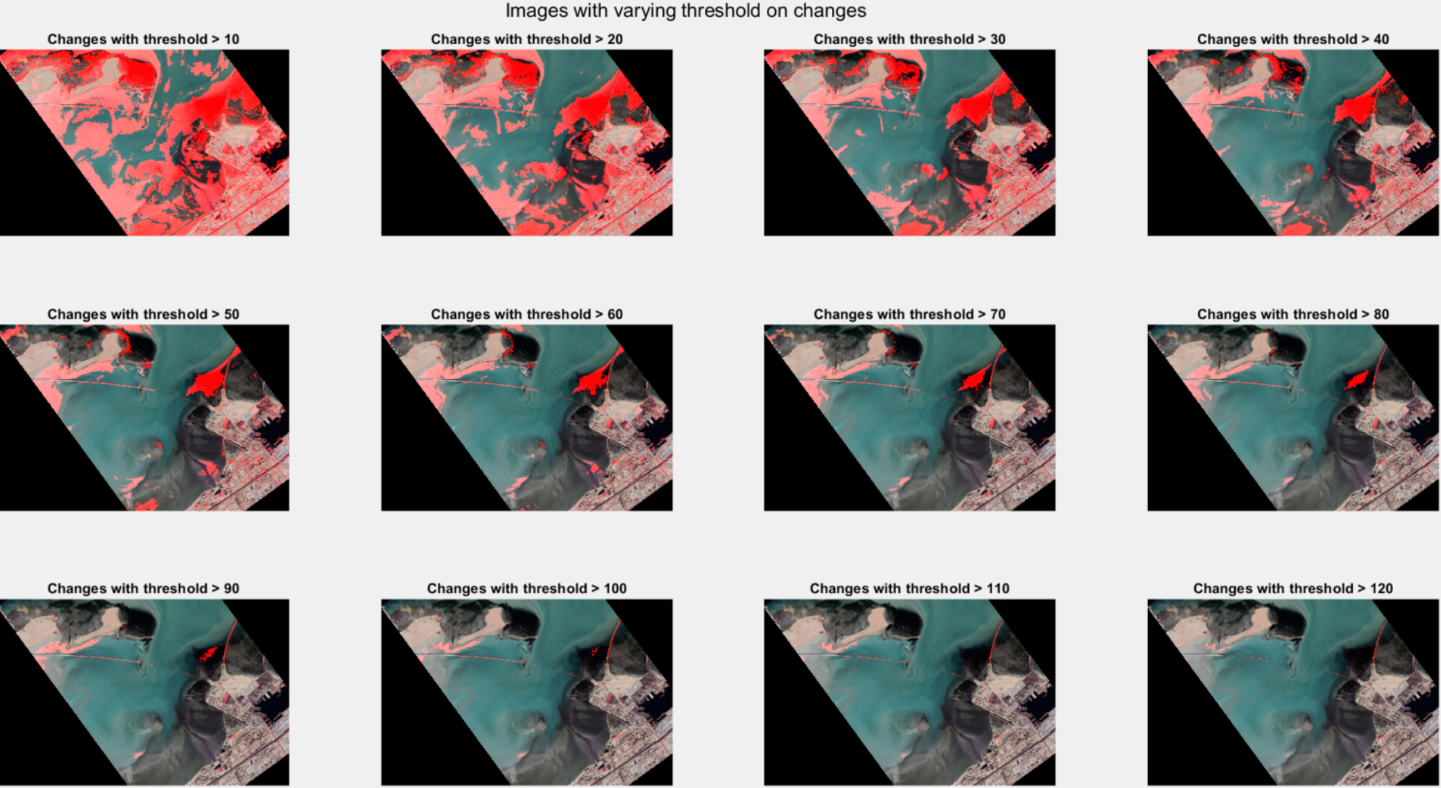
Computer Vision Challenge – Group 30
Chair for Data Processing
TUM Department of Electrical and Computer Engineering
Technical University Munich
A.Misik, R.Jacumet, M. Schneider, O.Inak
Department of Electrical and Computer Engineering, TUM
INTRODUCTION & OBJECTIVES
METHODOLOGY
SOFTWARE ARCHITECTURE
PROBLEMS
The extent of human impact on the Earth's ecosystem has reached immense proportions in the recent century. Negative consequences such as climate change, water shortages and man-made disasters have become more acute and have reached global proportions. Analysis of human influence is a rather complex problem given the proportions involved. One possible holistic approach is a satellite image-based analysis of ecosystem changes at different locations on Earth.
The goal of this year's Computer Vision Challenge is to develop software capable of displaying such changes. It is intended to allow the user to upload satellite images of a particular location shifted in time and perspective, and to choose a method of image visualization and change display. The software should run in reasonable runtime and be user-centric.
Technically, the main functionality of the software is to robustly establish correspondences between the input images and a 3D scene reconstruction. Emphasis is placed on the robustness, since it is assumed that each image has been affected by perturbations such as rotation, translation and brightness change. Further photometric perturbations are to be expected. A method for robust correspondence has been introduced in [1], capable of dealing with rotations and scale-variance in efficient runtime. The topic of robust 3D reconstruction has been discussed in [2] and [3].
The proposed approach consists of several sequential phases:
Image Pre-Processing: In the first part, the given images are converted to grayscale and unwanted image parts are sliced out (e.g. as the Google Maps logo).
Correspondence problem: After preprocessing, the feature-based correspondence between temporally ordered image pairs is established. The SURF feature detector presented in [1] is chosen for this phase due to its high robustness to image perturbation. The extracted features are then matched using a sum-of-squared-differences calculation.
3D Reconstruction: Beforehand, outlier filtering is applied on the matched features via the approach presented in [2]. The matched robust image features are then used to establish a geometric relationship of the image pair. This task can be solved by estimating the homography matrix with the 4-point algorithm or with ..... (other approach). Re-projection is then done using the estimated relationship.
Change and Visualization: The differences in reprojected images are then analyzed by a Euclidean similarity metrics. Figure 1 illustrates an absolute pixel difference calculation.
GUI
Correspondence Module
3D Reconstruction Module
Change & Visualization Module
Image Pre-Processing
Several problems have been identified during the project conception and first experiments:
For some image pairs, feature-based correspondence is not possible due to the high degree of image perturbation.
In some cases, 3D reconstruction from image pairs is not possible because there are not enough correspondence points.
For the visualization of changes between the images, it is not entirely clear how to implement a visualization showing city/rural/river changes.
TIMELINE
Milestone 1:
Image Pre-Processing & Correspondence - 14.06
Milestone 2:
3D Reconstruction - ..06
Milestone 3: Change & Visualization - ..06
Milestone 4: GUI - ..06
WORK DISTRIBUTION
REFERENCES
R.Jacumet is working on the 3D reconstruction pipeline and has already written a functionality for the visualization of differences.
M. Schneider works on an alternative approach for the 3D reconstruction pipeline based on the 4-point algorithm.
A.Misik supported the team in the correspondence pipeline and works on the change, visualization and the GUI.
O.Inak works on the optimization of the correspondence pipeline and is expanding the functionalities of the change and visualization pipeline.
[1] H. Bay, T. Tuytelaars, and L. Van Gool, „Surf: Speeded up robust features“, in European conference on computer vision, pp. 404-417, Springer, 2006.
[2] D.Baráth, „Five-Point Fundamental Matrix Estimation for Uncalibrated Cameras“, 10.1109/CVPR.2018.00032, 2018.
[3] P.H.S. Torr and A. Zisserman, „MLESAC: A New Robust Estimator with Application to Estimating Image Geometry“, Computer Vision and Image Understanding 78, no. 1 (April 2000): 138–56. https://doi.org/10.1006/cviu.1999.0832.
Figure 1: Changes between two shifted images based on absolute pixel differences.

