Slide 1
A GUIDE FOR TURKISH PEOPLE IN NEW YORK
By Afsar Onat Aydinhan

Slide 2
The Goal of the Project
New York is a very popular destination for tourists and Turkish people are no exception.
!The main aim of this project is to analyze the city of New York and determine locations that might be of interest for Turkish tourists, so they can make an informed decision about
The stakeholders would be interested in this project, because it might be too hard or time-consuming to do such an analysis by themselves and the results of this analysis can actually improve their vacation in New York. where to actually stay and/or go in New York.

Slide 3
Data
We will scrape our data about New York from the following link: ‘https://cocl.us/new_york_dataset’
We also need information about venues in the neighborhoods in order to be able to determine which places may attract Turkish people. We will use the Foursquare API to gather information about the venues.

Slide 4
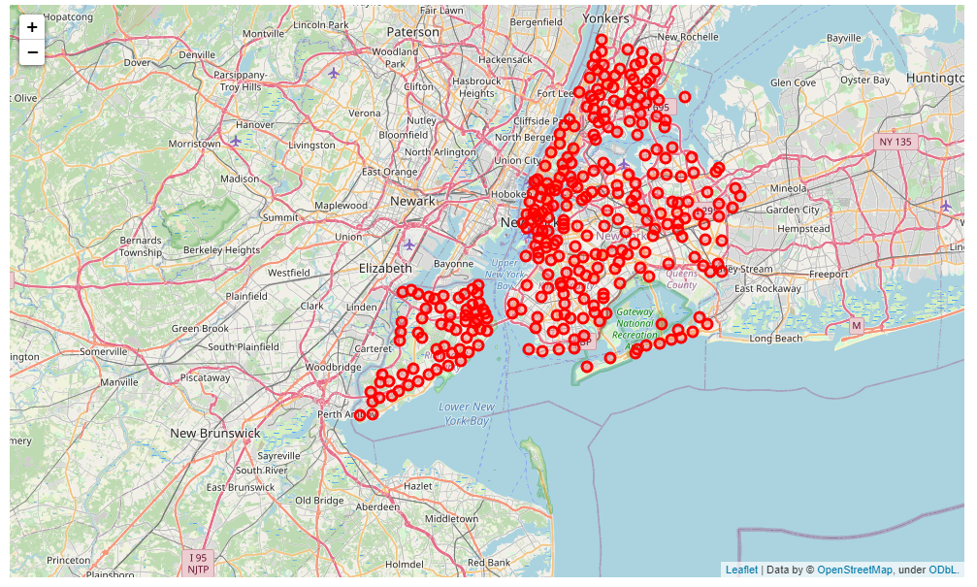
The map of New York
The neighborhood data we get from the API

Slide 5
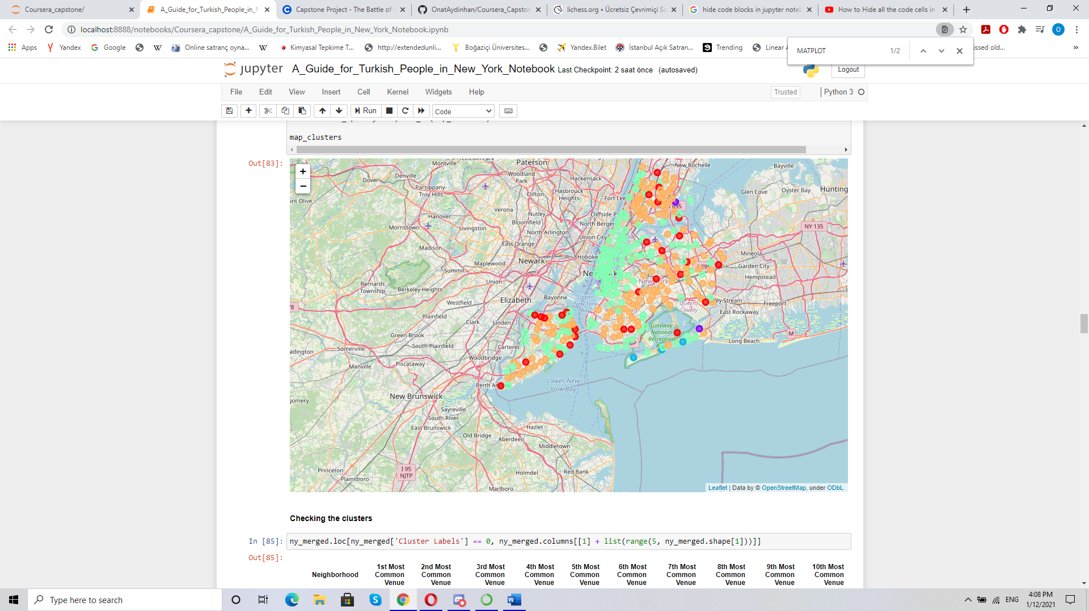
A General Approach
K-means clustering on all neighborhoods based on their venues. The point of this analysis is to help Turkish people to determine other places that they may enjoy given they liked a place that they already visited. This portion of the report is to be used after the tourists start enjoying the New York and develop their own tastes regarding New York.
We clearly see that the Manhattan area constitutes a cluster combined with other coastal regions of other parts of New York. This is an expected result since Manhattan is a relatively homogenous region filled with all sorts of entertainment possibilities. Staten Island, Brooklyn and Queens regions seem to be similar to each other in general, mostly orange dots with red dots here and there.

Slide 6
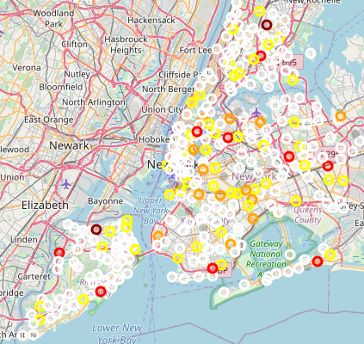
A Second Approach for Turkish People
We see that Manhattan and Staten Island is mostly white (not of interest) while the Brooklyn-Queens border is filled with multiple yellow and orange dots surrounded by occasional red dots. The coastal regions and Manhattan in general do not seem to be quite for the Turkish tourists.

Slide 7
Conclusion
The result of the first analysis can be used to determine other places that the stakeholder likes/dislikes based on their experiences in New York city.
The results of the second analysis reveals that the border of Brooklyn and Queens seem to be the most suitable spot for Turkish people.

