Slide 1
Wicket + CDI + JPA
(with JBoss AS 7)
Web developer's dream
Ondřej Žižka Feb 2012

Slide 2
Quick survey
Do you work with
  Wicket?
  Zend framework?
  JSF?
  Struts?
  Spring framework?
  EJB 3.x?
  CDI / Weld?

Slide 3

Wicket characteristics
Pros:
  Component-oriented
  Java-oriented
  No XML configuration
  Leightweight – small memory footprint
  Easily modifiable
  Clusterable
Cons:
  No spec
  Different way of thinking
    Need to undo brain damage done by JSF et al.

Slide 4
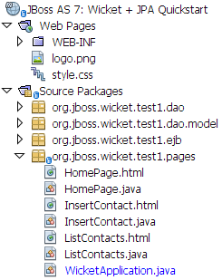
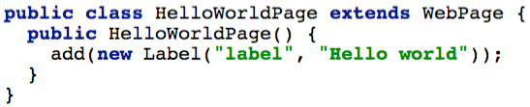
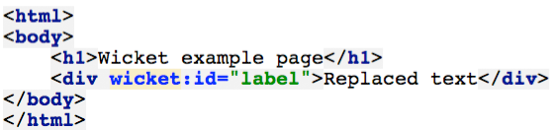
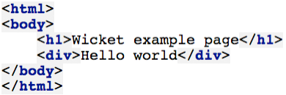
Wicket basic: Pages

Slide 5
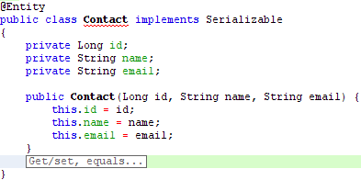
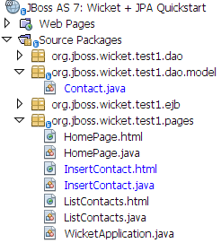
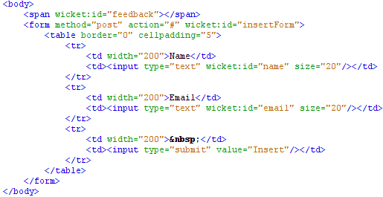
Wicket basic: Models & Binding to components

Slide 6
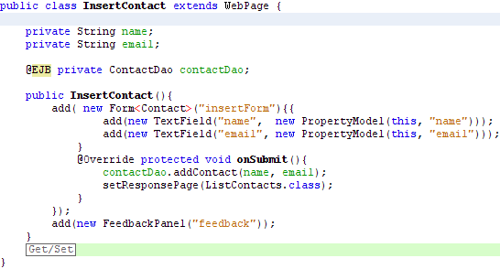
Wicket basic: Models & Binding to components

Slide 7
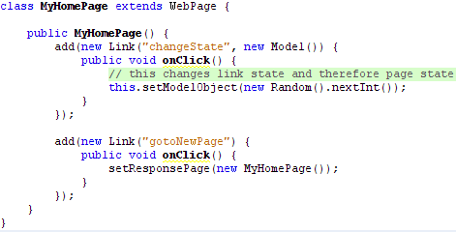
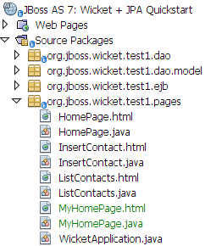
Wicket basic: Page update & navigation

Slide 8
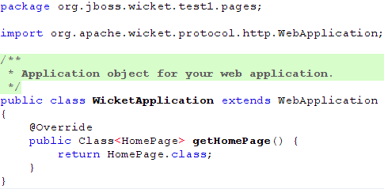
Wicket basic: Application object

Slide 9
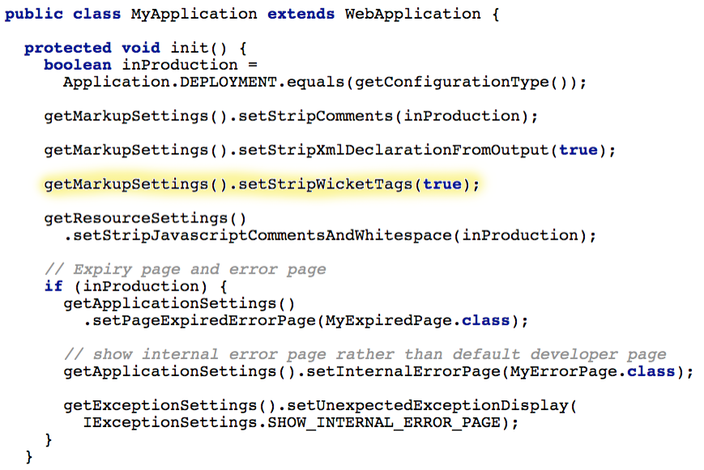
Wicket basic: Application object

Slide 10
Wicket basic: Reusable components

Slide 11
Wicket basic: Reusable components
?

Slide 12
Wicket basic: Creating reusable components
Navigation between pages
?

Slide 13
Wicket basic: Creating reusable components
Navigation between pages
?
AJAX

Slide 14
Wicket basic: Creating reusable components
Navigation between pages
?
AJAX
Sessions

Slide 15
Wicket basic: Creating reusable components
Navigation between pages
?
AJAX
Sessions
GWT-style AJAX-only apps

Slide 16
Wicket basic: Creating reusable components
Navigation between pages
?
AJAX
Validators
Sessions
GWT-style AJAX-only apps

Slide 17
Wicket basic: Creating reusable components
Navigation between pages
?
AJAX
Resources
(images, icons)
Validators
Sessions
GWT-style AJAX-only apps

Slide 18
Wicket basic: Creating reusable components
Navigation between pages
?
AJAX
Resources
(images, icons)
Validators
Sessions
GWT-style AJAX-only apps
Components hierarchy

Slide 19
Wicket basic: Creating reusable components
Navigation between pages
?
AJAX
Resources
(images, icons)
Validators
Sessions
Pre-existing rich components
GWT-style AJAX-only apps
Components hierarchy

Slide 20
Wicket basic: Creating reusable components
Navigation between pages
CSS and JavaScript
?
AJAX
Resources
(images, icons)
Validators
Sessions
Pre-existing rich components
GWT-style AJAX-only apps
Components hierarchy

Slide 21
Wicket basic: Creating reusable components
Navigation between pages
CSS and JavaScript
Leveraging Java inheritance
?
AJAX
Resources
(images, icons)
Validators
Sessions
Pre-existing rich components
GWT-style AJAX-only apps
Components hierarchy

Slide 22
Wicket basic: Creating reusable components
Navigation between pages
CSS and JavaScript
Leveraging Java inheritance
?
AJAX
Resources
(images, icons)
Validators
Sessions
Pre-existing rich components
GWT-style AJAX-only apps
Localization
Components hierarchy

Slide 23
Wicket basic: Creating reusable components
Navigation between pages
CSS and JavaScript
Leveraging Java inheritance
Come to JBug Brno
for more Wicket!
?
AJAX
Resources
(images, icons)
Validators
Sessions
Pre-existing rich components
GWT-style AJAX-only apps
Localization
Components hierarchy

Slide 24
Wicket vs. JSF
JSF:
  Inspired in JSP taglibs and Struts
  Bunch of XML configs
  Tries to pretend there's no HTML
  Logic and UI binding by “magic”
  Intranet oriented
Wicket:
  Inspired by XUL, Swing
  No XML (except Java EE's)
  Tries to pretend there's no HTTP
  Logic and UI binding next to each other
  Doesn't need a container → easily testable
  Modern web app oriented

Slide 25
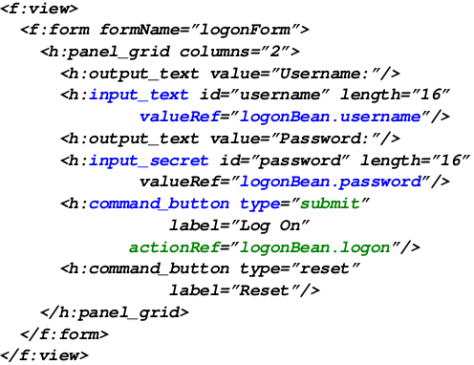
(JSF page)

Slide 26
Wicket + Java EE 6 (with JBoss AS 7.1)
AS 7:
  Java EE 6 container
  Starts faster than Tomcat (in ~3 seconds)
  Deploys faster than Tomcat
  Small memory footprint
Java EE 6:
  Much simpler than Java EE 5
  One class per component is enough – POJOs
  CDI (similar to Spring JavaConfig)

Slide 27
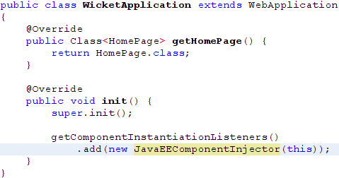
Wicket + Java EE 6 (with JBoss AS 7.1)
Make Wicket work with Java EE injection:

Slide 28

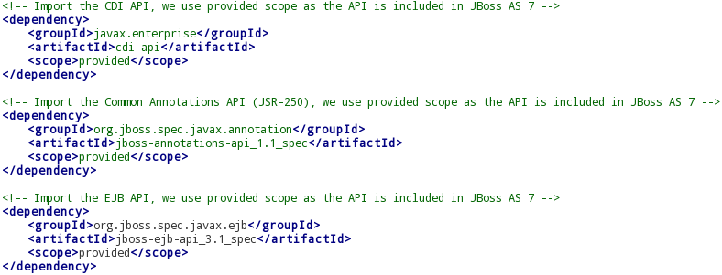
Wicket + Java EE 6 (with JBoss AS 7.1)
Make Wicket work with Java EE injection:

Slide 29
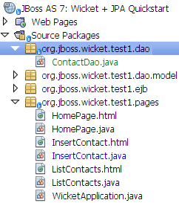
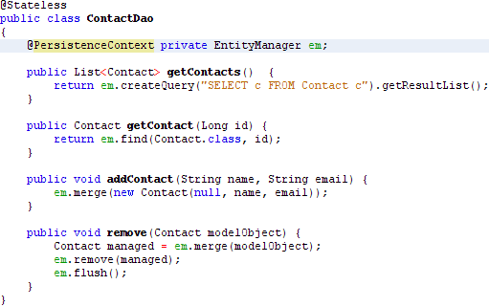
Wicket + JPA (with JBoss AS 7.1)

Slide 30
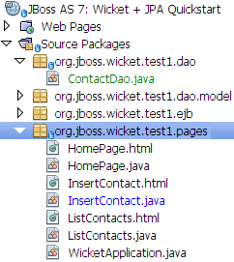
Wicket + EJB (with JBoss AS 7.1)

Slide 31
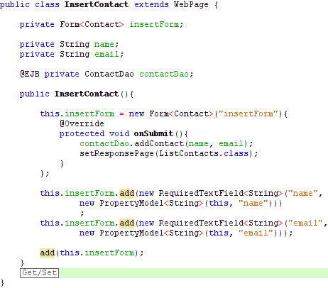
Wicket page (expanded version)

Slide 32
Questions?
ozizka@redhat.com

Slide 33
Thanks!
See you at JBug - monthly at FI MUNI.
Watch JBoss.cz for announcements.
Join Czech & Slovak Wicket Users Group
at LinkedIn.com

Slide 34
Wicket (slide template)

